Slide 1
AGENT PLAYBOOK:
Attract & Engage Agents with Co-Marketing
Notes:
Welcome everyone! Today, I'm excited to introduce you to the power of Total Expert — a platform built specifically to help originators like you drive more meaningful engagement, streamline your workflow, and ultimately close more deals.

Slide 2
Proven Plays for Attracting Agents

Slide 3
Laying the Groundwork with Agents
Start 1:1 first — quick touchpoint (in-person/text/email) before the invite
Set yourself as a CMP to learn the portal and demo confidently
Get the agent’s MLS ID upfront — make it a prerequisite (most important step)
Book a 15-min setup (Zoom or in-person) to activate the account together
Send the CMP invite ahead (same day or day before) so it lands on time
Pre-fill their profile as much as possible; they can edit later
Show ready-to-use templates (2–3 examples) to prove immediate value

Slide 4

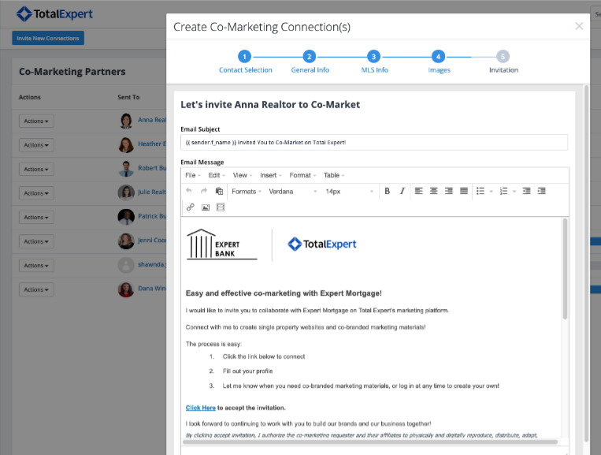
Why Agents Love Total Expert
Agents gain access to Total Expert at no cost
Ability to track relationships and marketing marketing materials created
Live chat support available six days a week
Notes:
Total Expert is available to every real estate agent and anyone in financial services
Agents have access to Total Expert at no cost, including a suite of powerful, user-friendly tools
Ability to track relationships and marketing materials created
Helps make the asset creation process easy and efficient
Live, local support is available six days a week for agents through the chat widget

Slide 5
Co-Marketing Tools:
Print Marketing Library
Lead Capture Apps and Open House’ Follow-Up
Single Property Websites
Social Media Content & Posting
Database Management
Shared leads, notes, communication
CRM / Groups
Email Marketing and tracking
Key Features & Benefits
Notes:
For agents, there are really two key areas of benefit – the co-marketing tools to support their listings and the CRM tools to help them manage their database.
<Read off key features and benefits >

Slide 6
Proven Plays for Engaging Agents

Slide 7
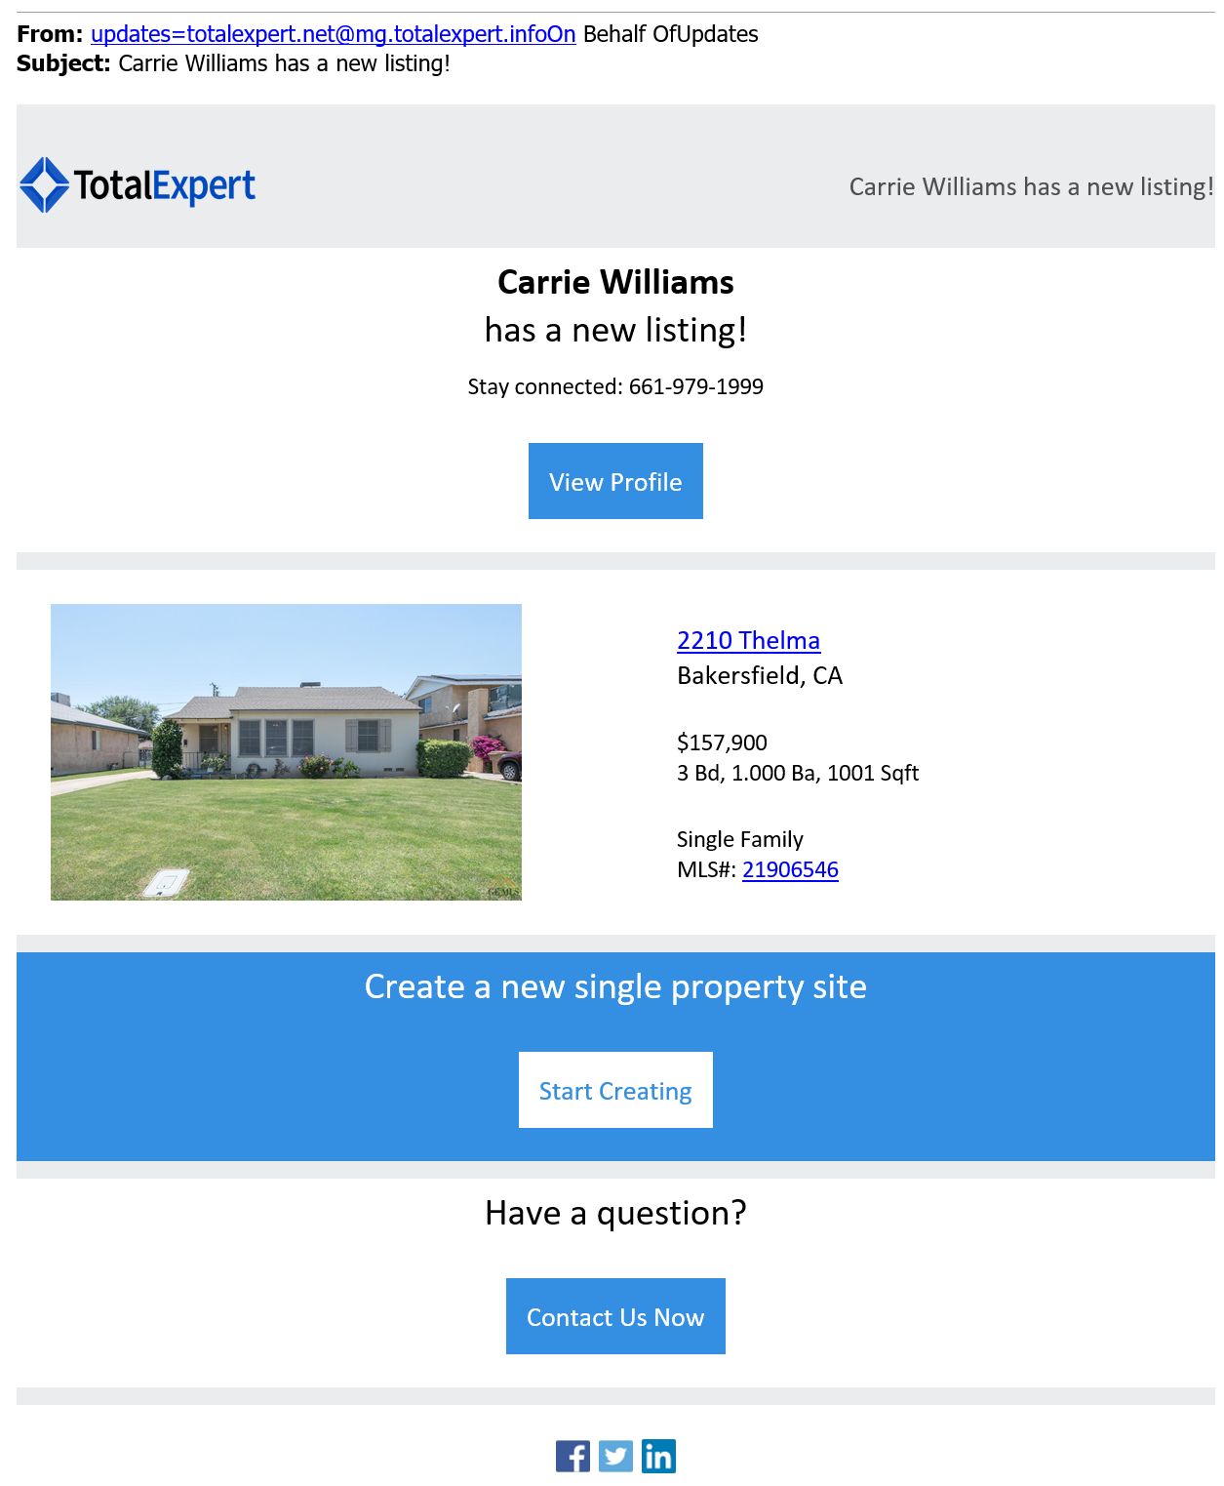
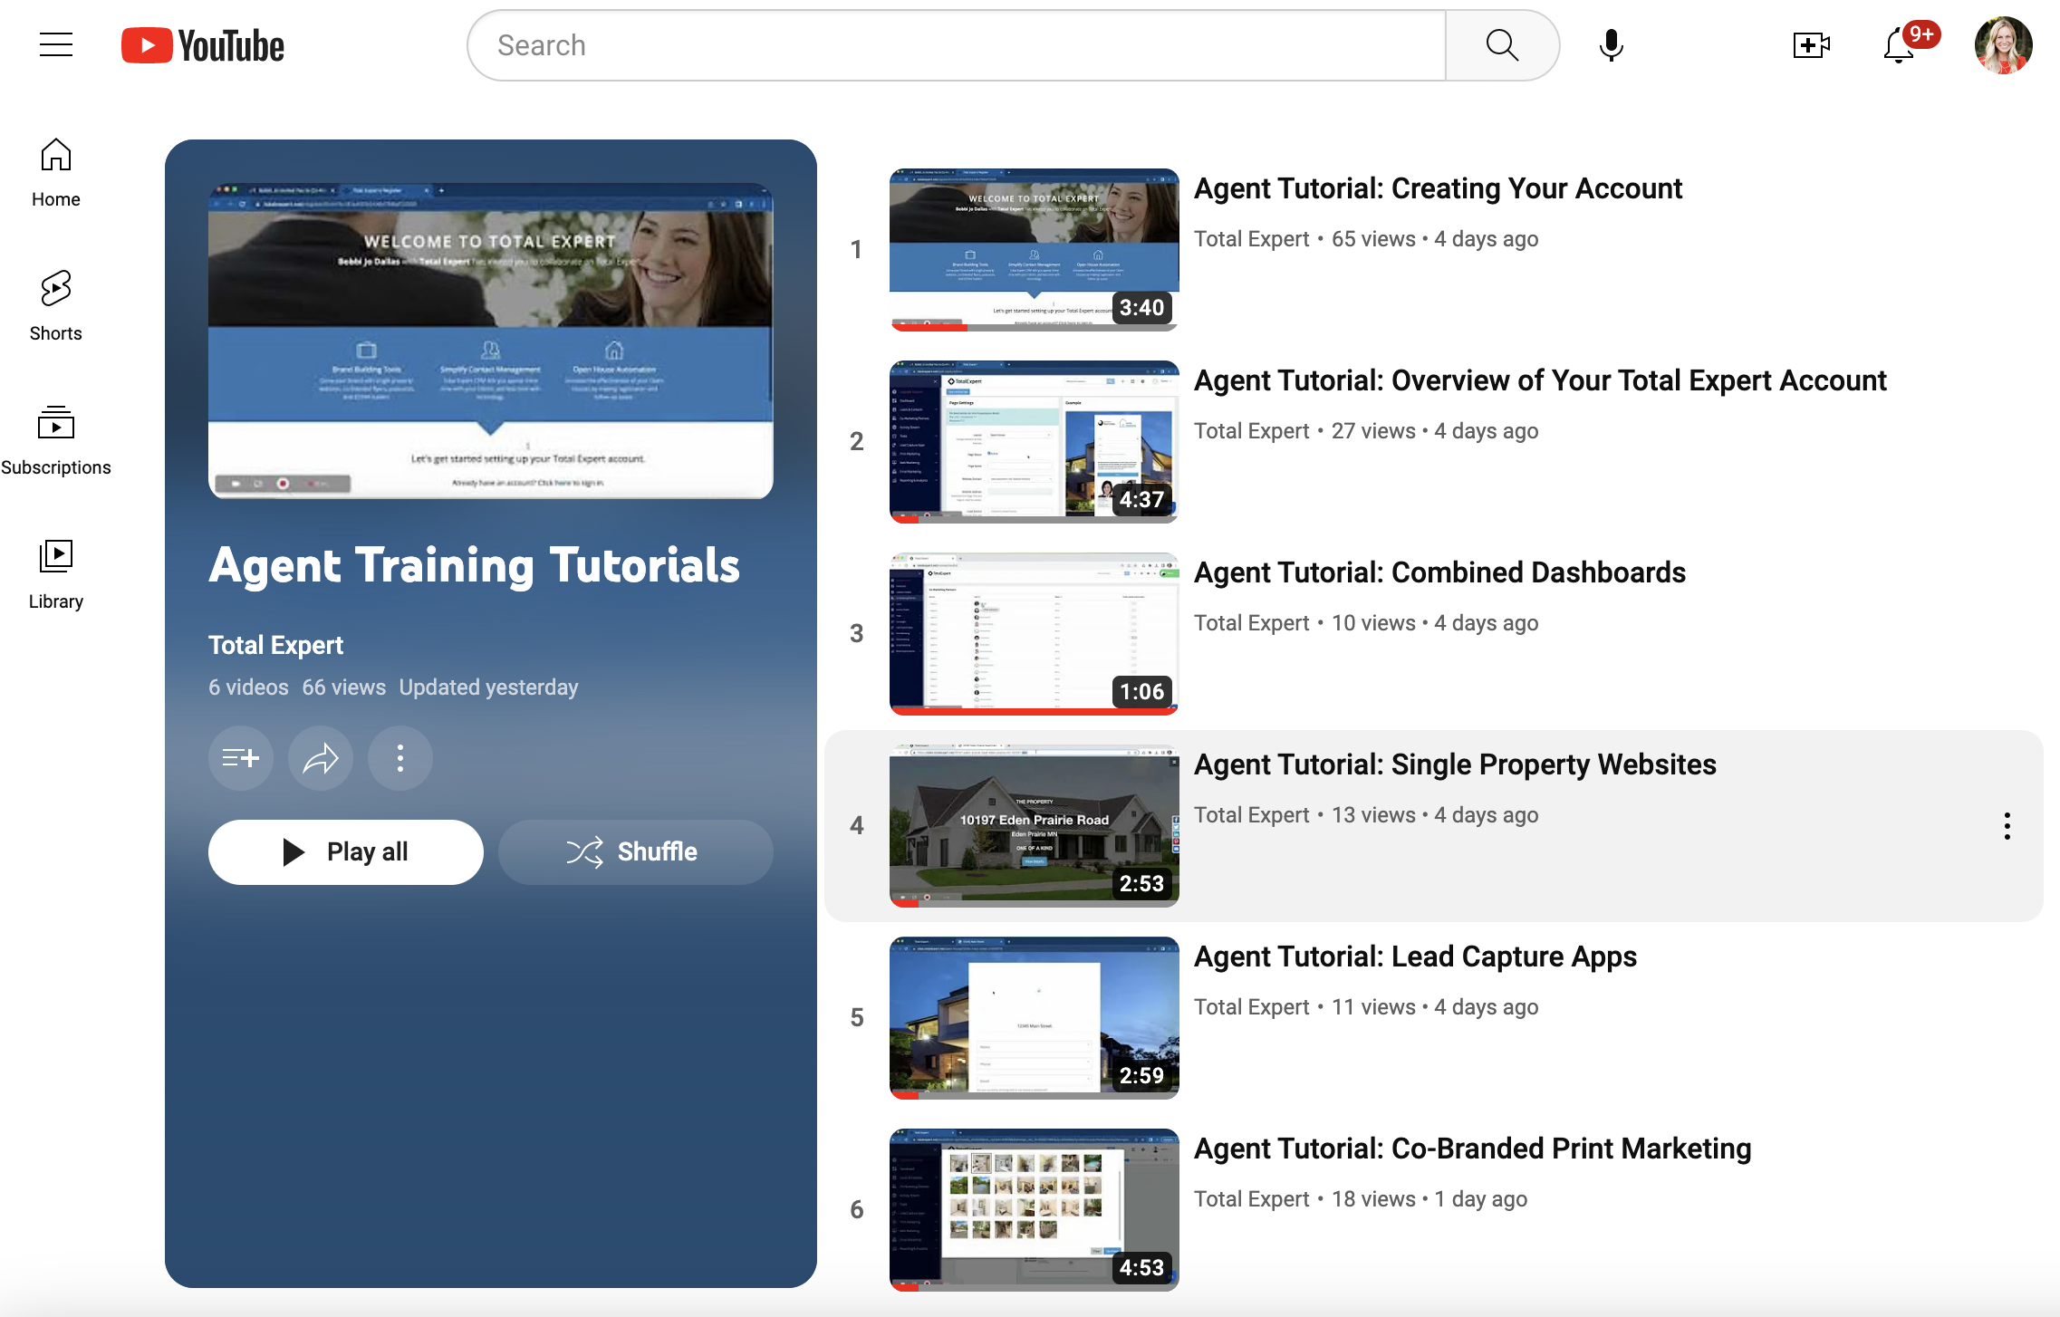
Maximize Co-Marketing Collaboration
Turn on listing alerts in account → notification settings
Act fast when alerts hit: create and send co-marketing resources:
  Single Property Website
  Lead Capture App
  Print Flyer
Show value: share analytics and leads generated
Amplify reach: post SPS on social and tag the agent
Empower agents: remind them they can create SPS, LCA, and flyers too
Support learning: share short YouTube training videos
Example CMP listing alert
Agent training videos

Slide 8
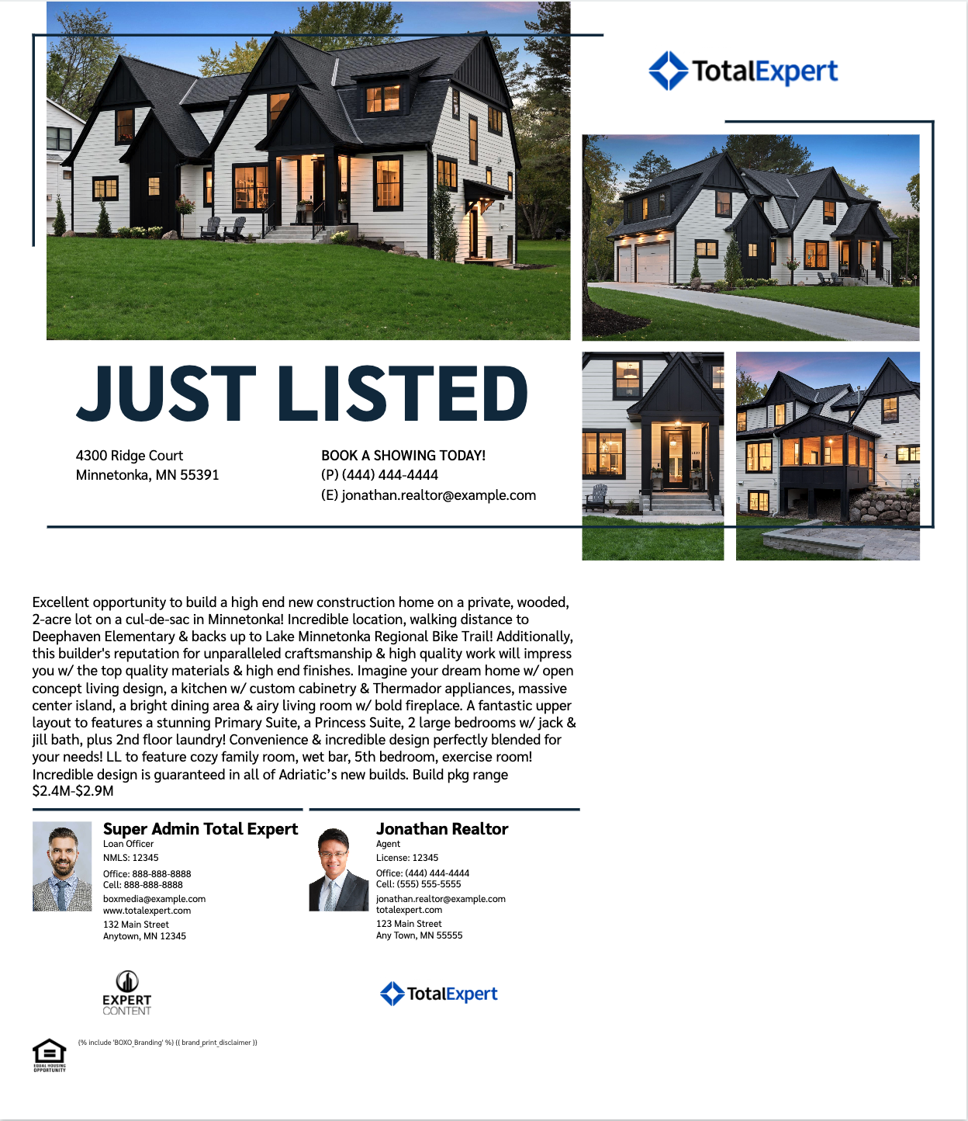
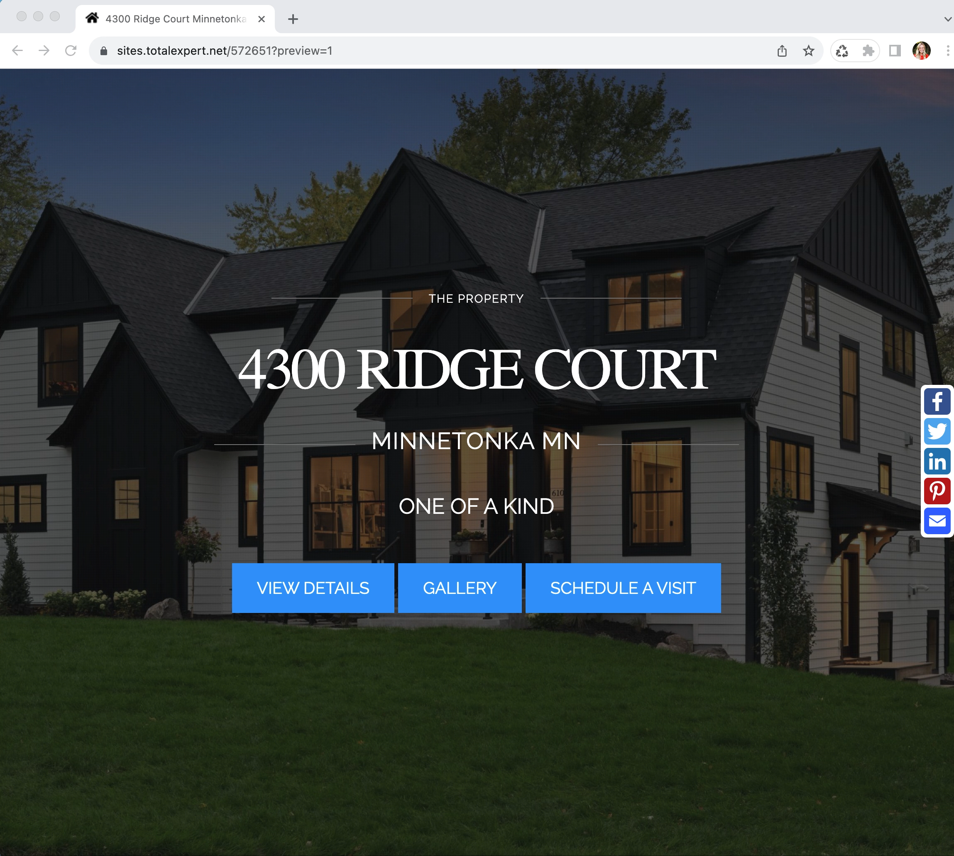
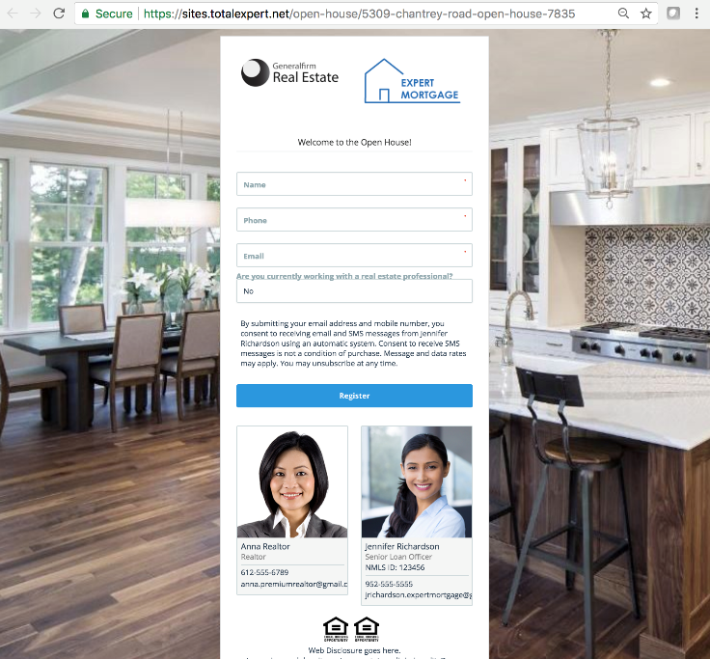
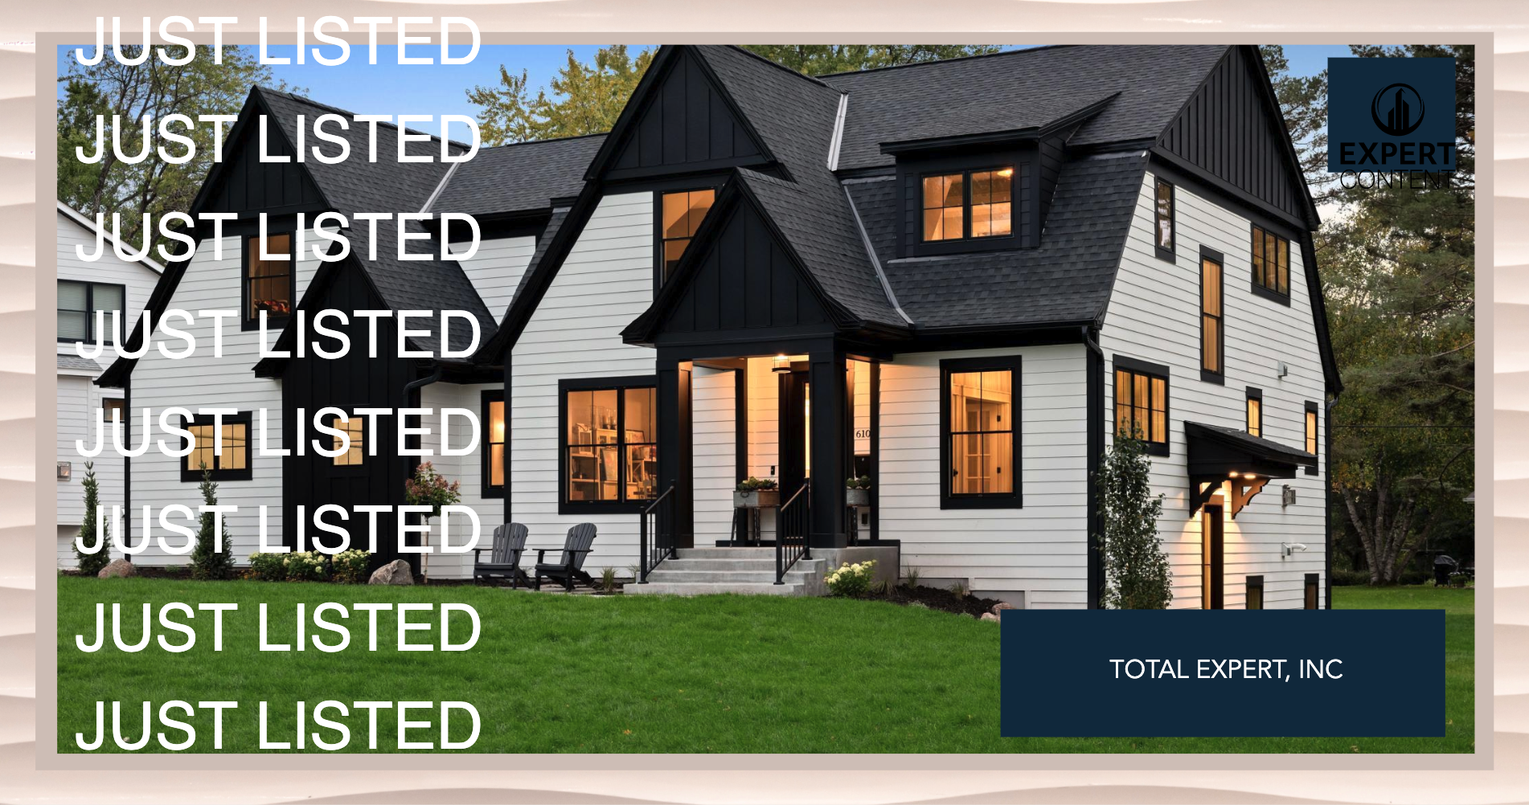
Example Resources:
Listing Flyer
Single Property Website
Open House Sign-In
MLS Social Post

Slide 9


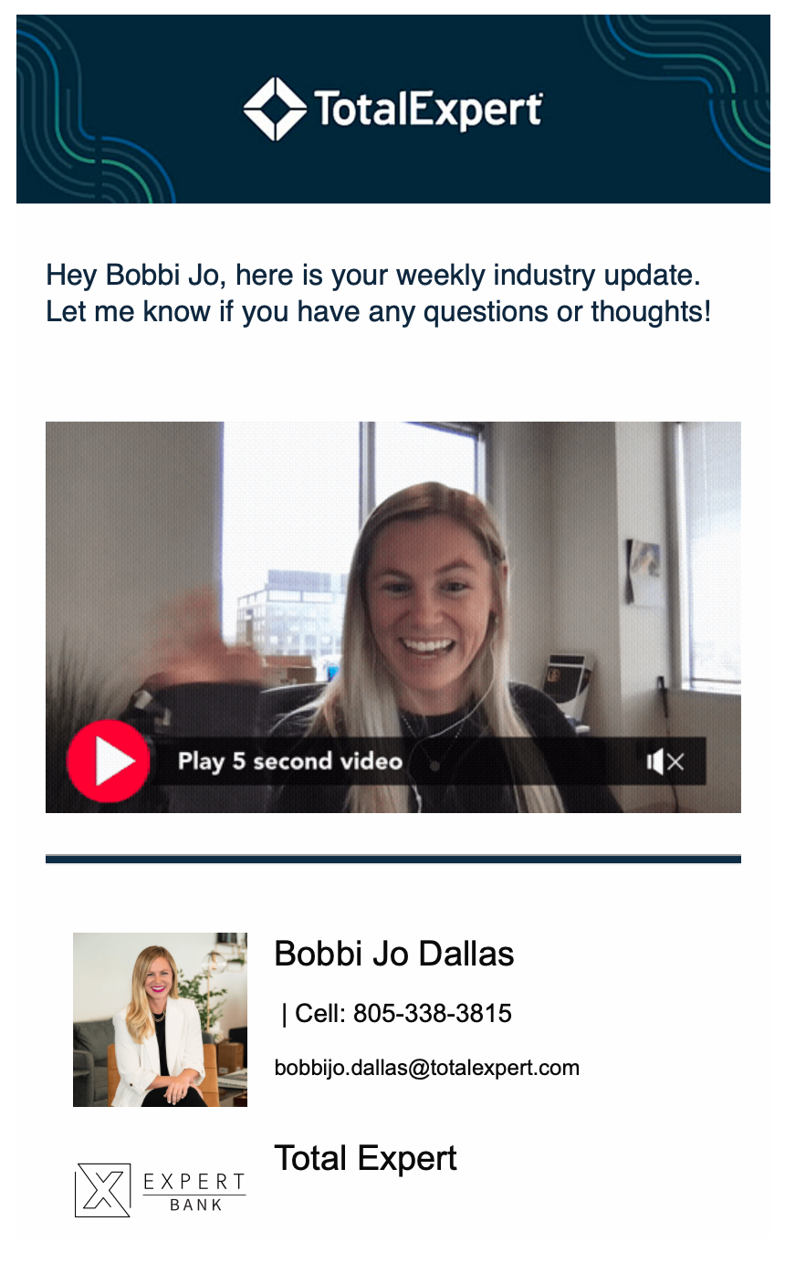
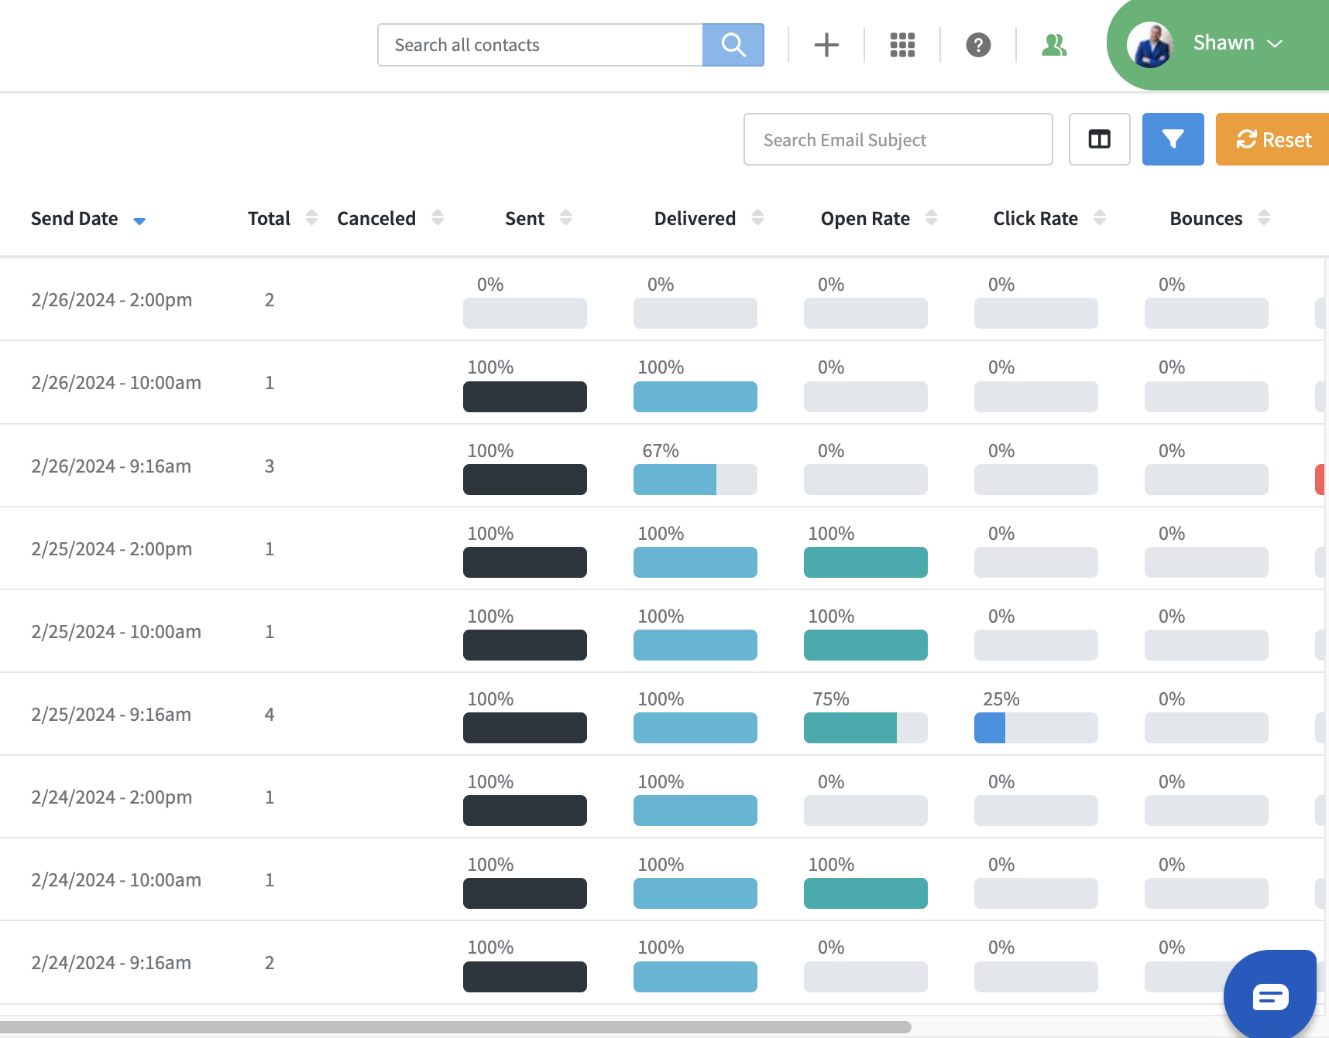
Strengthening Agent Relationships Through Email
Send a short weekly video to keep agents updated and engaged
Email new flyers/assets weekly and ask how you can support upcoming events or open houses
Track engagement (opens, clicks, views) and follow up with interested agents

