Slide 1
The Power of Partnership:
Co-Marketing in Total Expert
Notes:
Welcome, everyone! We’re excited to share how you can leverage Total Expert to grow your business.
Today, we’ll walk through the powerful co-marketing tools you have access to—at no cost—and how they help you stay connected, modern, and efficient in your marketing efforts.

Slide 2
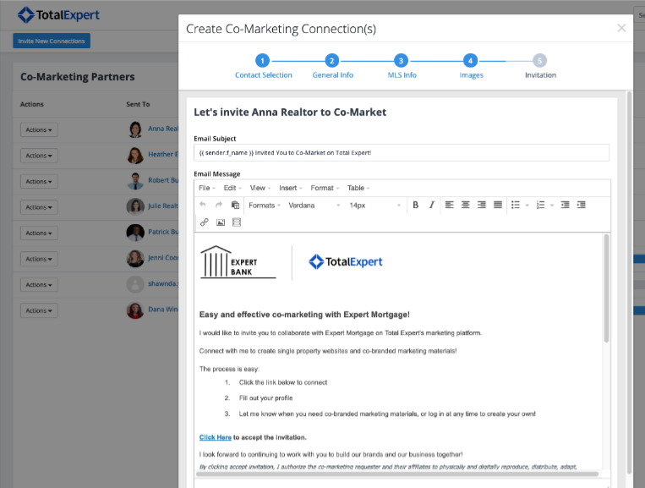
Co-Marketing Portal in Total Expert
You have access to Total Expert at no cost
Use powerful, easy-to-navigate sales and marketing tools
Easily manage your relationships and track your marketing efforts
Quickly create marketing assets with minimal effort
Get live, local support through the chat widget—available six days a week
Notes:
Total Expert gives you access to a full suite of sales and marketing tools at no cost – just by partnering with a loan officer at x organization.
The platform is easy to navigate and was built specifically with agents like you in mind.
You can manage relationships, create assets quickly, and even track marketing performance in one place.
And if you need help, support is just a click away through the chat widget, available six days a week.
Let’s explore the core tools:

Slide 3
Co-Marketing Tools:
Print Marketing Library
Lead Capture Apps and Open House Follow-Up
Single Property Websites
Social Media Content & Posting
Contact Management
Shared leads, notes, communication
CRM / Groups
Email Marketing and tracking
Key Features & Benefits
Notes:
There are two big buckets of functionality in Total Expert: Co-marketing tools and contact management. In the co-marketing suite, you’ll find tools for print marketing, lead capture apps, property websites, and social media. On the contact side, you can track shared leads, communicate with partners, and send email marketing—all in one place

Slide 4
Co-Marketing Tools
Notes:
Let’s dive into the co-marketing tools

Slide 5
Branded Print Marketing Library
Quickly and easily deploy beautiful flyers and brochures.
Pre-built library of content
Promote your listing in just a few clicks
Educate your clients
Notes:
Total Expert has a full library of pre-built templates you can customize and print in just a few clicks. It’s a great way to promote your listings and educate your clients with professional, co-branded materials

Slide 6
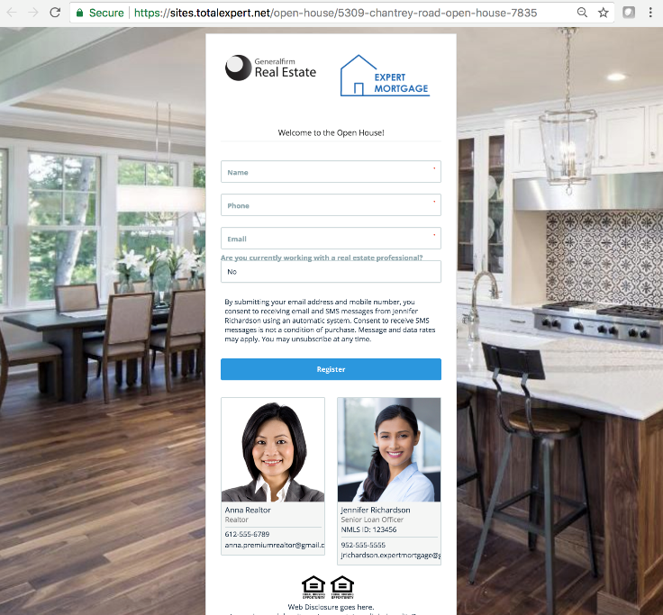
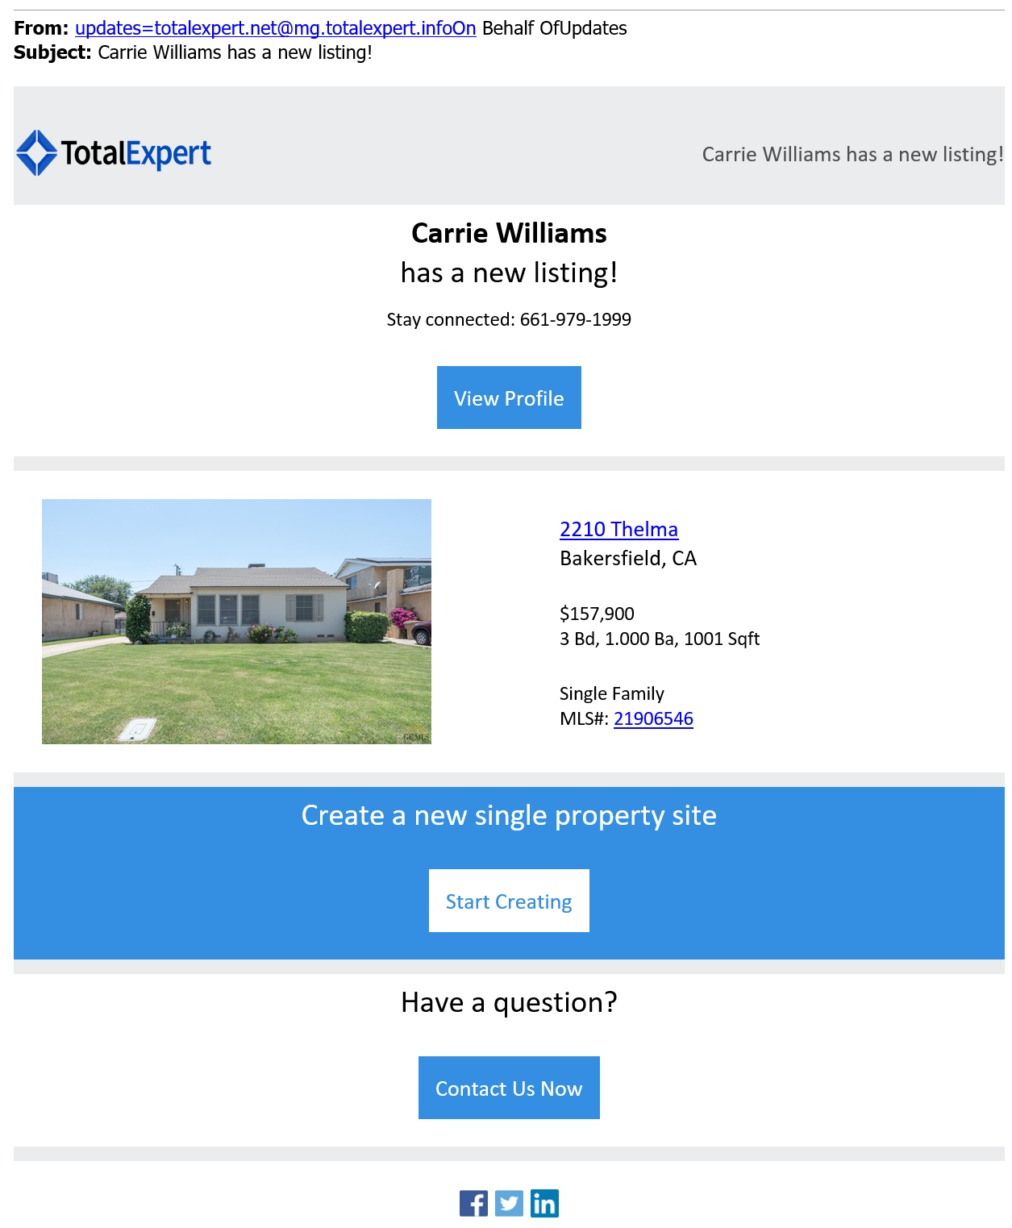
Lead Capture Apps & Open House Automation
Digital sign-in forms for your open houses
Leads automatically funnel into Total Expert
Automate follow-up
Notes:
Let’s look at one of the most popular tools—Lead Capture Apps. These are digital sign-in forms for your open houses. Instead of collecting paper sign-in sheets, leads automatically go right into Total Expert. From there, the system can automate follow-up to keep the conversation going after the event—without you lifting a finger.

Slide 7
Single Property Websites
Attract and engage homebuyers with beautiful landing pages for each of your listings
Expand your reach
Modernize your brand
Track engagement and leads
MLS integration
Multi-channel optimization
Notes:
Next, you can instantly generate stunning, mobile-optimized property websites for your listings. These pages integrate with the MLS, help expand your reach, and allow you to track engagement. This is a great way to modernize your brand and attract more eyes to your properties.

Slide 8
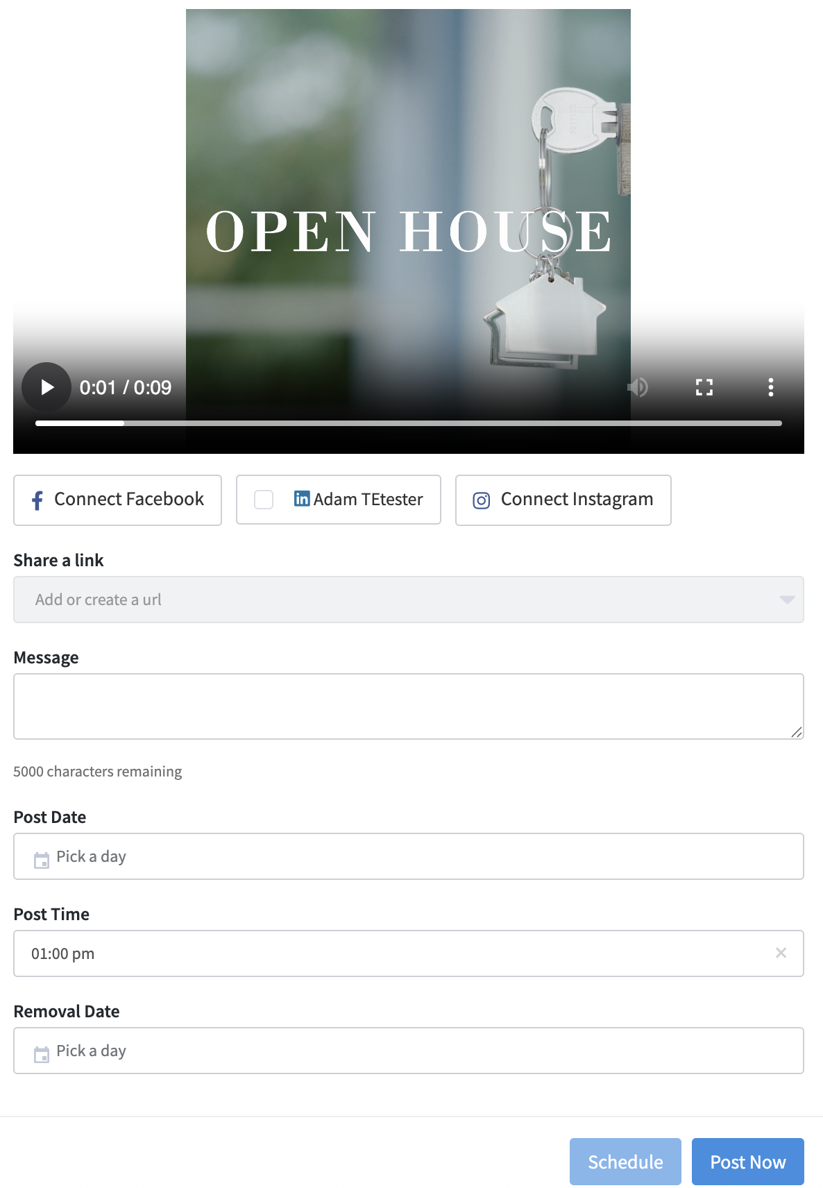
Social Media Library
Use pre-built content from Total Expert’s social library
Schedule and publish social posts with ease
Post educational, industry, and listing content listing content to stay relevant
Notes:
We also make it easy to stay active on social media. Choose from pre-built educational and promotional content, schedule it, and publish it directly to Facebook, Instagram, X, and LinkedIn. You don’t need to be a designer or writer—just pick and post.

Slide 9
Contact Management
Notes:
Let’s shift gears and talk about the ways you can manage your contacts in Total Expert.

Slide 10
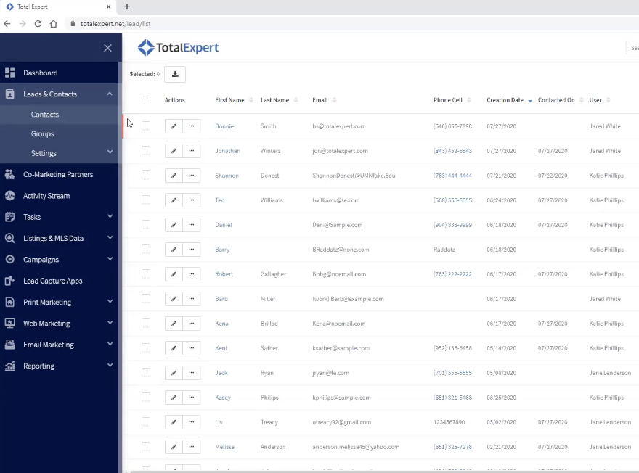
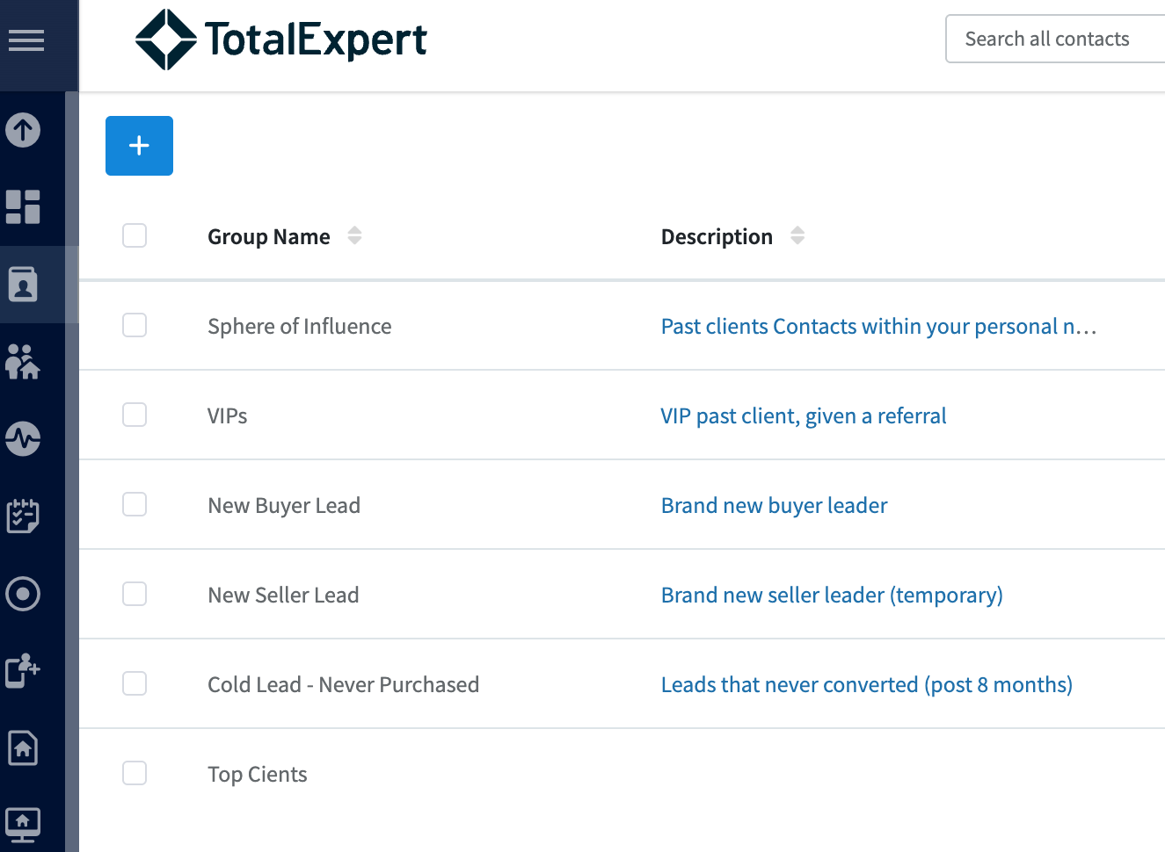
Lead and Contact Management
Input your database into Total Expert
Group and manage clients
Track and manage shared leads with your lending partners
Get loan status updates for each transaction
Notes:
First thing you should know is that you can load your database into Total Expert through our support team. From there, you can create your own groups and manage your workflow. You can also track shared leads with your lending partners and collaborate together in the system with shared notes and tasks. You will also get timely updates on where your shared client is in the homebuying process as well as key milestones.

Slide 11
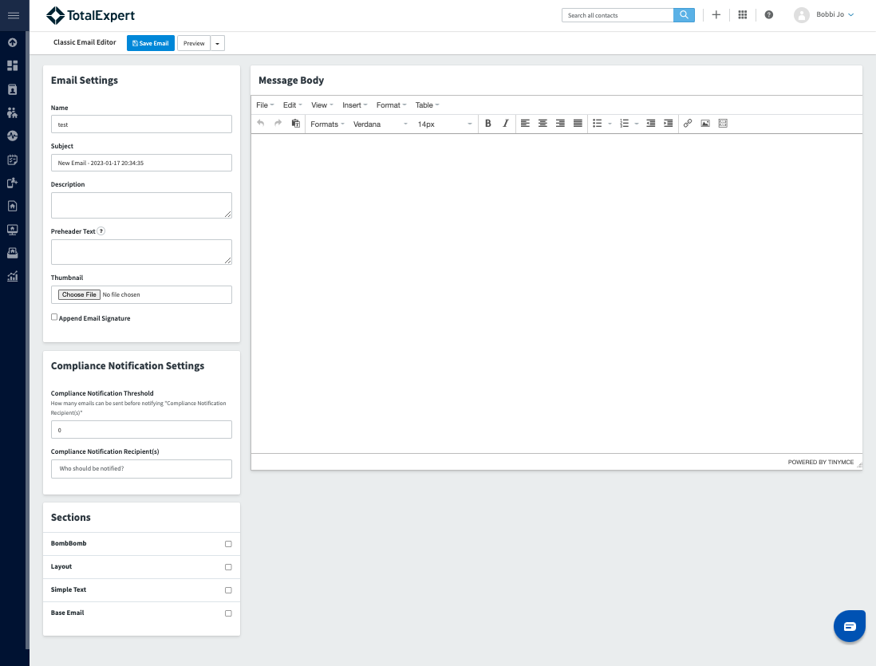
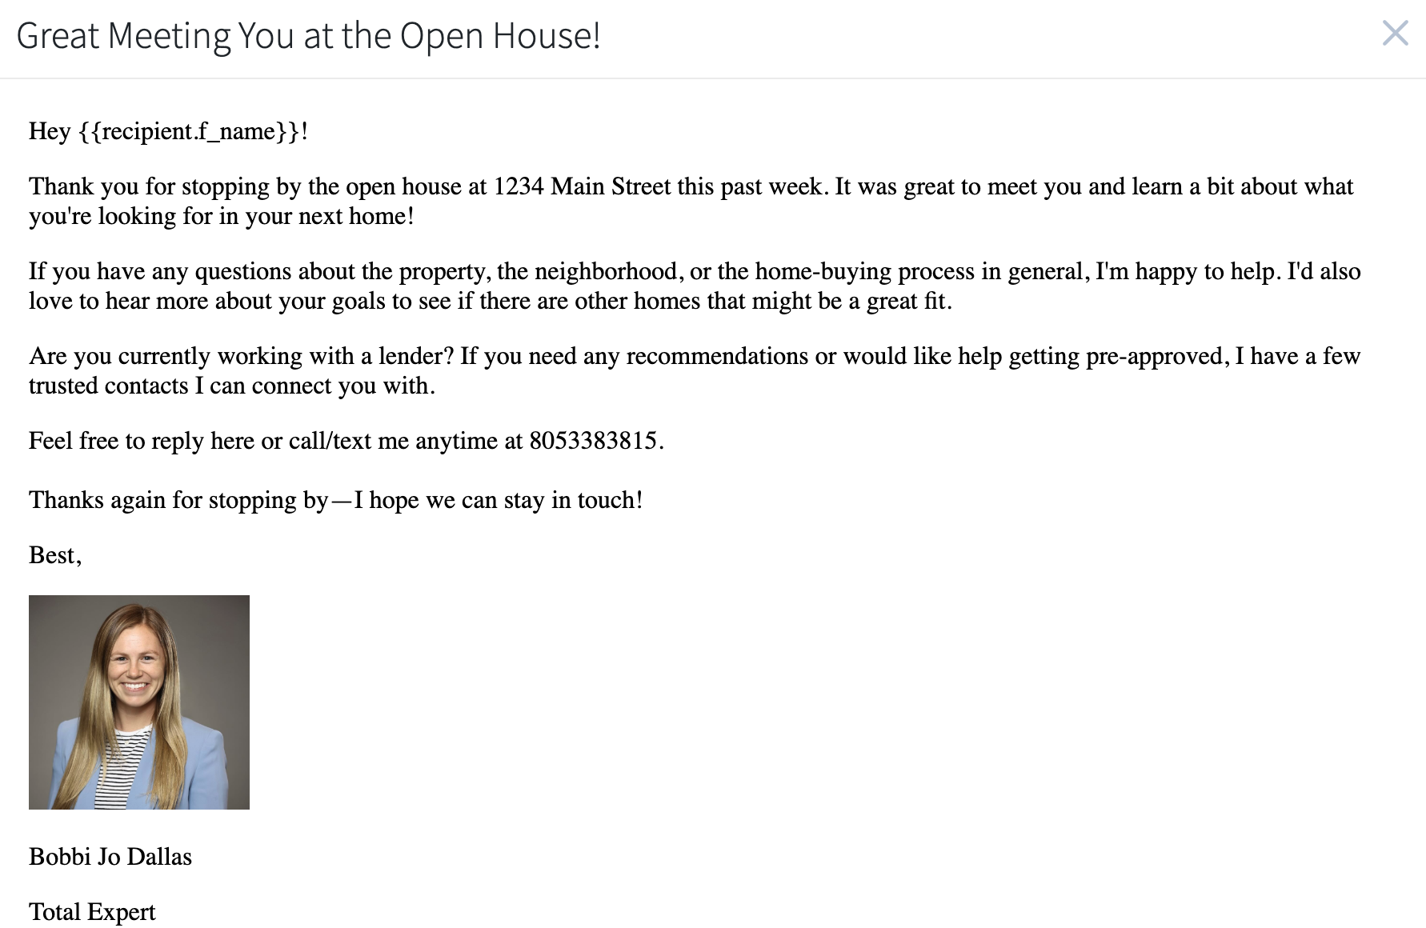
Email Marketing
Create custom emails that are timely, relevant, and personal.
Send emails directly from the platform and schedule them out in advance
Track engagement and interaction
Notes:
Total Expert also allows you to send emails directly from the platform. You can create messages that are timely, relevant, and personal. And you’ll be able to see who’s engaging with your emails so you can follow up with those most interested. Send targeted communication to different groups of your database.

Slide 12
Getting Started in Total Expert
Notes:
Let’s talk about how you get started with Total Expert.

Slide 13
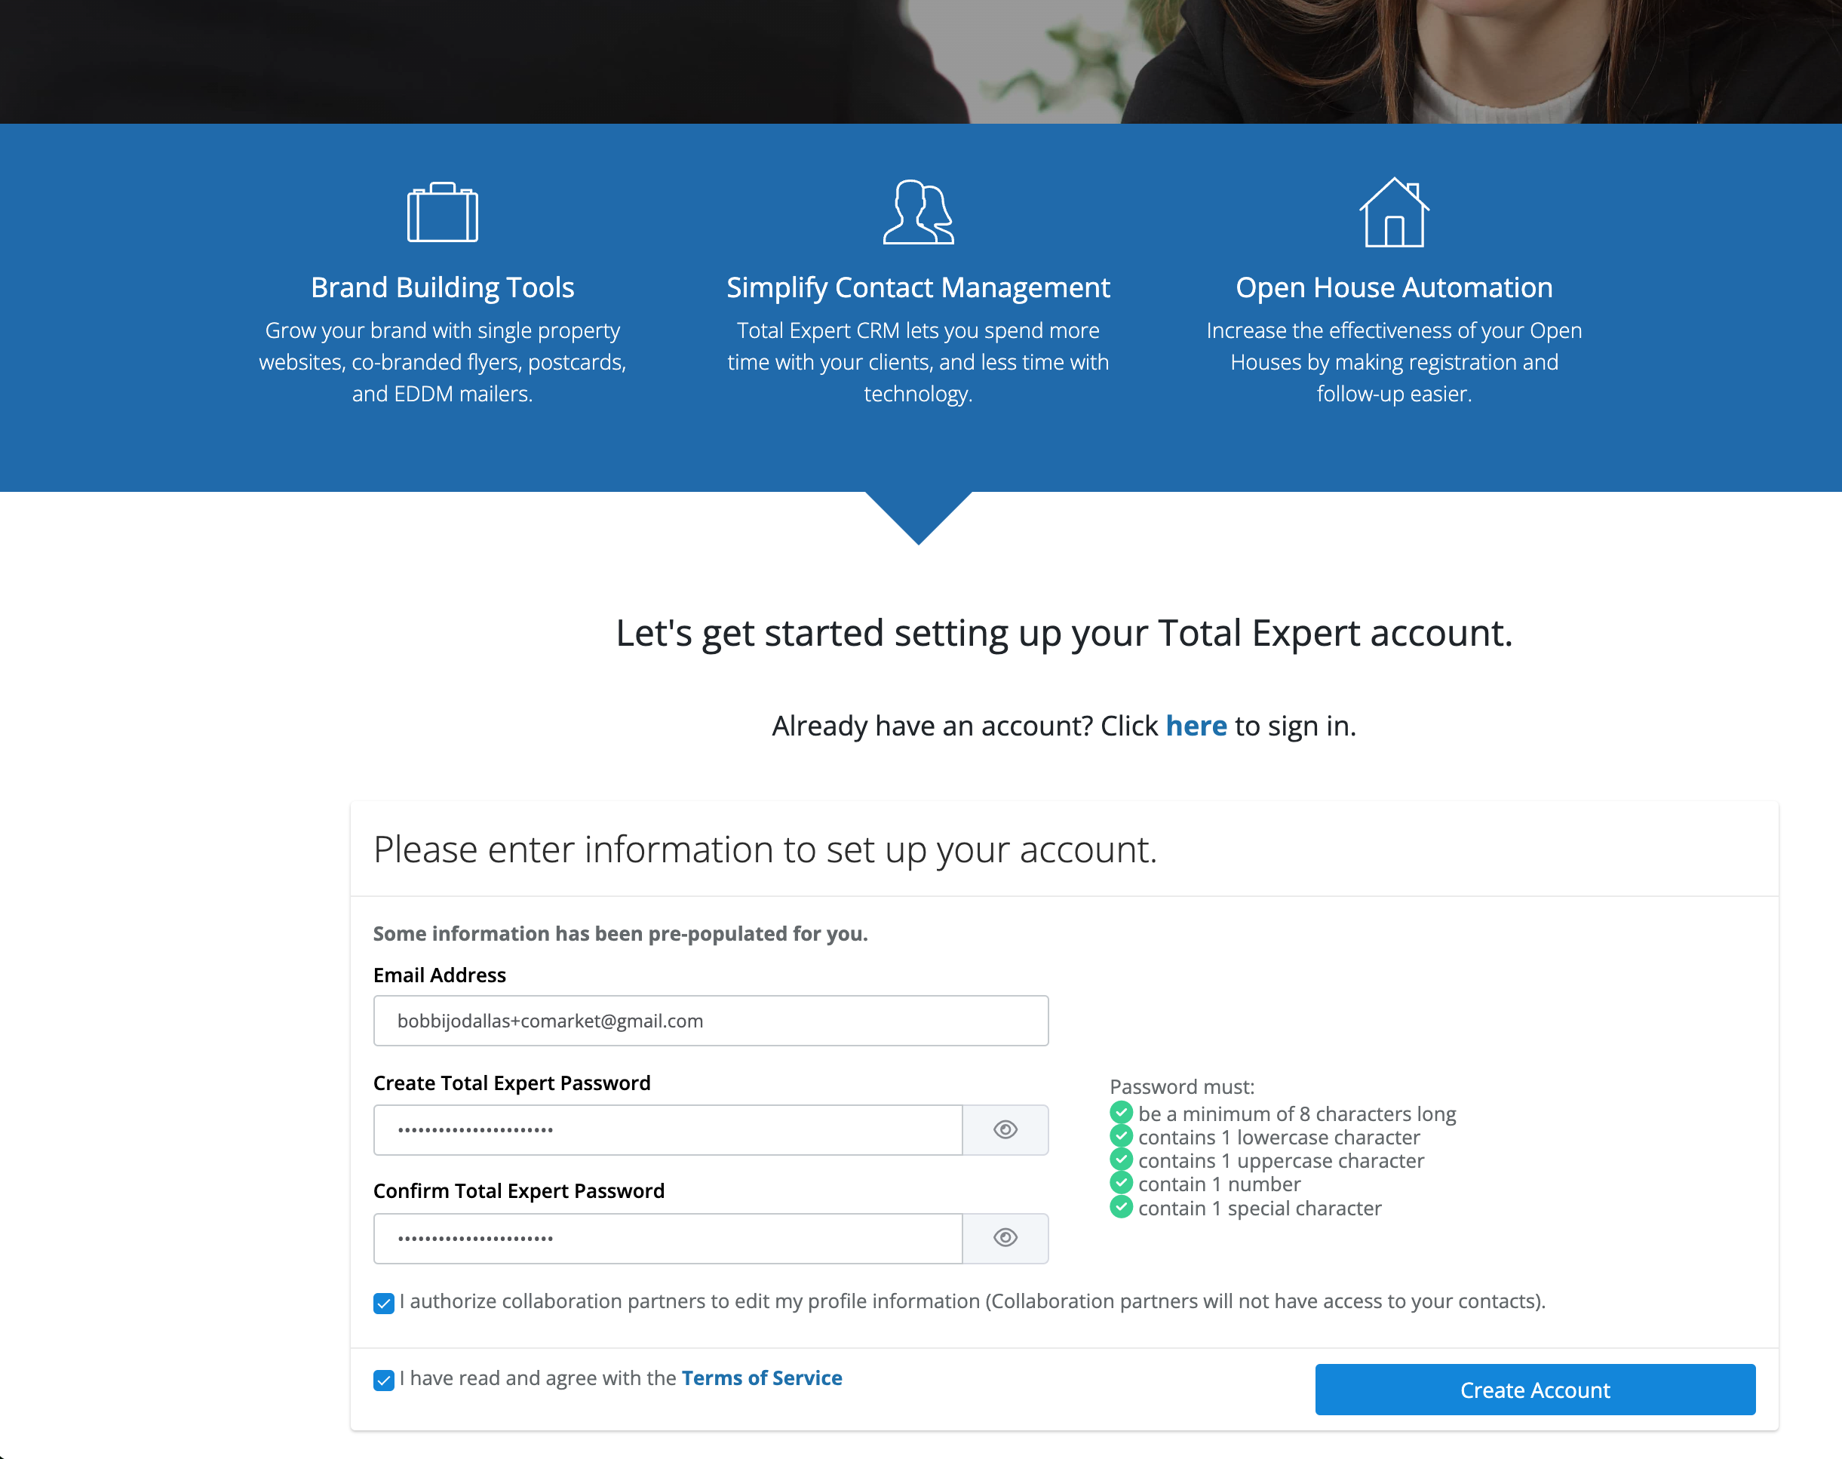
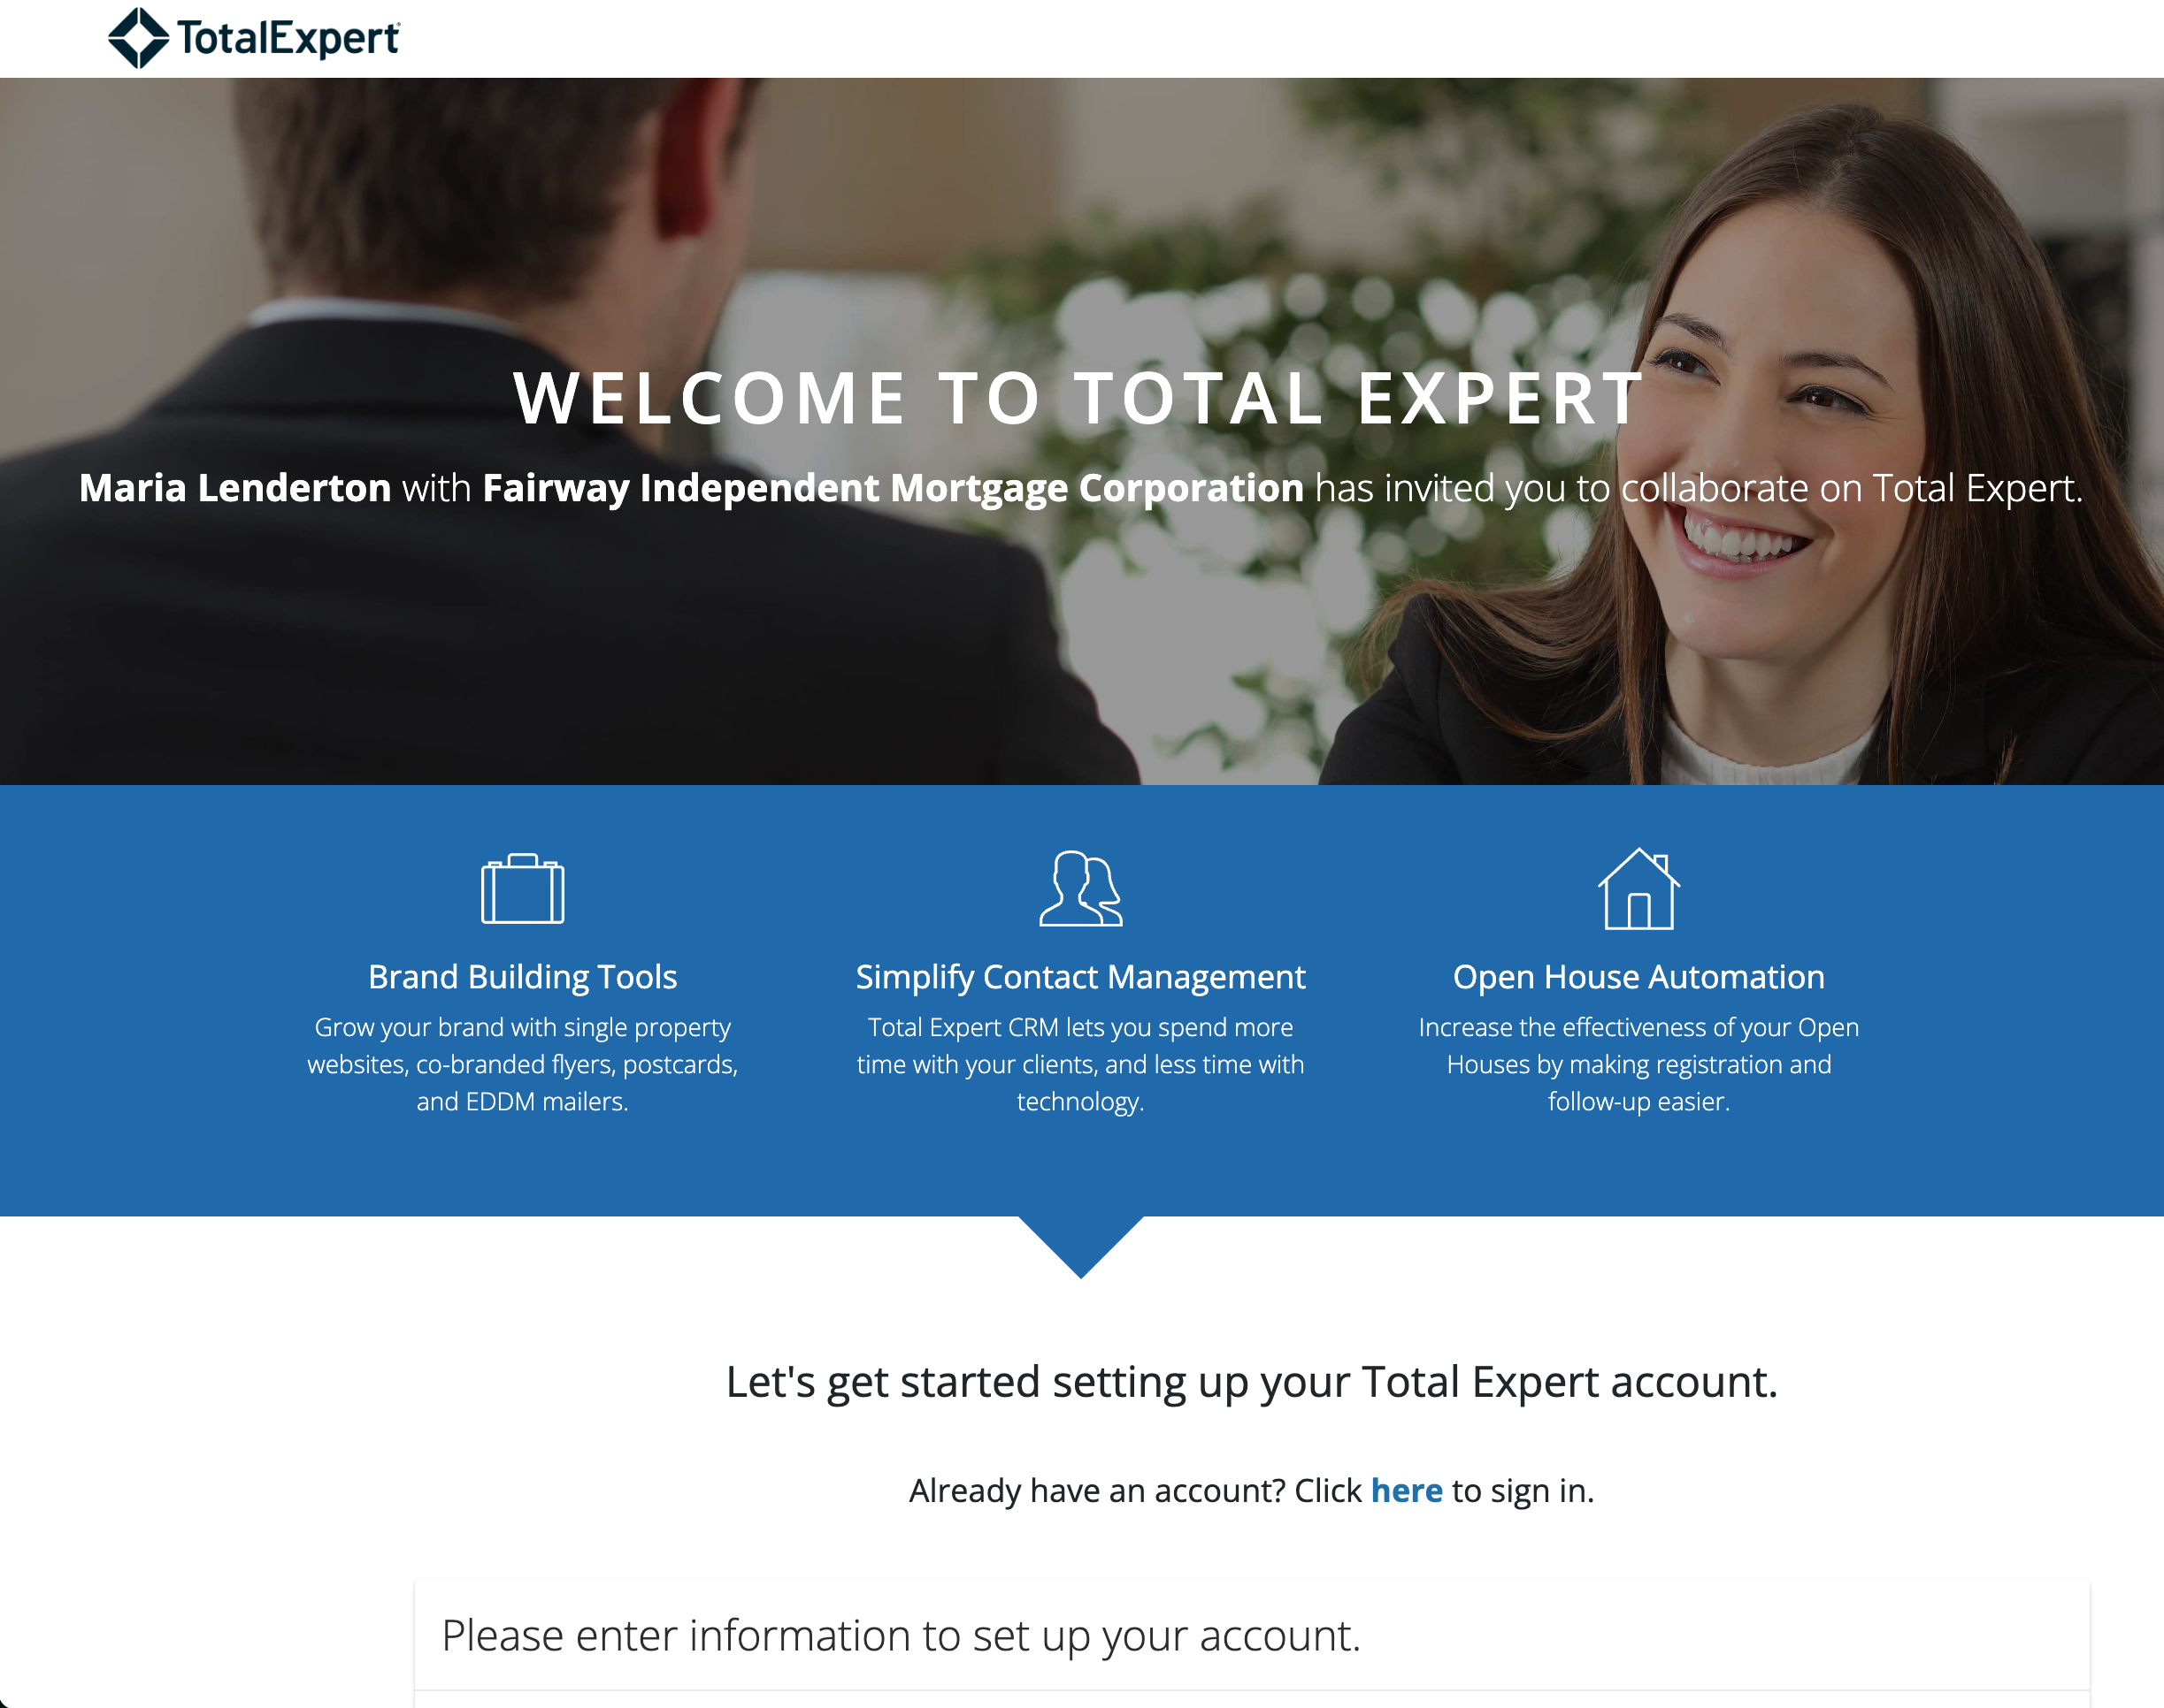
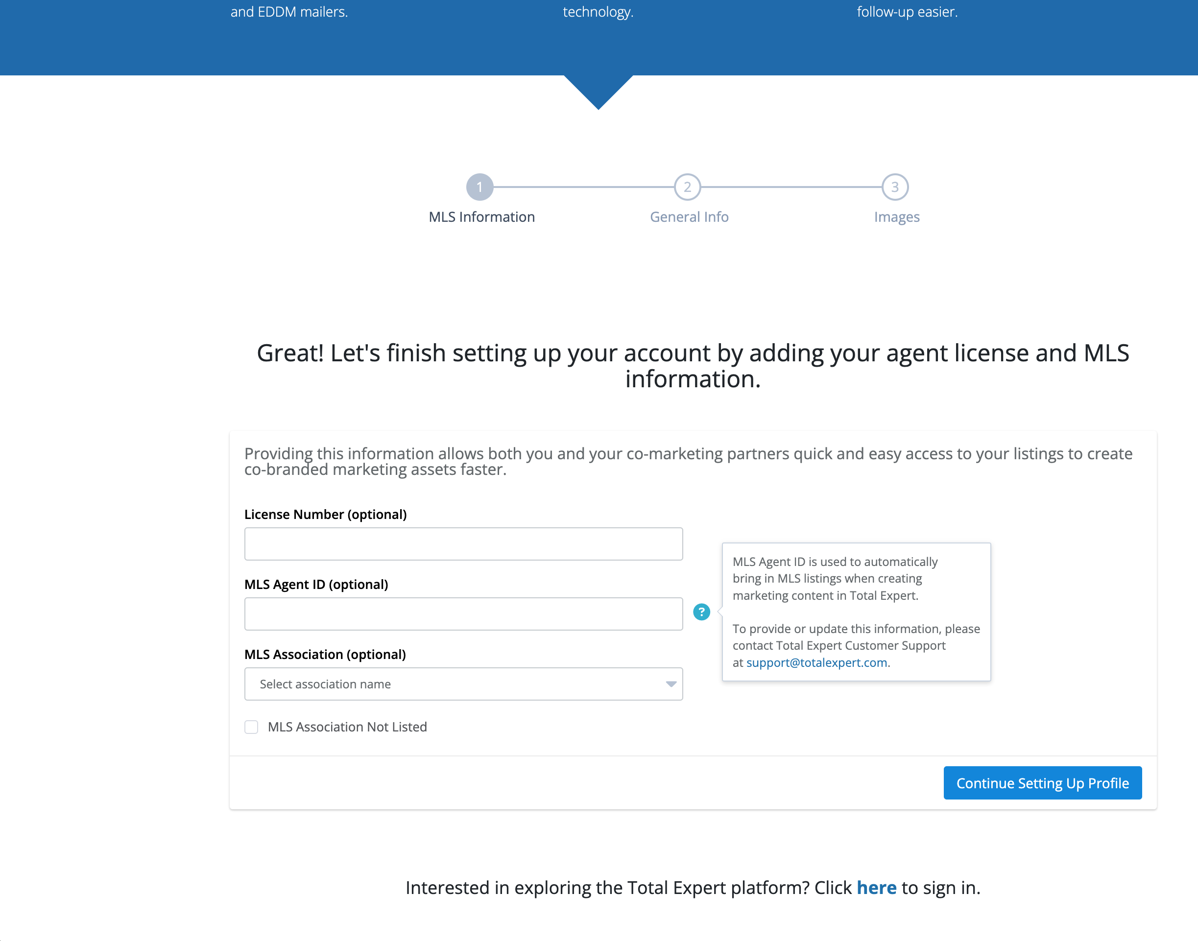
Setting up your TE account
Create login and password
Add MLS agent ID and Association
Notes:
First, you will get an invite from your lending partner and you will need to click the link to sign up. From there:
Getting started is easy. Create your username and password and then you will need to add your license number, MLS agent ID, and MLS association. It is SUPER important that you include your MLS Agent ID when you sign up, as this created the hookup to the MLS and will allow the system to auto populate your listings.

Slide 14
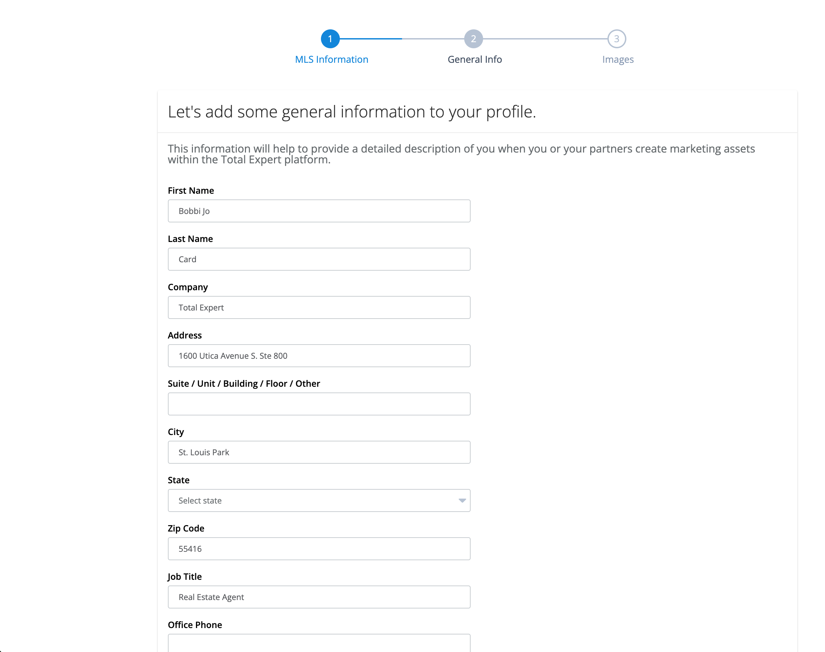
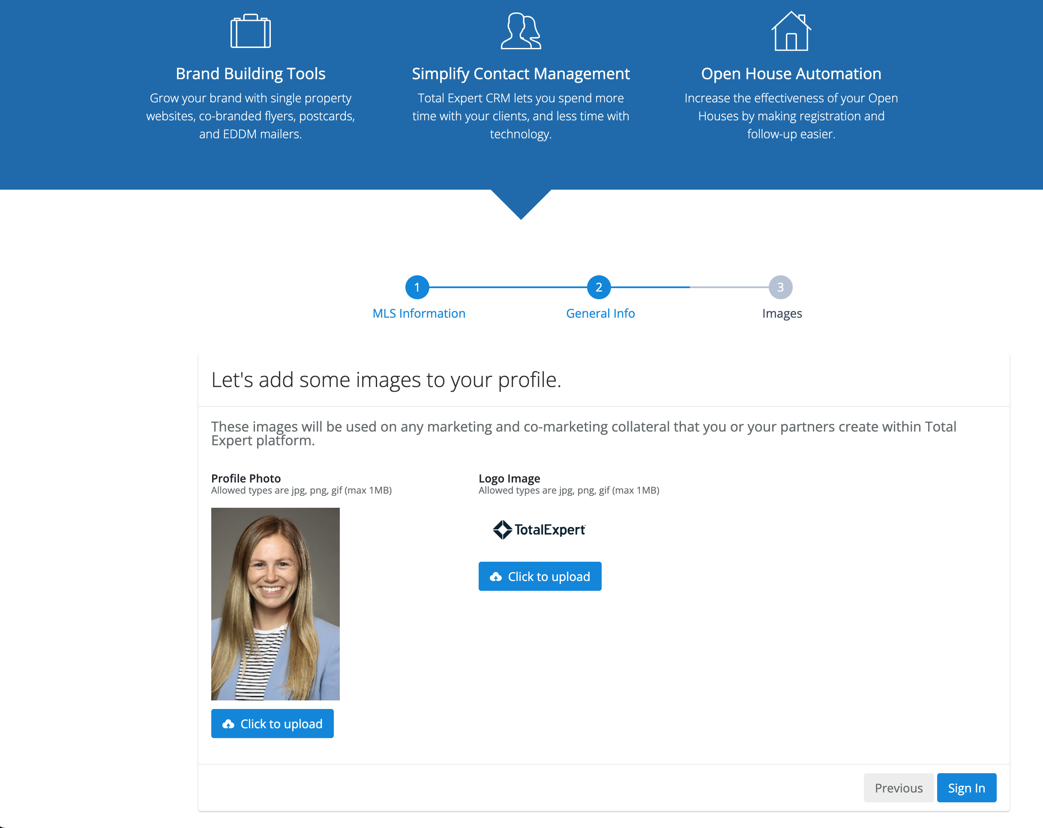
Setting up your TE account
Check Profile Information
Check Headshot / Logo
Notes:
Then you will fill out your profile information and add your headshot and logo. This is really important to include because it ensures all your marketing is branded professionally and accurately.

Slide 15
Agent Resources

Slide 16
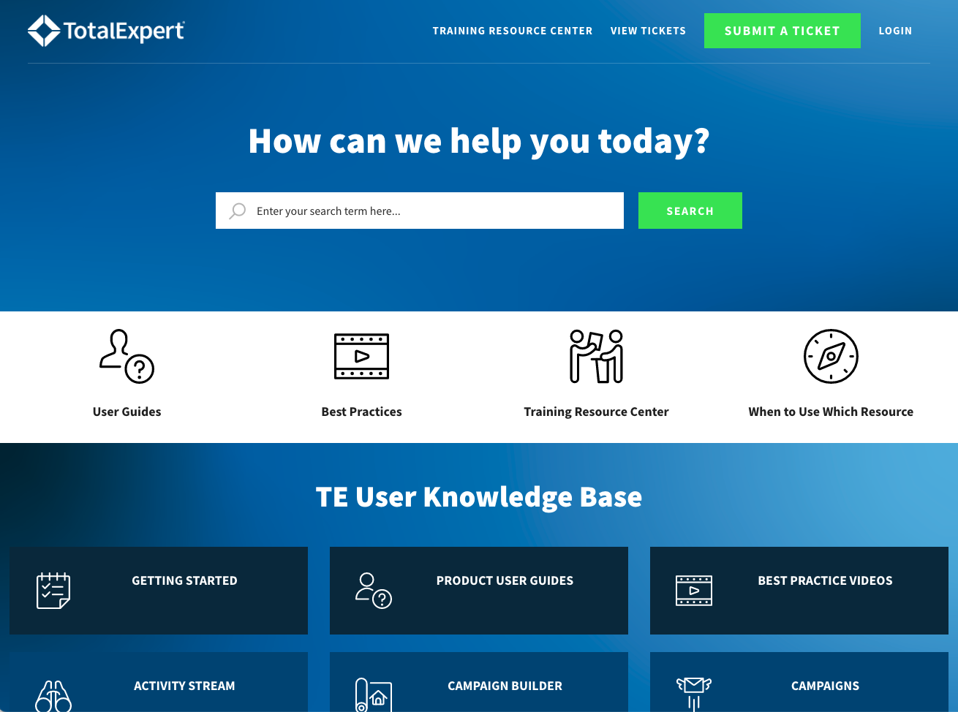
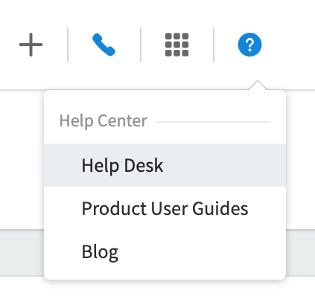
Help Desk
Notes:
If you ever get stuck, click on the question mark at the top right corner of the platform – this will take you to the Help Desk which gives you access to a robust knowledge base of resources to help you.

Slide 17
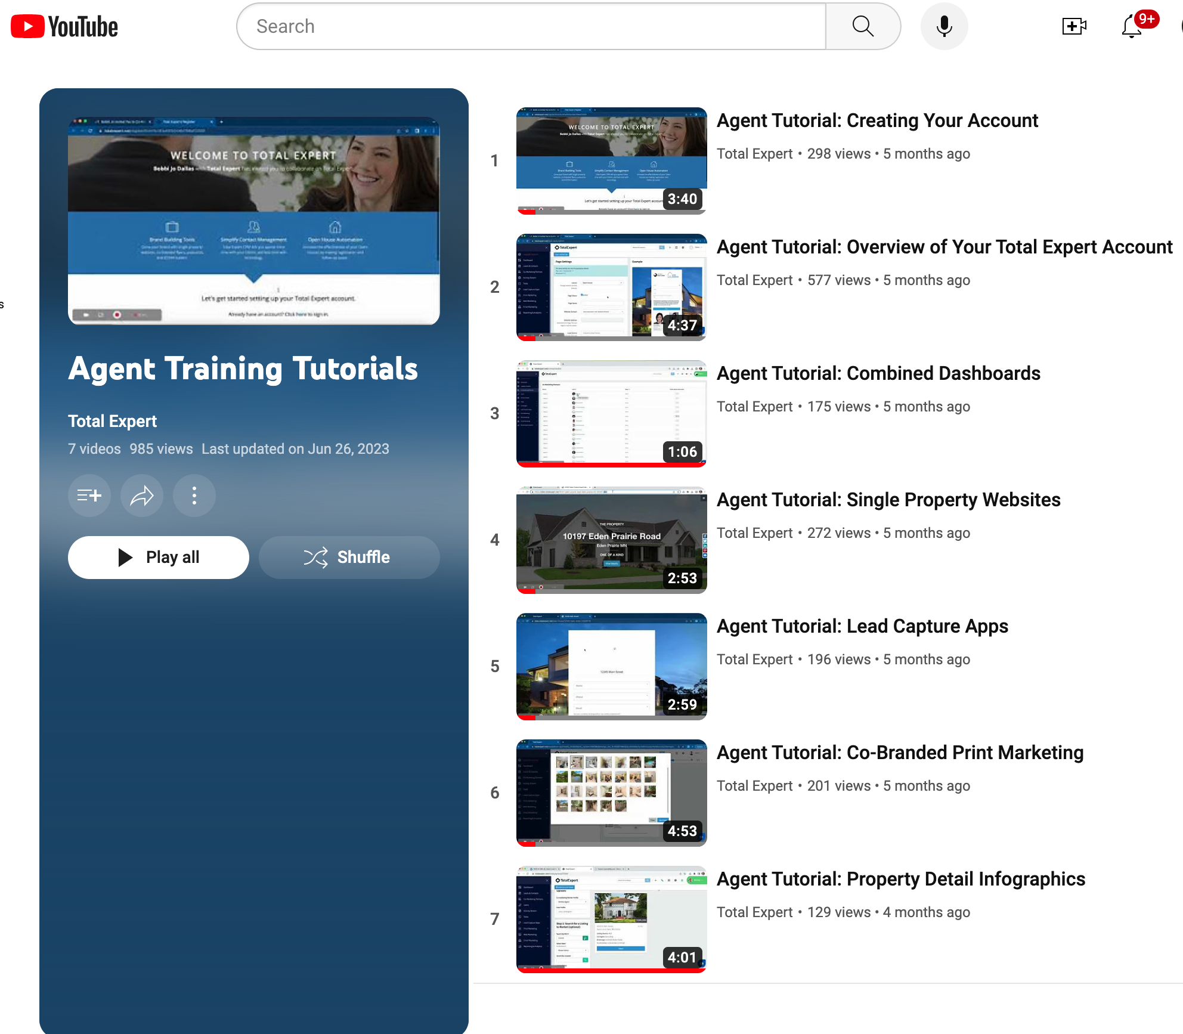
YouTube Training Videos
Notes:
Prefer to learn by watching? We’ve got a library of YouTube training videos that cover everything from managing contacts to creating property websites. They’re quick, easy, and available 24/7 on YouTube. You can also find these by clicking on the quicklinks at the top right corner of the platform and finding > agent training tutorials.

Slide 18
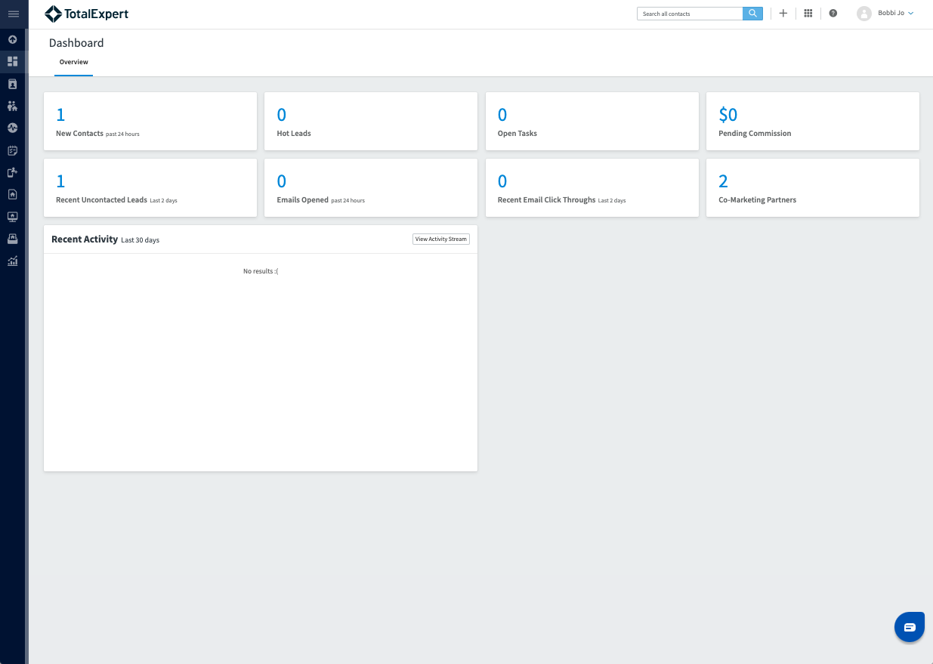
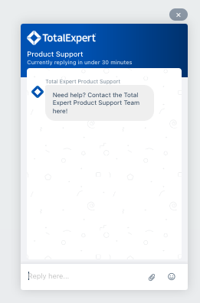
Customer Support
Notes:
And don’t forget—live support is available via the chat widget inside the platform. It’s staffed six days a week and ready to help you with any questions.

