Slide 1
Daily Activities to Drive Success in Total Expert

Slide 2
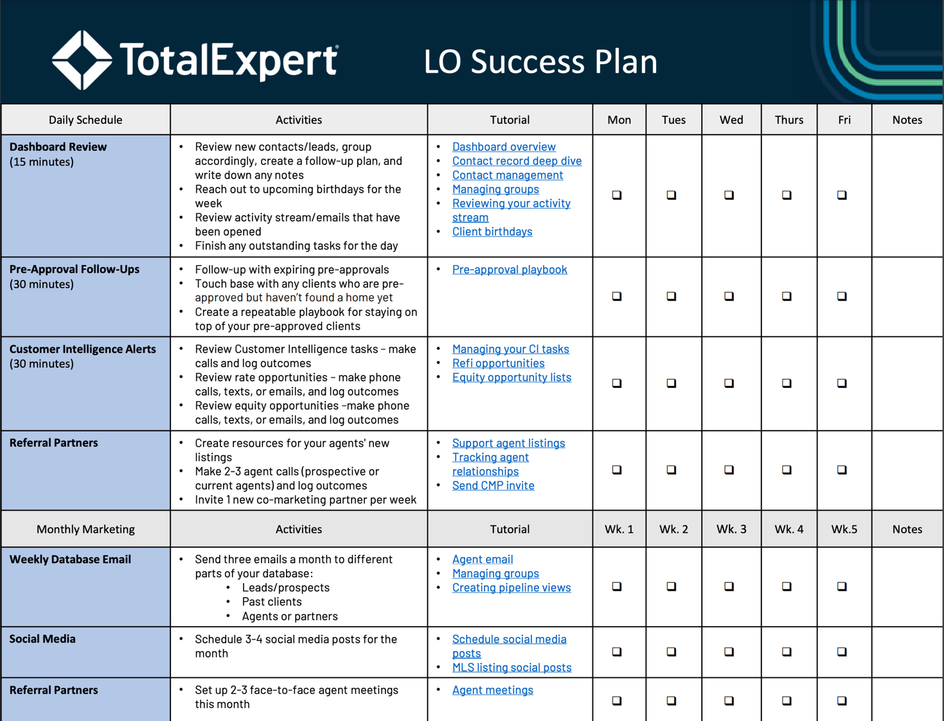
Update slide with edited Daily Success Plan

Slide 3
1
Dashboard Review

Slide 4
The Dashboard
Provides a concise overview of key information about platform activity at a glance.
Best Practices:
Review new contacts/leads, group accordingly, create a follow-up plan, and write down any notes
Reach out to upcoming birthdays for the week
Review activity stream/emails that have been opened
Finish any outstanding tasks for the day
“Total Expert gives me a roadmap of what to do each and every day. The dashboard outlines everything for me: who’s in my pipeline, what’s funded, who has a birthday, and who’s opening emails that have gone out. It develops my plan for me.”
Top LO from Prosperity (> 50M Production in 2024)

Slide 5
2
Pre-Approval Follow Up

Slide 6
Staying On Top Of Your Pre-Approvals
Don’t miss out on potential opportunities. Follow up and nurture pre-approvals to ensure they return to you when the time is right.
Best Practices:
Follow-up with expiring pre-approvals
Touch base with any clients who are pre-approved but haven’t found a home yet
Create a repeatable playbook for staying on top of your pre-approved clients
“At any moment in time, I have the ability to go back into the system, review my notes, and refresh my mind on the relationship so that I can have more meaningful conversations with the client.”
Top LO from Fairway (>25 M Production in 2024)

Slide 7
3
Customer Intelligence

Slide 8
Gaps in the Customer Journey Are Costing You Millions

Slide 9
Intelligence + Action
Data
An enriched, comprehensive customer profile
Insights
Actionable intelligence that continuously surfaces intent based alerts and opportunities to help customers.
Action
Hyper-personalized, multi-channel journeys that combine digital and human engagement

Slide 10
Maximize Opportunities with CI
Get notified when the system identifies critical moments to engage in high-quality opportunities.
“With the credit inquiry alert in Total Expert, I’ve had success with a simple text. The client seems more likely to engage. I’ve been able to recapture past clients with that approach, I’m not sure I would have got that with a different approach”
Best Practices:
Review Customer Intelligence tasks – make calls and log outcomes
Review rate opportunities – make phone calls, texts, or emails, and log outcomes
Review equity opportunities –make phone calls, texts, or emails, and log outcomes
Top LO from Lake Michigan Credit (>220 M Production in 2024)

Slide 11
4
Referral Partners

Slide 12
Build relationships with your referral partners
Utilize Total Expert's marketing and co-marketing tools to support your agents' listings.
“Every Friday, we send out an 'I'm working this weekend' email from Total Expert to all of our realtors, and we pick up a deal every single weekend just from these emails. If I send that email, my phone is ringing —no question. In under 5 minutes, I can go into the system and schedule these out for the whole month. It's so simple.”
Best Practices:
Create resources for your agents' new listings (listing alerts)
Make 2-3 agent calls (prospective or current agents) and log outcomes
Try to set up 2-3 agent in-person meetings every month
Invite one new co-marketing partner per week
Send weekly/monthly emails to agents to build your relationships
Top LO from Fairway (>60 M production in 2024)

Slide 13
5
Monthly database outreach

Slide 14
Consistently stay in front of your database
Stay in regular contact with your database to ensure they turn to you for their next financial transaction.
Best Practices:
Leverage Pipeline Views to stay on top of our database
Daily power hour – calling clients/update calls
Quickly and easily engage with your database in a consistent manner
Wednesday knowledge bomb
Send three emails a month to different parts of your database:
Leads/prospects
Past clients
Agents or partners Send weekly/monthly emails to agents to build your relationships
“I pick a different group every day and then my team and I sit down for a disciplined power hour where we make as many calls as we can with the goal of getting in front of as many clients as possible.”
Top LO at Intercap Lending (>45 M production in 2024)

Slide 15
6
Social Media

Slide 16
Expand your reach with social media
Build your brand and your exposure with social posting in Total Expert
Best Practices:
Schedule 3-4 social media posts for the month
Holidays
Industry updates
Agent’s listings
Check regularly for new content
“When one of my agents has an open house, it takes me less than three minutes to create a single property website and a flyer that I can then post on social media and tag them… now that‘s powerful.”
Top LO from PRMG
(>20M Production in 2024)

