Slide 1
Instructions Page
Delete slide before presenting
Be sure to review all the slides before presenting and delete any that do not make sense for your organization
Replace screenshots with screenshots of your organization’s instance of Total Expert, if you wish
Customize end-user CTA slides with accurate information for end users based on how your Journey is set up and how you want your team to approach CI

Slide 2
Introducing:
Customer Intelligence 🚀

Slide 3
Mortgage Credit Inquiry Alert
Credit Improvement Alert
Rate Alert & Enrichment
Equity Insight & Enrichment
Property Listing Alert
Customer Intelligence

Slide 4
Mortgage Credit Inquiry Alert
Customer Intelligence

Slide 5
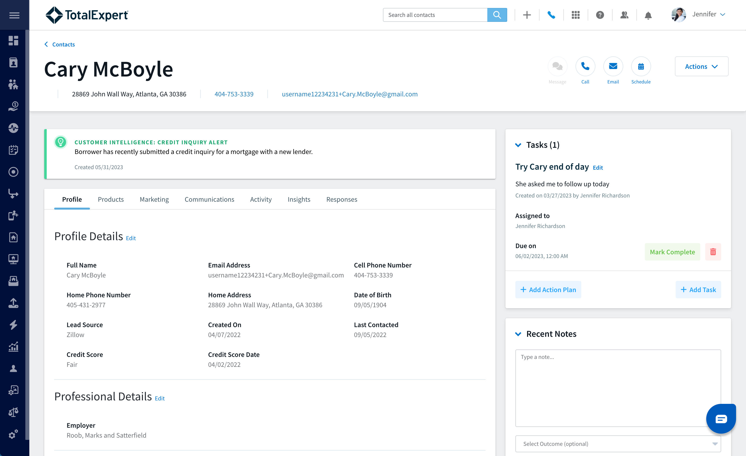
Mortgage Credit Inquiry:
Notifies you when a contact pulls credit for a mortgage at a competing lender or bank
The alert is generated by one of the Credit Bureaus, which sends Total Expert an alert any time a mortgage credit pull happens
When a Mortgage Credit Inquiry is generated, a FOC Journey will deliver the FOC email and/or print content to the consumer

Slide 6
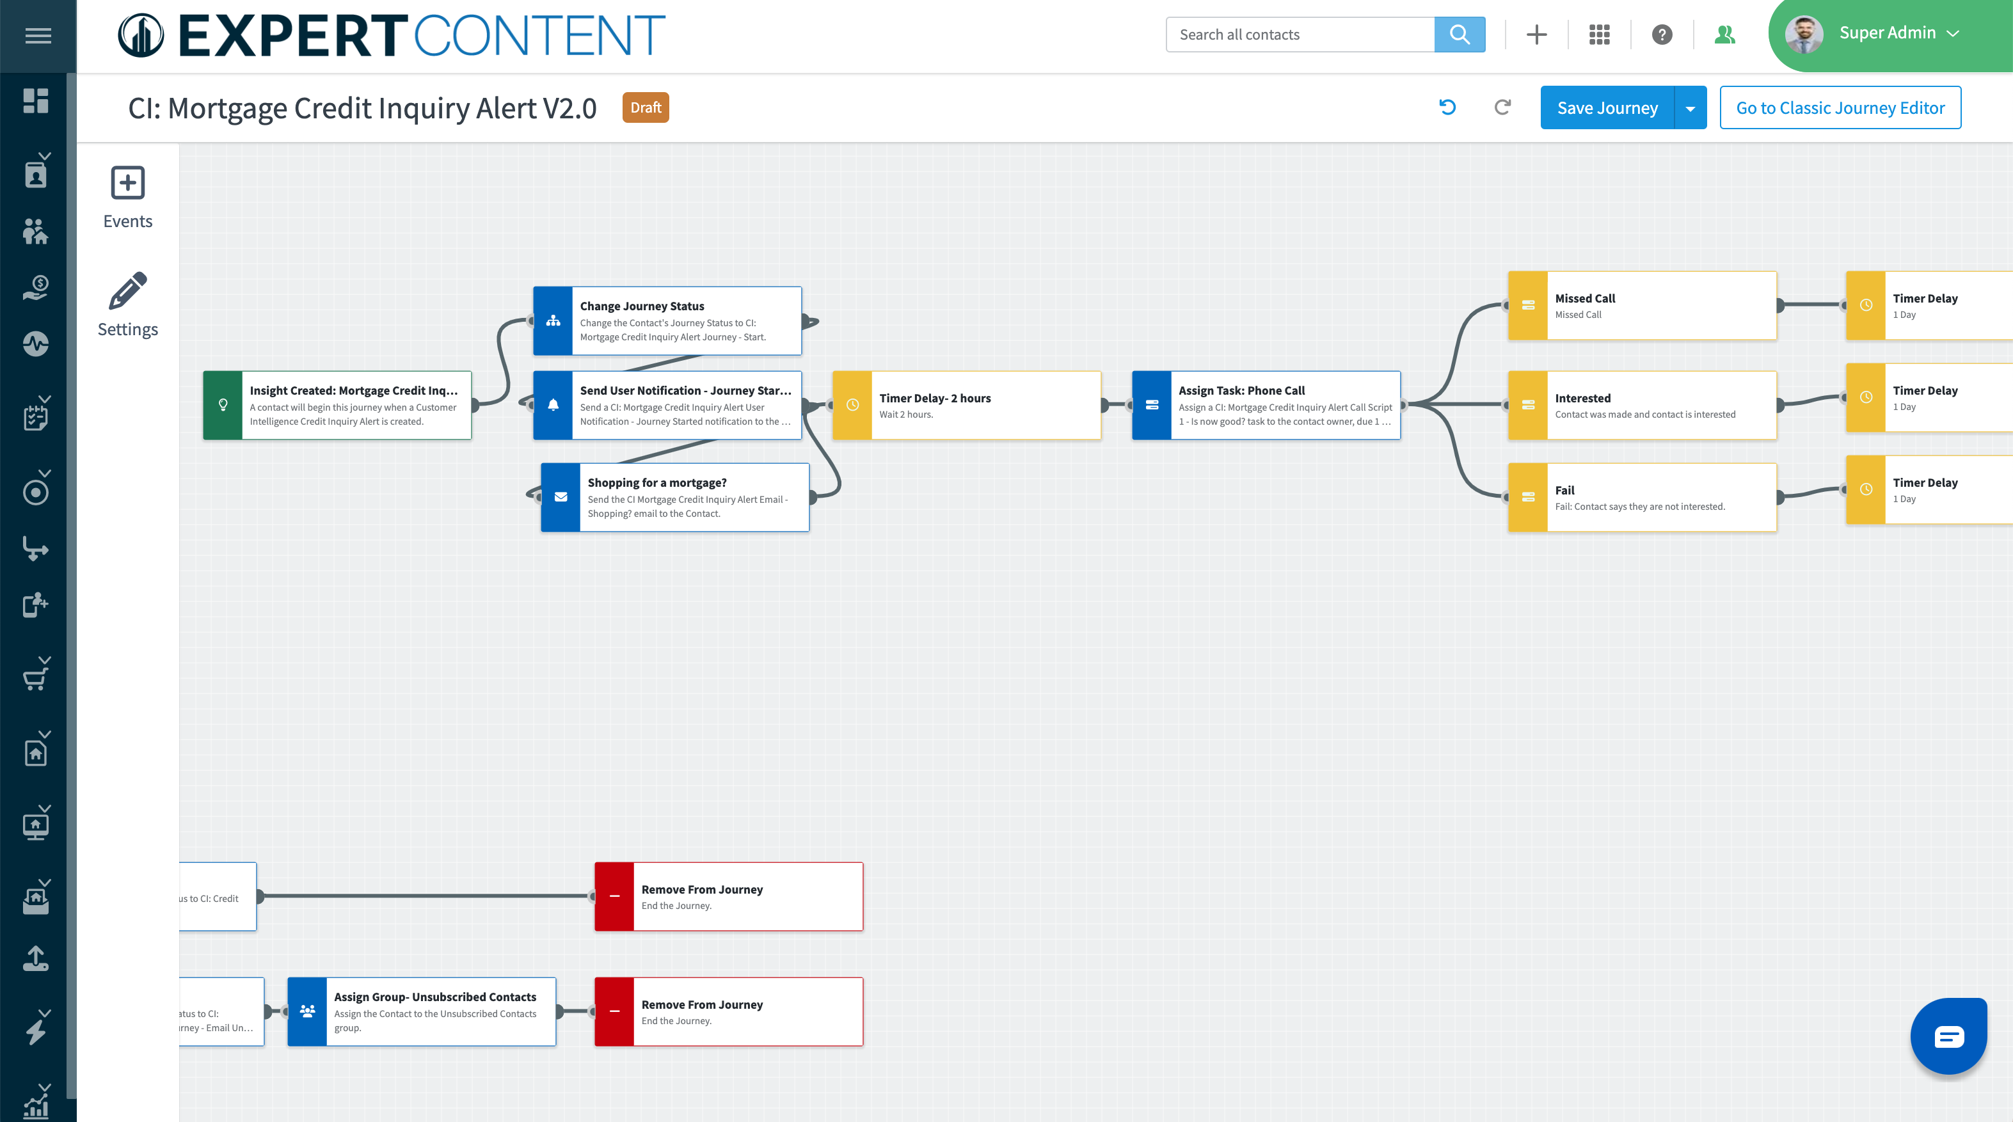
Mortgage Credit Inquiry Alert Journey
Task Outcomes
Task Assigned
Automated Communication
Notes:
Notes:
Replace image with your organization’s custom journey
Walk through the important parts that they need to know about: automated communication, task assignment, task outcomes

Slide 7
Best Practices For Leveraging Mortgage Credit Inquiry Alerts:
✅ When you get a notification of a mortgage credit inquiry alert, log into Total Expert and review the contact
✅ Use this as an opportunity to touch base with the client – you don’t need to directly address the credit inquiry, but rather use this as a relationship builder
✅ Think about your outreach method—whether it’s a phone call, email, or text. After you take action, be sure to log the outcome in Total Expert to keep track of your activities
✅ Log any notes from the call on the contact record to track key details from the conversation
✅ Set follow-up tasks if necessary
Notes:
Customize to your organization

Slide 8
Credit Improvement
Alert
Customer Intelligence

Slide 9
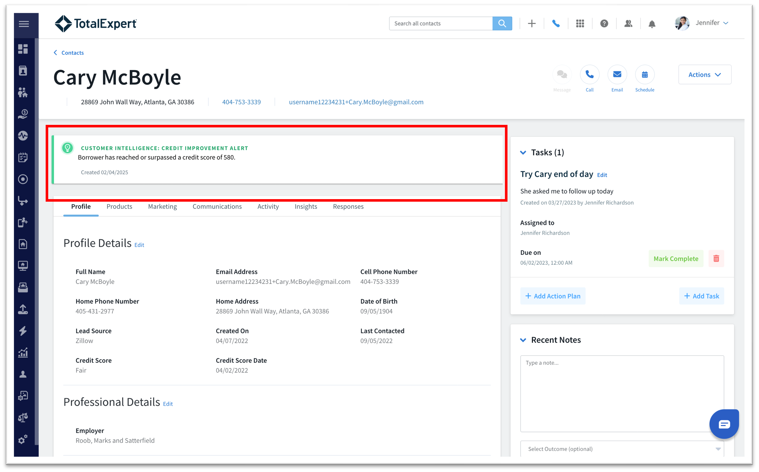
Credit Improvement Alert:
Notifies you when a contact in your database with a previously poor credit score has now reached the minimum threshold by your company
Monitored by Experian
When a credit improvement insight is generated, a FOC Journey will deliver FOC email and/or print content to the consumer to let them know they have been pre-approved based on their credit score

Slide 10
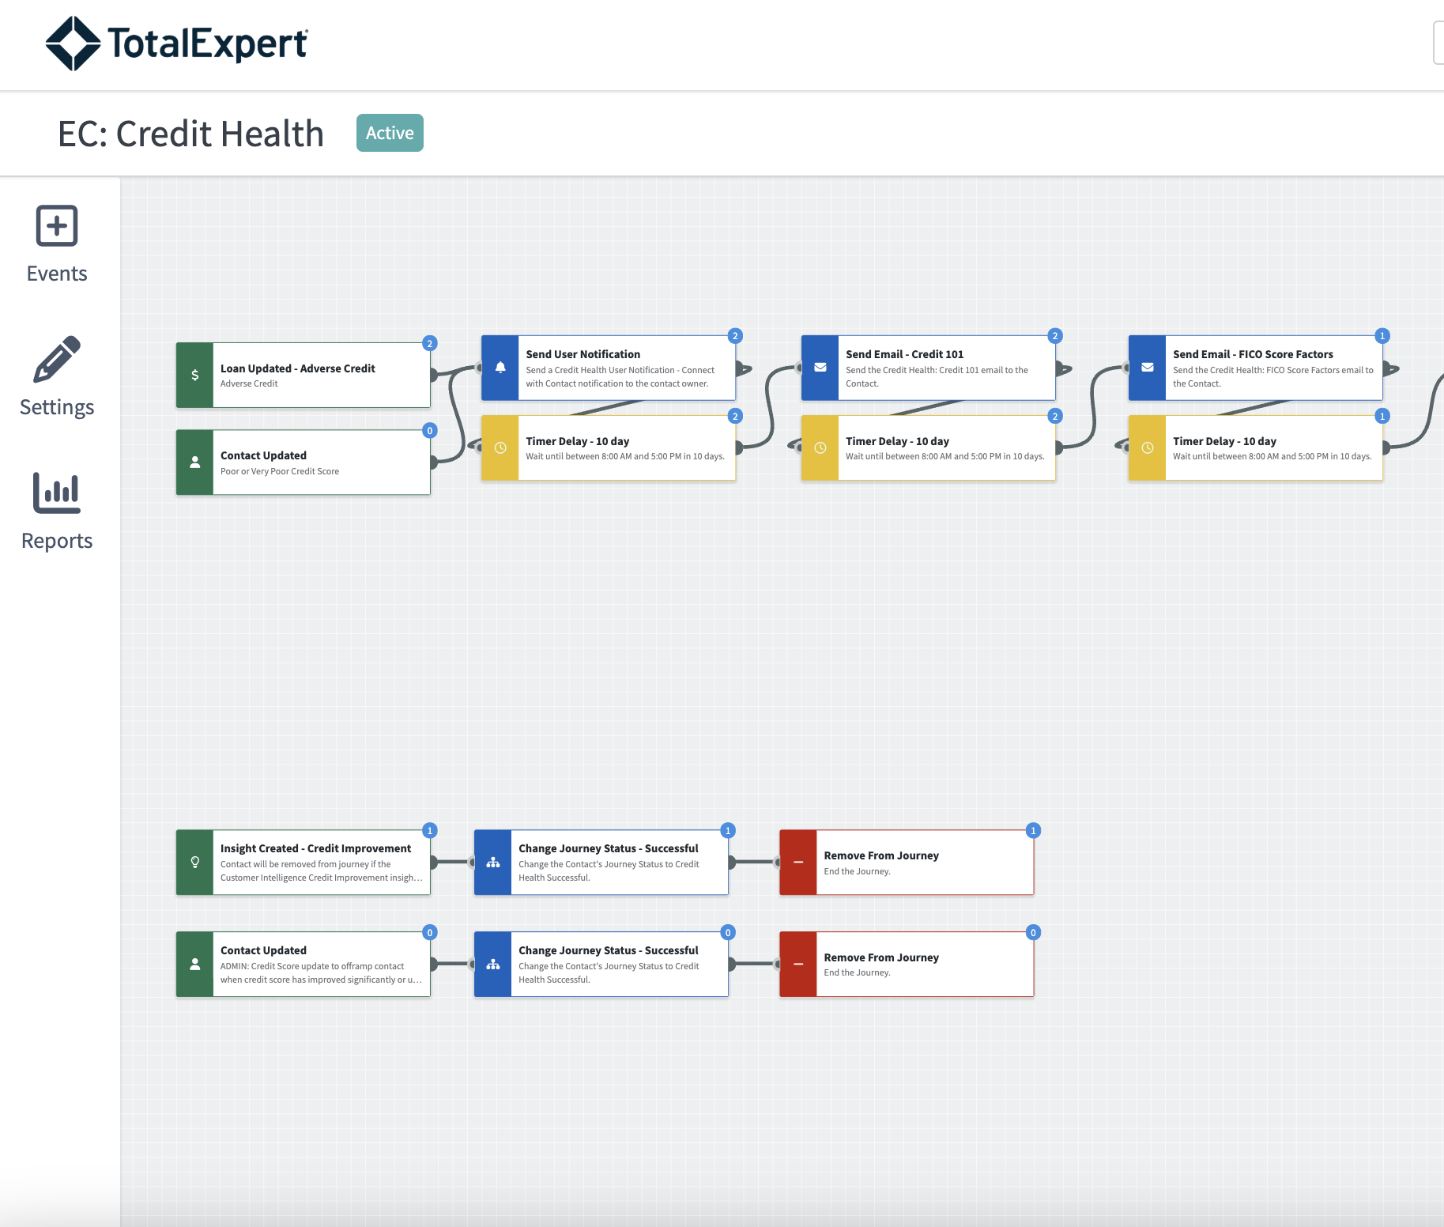
Credit Health Journey
If a loan is denied because of adverse credit, the contact will automatically be onboarded to a credit health journey
When the contact has improved their credit, you will receive a Credit Improvement alert, and the contact will be taken off the Credit Health journey and may be put on a credit improved journey (see next slide)
Notes:
Notes:
Replace image with your organization’s custom journey
Walk through the important parts that they need to know about: automated communication, task assignment, task outcomes

Slide 11
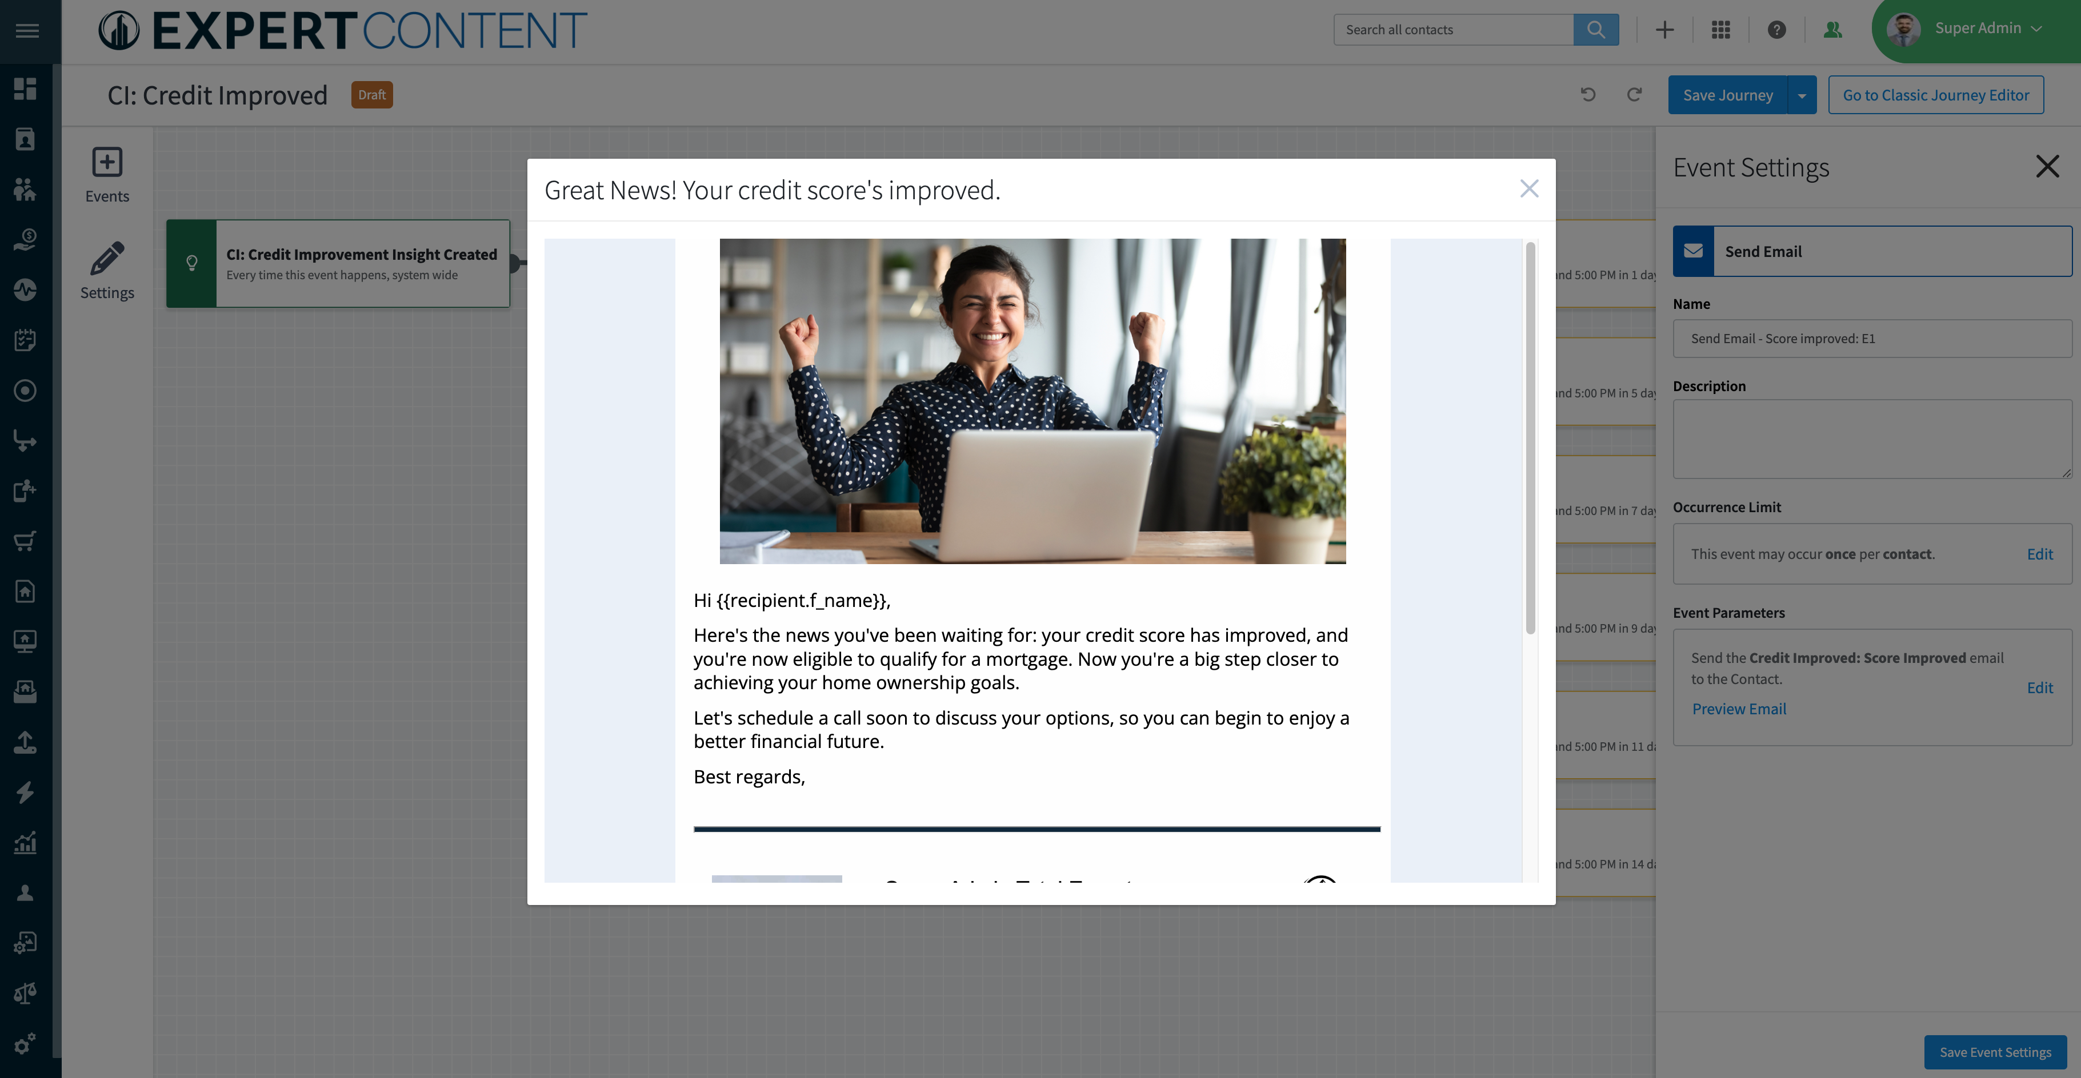
Credit Improved Journey

Slide 12
Best Practices for Leveraging Credit Improvement Insights:
✅ When you receive a credit improvement insight, re-engage with the contact and talk to them about what this means and next steps
✅ After you take action, be sure to log the outcome in Total Expert to keep track of your activities
✅ Log any notes from the call on the contact record to track key details from the conversation
✅ Set follow-up tasks if necessary
Notes:
Customize to your organization

Slide 13
Rate Alert & Rate Monitoring
Customer Intelligence

Slide 14
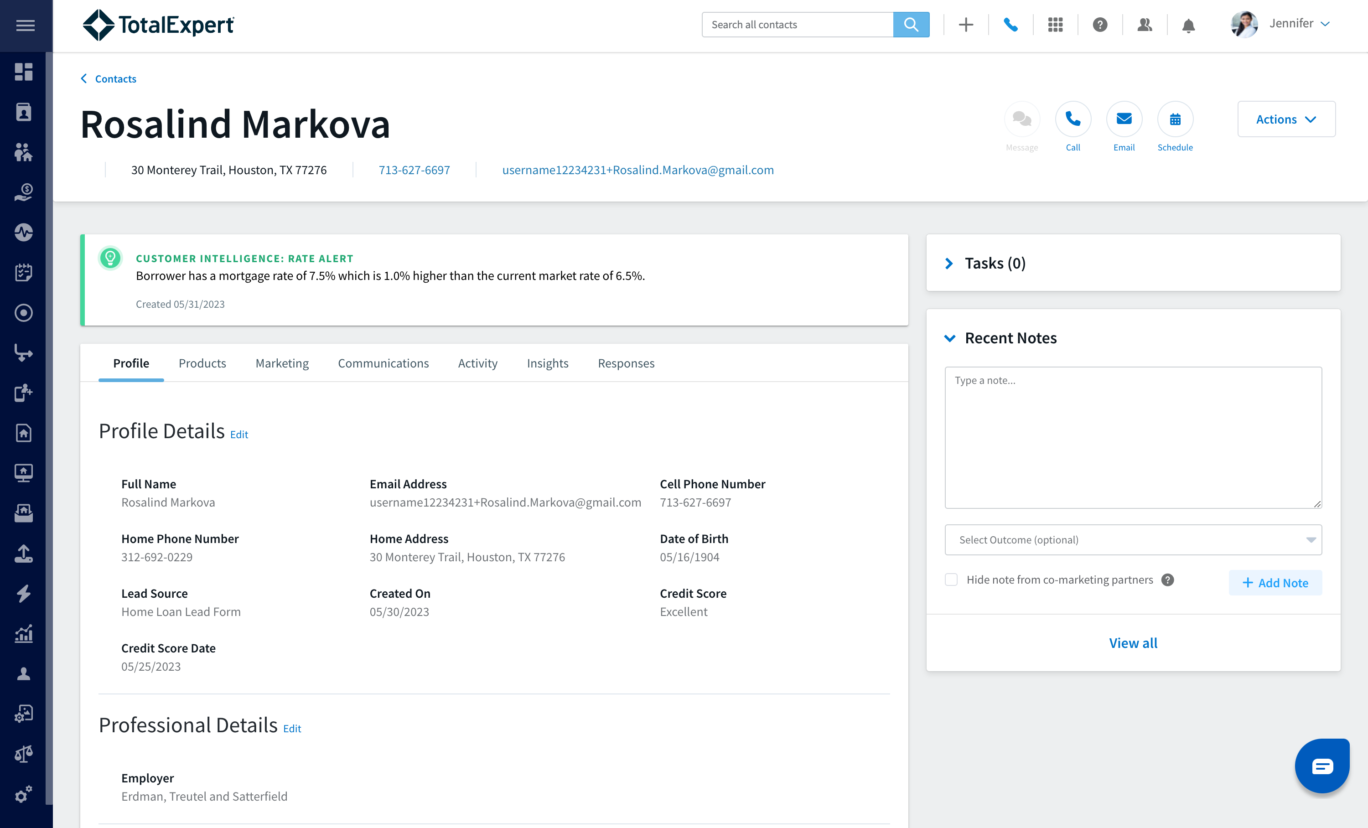
Rate Alert:
Notifies you when one of your customers could benefit from a refinance based on their original loan rate and the current market rates
Rates are updated weekly and compared to the OB market index by product and term

Slide 15
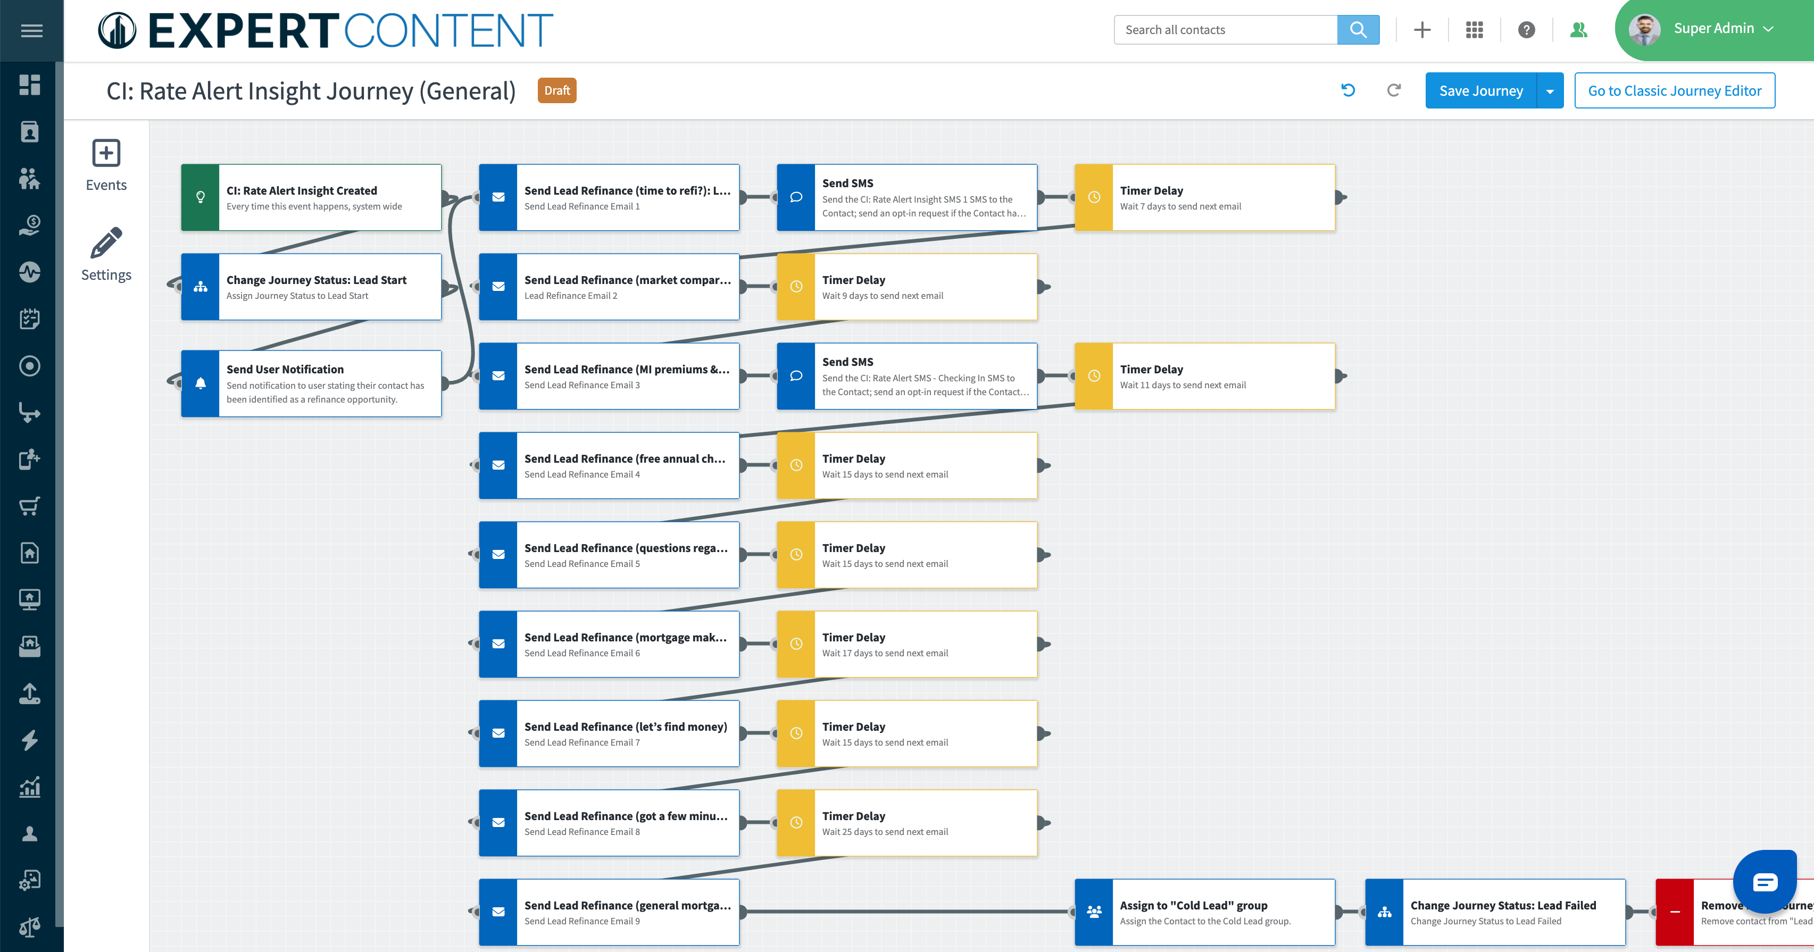
Rate Alert Journey
Automated Communication
Notes:
Notes:
Replace image with your organization’s custom journey
Walk through the important parts that they need to know about: automated communication

Slide 16
Best Practices for Leveraging Rate Alerts:
✅ When you receive a rate alert in Total Expert, log into Total Expert and review the rate alert and rate monitoring details on the contact record
✅ Decide the best outreach method—whether it’s a phone call, email, or text – and take immediate action.
✅ Log your outcome and any notes from the call on the contact record to track key details from the conversation
✅ Set follow-up tasks if necessary
Notes:
Customize to your organization

Slide 17
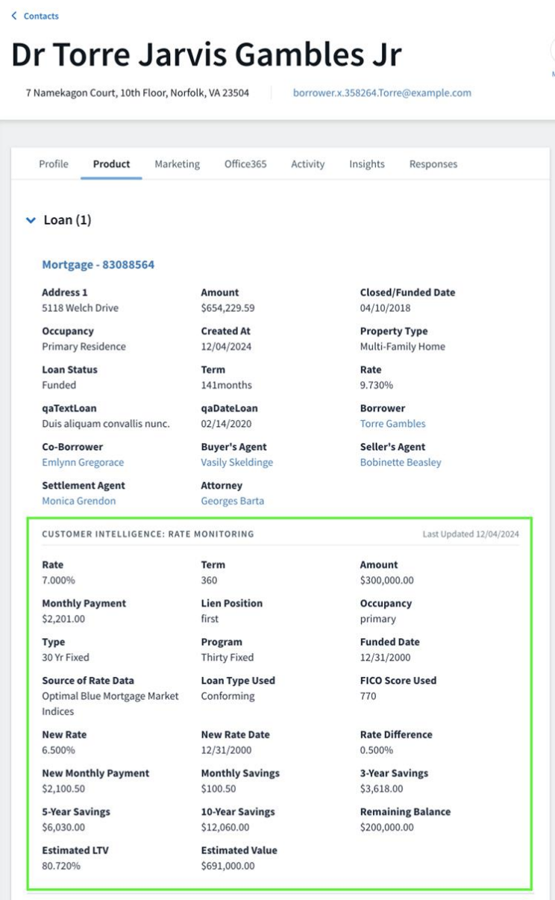
Rate Monitoring
Rich rate monitoring data is available on the contact record to enrich your conversations:
Rate difference
Estimated monthly payment
Estimated monthly cost savings
Estimated 3 or 5-year savings, and more!
Notes:
-Bryce
Automatically Segment and deliver personalized and targeted engagement strategies at scale for your equity rich consumers (position a HELOC, Cash Out, or Reverse Mortgage offering)
Allows your Originators to always have insight into their contacts current equity status to have more informed conversation with their contacts
Not just a trigger anymore but the data on the contact record to have those informed conversations

Slide 18
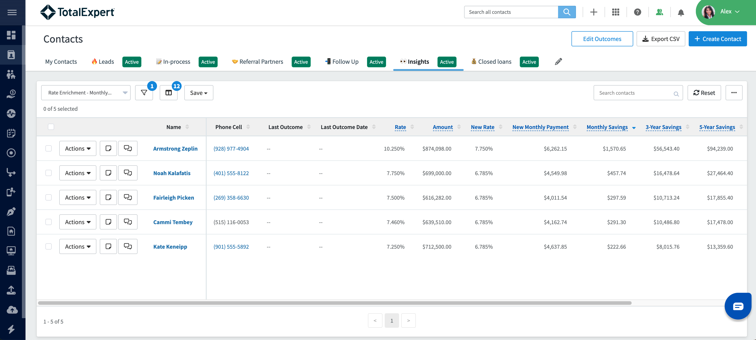
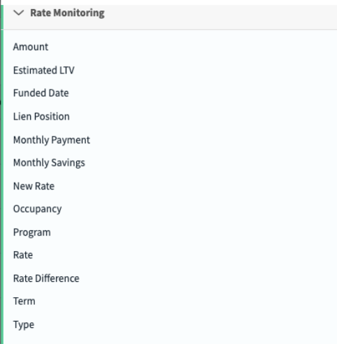
Create Refi Opportunity Lists with Rate Monitoring Data
Leverage the rate monitoring data to segment your database for different refinance opportunities
Monthly savings
Rate difference
And more!
Easily target and market to those opportunities

Slide 19
Equity Insight & Enrichment
Customer Intelligence

Slide 20
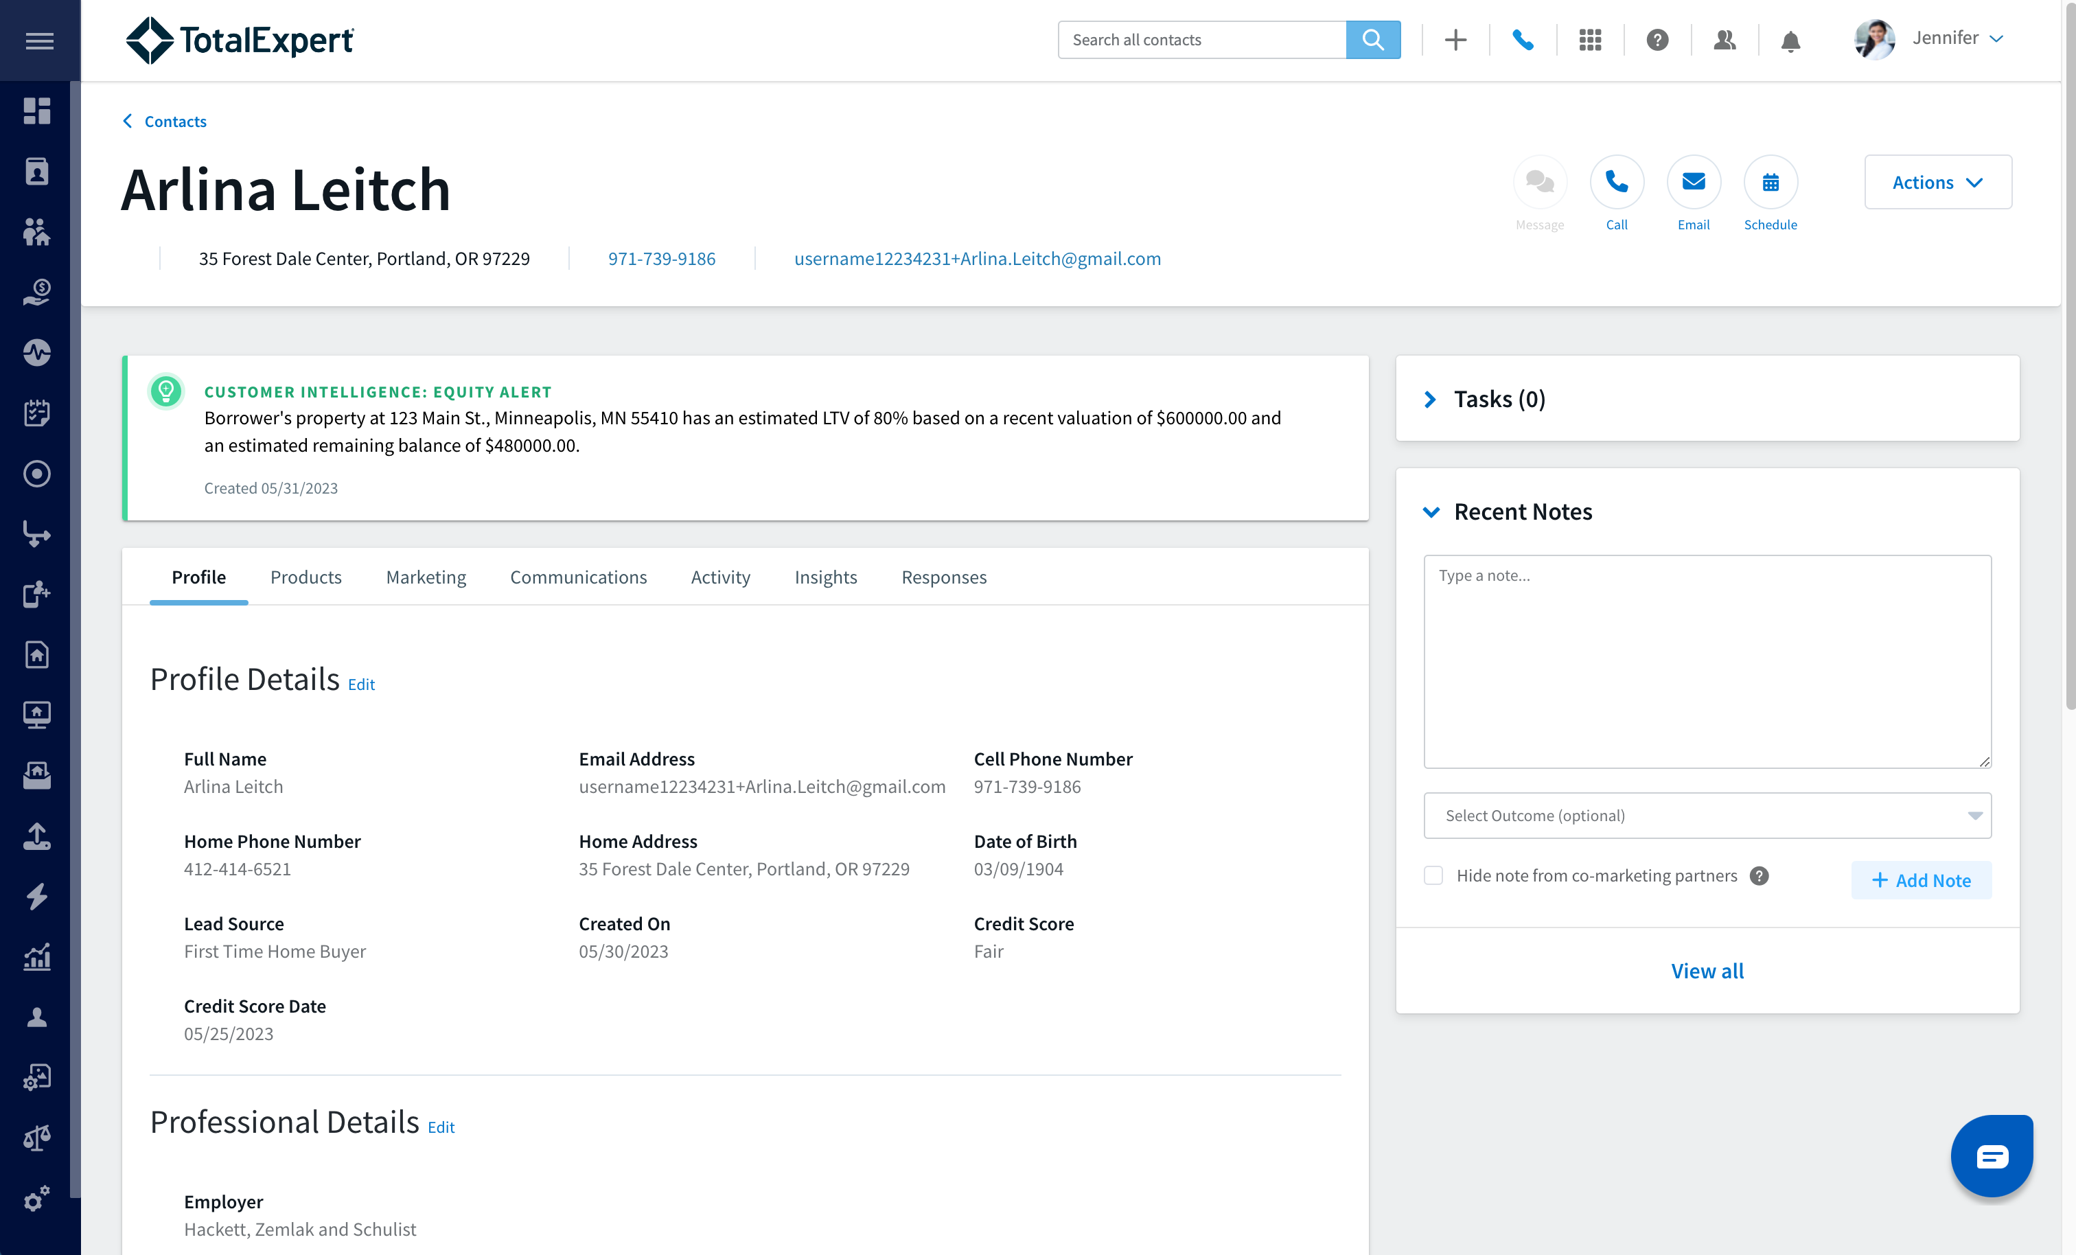
Equity Insight:
Notifies you of homeowners in your database who have built up enough equity in their property to potentially benefit from a HELOC, cash-out refinance, PMI removal, and other financing options
LTV is based on a valuation of their property and the estimated current mortgage balance

Slide 21
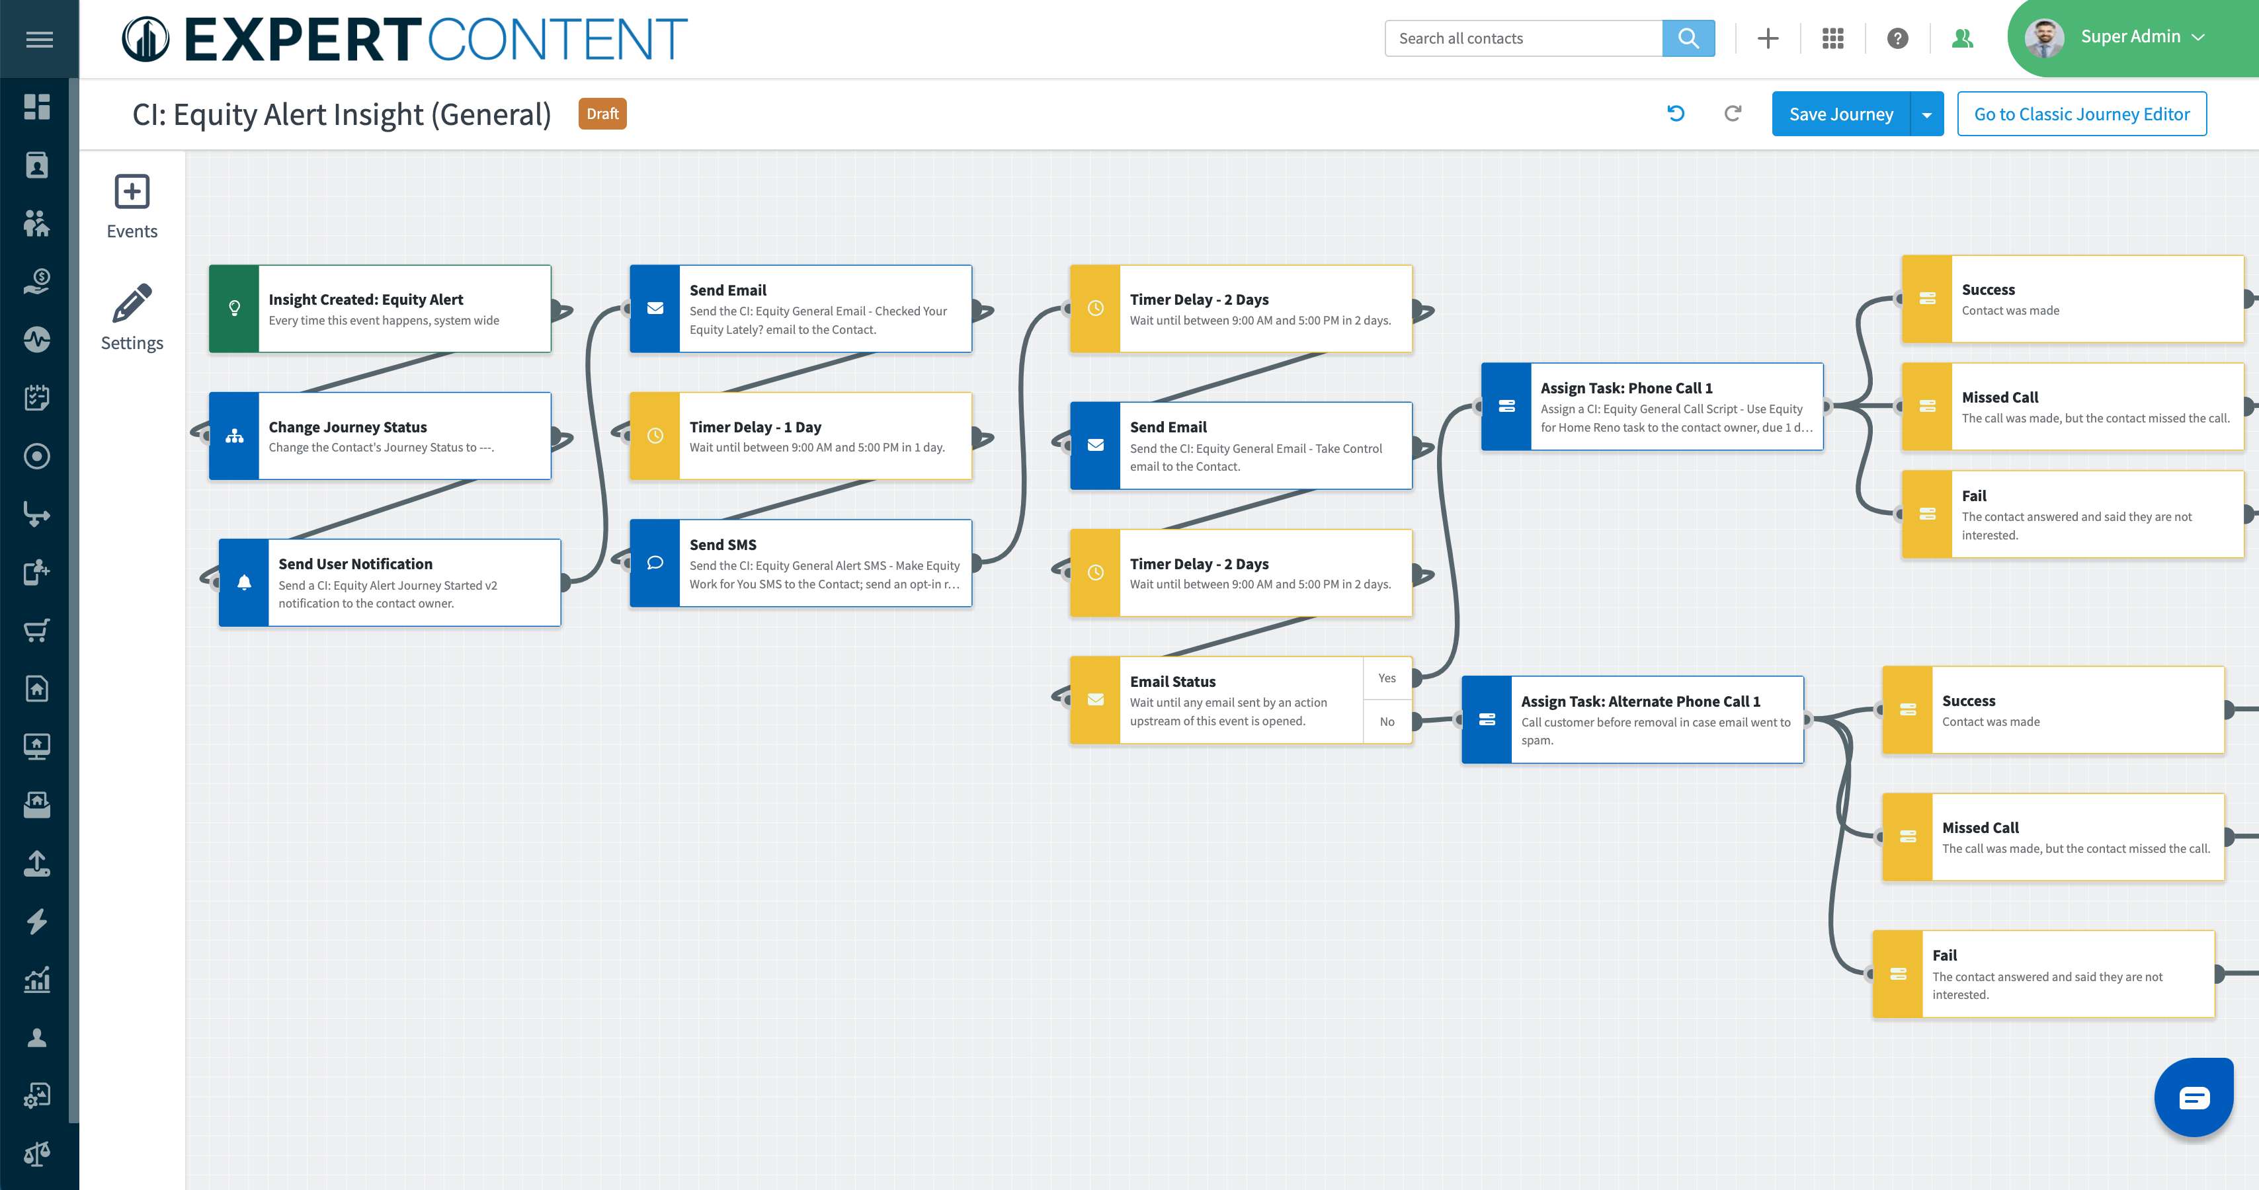
Equity Insight Journey
Automated Communication
Task Outcomes
Task Assigned
Notes:
Notes:
Replace image with your organization’s custom journey
Walk through the important parts that they need to know about: emails are going out automatically, tasks being assigned to them, task outcomes.

Slide 22
Equity
Enrichment
Rich equity data on the contact record:
Property Value
LTV
Equity %
Equity $
Remaining balance
Notes:
-Bryce
Automatically Segment and deliver personalized and targeted engagement strategies at scale for your equity rich consumers (position a HELOC, Cash Out, or Reverse Mortgage offering)
Allows your Originators to always have insight into their contacts current equity status to have more informed conversation with their contacts
Not just a trigger anymore but the data on the contact record to have those informed conversations

Slide 23
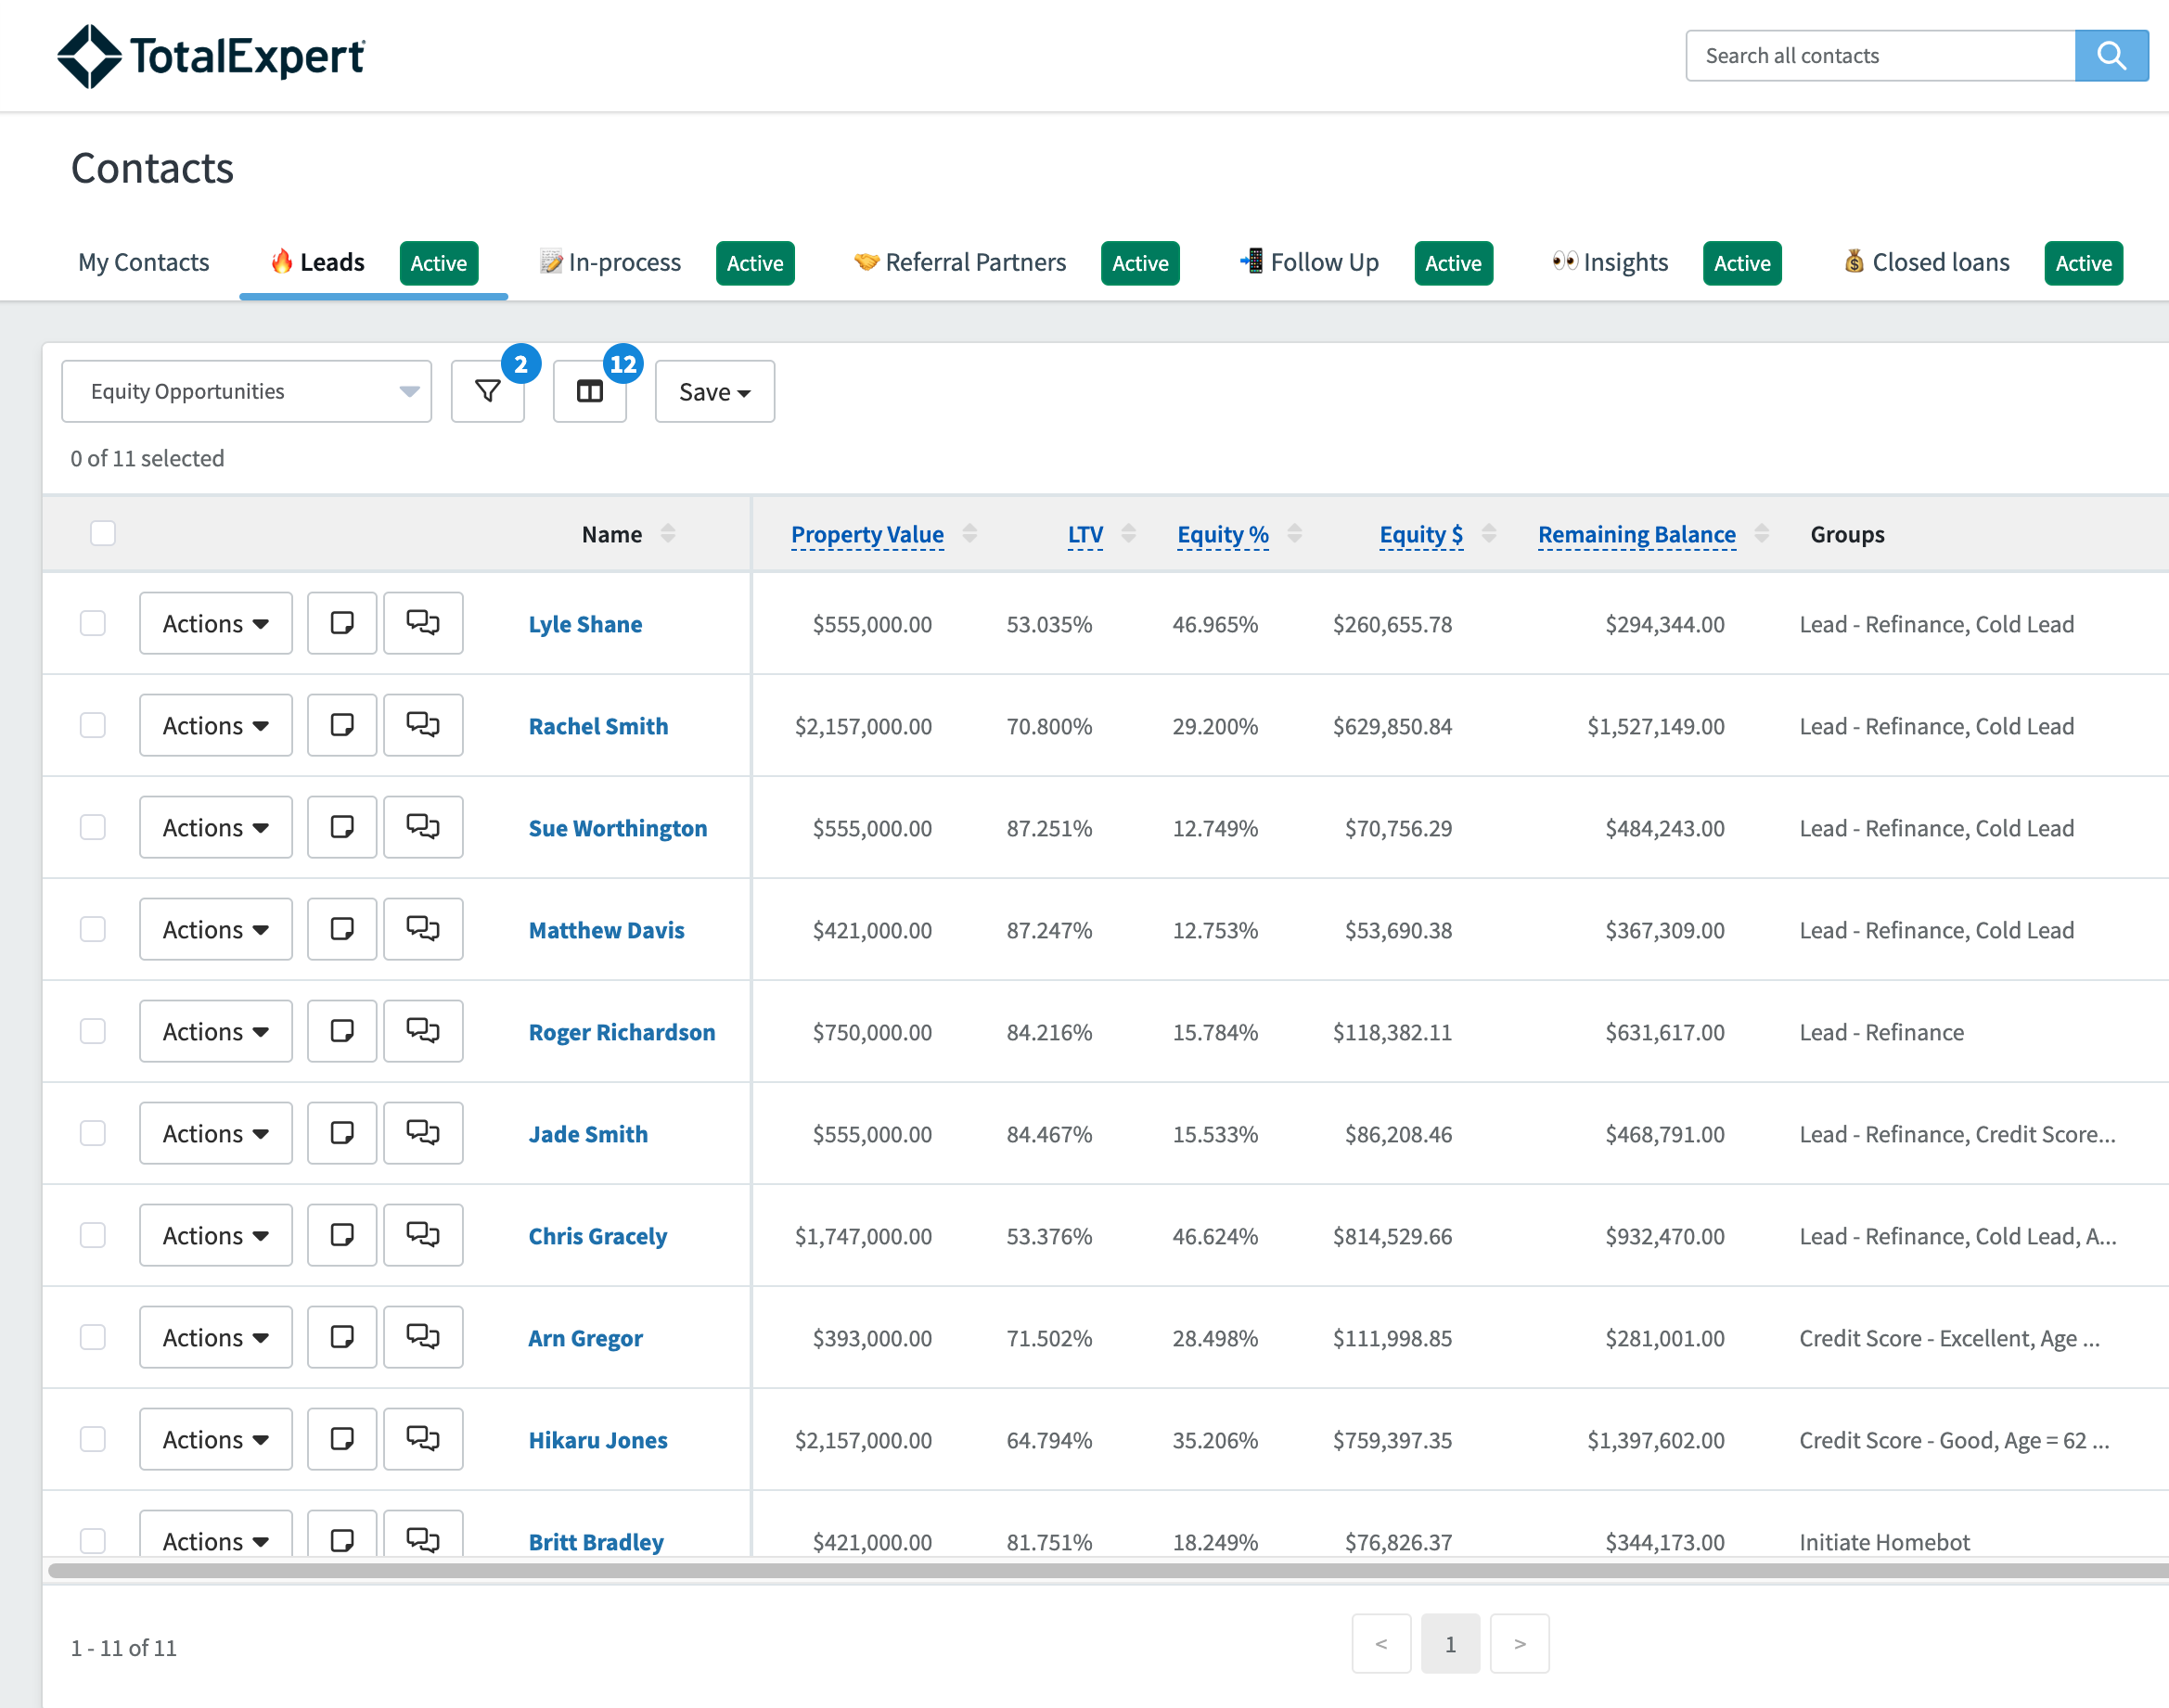
Build Equity Lists For Every Opportunity
Leverage the equity data to segment your database for additional financing needs:
Cash-out refi
HELOC
Reverse
PMI removal
And more!
Notes:
-Bryce
Automatically Segment and deliver personalized and targeted engagement strategies at scale for your equity rich consumers (position a HELOC, Cash Out, or Reverse Mortgage offering)
Allows your Originators to always have insight into their contacts current equity status to have more informed conversation with their contacts
Not just a trigger anymore but the data on the contact record to have those informed conversations

Slide 24
Best Practices for Leveraging Equity Insights:
✅ When you receive an equity insight, log in to Total Expert and review the contact record associated with the insight
✅ Familiarize yourself with the contact by viewing the below key tabs:
Products - familiarize yourself with their current loan product and their estimated equity position
Activity - familiarize yourself with their interaction with your previous marketing
✅ Use this as an opportunity to touch base with the client and educate the borrower on their equity position
✅ Log an outcome and any notes from the call on the contact record to track key details from the conversation
✅ Set follow-up tasks if necessary
Notes:
Customize to your organization

Slide 25
Property Listing Alert
Customer Intelligence

Slide 26
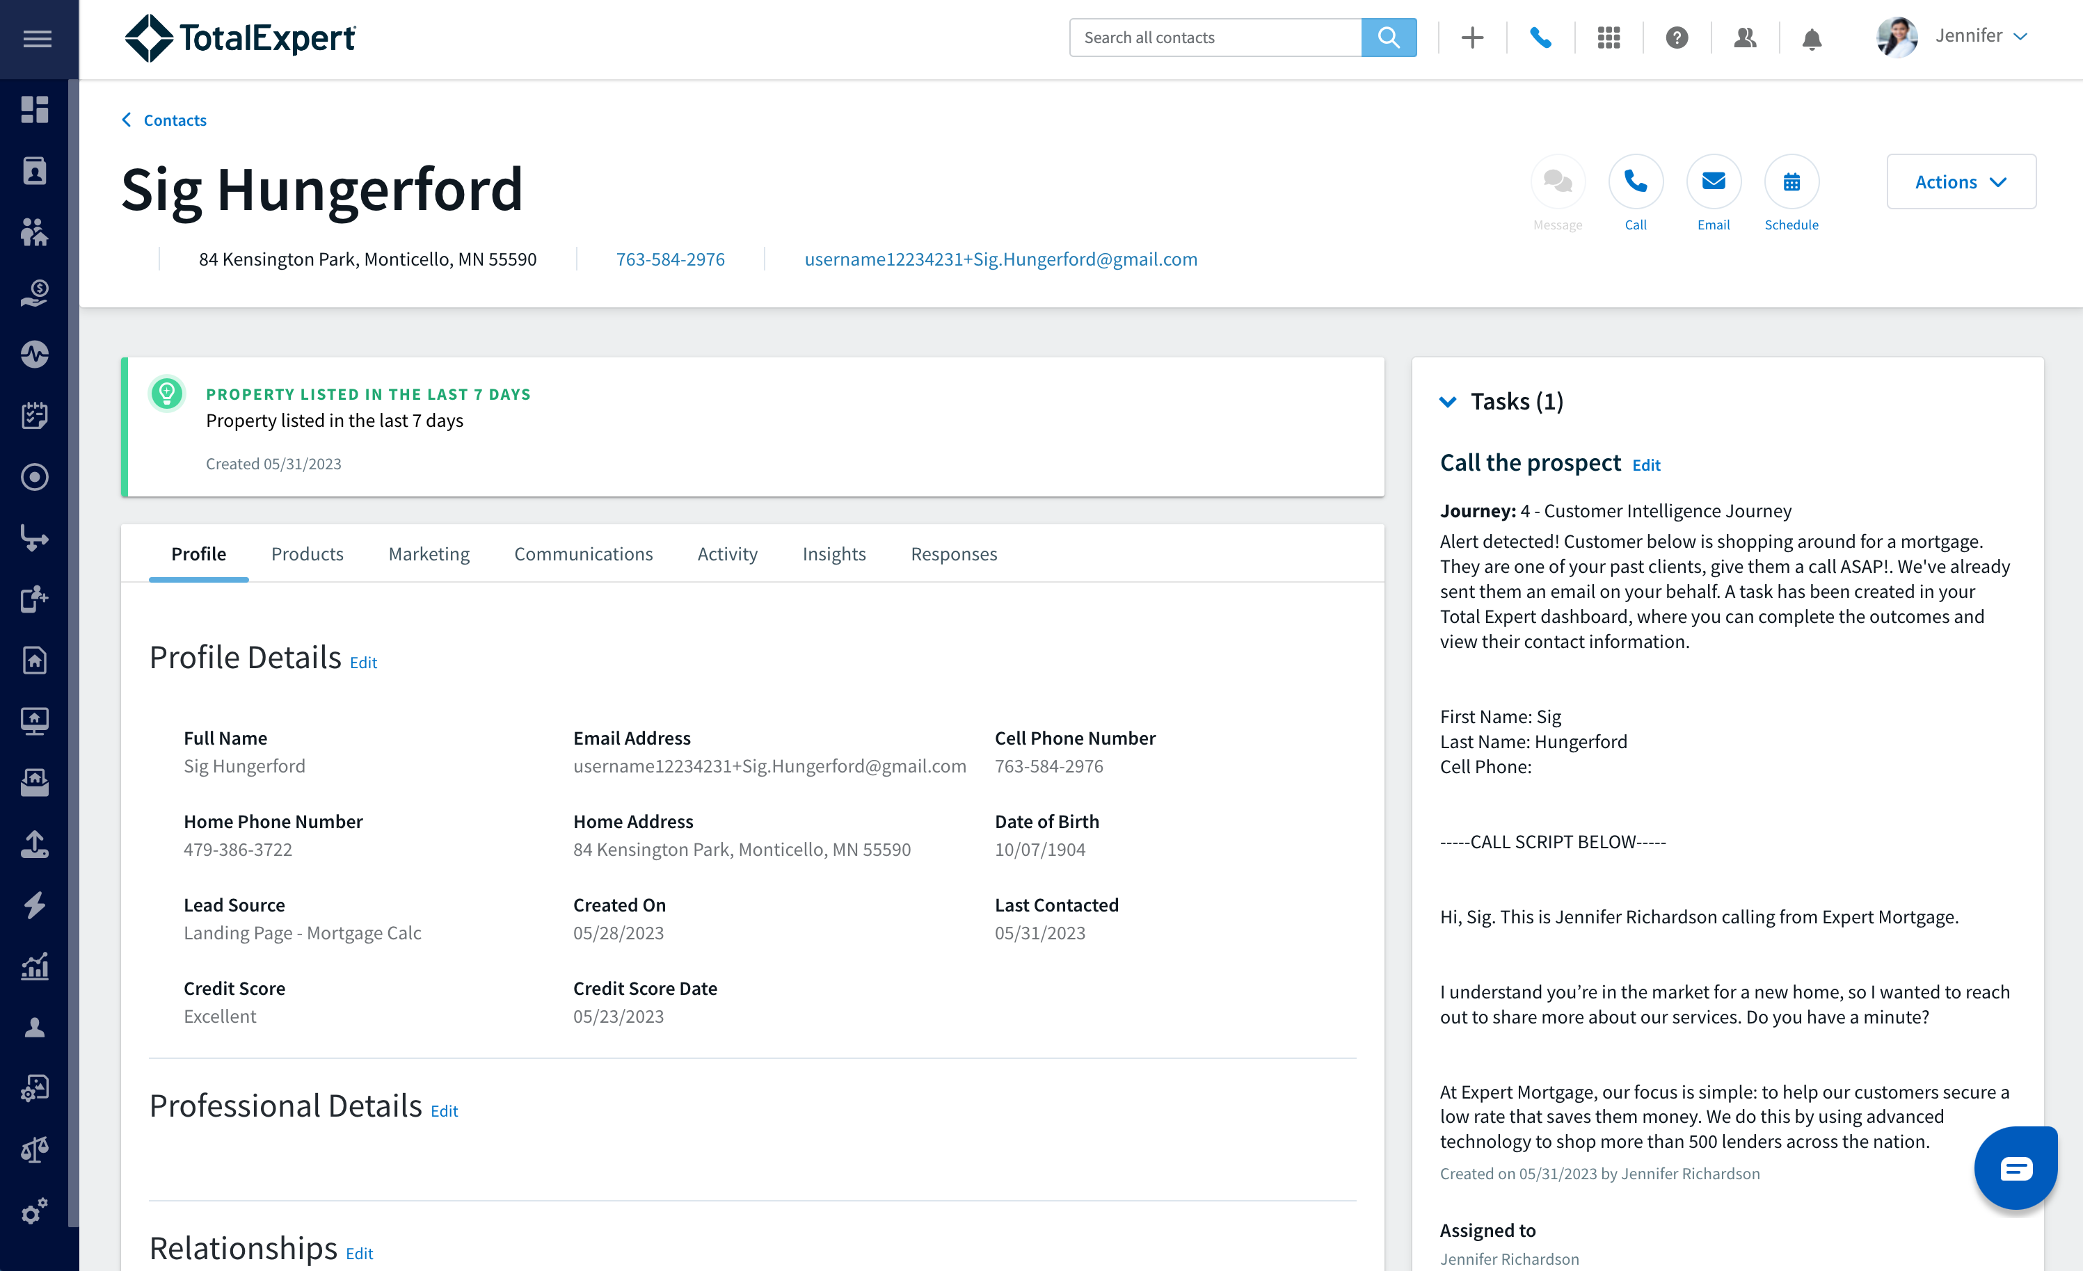
Property
Listing Alert:
A property listing alert notifies you when a client has listed their property within the last seven days

Slide 27
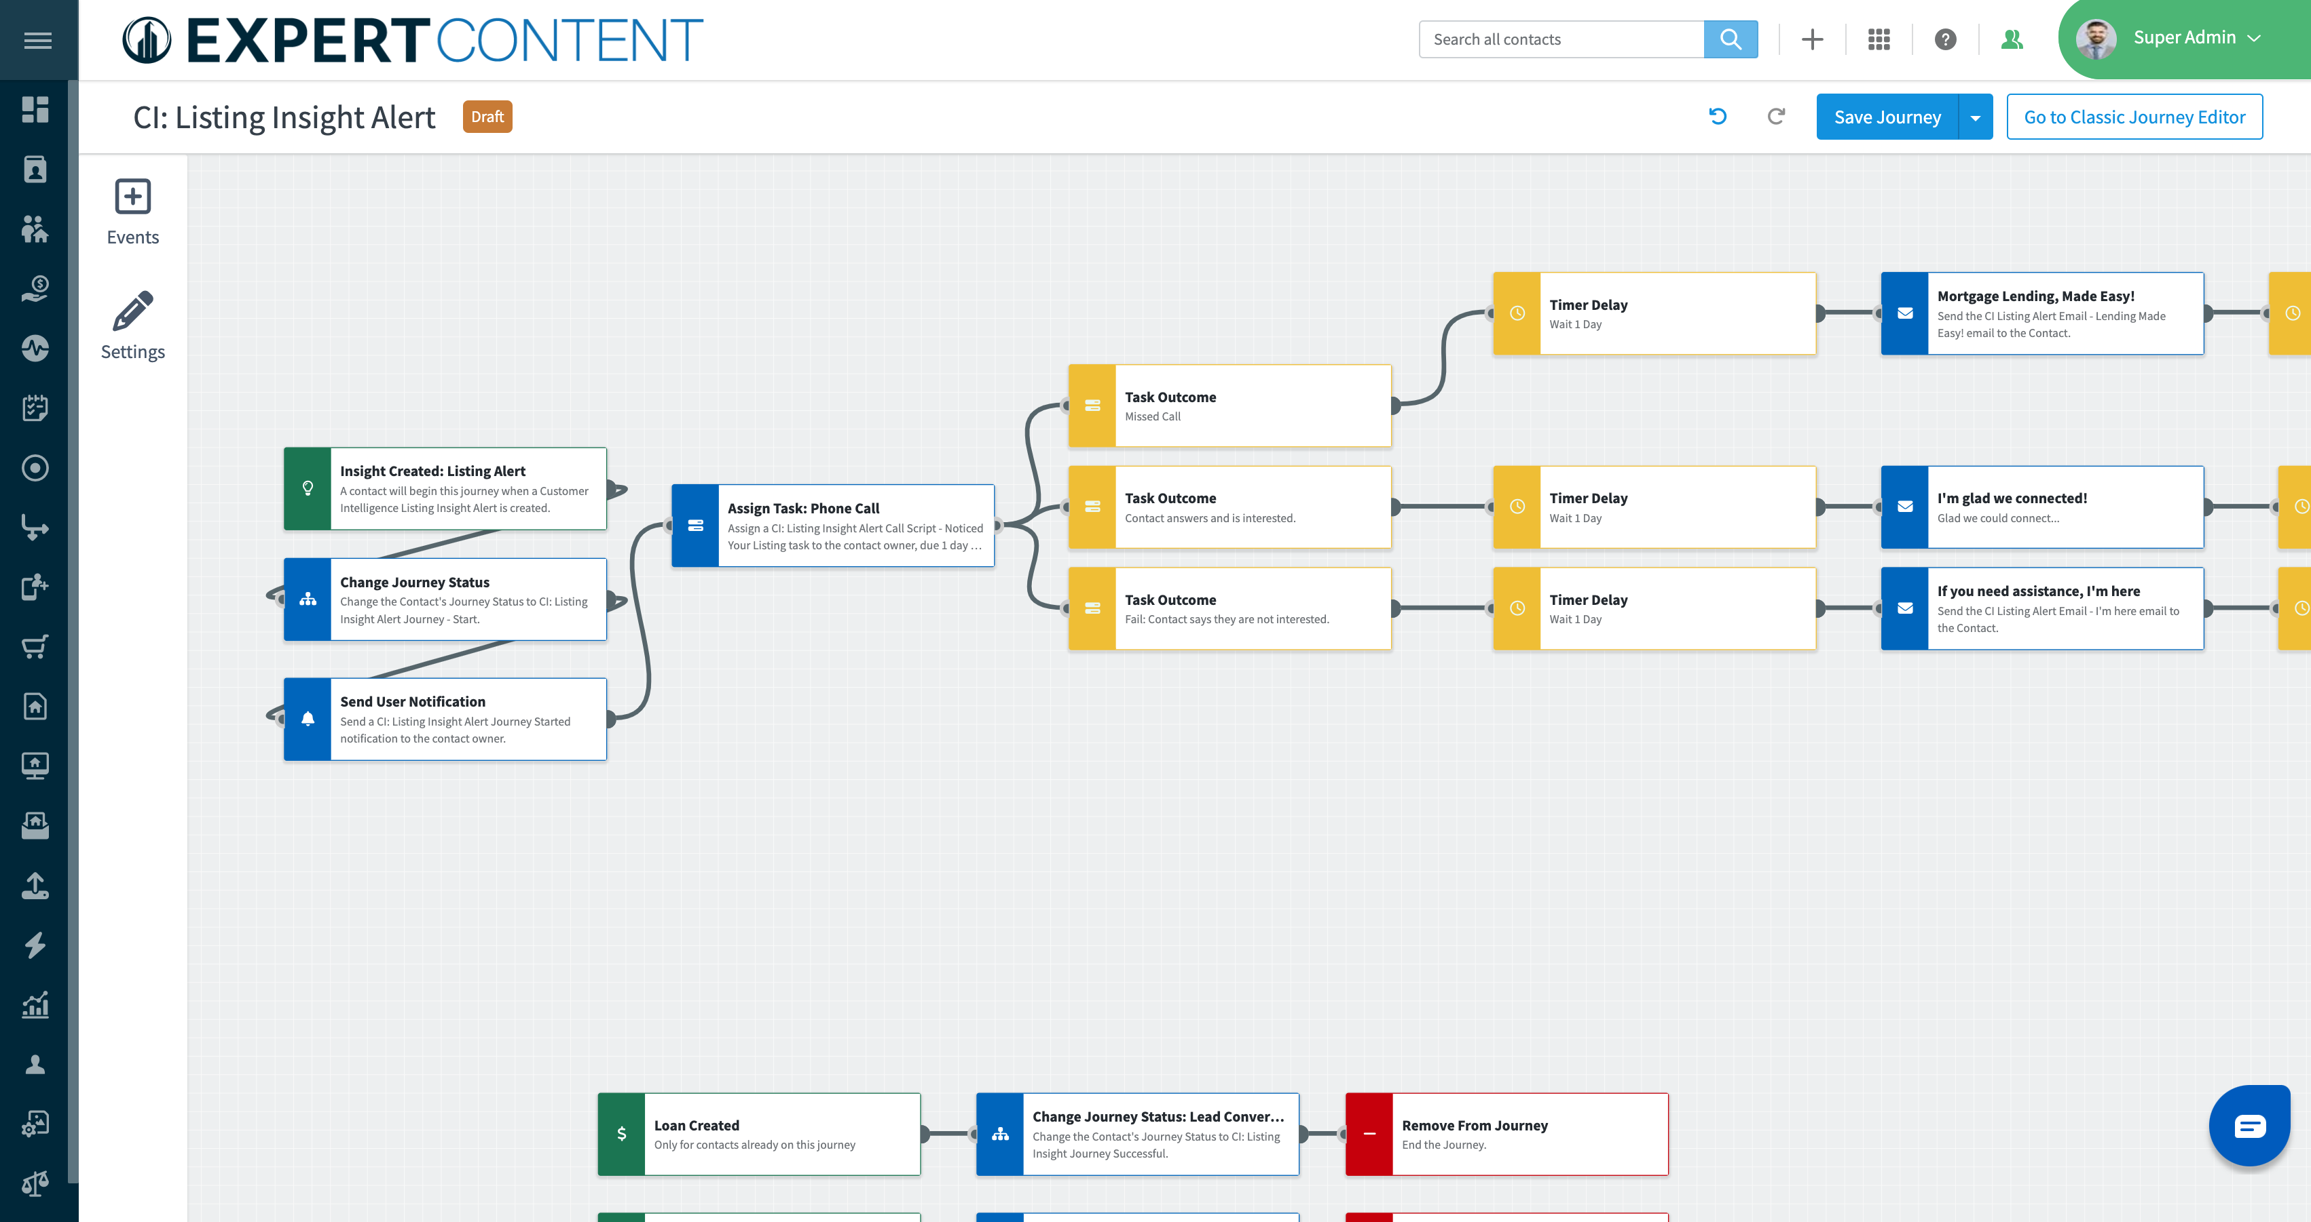
Property Listing Alert Journey
Task Outcomes
Task Assigned
Automated Communication
Notes:
Notes:
Replace image with your organization’s custom journey
Walk through the important parts that they need to know about: emails are going out automatically, tasks being assigned to them, task outcomes.

Slide 28
Best Practices for Leveraging Property Listing Insight Alerts:
✅ When you receive a listing insight, this is a good opportunity to re-engage with your past client and the listing agent
✅ Think about your outreach method—whether it’s a phone call, email, or text. After you take action, be sure to log the outcome in Total Expert to keep track of your activities
✅ Log any notes from the call on the contact record to track key details from the conversation
Notes:
Customize to your organization

Slide 29
Life Event Insights
Customer Intelligence

Slide 30
Mortgage Life Event Insights
New Parent / Birth
New Marriage
New Divorce

Slide 31
Best Practices for Handling Life Event Insights:
✅ All insights should all be handled with care - you are dealing with sensitive topics, and they should be handled appropriately based on your relationship with the client
✅ Start with a re-introduction to yourself - refer back to key specific details on the home if you can remember to build credibility
✅ You do not need to let them know that you received an insight, or know that they recently got married, had a baby, or got divorced - use this opportunity to simply check in on the client and touch base with how things are going
✅ You can approach the conversation by asking if they want to do a mortgage check-in (mortgage review) where you can provide valuable resources to the client
Loan review, mortgage payment, interest rate, escrow balance, LTV – PMI removal, equity data
Goal setting / financial education
What is it that you want to see with the house?
Paying off debt? Remodeling home?

Slide 32
New Parent / Birth Alert
This could be a good time to reach out to connect with the client to get an update on their life and home situation
Do not directly ask if they recently became a parent – use this opportunity to simply check in on the client and touch base with how things are going
Multiple use cases:
Time to upgrade, or remodel
Many new parents may desire a larger home with the addition of a new child
Potential new purchase
Potential HELOC opportunity for remodeling

Slide 33
New Marriage Alert
Married couples still make up the largest group of home buyers – at 61%
This may be a good time to reach out to the client and get an update on their life (do not directly ask if they got married, but if they tell you…)
Congratulate the client on their marriage
Ask the client about their plan for their living situation now that they are married – if they are planning to stay in the same home? Planning to move in the near future?
Reach out if they need anything down the road or if they decide they are looking to move!
Multiple use cases to consider:
Potential new purchase
Potential HELOC for remodeling

Slide 34
New Divorce Alert
Statistically, 46% of marriages end in divorce
This may be a good time to reach out to the client to check in – provide a mortgage check-up
Ask the client how things are going in the home, and if there are any changes - do not refer to the insight
Multiple use cases to consider:
Potential two new purchases
Potential HELOC opportunity as the couple fixes up their home to put on the market

Slide 35
How to Leverage Customer Intelligence in Total Expert
Best Practices

Slide 36
Insight on the Contact Record
CI insight appears in a banner at the top of the contact record
‘created date’ appears at the bottom of the insight

Slide 37
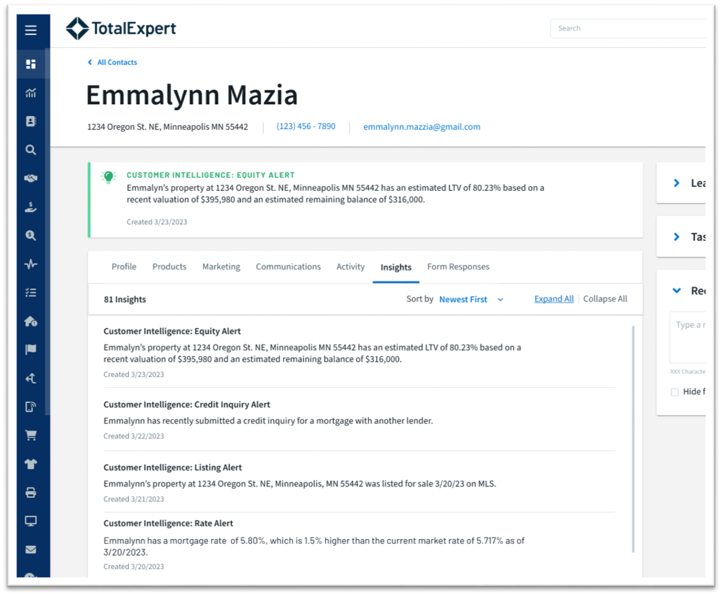
Insight History on the Insights Tab
Highlights and tracks all historical insights/alerts
Created dates on insights/alerts

Slide 38
Automated Communication
Task Notification
Data + Automation
User Notification

Slide 39
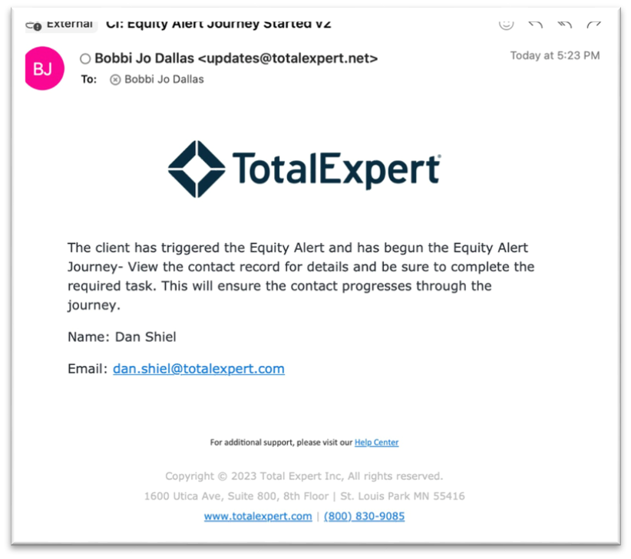
Take Action
You will receive an email notification when an insight is created
Task notification may surface to you to follow-up with the contact
**Ensure your task notifications are turned on in your account settings

Slide 40
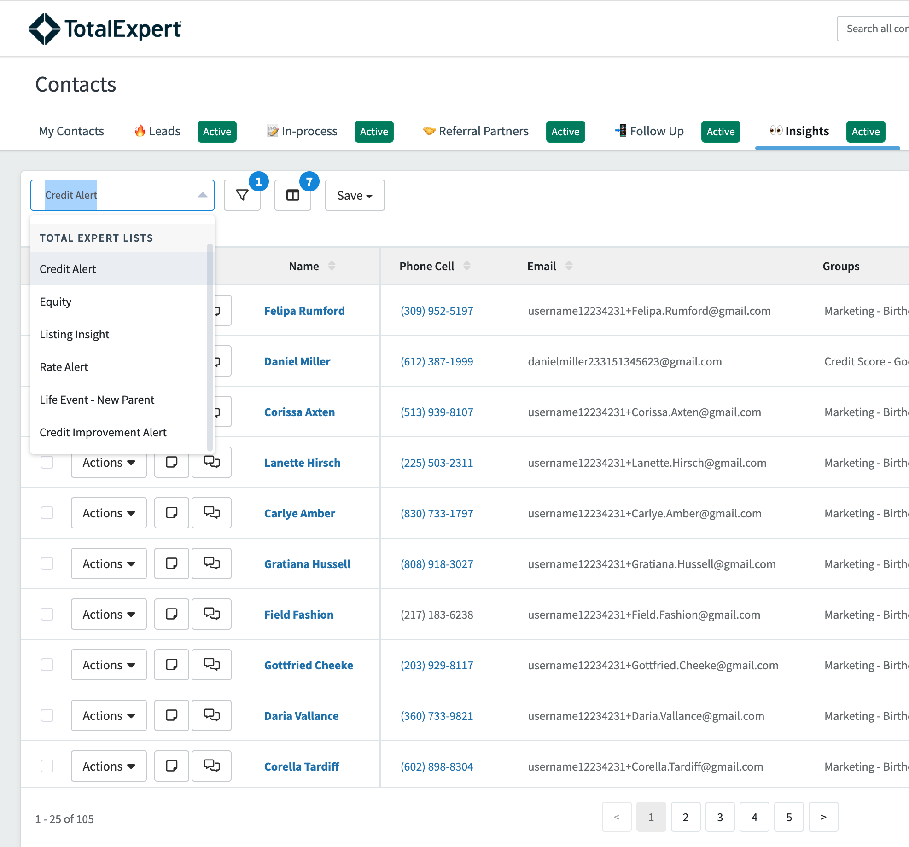
Your Daily Routine
Log into Total Expert and review your insights in Pipeline Views
Assess the opportunity – then take appropriate action if necessary (call/email/text)
Mark outcome, add notes, set follow-up task if necessary

