Slide 1
Expert Content
Strategy Guide
AI Sales Assistant - Retention: Credit Inquiry, Rate, and Periodic Mortgage Review
April 2026

Slide 2
AI Sales Assistant - Retention
Realize borrower intent and new opportunities through AI Voice engagement
AI Sales Assistant Journeys enable lenders to engage borrowers instantly when key signals of intent or opportunity arise. Each journey automates timely, personalized engagement through the AI Sales Assistant—helping protect revenue, reduce churn, and strengthen relationships proactively. These journeys fit seamlessly with Customer Intelligence insights and post-close engagements to ensure no opportunity is missed. Marketing admins can configure triggers, outcomes, and timing to align with their organization’s strategy.
The three included journeys are outlined below:
Customer Intelligence Credit Inquiry: Engage consumers showing high-intent signals—whether current borrowers or new opportunities.
Customer Intelligence Rate Alert: Engage borrowers who may benefit from refinancing or improved rate opportunities.
Periodic Mortgage Review: Engage borrowers regularly during post-close to maintain strong relationships and proactively identify new opportunities.
*All communications should be reviewed prior to initiating the journey.

Slide 3
Journey Configuration
General configuration best practices and recommendations for all retention journeys

Slide 4
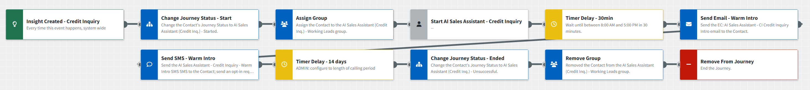
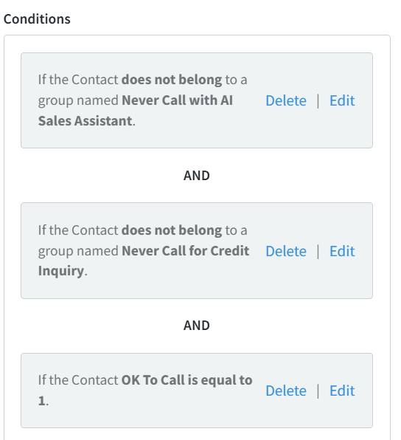
General Journey Configuration
General Journey Notes:
Adjust Timer Delay to the length of each use-case-specific calling period.
Determine whether email and SMS warm intros are part of your organization’s strategy. It is recommended to help introduce why the AI Sales Assistant is calling and to help prepare the contact for outreach.
  Review and adjust the messaging as desired.
  In most cases, it is recommended to send a warm intro prior to the ODC Push. However, in the cases where speed is imperative to success such as Credit Inquiry, the ODC Push should occur prior to email and SMS outreach.
If you apply additional Contact Groups to offramps, such as successful or unsuccessful outcomes, it is recommended to remove those Contact Groups when a contact re-enters the journey.
  For example, if you apply an “Appointment Scheduled” contact group, make sure to add a “Remove from Group” journey action after the Insight Trigger.
  Ensure all inline conditions of the onramp trigger are setup appropriately with additional groups such as “Do Not Contact”.
Consent and compliance strategies vary significantly by organization and are not included in the Expert Content wireframe. It is your organization’s responsibility to ensure appropriate controls are in place prior to activating these journeys.
  Define your organization’s method for establishing Existing Business Relationships, AI Consent, or servicing status checks as conditions after the trigger.
  Work with your Total Expert representative to determine the best approach for your organization.
Notes:
This page should be used for JOURNEY WIREFRAMES (duplicate as needed)

Slide 5
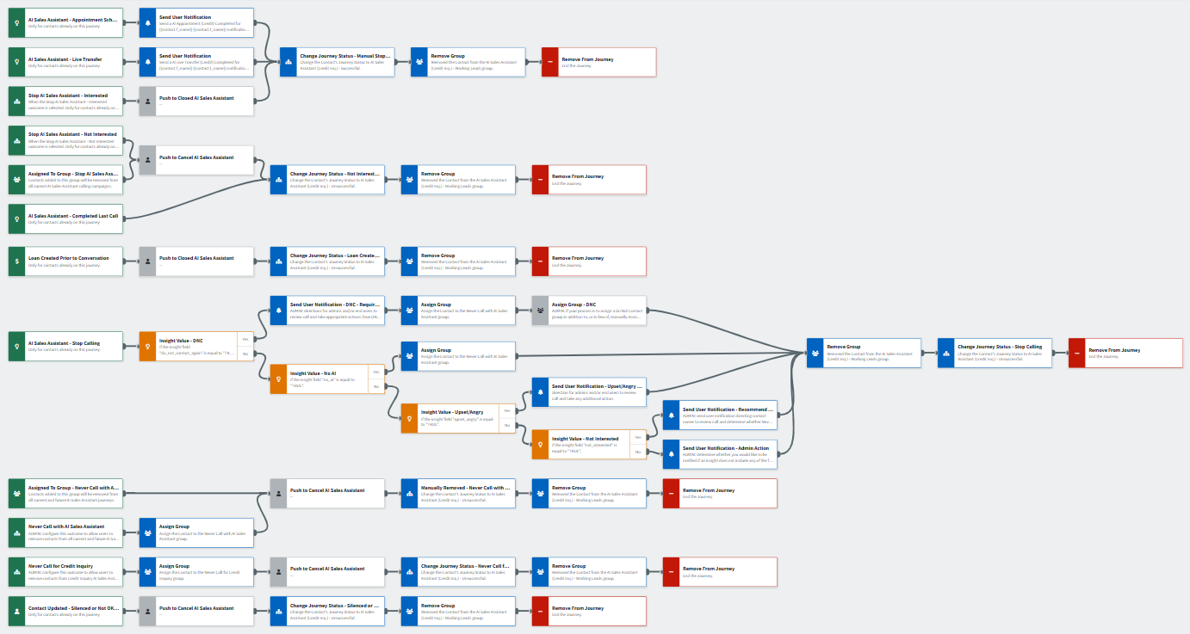
General Offramp Configuration
General Offramp Notes:
Add or adjust contact groups specific to your organization’s needs. Do Not Contact is one that you may want applied automatically when an Insight Attribute of “do_not_contact_again” is received.
  It’s recommended to use consolidated groups (e.g. Working Leads) rather than groups for each post-call outcome. Journey statuses, outcomes, and attributes can provide more granular tracking when used for reporting.
Review and adjust Outcomes for successful and unsuccessful conversions as needed.
Configure Loan Created Prior to Conversation trigger with org-specific inline conditions including relevant loan types, statuses, or dates. This captures conversions that occur during the journey but outside of AI Sales Assistant engagement, ensuring proper journey completion.
Notes:
This page should be used for JOURNEY WIREFRAMES (duplicate as needed)

Slide 6
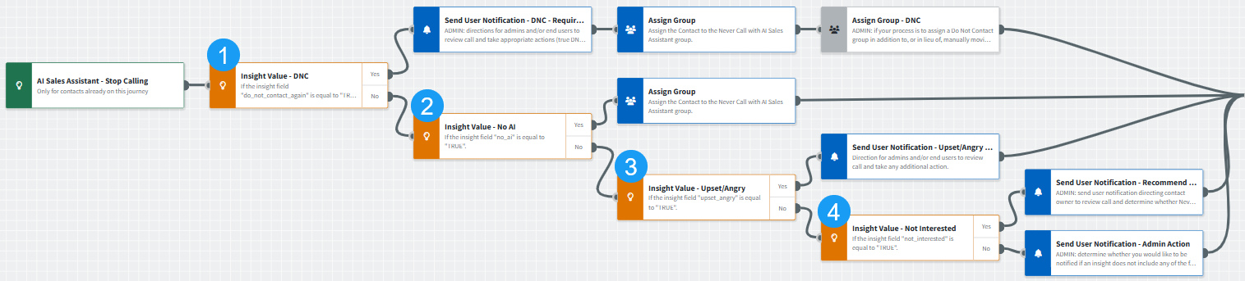
“Stop Calling” Offramp Configuration
“Stop Calling” Offramp Notes:
Determine how your organization will interpret each Outcome Attribute. At least one attribute will be passed along with a “Stop Calling” outcome. In some cases, multiple attributes may be received simultaneously. The "waterfall" approach handles these combinations by checking the highest-priority attributes with the most restrictive action first. The Total Expert definitions and recommended steps are as follows.
  do_not_contact_again = do not call this contact again → ok_to_call will be set to 0 (do not call) via the integration → automatically apply “Never Call with AI Sales Assistant” and “Do Not Contact” groups → send user notification → remove from journey
    Your organization may decide this means the contact is opting out of all communications. If so, it’s recommended to add a Silence Communications component, apply your standard “Do Not Contact” group, and retain a version of the User Notification. The notification should instruct users to a) review the call to confirm opt-out type, b) manually move the contact to the Do Not Contact list if appropriate, c) consider if other channels apply, and d) check for and update duplicate contact records as this is contact_id based.
  no_ai = do not use AI with this contact → apply “Never Call with AI Sales Assistant” contact group → remove from journey
  upset_angry = send a User Notification to the Contact Owner with next steps such as reviewing the call and identifying whether a personal check in would address the negative interaction → remove from journey
    If your organization would like to formalize an outreach path for each “upset_angry” Insight Attribute received, add this condition after each applicable step in the “Stop Calling” path. For example, add the Insight Value condition after both Yes and No paths for “No AI”.
  not_interested = the contact is not interested at this time → send user notification → remove from journey
    Your organization may determine that this means the contact is not interested in the specific topic and should be added to the appropriate group. A user notification may be helpful
Adjust User Notifications for each Outcome Attribute to include your organization’s preferred actions. You may consider adding an Admin User Notification for specific attributes like “upset_angry” or “do_not_contact_again” with additional tasks.
Notes:
This page should be used for JOURNEY WIREFRAMES (duplicate as needed)

Slide 7
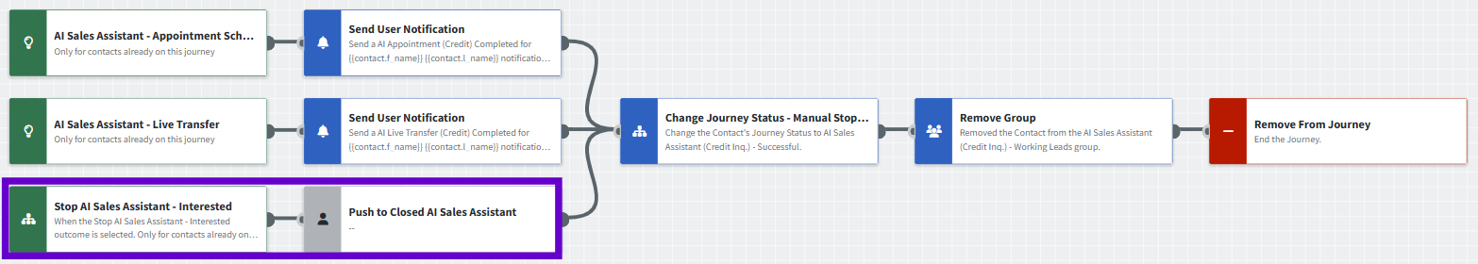
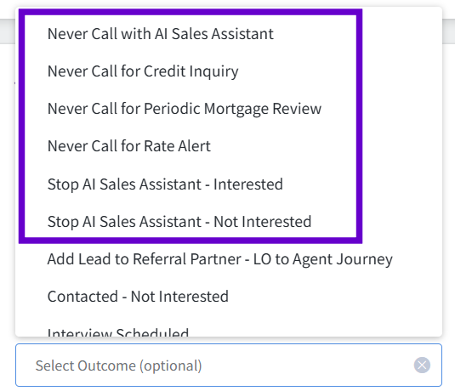
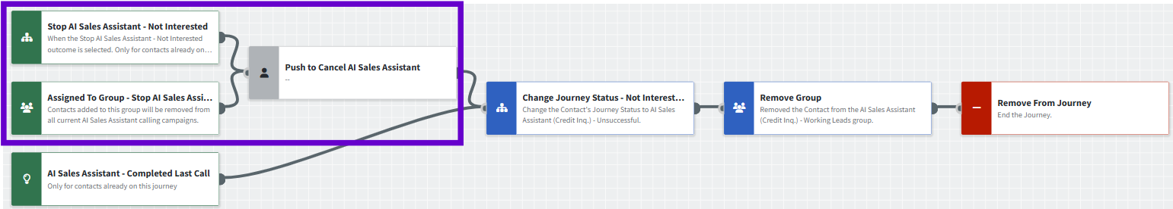
User Initiated Offramp Configuration
User Initiated Offramp Notes:
Group offramp – “Stop AI Sales Assistant”
  Primarily intended for mass removal of contacts for reasons such as deactivated users
  Contacts can be added to the group individually, added via API/import, or through the Pipeline View for Working Leads
Admins should create Outcomes for each of the following user-initiated offramps. Users should apply these outcomes when they learn through direct contact (phone call, text, email, in-person) that someone wants to opt out or modify their AI calling preferences.
  Never Call with AI Sales Assistant → intended to remove contacts from all current and future AI Sales Assistant campaigns
  Never Call for X Alert → intended to remove contacts from current and future specific AI Sales Assistant campaigns
  Stop Calling – Interested → intended to remove interested contacts from the campaign
  Stop Calling - Not Interested → intended to remove uninterested contacts from the campaign
Notes:
This page should be used for JOURNEY WIREFRAMES (duplicate as needed)

Slide 8
Credit Inquiry
AI Sales Assistant Journey Overview

Slide 9
Credit Inquiry – Summary
Communication types: Voice AI, Email, SMS, and User Notifications
Engage borrowers instantly after a credit inquiry to prevent churn and protect revenue. This journey ensures immediate engagement through the AI Sales Assistant, reinforcing loyalty and capturing opportunities before competitors do.
Key components:
Trigger: Credit Inquiry insight
Actions: Push contact to AI Sales Assistant for real-time call engagement
  Additional touchpoints: email & SMS introducing the assistant
Offramps: Appointment scheduled, live transfer, stop requests, or conversion event
  Users can manually remove contacts using Outcomes for interested and not interested scenarios
  Contacts added to the “Stop AI Sales Assistant” group will pass through the unsuccessful path and be removed from the calling campaign
  Contacts who are Silenced or marked “Not OK to Call” in the platform are removed as well
Timing: Immediate push with configurable contact-hour controls
*All communications should be reviewed prior to initiating the journey.

Slide 10
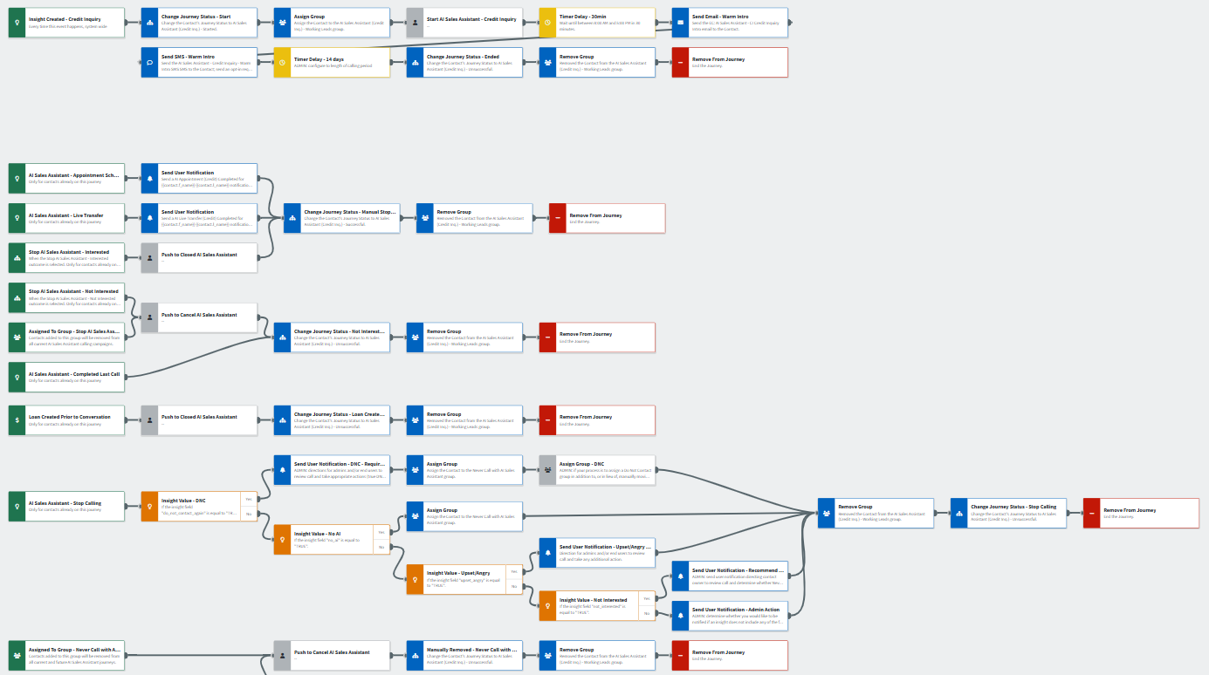
Credit Inquiry – Journey Overview
Journey Notes:
Configure Insight Created – Credit Inquiry trigger with org-specific inline conditions such as servicing and consent requirements to identify eligible contacts.
  Prioritize speed-to-lead by pushing contacts to the AI Sales Assistant before sending email or SMS touchpoints. Timing can be adjusted based on preference.
Review and adjust Outcomes for successful and unsuccessful conversions as needed.
Configure Loan Created Prior to Conversation trigger with org-specific inline conditions to isolate relevant loan types, statuses, or dates.
Notes:
This page should be used for JOURNEY WIREFRAMES (duplicate as needed)

Slide 11
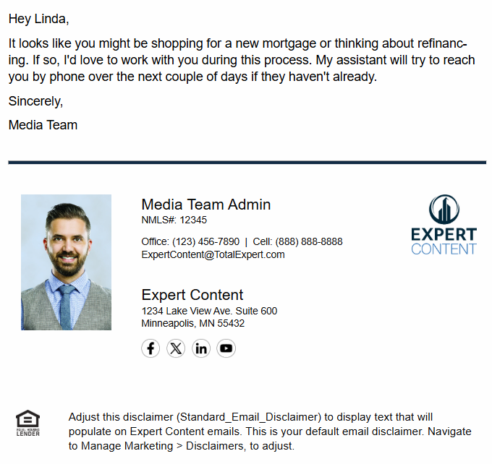
Credit Inquiry – Intro Email
Email Subject Line: A five-minute chat could save you thousands on home financing.
Hey {{recipient.f_name}},
It looks like you might be shopping for a new mortgage or thinking about refinancing. If so, I'd love to work with you during this process. My assistant will try to reach you by phone over the next couple of days if they haven't already.
Sincerely,
{{sender.f_name}}
**Recommend including the assistant’s name and changing to “AI Assistant” if required by compliance.
Notes:
This page should be used for EMAILS (duplicate as needed)

Slide 12
Credit Inquiry – Intro Text
SMS: AI Sales Assistant - Credit Inquiry - Warm Intro SMS
Hi {{recipient.f_name}} - it's {{sender.f_name}} from {{sender.company}}. If you're shopping for home financing, I can get you a better deal. If you haven't spoken with my assistant yet, call me at {{sender.phone_office}}.
Notes:
This page should be used for TASKS, USER NOTIFICATIONS, AND SMS TEMPLATES (duplicate as needed)

Slide 13
Credit Inquiry – User Notification
Appointment Scheduled
User Notification: AI Appointment (Credit) Completed for {{contact.f_name}} {{contact.l_name}}
The AI Assistant scheduled a call with you and {{contact.f_name}} {{contact.l_name}} at {{contact.custom.conversational_ai_date_time_of_meeting}} to connect about their credit inquiry.
Using the link below, please open the contact in TE to review their information and add notes and/or make a follow up task for yourself.
Contact details:
Name: {{contact.f_name}} {{contact.l_name}}
Email: {{contact.email}}
Mobile Number: {{contact.phone_cell}}
Click here to view contact.
Loan details:
Loan number: {{loan.loan_number}}
Loan amount: ${{loan.amount | formatNumber: 0}}
Loan program: {{loan.loan_program}}
Loan funded date: {{loan.funded_date | date: "m/d/Y"}}
Loan rate: {{loan.rate}}%
Contact Address: {{contact.address}} {{contact.city}}, {{contact.state}} {{contact.zipcode}}
Click here to view loan.
Notes:
This page should be used for TASKS, USER NOTIFICATIONS, AND SMS TEMPLATES (duplicate as needed)

Slide 14
Credit Inquiry – User Notification
Live Transfer
User Notification: AI Live Transfer (Credit) Completed for {{contact.f_name}} {{contact.l_name}}
The AI Assistant just completed a live transfer with you and {{contact.f_name}} {{contact.l_name}} to connect about their credit inquiry.
Using the link below, please open the contact in TE to review their information and add notes and/or make a follow up task for yourself.
Contact details:
Name: {{contact.f_name}} {{contact.l_name}}
Email: {{contact.email}}
Mobile Number: {{contact.phone_cell}}
Click here to view contact.
Loan details:
Loan number: {{loan.loan_number}}
Loan amount: ${{loan.amount | formatNumber: 0}}
Loan program: {{loan.loan_program}}
Loan funded date: {{loan.funded_date | date: "m/d/Y"}}
Loan rate: {{loan.rate}}%
Contact Address: {{contact.address}} {{contact.city}}, {{contact.state}} {{contact.zipcode}}
Click here to view loan.
Notes:
This page should be used for TASKS, USER NOTIFICATIONS, AND SMS TEMPLATES (duplicate as needed)

Slide 15
Credit Inquiry – Admin Notification
Do Not Contact
User Notification: Action Required: {{contact.f_name}} {{contact.l_name}} Requested Do Not Contact (Credit Inquiry)
The AI Assistant completed a call with {{contact.f_name}} {{contact.l_name}} about their credit inquiry where they requested not to be contacted again.
Action required:
Review the call recording to determine the scope of their opt-out request and take appropriate next steps:
If they said "do not contact me again" → Add to Do Not Contact list
If they said "do not call me again" → Verify ok_to_call is set to false (already updated automatically)
If they mentioned texting or email → Manually update SMS opt-out or email preferences as needed
Check for duplicate contact records across your organization and update those as well.
Contact details:
Name: {{contact.f_name}} {{contact.l_name}}
Click here to view contact.
*Note: It is recommended to send these notifications to a system administrator so that they can check across the organization to update duplicate contact records.
Notes:
This page should be used for TASKS, USER NOTIFICATIONS, AND SMS TEMPLATES (duplicate as needed)

Slide 16
Credit Inquiry – User Notification
Upset/Angry
User Notification: Follow-Up Recommended: {{contact.f_name}} {{contact.l_name}} Expressed Frustration (Credit Inquiry)
The AI Assistant completed a call with {{contact.f_name}} {{contact.l_name}} about their credit inquiry where they expressed frustration or anger during the conversation.
Recommended action: Review the call recording to understand their concern and determine whether a personal follow-up would help address the issue and maintain the relationship. Consider creating a task to call them directly or send a personalized message.
Contact details:
Name: {{contact.f_name}} {{contact.l_name}}
Email: {{contact.email}}
Mobile Number: {{contact.phone_cell}}
Click here to view contact.
Notes:
This page should be used for TASKS, USER NOTIFICATIONS, AND SMS TEMPLATES (duplicate as needed)

Slide 17
Credit Inquiry – User Notification
Not Interested
User Notification: Follow-Up Recommended: {{contact.f_name}} {{contact.l_name}} Indicated Disinterest in Credit Inquiry
The AI Assistant completed a call with {{contact.f_name}} {{contact.l_name}} about their credit inquiry where they indicated they are not interested.
Recommended action: Review the call recording to understand the scope of their disinterest, then apply the appropriate manual outcome to their contact record:
Not interested right now → No action needed (they've been removed from this campaign)
Not interested in Credit Inquiry alerts → Apply "Never Call for Credit Inquiry" outcome
Not interested in any AI calls → Apply "Never Call with AI Sales Assistant" outcome
Contact details:
Name: {{contact.f_name}} {{contact.l_name}}
Email: {{contact.email}}
Mobile Number: {{contact.phone_cell}}
Click here to view contact.
Notes:
This page should be used for TASKS, USER NOTIFICATIONS, AND SMS TEMPLATES (duplicate as needed)

Slide 18
Credit Inquiry – Admin Notification
No Reason Provided
User Notification: ADMIN ACTION: {{contact.f_name}} {{contact.l_name}} Stop Calling - No Reason Provided (Credit Inquiry)
The AI Assistant completed a call with {{contact.f_name}} {{contact.l_name}} about their credit inquiry that resulted in a "stop calling" outcome, but no specific reason attribute was provided by the system.
Admin action required: This is an unexpected scenario. Please review the call recording and contact record to:
Determine why the contact requested to stop calling
Apply the appropriate manual outcome based on what was said ("Never Call for Credit Inquiry", "Never Call with AI Sales Assistant", or other)
If the contact indicated "do not contact me again," verify whether ok_to_call is set correctly and consider adding them to the Do Not Contact list
Report this issue to Total Expert support for investigation
Contact details:
Name: {{contact.f_name}} {{contact.l_name}}
Contact Owner: {{journey_contact.owner_f_name}} {{journey_contact.owner_l_name}}
Click here to view contact.
Notes:
This page should be used for TASKS, USER NOTIFICATIONS, AND SMS TEMPLATES (duplicate as needed)

Slide 19
Rate Alert
AI Sales Assistant Journey Overview

Slide 20
Rate Alert – Summary
Communication types: Voice AI, Email, SMS, and User Notifications
Engage borrowers when rate opportunities arise to strengthen relationships and protect revenue. This journey ensures timely engagement through the AI Sales Assistant, helping borrowers act on favorable rate changes before competitors reach them.
Key components:
Trigger: Rate Alert insight
Actions: Push contact to AI Sales Assistant for real-time call engagement
  Additional touchpoints: email & SMS introducing the assistant
Offramps: Appointment scheduled, live transfer, stop requests, or conversion event
  Users can manually remove contacts using Outcomes for interested or not interested scenarios
  Contacts added to the “Stop AI Sales Assistant” group will pass through the unsuccessful path and be removed from the calling campaign
  Contacts who are Silenced or marked “Not OK to Call” in the platform are removed as well
Timing: Immediate push with configurable contact-hour controls
*All communications should be reviewed prior to initiating the journey.

Slide 21
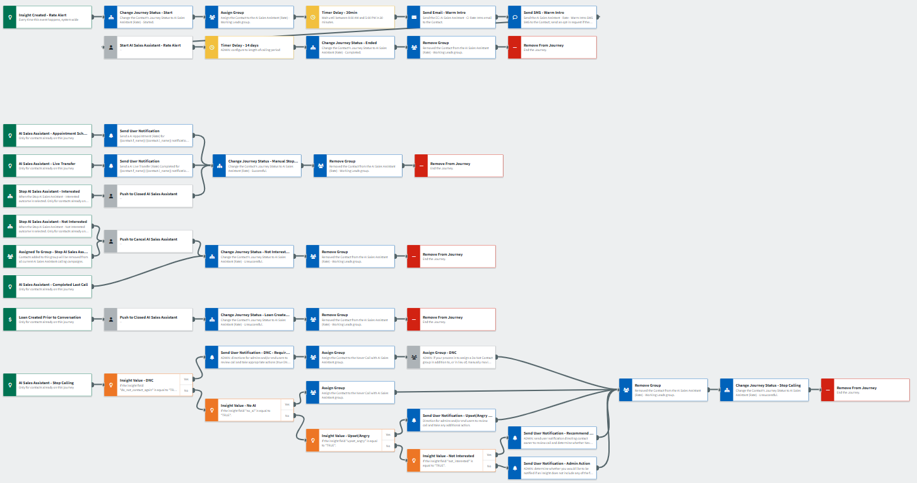
Rate Alert – Journey Overview
Journey Notes:
Configure Insight Created - Rate Alert trigger with org-specific inline conditions such as servicing and consent requirements to identify eligible contacts.
  Prioritize warm lead nurture by pushing contacts to the AI Sales Assistant after sending email or SMS touchpoints. Timing can be adjusted based on preference.
Review and adjust Outcomes for successful and unsuccessful conversions as needed.
Configure Loan Created Prior to Conversation trigger with org-specific inline conditions to isolate relevant loan types, statuses, or dates.
Notes:
This page should be used for JOURNEY WIREFRAMES (duplicate as needed)

Slide 22
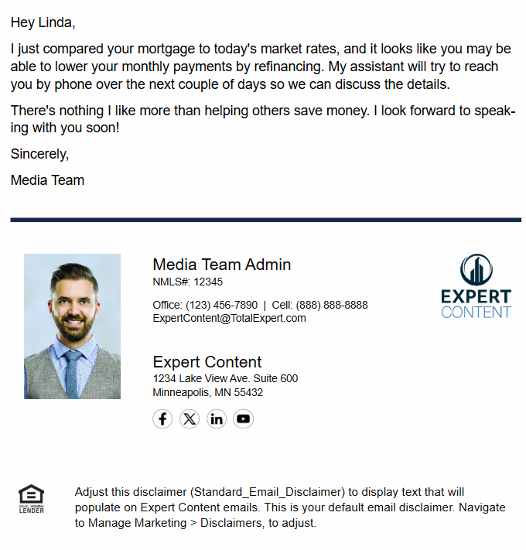
Rate Alert – Intro Email
Email Subject Line: Great news...interest rates are down!
Hey {{recipient.f_name}},
I just compared your mortgage to today's market rates, and it looks like you may be able to lower your monthly payments by refinancing. My assistant will try to reach you by phone over the next couple of days so we can discuss the details.
There's nothing I like more than helping others save money. I look forward to speaking with you soon!
Sincerely,
{{sender.f_name}}
**Recommend including the assistant’s name and changing to “AI Assistant” if required by compliance.
Notes:
This page should be used for EMAILS (duplicate as needed)

Slide 23
Rate Alert – Intro Text
SMS: AI Sales Assistant - Rate - Warm intro SMS
Have you noticed that mortgage interest rates are down? If you haven't heard from my assistant yet, text me back or call my office at {{sender.phone_office}} so we can talk about your potential savings. - {{sender.f_name}} {{sender.l_name}}
Notes:
This page should be used for TASKS, USER NOTIFICATIONS, AND SMS TEMPLATES (duplicate as needed)

Slide 24
Rate Alert – User Notification
Appointment Scheduled
User Notification: AI Appointment (Rate) for {{contact.f_name}} {{contact.l_name}}
The AI Assistant scheduled a call with you and {{contact.f_name}} {{contact.l_name}} at {{contact.custom.conversational_ai_date_time_of_meeting}} to connect about their rate alert.
An invite should be on your calendar for this appointment. Please review their information by opening the contact in TE using the link below, to see all notes from the call with the AI Assistant prior to your appointment.
Contact details:
Name: {{contact.f_name}} {{contact.l_name}}
Email: {{contact.email}}
Mobile Number: {{contact.phone_cell}}
Click here to view contact.
Loan details:
Loan number: {{contact.enriched.rate.loan_number}}
Loan amount: ${{contact.enriched.rate.loan_amount | formatNumber: 0}}
Loan program: {{contact.enriched.rate.loan_program}}
Loan funded date: {{contact.enriched.rate.loan_funded_date | date: "m/d/Y"}}
Loan rate: {{contact.enriched.rate.loan_rate}}% | Market rate: {{contact.enriched.rate.current_market_rate}}%
Potential monthly savings: ${{contact.enriched.rate.estimated_monthly_savings | formatNumber: 0}}/month
Contact Address: {{contact.address}} {{contact.city}}, {{contact.state}} {{contact.zipcode}}
Click here to view loan.
Notes:
This page should be used for TASKS, USER NOTIFICATIONS, AND SMS TEMPLATES (duplicate as needed)

Slide 25
Rate Alert – User Notification
Live Transfer
User Notification: AI Live Transfer (Rate) Completed for {{contact.f_name}} {{contact.l_name}}
The AI Assistant just completed a live transfer with you and {{contact.f_name}} {{contact.l_name}} to connect about their rate alert.
Using the link below, please open the contact in TE to review their information and add notes and/or make a follow up task for yourself.
Contact details:
Name: {{contact.f_name}} {{contact.l_name}}
Email: {{contact.email}}
Mobile Number: {{contact.phone_cell}}
Click here to view contact.
Loan details:
Loan number: {{contact.enriched.rate.loan_number}}
Loan amount: ${{contact.enriched.rate.loan_amount | formatNumber: 0}}
Loan program: {{contact.enriched.rate.loan_program}}
Loan funded date: {{contact.enriched.rate.loan_funded_date | date: "m/d/Y"}}
Loan rate: {{contact.enriched.rate.loan_rate}}% | Market rate: {{contact.enriched.rate.current_market_rate}}%
Potential monthly savings: ${{contact.enriched.rate.estimated_monthly_savings | formatNumber: 0}}/month
Contact Address: {{contact.address}} {{contact.city}}, {{contact.state}} {{contact.zipcode}}
Click here to view loan.
Notes:
This page should be used for TASKS, USER NOTIFICATIONS, AND SMS TEMPLATES (duplicate as needed)

Slide 26
Rate Alert – Admin Notification
Do Not Contact
User Notification: Action Required: {{contact.f_name}} {{contact.l_name}} Requested Do Not Contact (Rate Alert)
The AI Assistant completed a call with {{contact.f_name}} {{contact.l_name}} about a Rate Alert where they requested not to be contacted again.
Action required:
Review the call recording to determine the scope of their opt-out request and take appropriate next steps:
If they said "do not contact me again" → Add to Do Not Contact list
If they said "do not call me again" → Verify ok_to_call is set to false (already updated automatically)
If they mentioned texting or email → Manually update SMS opt-out or email preferences as needed
Check for duplicate contact records across your organization and update those as well.
Contact details:
Name: {{contact.f_name}} {{contact.l_name}}
Click here to view contact.
*Note: It is recommended to send these notifications to a system administrator so that they can check across the organization to update duplicate contact records.
Notes:
This page should be used for TASKS, USER NOTIFICATIONS, AND SMS TEMPLATES (duplicate as needed)

Slide 27
Rate Alert – User Notification
Upset/Angry
User Notification: Follow-Up Recommended: {{contact.f_name}} {{contact.l_name}} Expressed Frustration (Rate Alert)
The AI Assistant completed a call with {{contact.f_name}} {{contact.l_name}} about a Rate Alert where they expressed frustration or anger during the conversation.
Recommended action: Review the call recording to understand their concern and determine whether a personal follow-up would help address the issue and maintain the relationship. Consider creating a task to call them directly or send a personalized message.
Contact details:
Name: {{contact.f_name}} {{contact.l_name}}
Email: {{contact.email}}
Mobile Number: {{contact.phone_cell}}
Click here to view contact.
Notes:
This page should be used for TASKS, USER NOTIFICATIONS, AND SMS TEMPLATES (duplicate as needed)

Slide 28
Rate Alert – User Notification
Not Interested
User Notification: Follow-Up Recommended: {{contact.f_name}} {{contact.l_name}} Indicated Disinterest in Rate Alert
The AI Assistant completed a call with {{contact.f_name}} {{contact.l_name}} about a Rate Alert where they indicated they are not interested.
Recommended action: Review the call recording to understand the scope of their disinterest, then apply the appropriate manual outcome to their contact record:
Not interested right now → No action needed (they've been removed from this campaign)
Not interested in Credit Inquiry alerts → Apply "Never Call for Rate Alert" outcome
Not interested in any AI calls → Apply "Never Call with AI Sales Assistant" outcome
Contact details:
Name: {{contact.f_name}} {{contact.l_name}}
Email: {{contact.email}}
Mobile Number: {{contact.phone_cell}}
Click here to view contact.
Notes:
This page should be used for TASKS, USER NOTIFICATIONS, AND SMS TEMPLATES (duplicate as needed)

Slide 29
Rate Alert – Admin Notification
No Reason Provided
User Notification: ADMIN ACTION: {{contact.f_name}} {{contact.l_name}} Stop Calling - No Reason Provided (Rate Alert)
The AI Assistant completed a call with {{contact.f_name}} {{contact.l_name}} about a Rate Alert that resulted in a "stop calling" outcome, but no specific reason attribute was provided by the system.
Admin action required: This is an unexpected scenario. Please review the call recording and contact record to:
Determine why the contact requested to stop calling
Apply the appropriate manual outcome based on what was said ("Never Call for Rate Alert", "Never Call with AI Sales Assistant", or other)
If the contact indicated "do not contact me again," verify whether ok_to_call is set correctly and consider adding them to the Do Not Contact list
Report this issue to Total Expert support for investigation
Contact details:
Name: {{contact.f_name}} {{contact.l_name}}
Contact Owner: {{journey_contact.owner_f_name}} {{journey_contact.owner_l_name}}
Click here to view contact.
Notes:
This page should be used for TASKS, USER NOTIFICATIONS, AND SMS TEMPLATES (duplicate as needed)

Slide 30
Periodic Mortgage Review
AI Sales Assistant Journey Overview

Slide 31
Periodic Mortgage Review – Summary
Communication types: Voice AI, Email, SMS, and User Notifications
Engage borrowers post-close to reinforce loyalty, prevent churn, and uncover new opportunities. This journey leverages the AI Sales Assistant for timely, personalized engagement ensuring consistent and proactive relationship building.
Key components:
Trigger: Loan Date (configurable cadence), or Customer Intelligence Equity Alerts or Life Events
Actions: Push contact to AI Sales Assistant for real-time call engagement
  Additional touchpoints: email & SMS introducing the assistant
Offramps: Appointment scheduled, live transfer, stop requests, or conversion event
  Users can manually remove contacts using Outcomes for interested or not interested scenarios
  Contacts added to the “Stop AI Sales Assistant” group will pass through the unsuccessful path and be removed from the calling campaign
  Contacts who are Silenced or marked “Not OK to Call” in the platform are removed as well
Timing: Immediate push with configurable contact-hour controls
*All communications should be reviewed prior to initiating the journey.

Slide 32
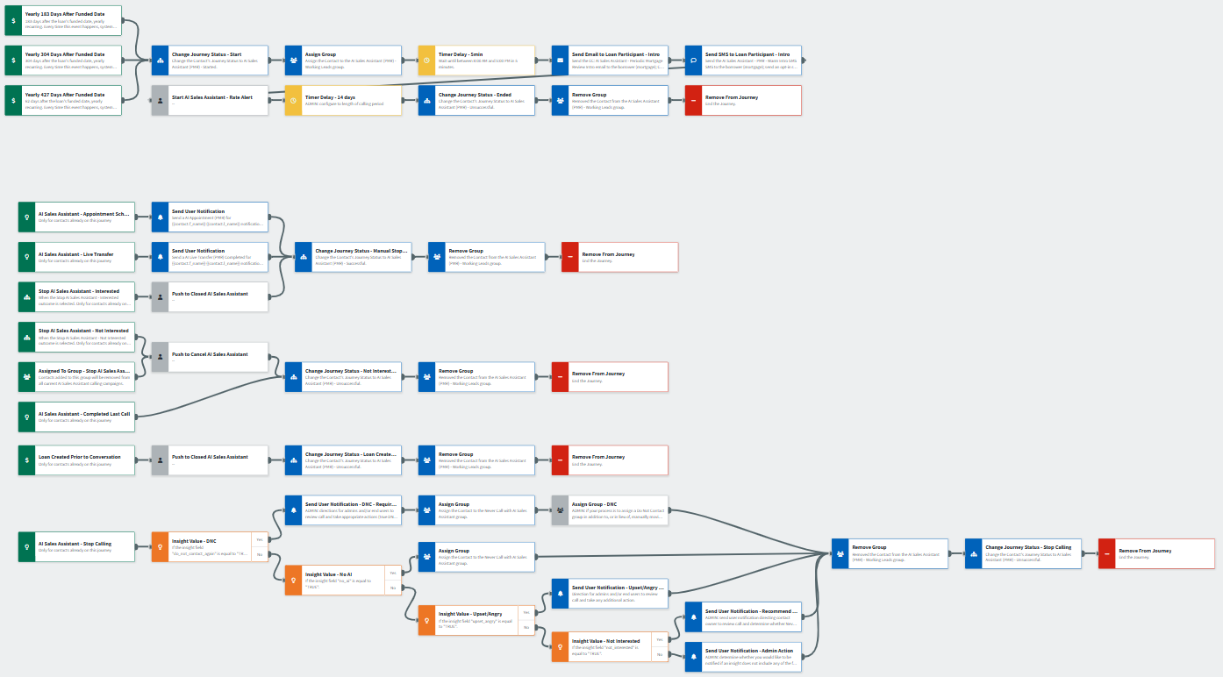
Periodic Mortgage Review – Journey Overview
Journey Notes:
Configure On Loan Date trigger with org-specific inline conditions such as servicing and consent requirements to identify eligible contacts.
  The base journey includes 6-, 10-, and 14-month post-funding check-ins that recur annually.
  Stagger timing with other campaigns, such as Customer Intelligence Equity or post-close journeys, to avoid overlap.
Review and adjust Outcomes for successful and unsuccessful conversions as needed.
Configure Loan Created Prior to Conversation trigger with org-specific inline conditions to isolate relevant loan types, statuses, or dates.
Notes:
This page should be used for JOURNEY WIREFRAMES (duplicate as needed)

Slide 33
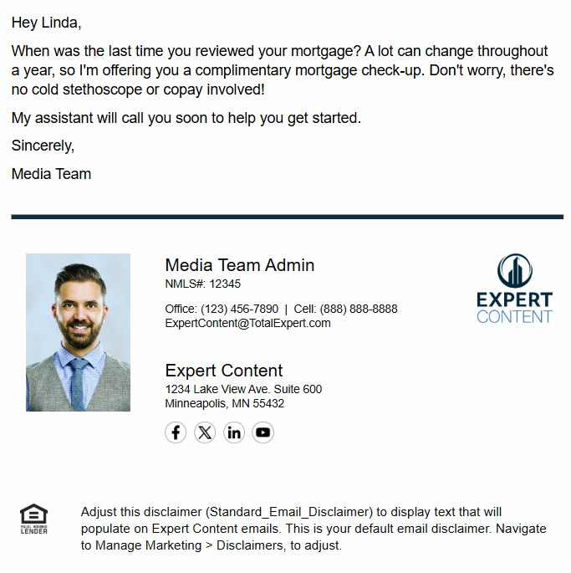
Periodic Mortgage Review – Intro Email
Email Subject Line: Healthier home financing starts with a mortgage check-up.
Hey {{recipient.f_name}},
When was the last time you reviewed your mortgage? A lot can change throughout a year, so I'm offering you a complimentary mortgage check-up. Don't worry, there's no cold stethoscope or copay involved!
My assistant will call you soon to help you get started.
Sincerely,
{{sender.f_name}}
**Recommend including the assistant’s name and changing to “AI Assistant” if required by compliance.
Notes:
This page should be used for EMAILS (duplicate as needed)

Slide 34
Periodic Mortgage Review – Intro Text
SMS: AI Sales Assistant - PMR - Warm Intro SMS
A mortgage checkup can keep your home loan healthy...and yours is complimentary. If you haven't heard from my assistant yet, call me at {{sender.phone_office}} so we can talk. - {{sender.f_name}} {{sender.l_name}}
Notes:
This page should be used for TASKS, USER NOTIFICATIONS, AND SMS TEMPLATES (duplicate as needed)

Slide 35
Periodic Mortgage Review –
User Notification Appointment Scheduled
User Notification: AI Appointment (PMR) for {{contact.f_name}} {{contact.l_name}}
The AI Assistant scheduled a call with you and {{contact.f_name}} {{contact.l_name}} at {{contact.custom.conversational_ai_date_time_of_meeting}} to connect about their current mortgage.
An invite should be on your calendar for this appointment. Please review their information by opening the contact in TE using the link below and to see all notes from the call with the AI Assistant prior to your appointment.
Contact details:
Name: {{contact.f_name}} {{contact.l_name}}
Email: {{contact.email}}
Mobile Number: {{contact.phone_cell}}
Click here to view contact.
Loan details:
Loan number: {{loan.loan_number}}
Loan amount: ${{loan.amount | formatNumber: 0}}
Loan program: {{loan.loan_program}}
Loan funded date: {{loan.funded_date | date: "m/d/Y"}}
Loan rate: {{loan.rate}}%
Contact Address: {{contact.address}} {{contact.city}}, {{contact.state}} {{contact.zipcode}}
Click here to view loan.
Notes:
This page should be used for TASKS, USER NOTIFICATIONS, AND SMS TEMPLATES (duplicate as needed)

Slide 36
Periodic Mortgage Review –
User Notification Live Transfer
User Notification: AI Live Transfer (PMR) Completed for {{contact.f_name}} {{contact.l_name}}
The AI Assistant just completed a live transfer with you and {{contact.f_name}} {{contact.l_name}} to connect about their current mortgage.
Using the link below, please open the contact in TE to review their information and add notes and/or make a follow up task for yourself.
Contact details:
Name: {{contact.f_name}} {{contact.l_name}}
Email: {{contact.email}}
Mobile Number: {{contact.phone_cell}}
Click here to view contact.
Loan details:
Loan number: {{loan.loan_number}}
Loan amount: ${{loan.amount | formatNumber: 0}}
Loan program: {{loan.loan_program}}
Loan funded date: {{loan.funded_date | date: "m/d/Y"}}
Loan rate: {{loan.rate}}%
Contact Address: {{contact.address}} {{contact.city}}, {{contact.state}} {{contact.zipcode}}
Click here to view loan.
Notes:
This page should be used for TASKS, USER NOTIFICATIONS, AND SMS TEMPLATES (duplicate as needed)

Slide 37
Periodic Mortgage Review –
Admin Notification Do Not Contact
User Notification: Action Required: {{contact.f_name}} {{contact.l_name}} Requested Do Not Contact (Mortgage Review)
The AI Assistant completed a call with {{contact.f_name}} {{contact.l_name}} to review their current mortgage where they requested not to be contacted again.
Action required: Review the call recording to determine the scope of their opt-out request and take appropriate next steps:
If they said "do not contact me again" → Add to Do Not Contact list
If they said "do not call me again" → Verify ok_to_call is set to false (already updated automatically)
If they mentioned texting or email → Manually update SMS opt-out or email preferences as needed
Check for duplicate contact records across your organization and update those as well.
Contact details:
Name: {{contact.f_name}} {{contact.l_name}}
Click here to view contact.
*Note: It is recommended to send these notifications to a system administrator so that they can check across the organization to update duplicate contact records.
Notes:
This page should be used for TASKS, USER NOTIFICATIONS, AND SMS TEMPLATES (duplicate as needed)

Slide 38
Periodic Mortgage Review –
User Notification Upset/Angry
User Notification: Follow-Up Recommended: {{contact.f_name}} {{contact.l_name}} Expressed Frustration (Mortgage Review)
The AI Assistant completed a call with {{contact.f_name}} {{contact.l_name}} to review their current mortgage where they expressed frustration or anger during the conversation.
Recommended action: Review the call recording to understand their concern and determine whether a personal follow-up would help address the issue and maintain the relationship. Consider creating a task to call them directly or send a personalized message.
Contact details:
Name: {{contact.f_name}} {{contact.l_name}}
Email: {{contact.email}}
Mobile Number: {{contact.phone_cell}}
Click here to view contact.
Notes:
This page should be used for TASKS, USER NOTIFICATIONS, AND SMS TEMPLATES (duplicate as needed)

Slide 39
Periodic Mortgage Review –
User Notification Not Interested
User Notification: Follow-Up Recommended: {{contact.f_name}} {{contact.l_name}} Indicated Disinterest in Mortgage Review
The AI Assistant completed a call with {{contact.f_name}} {{contact.l_name}} to review their current mortgage where they indicated they are not interested.
Recommended action: Review the call recording to understand the scope of their disinterest, then apply the appropriate manual outcome to their contact record:
Not interested right now → No action needed (they've been removed from this campaign)
Not interested in Periodic Mortgage Reviews → Apply "Never Call for Periodic Mortgage Review" outcome
Not interested in any AI calls → Apply "Never Call with AI Sales Assistant" outcome
Contact details:
Name: {{contact.f_name}} {{contact.l_name}}
Email: {{contact.email}}
Mobile Number: {{contact.phone_cell}}
Click here to view contact.
Notes:
This page should be used for TASKS, USER NOTIFICATIONS, AND SMS TEMPLATES (duplicate as needed)

Slide 40
Periodic Mortgage Review –
User Notification No Reason Provided
User Notification: ADMIN ACTION: {{contact.f_name}} {{contact.l_name}} Stop Calling - No Reason Provided (Mortgage Review)
The AI Assistant completed a call with {{contact.f_name}} {{contact.l_name}} to review their current mortgage that resulted in a "stop calling" outcome, but no specific reason attribute was provided by the system.
Admin action required: This is an unexpected scenario. Please review the call recording and contact record to:
Determine why the contact requested to stop calling
Apply the appropriate manual outcome based on what was said ("Never Call for Periodic Mortgage Review", "Never Call with AI Sales Assistant", or other)
If the contact indicated "do not contact me again," verify whether ok_to_call is set correctly and consider adding them to the Do Not Contact list
Report this issue to Total Expert support for investigation
Contact details:
Name: {{contact.f_name}} {{contact.l_name}}
Contact Owner: {{journey_contact.owner_f_name}} {{journey_contact.owner_l_name}}
Click here to view contact.
Notes:
This page should be used for TASKS, USER NOTIFICATIONS, AND SMS TEMPLATES (duplicate as needed)

