Slide 1
Expert Content
Strategy Guide
CI: Mortgage Credit Inquiry
April 2026

Slide 2
CI: Mortgage Credit Inquiry
Communication types: Email, SMS, and User Notifications
Use customer intelligence alerts to identify contacts who’ve recently had a credit inquiry from another lender. Whether they are shopping rates or looking to refinance, this journey reminds the contact that your loan officers are there to support their needs. Four emails and two SMS messages are sent to the contact over eight days.
*All communications should be reviewed prior to initiating the journey.

Slide 3
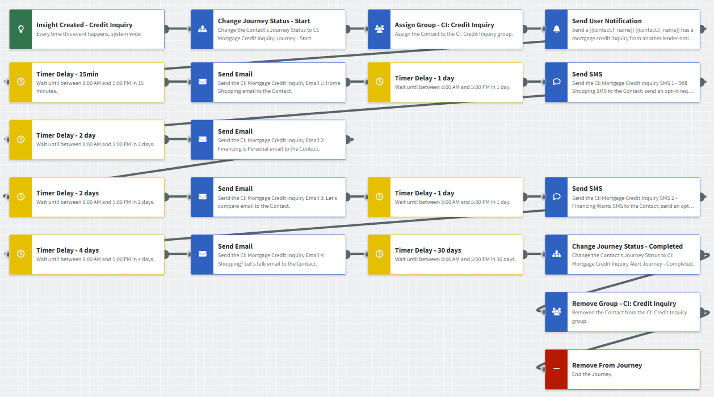
CI: Mortgage Credit Inquiry
Journey Notes:
Keep emails that work for your organization, edit to meet your organization’s tone, swap with custom, or add these emails to your existing campaigns.
Configure trigger and condition components with organization specific inline conditions, contact groups, and Focused View outcomes.
Notes:
This page should be used for JOURNEY WIREFRAMES (duplicate as needed)

Slide 4
CI: Mortgage Credit Inquiry
Journey Notes:
Keep emails that work for your organization, edit to meet your organization’s tone, swap with custom, or add these emails to your existing campaigns.
Configure trigger and condition components with organization specific inline conditions, contact groups, and Focused View outcomes.
Notes:
This page should be used for JOURNEY WIREFRAMES (duplicate as needed)

Slide 5
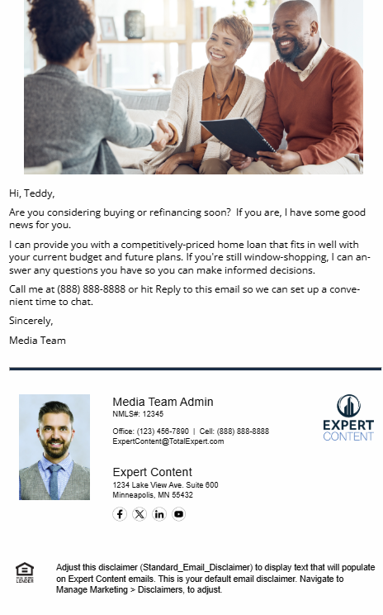
CI: Mortgage Credit Inquiry
Email Subject Line: Shopping for home financing? Let's talk.
Hi, {{recipient.f_name}},
Are you considering buying or refinancing soon? If you are, I have some good news for you.
I can provide you with a competitively-priced home loan that fits in well with your current budget and future plans. If you're still window-shopping, I can answer any questions you have so you can make informed decisions.
Call me at {{sender.phone_cell}} or hit Reply to this email so we can set up a convenient time to chat.
Sincerely,
{{sender.f_name}}
Notes:
This page should be used for EMAILS (duplicate as needed)

Slide 6
CI: Mortgage Credit Inquiry
Email Subject Line: Home financing should be personal.
Hello {{recipient.f_name}},
You may already be talking to other lenders about home financing and even received one or two offers. But will they help you accomplish your other financial goals?
Whether it's your first home purchase or third refinance, you can rely on me to ask the right questions before preparing some options for you.
Home financing is a big investment, and taking the time to shop around can save you thousands. Call me at {{sender.phone_cell}} and we'll do some serious number crunching.
Sincerely,
{{sender.f_name}}
Notes:
This page should be used for EMAILS (duplicate as needed)

Slide 7
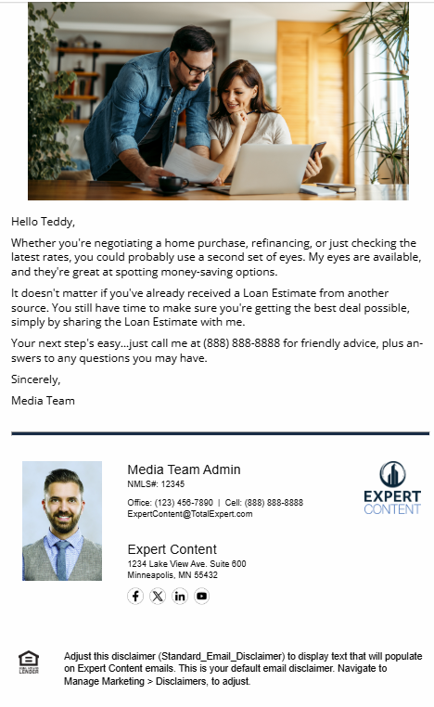
CI: Mortgage Credit Inquiry
Email Subject Line: Let's compare home financing notes.
Hello {{recipient.f_name}},
Whether you're negotiating a home purchase, refinancing, or just checking the latest rates, you could probably use a second set of eyes. My eyes are available, and they're great at spotting money-saving options.
It doesn't matter if you've already received a Loan Estimate from another source. You still have time to make sure you're getting the best deal possible, simply by sharing the Loan Estimate with me.
Your next step's easy...just call me at {{sender.phone_cell}} for friendly advice, plus answers to any questions you may have.
Sincerely,
{{sender.f_name}}
Notes:
This page should be used for EMAILS (duplicate as needed)

Slide 8

CI: Mortgage Credit Inquiry
Email Subject Line: Not all home loans are created equal.
Hi {{recipient.f_name}},
Whether you're buying a new home, refinancing, or just doing some window shopping, I'm here and ready to help.
I can introduce you to the latest home financing options so you can decide how to proceed. If you'd like to go a step further, ask for a fast, free loan pre-qualification.
Call me at {{sender.phone_cell}} so we can set up a convenient time to discuss your plans. Some seriously good news may be just a phone call away.
Sincerely,
{{sender.f_name}}
Notes:
This page should be used for EMAILS (duplicate as needed)

Slide 9
CI: Mortgage Credit Inquiry
SMS: CI: Mortgage Credit Inquiry SMS 1 - Still Shopping
Hi, {{recipient.f_name}}! This is {{sender.f_name}} from {{sender.company}}. If you're thinking of buying or refinancing a home, call me at {{sender.phone_cell}}. I'll provide you with some competitively priced options so you can choose the financing that's right for you.
SMS: CI: Mortgage Credit Inquiry SMS 2 - Financing Wants
{{recipient.f_name}}, got a minute to tell me what you want from your home's financing? This is {{sender.f_name}} with {{sender.company}}, and I’d like to make sure you get the best deal. Call me at {{sender.phone_cell}} to learn more.
Notes:
This page should be used for TASKS, USER NOTIFICATIONS, AND SMS TEMPLATES (duplicate as needed)

Slide 10
CI: Mortgage Credit Inquiry
User Notification: {{contact.f_name}} {{contact.l_name}} has a mortgage credit inquiry from another lender
The contact below has a mortgage credit inquiry pending with another lender. The contact will receive a series of emails automatically. It could be beneficial to discuss your lending options and how it compares to the other organization.
Contact name: {{contact.f_name}} {{contact.l_name}}
Contact phone: {{contact.phone_cell}}
Notes:
This page should be used for TASKS, USER NOTIFICATIONS, AND SMS TEMPLATES (duplicate as needed)

