Slide 1
Expert Content
Strategy Guide
AI Sales Assistant - Retention: Credit Inquiry, Rate, and Periodic Mortgage Review
November 2025

Slide 2
AI Sales Assistant - Retention
Realize borrower intent and new opportunities through AI Voice engagement
AI Sales Assistant Journeys enable lenders to engage borrowers instantly when key signals of intent or opportunity arise. Each journey automates timely, personalized engagement through the AI Sales Assistant—helping protect revenue, reduce churn, and strengthen relationships proactively. These journeys fit seamlessly with Customer Intelligence insights and post-close engagements to ensure no opportunity is missed. Marketing admins can configure triggers, outcomes, and timing to align with their organization’s strategy.
The three included journeys are outlined below:
Customer Intelligence Credit Inquiry: Engage consumers showing high-intent signals—whether current borrowers or new opportunities.
Customer Intelligence Rate Alert: Engage borrowers who may benefit from refinancing or improved rate opportunities.
Periodic Mortgage Review: Engage borrowers regularly during post-close to maintain strong relationships and proactively identify new opportunities.
*All communications should be reviewed prior to initiating the journey.

Slide 3
Credit Inquiry

Slide 4
AI Sales Assistant - Credit Inquiry
Communication types: Voice AI, Email, SMS, and User Notifications
Engage borrowers instantly after a credit inquiry to prevent churn and protect revenue. This journey ensures immediate engagement through the AI Sales Assistant, reinforcing loyalty and capturing opportunities before competitors do.
Key components:
Trigger: Credit Inquiry insight
Actions: Push contact to AI Sales Assistant for real-time call engagement
  Additional touchpoints: email & SMS introducing the assistant
Offramps: Appointment scheduled, live transfer, stop request, or conversion event
  Users can manually remove contacts using Outcomes for both interested and not interested scenarios
  Contacts who are Silenced or marked “Not OK to Call” in the platform are removed as well
Timing: Immediate push with configurable contact-hour controls
*All communications should be reviewed prior to initiating the journey.

Slide 5
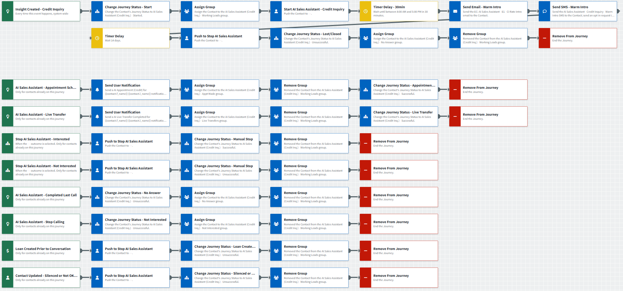
AI Sales Assistant - Credit Inquiry
Journey Notes:
Configure Insight Created – Credit Inquiry trigger with org-specific inline conditions such as servicing and consent requirements to identify eligible contacts.
  Prioritize speed-to-lead by pushing contacts to the AI Sales Assistant before sending email or SMS touchpoints. Timing can be adjusted based on preference.
Review and adjust Outcomes for successful and unsuccessful conversions as needed.
Configure Loan Created Prior to Conversation trigger with org-specific inline conditions to isolate relevant loan types, statuses, or dates.
Notes:
This page should be used for JOURNEY WIREFRAMES (duplicate as needed)

Slide 6
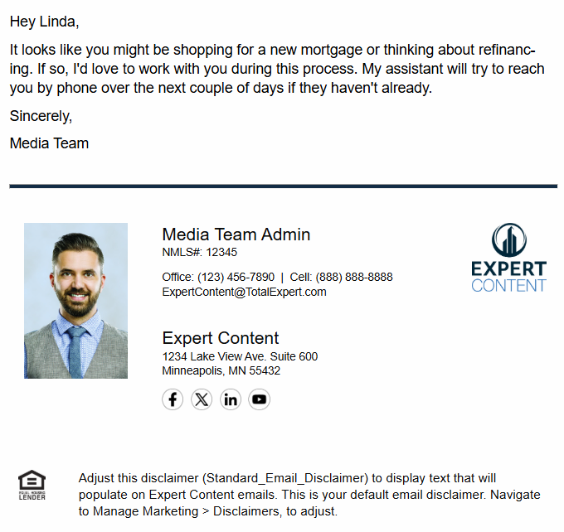
AI Sales Assistant - Credit Inquiry
Email Subject Line: A five-minute chat could save you thousands on home financing.
Hey {{recipient.f_name}},
It looks like you might be shopping for a new mortgage or thinking about refinancing. If so, I'd love to work with you during this process. My assistant will try to reach you by phone over the next couple of days if they haven't already.
Sincerely,
{{sender.f_name}}
**Recommend including the assistant’s name and changing to “AI Assistant” if required by compliance.
Notes:
This page should be used for EMAILS (duplicate as needed)

Slide 7
AI Sales Assistant - Credit Inquiry
SMS: AI Sales Assistant - Credit Inquiry - Warm Intro SMS
Hi {{recipient.f_name}} - it's {{sender.f_name}} from {{sender.company}}. If you're shopping for home financing, I can get you a better deal. If you haven't spoken with my assistant yet, call me at {{sender.phone_office}}.
Notes:
This page should be used for TASKS, USER NOTIFICATIONS, AND SMS TEMPLATES (duplicate as needed)

Slide 8
AI Sales Assistant - Credit Inquiry
User Notification: AI Appointment (Credit) Completed for {{contact.f_name}} {{contact.l_name}}
The AI Assistant scheduled a call with you and {{contact.f_name}} {{contact.l_name}} at {{recipient.custom.conversational_ai_date_time_of_meeting}} to connect about their credit inquiry.
Using the link below, please open the contact in TE to review their information and add notes and/or make a follow up task for yourself.
Contact details:
Name: {{contact.f_name}} {{contact.l_name}}
Email: {{contact.email}}
Mobile Number: {{contact.phone_cell}}
Click here to view contact.
Loan details:
Loan number: {{loan.loan_number}}
Loan amount: ${{loan.amount | formatNumber: 0}}
Loan program: {{loan.loan_program}}
Loan funded date: {{loan.funded_date | date: "m/d/Y"}}
Loan rate: {{loan.rate}}%
Contact Address: {{contact.address}} {{contact.city}}, {{contact.state}} {{contact.zipcode}}
Click here to view loan.
Notes:
This page should be used for TASKS, USER NOTIFICATIONS, AND SMS TEMPLATES (duplicate as needed)

Slide 9
AI Sales Assistant - Credit Inquiry
User Notification: AI Live Transfer (Credit) Completed for {{contact.f_name}} {{contact.l_name}}
The AI Assistant just completed a live transfer with you and {{contact.f_name}} {{contact.l_name}} to connect about their credit inquiry.
Using the link below, please open the contact in TE to review their information and add notes and/or make a follow up task for yourself.
Contact details:
Name: {{contact.f_name}} {{contact.l_name}}
Email: {{contact.email}}
Mobile Number: {{contact.phone_cell}}
Click here to view contact.
Loan details:
Loan number: {{loan.loan_number}}
Loan amount: ${{loan.amount | formatNumber: 0}}
Loan program: {{loan.loan_program}}
Loan funded date: {{loan.funded_date | date: "m/d/Y"}}
Loan rate: {{loan.rate}}%
Contact Address: {{contact.address}} {{contact.city}}, {{contact.state}} {{contact.zipcode}}
Click here to view loan.
Notes:
This page should be used for TASKS, USER NOTIFICATIONS, AND SMS TEMPLATES (duplicate as needed)

Slide 10
Rate Alert

Slide 11
AI Sales Assistant - Rate Alert
Communication types: Voice AI, Email, SMS, and User Notifications
Engage borrowers when rate opportunities arise to strengthen relationships and protect revenue. This journey ensures timely engagement through the AI Sales Assistant, helping borrowers act on favorable rate changes before competitors reach them.
Key components:
Trigger: Rate Alert insight
Actions: Push contact to AI Sales Assistant for real-time call engagement
  Additional touchpoints: email & SMS introducing the assistant
Offramps: Appointment scheduled, live transfer, stop request, or conversion event
  Users can manually remove contacts using Outcomes for interested or not interested scenarios
  Contacts who are Silenced or marked “Not OK to Call” in the platform are removed as well
Timing: Immediate push with configurable contact-hour controls
*All communications should be reviewed prior to initiating the journey.

Slide 12
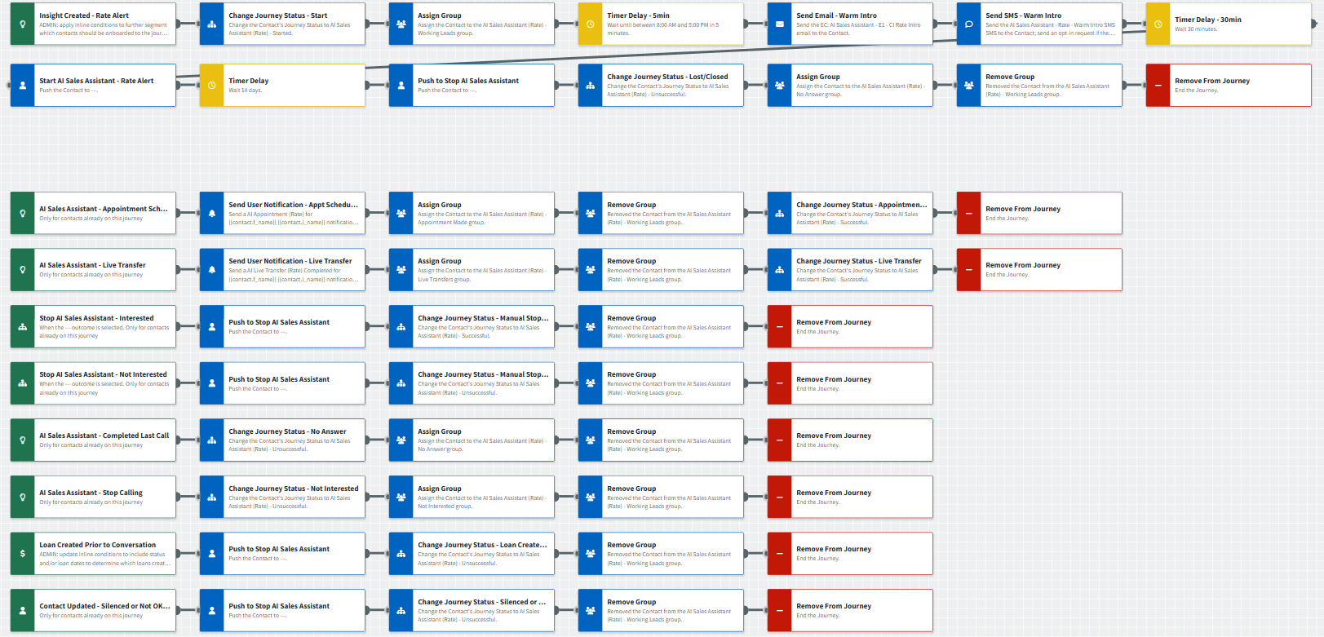
AI Sales Assistant - Rate Alert
Journey Notes:
Configure Insight Created - Rate Alert trigger with org-specific inline conditions to identify eligible borrowers.
  Prioritize warm lead nurture by pushing contacts to the AI Sales Assistant after sending email or SMS touchpoints. Timing can be adjusted based on preference.
Review and adjust Outcomes for successful and unsuccessful conversions as needed.
Configure Loan Created Prior to Conversation trigger with org-specific inline conditions to isolate relevant loan types, statuses, or dates.
Notes:
This page should be used for JOURNEY WIREFRAMES (duplicate as needed)

Slide 13
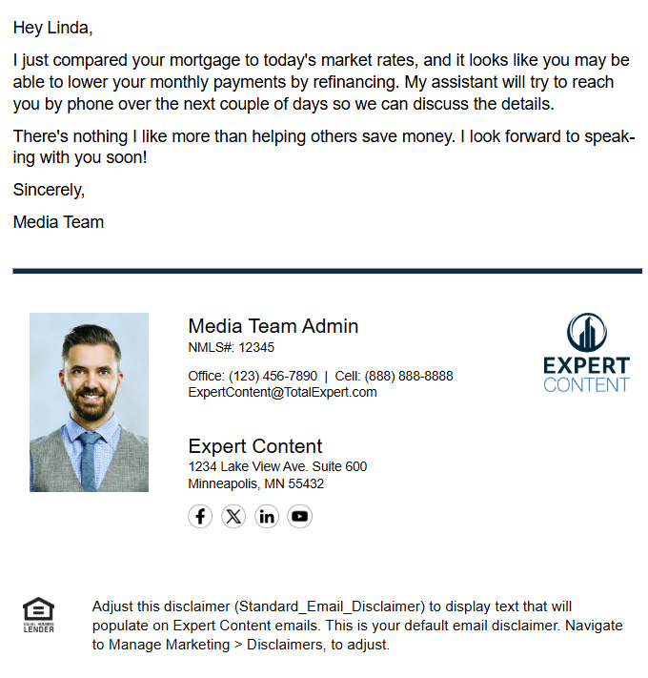
AI Sales Assistant - Rate Alert
Email Subject Line: Great news...interest rates are down!
Hey {{recipient.f_name}},
I just compared your mortgage to today's market rates, and it looks like you may be able to lower your monthly payments by refinancing. My assistant will try to reach you by phone over the next couple of days so we can discuss the details.
There's nothing I like more than helping others save money. I look forward to speaking with you soon!
Sincerely,
{{sender.f_name}}
**Recommend including the assistant’s name and changing to “AI Assistant” if required by compliance.
Notes:
This page should be used for EMAILS (duplicate as needed)

Slide 14
AI Sales Assistant - Rate Alert
SMS: AI Sales Assistant - Rate - Warm intro SMS
Have you noticed that mortgage interest rates are down? If you haven't heard from my assistant yet, text me back or call my office at {{sender.phone_office}} so we can talk about your potential savings. - {{sender.f_name}} {{sender.l_name}}
Notes:
This page should be used for TASKS, USER NOTIFICATIONS, AND SMS TEMPLATES (duplicate as needed)

Slide 15
AI Sales Assistant - Rate Alert
User Notification: AI Appointment (Rate) for {{contact.f_name}} {{contact.l_name}}
The AI Assistant scheduled a call with you and {{contact.f_name}} {{contact.l_name}} at {{recipient.custom.conversational_ai_date_time_of_meeting}} to connect about their rate alert.
An invite should be on your calendar for this appointment. Please review their information by opening the contact in TE using the link below, to see all notes from the call with the AI Assistant prior to your appointment.
Contact details:
Name: {{contact.f_name}} {{contact.l_name}}
Email: {{contact.email}}
Mobile Number: {{contact.phone_cell}}
Click here to view contact.
Loan details:
Loan number: {{contact.enriched.rate.loan_number}}
Loan amount: ${{contact.enriched.rate.loan_amount | formatNumber: 0}}
Loan program: {{contact.enriched.rate.loan_program}}
Loan funded date: {{contact.enriched.rate.loan_funded_date | date: "m/d/Y"}}
Loan rate: {{contact.enriched.rate.loan_rate}}% | Market rate: {{contact.enriched.rate.current_market_rate}}%
Potential monthly savings: ${{contact.enriched.rate.estimated_monthly_savings | formatNumber: 0}}/month
Contact Address: {{contact.address}} {{contact.city}}, {{contact.state}} {{contact.zipcode}}
Click here to view loan.
Notes:
This page should be used for TASKS, USER NOTIFICATIONS, AND SMS TEMPLATES (duplicate as needed)

Slide 16
AI Sales Assistant - Rate Alert
User Notification: AI Live Transfer (Rate) Completed for {{contact.f_name}} {{contact.l_name}}
The AI Assistant just completed a live transfer with you and {{contact.f_name}} {{contact.l_name}} to connect about their rate alert.
Using the link below, please open the contact in TE to review their information and add notes and/or make a follow up task for yourself.
Contact details:
Name: {{contact.f_name}} {{contact.l_name}}
Email: {{contact.email}}
Mobile Number: {{contact.phone_cell}}
Click here to view contact.
Loan details:
Loan number: {{contact.enriched.rate.loan_number}}
Loan amount: ${{contact.enriched.rate.loan_amount | formatNumber: 0}}
Loan program: {{contact.enriched.rate.loan_program}}
Loan funded date: {{contact.enriched.rate.loan_funded_date | date: "m/d/Y"}}
Loan rate: {{contact.enriched.rate.loan_rate}}% | Market rate: {{contact.enriched.rate.current_market_rate}}%
Potential monthly savings: ${{contact.enriched.rate.estimated_monthly_savings | formatNumber: 0}}/month
Contact Address: {{contact.address}} {{contact.city}}, {{contact.state}} {{contact.zipcode}}
Click here to view loan.
Notes:
This page should be used for TASKS, USER NOTIFICATIONS, AND SMS TEMPLATES (duplicate as needed)

Slide 17
Periodic Mortgage Review

Slide 18
AISA - Periodic Mortgage Review
Communication types: Voice AI, Email, SMS, and User Notifications
Engage borrowers post-close to reinforce loyalty, prevent churn, and uncover new opportunities. This journey leverages the AI Sales Assistant for timely, personalized engagement ensuring consistent and proactive relationship building.
Key components:
Trigger: Loan Date (configurable cadence), or Customer Intelligence Equity Alerts or Life Events
Actions: Push contact to AI Sales Assistant for real-time call engagement
  Additional touchpoints: email & SMS introducing the assistant
Offramps: Appointment scheduled, live transfer, stop request, or conversion event
  Users can manually remove contacts using Outcomes for interested or not interested scenarios
  Contacts who are Silenced or marked “Not OK to Call” in the platform are removed as well
Timing: Immediate push with configurable contact-hour controls
*All communications should be reviewed prior to initiating the journey.

Slide 19
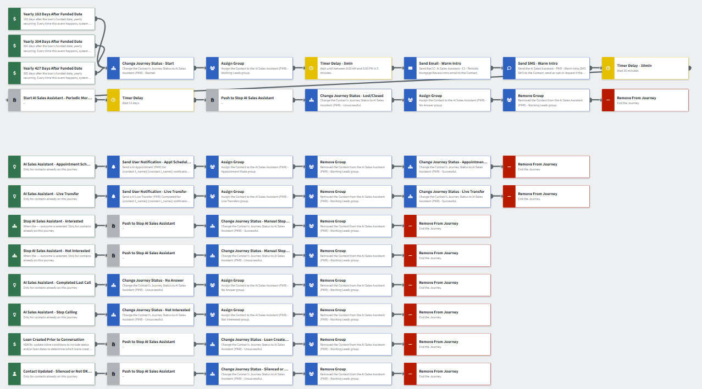
AISA - Periodic Mortgage Review
Journey Notes:
Configure On Loan Date trigger with preferred cadence and org-specific inline conditions to identify eligible borrowers. The base journey includes 6-, 10-, and 14-month post-funding check-ins that recur annually.
  Stagger timing with other campaigns, such as Customer Intelligence Equity or post-close journeys, to avoid overlap.
Review and adjust Outcomes for successful and unsuccessful conversions as needed.
Configure Loan Created Prior to Conversation trigger with org-specific inline conditions to isolate relevant loan types, statuses, or dates.
Notes:
This page should be used for JOURNEY WIREFRAMES (duplicate as needed)

Slide 20
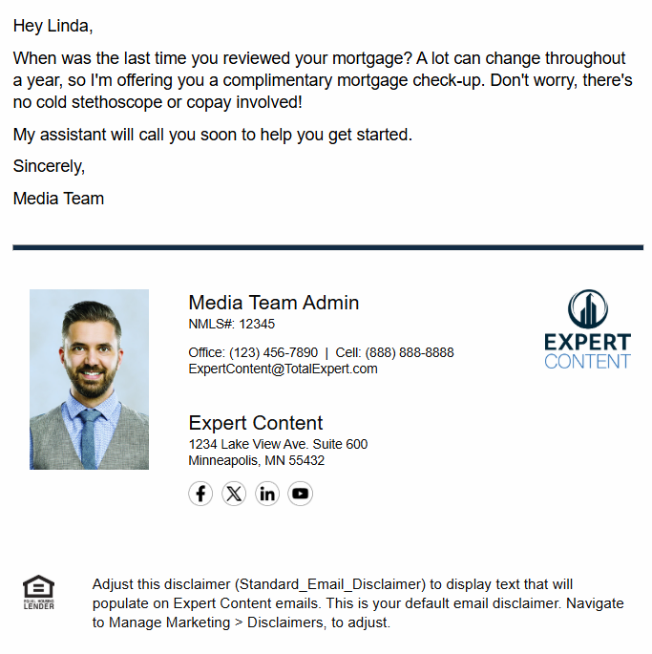
AISA - Periodic Mortgage Review
Email Subject Line: Healthier home financing starts with a mortgage check-up.
Hey {{recipient.f_name}},
When was the last time you reviewed your mortgage? A lot can change throughout a year, so I'm offering you a complimentary mortgage check-up. Don't worry, there's no cold stethoscope or copay involved!
My assistant will call you soon to help you get started.
Sincerely,
{{sender.f_name}}
**Recommend including the assistant’s name and changing to “AI Assistant” if required by compliance.
Notes:
This page should be used for EMAILS (duplicate as needed)

Slide 21
AISA - Periodic Mortgage Review
SMS: AI Sales Assistant - PMR - Warm Intro SMS
A mortgage checkup can keep your home loan healthy...and yours is complimentary. If you haven't heard from my assistant yet, call me at {{sender.phone_office}} so we can talk. - {{sender.f_name}} {{sender.l_name}}
Notes:
This page should be used for TASKS, USER NOTIFICATIONS, AND SMS TEMPLATES (duplicate as needed)

Slide 22
AISA - Periodic Mortgage Review
User Notification: AI Live Transfer (PMR) Completed for {{contact.f_name}} {{contact.l_name}}
The AI Assistant just completed a live transfer with you and {{contact.f_name}} {{contact.l_name}} to connect about their current mortgage.
Using the link below, please open the contact in TE to review their information and add notes and/or make a follow up task for yourself.
Contact details:
Name: {{contact.f_name}} {{contact.l_name}}
Email: {{contact.email}}
Mobile Number: {{contact.phone_cell}}
Click here to view contact.
Loan details:
Loan number: {{loan.loan_number}}
Loan amount: ${{loan.amount | formatNumber: 0}}
Loan program: {{loan.loan_program}}
Loan funded date: {{loan.funded_date | date: "m/d/Y"}}
Loan rate: {{loan.rate}}%
Contact Address: {{contact.address}} {{contact.city}}, {{contact.state}} {{contact.zipcode}}
Click here to view loan.
Notes:
This page should be used for TASKS, USER NOTIFICATIONS, AND SMS TEMPLATES (duplicate as needed)

Slide 23
AISA - Periodic Mortgage Review
User Notification: AI Appointment (PMR) for {{contact.f_name}} {{contact.l_name}}
The AI Assistant scheduled a call with you and {{contact.f_name}} {{contact.l_name}} at {{recipient.custom.conversational_ai_date_time_of_meeting}} to connect about their current mortgage.
An invite should be on your calendar for this appointment. Please review their information by opening the contact in TE using the link below and to see all notes from the call with the AI Assistant prior to your appointment.
Contact details:
Name: {{contact.f_name}} {{contact.l_name}}
Email: {{contact.email}}
Mobile Number: {{contact.phone_cell}}
Click here to view contact.
Loan details:
Loan number: {{loan.loan_number}}
Loan amount: ${{loan.amount | formatNumber: 0}}
Loan program: {{loan.loan_program}}
Loan funded date: {{loan.funded_date | date: "m/d/Y"}}
Loan rate: {{loan.rate}}%
Contact Address: {{contact.address}} {{contact.city}}, {{contact.state}} {{contact.zipcode}}
Click here to view loan.
Notes:
This page should be used for TASKS, USER NOTIFICATIONS, AND SMS TEMPLATES (duplicate as needed)

