Slide 1
Expert Content
Strategy Guide
Bank Onboarding

Slide 2
Bank Onboarding
Email or video email series
Four journey versions are provided with variation in look and feel. Each campaign includes emails detailing the benefits of the four following topics: online banking, mobile app, direct-deposit, and eStatements. There are two campaigns that include header images and body copy, and two campaigns include linked videos that describe the same information. Each campaign follows the same wireframe but offers variation in the design and the way information is presented.
*All communications should be reviewed prior to initiating the journey.

Slide 3
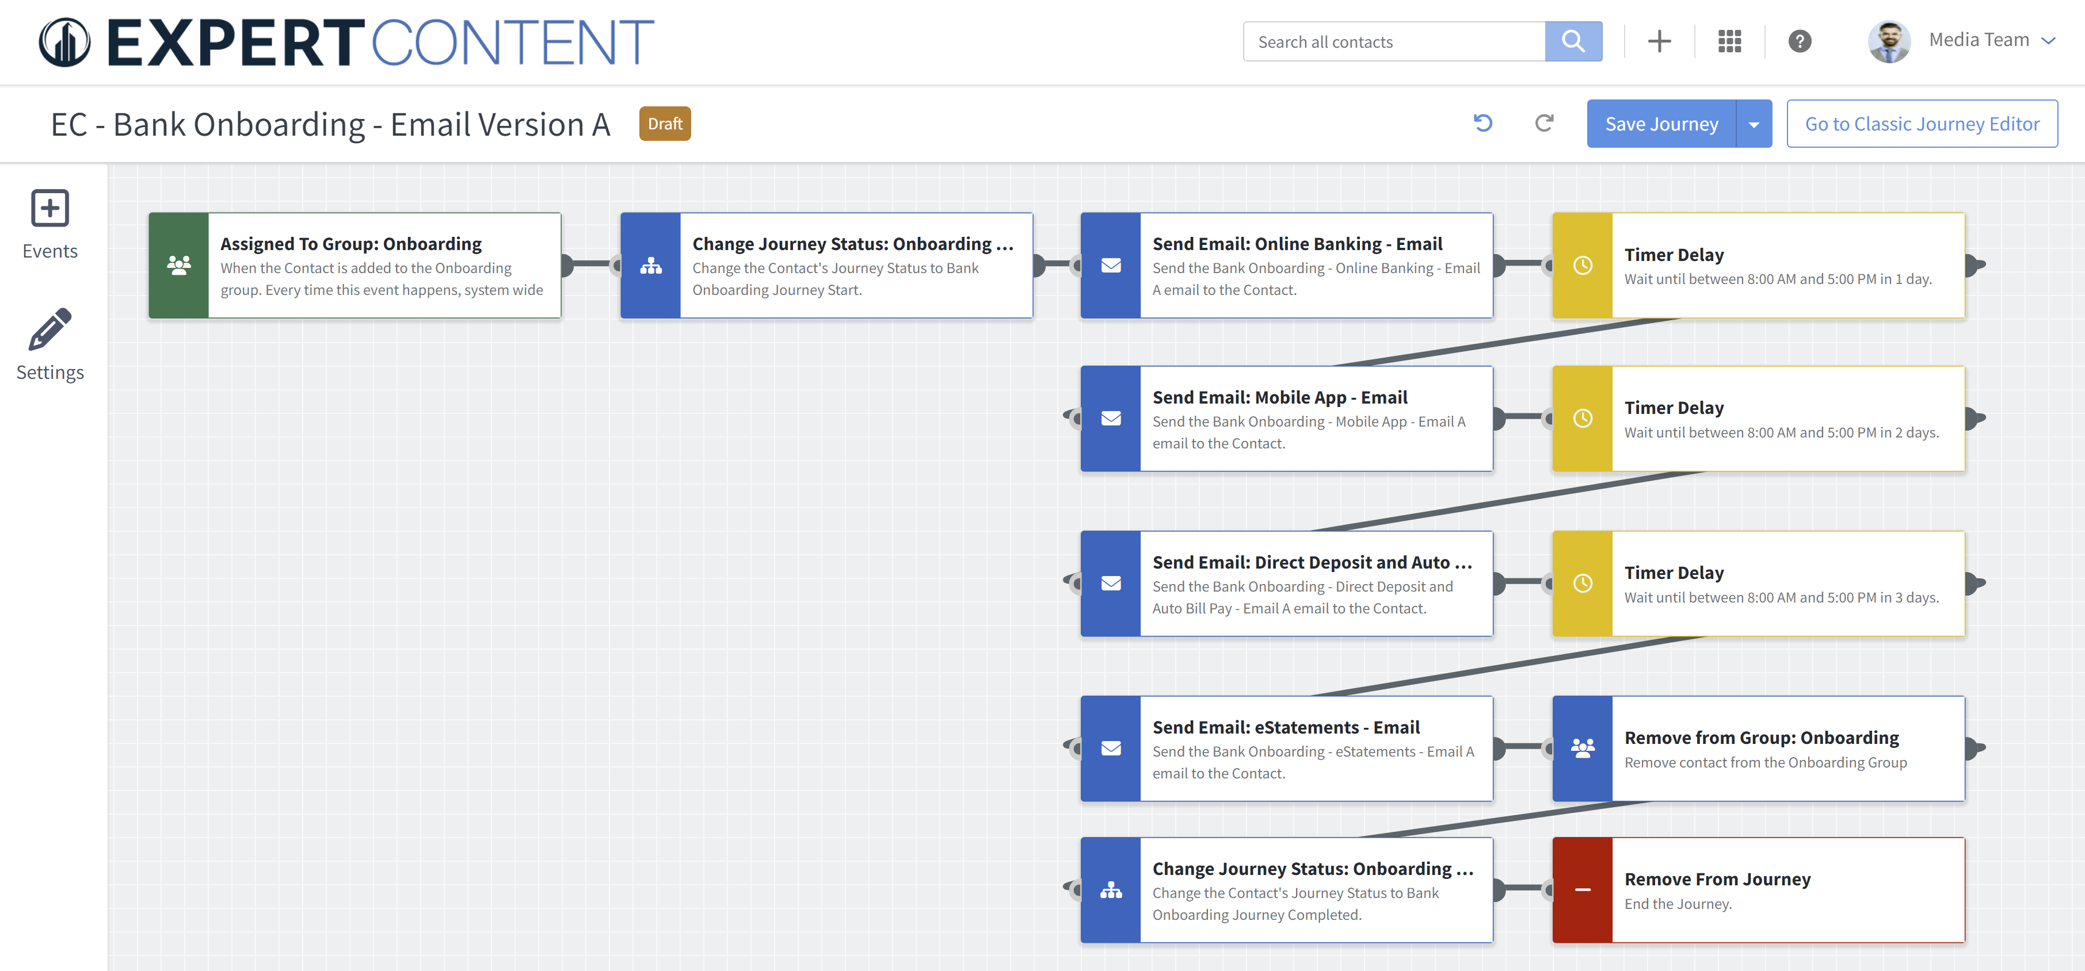
Journey Map Notes:
Contacts created in the past 1 day with a contact group of “Onboarding” will receive a series of 4 emails detailing the benefits of online banking, a mobile app, direct deposit, and eStatements.
Custom fields can be manually added throughout email content to personalize messaging further.

Slide 4
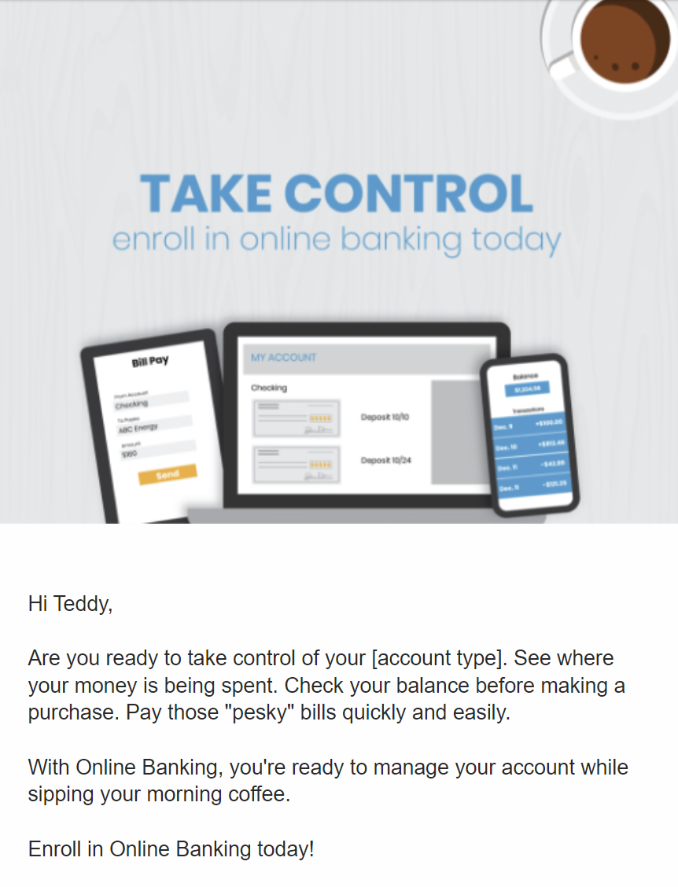
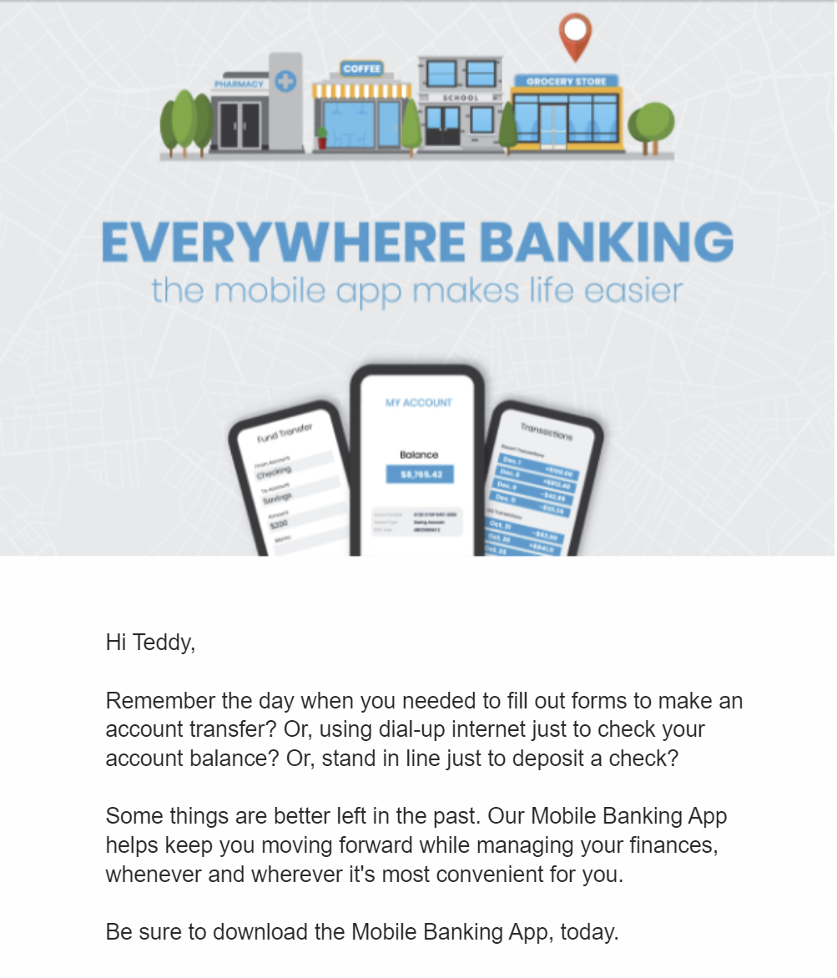
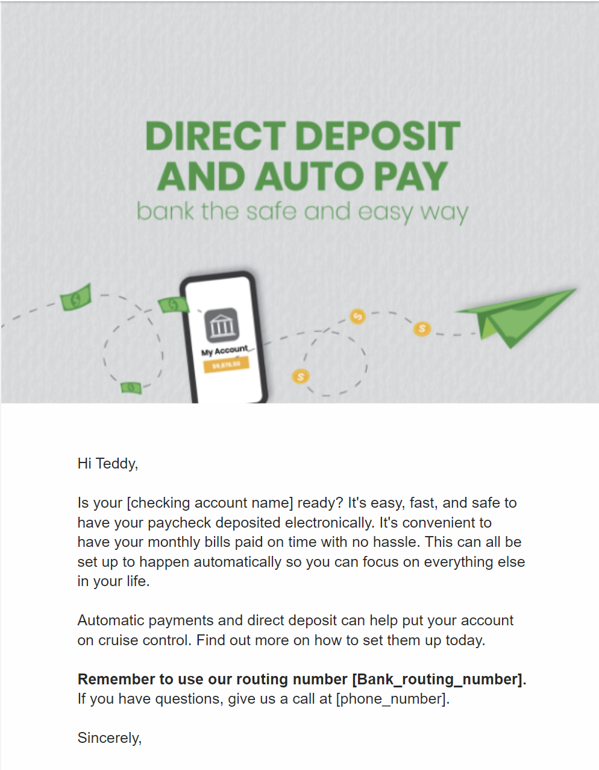
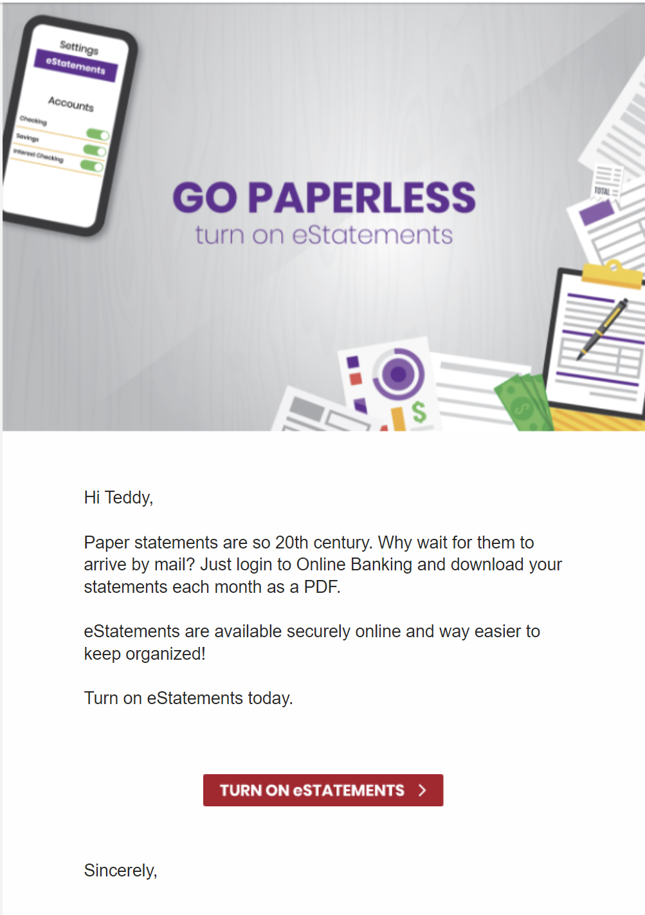
Bank Onboarding – Email Version A
Email Subject:
Bank Onboarding - Online Banking - Email A
Bank Onboarding - Mobile App - Email A
Bank Onboarding - Direct Deposit and Auto Bill Pay - Email A
Bank Onboarding - eStatements - Email A
Notes:
This page should be used for JOURNEY EMAILS (duplicate as needed)

Slide 5
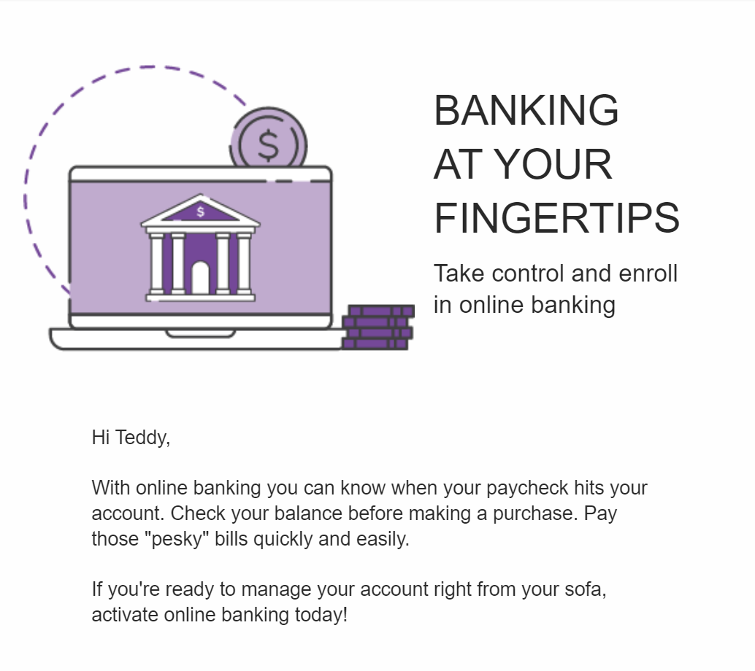
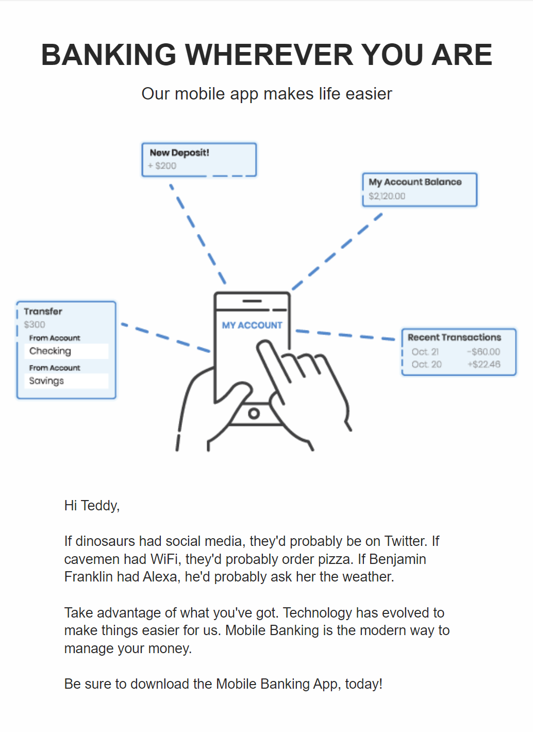
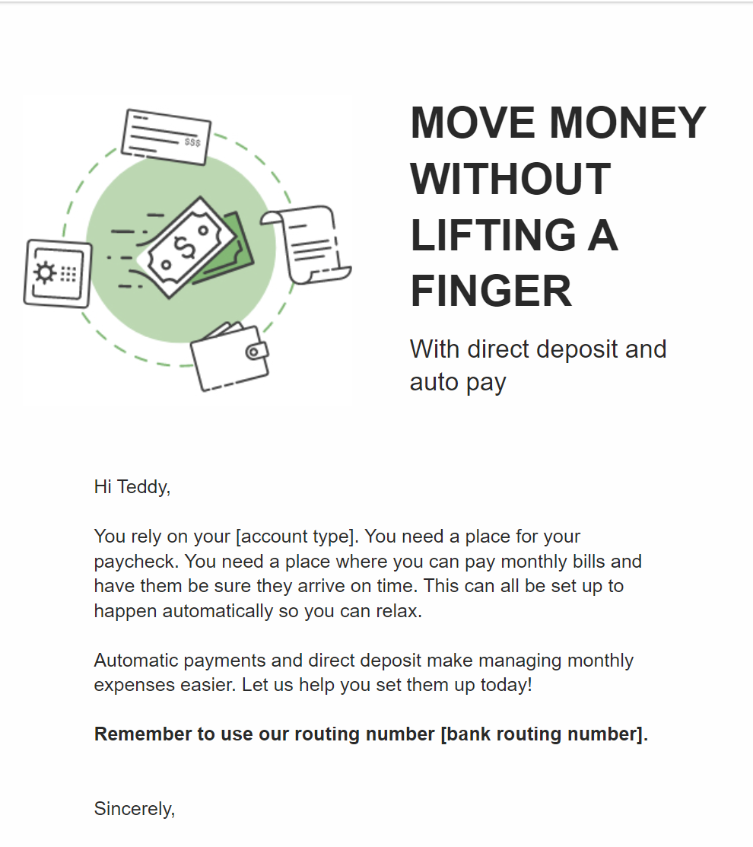
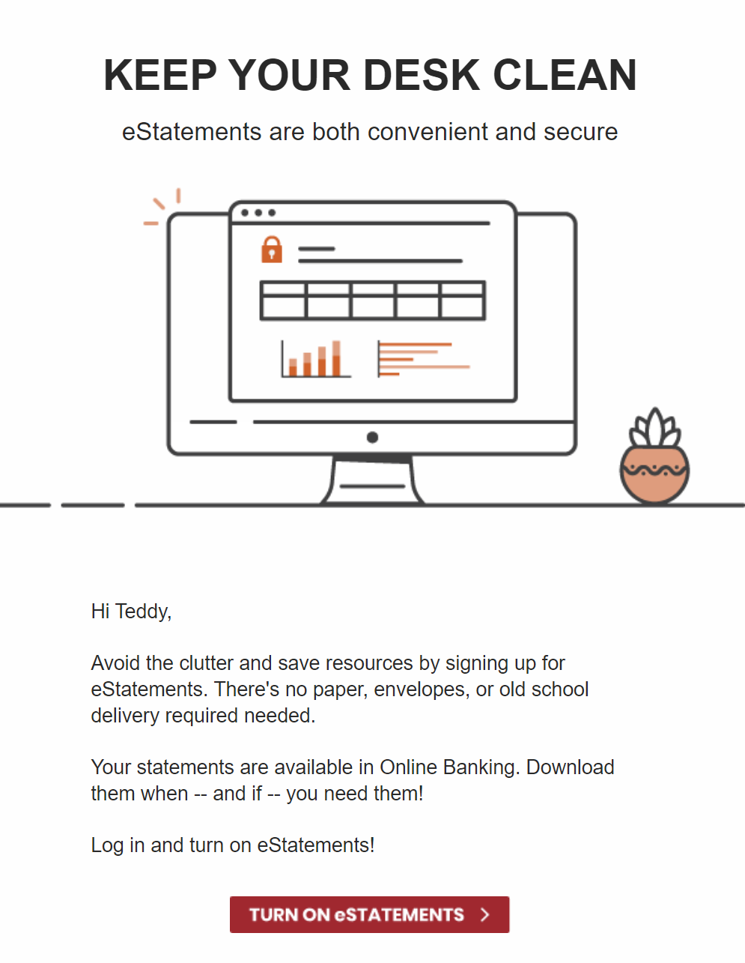
Bank Onboarding – Email Version B
Email Subject:
Bank Onboarding - Online Banking - Email B
Bank Onboarding - Mobile App - Email B
Bank Onboarding - Direct Deposit and Auto Bill Pay - Email B
Bank Onboarding - eStatements - Email B
Notes:
This page should be used for JOURNEY EMAILS (duplicate as needed)

