Slide 1
Expert Content
Strategy Guide
Savings Cross Sell

Slide 2
Savings Cross Sell
Emails only
Journey wireframe onramps contacts after a new checking account product is created. Inline trigger conditions limit contacts who already have a savings account. Admins should adjust trigger conditions to include/exclude any sub-product type(s) required for their organization (e.g. include contacts with basic checking and exclude contacts with business checking). Three emails are sent to the contact over 3 weeks educating them on the benefits of a savings account. This journey delays marketing automation for contacts included in an Onboarding group for 20 days to reduce the number of emails they receive during their onboarding period. Timing may be adjusted based on the organizations onboarding journey length.
*All communications should be reviewed prior to initiating the journey.

Slide 3
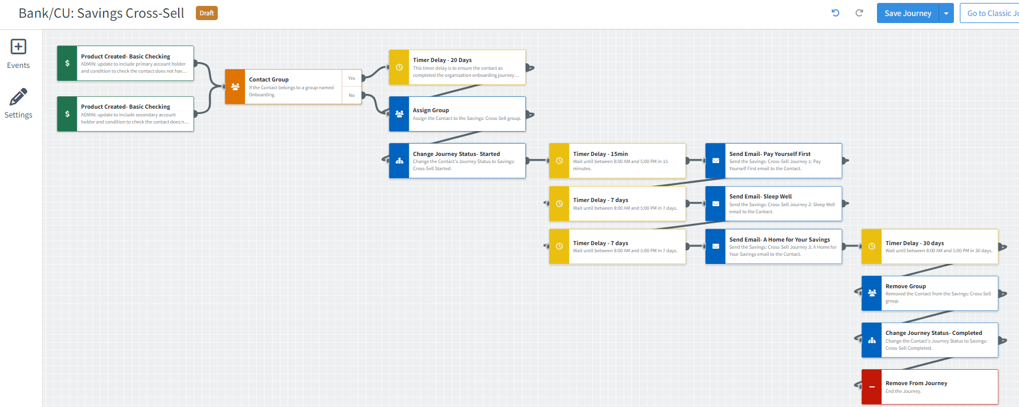
Journey Map Notes:
Adjust onramps with organization specific product types – e.g. basic checking or student checking and no savings account.
Emails may be used as-is or adjusted/replaced to meet the organization’s goals.

Slide 4
Journey Map Notes:
Contacts are added to the journey based on a new checking account product (can be modified by admins to include or exclude specific checking account types).
Contacts are removed from the journey after a savings product is created or when the email communications are complete.

Slide 5
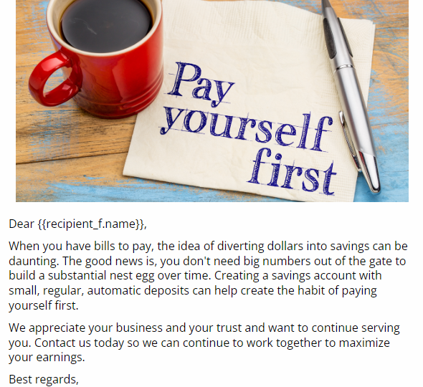
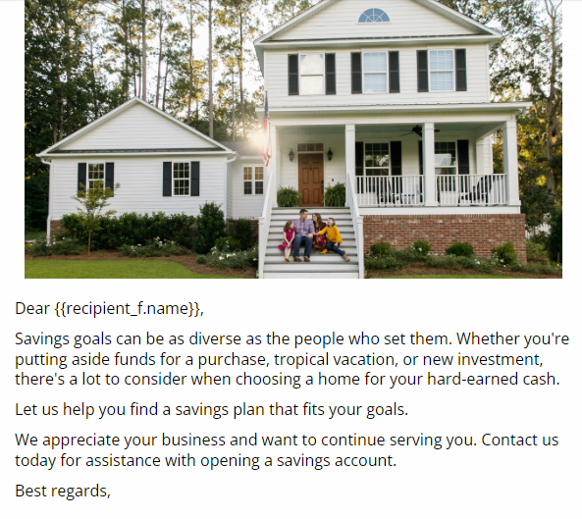
Savings Cross Sell
Email Subject:
Pay yourself first - your future will thank you.
Sleep well with an established emergency fund
A Home for Your Savings
Notes:
This page should be used for JOURNEY EMAILS (duplicate as needed)

