Slide 1
Expert Content
Strategy Guide
Bank/CU: Checking Cross-Sell
July 2025

Slide 2
Bank/CU: Checking Cross-Sell
Communication types: Email and SMS
Leverage this journey to educate contacts on the benefits of checking accounts in combination with their savings account. New savings account holders are onboarded when the account is created, cross-referencing to check for a checking account in their name, and educating on benefits of checking accounts if they don't have one already. Contacts on a bank onboarding journey/new customer journey will be delayed by 90 days to avoid crossover.
*All communications should be reviewed prior to initiating the journey.

Slide 3
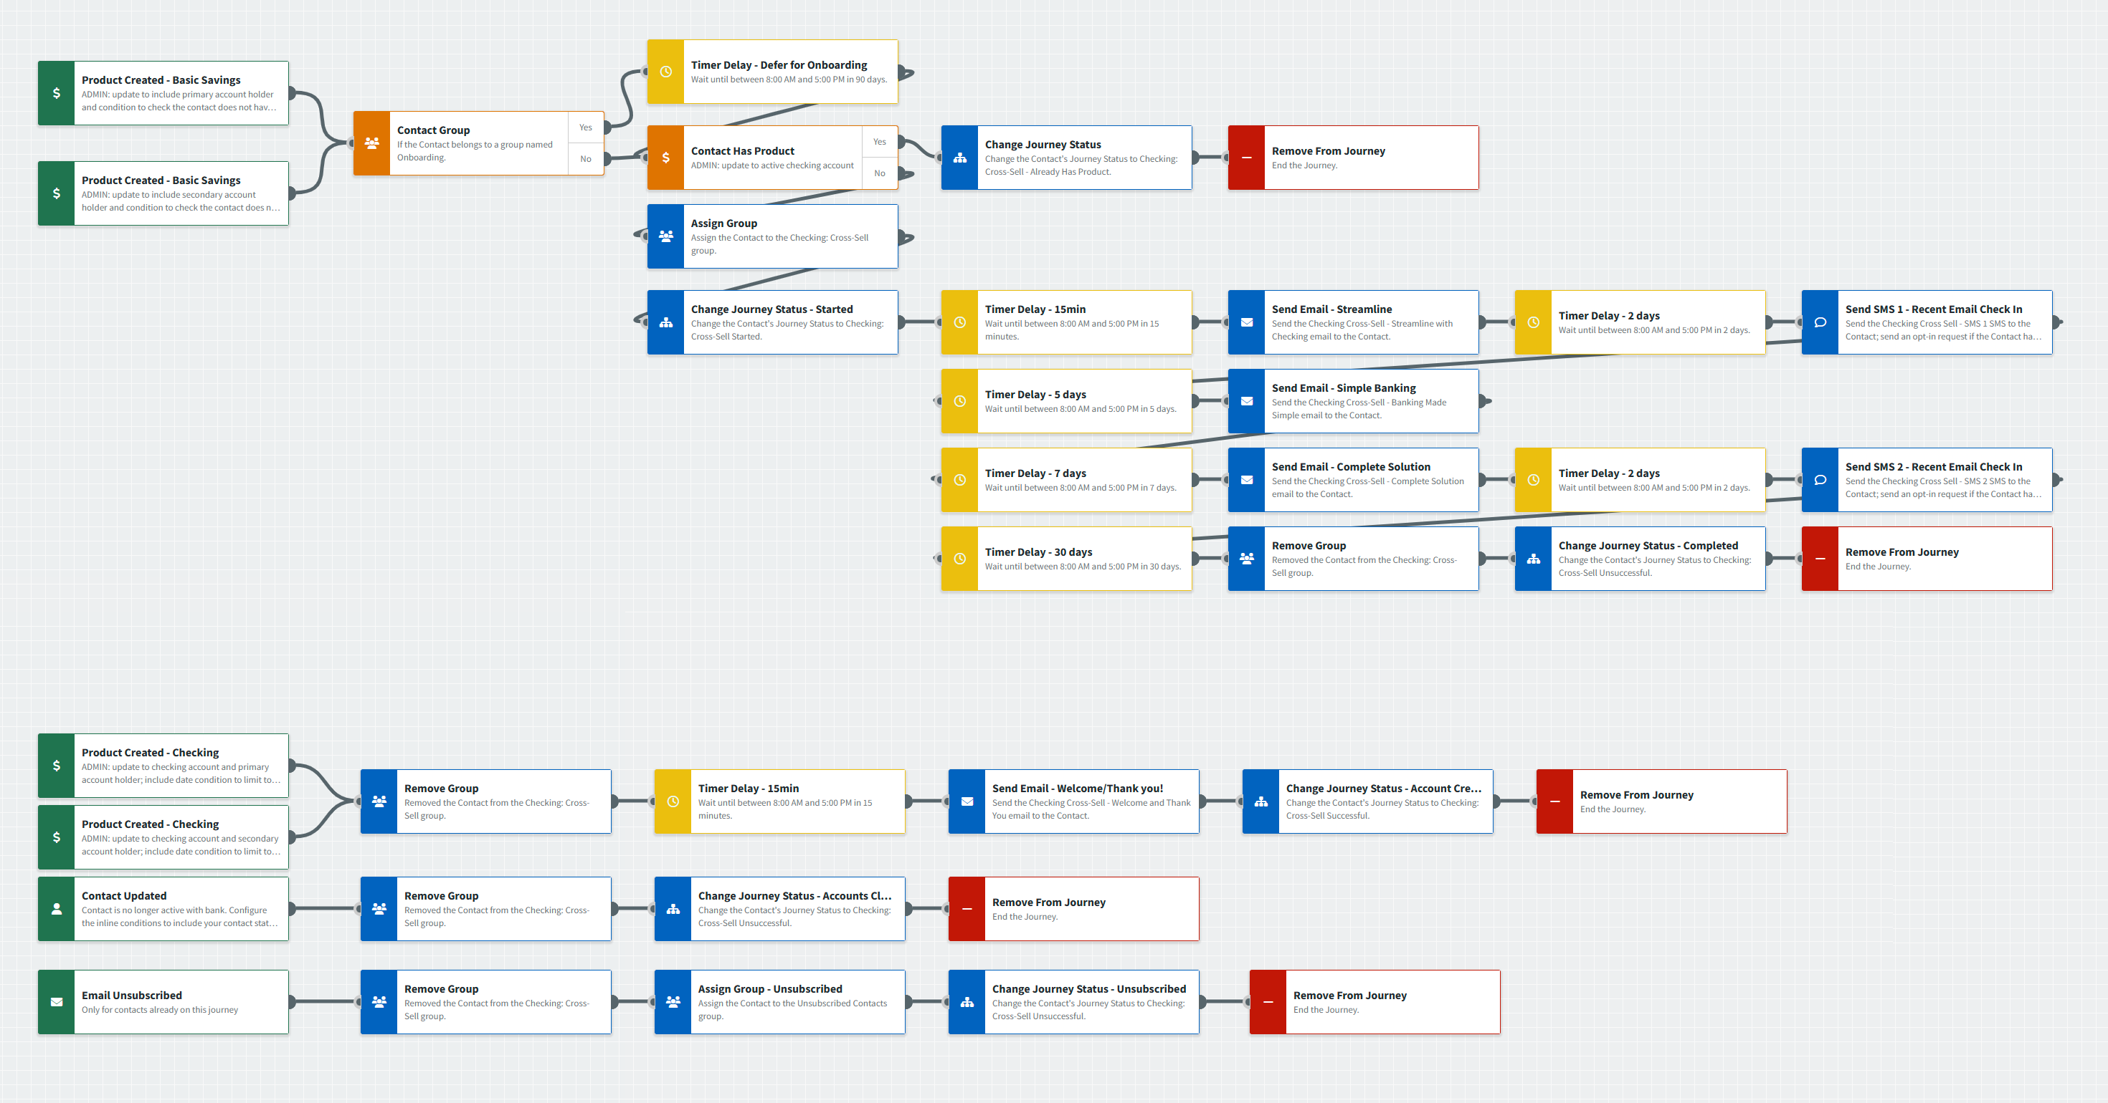
Bank/CU: Checking Cross-Sell
Journey Map Notes:
Keep emails that work for your organization, edit to meet your organization’s tone, swap with custom, or add these emails to your existing campaigns.
Adjust onramp trigger and condition components with organization specific inline conditions such as product date and value conditions.

Slide 4
Bank/CU: Checking Cross-Sell
Journey Map Notes:
Adjust offramp trigger components with organization specific inline conditions such as product date and value conditions.
Review “Welcome/Thank you!” email to determine if there is cross-over with existing Checking Onboarding campaign. If so, remove or edit the email to align with comprehensive customer experience.

Slide 5
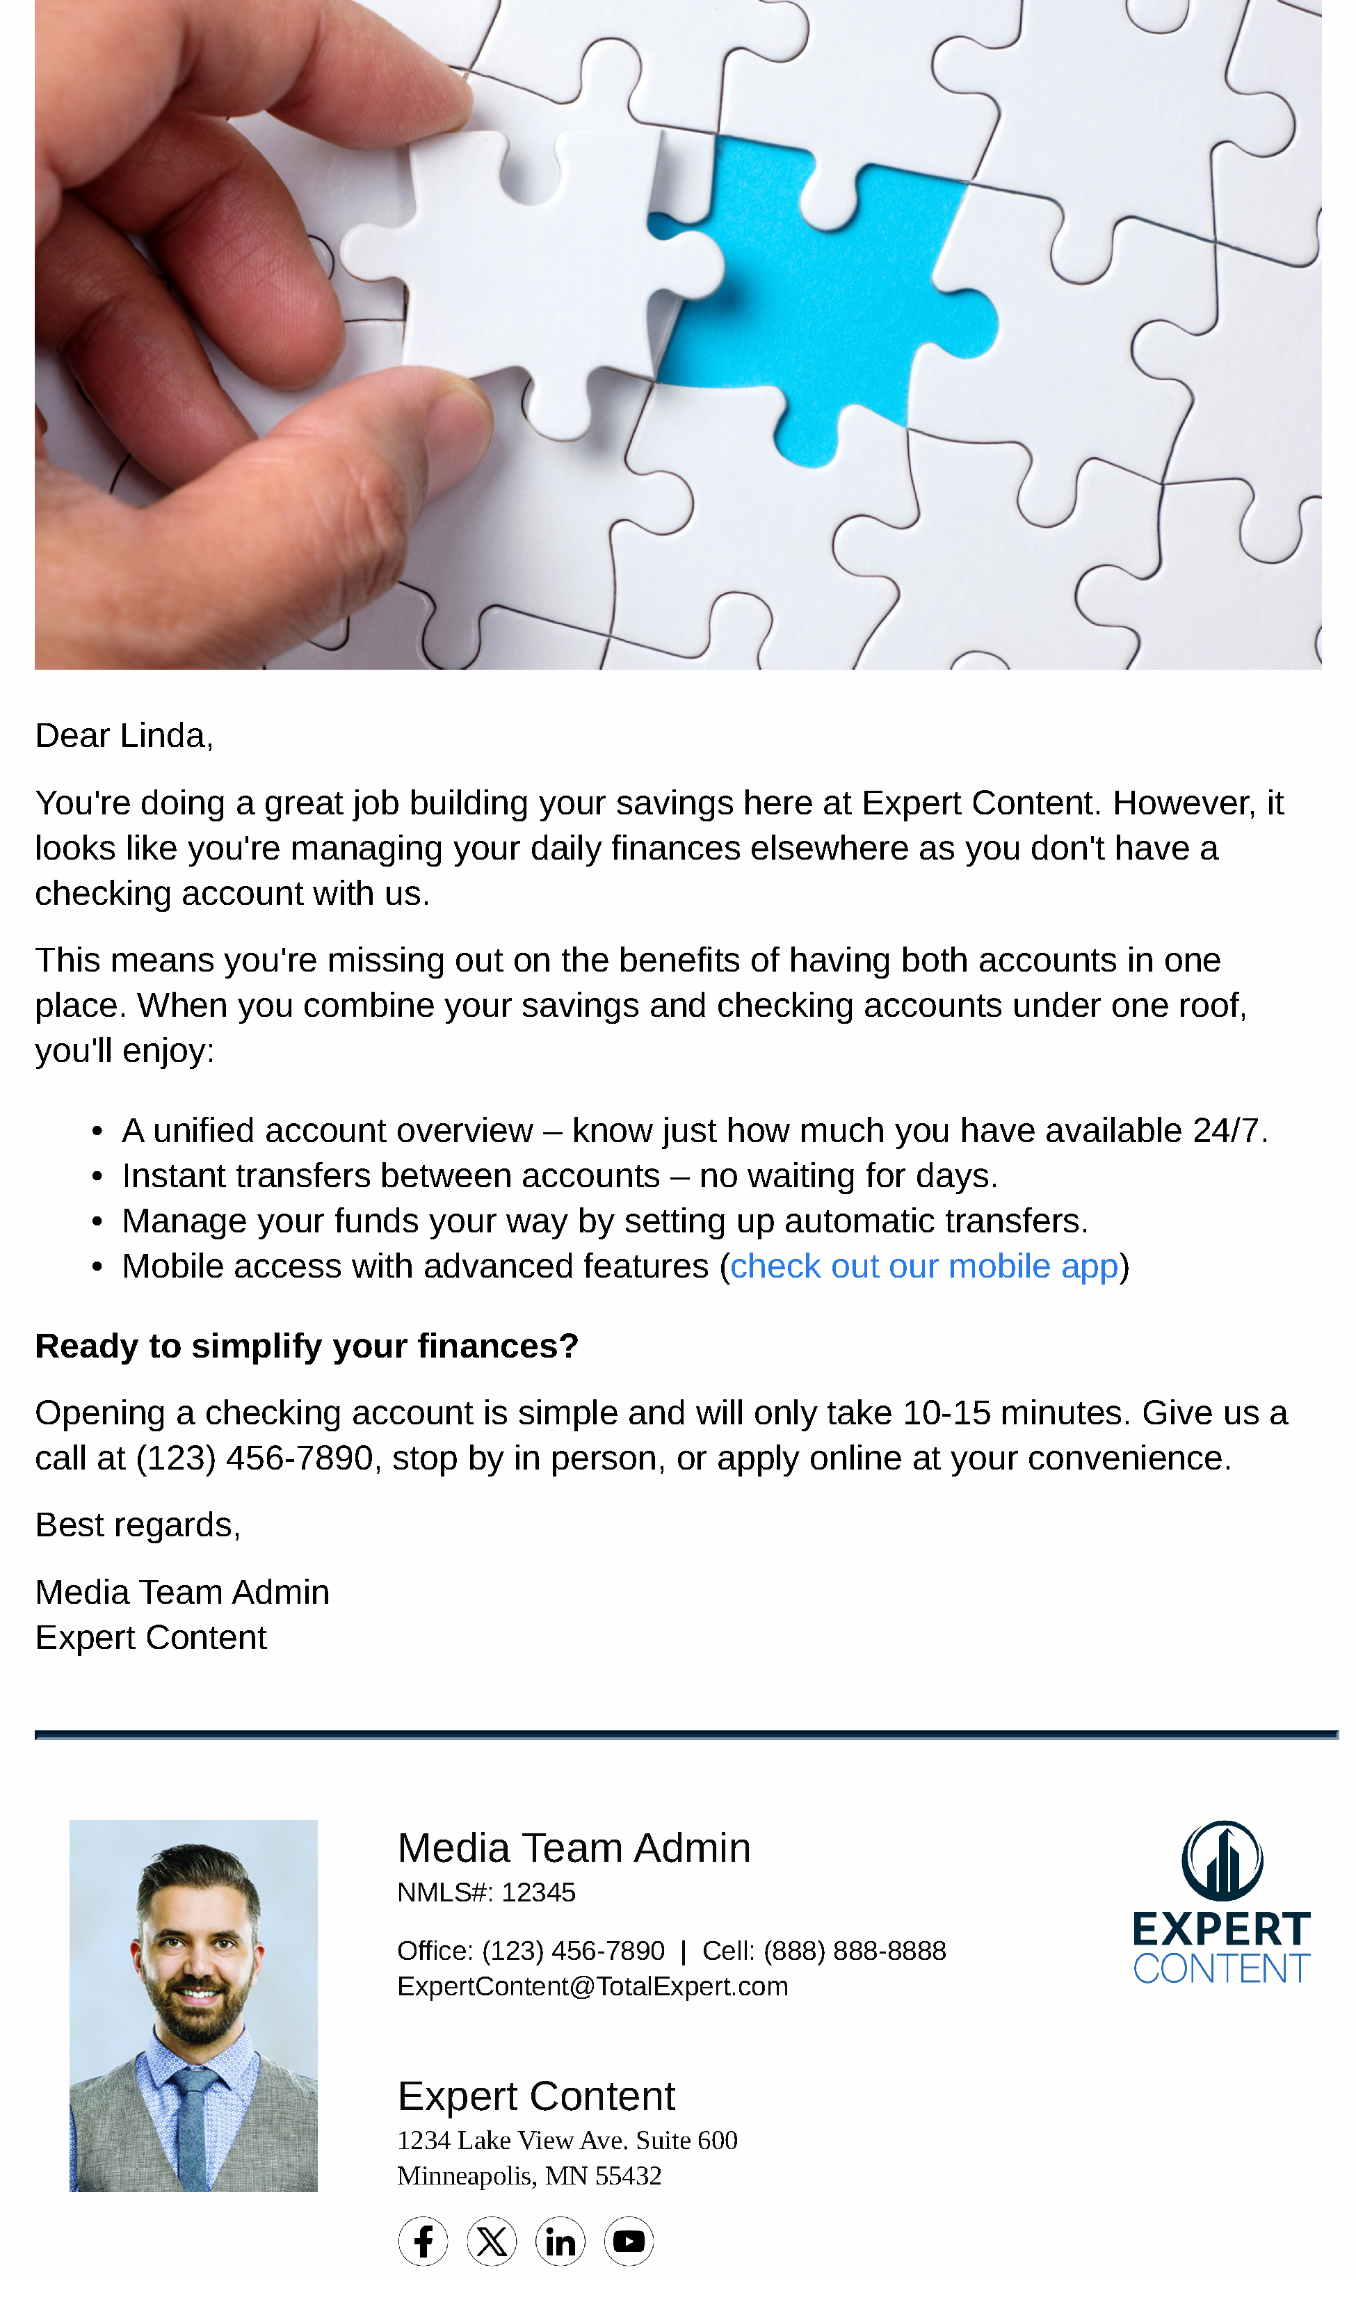
Bank/CU: Checking Cross-Sell
Email Subject Line: Checking Cross-Sell - Streamline with Checking
Dear {{recipient.f_name}},
You're doing a great job building your savings here at {{sender.company}}. However, it looks like you're managing your daily finances elsewhere as you don't have a checking account with us.
This means you're missing out on the benefits of having both accounts in one place. When you combine your savings and checking accounts under one roof, you'll enjoy:
A unified account overview – know just how much you have available 24/7.
Instant transfers between accounts – no waiting for days.
Manage your funds your way by setting up automatic transfers.
Mobile access with advanced features (check out our mobile app)
Ready to simplify your finances?
Opening a checking account is simple and will only take 10-15 minutes. Give us a call at {{sender.phone_office}}, stop by in person, or apply online at your convenience.
Best regards,
{{sender.f_name}} {{sender.l_name}}
{{sender.company}}
Notes:
This page should be used for JOURNEY EMAILS (duplicate as needed)

Slide 6
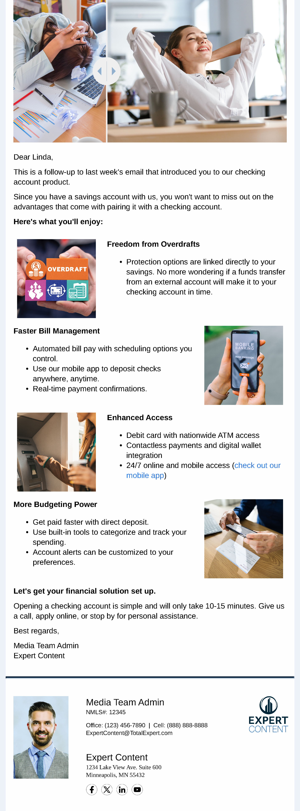
Bank/CU: Checking Cross-Sell
Email Subject Line: Checking Cross-Sell - Banking Made Simple
Dear {{recipient.f_name}},
This is a follow-up to last week's email that introduced you to our checking account product.
Since you have a savings account with us, you won't want to miss out on the advantages that come with pairing it with a checking account.
Here's what you'll enjoy:
Freedom from Overdrafts
Protection options are linked directly to your savings. No more wondering if a funds transfer from an external account will make it to your checking account in time.
Faster Bill Management
Automated bill pay with scheduling options you control.
Use our mobile app to deposit checks anywhere, anytime.
Real-time payment confirmations.
Enhanced Access
Debit card with nationwide ATM access
Contactless payments and digital wallet integration
24/7 online and mobile access (check out our mobile app)
More Budgeting Power
Get paid faster with direct deposit.
Use built-in tools to categorize and track your spending.
Account alerts can be customized to your preferences.
Let's get your financial solution set up.
Opening a checking account is simple and will only take 10-15 minutes. Give us a call, apply online, or stop by for personal assistance.
Best regards,
{{sender.f_name}} {{sender.l_name}}
{{sender.company}}
Notes:
This page should be used for JOURNEY EMAILS (duplicate as needed)

Slide 7
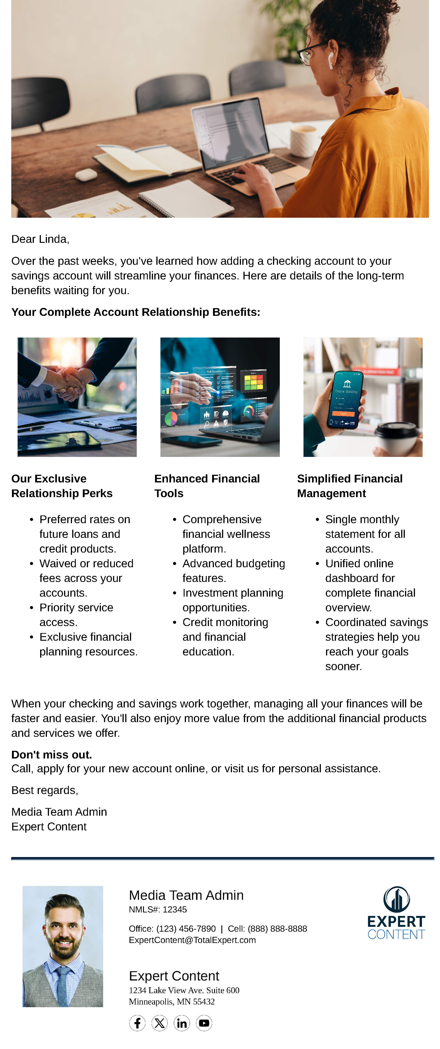
Bank/CU: Checking Cross-Sell
Email Subject Line: Checking Cross-Sell - Complete Solution
Dear {{recipient.f_name}},
Over the past weeks, you've learned how adding a checking account to your savings account will streamline your finances. Here are details of the long-term benefits waiting for you.
Your Complete Account Relationship Benefits:
Our Exclusive Relationship Perks
Preferred rates on future loans and credit products.
Waived or reduced fees across your accounts.
Priority service access.
Exclusive financial planning resources.
Enhanced Financial Tools
Comprehensive financial wellness platform.
Advanced budgeting features.
Investment planning opportunities.
Credit monitoring and financial education.
Simplified Financial Management
Single monthly statement for all accounts.
Unified online dashboard for complete financial overview.
Coordinated savings strategies help you reach your goals sooner.
When your checking and savings work together, managing all your finances will be faster and easier. You'll also enjoy more value from the additional financial products and services we offer.
Don't miss out.
Call, apply for your new account online, or visit us for personal assistance.
Best regards,
{{sender.f_name}} {{sender.l_name}}
{{sender.company}}
Notes:
This page should be used for JOURNEY EMAILS (duplicate as needed)

Slide 8
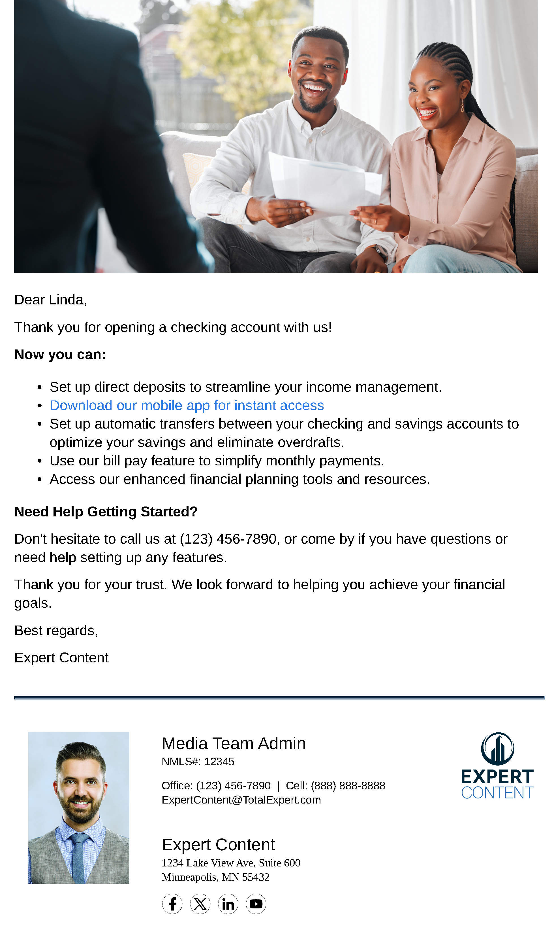
Bank/CU: Checking Cross-Sell
Email Subject Line: Checking Cross-Sell - Welcome and Thank You
Dear {{recipient.f_name}},
Thank you for opening a checking account with us!
Now you can:
Set up direct deposits to streamline your income management.
Download our mobile app for instant access
Set up automatic transfers between your checking and savings accounts to optimize your savings and eliminate overdrafts.
Use our bill pay feature to simplify monthly payments.
Access our enhanced financial planning tools and resources.
Need Help Getting Started?
Don't hesitate to call us at {{sender.phone_office}}, or come by if you have questions or need help setting up any features.
Thank you for your trust. We look forward to helping you achieve your financial goals.
Best regards,
{{sender.company}}
Notes:
This page should be used for JOURNEY EMAILS (duplicate as needed)

Slide 9
Bank/CU: Checking Cross-Sell
Checking Cross Sell - SMS 1
Hi {{recipient.f_name}}, this is {{sender.company}}. We recently emailed you with the benefits you'll enjoy when consolidating your savings and checking accounts. Give us a call to assist or apply online today!
Checking Cross Sell - SMS 2
{{recipient.f_name}}, As a savings account holder, you’ll qualify for lots of special perks when you add our checking account. Ready to simplify everything? Call {{sender.phone_office}} or stop in to learn more!
Notes:
This page should be used for Tasks, User Notifications, and SMS templates (duplicate as needed)

