Slide 1
Expert Content
Strategy Guide
Stair Stepping Cross Sell

Slide 2
Stair Stepping Cross Sell
Emails only
Journey wireframe onramps contacts over $5k in total deposit balance and further identifies relevant products to four separate thresholds of total deposit balance. Admins will need to confirm contact-level field that aggregates total deposit account balances. This is used to trigger and segment the contacts through the journey. Admins can use the thresholds and associated products as-is or adjust based on their organization’s needs.
$50k+ balance: investment products
$25k+ balance: certificate of deposits
$15k+ balance: money market accounts
$5k+ balance: savings and budgeting products
*All communications should be reviewed prior to initiating the journey.

Slide 3
Journey Map Notes:
Adjust onramps with organization specific contact fields leveraging an aggregate deposit balance field.
Contacts at each account balance level receive an automated email with a relevant product for their balance. Admins can adjust the balance thresholds or related products that best fit their organization.

Slide 4
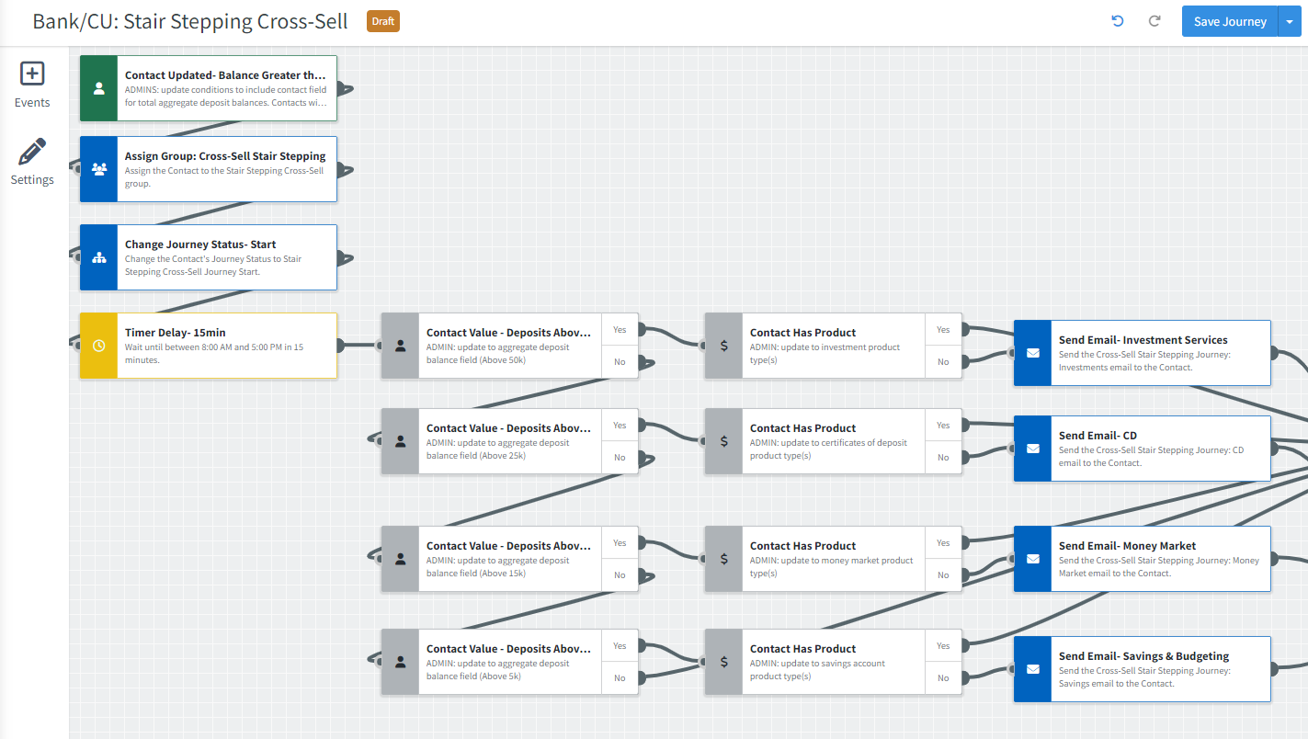
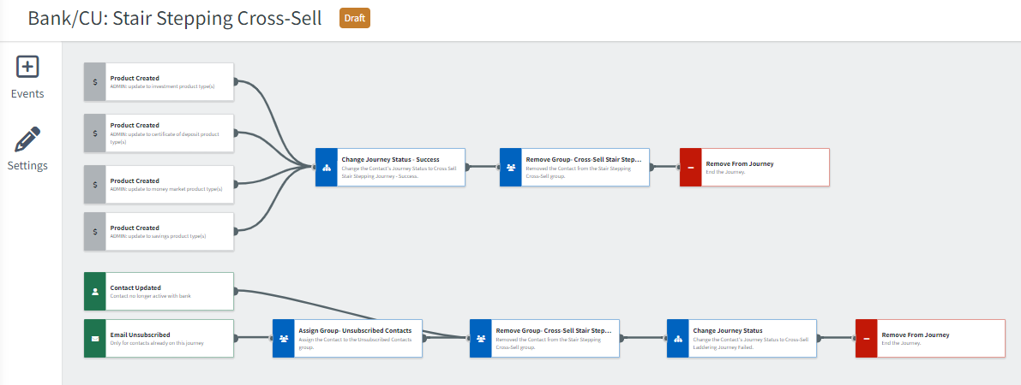
Journey Map Notes:
Contacts are added to the journey based on an update to their total account balance (over $5k) and further segmented by threshold to market specific products.
Contacts are removed if they’ve created one of the four marketed products or already have all four. Contacts will remain on the journey after a marketed email is sent for 30 days. If no product created within that waiting period, they are removed.

Slide 5
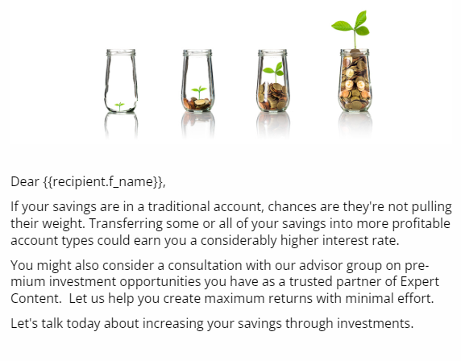
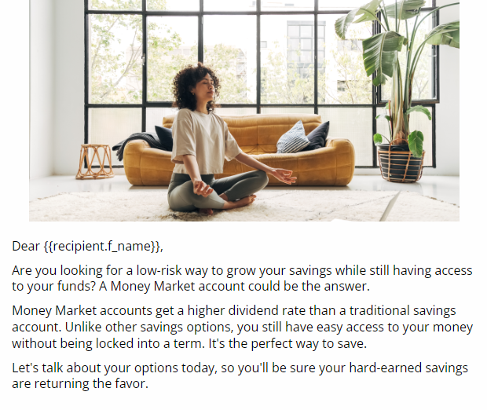
Stair Stepping Cross Sell
Email Subject:
If your savings are snoozing in a low-interest account, let's wake them up.
Your savings will work harder as a Certificate of Deposit (CD).
Low risk growth with access to your funds - a win-win!
Lay the foundation for your financial success.
Notes:
This page should be used for JOURNEY EMAILS (duplicate as needed)

