Slide 1
Expert Content
Strategy Guide
Birthday Email Journey
May 2025

Slide 2
Birthday Email Journey
Communication types: Email
Four (4) emails to celebrate the recipient’s birthday. Contacts are added to the journey on their birthday and will loop back to the first email on year five (5). This lifetime journey is meant to keep users and/or companies in front of contacts but not to sell or market a product.
*All communications should be reviewed prior to initiating the journey.

Slide 3
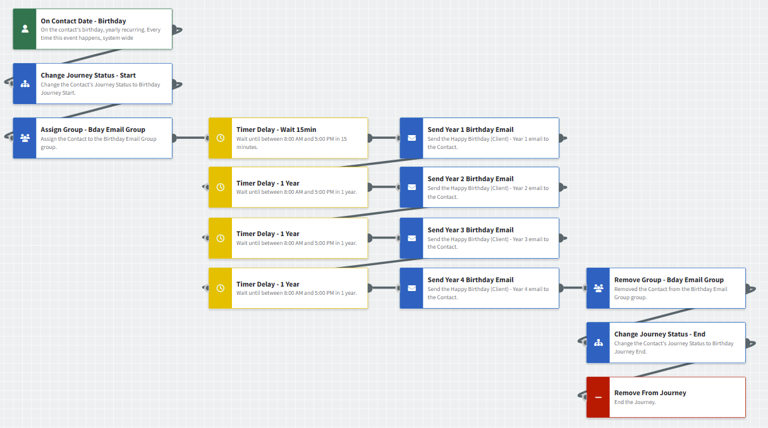
Birthday Email Journey
Journey Notes:
Keep emails that work for your organization, swap with custom, or add these emails to your existing campaigns.
Adjust onramps with organization specific groups, Manually Add Contact, or other applicable triggers.
Notes:
This page should be used for JOURNEY WIREFRAMES (duplicate as needed)

Slide 4
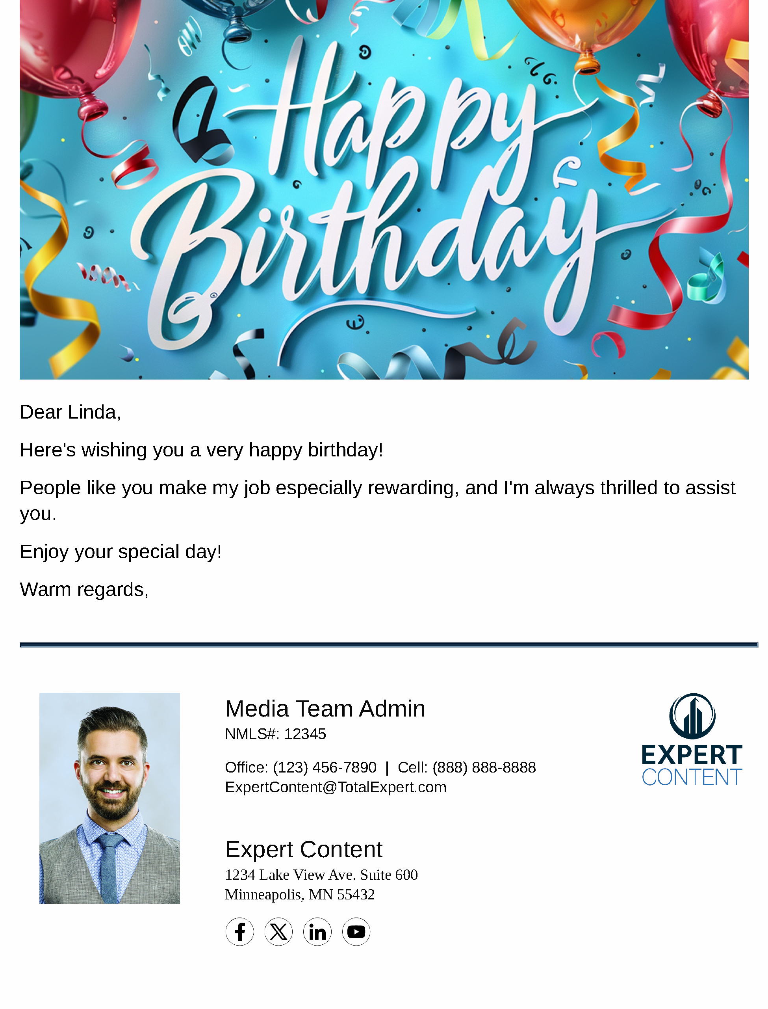
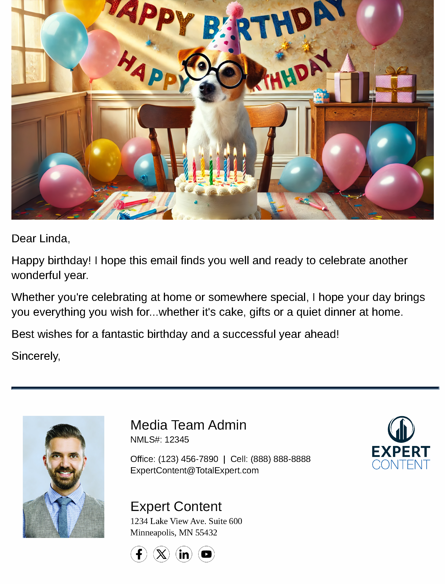
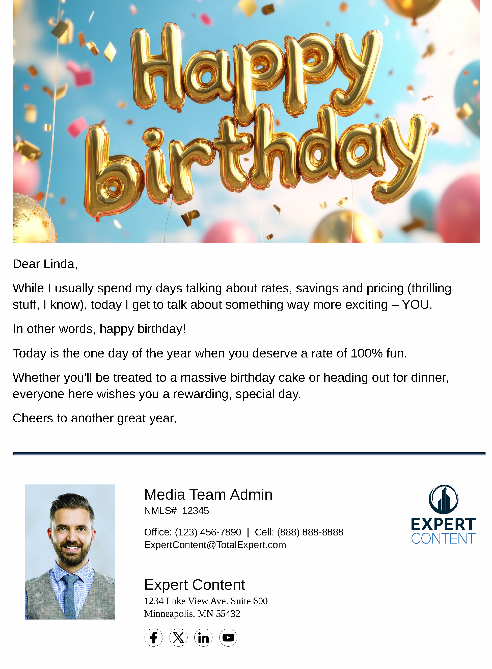
Birthday Email Journey
Email Subject Lines:
Happy Birthday from Everyone at {{sender.company}}!
A Birthday Wish for You
Another Year. Another Birthday.
Notes:
This page should be used for JOURNEY EMAILS (duplicate as needed)

Slide 5
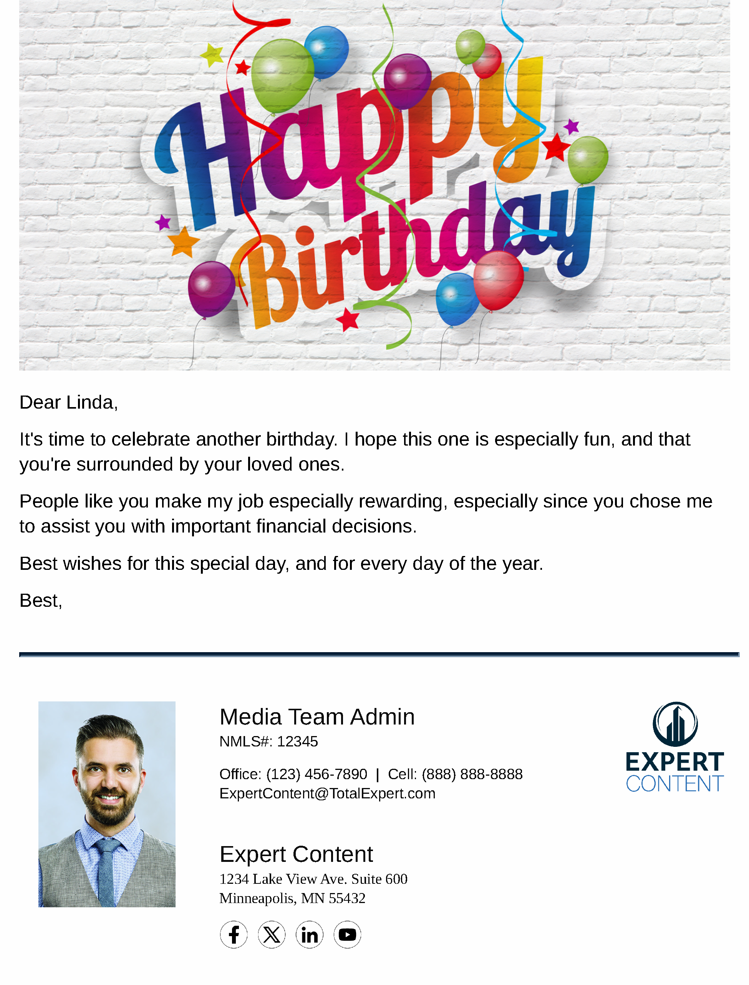
Birthday Email Journey
Email Subject Lines:
Happy Cake Day!
Notes:
This page should be used for JOURNEY EMAILS (duplicate as needed)

