Slide 1
Expert Content
Strategy Guide
Birthday Video Journey
May 2025

Slide 2
Birthday Video Journey
Communication types: Email with dynamic videos
Three (3) emails with dynamic videos celebrate the recipient’s birthday. Videos include the recipient’s first name. Contacts are added to the journey on their birthday and will loop back to the first video email on year four (4). This lifetime journey is meant to keep users and/or companies in front of contacts but not to sell or market a product.
*All communications should be reviewed prior to initiating the journey.

Slide 3
Birthday Video Journey
Journey Map Notes:
Keep emails that work for your organization, swap with custom, or add these emails to your existing campaigns.
Adjust onramps with organization specific groups, Manually Add Contact, or other applicable triggers.

Slide 4
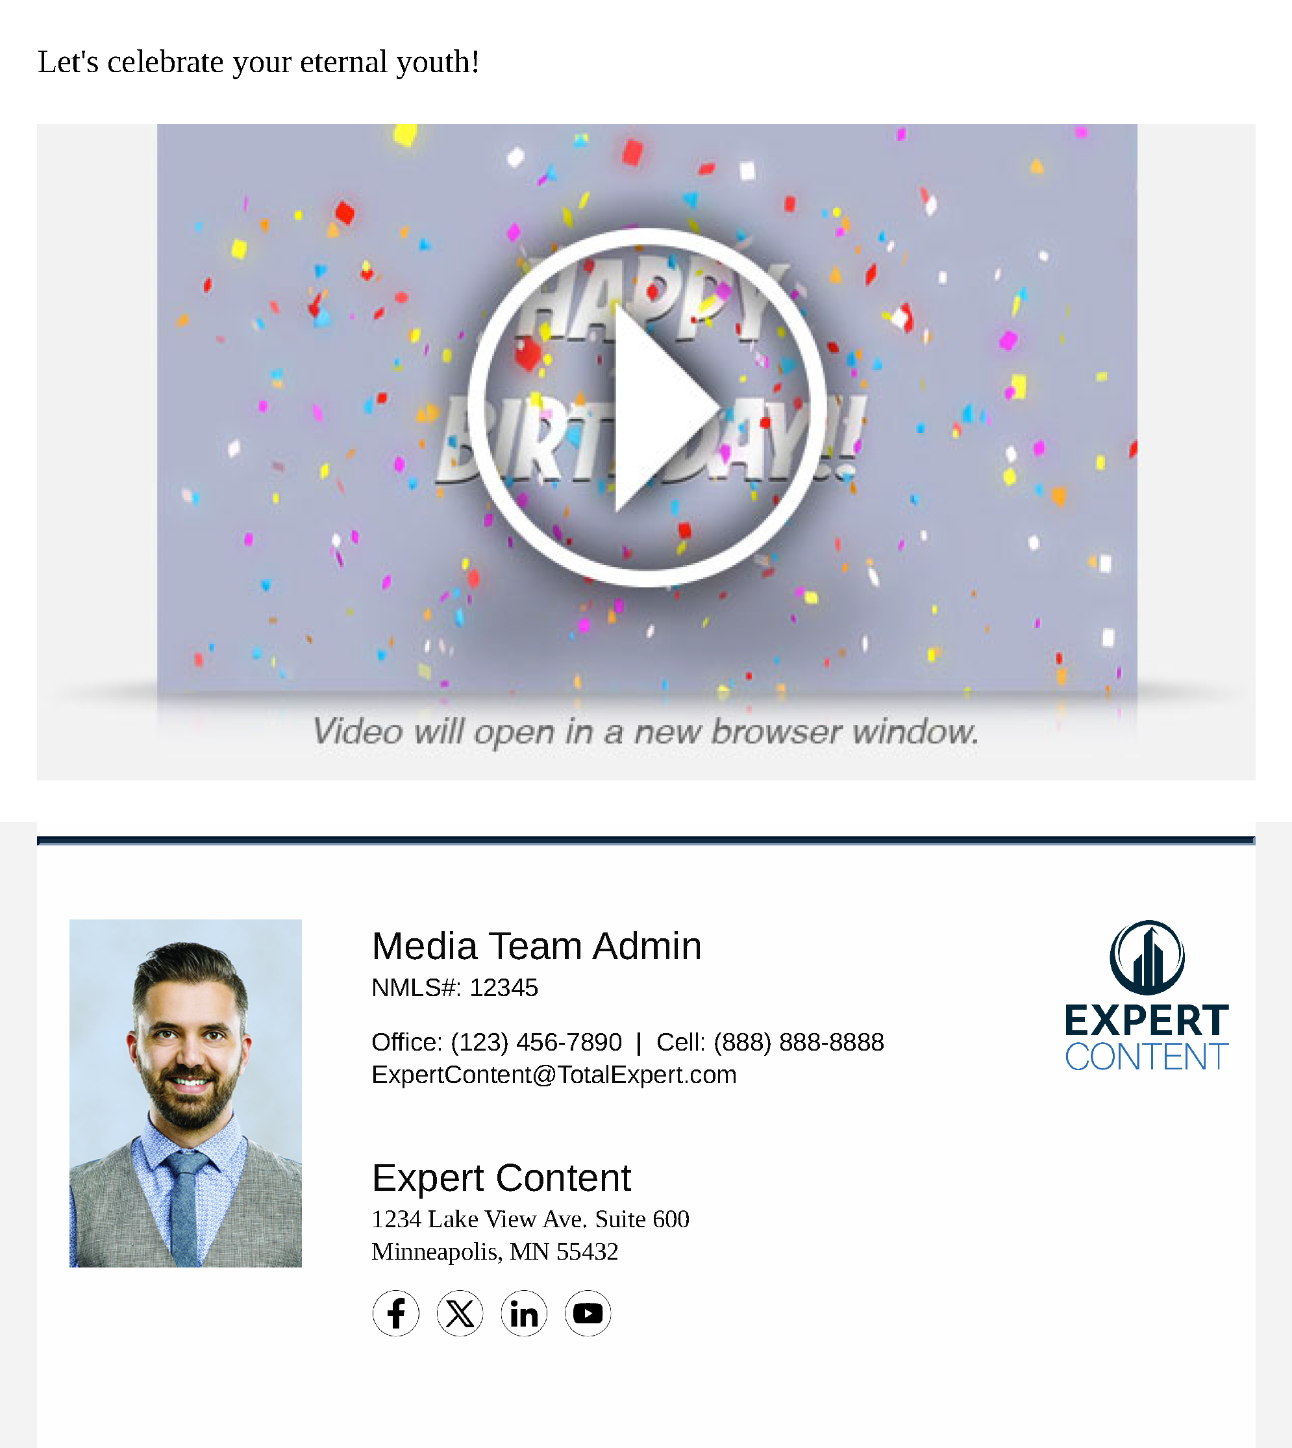
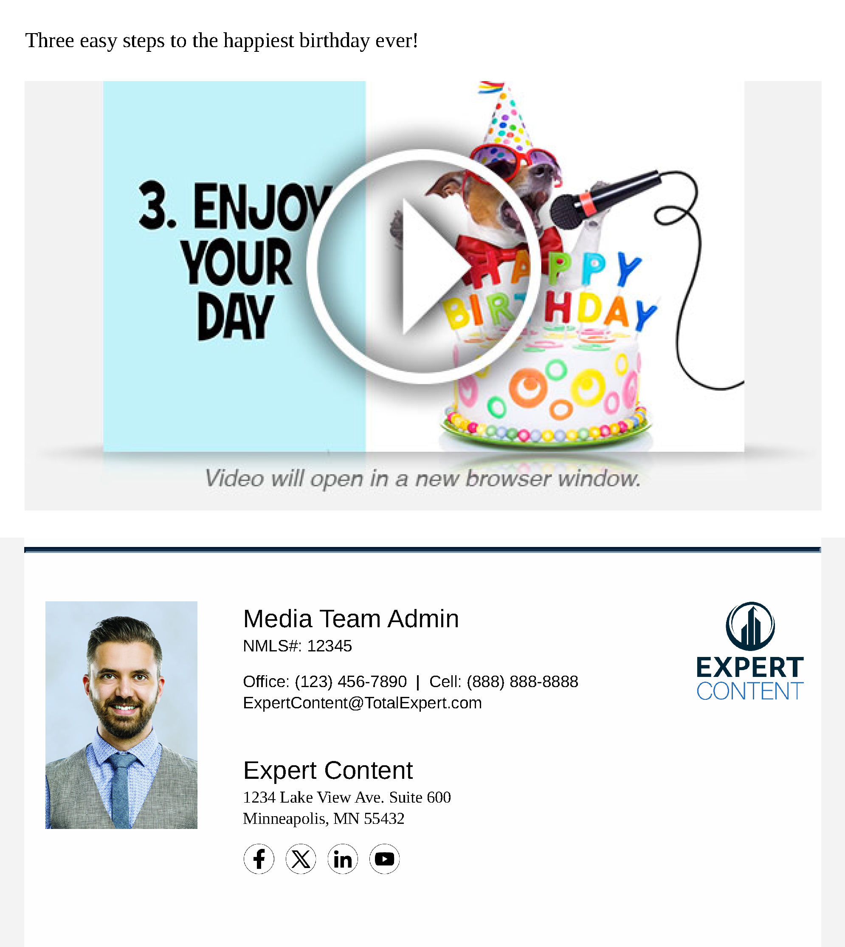
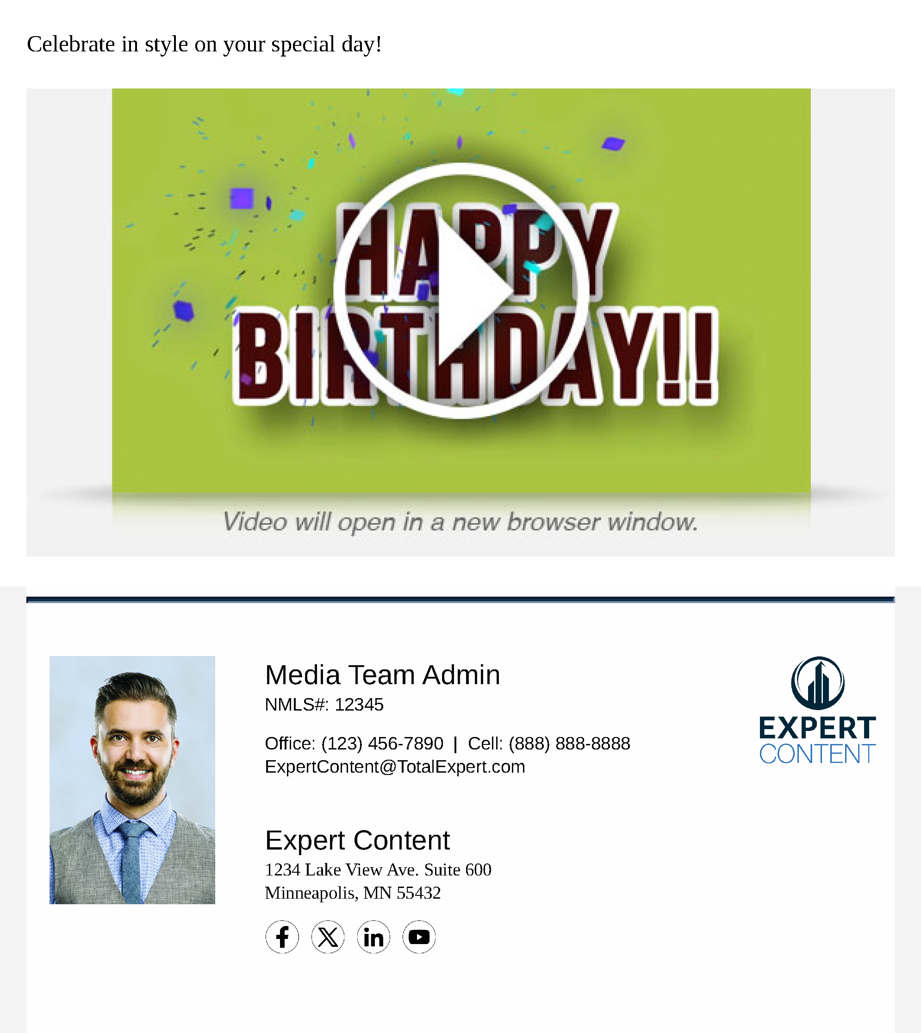
Birthday Video Journey
Email Subject Lines:
Look at it this way: you’re wiser
Go on – tell us your wish
Feeling festive?
Notes:
This page should be used for JOURNEY EMAILS (duplicate as needed)

