Slide 1
Expert Content
Strategy Guide
Business Cards
July 2025

Slide 2
Business Cards
The business card library is intended to be a standard offering from which admins can configure and build out a larger offering. Some designs default to non-branded colors but can be updated for dynamic primary and secondary colors. This strategy guide shows the default designs. Then, it shows a variation of each design to give you an idea of what can be created from the default. If users don’t have profile images, license numbers or other values in their profile, those will collapse during the user creation process.
Toggle options:
Background and text colors: change to primary/secondary, HEX#/RGB; in some designs, background images can be added
Logo variations: choose between stacked, horizontal, black, white or standard; choose a background color or transparency for the logo
NMLS#/License title: (e.g. change from NMLS# to License # or NPN)
Cell/Office number title: (e.g. change from Office to Business)
End user editability: choose whether end users can edit elements of the design (contact fields, logo, QR code)
QR codes: choose between QR Code 1 or 2 from user profiles; visibility
Disclaimer/EH logos: color and visibility; disclaimer minimum and maximum font size

Slide 3
Business Cards
Front Customization:
Background and font color
“NMLS#:” title
Back Customization:
Background color or image upload
Disclaimer text and EHO/EHL visibility and color
Logo variations and visibility
Notes:
This page should be used for PRINT FLYERS (duplicate as needed)

Slide 4
Business Cards
Front Customization:
Background and font color
“NMLS#:” title
Back Customization:
Background color or background image
Disclaimer text and EHO/EHL visibility and color
Logo variations and visibility
Notes:
This page should be used for PRINT FLYERS (duplicate as needed)

Slide 5
Business Cards
Front Customization:
Background and font color
Background image upload
Back Customization:
Background and font color
Disclaimer text and EHO/EHL visibility and color
“NMLS#:” title
Notes:
This page should be used for PRINT FLYERS (duplicate as needed)

Slide 6
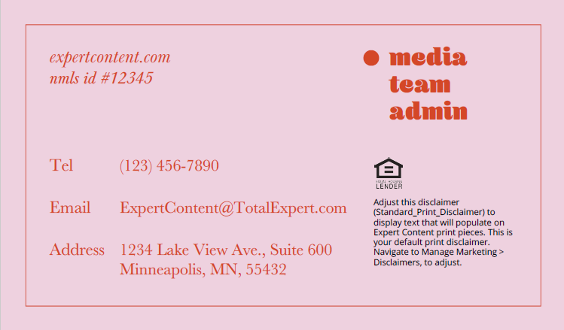
Business Cards
Front Customization:
Background and font color
Background image upload
Title text
Back Customization:
Background and font color
Border color
Disclaimer text and EHO/EHL visibility and color
“NMLS#:” title
Notes:
This page should be used for PRINT FLYERS (duplicate as needed)

Slide 7
Business Cards
Front Customization:
Background and font color
Background image upload
End user editability (all on/off)
Logo variations and visibility
Back Customization:
Background and font color
Background image upload
Disclaimer and EHO/EHL visibility and color
“NMLS#:” title
QR code variations, visibility and editability
Notes:
This page should be used for PRINT FLYERS (duplicate as needed)

Slide 8
Business Cards
← Front Customization
Background and font color
End user editability (all on/off)
Logo variations and visibility
“NMLS ID#” title (changes both front and back)
Back Customization →
Background and font color
Background image upload
Disclaimer text and EHO/EHL visibility and color
Notes:
This page should be used for PRINT FLYERS (duplicate as needed)

Slide 9
Business Card “Static” Templates
Upload completed designs into horizontal or vertical templates to print through Total Expert. Admins can also allow end users to upload their own finished designs to be printed through the platform. It’s recommended that approval flows are on in this case.
Notes:
This page should be used for PRINT FLYERS (duplicate as needed)

Slide 10
Business Card
Example variations of business card designs using admin toggles to configure and create additional assets.

Slide 11
Business Card Variation Example
Use the settings below to take the default business card (left) to the example variation (right).
Background color: page 1 – secondary; page 2 - primary
Front page text color: primary
Back page text color: white
Disclaimer/EHL logo color: white
Logo variation: brand_user_logo_horizontal_white
Default
Example Variation
Notes:
This page should be used for PRINT FLYERS (duplicate as needed)

Slide 12
Business Card Variation Example
Use the settings below to take the default business card (left) to the example variation (right).
Background color: page 1 – black; page 2 - secondary
Front page text color: white
Disclaimer/EHL logo color: black
Logo variation: brand_user_logo_horizontal_black
Default
Example Variation
Notes:
This page should be used for PRINT FLYERS (duplicate as needed)

Slide 13
Business Card Variation Example
Use the settings below to take the default business card (left) to the example variation (right).
Background color: page 1 – primary; page 2 - white
Front page text color: secondary
Back page text color: primary
Disclaimer/EHL logo color: black
Default
Example Variation
Notes:
This page should be used for PRINT FLYERS (duplicate as needed)

Slide 14
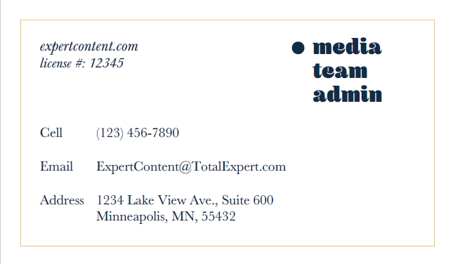
Business Card Variation Example
Use the settings below to take the default business card (left) to the example variation (right).
Background color: page 1 – primary; page 2 – white
Title override: “Hey!”
Front page text color: secondary
Back page text color: primary
Back page border color: secondary
NMLS# title override: “license #:”
Tel title override: “Cell”
Disclaimer/EHL logo color: not visible
Default
Example Variation
Notes:
This page should be used for PRINT FLYERS (duplicate as needed)

Slide 15
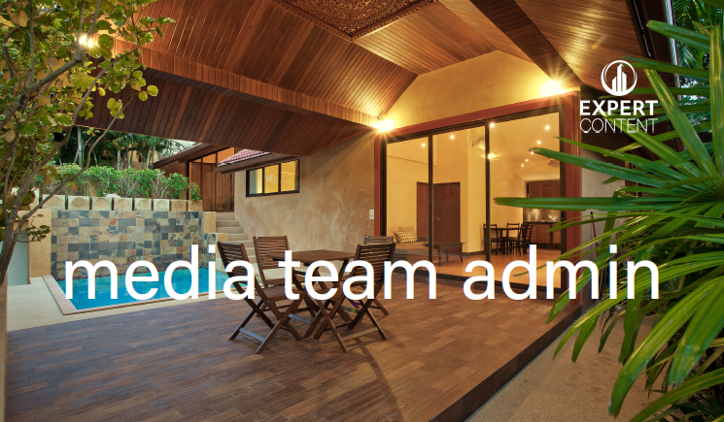
Business Card Variation Example
Use the settings below to take the default business card (left) to the example variation (right).
Background color: page 1 – upload your own image; page 2 – primary
Logo variation: brand_user_logo_stacked_white
Front page text color: white
Back page text color: secondary
NMLS# title override: “nmls id# “
Disclaimer/EHL logo color: white
Default
Example Variation
Notes:
This page should be used for PRINT FLYERS (duplicate as needed)

Slide 16
Business Card Variation Example
Use the settings below to take the default business card (left) to the example variation (right).
Background color: page 1 – primary; page 2 – black
Front page text color: white
Logo variation: brand_user_logo_stacked_white
Default
Example Variation
Notes:
This page should be used for PRINT FLYERS (duplicate as needed)

