Slide 1
Expert Content
Strategy Guide
CI Credit Improved
Credit Health

Slide 2
CI: Credit Improved
Email, user notification
This campaign targets prospects who have seen an improvement in their credit score that makes financing opportunities available to them. This campaign keeps the loan officer and company in front of the prospect with relevant information. Triggered by the CI: Credit Improvement Alert, this campaign spans 35 days, contains 5 emails.
*All communications should be reviewed prior to initiating the journey.

Slide 3
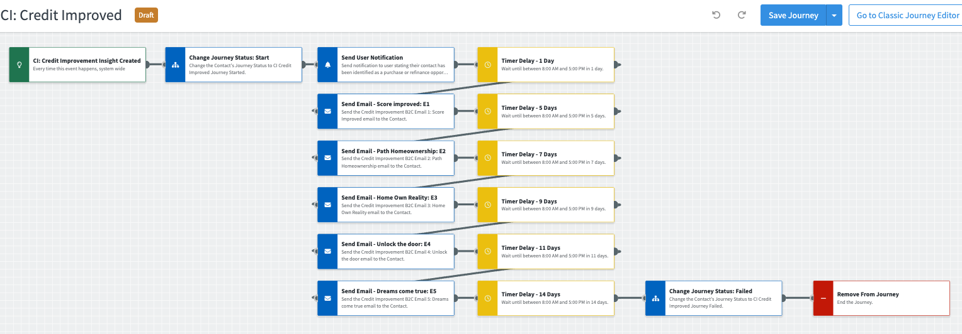
Journey Map Notes:
Keep emails that work for your organization, swap with custom, or add these emails to your existing campaigns.
Adjust onramps with organization specific groups and Focused View outcomes.

Slide 4
CI: Credit Improved
Email Subject:
Your score improved
Path to homeownership
Home ownership a reality
Unlock the door
Notes:
This page should be used for JOURNEY EMAILS (duplicate as needed)

Slide 5
CI: Credit Improved
Email Subject:
Dream come true
Notes:
This page should be used for JOURNEY EMAILS (duplicate as needed)

Slide 6
CI: Credit Improved
User Notification: CI: Credit Improvement Alert Insight Received (New)
The following contact has triggered a credit score improvement alert indicating they may now be eligible for financing. Emails will be sent on your behalf but can be more impactful if you reach out to them directly.
Contact name: {{contact.f_name}} {{contact.l_name}}
Contact phone: {{contact.phone}}
Notes:
This page should be used for Social Media (duplicate as needed)

Slide 7
Credit Health
Email, user notification
The Expert Content team has put together a series of emails directed to consumers regarding credit health. This series of 9 emails can be used in conjunction with the CI Credit Improvement journey, can be used in a separate journey created by admins, or as stand-alone emails.
*All communications should be reviewed prior to initiating the journey.

Slide 8
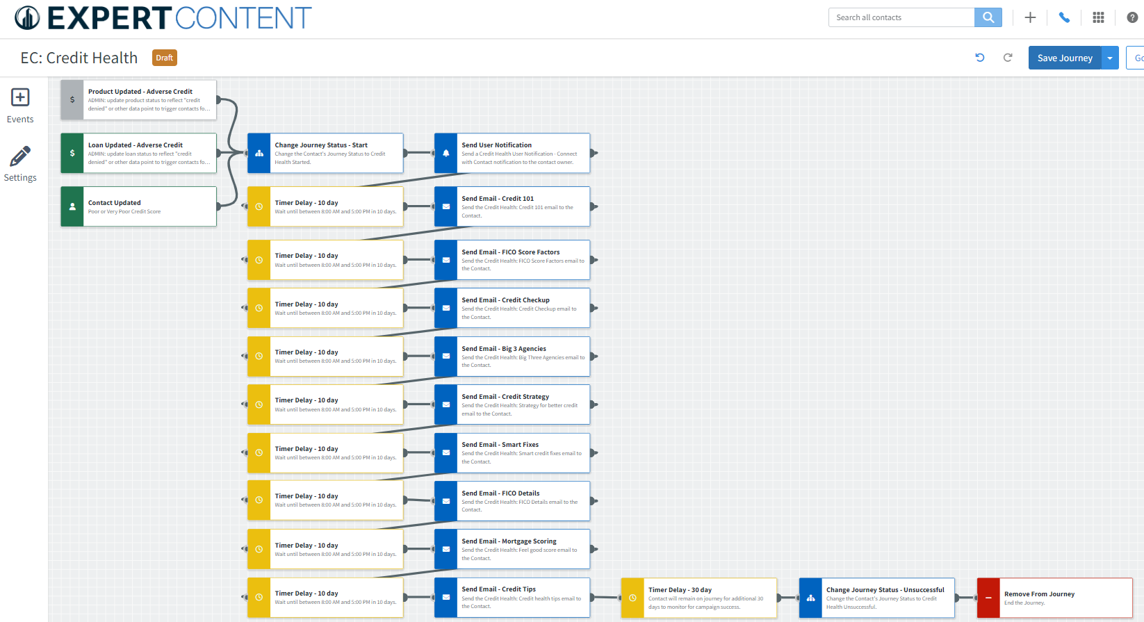
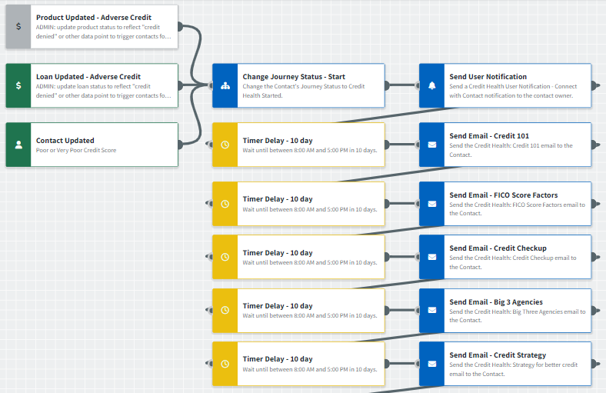
Journey Map Notes:
Review and adjust content of notifications, tasks, and SMS to meet organization-specific messaging

Slide 9
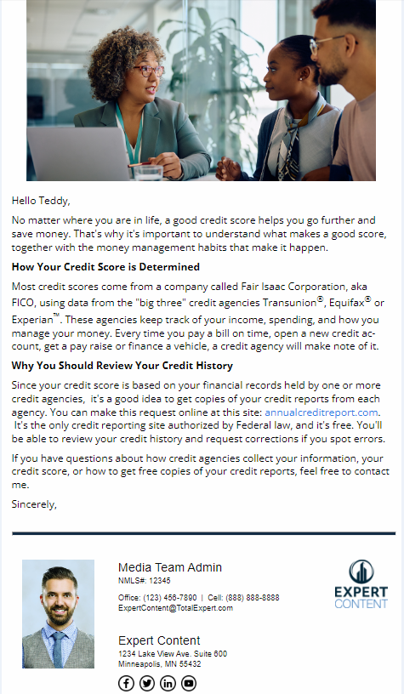
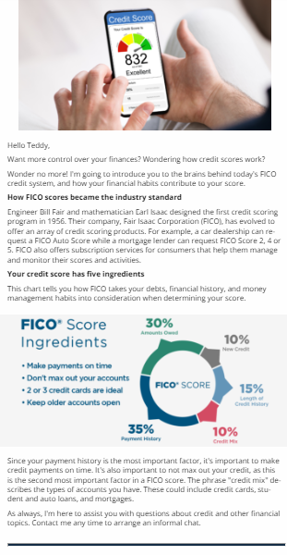
Credit Health
Email Subject:
Got questions about credit scores? Here are answers.
Meet the five FICO credit score factors
How to give your credit score a checkup
Notes:
This page should be used for JOURNEY EMAILS (duplicate as needed)

Slide 10
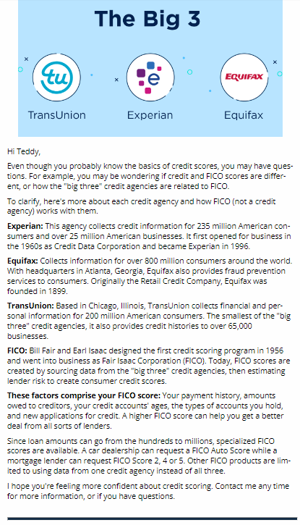
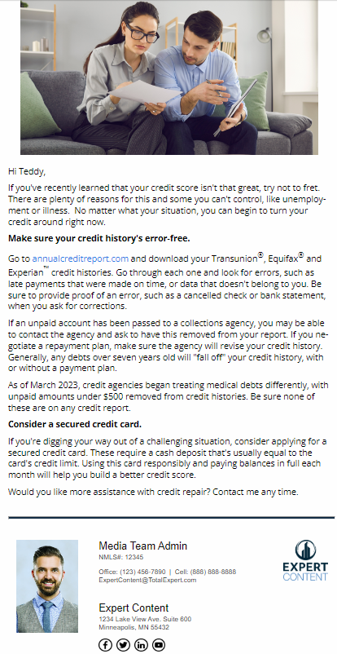
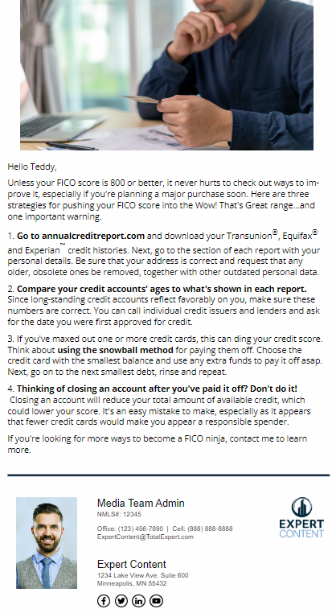
Credit Health
Email Subject:
Introducing the Big Three credit agencies
Strategies for better credit scores
Inside: smart fixes for credit problems
Notes:
This page should be used for JOURNEY EMAILS (duplicate as needed)

Slide 11
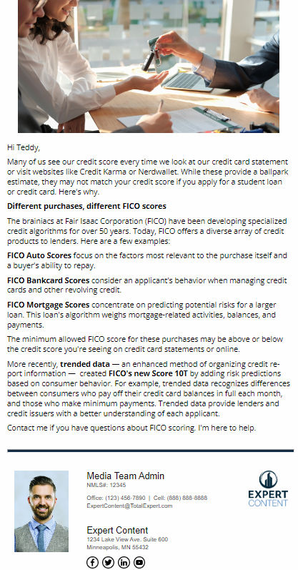
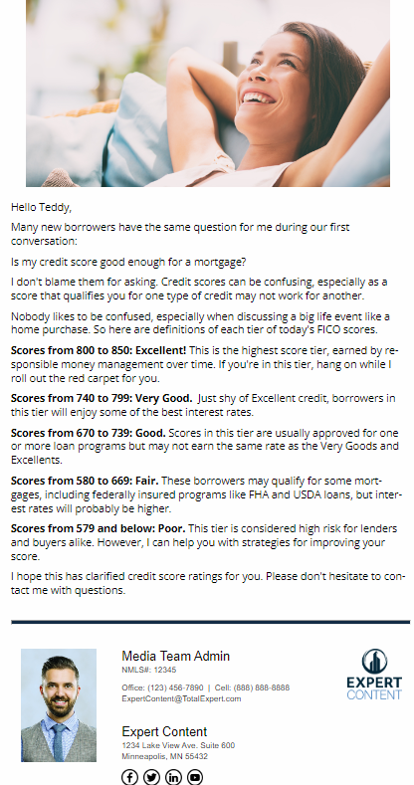
Credit Health
Email Subject:
There's no such thing as one FICO credit score. Here's why.
Feeling good about your credit score? I've got your number.
Tips for Credit Health
Notes:
This page should be used for JOURNEY EMAILS (duplicate as needed)

Slide 12
Credit Health
Credit Health User Notification - Connect with Contact
The contact below has triggered the Credit Health journey and will begin receiving automated emails within the next 10 days. This campaign includes general credit information, tips/tricks, and ways to reach out to you for more help. You can visit their contact details page for additional information and to reach out directly prior to the campaign start.
Contact name: {{contact.f_name}} {{contact.l_name}}
Contact phone: {{contact.phone}}
Notes:
This page should be used for Social Media (duplicate as needed)

