Slide 1
Expert Content
Strategy Guide
CI: Equity

Slide 2
CI: Equity
Email, SMS, User Notifications
Use customer intelligence alerts to inform customers about their home equity and the potential benefits of accessing it. If the contact has mortgage insurance (MI) on their most recent loan, there’s a path offering them the opportunity to remove it. The journey incorporates estimated equity dollar amount and segments contacts based on equity percentage thresholds.
For customers who wish to limit the number of times a contact can onboard this journey, leverage occurrence limits in the onboarding trigger. Find additional email options in the email gallery or leverage the HELOC Opportunities journey and reconfigure it to onboard contacts after they’ve been through this initial equity campaign.
*All communications should be reviewed prior to initiating the journey.

Slide 3
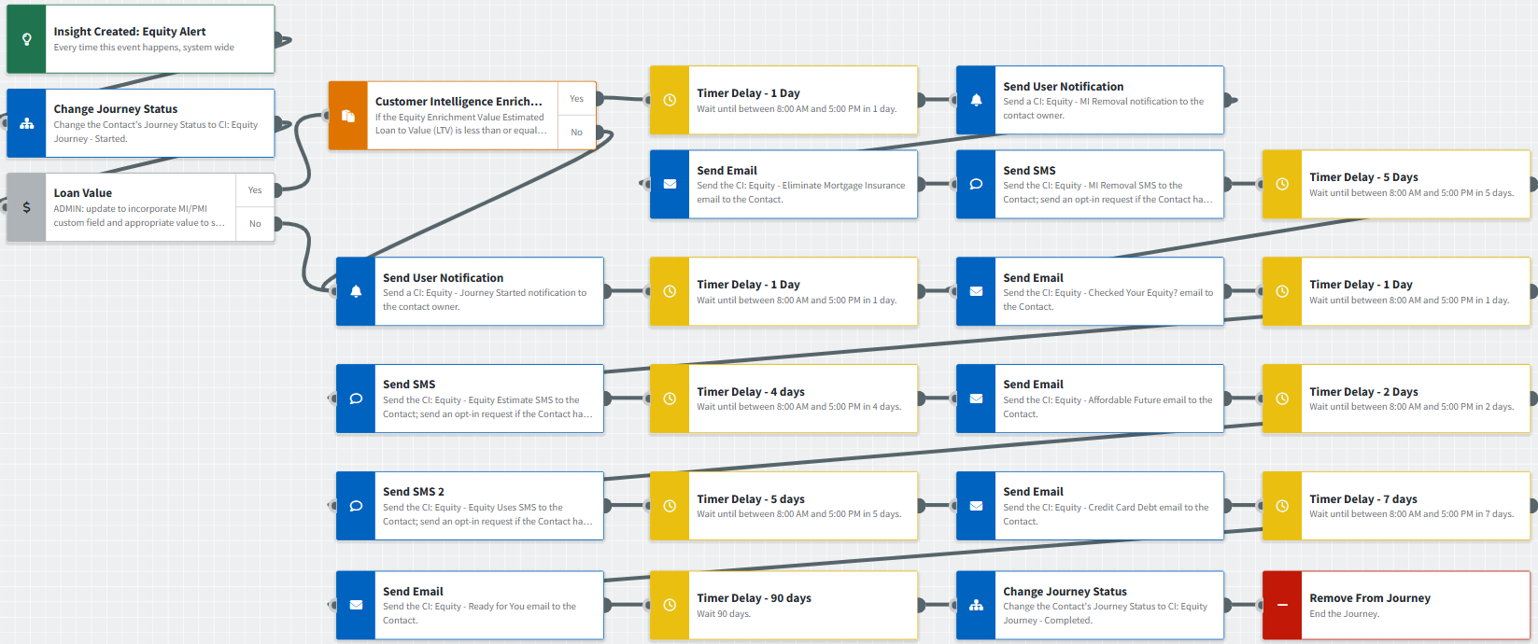
Journey Map Notes:
Keep emails that work for your organization, swap with custom, pull from the email gallery, or add these emails to your existing campaigns.
Adjust onramps with organization specific groups and Focused View outcomes.
Adjust occurrence limits to reduce the number of times a contact can onboard this journey. Leverage email received conditions or journey event fired configurations to add contacts to a different path or journey such as CI: HELOC opportunities.

Slide 4
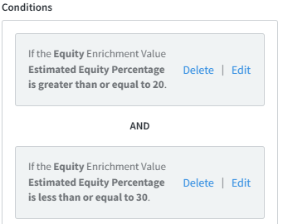
Journey Map Notes:
Contacts are segmented using Contact Groups to easily identify equity percentage thresholds. This can be used to filter in campaign builder or other areas of the platform where groups are available. It can also be used to segment contacts on journeys to market specific products.
Adjust thresholds by updating the trigger conditions and then updating group names to match. You can also add more thresholds to identify opportunities above 40% equity.

Slide 5
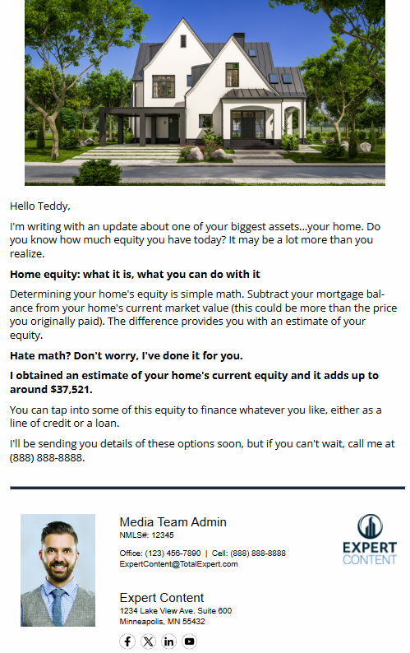
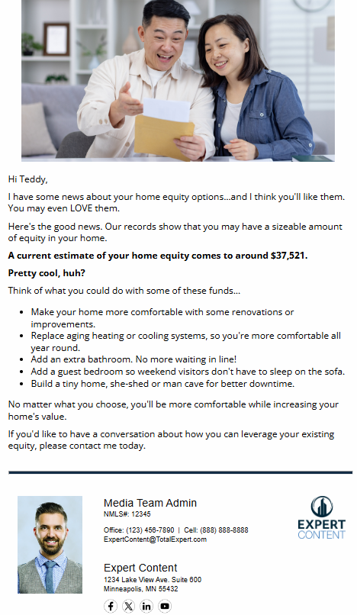
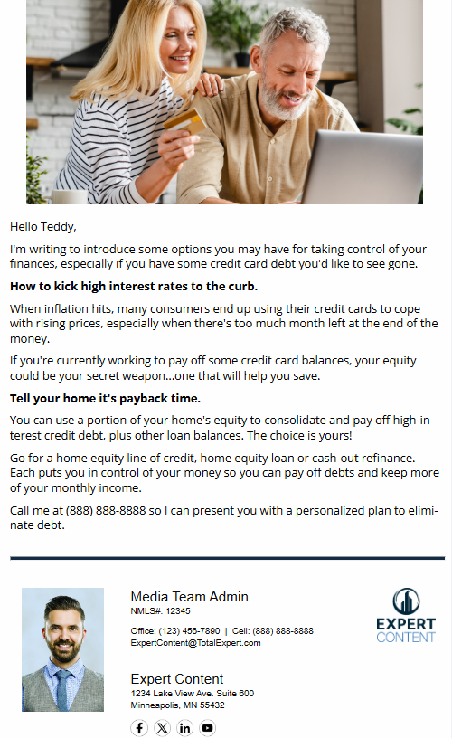
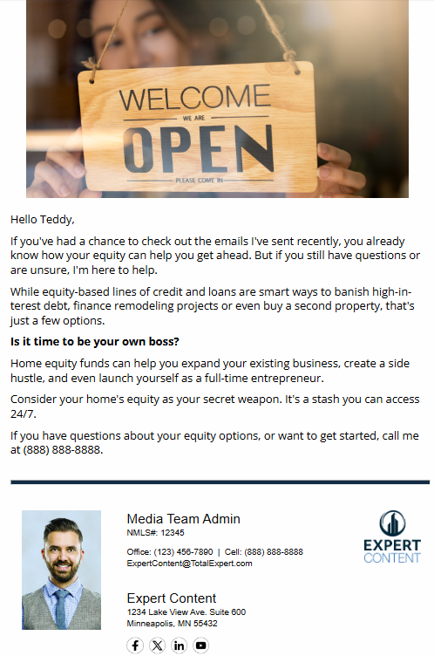
CI: Equity
Email Subject:
Have you checked your home’s equity lately?
The future's more affordable with home equity
How home equity can help you tame inflation
Your home equity's ready when you are.
Notes:
This page should be used for JOURNEY EMAILS (duplicate as needed)

Slide 6
CI: Equity
Email Subject:
Find out if you're done paying mortgage insurance
Notes:
This page should be used for JOURNEY EMAILS (duplicate as needed)

Slide 7
CI: Equity
SMS: CI: Equity - Equity Estimate
Hi {{recipient.f_name}}, this is {{sender.f_name}} with {{sender.company}}. If you’ve thought about tapping into the equity in your home, let’s connect! I can provide you with an equity estimate that you could potentially put to use. Call me at {{sender.phone_cell}} or reply to this message to chat!
SMS: CI: Equity - Equity Uses
Hi {{recipient.f_name}}, did you know that you could use the equity in your home to pay down high-interest debt, add to your emergency fund, or even renovate your home? Reply to this message to learn more about your equity-based options or call {{sender.phone_cell}} if you have questions.
SMS: CI: Equity - MI Removal
Hi {{recipient.f_name}}, this is {{sender.f_name}} with {{sender.company}}. You may have enough equity to eliminate your MI! Give me a call at {{sender.phone_cell}} if you are interested in potential savings on your mortgage.
Notes:
This page should be used for Tasks, User Notifications, and SMS templates (duplicate as needed)

Slide 8
CI: Equity
User Notification: CI: Equity - Remove Mortgage Insurance
The contact below has triggered an equity alert and shows their LTV is less than or equal to 80%. It appears this contact also had mortgage insurance on their most recent loan, it may be time to connect with them about removing it. Visit their contact record to review more in depth.
Contact name: {{contact.f_name}} {{contact.l_name}}
Contact phone: {{contact.phone}}
User Notification: CI: Equity - Journey Started
The contact below has triggered an equity alert and will receive a series of emails describing the value of tapping into it. Visit their contact record to review more in depth and determine strategy to reach out.
Contact name: {{contact.f_name}} {{contact.l_name}}
Contact phone: {{contact.phone}}
Notes:
This page should be used for Tasks, User Notifications, and SMS templates (duplicate as needed)

Slide 9
Print Flyers
Notes:
This page should be used for Print Flyers (duplicate as needed)

Slide 10
Postcards
Notes:
This page should be used for Postcards (duplicate as needed)

Slide 11
Social Media
Notes:
This page should be used for Social Media (duplicate as needed)

