Slide 1
Expert Content
Strategy Guide
Customer Intelligence: HELOC Opportunities

Slide 2
CI: HELOC Opportunities
Email, user notification
Triggered by the CI Equity Alert, this journey contains 5 emails spanning 5 weeks detailing the benefits of a home equity line of credit and how the funds can be leveraged. The journey leverages product conditions and triggers but can easily be swapped for loan-based journey components as well. Admins will need to configure product or loan type conditions to match org-specific statuses or names.
*All communications should be reviewed prior to initiating the journey.

Slide 3
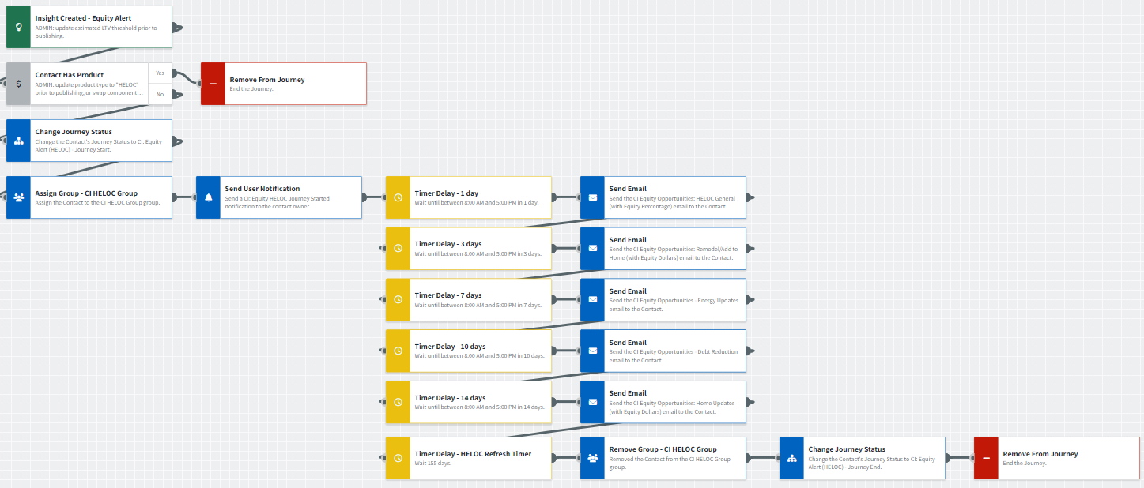
Journey Map Notes:
Keep emails that work for your organization, swap with custom, or add these emails to your existing campaigns.
Adjust “Contact has Product” component to leverage contact groups or loan conditions to exclude customers from the campaign with active HELOC products.

Slide 4
CI: HELOC Opportunities
Email Subject:
Unlock your home's potential with a HELOC
Is it time to add onto your home?
Consolidate into one monthly payment
Notes:
This page should be used for JOURNEY EMAILS (duplicate as needed)

Slide 5
CI: HELOC Opportunities
Email Subject:
Time for some energy updates?
Is your home feeling a little out of date?
Notes:
This page should be used for JOURNEY EMAILS (duplicate as needed)

Slide 6
CI: HELOC Opportunities
User Notification: CI: Equity HELOC Journey Started
The client has triggered the Equity Alert and has begun the HELOC Opportunity Journey as they do not currently have a line of credit with us.
Head to Focus View and the contact record to dig in further with this opportunity.
Name: {{contact.f_name}} {{contact.l_name}}
Email: {{contact.email}}
Notes:
This page should be used for Tasks, User Notifications, and SMS templates (duplicate as needed)

Slide 7
Associated Social Media
Leveraging the equity in your home can help with a growing family. Whether you need new baby furniture or another bedroom, a home equity line of credit (HELOC) can help with the expenses. Contact me today to see if a HELOC is right for you!
Whether you’re 25 or 55, it’s important to continually build your nest egg – and a HELOC could help. Help boost your savings by tapping into the equity in your home. Ask me how!
Do you need to upgrade your kitchen or remodel your outdated master bathroom? Leverage your home equity with a HELOC! You have the resources you need to make that dream a reality. Contact me today to explore the possibilities.
Life is full of “What if’s” – but what if there was an easy solution? Tapping into the equity in your home could be just the solution you need for unexpected expenses. Call me today to see if a HELOC is right for you!

