Slide 1
Expert Content
Strategy Guide
CI: Life Events – New Divorce (Mortgage)

Slide 2
CI: Life Events – Divorce (Mortgage)
Email, user notifications
This journey is intended for use with Customer Intelligence Life Event insights for a new divorce. Two emails are sent to the contacts within the household. An initial user notification is sent when the insight is received alerting the contact owner that the contact has started the journey and encouraging an informal check in. An email is sent to the contact offering a free mortgage check up due to life changes. If the contact clicks a link during the journey, a second generic “link clicked” user notification is sent. Contacts are offboarded when a new mortgage loan (refi or purchase) is created, or after the journey concludes.
*All communications should be reviewed prior to initiating the journey.

Slide 3
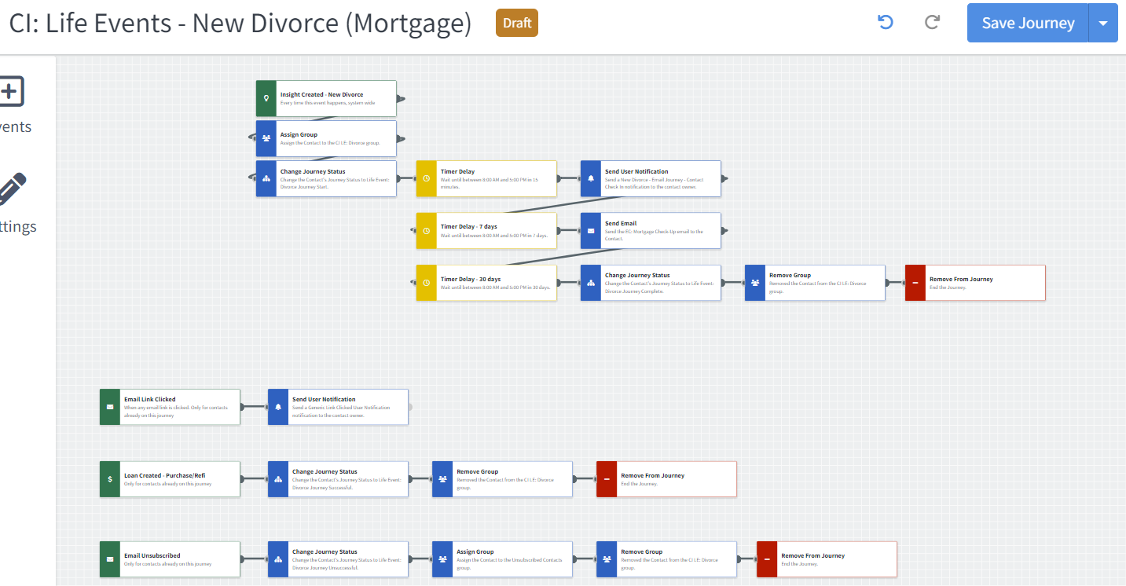
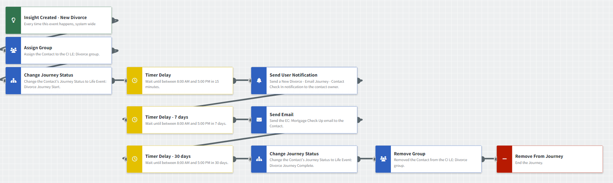
Journey Map Notes:
Keep emails that work for your organization, swap with custom, or add these emails to your existing campaigns.
Adjust onramps with organization specific groups and Focused View outcomes.

Slide 4

CI: Life Events – Divorce (Mortgage)
Email Subject:
Is it time for a mortgage check-up?
Notes:
This page should be used for JOURNEY EMAILS (duplicate as needed)

Slide 5
CI: Life Events – Divorce (Mortgage)
User Notification: New Divorce - Email Journey - Contact Check In
The contact's household below has received a Life Event insight for a divorce and may benefit from a general check in on their accounts. They will receive an email after 7 days offering a free mortgage checkup.
Contact name: {{contact.f_name}} {{contact.l_name}}
User Notification: Generic Link Clicked User Notification
The below contact clicked a link from within a journey email. Visit their contact details page for additional information.
Contact name: {{contact.f_name}} {{contact.l_name}}
Contact email: {{contact.email}}
Contact phone: {{contact.phone}}
Notes:
This page should be used for Tasks, User Notifications, and SMS templates (duplicate as needed)

