Slide 1
Expert Content
Strategy Guide
CI: Listing

Slide 2
CI: Listing
Email, SMS, User Notification
Use customer intelligence alerts to identify contacts who recently listed their home for sale. Engage with them through four emails and two test messages letting them know how a loan officer can help. Briefly discuss why now is the time to start looking at loan options for their next purchase and how the process can be smoother with your help.
*All communications should be reviewed prior to initiating the journey.

Slide 3
Journey Map Notes:
Keep emails that work for your organization, swap with custom, pull from the email gallery, or add these emails to your existing campaigns.
Adjust onramps with organization specific groups and Focused View outcomes.
Adjust occurrence limits to reduce the number of times a contact can onboard this journey. Leverage email received conditions or journey event fired configurations to add contacts to a different path or journey.

Slide 4
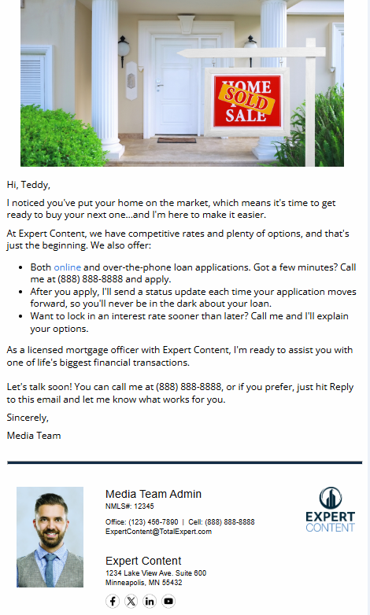
CI: Listing
Email Subject:
Selling’s Easier When You’re Ready to Buy.
On the move? I’m ready to help.
Has your home sold yet?
Why moving’s easier with my help.
Notes:
This page should be used for JOURNEY EMAILS (duplicate as needed)

Slide 5
CI: Listing
SMS: CI: Listing - Check Out Loan Options
Hi {{recipient.f_name}}, this is {{sender.f_name}} with {{sender.company}}. I noticed you've just put your home on the market, which means it's a great time to check out your loan options for your next home. Call me any time at {{sender.phone_cell}}.
User Notification: CI: Listing - Journey Started
The contact below has triggered a listing alert and will receive a series of emails on how you can help during the sale and/or purchase of a new home. Visit their contact record to review more in depth and determine strategy to reach out.
Contact name: {{contact.f_name}} {{contact.l_name}}
Contact phone: {{contact.phone}}
SMS: CI: Listing - Discuss Options
Hi {{recipient.f_name}}, this is {{sender.f_name}} with {{sender.company}}. I noticed you recently put your home on the market. Let's discuss your loan options for your next home. I think you'll like them! Call {{sender.phone_cell}} to find out more.
Notes:
This page should be used for Tasks, User Notifications, and SMS templates (duplicate as needed)

