Slide 1
Expert Content
Strategy Guide
CI: Mortgage Credit Inquiry

Slide 2
CI: Mortgage Credit Inquiry
Email, SMS, User Notification
Use customer intelligence alerts to identify contacts who’ve recently had a credit inquiry from another lender. Whether they are shopping rates or looking to refinance, this journey reminds the contact that your loan officers are there to support their needs. Four emails and two SMS messages are sent to the contact over eight days.
*All communications should be reviewed prior to initiating the journey.

Slide 3
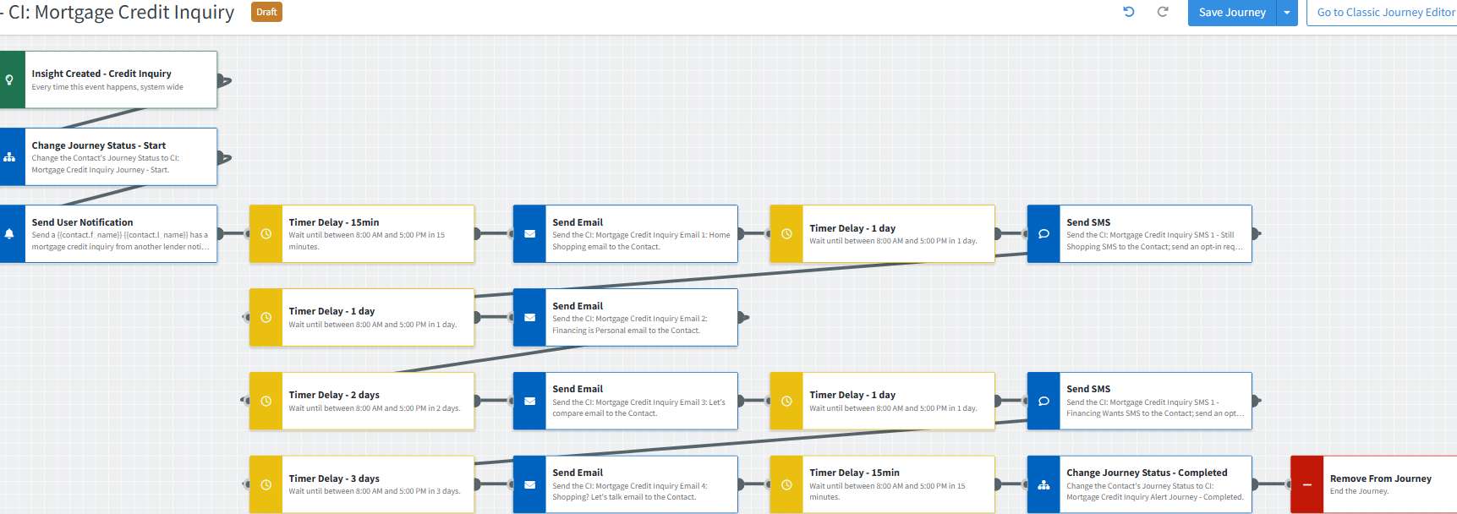
Journey Map Notes:
Keep emails that work for your organization, swap with custom, pull from the email gallery, or add these emails to your existing campaigns.
Adjust onramps with organization specific requirements including groups and Focused View outcomes.

Slide 4
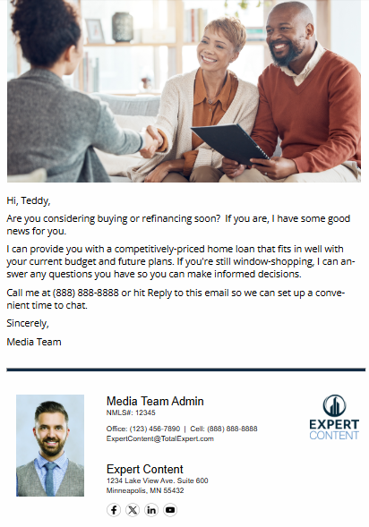
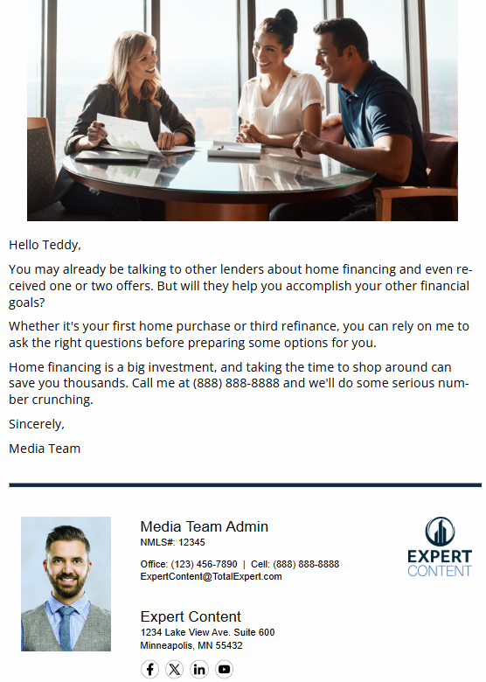
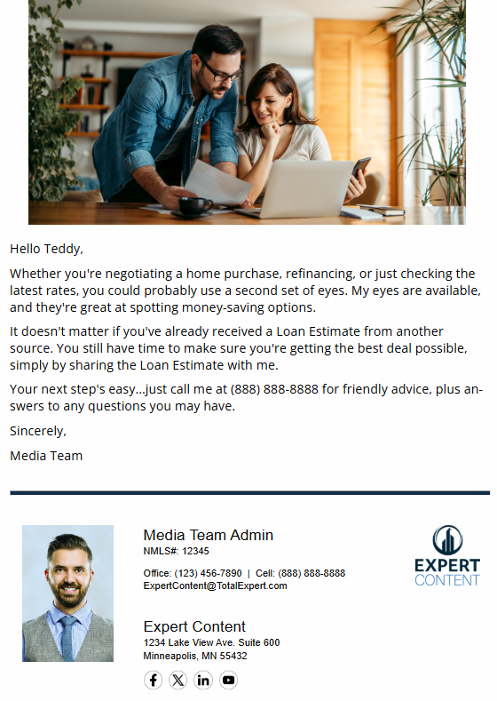
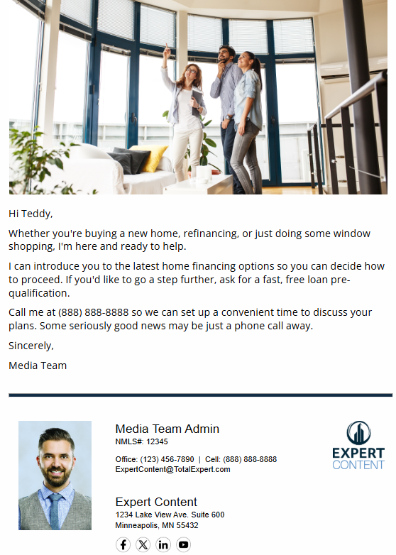
CI: Mortgage Credit Inquiry
Email Subject:
Shopping for home financing? Let’s talk.
Home financing should be personal.
Let’s compare home financing notes.
Not all home loans are created equal.
Notes:
This page should be used for JOURNEY EMAILS (duplicate as needed)

Slide 5
CI: Mortgage Credit Inquiry
SMS: CI: Mortgage Credit Inquiry SMS 1 - Still Shopping
Hi, {{recipient.f_name}}! This is {{sender.f_name}} from {{sender.company}}. If you're thinking of buying or refinancing a home, call me at {{sender.phone_cell}}. I'll provide you with some competitively priced options so you can choose the financing that's right for you.
User Notification: {{contact.f_name}} {{contact.l_name}} has a mortgage credit inquiry from another lender
The contact below has a mortgage credit inquiry pending with another lender. The contact will receive a series of emails automatically. It could be beneficial to discuss your lending options and how it compares to the other organization.
Contact name: {{contact.f_name}} {{contact.l_name}}
Contact phone: {{contact.phone}}
SMS: CI: Mortgage Credit Inquiry SMS 2 - Financing Wants
{{recipient.f_name}}, got a minute to tell me what you want from your home's financing? This is {{sender.f_name}} with {{sender.company}}, and I’d like to make sure you get the best deal. Call me at {{sender.phone_cell}} to learn more.
Notes:
This page should be used for Tasks, User Notifications, and SMS templates (duplicate as needed)

