Slide 1
Expert Content
Strategy Guide
CI Rate Alert

Slide 2
CI: Rate Alert
Email
The CI Rate Alert journey will alert loan officers and customers when there has been an improvement in current mortgage rates that are markedly better than their current note rate to enable refinance opportunities.
Series of 9 emails with the first 3 targeting the improvement to the rate specifically, the remaining 6 emails discuss financing options for the customer.
*All communications should be reviewed prior to initiating the journey.

Slide 3
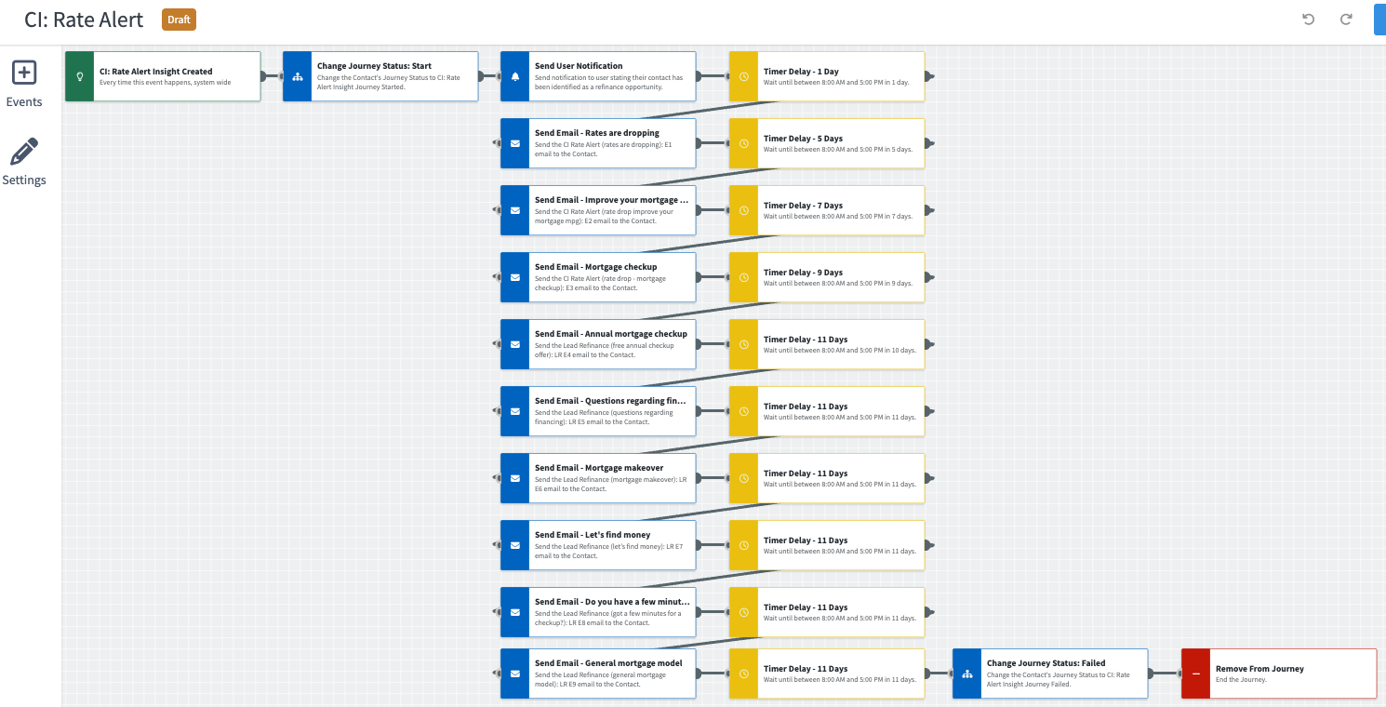
Journey Map Notes:
Keep emails that work for your organization, swap with custom, or add these emails to your existing campaigns.
Adjust onramps with organization specific groups and Focused View outcomes.

Slide 4
CI Rate Alert
Email Subject:
Great news – rates are dropping
Improve your mortgage MPG
Mortgage checkup
Free annual checkup
Notes:
This page should be used for JOURNEY EMAILS (duplicate as needed)

Slide 5
CI Rate Alert
Email Subject:
Questions regarding financing
Mortgage Makeover
Let’s find money
Do you have a few minutes?
Notes:
This page should be used for JOURNEY EMAILS (duplicate as needed)

Slide 6
CI Rate Alert
Email Subject:
General mortgage model
Notes:
This page should be used for JOURNEY EMAILS (duplicate as needed)

