Slide 1
Expert Content
Strategy Guide
CI: Rate Alert
April 2025

Slide 2
CI: Rate Alert
Communication types: Email, SMS, and User Notifications
This campaign targets homeowners who have mortgage rates higher than the market indices. It invites the homeowner to consider: equity position, value review, potential effects of a HELOC reset, and whether they can stop paying mortgage insurance. This campaign keeps loan officer and company in front of refinance prospects with relevant information. Triggered by the CI: Rate Alert, this campaign spans 4 months, contains 9 emails and 3 SMS messages.
*All communications should be reviewed prior to initiating the journey.

Slide 3
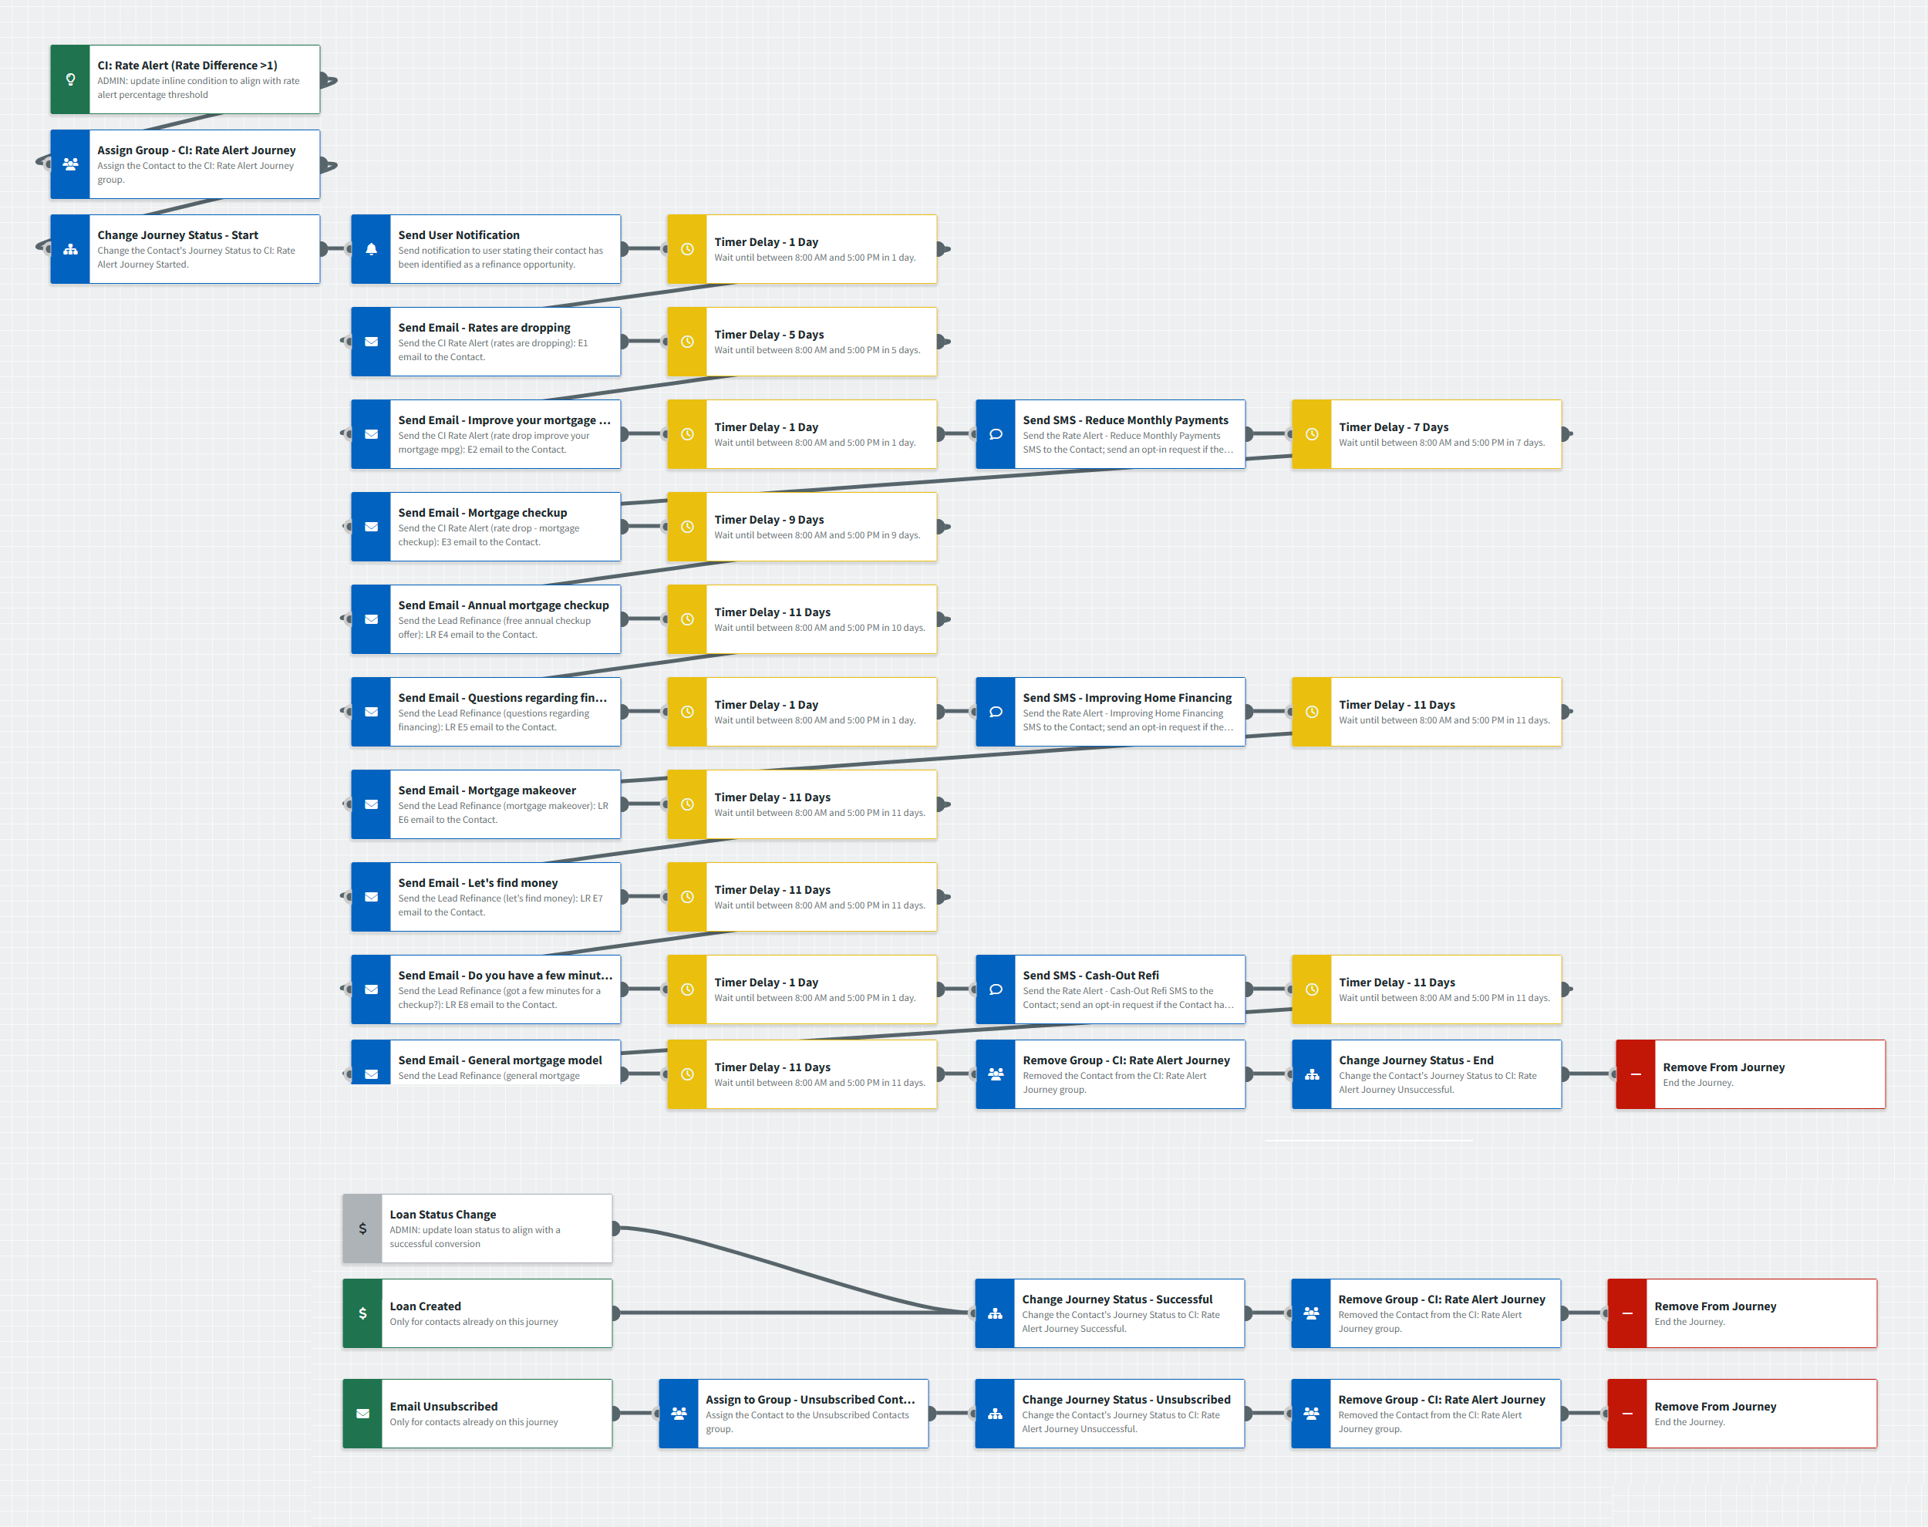
CI: Rate Alert
Journey Map Notes:
Keep emails that work for your organization, swap with custom, or add these emails to your existing campaigns.
Adjust onramps with organization specific groups and Focused View outcomes.

Slide 4
CI: Rate Alert
Email Subject Line:
Great news - interest rates are dropping!
Improve your mortgage MPG
Got a few minutes for a mortgage checkup?
Notes:
This page should be used for JOURNEY EMAILS (duplicate as needed)

Slide 5
CI: Rate Alert
Email Subject Line:
Is it time for your mortgage's annual checkup?
Questions about your mortgage?
Does your mortgage need a makeover?
Notes:
This page should be used for JOURNEY EMAILS (duplicate as needed)

Slide 6
CI: Rate Alert
Email Subject Line:
Let’s look for found money
Looking to save money?
Let's chat about your current mortgage model.
Notes:
This page should be used for JOURNEY EMAILS (duplicate as needed)

Slide 7
CI: Rate Alert
SMS: Rate Alert - Reduce Monthly Payments
Hi {{contact.f_name}} - it's {{sender.f_name}} with {{sender.company}}. I know we're all looking for ways to reduce monthly bills. Did you know that refinancing your mortgage can reduce your monthly payments and free up more of your monthly income? Text or call me back to learn more!
SMS: Rate Alert - Improving Home Financing
Hey {{contact.f_name}} - when home prices change, your home financing options may improve. For example, you may have much more equity available than you think. Or you may qualify for mortgage refinancing that reduces your monthly payments. Call when you're free to chat!
SMS: Rate Alert - Cash-Out Refi
Who doesn't want to keep more of their money? Refinancing your home can be the key! A cash-out refinance can offer plenty of options, as you can use it for anything from financing a major remodeling project to paying off high-interest debt. Text or call me to learn more.
Notes:
This page should be used for Tasks, User Notifications, and SMS templates (duplicate as needed)

Slide 8
CI: Rate Alert
User Notification: CI: Rate Alert Insight Received
The following contact has triggered a rate alert indicating their current mortgage rate is higher than our company threshold and is a candidate for refinancing. Emails will be sent on your behalf but can be more impactful if you reach out directly to them.
Contact name: {{contact.f_name}} {{contact.l_name}}
Contact phone: {{contact.phone}}
Notes:
This page should be used for Tasks, User Notifications, and SMS templates (duplicate as needed)

