Slide 1
Expert Content
Strategy Guide
CI: Rate Alert
September 2025

Slide 2
CI: Rate Alert
Communication types: Email, SMS, Task, and User Notifications
This campaign targets homeowners who have mortgage rates higher than the market indices. It invites the homeowner to consider: equity position, value review, potential effects of a HELOC reset, and whether they can stop paying mortgage insurance. This campaign keeps loan officer and company in front of refinance prospects with relevant information. Triggered by the CI: Rate Alert, this campaign spans 4 months, contains 9 emails and 3 SMS messages.
If the contact’s most recent loan has a funded date within 6 months, they will be segmented down a path for the contact owner to reach out directly. Confirm or update Customer Intelligence settings for monitoring window to leverage this path.
*All communications should be reviewed prior to initiating the journey.

Slide 3
CI: Rate Alert
Journey Notes:
Keep emails that work for your organization, edit to meet your organization’s tone, swap with custom, or add these emails to your existing campaigns.
Configure trigger and condition components with organization specific inline conditions, contact groups, and Focused View outcomes.
Notes:
This page should be used for JOURNEY WIREFRAMES (duplicate as needed)

Slide 4
CI: Rate Alert
Journey Notes:
The Loan Date condition for a Funded Date within 6 months can be modified to a shorter timeframe to better align with sales processes. For example, if you would rather your sales team focus on loans within 4 or 5 months, you can adjust this condition to match.
Confirm or update Customer Intelligence settings to align with monitoring windows. If your settings begin to monitor at 6 months, the EPO path will not be applicable.
When a contact’s loan funded date is within 6 months, the contact owner will receive a task and daily notifications for the next week.
Two task outcomes note whether the EPO has been avoided or not. Update the due date for the task and timer delays to align with your sales process.
If the task has been completed within 7 days, the contact owner will no longer receive notifications.
Notes:
This page should be used for JOURNEY WIREFRAMES (duplicate as needed)

Slide 5
CI: Rate Alert
Email Subject Line: Great news - interest rates are dropping!
Hi {{recipient.f_name}},
As you may be aware, we've seen a drop in mortgage interest rates recently. Mortgage rates fluctuate all the time, but these types of interest rate decreases shouldn't be casually ignored - especially when they can save you money.
Based on your previous home loan transaction with {{sender.company}}, our records indicate that you may be eligible to lower your mortgage payment enough to make it worth your while.
Don't wait - reach out today for a no-obligation consultation to find out if refinancing your current mortgage loan is right for you.
I look forward to speaking with you soon!
Sincerely,
Notes:
This page should be used for EMAILS (duplicate as needed)

Slide 6
CI: Rate Alert
Email Subject Line: Improve your mortgage MPG
Hi {{recipient.f_name}},
These days, a lot of people are looking to get the best mileage per gallon out of their cars...but what about your house?
With interest rates moving lower recently, this might be a good time for you to find a more economical mortgage model. Reducing your monthly mortgage payment can be a big help managing your overall household budget.
Why wait? Contact me today to see if refinancing your home mortgage loan interest rate would save you money.
Sincerely,
Notes:
This page should be used for EMAILS (duplicate as needed)

Slide 7
CI: Rate Alert
Email Subject Line: Got a few minutes for a mortgage checkup?
Hi {{recipient.f_name}},
Have you thought about consolidating your debt, or remodeling your current home? With interest rates moving lower recently, now may be a good time to see if {{sender.company}} can help!
As a licensed mortgage professional, I take pride in helping my customers improve their quality of life and financial outlook. A home loan refinance with a lower interest rate can unlock opportunities for you.
If you would like to explore your options and see if this is a good fit for you, please reach out at your convenience. I'm here to help.
Sincerely,
Notes:
This page should be used for EMAILS (duplicate as needed)

Slide 8
CI: Rate Alert
Email Subject Line: Is it time for your mortgage's annual checkup?
Hello {{recipient.f_name}},
Your mortgage and finances can benefit from an annual checkup, to see if you qualify for lower monthly payments. I offer these checkups free of charge. Think of me as a home financing doctor...without the cold stethoscope!
For example, if you're paying mortgage insurance and have been in your home for a while, you may qualify to lower your monthly loan payments by cancelling the insurance.
Another possible diagnosis: a refinance could put your mortgage payments on a diet. Lowering your payments by refinancing could save you a great deal of money over the life of your loan, especially if you shorten your mortgage's term.
I'd love to talk and provide you with a complimentary, routine check-up. Contact me at {{sender.phone_cell}} to chat.
Sincerely,
Notes:
This page should be used for EMAILS (duplicate as needed)

Slide 9
CI: Rate Alert
Email Subject Line: Questions about your mortgage?
Hi {{recipient.f_name}},
I'm wondering if you have any questions for me regarding your home's financing. Home values, market conditions and your home's equity position can change fast.
Do you have the latest information?
I can get you up to speed!
Call me at {{sender.phone_cell}} or reply to this email – I'm happy to assist you.
Sincerely,
Notes:
This page should be used for EMAILS (duplicate as needed)

Slide 10
CI: Rate Alert
Email Subject Line: Does your mortgage need a makeover?
Hello {{recipient.f_name}},
While your mortgage's term and payments may be looking good to you, it never hurts to see if a "makeover" could make it better.
A review of your home's current equity (what you owe on your mortgage, plus any change in your home's value) is a smart idea.
What are your short and long-term plans? Does your current home's financing complement those plans? We can review your current mortgage and find out if there are opportunities you may want to consider.
Sincerely,
Notes:
This page should be used for EMAILS (duplicate as needed)

Slide 11
CI: Rate Alert
Email Subject Line: Let’s look for found money
Hi {{recipient.f_name}},
Have you ever found some money in the pocket of your clothing?
That's usually a day-brightener - no matter what you find.
Your home's financing may provide you with a similar, although much bigger surprise, since property values have made a lot of progress in recent years. You may be surprised to find you have more equity in your home than you thought.
It's worth a few minutes of your time - at no cost or obligation - to take a closer look at your home's current value, available equity, and more. Refinancing may offer you ways to save money every month, and during the life of your mortgage.
You may have options available you didn't realize you had.
Let's dig in and find out!
Sincerely,
Notes:
This page should be used for EMAILS (duplicate as needed)

Slide 12
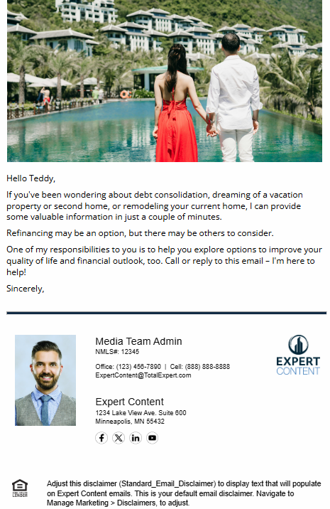
CI: Rate Alert
Email Subject Line: Looking to save money?
Hello {{recipient.f_name}},
If you've been wondering about debt consolidation, dreaming of a vacation property or second home, or remodeling your current home, I can provide some valuable information in just a couple of minutes.
Refinancing may be an option, but there may be others to consider.
One of my responsibilities to you is to help you explore options to improve your quality of life and financial outlook, too. Call or reply to this email – I'm here to help!
Sincerely,
Notes:
This page should be used for EMAILS (duplicate as needed)

Slide 13
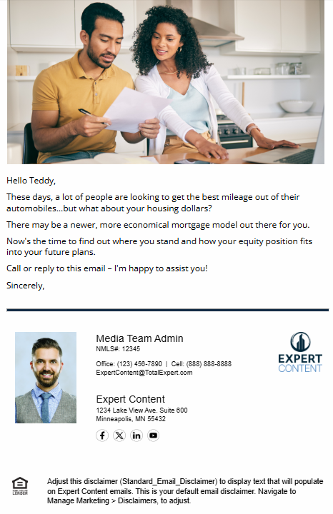
CI: Rate Alert
Email Subject Line: Let's chat about your current mortgage model.
Hello {{recipient.f_name}},
These days, a lot of people are looking to get the best mileage out of their automobiles...but what about your housing dollars?
There may be a newer, more economical mortgage model out there for you.
Now's the time to find out where you stand and how your equity position fits into your future plans.
Call or reply to this email – I'm happy to assist you!
Sincerely,
Notes:
This page should be used for EMAILS (duplicate as needed)

Slide 14
CI: Rate Alert
SMS: Rate Alert - Reduce Monthly Payments
Hi {{contact.f_name}} - it's {{sender.f_name}} with {{sender.company}}. I know we're all looking for ways to reduce monthly bills. Did you know that refinancing your mortgage can reduce your monthly payments and free up more of your monthly income? Text or call me back to learn more!
SMS: Rate Alert - Improving Home Financing
Hey {{contact.f_name}} - when home prices change, your home financing options may improve. For example, you may have much more equity available than you think. Or you may qualify for mortgage refinancing that reduces your monthly payments. Call when you're free to chat!
SMS: Rate Alert - Cash-Out Refi
Who doesn't want to keep more of their money? Refinancing your home can be the key! A cash-out refinance can offer plenty of options, as you can use it for anything from financing a major remodeling project to paying off high-interest debt. Text or call me to learn more.
Notes:
This page should be used for TASKS, USER NOTIFICATIONS, AND SMS TEMPLATES (duplicate as needed)

Slide 15
CI: Rate Alert
User Notification: CI: Rate Alert Insight Received
The following contact has triggered a rate alert indicating their current mortgage rate is higher than our company threshold and is a candidate for refinancing. Emails will be sent on your behalf but are more impactful if you reach out directly to them.
Contact name: {{contact.f_name}} {{contact.l_name}}
Contact phone: {{contact.phone_cell}}
Loan number: {{contact.enriched.rate.loan_number}}
Loan amount: ${{contact.enriched.rate.loan_amount | formatNumber: 0}}
Loan program: {{contact.enriched.rate.loan_program}}
Loan funded date: {{contact.enriched.rate.loan_funded_date | date: "m/d/Y"}}
Loan rate: {{contact.enriched.rate.loan_rate}}% | Market rate: {{contact.enriched.rate.current_market_rate}}%
Potential monthly savings: ${{contact.enriched.rate.estimated_monthly_savings | formatNumber: 0}}/month
Notes:
This page should be used for TASKS, USER NOTIFICATIONS, AND SMS TEMPLATES (duplicate as needed)

Slide 16
CI: Rate Alert
Task: CI: Rate - EPO Risk
The contact below has triggered a rate alert and their funded date is less than 6 months ago. This is an EPO risk and should be followed up on within the next 7 days. You will receive daily notifications for this contact over the next week or until you have selected an outcome.
Below are the details of the contact and loan that triggered this alert.
Contact name: {{contact.f_name}} {{contact.l_name}}
Contact phone: {{contact.phone_cell}}
Loan number: {{contact.enriched.rate.loan_number}}
Loan amount: ${{contact.enriched.rate.loan_amount | formatNumber: 0}}
Loan program: {{contact.enriched.rate.loan_program}}
Loan funded date: {{contact.enriched.rate.loan_funded_date | date: "m/d/Y"}}
Loan rate: {{contact.enriched.rate.loan_rate}}% | Market rate: {{contact.enriched.rate.current_market_rate}}%
Potential monthly savings: ${{contact.enriched.rate.estimated_monthly_savings | formatNumber: 0}}/month
Notes:
This page should be used for TASKS, USER NOTIFICATIONS, AND SMS TEMPLATES (duplicate as needed)

Slide 17
CI: Rate Alert
User Notification: CI: Rate Alert - Early Pay Off (EPO) Risk
The contact below has triggered a credit inquiry alert and their funded date is less than 6 months ago. This is an EPO risk and should be followed up on as soon as possible. Below are the details of the contact and loan that triggered this alert.
The contact below has triggered a rate alert and their funded date is less than 6 months ago. This is an EPO risk and should be followed up on as soon as possible. Below are the details of the contact and loan that triggered this alert.
Contact name: {{contact.f_name}} {{contact.l_name}}
Contact phone: {{contact.phone_cell}}
Loan number: {{contact.enriched.rate.loan_number}}
Loan amount: ${{contact.enriched.rate.loan_amount | formatNumber: 0}}
Loan program: {{contact.enriched.rate.loan_program}}
Loan funded date: {{contact.enriched.rate.loan_funded_date | date: "m/d/Y"}}
Loan rate: {{contact.enriched.rate.loan_rate}}% | Market rate: {{contact.enriched.rate.current_market_rate}}%
Potential monthly savings: ${{contact.enriched.rate.estimated_monthly_savings | formatNumber: 0}}/month
Notes:
This page should be used for TASKS, USER NOTIFICATIONS, AND SMS TEMPLATES (duplicate as needed)

