Slide 1
Expert Content
Strategy Guide
Certificate of Deposit Cross Sell

Slide 2
Certificate of Deposit Cross Sell
Email
This journey is intended to educate clients on the benefits of opening a new CD. The campaign includes four emails on the benefits of certificates of deposits over the course of one month. TE recommends leveraging the related CD Renewals journey to complement this cross-sell journey.
*All communications should be reviewed prior to initiating the journey.

Slide 3
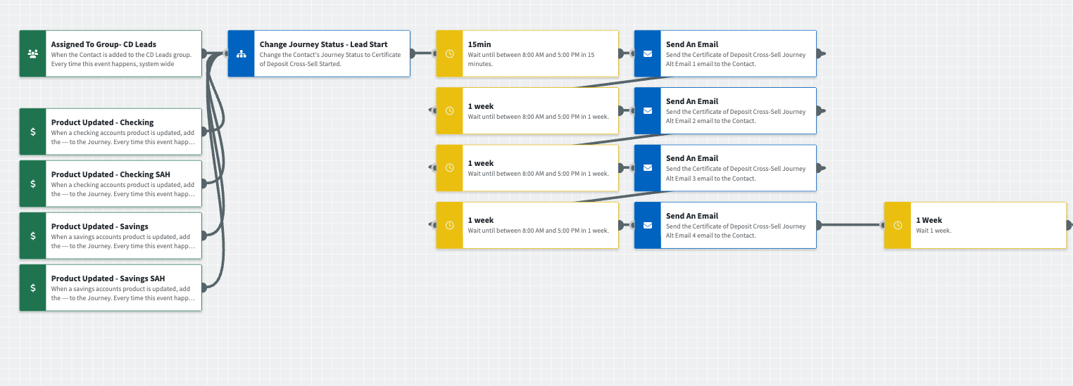
Journey Map Notes:
Keep emails that work for your organization, swap with custom, or add these emails to your existing campaigns.
Adjust onramps with organization specific groups and Focused View outcomes.

Slide 4
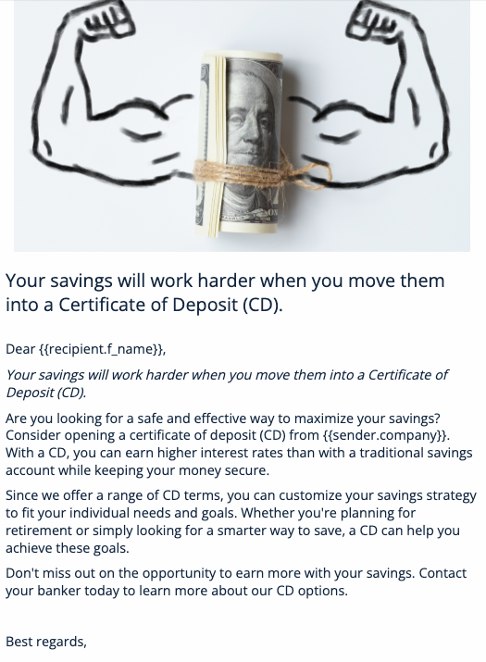
Certificate of Deposit Cross Sell
Email Subject:
How a CD can help you achieve your financial goals
Peace of mind for your retirement: Why a CD is a smart investment choice
How a CD helps you grow your money safely
Build your emergency fund the smart way: with a CD
Notes:
This page should be used for JOURNEY EMAILS (duplicate as needed)

