Slide 1
Expert Content
Strategy Guide
Credit Health

Slide 2
Credit Health
Emails, user notification
Contacts will be automatically added to this campaign due to an adverse loan or product status, or if their credit score is Poor or Very Poor. The campaign can be reconfigured to leverage Focused View or Insights. This campaign includes 9 emails and one user notification over the course of 90 days. Educate contacts who may have little credit history or for those with poor credit on how to improve their score, why it matters, and how to maintain good credit.
*All communications should be reviewed prior to initiating the journey.

Slide 3
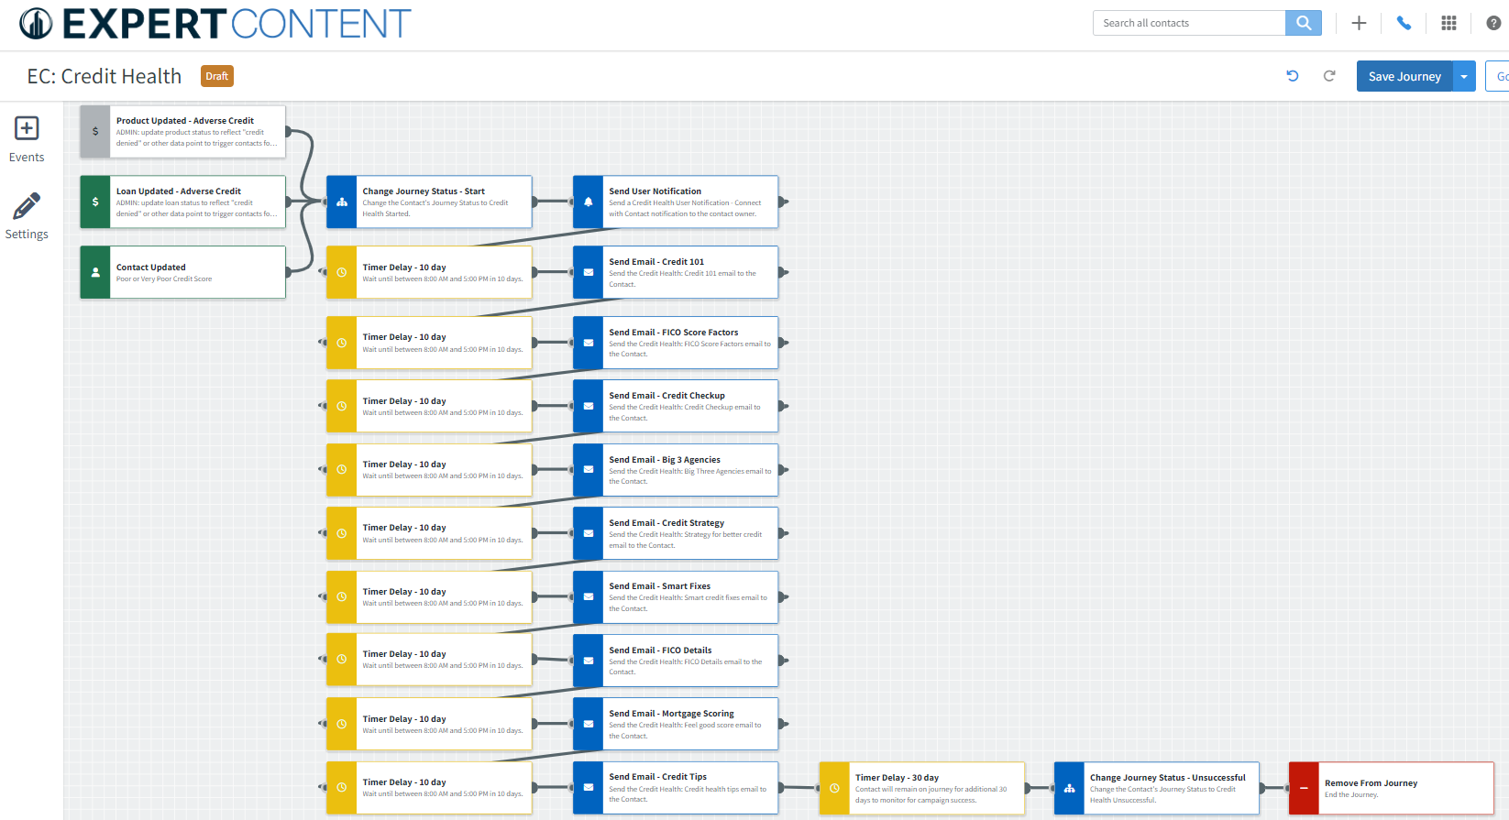
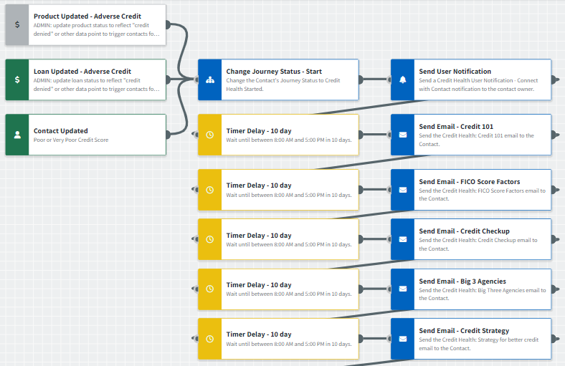
Journey Map Notes:
Review and adjust content of notifications, tasks, and SMS to meet organization-specific messaging

Slide 4
Credit Health
Email Subject:
Got questions about credit scores? Here are answers.
Meet the five FICO credit score factors
How to give your credit score a checkup
Notes:
This page should be used for JOURNEY EMAILS (duplicate as needed)

Slide 5
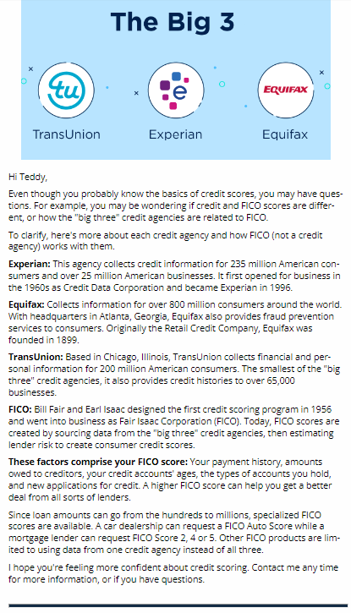
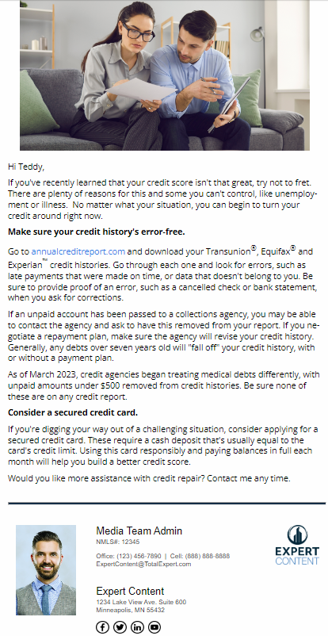
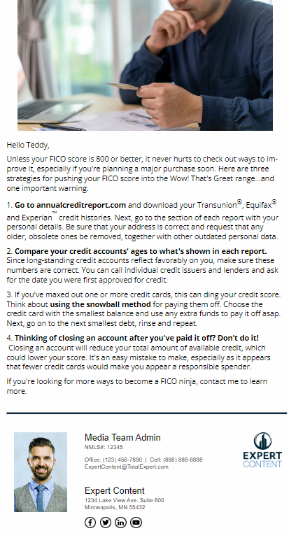
Credit Health
Email Subject:
Introducing the Big Three credit agencies
Strategies for better credit scores
Inside: smart fixes for credit problems
Notes:
This page should be used for JOURNEY EMAILS (duplicate as needed)

Slide 6
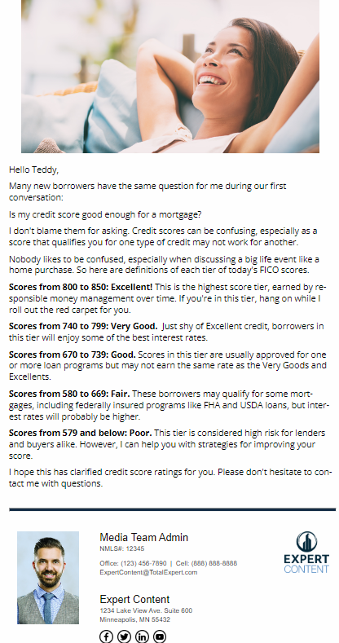
Credit Health
Email Subject:
There's no such thing as one FICO credit score. Here's why.
Feeling good about your credit score? I've got your number.
Tips for Credit Health
Notes:
This page should be used for JOURNEY EMAILS (duplicate as needed)

Slide 7
Credit Health
Credit Health User Notification - Connect with Contact
The contact below has triggered the Credit Health journey and will begin receiving automated emails within the next 10 days. This campaign includes general credit information, tips/tricks, and ways to reach out to you for more help. You can visit their contact details page for additional information and to reach out directly prior to the campaign start.
Contact name: {{contact.f_name}} {{contact.l_name}}
Contact phone: {{contact.phone}}
Notes:
This page should be used for Social Media (duplicate as needed)

