Slide 1
Expert Content
Strategy Guide
Customer Intelligence Rate Journey
July 2026

Slide 2
Customer Intelligence Rate Journey
Communication types: Email, SMS, and User Notification
Engage borrowers when rate opportunities arise to strengthen relationships and protect revenue.
This journey ensures timely engagement when Customer Intelligence Rate insights indicate a borrower's current mortgage rate exceeds market rates—helping them act on refinancing opportunities before competitors reach them. Marketing admins can configure triggers, conditions, and messaging to align with organizational strategy.
Intentionally condensed because mortgage rate fluctuations are time-sensitive. This 9-day, 7-touch journey (4 emails + 3 SMS) moves borrowers through awareness, consideration, and action. The timing allows for thought without losing urgency.
Topics covered:
Emails: Rate news + savings analysis, financial goal alignment (debt payoff, home improvements), urgency messaging with market context
SMS: Rate opportunity hook, engagement check-in, time-sensitive call-to-action
*All communications should be reviewed prior to initiating the journey.

Slide 3
Customer Intelligence Rate Journey
Campaign Schedule & Execution
Day 1
SMS: Interest Rates Dropping
8:00 AM – 5:00 PM
Email: Refinance with Monthly Savings
30-minute timer delay after SMS
Day 2
Email: Rate/Term versus cash-out to reach financial goals
9:30 AM
Day 3
SMS: Check with borrower to see if they have reviewed the refinance details
11:00 AM
Day 5
Email: What would you do with an extra $x/month?
9:00 AM
Day 9
SMS: Rates can change, act now
8:00 AM
Email: Early birds get the lower rates
9:00 AM
Campaign Schedule Notes
First touchpoint: Hook with rate news + financial benefit to establish credibility and offer real savings
Re-engage with dynamic estimated savings data throughout to increase relevance and trust.
Final touchpoint: Rates won't last—encourage quick action.
Rates move quickly but borrowers need time to consider. This window allows that without losing urgency.
Days Total
9
Touches
7
Email + SMS
4 + 3
Primary Goal
Refinance loan
Notes:
This page should be used for TASKS, USER NOTIFICATIONS, AND SMS TEMPLATES (duplicate as needed)

Slide 4
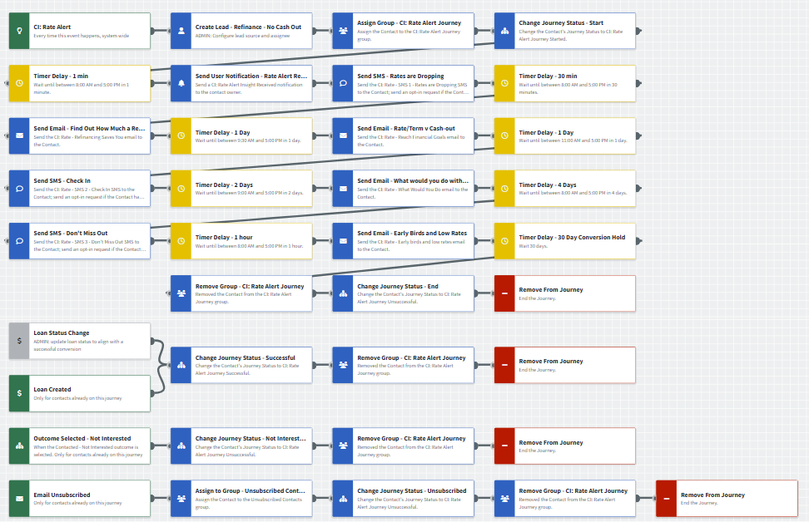
Customer Intelligence Rate Journey
Journey Notes:
Configure onramp triggers: Use Insight Created – Rate Alert with organization-specific inline conditions (servicing status, consent requirements, segment targeting)
Configure offramp triggers:
  Use Loan Status Change and Loan Created with organization-specific inline conditions (loan purpose, loan status).
  If you have a point-of-sale integration, consider adding an Application Started offramp.
  Train LOs to use Outcomes to remove uninterested contacts.
Customize messaging: Keep emails that work for your organization, edit to meet your tone, swap with custom alternatives, or layer these into existing campaigns
Timing: Adjust day/time delivery based on your organization’s contact preference (operating hours, day-of-week patterns)
Notes:
This page should be used for JOURNEY WIREFRAMES (duplicate as needed)

Slide 5

Customer Intelligence Rate Journey
Email Subject Line:
Find out how much refinancing can save you. (Hint: you'll like it!)
Hi {{recipient.f_name}},
You may have already noticed that mortgage interest rates are dropping.
Since I assisted you with your current mortgage with {{sender.company}}, I'd like to help you save money by refinancing to a lower rate.
You'll need to act quickly to lock in lower rates, so I've already done the math for you.
You could save up to ${{recipient.enriched.rate.estimated_monthly_savings | formatNumber: 0}} each month by refinancing to market rates.
Call me at {{sender.phone_cell}} today to apply, or if you have questions. I'm ready to help you save.
Notes:
This page should be used for EMAILS (duplicate as needed)

Slide 6

Customer Intelligence Rate Journey
Email Subject Line:
Reach more financial goals with the right refinance.
Hi {{recipient.f_name}},
Are you planning some home renovations soon? Want to get rid of your credit card debt? Interest rates have just dropped, which means that refinancing your mortgage with {{sender.company}} could help make these happen.
Based on current market rates, refinancing to a lower interest rate could save you up to ${{recipient.enriched.rate.estimated_monthly_savings | formatNumber: 0}} monthly. That adds up to ${{recipient.enriched.rate.estimated_5_year_savings | formatNumber: 0}} over five years.
You can choose from a rate-term refinance, which lowers your interest rate for lower monthly payments, or a cash-out refinance that provides funds for whatever's on your financial to-do list.
Low rates don't wait around, so let's talk soon. Call me at {{sender.phone_cell}} today for details of your potential savings or email me and request a personalized quote.
Notes:
This page should be used for EMAILS (duplicate as needed)

Slide 7

Customer Intelligence Rate Journey
Email Subject Line:
What would you do with an extra ${{Auto-generated}} every month?
Hello {{recipient.f_name}},
Staying healthy is easier when you go for an annual checkup...and this applies to your mortgage, especially when interest rates are lower.
Here are some positive results about your mortgage's recent diagnosis:
Based on current market rates, refinancing to a lower interest rate could save you up to ${{recipient.enriched.rate.estimated_monthly_savings | formatNumber: 0}} monthly. That adds up to ${{recipient.enriched.rate.estimated_5_year_savings | formatNumber: 0}} over five years.
You can lower your monthly mortgage payments by refinancing, or you can opt for a shorter loan term that will reduce the amount of interest. These savings often add up to more than my borrowers expect!
Call me at {{sender.phone_cell}} or email me back and I'll send you a quote!
Notes:
This page should be used for EMAILS (duplicate as needed)

Slide 8

Customer Intelligence Rate Journey
Email Subject Line:
Early birds get the worms AND the lower mortgage interest rates.
Hi {{recipient.f_name}},
I'm afraid I can't provide any worms, but if you act fast, I can help you save on your mortgage. I've already done the math!
Refinancing to a lower interest rate could save you up to ${{recipient.enriched.rate.estimated_monthly_savings | formatNumber: 0}} monthly, based on current market rates.
You can lower your monthly mortgage payments — this is called a rate-term refinance — or consider a cash-out refinance so you can pay off high-interest debts or make some home improvements.
Let's talk soon, before these low rates fly away. Call me at {{sender.phone_office}} to learn more.
Notes:
This page should be used for EMAILS (duplicate as needed)

Slide 9
Customer Intelligence Rate Journey
CI: Rate - SMS 1 - Rates are Dropping
Hi {{recipient.f_name}}, this is {{sender.f_name}} with {{sender.company}}. Interest rates are dropping, which means you may be able to save by refinancing your mortgage. I'll send you an email today with more details, but you can call me right now at {{sender.phone_cell}} to learn more.
CI: Rate - SMS 2 - Check In
Psst! This is {{sender.f_name}} with {{sender.company}}. Have you had time to review the refinance offer I emailed you? Interest rates have fallen, which means you have opportunities to lower your monthly mortgage payments. Call me at {{sender.phone_cell}} to learn more.
CI: Rate - SMS 3 - Don't Miss Out
Hi {{recipient.f_name}}, this is {{sender.f_name}} with {{sender.company}}. Time's running out to save by refinancing your mortgage. I would hate to see you miss out on lower mortgage payments, but rates could change before you know it. Call me at {{sender.phone_cell}} to learn how much you could save.
Notes:
This page should be used for TASKS, USER NOTIFICATIONS, AND SMS TEMPLATES (duplicate as needed)

Slide 10
Customer Intelligence Rate Journey
Send User Notification - Rate Alert Received
CI: Rate Alert Insight Received
The following contact has triggered a rate alert indicating their current mortgage rate is higher than our company threshold and is a candidate for refinancing. Emails will be sent on your behalf but are more impactful if you reach out directly to them.
Contact name: {{contact.f_name}} {{contact.l_name}}
Contact phone: {{contact.phone_cell}}
Loan number: {{contact.enriched.rate.loan_number}}
Loan amount: ${{contact.enriched.rate.loan_amount | formatNumber: 0}}
Loan program: {{contact.enriched.rate.loan_program}}
Loan funded date: {{contact.enriched.rate.loan_funded_date | date: "m/d/Y"}}
Loan rate: {{contact.enriched.rate.loan_rate}}% | Market rate: {{contact.enriched.rate.current_market_rate}}%
Potential monthly savings: ${{contact.enriched.rate.estimated_monthly_savings | formatNumber: 0}}/month
Notes:
This page should be used for TASKS, USER NOTIFICATIONS, AND SMS TEMPLATES (duplicate as needed)

