Slide 1
Expert Content
Strategy Guide
Email Headers
November 2025

Slide 2
Expert Content Email Headers
The Expert Content library includes email headers in a variety of design options. These layouts are optimized for top email clients and devices and are built to deliver brand consistency and personalization at scale.
Email headers are designed to meet the needs of most organizations’ branding requirements and visual preferences. They may not meet the needs of unique or highly customized brand layouts. Adjustments outside the standard content blocks require custom work. For more information on those requirements, visit this resource.
Email headers include:
Dynamic user data (name, title, contact info)*
Dynamic branding elements (company/brand name, logos and colors)*
Collapsing field functionality (e.g. if a user doesn’t have a social link filled in, the corresponding social icon will collapse)
Responsive layouts for desktop and mobile
*Available fields vary by design (e.g., stacked or horizontal logos, user profile image, address, and website). See “Available Fields by Design” in the Appendix for specific field inclusion per layout.

Slide 3

EC - Email Header - Stacked Logo and User Info
Mobile
Desktop

Slide 4


EC - Email Header - Horizontal Logo and User Info
Mobile
Desktop

Slide 5

EC - Email Header - Centered Logo Only
Mobile
Desktop

Slide 6
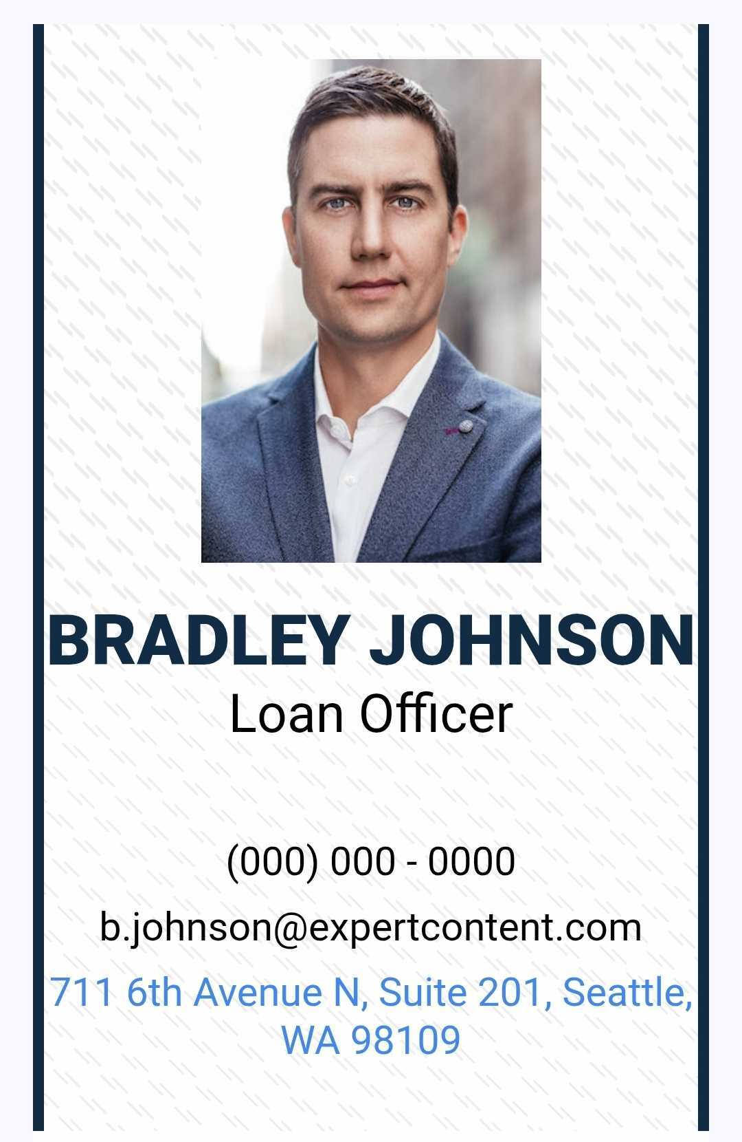
EC - User Email Header, SB – 0054
Mobile
Desktop

Slide 7
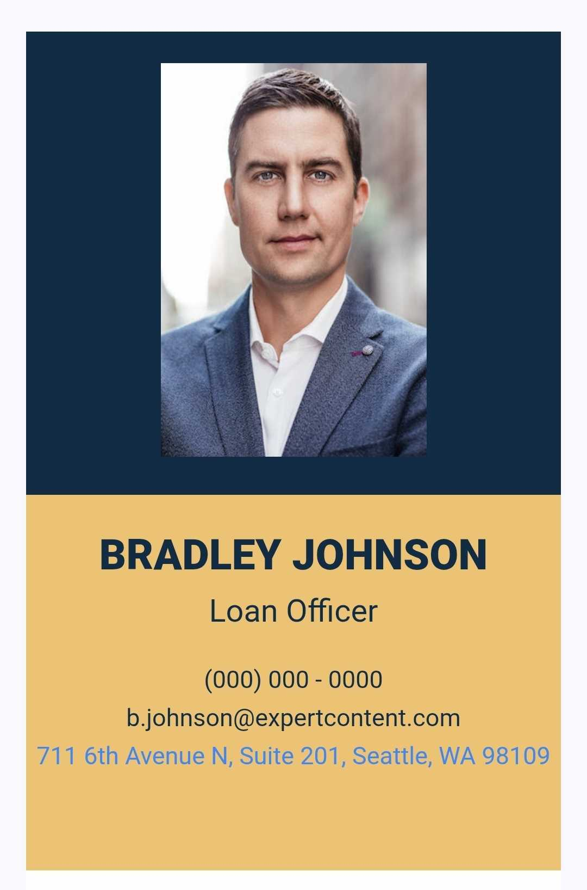
EC - User Email Header, SB - 0055
Mobile
Desktop

Slide 8

EC - User Email Header, SB - 0056
Mobile
Desktop

Slide 9

EC - User Email Header, SB - 0057
Mobile
Desktop

Slide 10
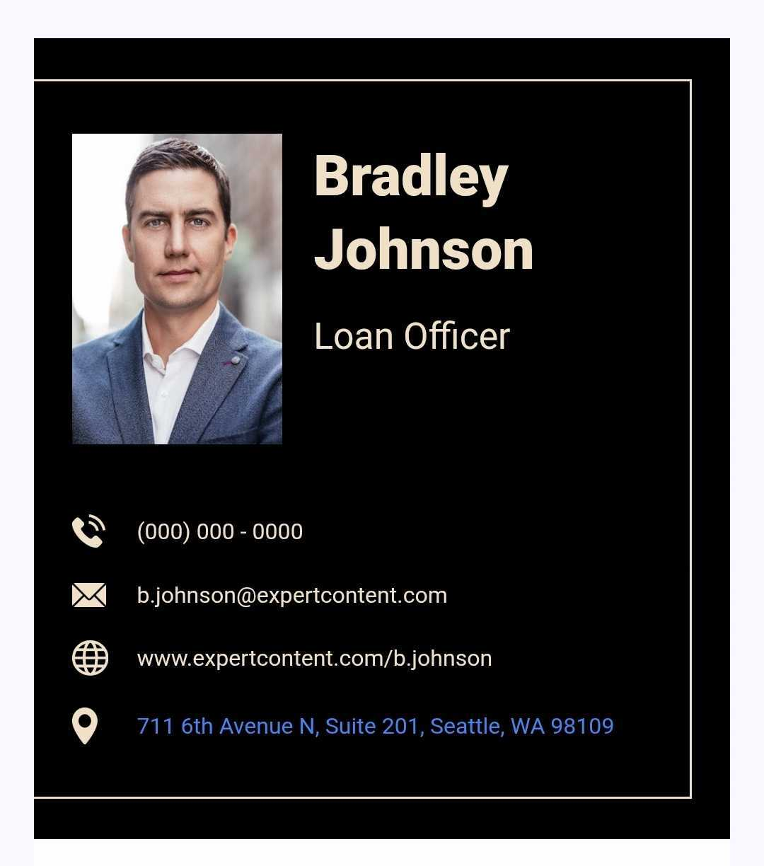
EC - User Email Header, SB - 0058
Mobile
Desktop

Slide 11
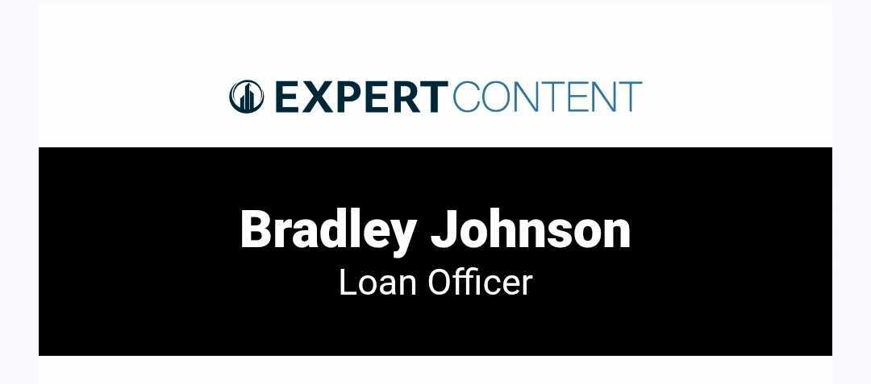
EC - User Email Header, SB - 0059
Mobile
Desktop

Slide 12
Appendix
Fields available in each design

Slide 13
Available Fields by Design
 | Email Headers
User Profile Fields | Stacked Logo | Horizontal Logo | Centered Logo Only | 0054 | 0055 | 0056 | 0057 | 0058 | 0059
First and Last Name | X | X |  | X | X | X | X | X | X
License #
Title |  |  |  | X | X | X | X | X | X
Profile Image |  |  |  | X | X | X | X | X
Company Logo (brand_user_logo) | Stacked | Horizontal | Stacked |  |  |  | Horizontal |  | Horizontal
Office Phone |  |  |  | X | X | X | X | X
Cell Phone
Email Address |  |  |  | X | X | X | X | X
Company Name (brand_company_name) | X | X
Address |  |  |  | X | X | X |  | X
User Website | X | X |  |  |  | X | X | X

