Slide 1
Expert Content
Strategy Guide
Email Signatures

Slide 2
Expert Content Email Signatures
The Expert Content library includes email signatures in a variety of design options. These designs are based on common industry and email signature practices. They are optimized for the top email clients and operating system combinations but may render differently based on the combination. They are designed to meet the needs of most customer’s compliance requirements and design preferences. They may not meet the needs of the strictest or more unique requirements. If no option meets your organization’s requirements or standards, custom signatures can be created through service packages. For more information on what adjustments would require custom work, visit this resource.
Email signatures include:
Personalized user and comarketing partner information.
Dynamic branding elements including company/brand name, logos and colors where applicable.
Dynamic disclaimers leveraging the organization’s standard email compliance verbiage. Additional or override disclaimer options are available to apply on individual emails.
Collapsing field functionality (e.g. if a user doesn’t have a social link filled in, the corresponding social icon will collapse).
Responsive signatures that adjust based on screen resolution such as mobile devices.

Slide 3
Mortgage

Slide 4
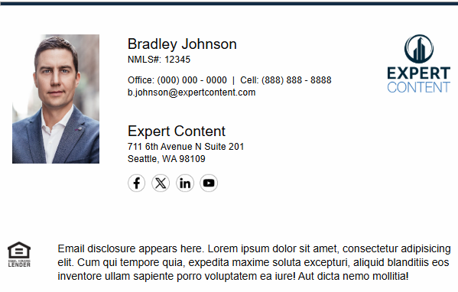
Single Branded
EC - Email Footer Concept A - SB
Single Branded email signature notes:
Single branded email signatures A-C have corresponding co-branded email signatures. The fields available in these designs are the same for both the user and comarketing partners.
If your organization prefers to have the same or similar single and co-branded signatures, these will best align with that approach.
Due to user profiles having a more robust set of information, D-F were designed only in single branded variations. D-F utilize additional fields not available in the comarketer profiles.

Slide 5
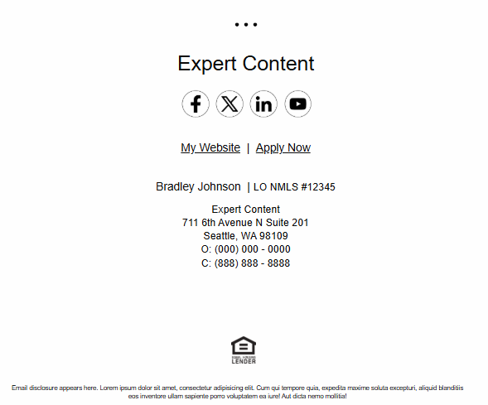
Single Branded
EC - Email Footer Concept B - SB
EC - Email Footer Concept Bv2 - SB

Slide 6
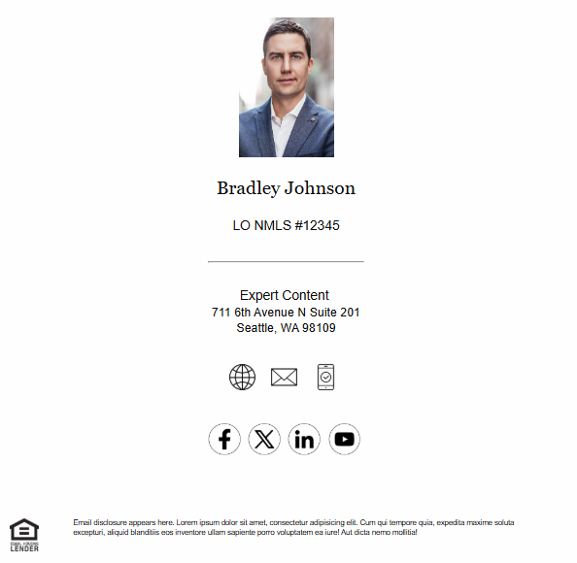
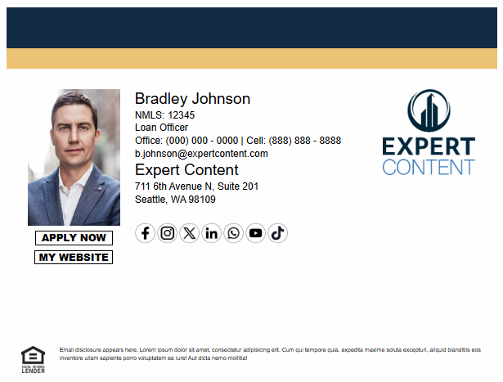
Single Branded
EC - Email Footer Concept C - SB
EC - Email Footer Concept D - SB

Slide 7
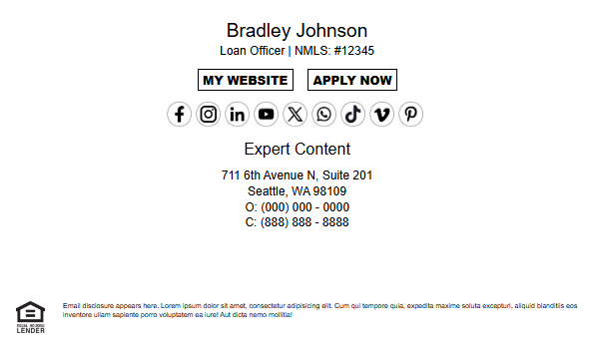
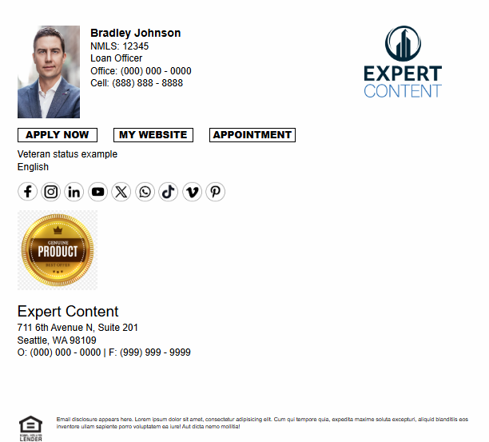
Single Branded
EC - Email Footer Concept E - SB
EC - Email Footer Concept F - SB

Slide 8
Co-branded
EC - Email Footer Concept A - CB
Co-branded email signature notes:
Signatures A-C have corresponding single branded email signatures.
Unlike print contact blocks, email signatures are not editable prior to sending. Information that is not filled out in either the user or comarketer’s profile will collapse and shift to eliminate blank spaces.

Slide 9
Co-branded
EC - Email Footer Concept B - SB
EC - Email Footer Concept Bv2 - SB

Slide 10
Co-branded
EC - Email Footer Concept C - SB

Slide 11
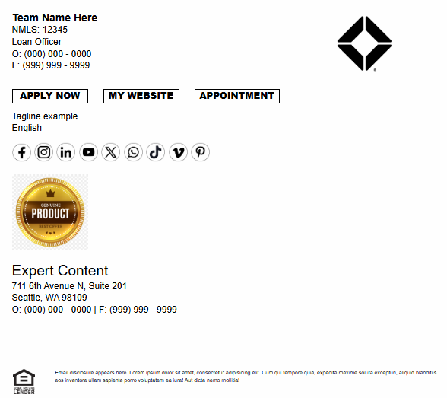
Team Branded
EC - Email Footer Concept Team Branded - SB
Team Branded email signature notes:
Team branded email signatures do not pull from multiple users’ profiles or a centralized location. Team fields do not associate multiple users to the same team entity.
Fields in this signature reference team elements such as Team Name, Team Tagline, and Team Logo, from an individual user’s profile. These fields must be populated on each team member’s profile separately.
Fields such as NMLS, Phone Numbers, and Social Media Platform Links will be user-specific.
Replies to the email will go to the user from which the initial email was sent.
Team Logo

Slide 12
Insurance

Slide 13
Agent Branded
EC - Insurance Email Signature - Agent Branded
Agent Branded email signature notes:
Primary and secondary colors are applied to the top divider bar.
Websites, social icons, and app store icons are clickable.
All contact information is pulled from the individual agent’s user profile. Company name and logo are pulled from branding/cost center logic.

Slide 14
Company Branded
EC - Insurance Email Signature - Company Branded
Company Branded email signature notes:
Contact information is pulled from the agent’s user profile from which the email is sent/sent on behalf of. Company name and logo are pulled from branding/cost center logic.
Brand primary and secondary colors are applied to the top divider bar.
Brand primary is applied to the middle divider.

Slide 15
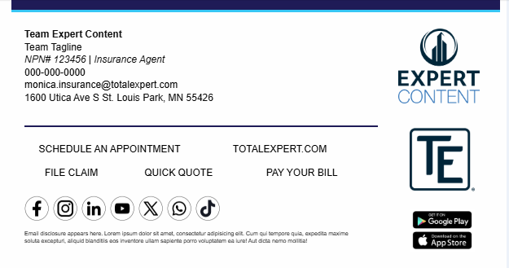
Team Branded
Team Branded email signature notes:
Team branded email signatures do not pull from multiple users’ profiles or a centralized location. Team fields do not associate multiple users to the same team entity.
Fields in this signature reference team elements such as Team Name, Team Tagline, and Team Logo, from an individual user’s profile. These fields must be populated on each team member’s profile separately.
Fields such as NPN/license #, Phone Numbers, and Social Media Platform Links will be user-specific.
Replies to the email will go to the user from which the initial email was sent.
EC - Insurance Email Signature -Team Branded
Team Logo

Slide 16
Banking and Credit Union

Slide 17
Appendix
Tips for testing, field comparison for each signature,

Slide 18
Available Fields by Design - Mortgage
 | Single Branded |  |  |  |  |  |  | Co-Branded |  |  |  | Team
User Profile Fields | Concept A | Concept B | Concept Bv2 | Concept C | Concept D | Concept E | Concept F | Concept A | Concept B | Concept Bv2 | Concept C | Team Branded
First and Last Name | X | X | X | X | X | X | X | X | X | X | X
License # | X | X | X | X | X | X | X | X | X | X | X | X
Title | X |  |  |  | X | X | X | X |  |  |  | X
Profile Image | X |  | X | X | X |  | X | X |  | X | X
Company Logo (brand_user_logo) | X |  |  |  | X |  | X | X
Office Phone | X | X | X |  | X | X | X | X | X | X |  | X
Cell Phone | X | X | X | X | X | X | X | X | X | X | X | X
Email Address | X |  |  | X | X |  |  | X |  |  | X
Company Name (brand_company_name) | X | X | X | X | X | X | X | X | X | X | X | X
Address | X | X | X | X | X | X | X | X | X | X | X | X
User Website |  | X | X | X | X | X | X |  | X | X | X | X
Application Link |  | X | X |  | X | X | X |  | X | X |  | X
Appointment Scheduling |  |  |  |  |  |  | X |  |  |  |  | X
Facebook | X | X | X | X | X | X | X | X | X | X | X | X
X/Twitter | X | X | X | X | X | X | X | X | X | X | X | X
LinkedIn | X | X | X | X | X | X | X | X | X | X | X | X
Youtube | X | X | X | X | X | X | X | X | X | X | X | X
Instagram |  |  |  |  | X | X | X |  |  |  |  | X
WhatsApp |  |  |  |  | X | X | X |  |  |  |  | X
TikTok |  |  |  |  | X | X | X |  |  |  |  | X
Veteran Status |  |  |  |  |  |  | X |  |  |  |  | X
Languages |  |  |  |  |  |  | X |  |  |  |  | X
Award Image #1 |  |  |  |  |  |  | X |  |  |  |  | X
Team Logo |  |  |  |  |  |  |  |  |  |  |  | X
Team Name |  |  |  |  |  |  |  |  |  |  |  | X
Team Tagline |  |  |  |  |  |  |  |  |  |  |  | X
Notes:
Add agent version of these possibly

Slide 19
Available Fields by Design - Insurance
User Profile Fields | Agent Branded | Company Branded | Team Branded
First and Last Name | X
License # | X | X | X
Title | X | X | X
Profile Image | X
Company Logo (brand_user_logo) | X | X | X
Office Phone | X | X | X
Email Address | X |  | X
Company Name (brand_company_name) | X | X
Address | X | X | X
User Website | X | X | X
File Claim Link | X | X | X
Application Link (Quick Quote) | X | X | X
Bill Pay Link | X | X | X
Appointment Scheduling | X |  | X
Mobile App Download | X | X | X
Facebook | X | X | X
X/Twitter | X | X | X
LinkedIn | X | X | X
Youtube | X | X | X
Instagram | X | X | X
WhatsApp | X | X | X
TikTok | X | X | X
Award Image #1 | X | X
Team Logo |  |  | X
Team Name |  |  | X
Team Tagline |  |  | X
Notes:
Disclaimer: reference the design earlier in the deck to see visual representation
Add agent version of these possibly

Slide 20
Available Fields by Design - Bank/CU
Notes:
Disclaimer: reference the design earlier in the deck to see visual representation
Add agent version of these possibly

Slide 21
Tips for testing email signatures
Test both desktop and mobile versions across your organization’s most used operating systems, email clients and browsers.
Use a test user that has all user profile fields and images populated.
You can remove several fields from this user, or use a different test user, to see fields collapse when various contact data isn’t present. Example: if Facebook link is missing, the icon will not be present and other icons will shift to remove empty space.
Test disclaimers with multiple users from different cost centers, if applicable.
This needs to be a separate KB article – couldn’t find anything similar or as detailed.

Slide 22
This probably needs to be a separate KB article – couldn’t find anything similar or as detailed.
FAQs
Why does my logo look small?
Logos are best represented in a stacked version to fill most of the allotted 1:1 space.
Why do some of my users have profile images and others do not?
Check to see that the users have profile images uploaded in their user settings.
Why does the signature look different in Outlook and Gmail?
Signatures are optimized for the top email clients and operating system combinations but may render differently based on the combination.
The disclaimer font size is too small, how do I change this?
For more information on Expert Content adjustments, visit this resource.
What is the width of the email signatures?
Desktop is 600px; Mobile versions are ___

