Slide 1
Expert Content
Strategy Guide
First Time Homebuyers & Mortgage Education

Slide 2
First Time Homebuyers &
Mortgage Education
Journey emails, Social Media
Series of 14 emails formatted into a journey that are created to help inform customers about the types of loans available, common misconceptions about the mortgage process and general talking points surrounding obtaining a mortgage.
The journey outline can be tailored to help target your designated prospect audience and supplemented with any additional content in your library.
*All communications should be reviewed prior to initiating the journey.

Slide 3
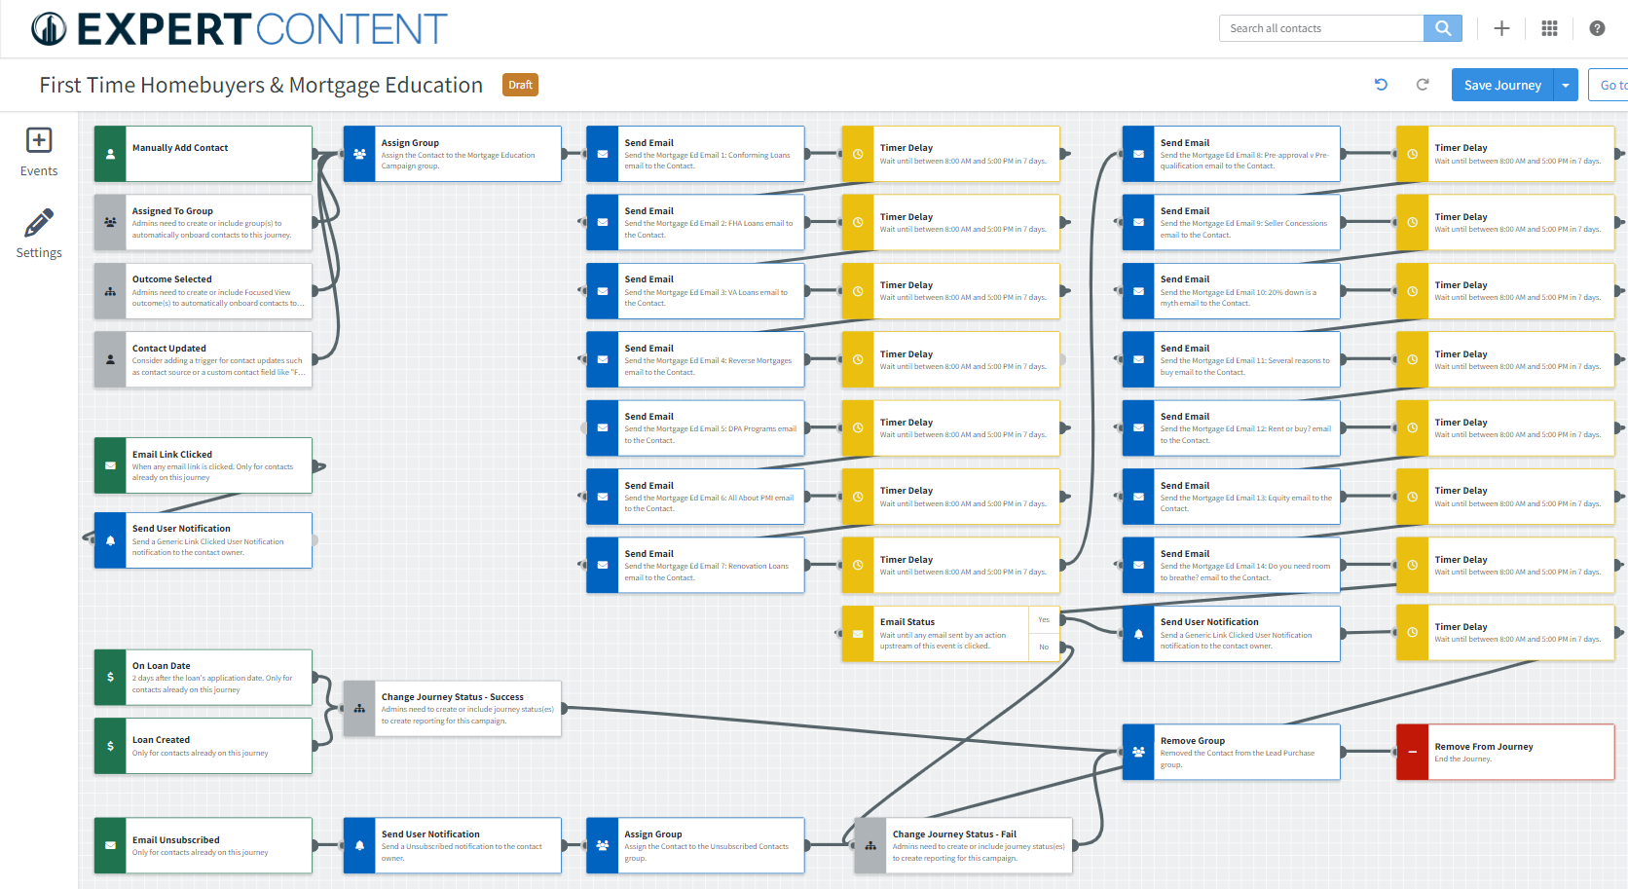
Journey Wireframe

Slide 4
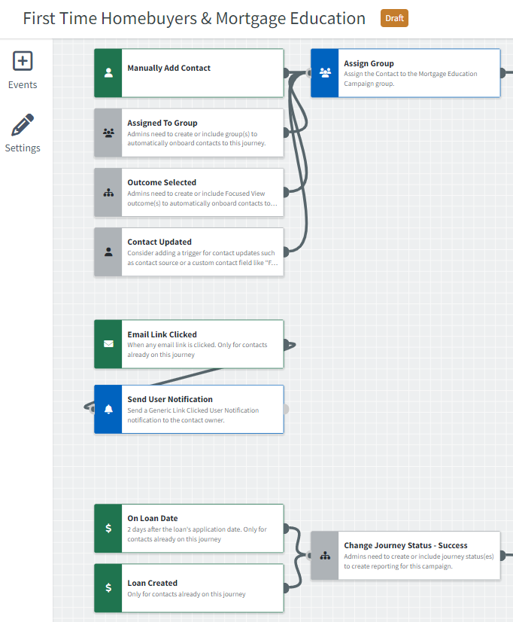
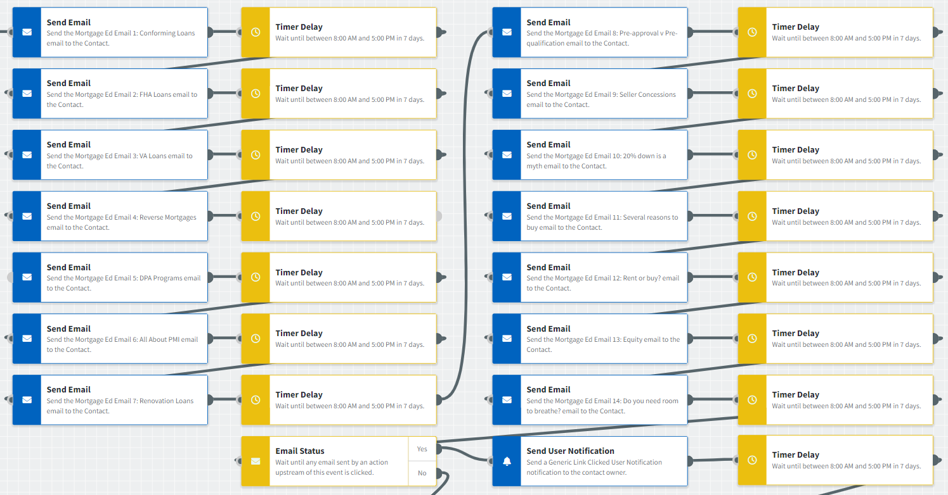
Journey Wireframe Notes:
Keep emails that work for your organization, swap with custom, or add these emails to your existing campaigns.
Adjust onramps with organization specific groups and Focused View outcomes.

Slide 5
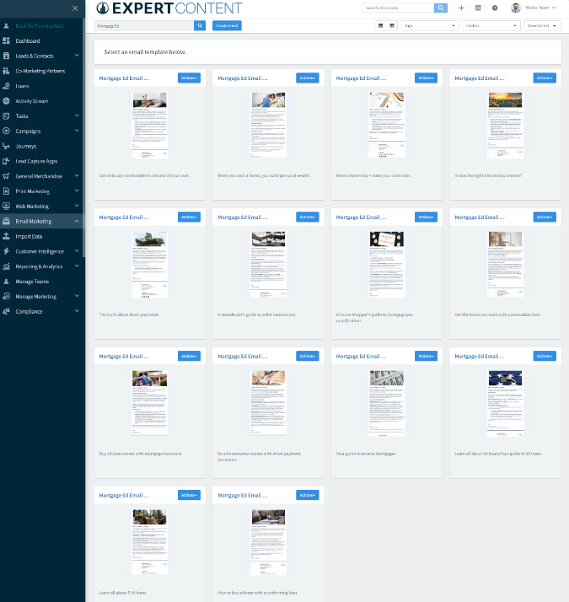
Email Subject:
Get seriously comfortable in a home of your own
When you own a home, you build personal wealth
Home ownership = make your own rules

Slide 6
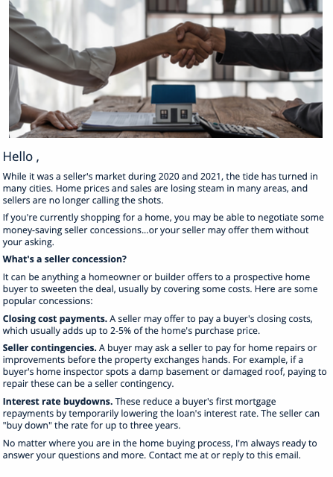
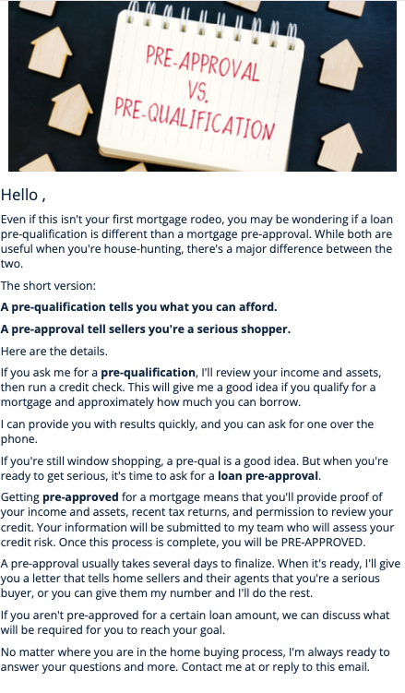
Email Subject:
Is now the right time to buy a home
The truth about down payments
A homebuyer’s guide to seller concessions
A house-shopper’s guide to mortgage pre-qualification

Slide 7
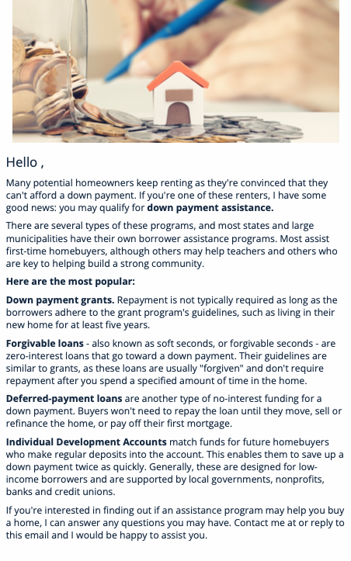
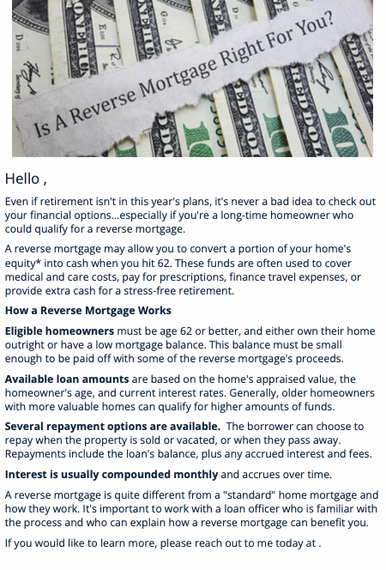
Email Subject:
Get the home you want with a renovation loan
Be a homeowner sooner with down payment assistance
Buy a home sooner with mortgage insurance
Your guide to reverse mortgages

Slide 8
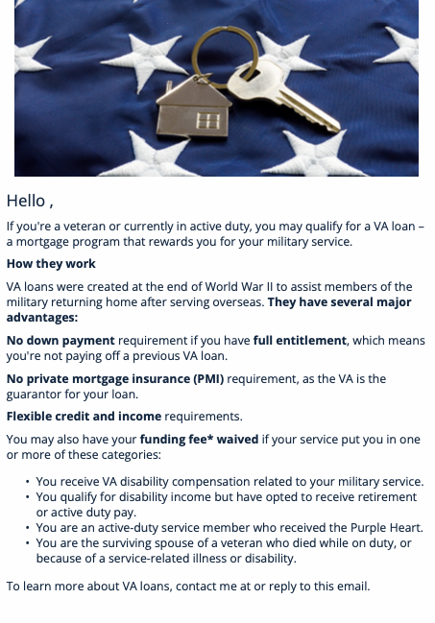
Email Subject:
Your guide to VA loans
Learn all about FHA loans
How to buy a home with a conforming loan

Slide 9
Social Media
Notes:
This page should be used for Social Media (duplicate as needed)

Slide 10
Social Media
Notes:
This page should be used for Social Media (duplicate as needed)

Slide 11
Social Media
Notes:
This page should be used for Social Media (duplicate as needed)

Slide 12
Social Media
Notes:
This page should be used for Social Media (duplicate as needed)

