Slide 1
Expert Content
Strategy Guide
General Postcards – Home Maintenance
June 2026

Slide 2
General Postcard Library
Ready-to-deploy postcards that keep you in front of customers and prospects.
A turnkey content library. Launch with a curated set of seasonal home maintenance postcards designed to drive ongoing engagement.
Flexible by default. Every asset ships in all ordering methods (Direct Mail, Non-Direct Mail, EDDM) and both single and cobranded formats — so any team member, in any market, can use them.
Make it your own. Easily duplicate any asset to create variations across ordering methods and branding types, or rework the template entirely to build a postcard for something different.
What’s in this guide. Each page covers two postcard topics and their supported ordering and branding options.
*All communications should be reviewed prior to publishing the assets to end users.

Slide 3
Seasonal Home Maintenance
Quarterly home maintenance checklist for each season

Slide 4
Seasonal Home Maintenance
Home maintenance recommendations for each season
Four ready-to-send postcards — one per season — that give homeowners (and renters) a quick checklist to keep their space in shape:
Spring (1319) – roof inspection, gutter cleaning, AC tune-up, exterior caulking, pruning, and fence/walkway checks.
Summer (1320) – deck and patio prep, foundation grading, fence and vent inspection, pool chemistry, and pest-screen repair.
Fall (1321) – gutters and downspouts, heating system service, hose draining, fireplace damper check, and weatherstripping.
Winter (1322) – pipe protection, smoke and CO detector tests, reversing ceiling fans, ice-dam roof checks, and dryer-vent cleaning.
Use as-is, duplicate to create regional variations, or rework the template entirely to build a checklist for something different — back-to-school prep, hurricane season, year-end financial tasks.
*All communications should be reviewed prior to publishing the assets to end users.

Slide 5
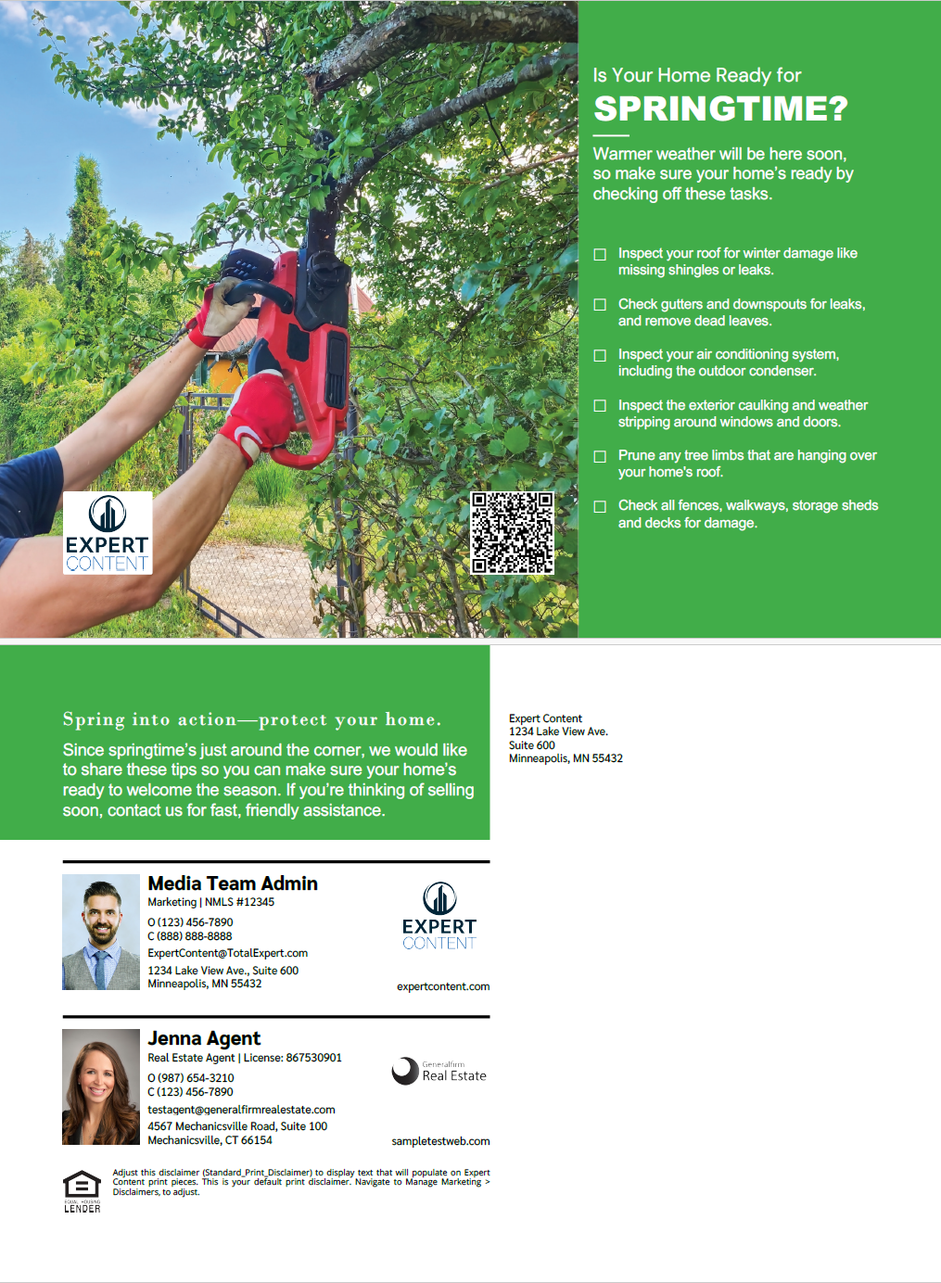

Seasonal Home Maintenance
Spring Home Maintenance (1319) and Summer Home Maintenance (1320)
Direct Mail, Non-Direct Mail, and EDDM
Single and Cobranded
Share spring and summer seasonal home maintenance recommendations with homeowners.
Notes:
This page should be used for POSTCARDS (duplicate as needed)

Slide 6
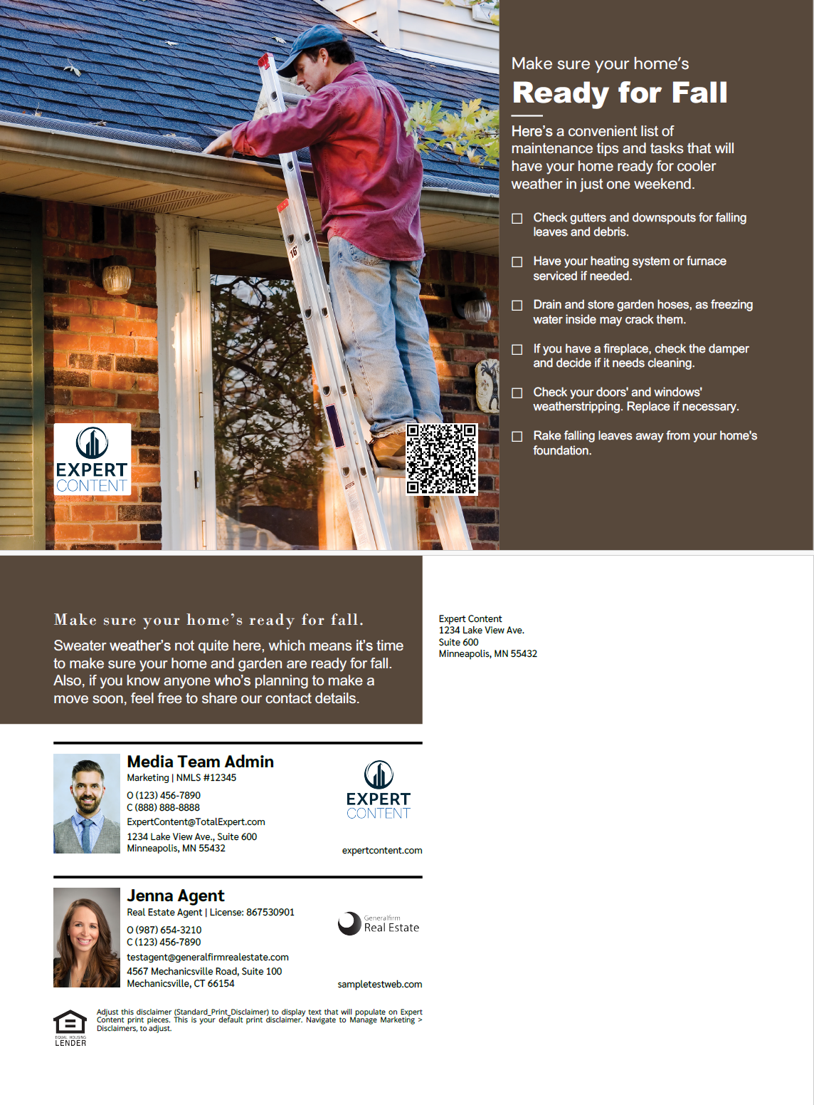
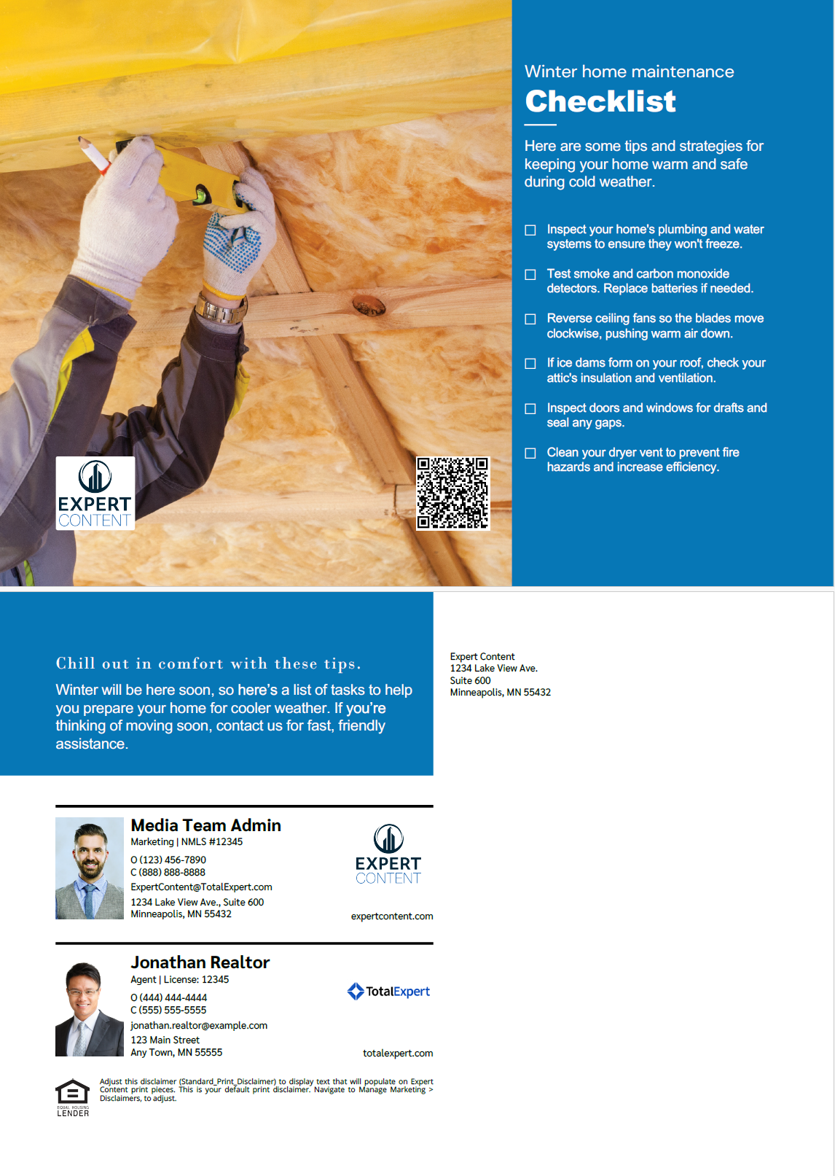
Seasonal Home Maintenance
Fall Home Maintenance (1321) and Winter Home Maintenance (1322)
Direct Mail, Non-Direct Mail, and EDDM
Single and Cobranded
Share fall and winter seasonal home maintenance recommendations with homeowners.
Notes:
This page should be used for POSTCARDS (duplicate as needed)

