Slide 1
Expert Content
Strategy Guide
General Postcards – Seasonal Recipes, Home Maintenance and Home DIY Tips
August 2026

Slide 2
General Postcard Library
Ready-to-deploy postcards that keep you in front of customers and prospects.
A turnkey content library. Launch with a curated set of seasonal home maintenance and home DIY tips postcards designed to drive ongoing engagement.
Flexible by default. Every asset ships in all ordering methods (Direct Mail, Non-Direct Mail, EDDM) and both single and cobranded formats — so any team member, in any market, can use them.
Make it your own. Easily duplicate any asset to create variations across ordering methods and branding types, or rework the template entirely to build a postcard for something different — back-to-school prep, hurricane season, year-end financial tasks.
What’s in this guide. Each page covers a postcard topic and its supported ordering and branding options.
*All communications should be reviewed prior to publishing the assets to end users.

Slide 3
Seasonal Recipes
Recipe postcards for low-effort, high-relevance touchpoints

Slide 4
Seasonal Recipes
Curated recipes for each season in configurable postcard templates
Ready-to-send postcards — two per season — that keep loan officers and organizations top-of-mind while providing a fun, seasonally-relevant recipe for borrowers, prospects, and partners alike.
Fall: Grilled Cheese Apple Bacon (1327) and Pumpkin Espresso Bundt Cake (1328)
Winter: releasing ahead of the season
Spring: releasing ahead of the season
Summer: releasing ahead of the season
Use as-is, duplicate and adjust for recipe variations, or rework the template entirely to build a postcard for something else – checklists, step-by-step guides, or educational content.
*All communications should be reviewed prior to publishing the assets to end users.

Slide 5
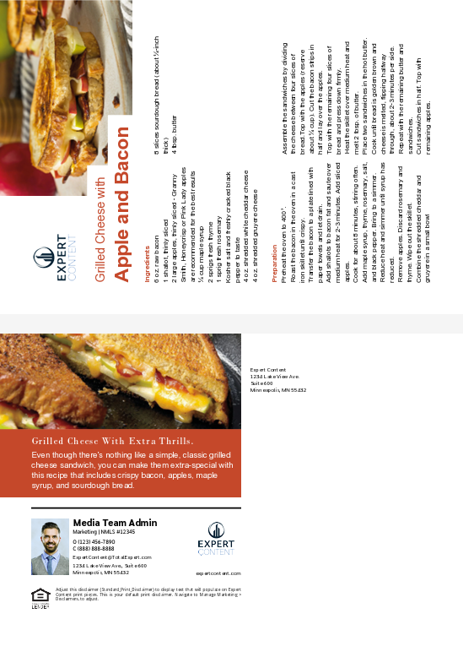
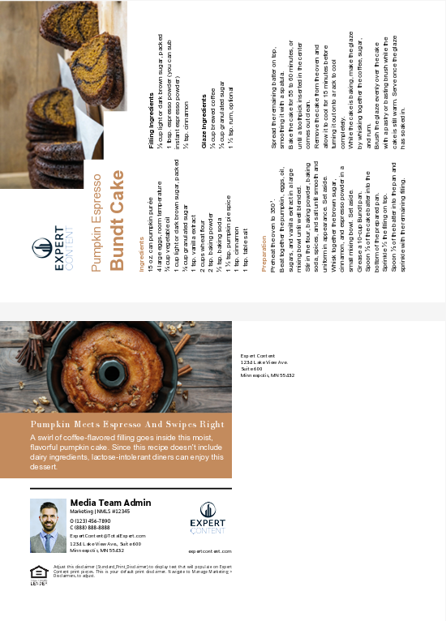
Seasonal Home Maintenance
Grilled Cheese Apple Bacon (1327) and Pumpkin Espresso Bundt Cake (1328)
Direct Mail, Non-Direct Mail, and EDDM
Single and Cobranded
Share Fall seasonal recipes with contacts of all types – borrowers, prospects, or partners.
Notes:
This page should be used for POSTCARDS (duplicate as needed)

Slide 6
Seasonal Home Maintenance
Quarterly home maintenance checklist for each season

Slide 7
Seasonal Home Maintenance
Home maintenance recommendations for each season
Four ready-to-send postcards — one per season — that give homeowners (and renters) a quick checklist to keep their space in shape:
Spring (1319) – roof inspection, gutter cleaning, AC tune-up, exterior caulking, pruning, and fence/walkway checks.
Summer (1320) – deck and patio prep, foundation grading, fence and vent inspection, pool chemistry, and pest-screen repair.
Fall (1321) – gutters and downspouts, heating system service, hose draining, fireplace damper check, and weatherstripping.
Winter (1322) – pipe protection, smoke and CO detector tests, reversing ceiling fans, ice-dam roof checks, and dryer-vent cleaning.
Use as-is, duplicate to create regional variations, or rework the template entirely to build a checklist for something different — back-to-school prep, hurricane season, year-end financial tasks.
*All communications should be reviewed prior to publishing the assets to end users.

Slide 8
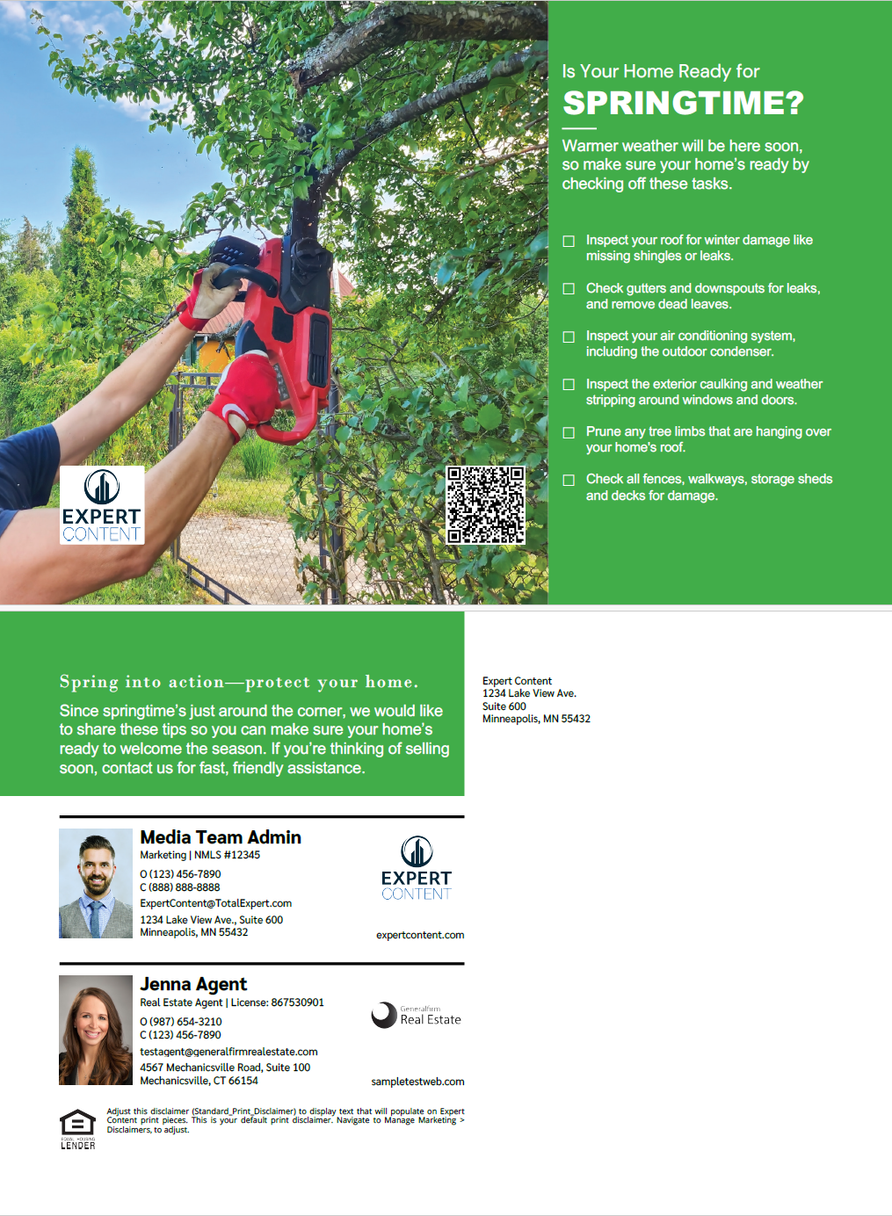

Seasonal Home Maintenance
Spring Home Maintenance (1319) and Summer Home Maintenance (1320)
Direct Mail, Non-Direct Mail, and EDDM
Single and Cobranded
Share spring and summer seasonal home maintenance recommendations with homeowners.
Notes:
This page should be used for POSTCARDS (duplicate as needed)

Slide 9
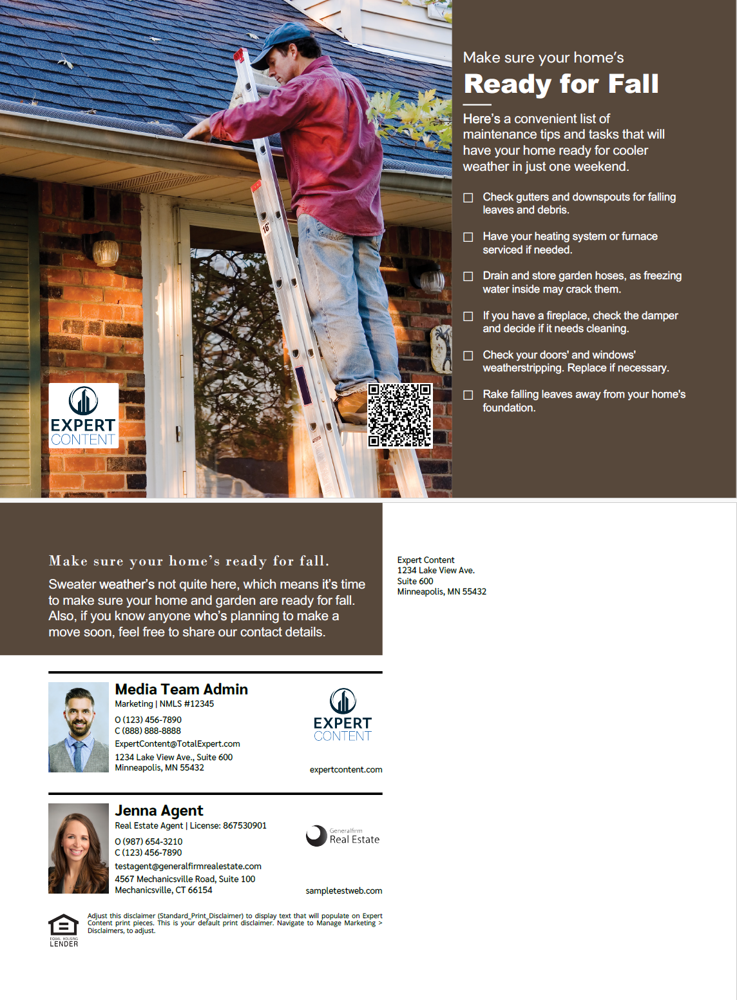
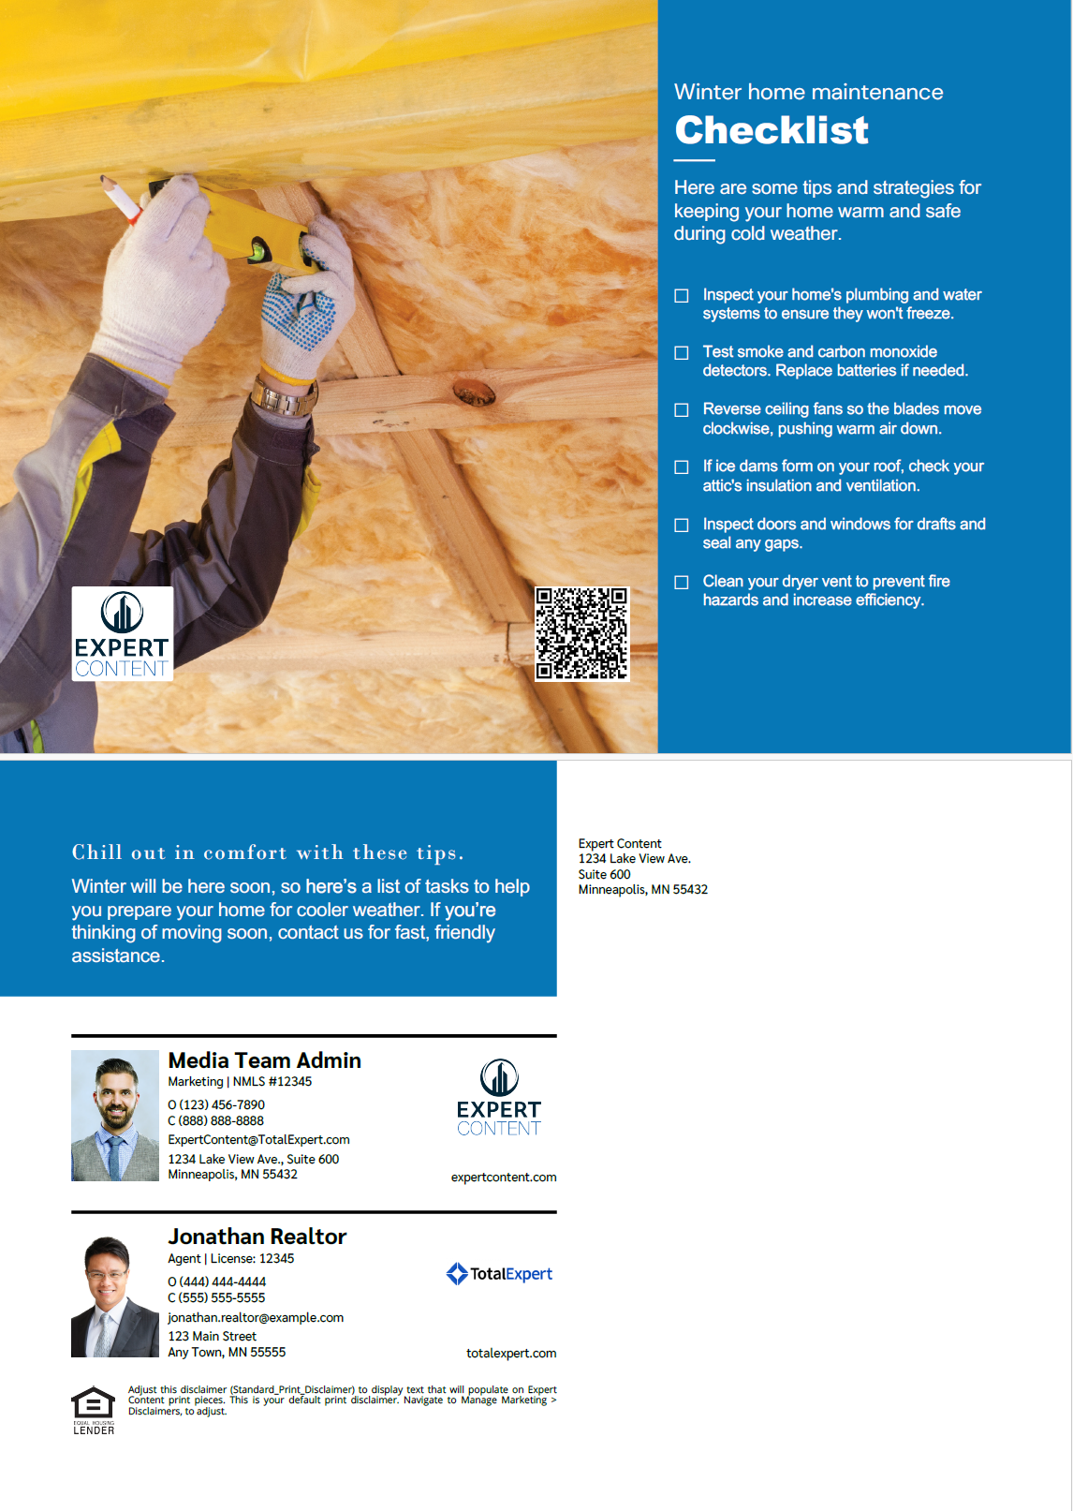
Seasonal Home Maintenance
Fall Home Maintenance (1321) and Winter Home Maintenance (1322)
Direct Mail, Non-Direct Mail, and EDDM
Single and Cobranded
Share fall and winter seasonal home maintenance recommendations with homeowners.
Notes:
This page should be used for POSTCARDS (duplicate as needed)

Slide 10
Home DIY Tips

Slide 11
Home DIY Tips and Tricks
Quick, shareable home-improvement projects for homeowners
Four ready-to-send postcards that give homeowners (and renters) easy DIY project ideas they can tackle in a weekend:
Door Facelift (1323) – simple updates to refresh a front door and boost curb appeal.
Paint a Room (1324) – step-by-step tips for prepping and painting an interior room.
Spare Room (1325) – ideas to convert an unused spare room into functional space.
Update Hardware (1326) – easy ways to refresh kitchen and cabinet hardware for a modern look.
Use as-is, duplicate to create variations for other DIY tips and tricks, or rework the template entirely to build a postcard for something different — installing ceiling fans, open house prep, refreshing outdoor spaces.
*All communications should be reviewed prior to publishing the assets to end users.

Slide 12
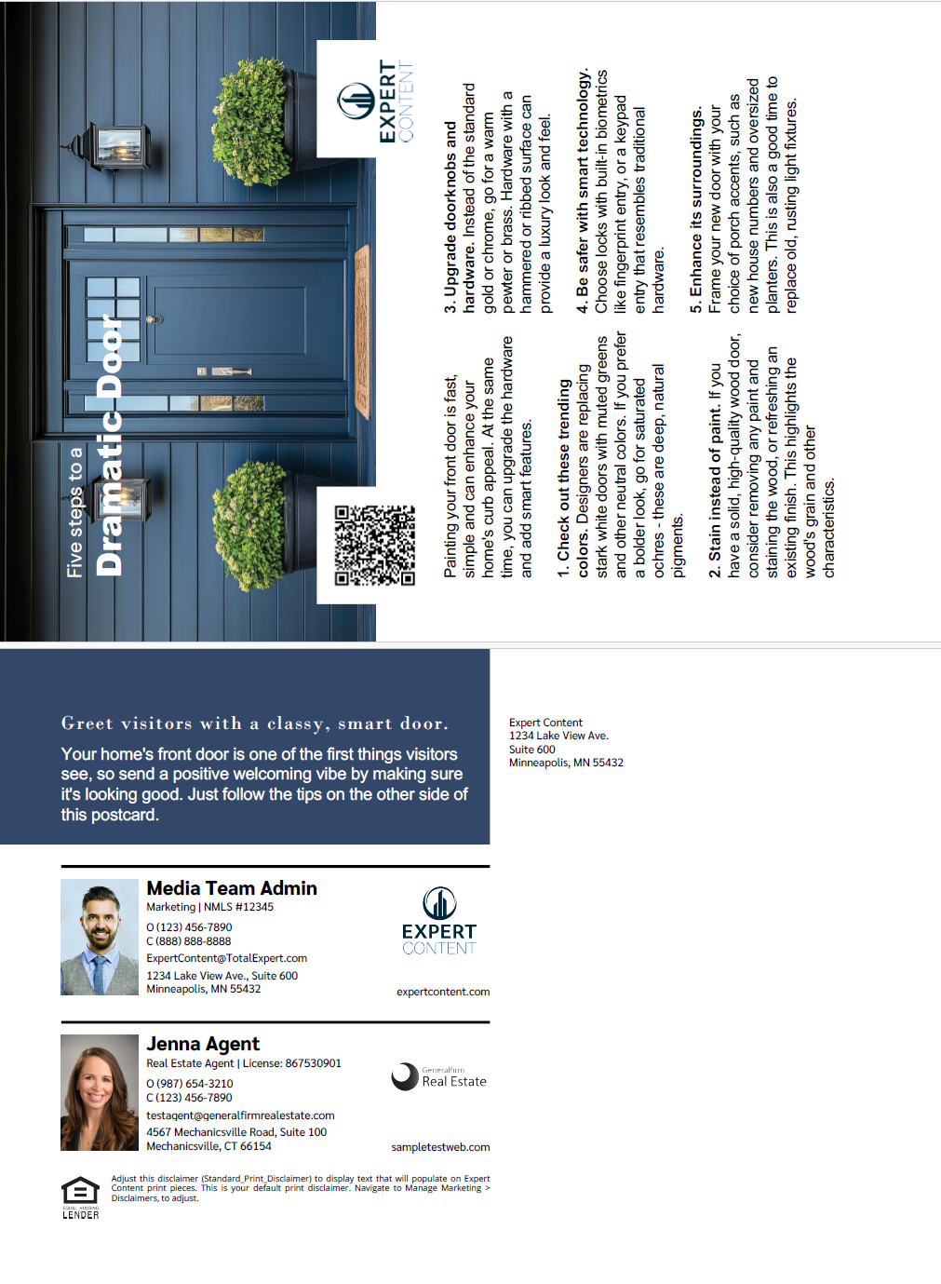
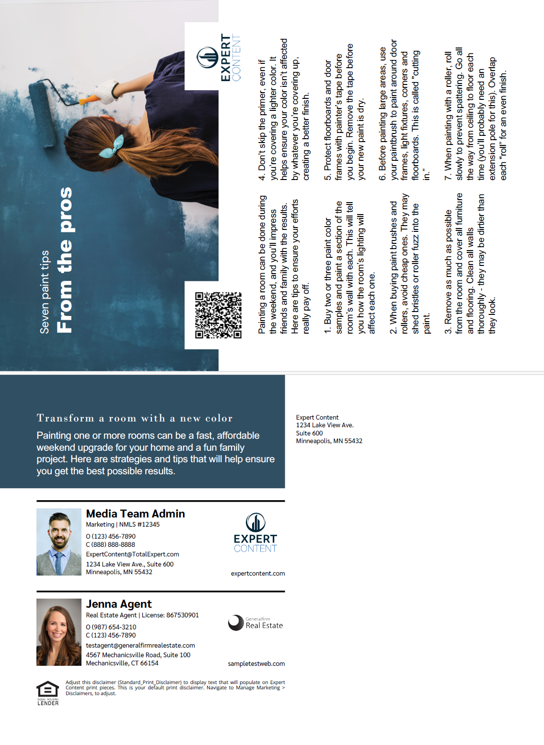
DIY Tips Postcards
Door Facelift (1323) and Paint a Room (1324)
Direct Mail, Non-Direct Mail, and EDDM
Single and Cobranded
Share DIY home tips to homeowners directly to their home with these postcards. Suggest tips to give front doors a facelift and for painting rooms.
Notes:
This page should be used for POSTCARDS (duplicate as needed)

Slide 13
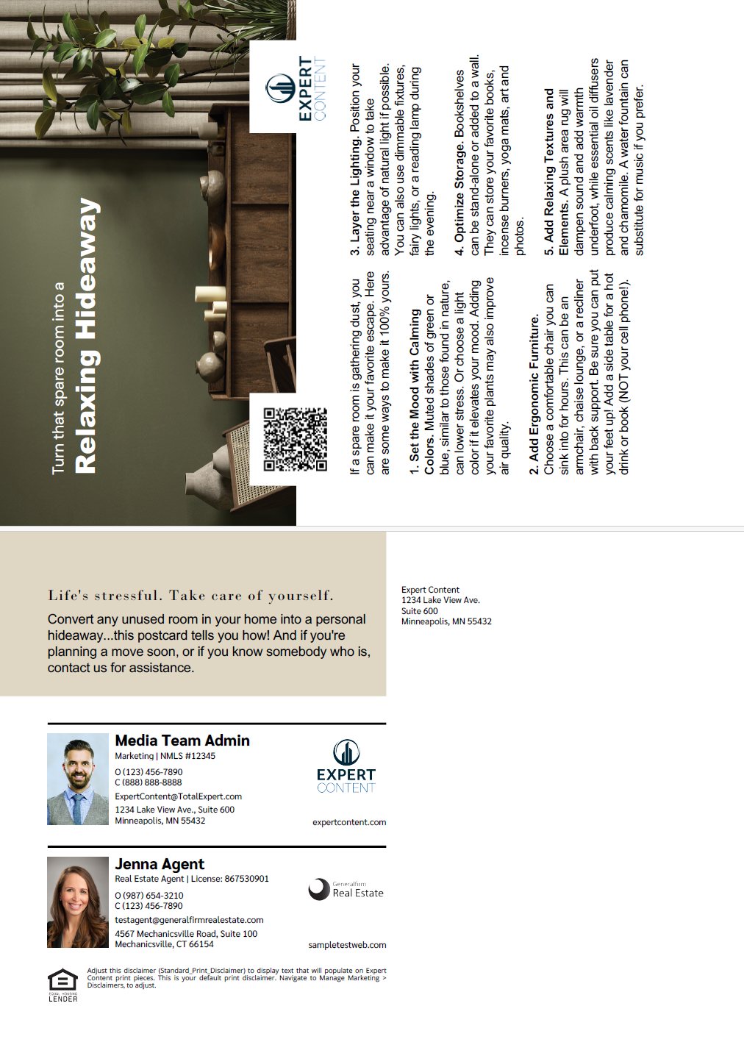
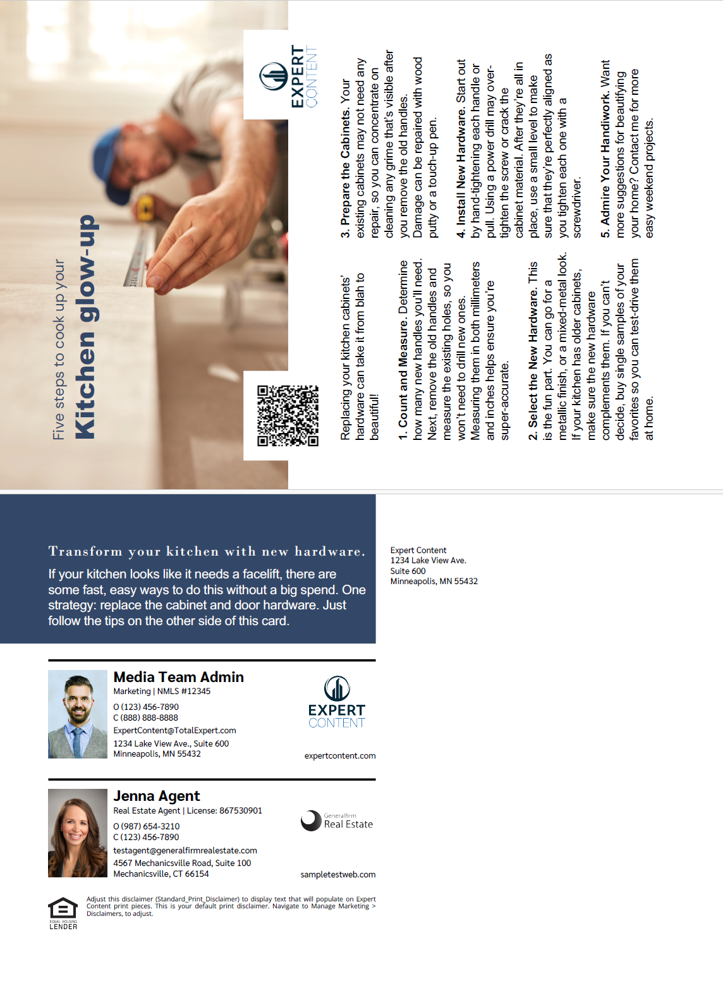
DIY Tips Postcards
Spare Room (1325) and Update Hardware (1326)
Direct Mail, Non-Direct Mail, and EDDM
Single and Cobranded
Share DIY home tips to homeowners directly to their home with these postcards. Suggest tips to convert spare rooms and update kitchen hardware.
Notes:
This page should be used for POSTCARDS (duplicate as needed)

