Slide 1
Expert Content
Strategy Guide
General Savings Education
September 2025

Slide 2
General Savings Education
Communication types: Email
Leverage this journey to educate contacts on the benefits of saving, strategies to fit different lifestyles, and more. Add emails specific to your organization's products, adjust call-to-actions to fit your services, or leverage the journey as an educational-only campaign. Banks and credit unions can include savings account information. Insurance agencies and mortgage lenders can include products that support or complement savings goals or provide referrals to financial partners. Eight emails over the course of about 4 months.
*All communications should be reviewed prior to initiating the journey.

Slide 3
General Savings Education
Journey Notes:
Keep emails that work for your organization, edit to meet your organization’s tone, swap with custom, or add these emails to your existing campaigns.
Timer delays are 2-3 weeks to allow the contact to apply the new strategies and knowledge to their personal savings strategy.
Configure onramp trigger components with organization specific inline conditions, contact groups, and Focused View outcomes.
Notes:
This page should be used for JOURNEY WIREFRAMES (duplicate as needed)

Slide 4
General Savings Education
Journey Map Notes:
Configure trigger and condition components with organization specific inline conditions, contact groups, and Focused View outcomes.
For banks and credit unions, adjust the Product Created offramp trigger to align with intended savings account types. Add more offramp triggers as needed to measure successful journey tracking.
For insurance companies, adjust the Product Created offramp trigger if desired and remove other unnecessary offramps.
For mortgage lenders, adjust Loan Created offramp trigger if desired and remove other unnecessary offramps.
Notes:
This page should be used for JOURNEY WIREFRAMES (duplicate as needed)

Slide 5
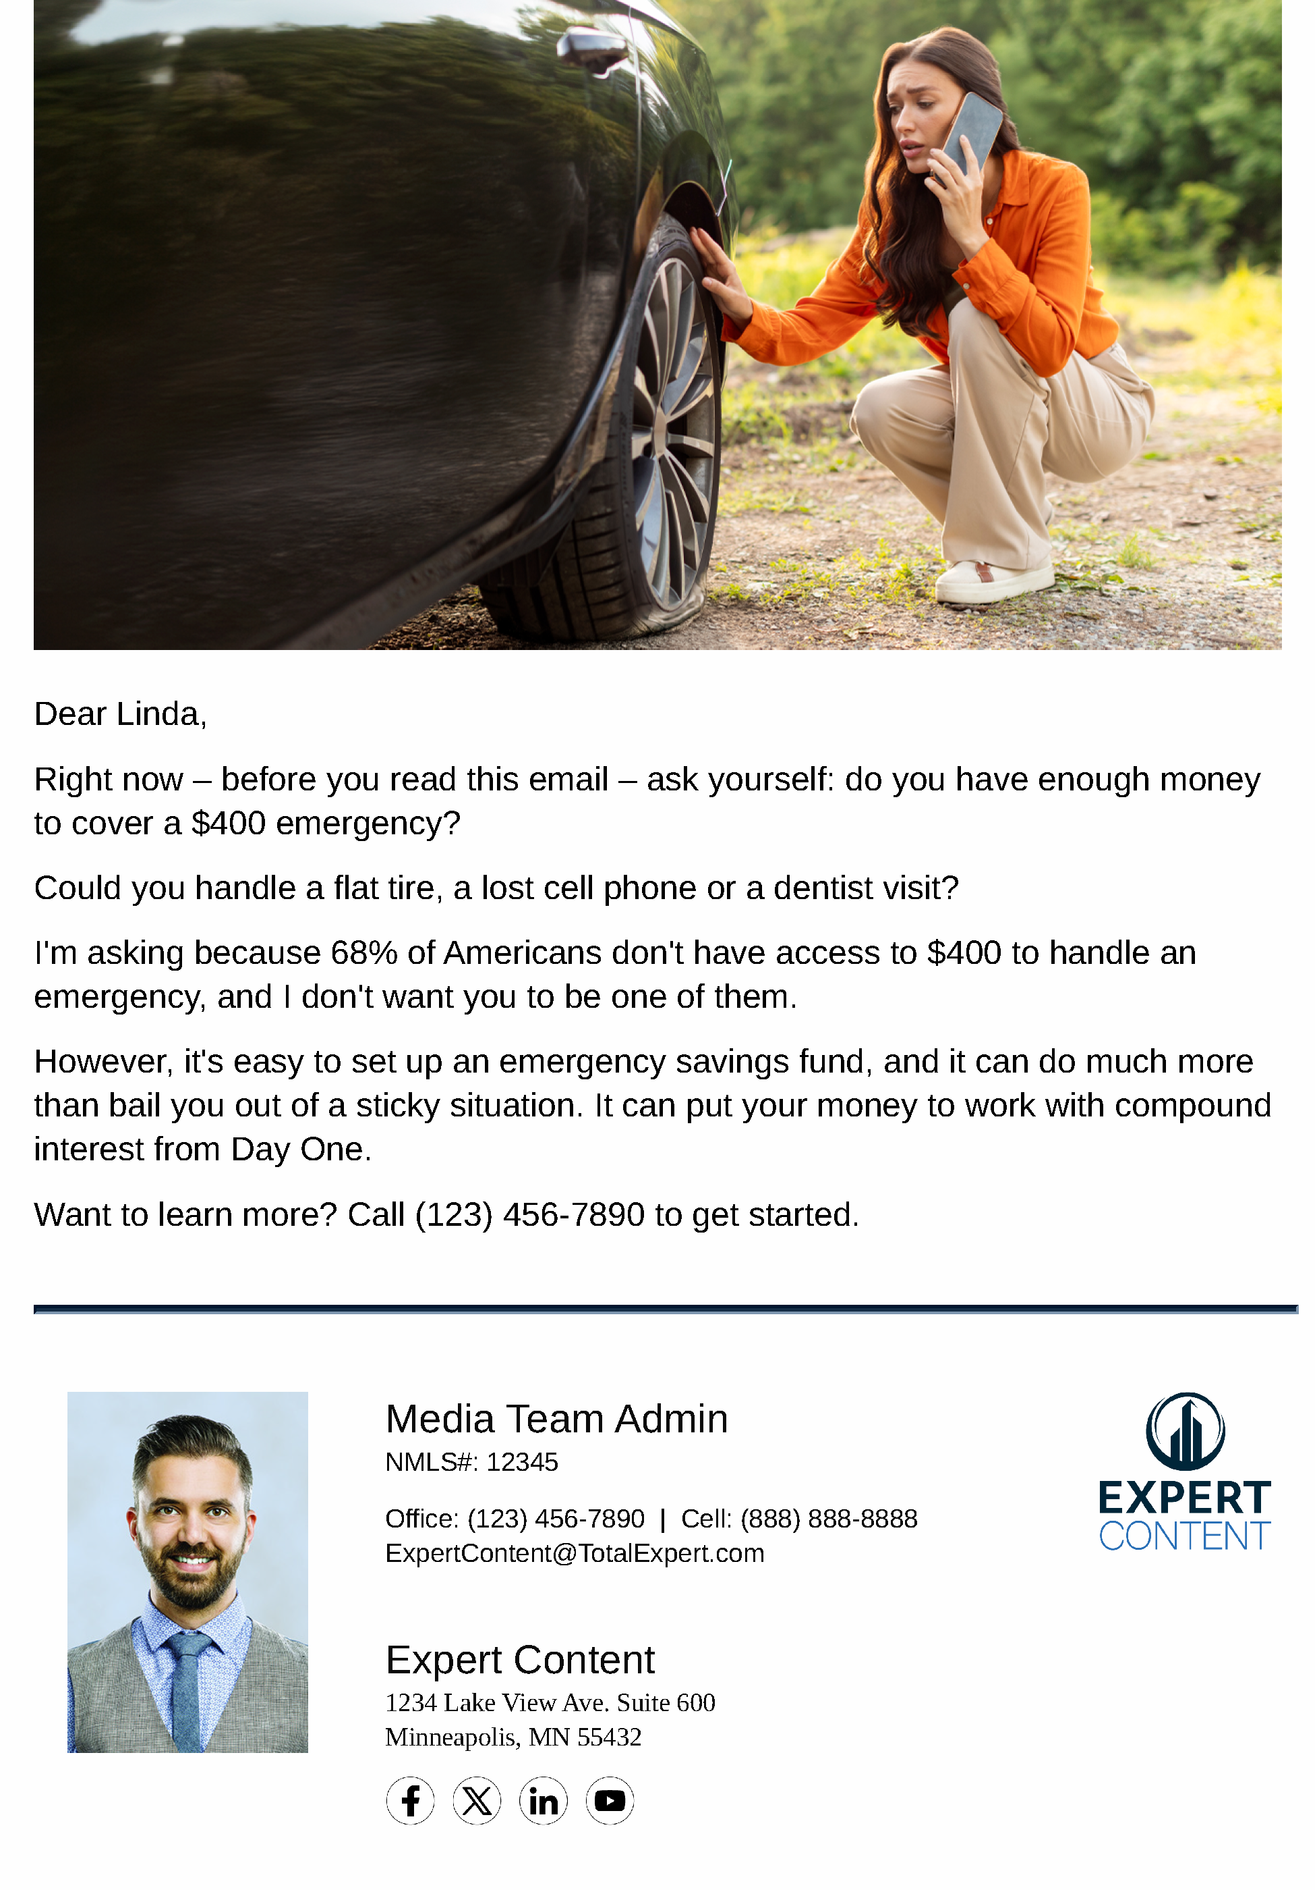
General Savings Education
Email Subject Line: General Savings Education - E1 - Why Savings Matter
Dear {{recipient.f_name}},
Right now – before you read this email – ask yourself: do you have enough money to cover a $400 emergency?
Could you handle a flat tire, a lost cell phone or a dentist visit?
I'm asking because 68% of Americans don't have access to $400 to handle an emergency, and I don't want you to be one of them.
However, it's easy to set up an emergency savings fund, and it can do much more than bail you out of a sticky situation. It can put your money to work with compound interest from Day One.
Want to learn more? Call {{sender.phone_office}} to get started.
Notes:
This page should be used for EMAILS (duplicate as needed)

Slide 6
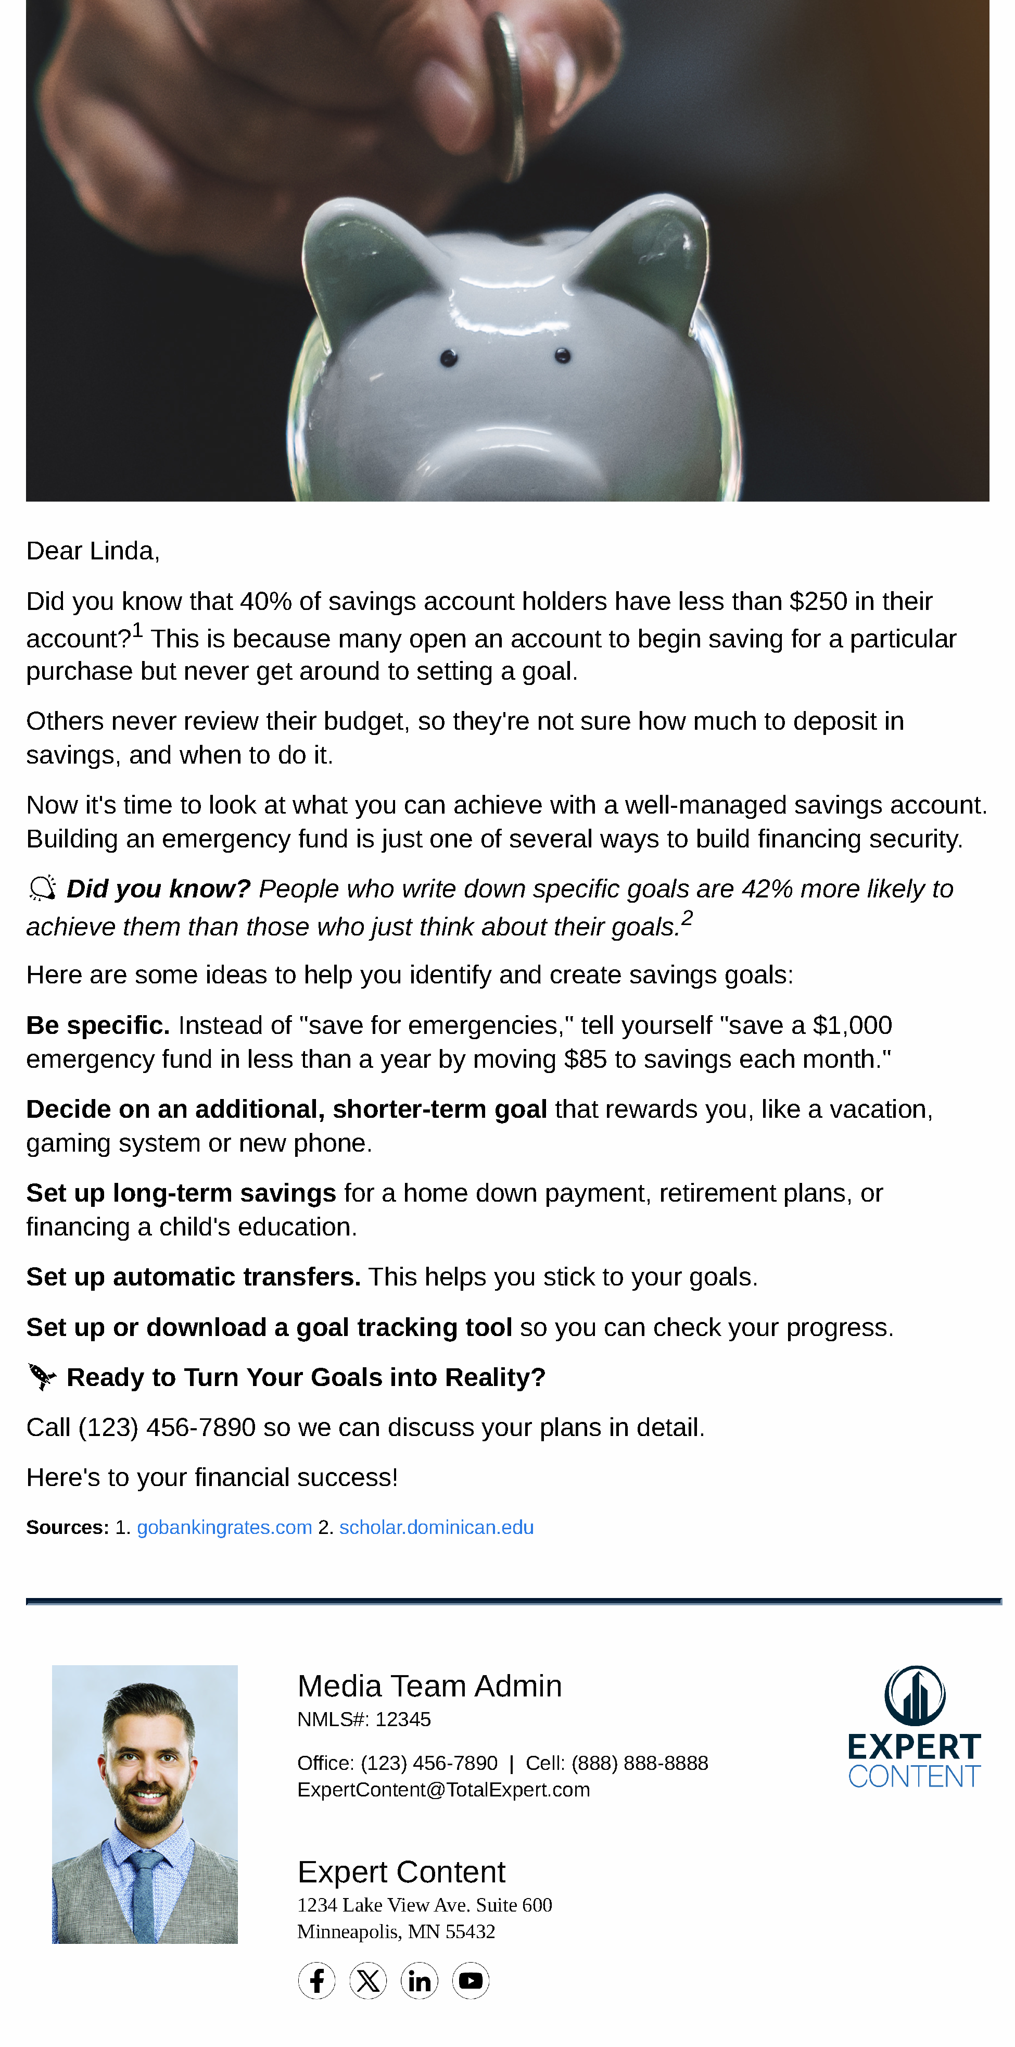
General Savings Education
Email Subject Line: General Savings Education - E2 - Realistic Goals
Dear {{recipient.f_name}},
Did you know that 40% of savings account holders have less than $250 in their account?1 This is because many open an account to begin saving for a particular purchase but never get around to setting a goal.
Others never review their budget, so they're not sure how much to deposit in savings, and when to do it.
Now it's time to look at what you can achieve with a well-managed savings account. Building an emergency fund is just one of several ways to build financing security.
💡 Did you know? People who write down specific goals are 42% more likely to achieve them than those who just think about their goals.2
Here are some ideas to help you identify and create savings goals:
Be specific. Instead of "save for emergencies," tell yourself "save a $1,000 emergency fund in less than a year by moving $85 to savings each month."
Decide on an additional, shorter-term goal that rewards you, like a vacation, gaming system or new phone.
Set up long-term savings for a home down payment, retirement plans, or financing a child's education.
Set up automatic transfers. This helps you stick to your goals.
Set up or download a goal tracking tool so you can check your progress.
🚀 Ready to Turn Your Goals into Reality?
Call {{sender.phone_office}} so we can discuss your plans in detail.
Here's to your financial success!
Notes:
This page should be used for EMAILS (duplicate as needed)

Slide 7
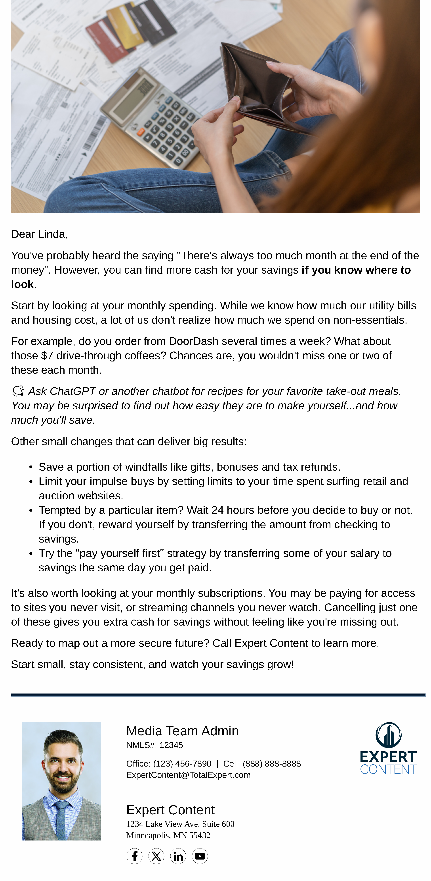
General Savings Education
Email Subject Line: General Savings Education - E3 - Finding Money
Dear {{recipient.f_name}},
You've probably heard the saying "There's always too much month at the end of the money". However, you can find more cash for your savings if you know where to look.
Start by looking at your monthly spending. While we know how much our utility bills and housing cost, a lot of us don't realize how much we spend on non-essentials.
For example, do you order from DoorDash several times a week? What about those $7 drive-through coffees? Chances are, you wouldn't miss one or two of these each month.
💡 Ask ChatGPT or another chatbot for recipes for your favorite take-out meals. You may be surprised to find out how easy they are to make yourself...and how much you'll save.
Other small changes that can deliver big results:
Save a portion of windfalls like gifts, bonuses and tax refunds.
Limit your impulse buys by setting limits to your time spent surfing retail and auction websites.
Tempted by a particular item? Wait 24 hours before you decide to buy or not. If you don't, reward yourself by transferring the amount from checking to savings.
Try the "pay yourself first" strategy by transferring some of your salary to savings the same day you get paid.
It's also worth looking at your monthly subscriptions. You may be paying for access to sites you never visit, or streaming channels you never watch. Cancelling just one of these gives you extra cash for savings without feeling like you're missing out.
Ready to map out a more secure future? Call {{sender.company}} to learn more.
Start small, stay consistent, and watch your savings grow!
Notes:
This page should be used for EMAILS (duplicate as needed)

Slide 8
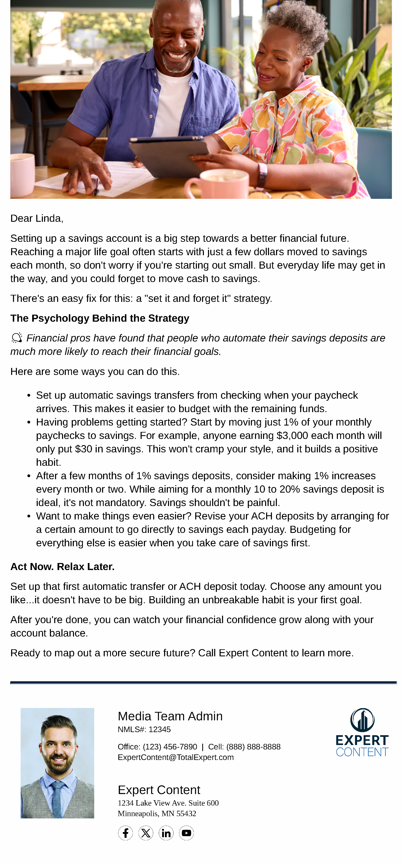
General Savings Education
Email Subject Line: General Savings Education - E4 - Automation and Habits
Dear {{recipient.f_name}},
Setting up a savings account is a big step towards a better financial future. Reaching a major life goal often starts with just a few dollars moved to savings each month, so don't worry if you're starting out small. But everyday life may get in the way, and you could forget to move cash to savings.
There's an easy fix for this: a "set it and forget it" strategy.
The Psychology Behind the Strategy
💡 Financial pros have found that people who automate their savings deposits are much more likely to reach their financial goals.
Here are some ways you can do this.
Set up automatic savings transfers from checking when your paycheck arrives. This makes it easier to budget with the remaining funds.
Having problems getting started? Start by moving just 1% of your monthly paychecks to savings. For example, anyone earning $3,000 each month will only put $30 in savings. This won't cramp your style, and it builds a positive habit.
After a few months of 1% savings deposits, consider making 1% increases every month or two. While aiming for a monthly 10 to 20% savings deposit is ideal, it's not mandatory. Savings shouldn't be painful.
Want to make things even easier? Revise your ACH deposits by arranging for a certain amount to go directly to savings each payday. Budgeting for everything else is easier when you take care of savings first.
Act Now. Relax Later.
Set up that first automatic transfer or ACH deposit today. Choose any amount you like...it doesn't have to be big. Building an unbreakable habit is your first goal.
After you're done, you can watch your financial confidence grow along with your account balance.
Ready to map out a more secure future? Call {{sender.company}} to learn more.
Notes:
This page should be used for EMAILS (duplicate as needed)

Slide 9
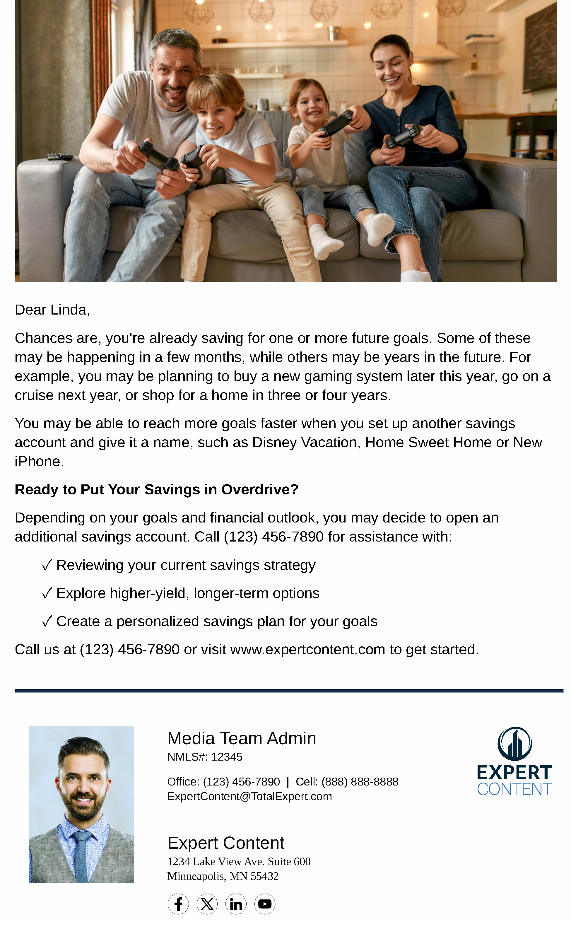
General Savings Education
Email Subject Line: General Savings Education - E5 - Max Savings Growth
Dear {{recipient.f_name}},
Chances are, you're already saving for one or more future goals. Some of these may be happening in a few months, while others may be years in the future. For example, you may be planning to buy a new gaming system later this year, go on a cruise next year, or shop for a home in three or four years.
You may be able to reach more goals faster when you set up another savings account and give it a name, such as Disney Vacation, Home Sweet Home or New iPhone.
Ready to Put Your Savings in Overdrive?
Depending on your goals and financial outlook, you may decide to open an additional savings account. Call {{sender.phone_office}} for assistance with:
✓ Reviewing your current savings strategy
✓ Explore higher-yield, longer-term options
✓ Create a personalized savings plan for your goals
Call us at {{sender.phone_office}} or visit {{sender.website}} to get started.
Notes:
This page should be used for EMAILS (duplicate as needed)

Slide 10
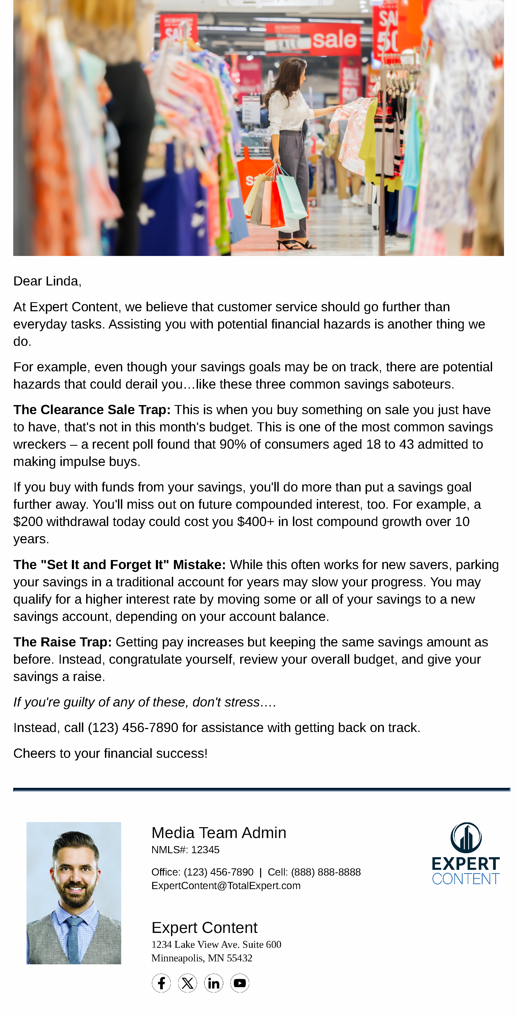
General Savings Education
Email Subject Line: General Savings Education - E6 - Common Mistakes
Dear {{recipient.f_name}},
At {{sender.company}}, we believe that customer service should go further than everyday tasks. Assisting you with potential financial hazards is another thing we do.
For example, even though your savings goals may be on track, there are potential hazards that could derail you…like these three common savings saboteurs.
The Clearance Sale Trap: This is when you buy something on sale you just have to have, that's not in this month's budget. This is one of the most common savings wreckers – a recent poll found that 90% of consumers aged 18 to 43 admitted to making impulse buys.
If you buy with funds from your savings, you'll do more than put a savings goal further away. You'll miss out on future compounded interest, too. For example, a $200 withdrawal today could cost you $400+ in lost compound growth over 10 years.
The "Set It and Forget It" Mistake: While this often works for new savers, parking your savings in a traditional account for years may slow your progress. You may qualify for a higher interest rate by moving some or all of your savings to a new savings account, depending on your account balance.
The Raise Trap: Getting pay increases but keeping the same savings amount as before. Instead, congratulate yourself, review your overall budget, and give your savings a raise.
If you're guilty of any of these, don't stress….
Instead, call {{sender.phone_office}} for assistance with getting back on track.
Cheers to your financial success!
Notes:
This page should be used for EMAILS (duplicate as needed)

Slide 11
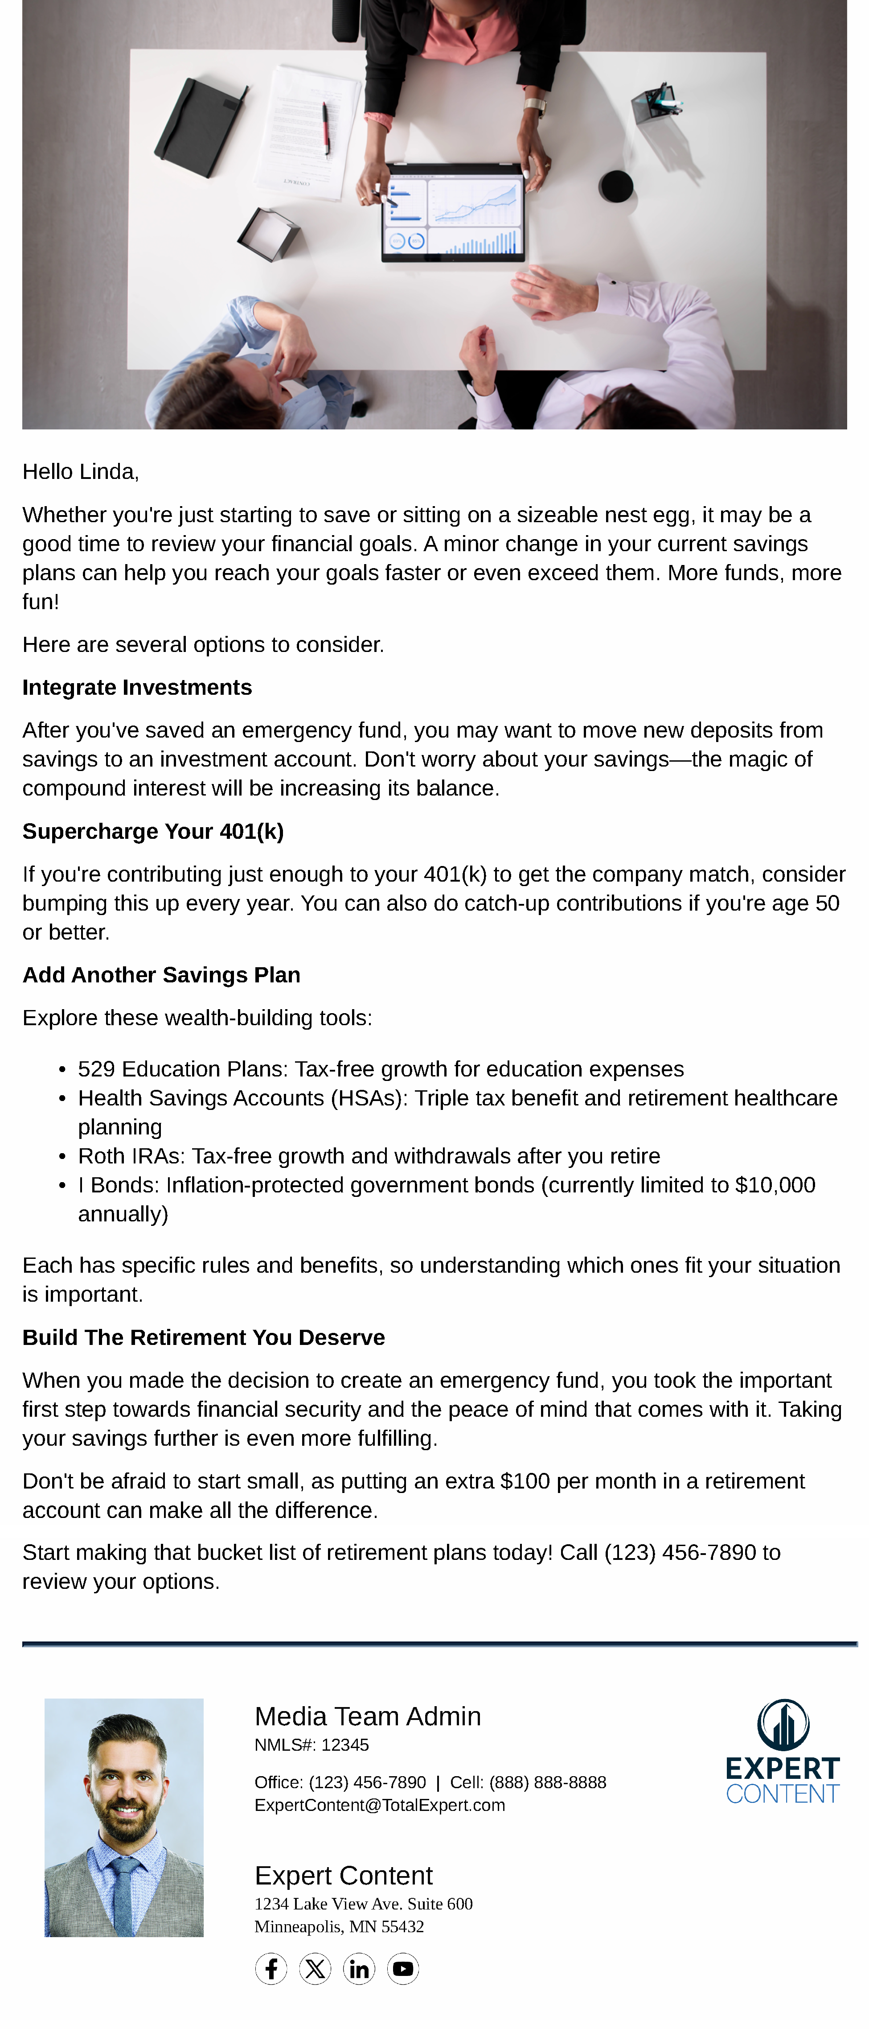
General Savings Education
Email Subject Line: General Savings Education - E7 - Build Wealth
Hello {{recipient.f_name}},
Whether you're just starting to save or sitting on a sizeable nest egg, it may be a good time to review your financial goals. A minor change in your current savings plans can help you reach your goals faster or even exceed them. More funds, more fun!
Here are several options to consider.
Integrate Investments
After you've saved an emergency fund, you may want to move new deposits from savings to an investment account. Don't worry about your savings—the magic of compound interest will be increasing its balance.
Supercharge Your 401(k)
If you're contributing just enough to your 401(k) to get the company match, consider bumping this up every year. You can also do catch-up contributions if you're age 50 or better.
Add Another Savings Plan
Explore these wealth-building tools:
529 Education Plans: Tax-free growth for education expenses
Health Savings Accounts (HSAs): Triple tax benefit and retirement healthcare planning
Roth IRAs: Tax-free growth and withdrawals after you retire
I Bonds: Inflation-protected government bonds (currently limited to $10,000 annually)
Each has specific rules and benefits, so understanding which ones fit your situation is important.
Build The Retirement You Deserve
When you made the decision to create an emergency fund, you took the important first step towards financial security and the peace of mind that comes with it. Taking your savings further is even more fulfilling.
Don't be afraid to start small, as putting an extra $100 per month in a retirement account can make all the difference.
Start making that bucket list of retirement plans today! Call {{sender.phone_office}} to review your options.
Notes:
This page should be used for EMAILS (duplicate as needed)

Slide 12
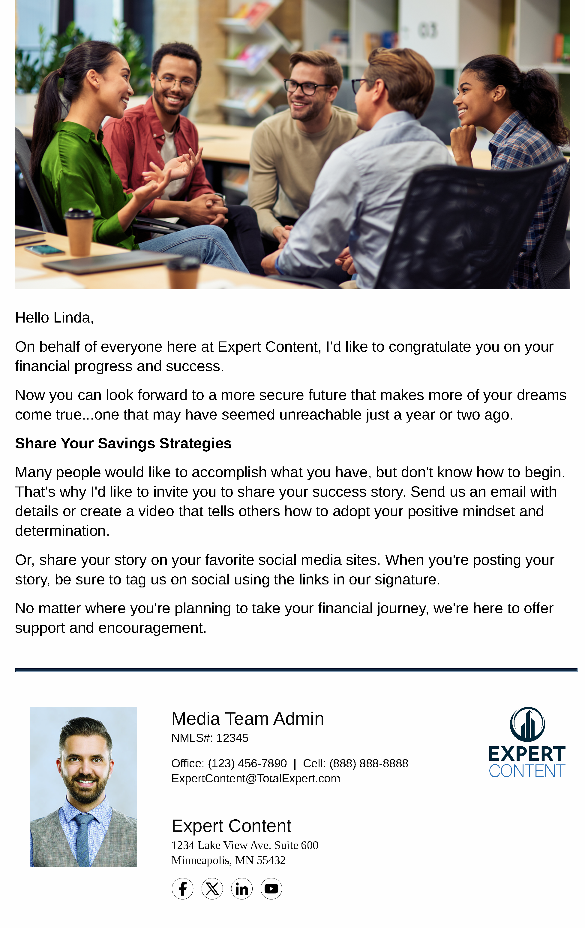
General Savings Education
Email Subject Line: General Savings Education - E8 - Celebrate Progress
Hello {{recipient.f_name}},
On behalf of everyone here at {{sender.company}}, I'd like to congratulate you on your financial progress and success.
Now you can look forward to a more secure future that makes more of your dreams come true...one that may have seemed unreachable just a year or two ago.
Share Your Savings Strategies
Many people would like to accomplish what you have, but don't know how to begin. That's why I'd like to invite you to share your success story. Send us an email with details or create a video that tells others how to adopt your positive mindset and determination.
Or, share your story on your favorite social media sites. When you're posting your story, be sure to tag us on social using the links in our signature.
No matter where you're planning to take your financial journey, we're here to offer support and encouragement.
Notes:
This page should be used for EMAILS (duplicate as needed)

