Slide 1
Expert Content
Strategy Guide
Home Loan Anniversary
July 2026

Slide 2
Home Loan Anniversary
Communication types: Email and SMS
Strengthen long-term borrower relationships and identify growth opportunities at key lifecycle moments.
This journey automatically reaches borrowers on their loan anniversary (Years 1, 2, and 3) with celebratory touchpoints that acknowledge their commitment to homeownership. Marketing admins choose between two email sets: the default, purely celebratory messaging, or an alternative set that layers in equity-based products and refinancing opportunities when borrowers are most receptive.
Spaced over 3 years with 2 touches per anniversary (email + SMS). Admins can apply one email set consistently across all three anniversaries, or mix selections from both sets year-to-year based on organizational priorities.
*All communications should be reviewed prior to initiating the journey.

Slide 3
Home Loan Anniversary
Campaign Schedule & Execution
Day 365
Email: Congrats on your first…
Between 8:00 AM – 6:00 PM
SMS: Year 1 Congratulations
Between 8:00 AM – 6:00 PM
Day 730
Email: Celebrate your second…
Between 8:00 AM – 6:00 PM
SMS: Year 2 Congratulations
Between 8:00 AM – 6:00 PM
Day 1095
Email: Celebrate your third…
Between 8:00 AM – 6:00 PM
SMS: Year 3 Congratulations
Between 8:00 AM – 6:00 PM
Alternate Emails*
Additional emails in the journey canvas layer in equity-based products and refinancing options for borrowers possibly ready for the next conversation.
Campaign Schedule Notes
All touchpoints are celebratory and relationship-focused. Alternative emails (slides 9-11) layer in equity and refinancing information.*
  Optional enhancement: If your organization has Equity insights and enrichment data, consider adding a separate branch for contacts with equity data. Apply dynamic estimated equity values in those emails to build trust and position the loan officer as the expert.
Emails and SMS are sent simultaneously to connect with borrowers in either channel.
If your organization has integrations with post-close touchpoints (DirectMailers, Tiff’s Treats, etc.), consider how all journeys interact/overlap.
Days Total
1095
Touches
6
Email + SMS
3 + 3
Primary Goal
Relationship Building
Notes:
This page should be used for TASKS, USER NOTIFICATIONS, AND SMS TEMPLATES (duplicate as needed)

Slide 4
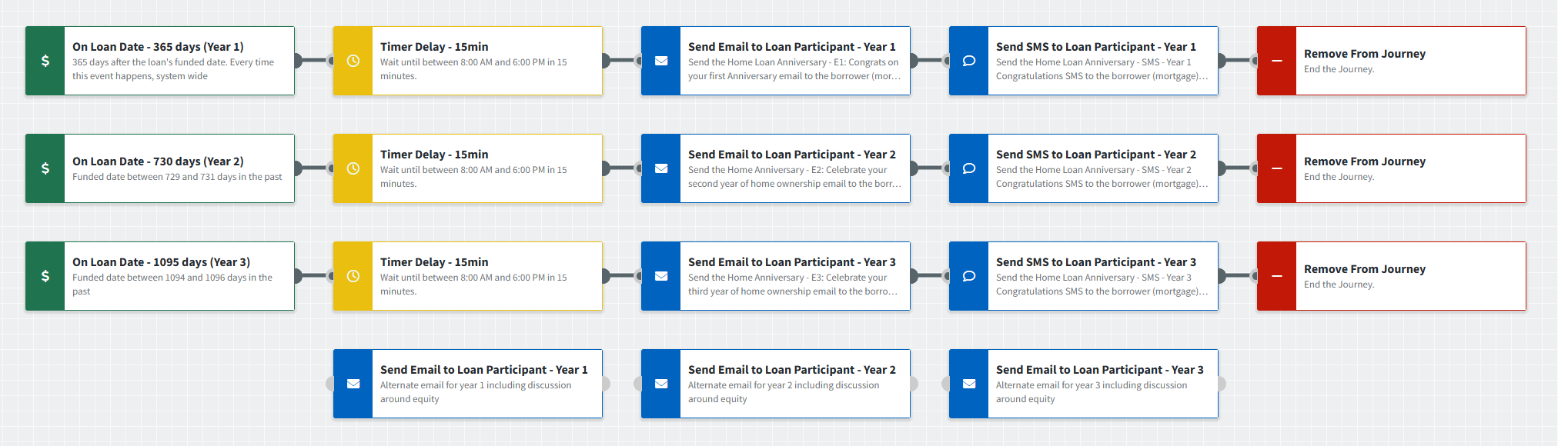
Home Loan Anniversary
Journey Notes:
Configure loan date trigger: Use Loan Funded Date with organization-specific inline conditions (loan purpose/type, servicing, and most recent loan). By default, the trigger is set to fire within +/- 2 days to account for historical imports or other data-related nuances.
  Suppression strategy: Consider including contact groups to suppress segments of your customers such as loans with servicing sold; including the Most Recent Loan condition with a purpose of Purchase will suppress refinance loans.
Choose email approach: Select relationship-only emails (slides 5-7)) to maintain celebratory-only tone, swap for alternate emails (slides 9-11) that introduce equity and refinancing, or mix and match.
Timing: Emails and SMS send simultaneously by default; add timer delays (30–60 min) if your organization prefers staggered delivery.
Consider existing post-close journeys: If you are running other post-close campaigns, consider how this journey complements them or how they can best interact. Expert Content provides a post-close campaign with a 1-year anniversary touchpoint. If you plan to run both, it’s recommended to remove the 1-year touchpoint from the post-close journey.
Notes:
This page should be used for JOURNEY WIREFRAMES (duplicate as needed)

Slide 5
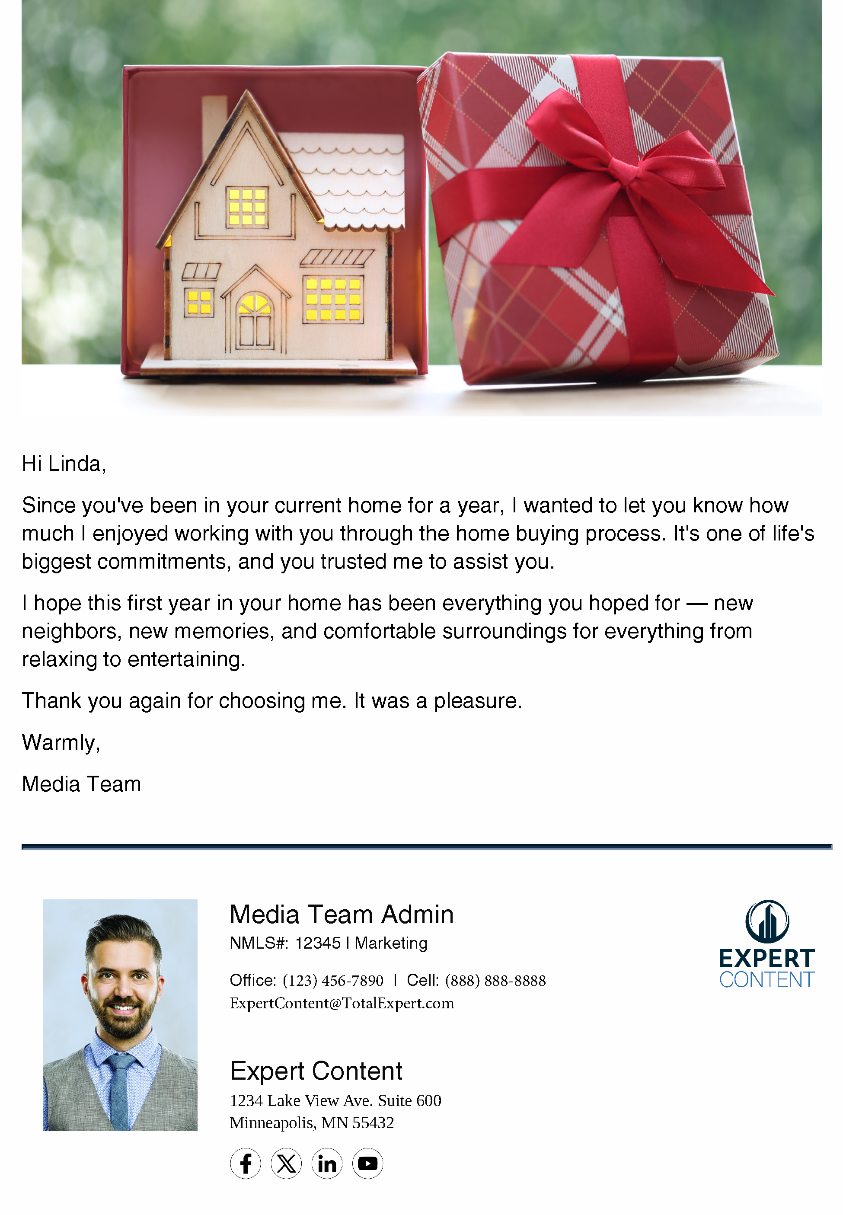
Home Loan Anniversary
Email Subject Line:
Congrats on your first anniversary.
Hi {{recipient.f_name}},
Since you've been in your current home for a year, I wanted to let you know how much I enjoyed working with you through the home buying process. It's one of life's biggest commitments, and you trusted me to assist you.
I hope this first year in your home has been everything you hoped for — new neighbors, new memories, and comfortable surroundings for everything from relaxing to entertaining.
Thank you again for choosing me. It was a pleasure.
Warmly,
{{sender.f_name}}
Notes:
This page should be used for EMAILS (duplicate as needed)

Slide 6
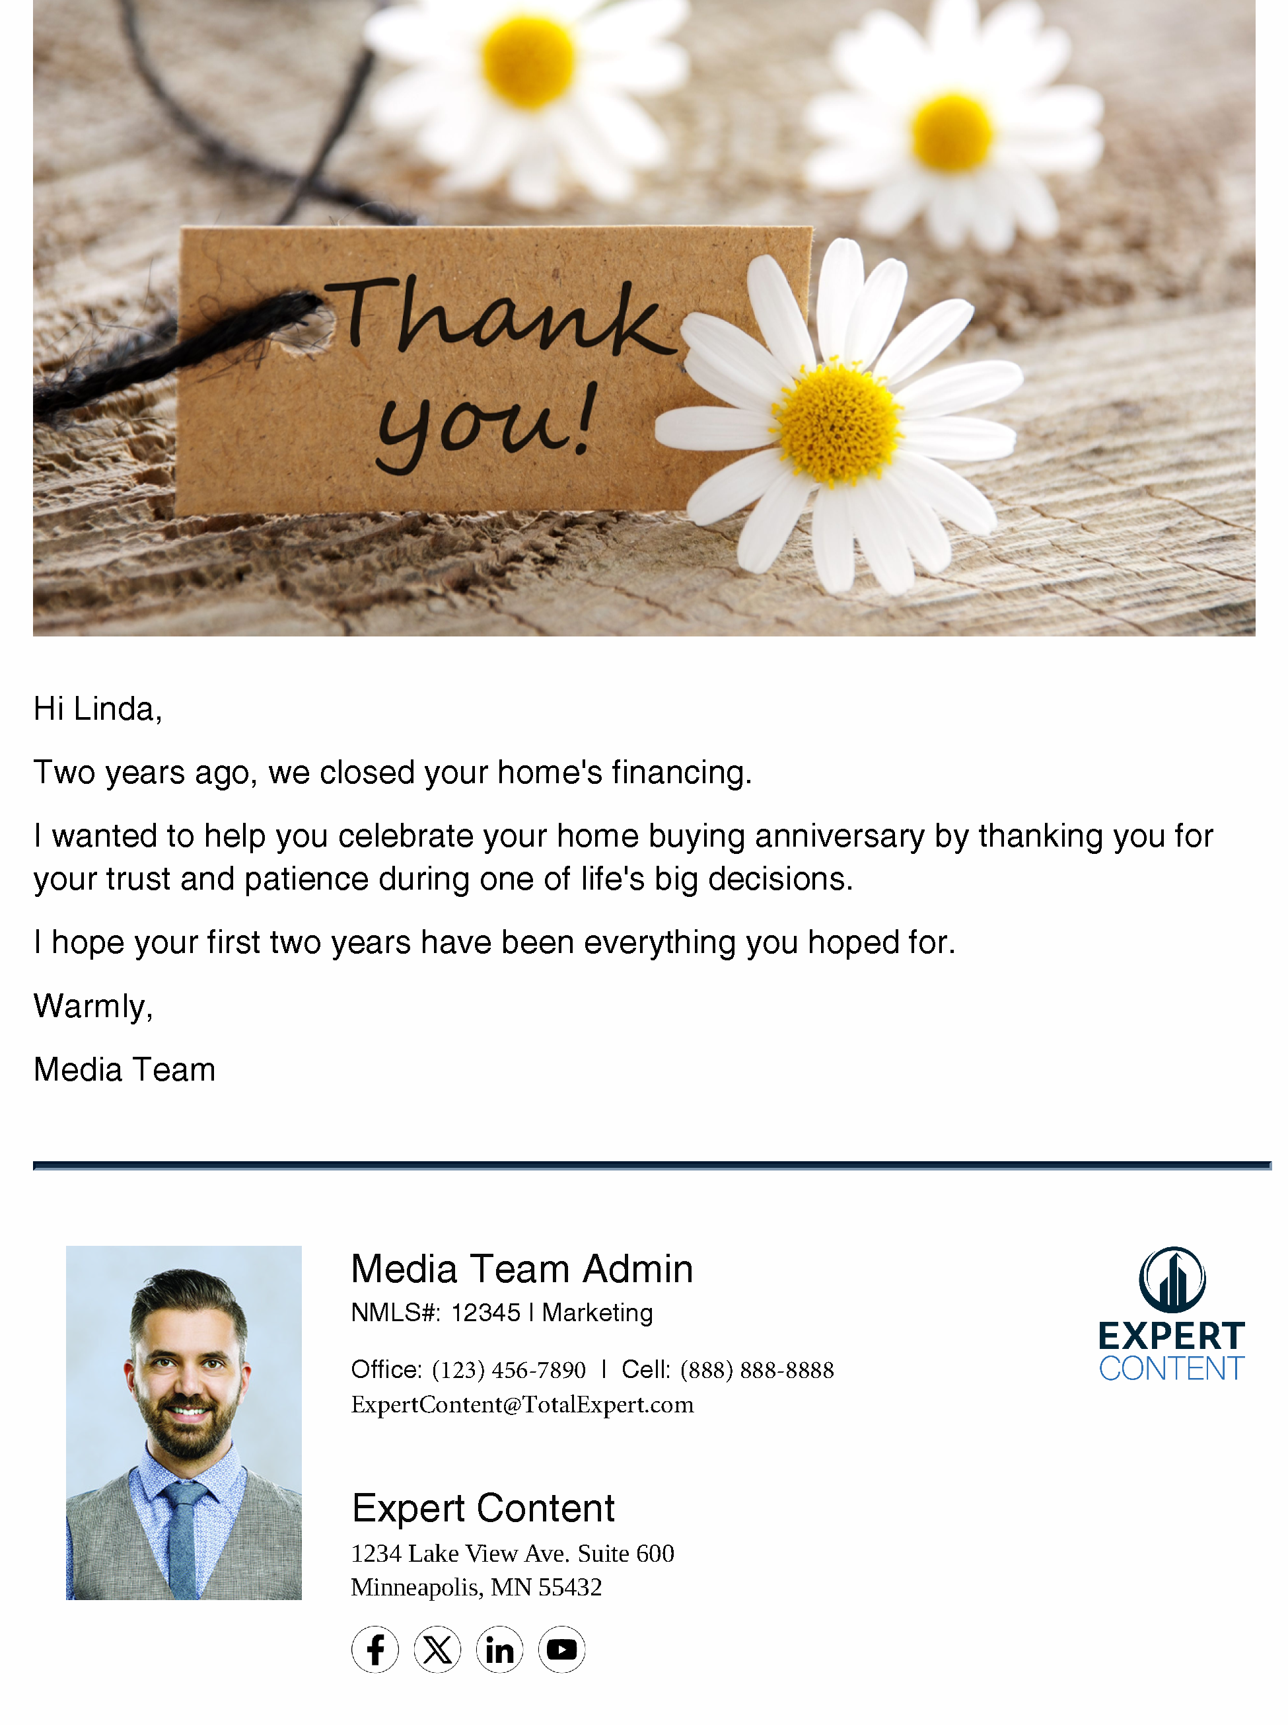
Home Loan Anniversary
Email Subject Line:
Celebrate your second year of home ownership
Hi {{recipient.f_name}},
Two years ago, we closed your home's financing.
I wanted to help you celebrate your home buying anniversary by thanking you for your trust and patience during one of life's big decisions.
I hope your first two years have been everything you hoped for.
Warmly,
{{sender.f_name}}
Notes:
This page should be used for EMAILS (duplicate as needed)

Slide 7
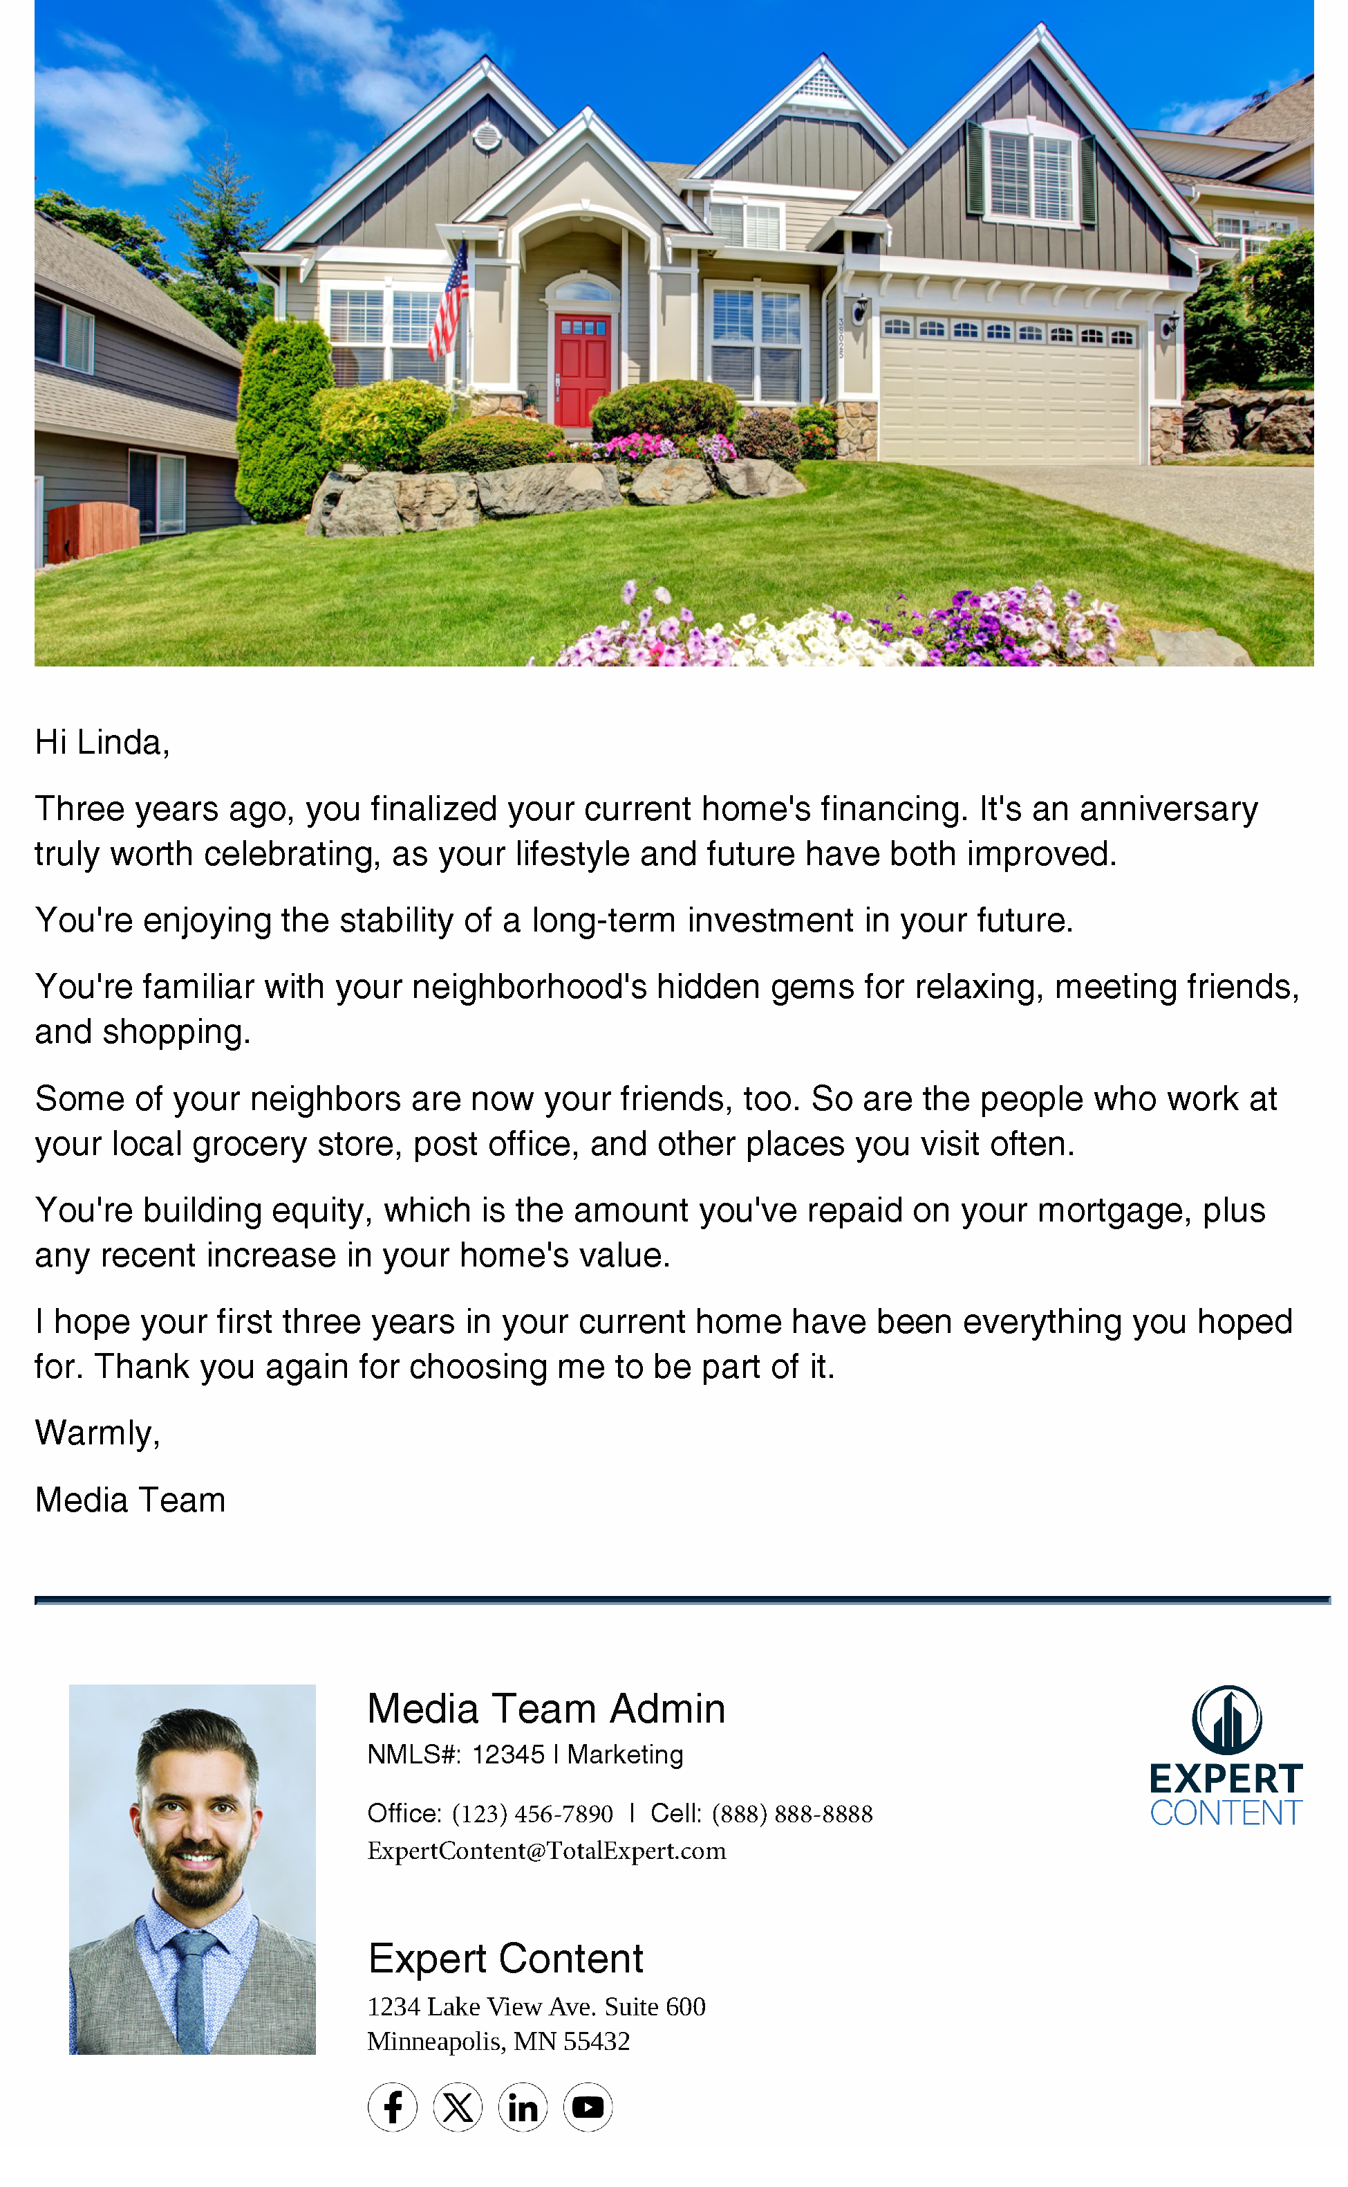
Home Loan Anniversary
Email Subject Line:
Celebrate your third year of home ownership
Hi {{recipient.f_name}},
Three years ago, you finalized your current home's financing. It's an anniversary truly worth celebrating, as your lifestyle and future have both improved.
You're enjoying the stability of a long-term investment in your future.
You're familiar with your neighborhood's hidden gems for relaxing, meeting friends, and shopping.
Some of your neighbors are now your friends, too. So are the people who work at your local grocery store, post office, and other places you visit often.
You're building equity, which is the amount you've repaid on your mortgage, plus any recent increase in your home's value.
I hope your first three years in your current home have been everything you hoped for. Thank you again for choosing me to be part of it.
Warmly,
{{sender.f_name}}
Notes:
This page should be used for EMAILS (duplicate as needed)

Slide 8
Home Loan Anniversary
Home Loan Anniversary - SMS - Year 1 Congratulations
Hi {{recipient.f_name}} - Happy one-year home anniversary! Sending you my wishes that you enjoy many more years of building memories. I'm grateful to have been part of your home buying journey. Warmly, {{sender.f_name}} with {{sender.company}}
Home Loan Anniversary - SMS - Year 2 Congratulations
Hi {{recipient.f_name}} - Can you believe you've already spent two years in your current home? It's an anniversary worth celebrating! Thank you for letting me be part of one of life's biggest, most rewarding decisions - {{sender.f_name}} with {{sender.company}}
Home Loan Anniversary - SMS - Year 3 Congratulations
Hi {{recipient.f_name}} - Congrats! It's your third-year home anniversary, which means it's time to celebrate three years of memories and financial growth. Questions about the equity you've built over the years? I'm here to help. {{sender.f_name}} with {{sender.company}}
Notes:
This page should be used for TASKS, USER NOTIFICATIONS, AND SMS TEMPLATES (duplicate as needed)

Slide 9
Alternate Emails
These emails layer in product information including refinancing and equity-based lending each year.

Slide 10

Home Loan Anniversary
Email Subject Line:
Best wishes for your first homeowner anniversary! 🎂
Hi {{recipient.f_name}},
You've had an entire year to create a home that's really yours. I hope you've enjoyed meeting your neighbors and making new friends.
Also, I thought it would be a good time to talk about your home's equity, and what it can do for you.
Equity is the amount you've repaid on your loan, plus any rise in your home's appraised value. This means your wealth increases with every payment...maybe faster than you realize.
If you'd like to learn more, have questions about your mortgage, or just want to say hi, call me at {{sender.phone_cell}}.
Here's to a lifetime of home ownership.
Warmly,
{{sender.f_name}}
Notes:
This page should be used for EMAILS (duplicate as needed)

Slide 11
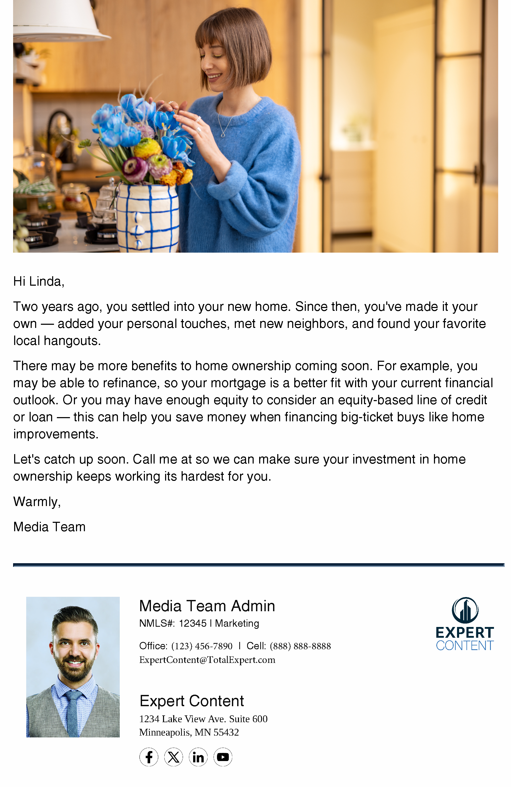
Home Loan Anniversary
Email Subject Line:
I understand your 🏠 just had a birthday! Congrats! 🥂
Hi {{recipient.f_name}},
Two years ago, you settled into your new home. Since then, you've made it your own — added your personal touches, met new neighbors, and found your favorite local hangouts.
There may be more benefits to home ownership coming soon. For example, you may be able to refinance, so your mortgage is a better fit with your current financial outlook. Or you may have enough equity to consider an equity-based line of credit or loan — this can help you save money when financing big-ticket buys like home improvements.
Let's catch up soon. Call me at {{sender.phone_cell}} so we can make sure your investment in home ownership keeps working its hardest for you.
Warmly,
{{sender.f_name}}
Notes:
This page should be used for EMAILS (duplicate as needed)

Slide 12
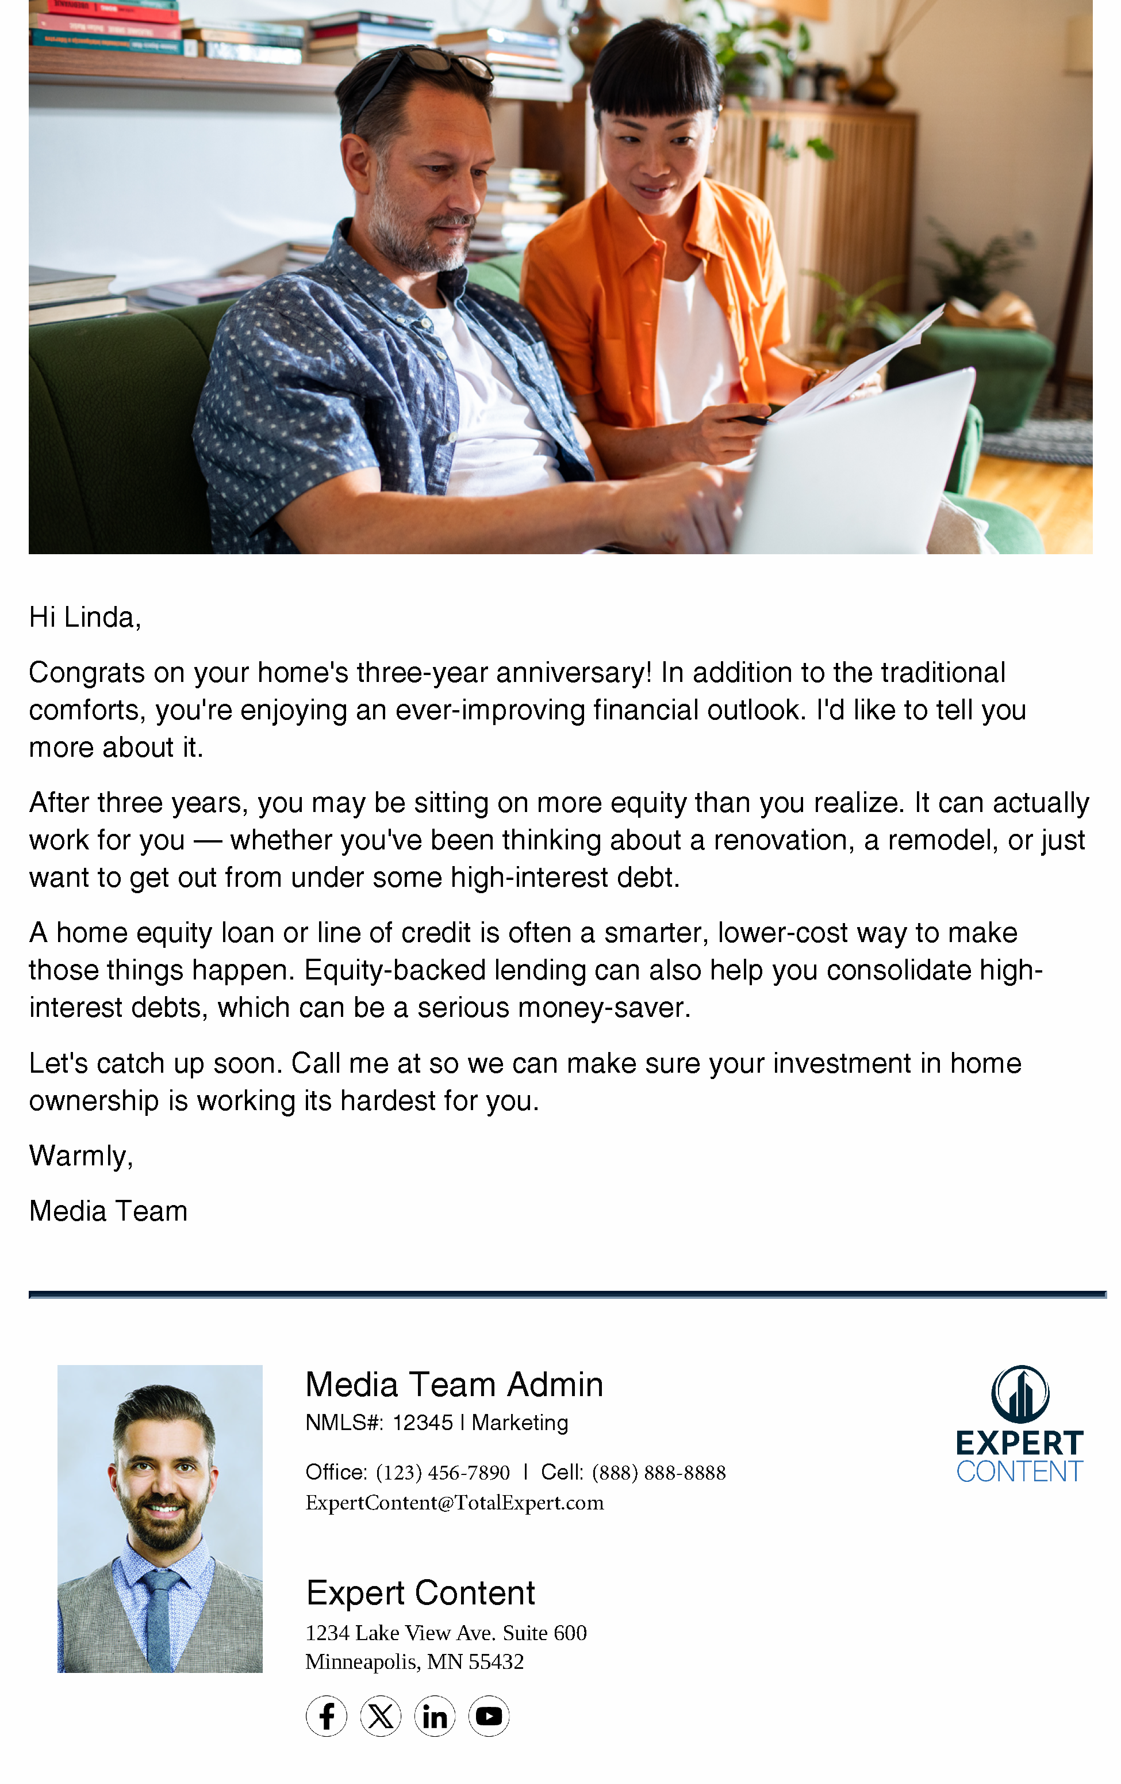
Home Loan Anniversary
Email Subject Line:
You've been building equity for 1,095 days. Here's what that means.
Hi {{recipient.f_name}},
Congrats on your home's three-year anniversary! In addition to the traditional comforts, you're enjoying an ever-improving financial outlook. I'd like to tell you more about it.
After three years, you may be sitting on more equity than you realize. It can actually work for you — whether you've been thinking about a renovation, a remodel, or just want to get out from under some high-interest debt.
A home equity loan or line of credit is often a smarter, lower-cost way to make those things happen. Equity-backed lending can also help you consolidate high-interest debts, which can be a serious money-saver.
Let's catch up soon. Call me at {{sender.phone_cell}} so we can make sure your investment in home ownership is working its hardest for you.
Warmly,
{{sender.f_name}}
Notes:
This page should be used for EMAILS (duplicate as needed)

