Slide 1
Expert Content
Strategy Guide
In Process Refinance Milestone
May 2025

Slide 2
In Process Refinance Milestone
Communication types: Email, SMS, and User Notifications
This journey includes a series of emails and SMS that are triggered by events within the LOS. Each loan status change will initiate communication about the milestone to the borrower, the coborrower. Status updates will CC the real estate agent(s) and BCC the sender. Additional emails provide information only to the borrower and coborrower such as e-signature information and dos and don’ts during the loan process. SMS touchpoints are included for each milestone and are sent to the primary borrower. Additional touchpoints for coborrower or other loan participants can be added manually.
*All communications should be reviewed prior to initiating the journey.

Slide 3
In Process Refinance Milestone
Journey Map Notes:
Keep emails and SMS that work for your organization, edit the content, swap with custom, or add these touchpoints to your existing campaigns.
Adjust onramps with organization specific loan statuses or use as-is.

Slide 4
In Process Refinance Milestone
Journey Map Notes:
If your organization has Customer Intelligence enabled, there is also a user notification if a contact on the journey triggers the Credit Inquiry insight.

Slide 5
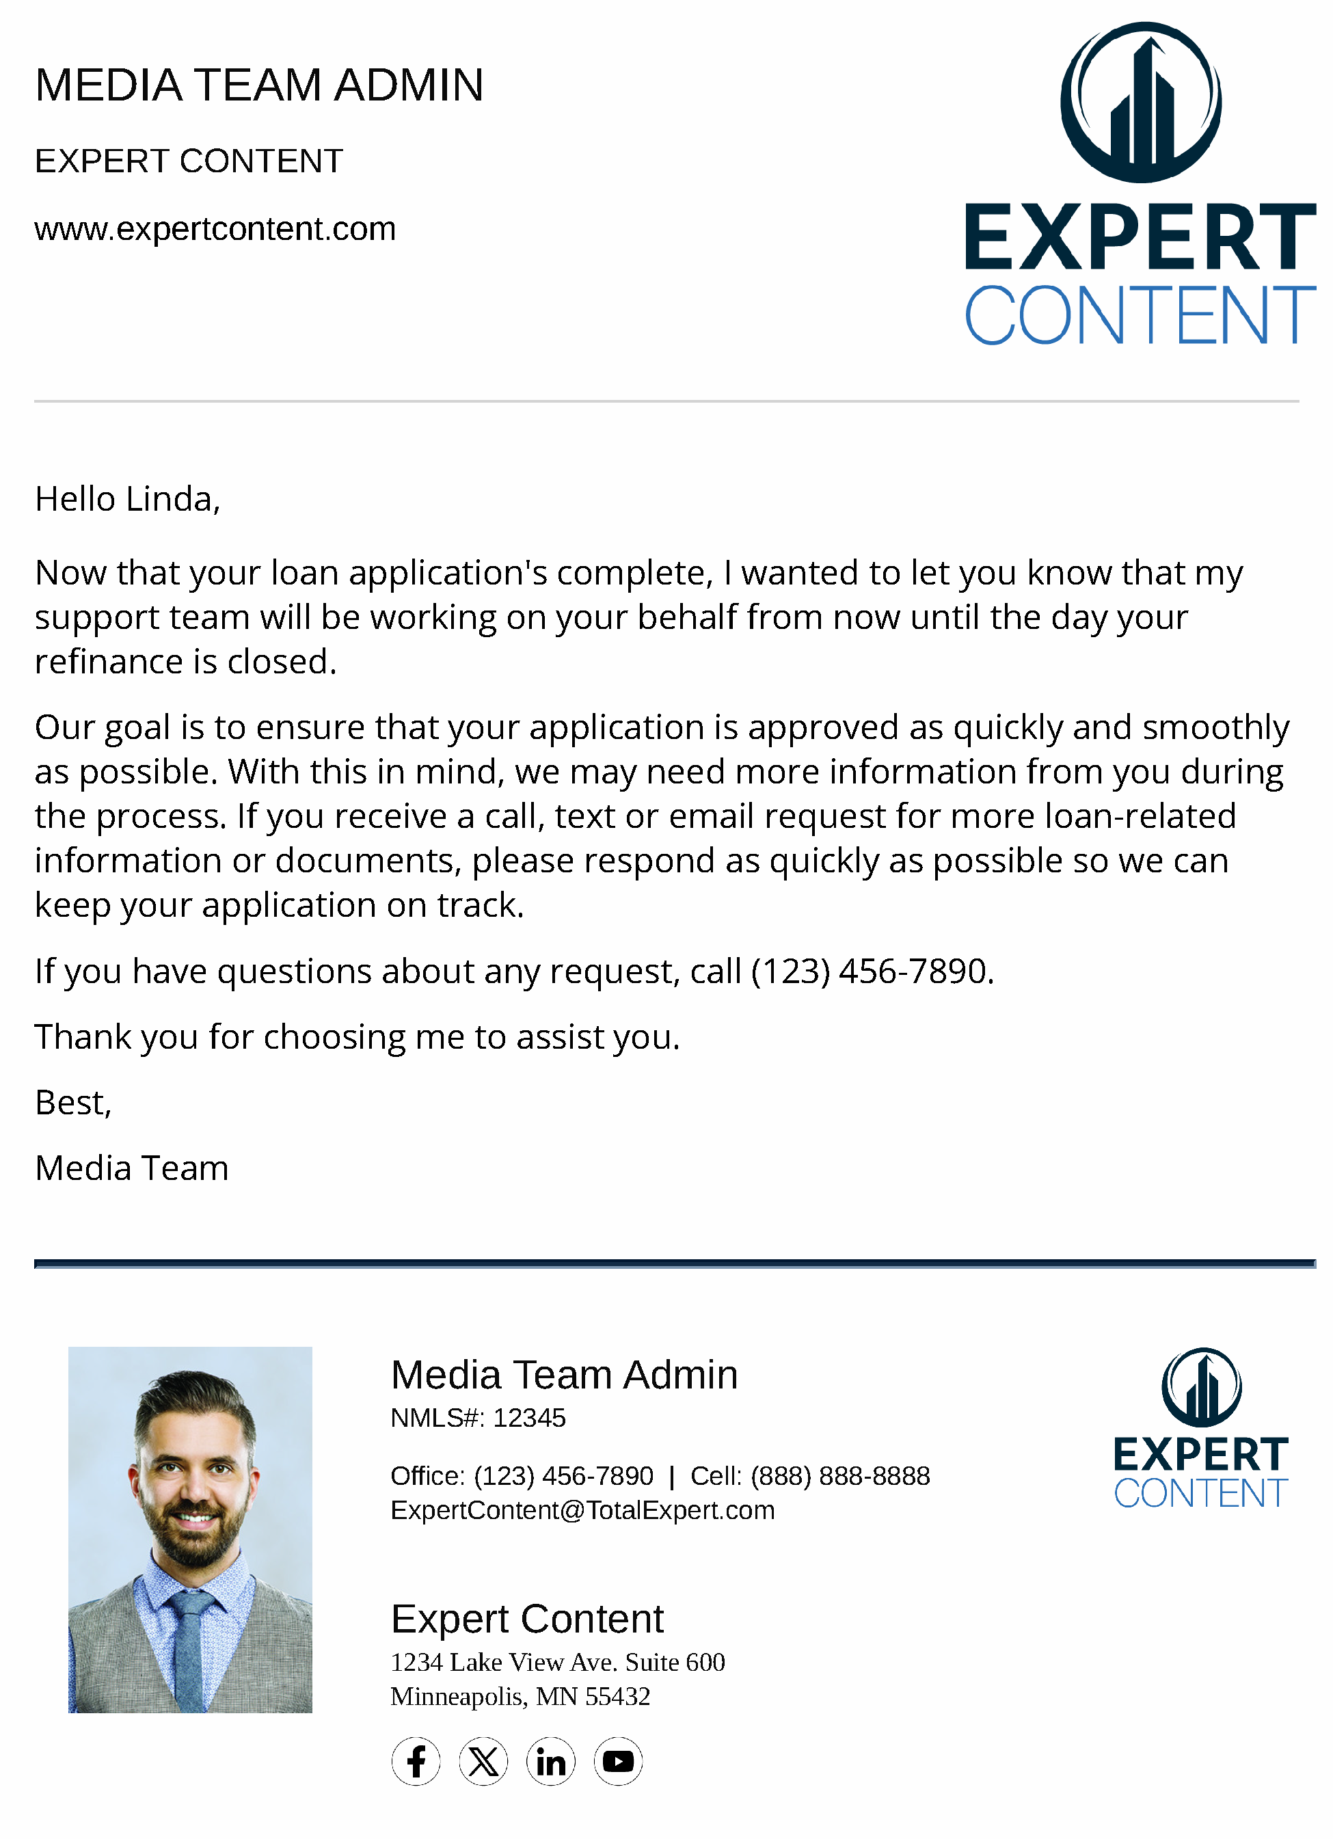
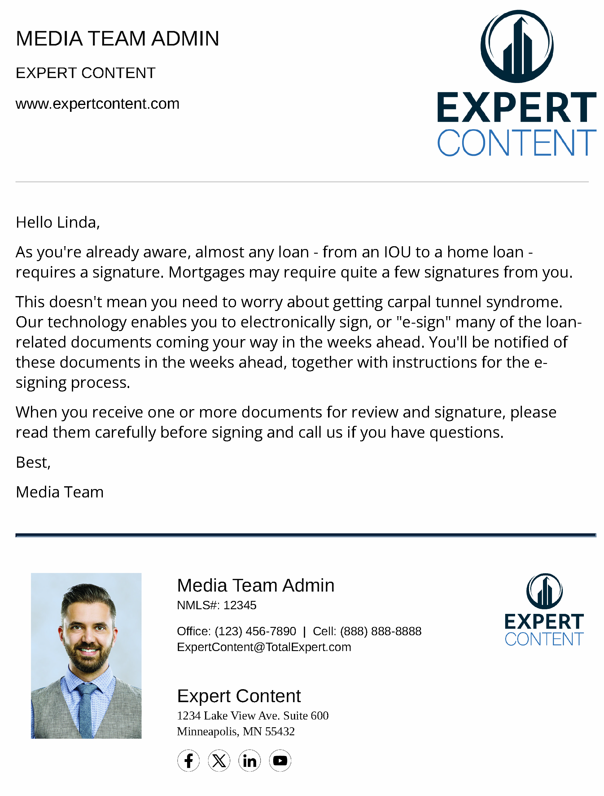
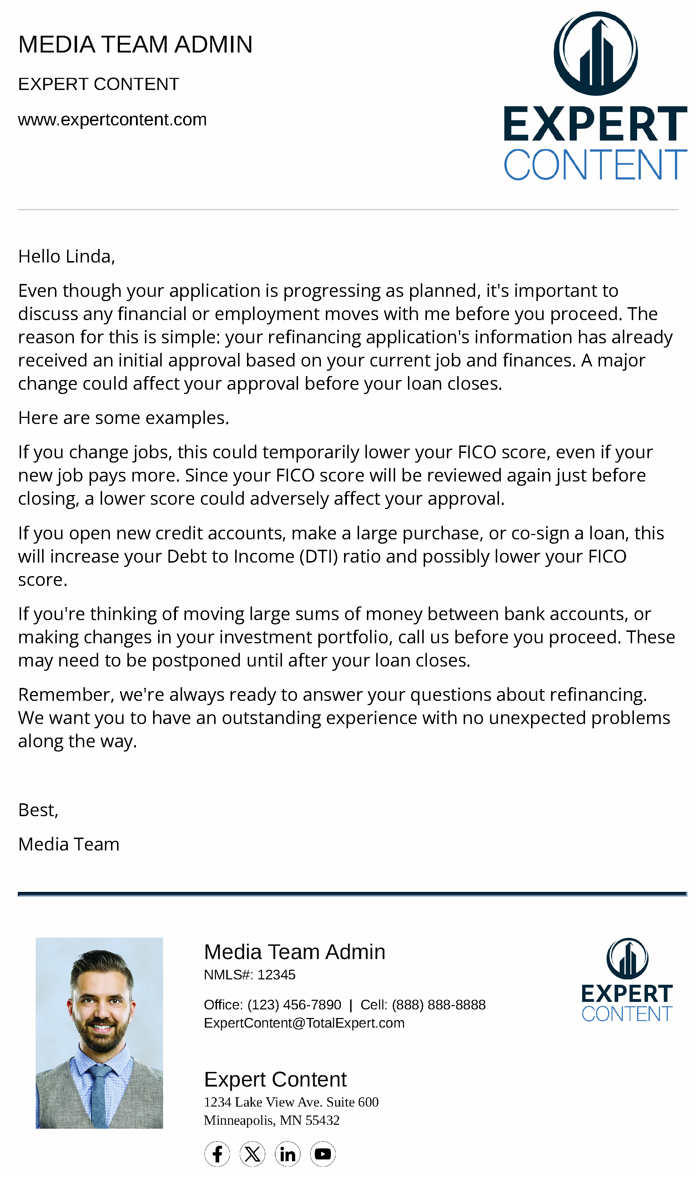
In Process Refinance Milestone
Email Subject Line:
Thank you for trusting us!
Your electronic signature options explained
Some financial Dos and Don’ts to remember
Notes:
This page should be used for JOURNEY EMAILS (duplicate as needed)

Slide 6
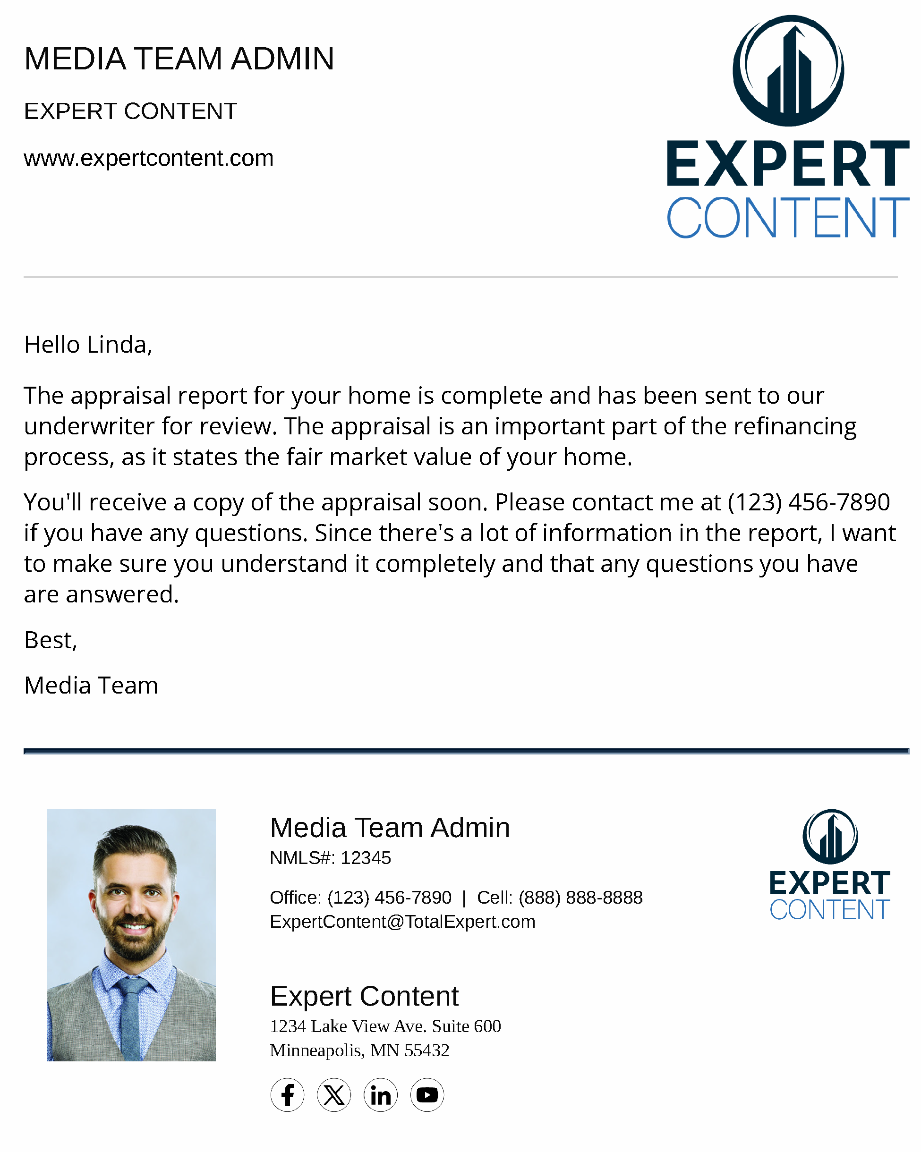
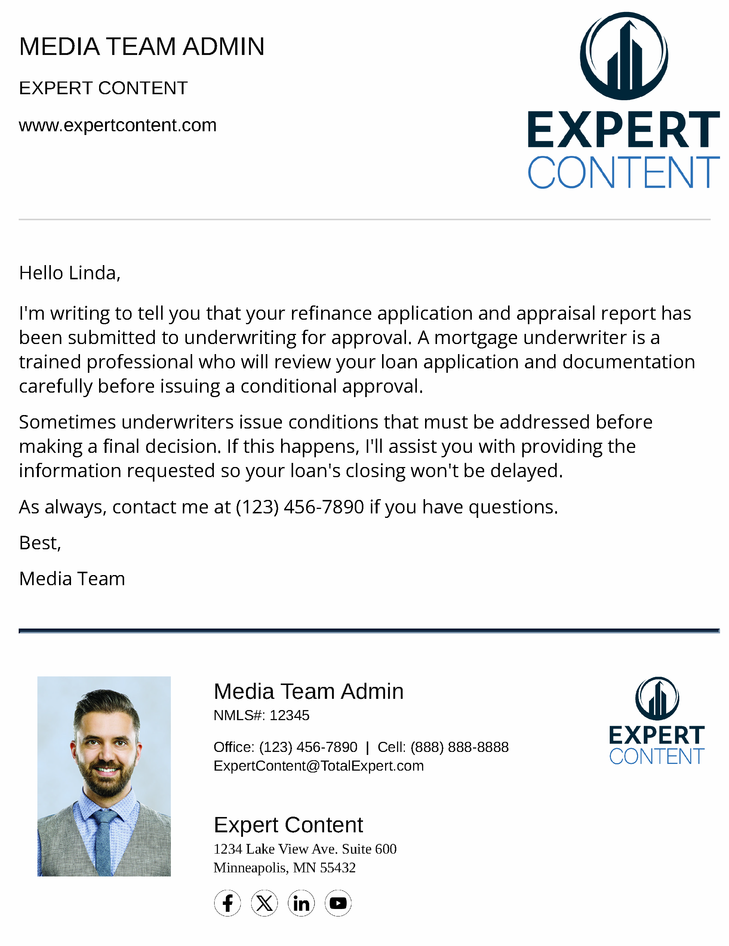
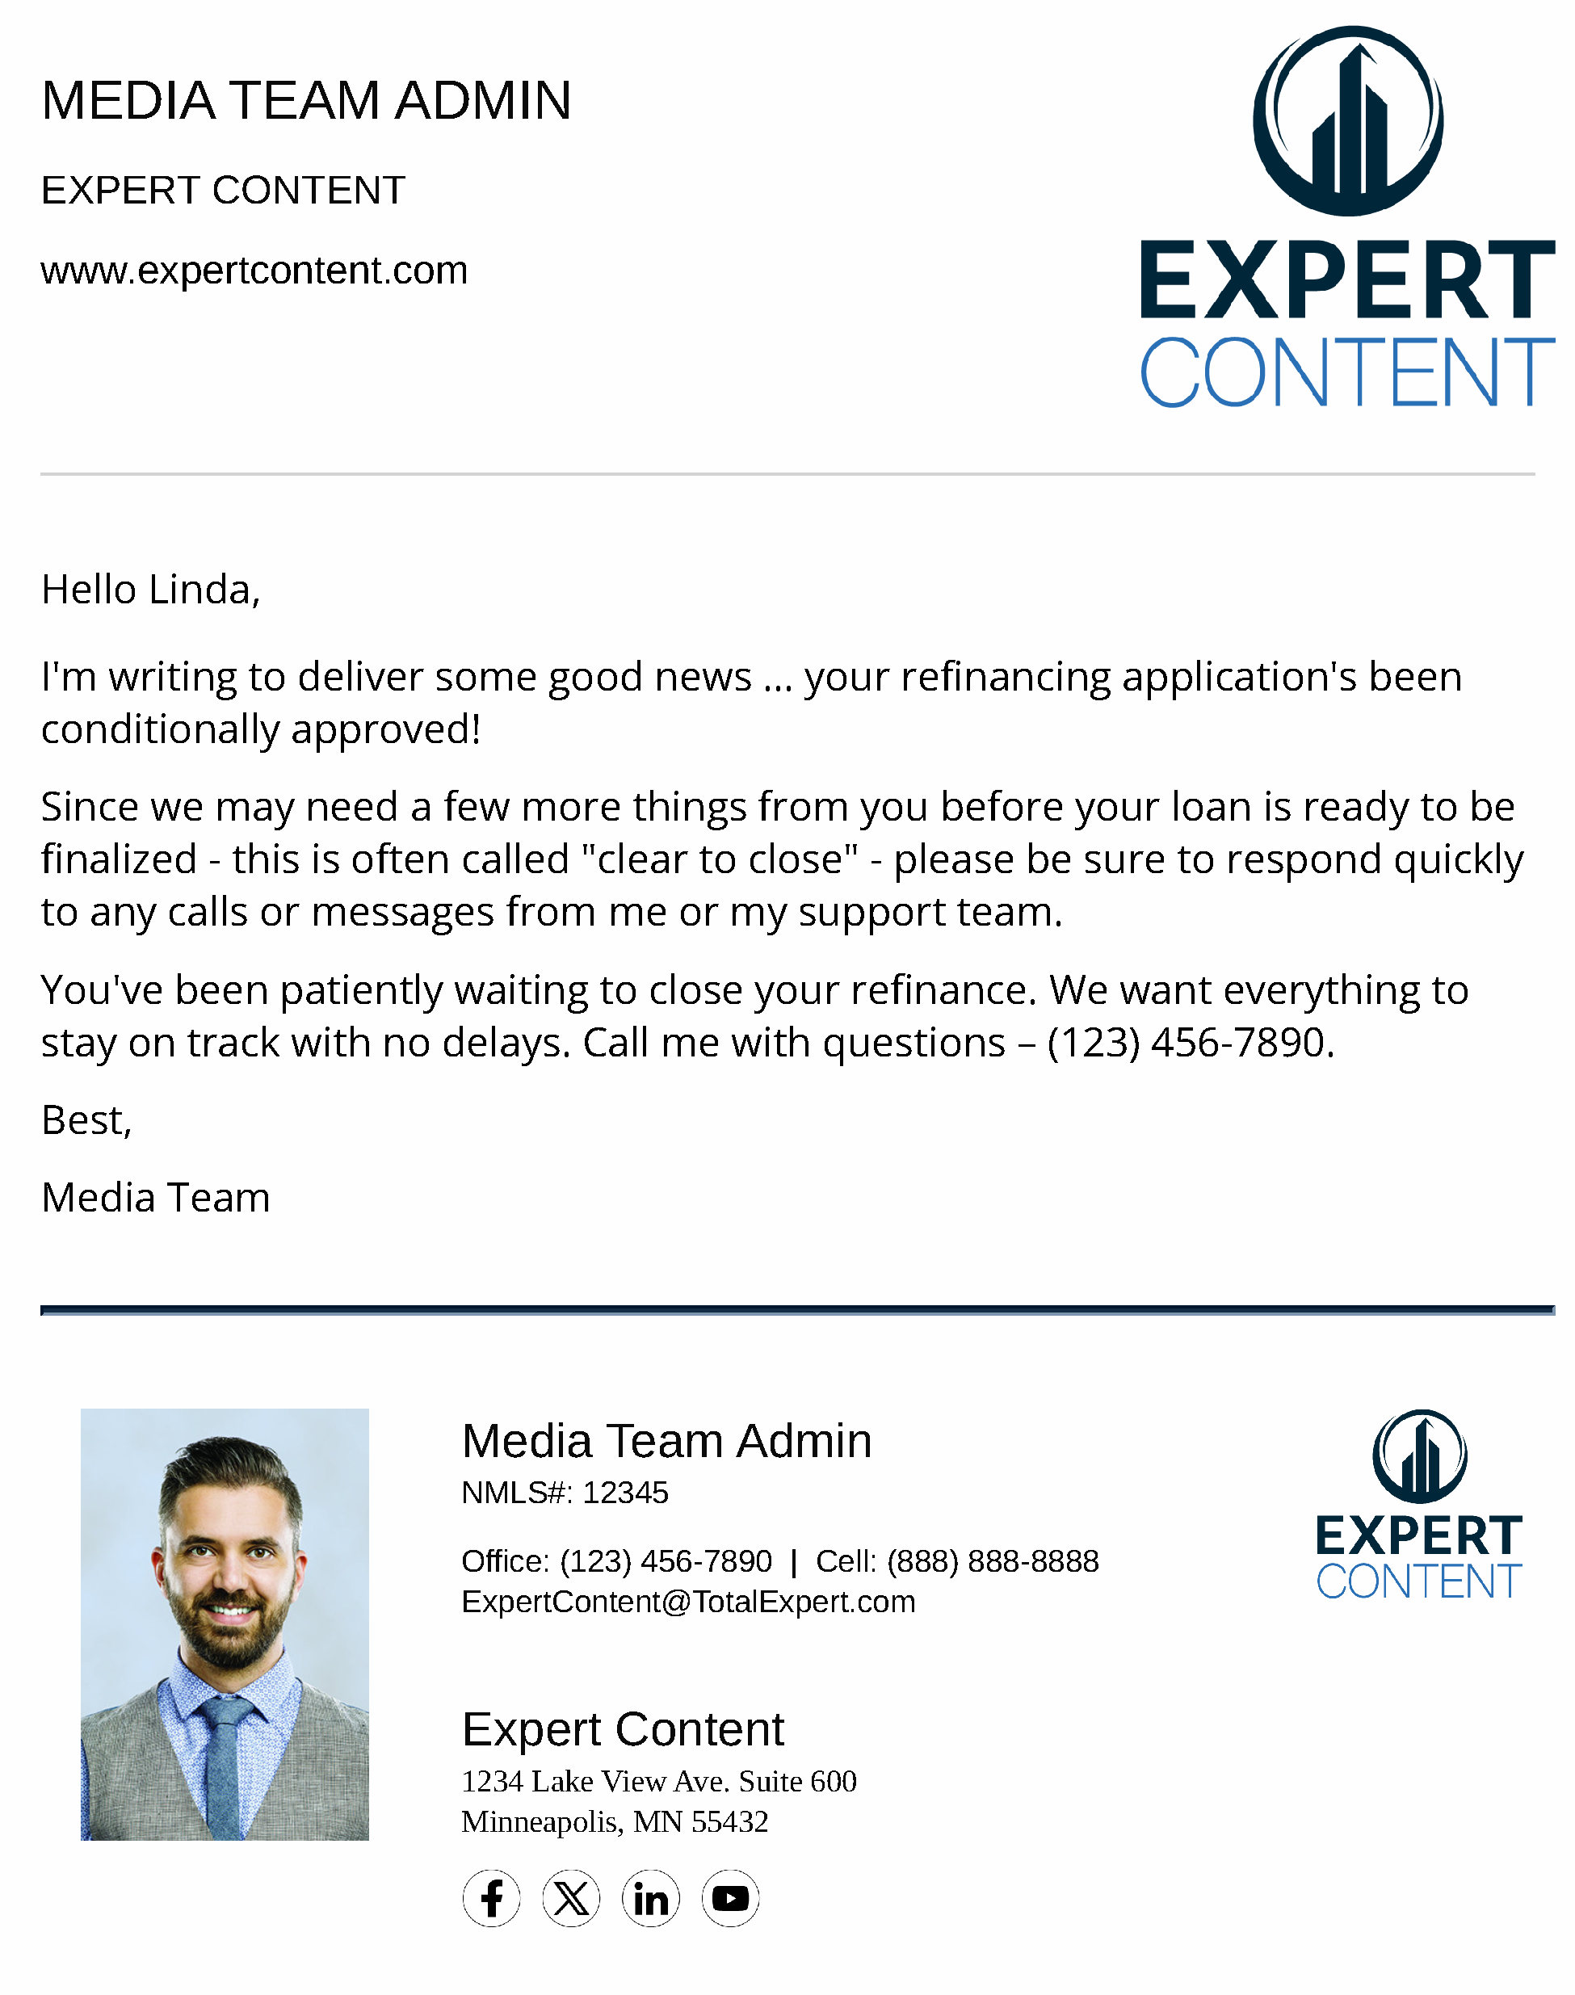
In Process Refinance Milestone
Email Subject Line:
Your home appraisal’s ready to review.
Your loan’s been submitted to underwriting
You’re a big step closer to closing.
Notes:
This page should be used for JOURNEY EMAILS (duplicate as needed)

Slide 7
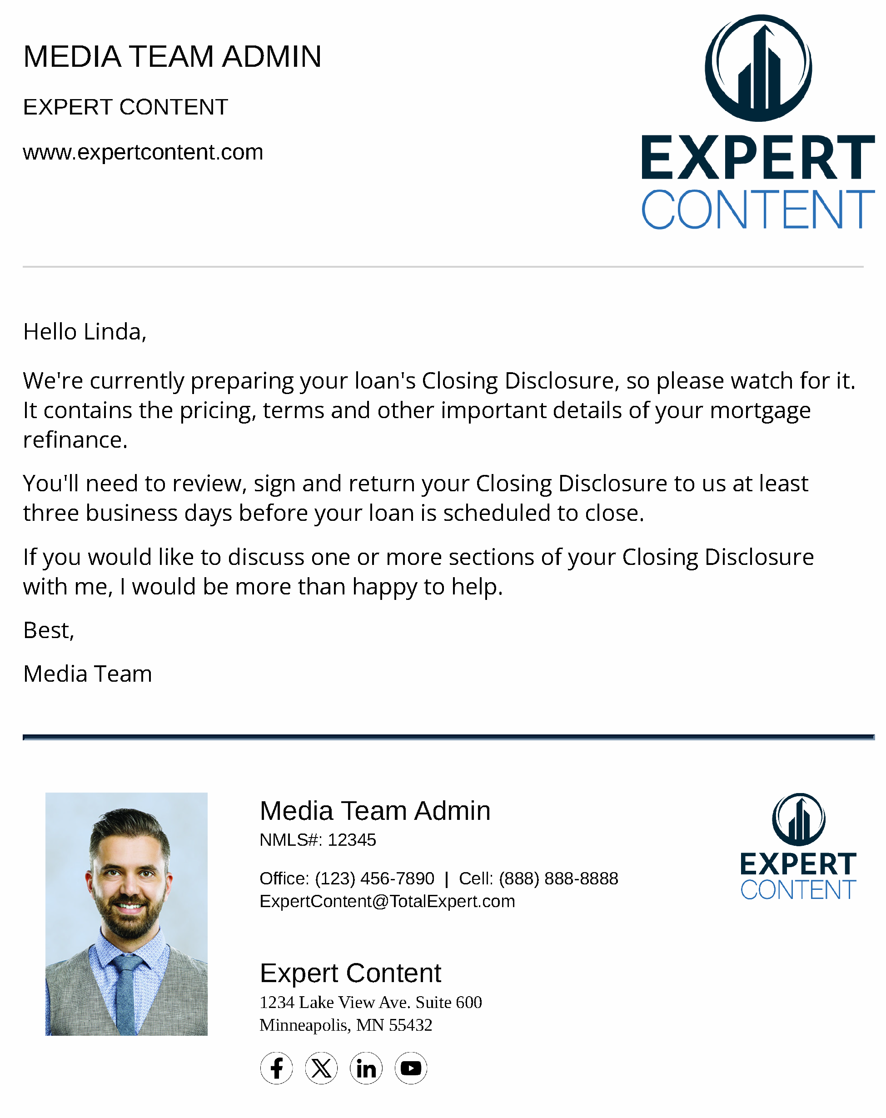
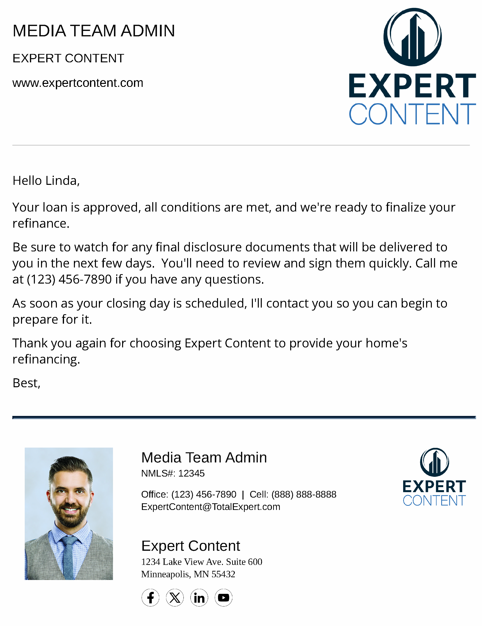
In Process Refinance Milestone
Email Subject Line:
Important Documents Headed Your Way
Congratulations! We’re clear to close!
Notes:
This page should be used for JOURNEY EMAILS (duplicate as needed)

Slide 8
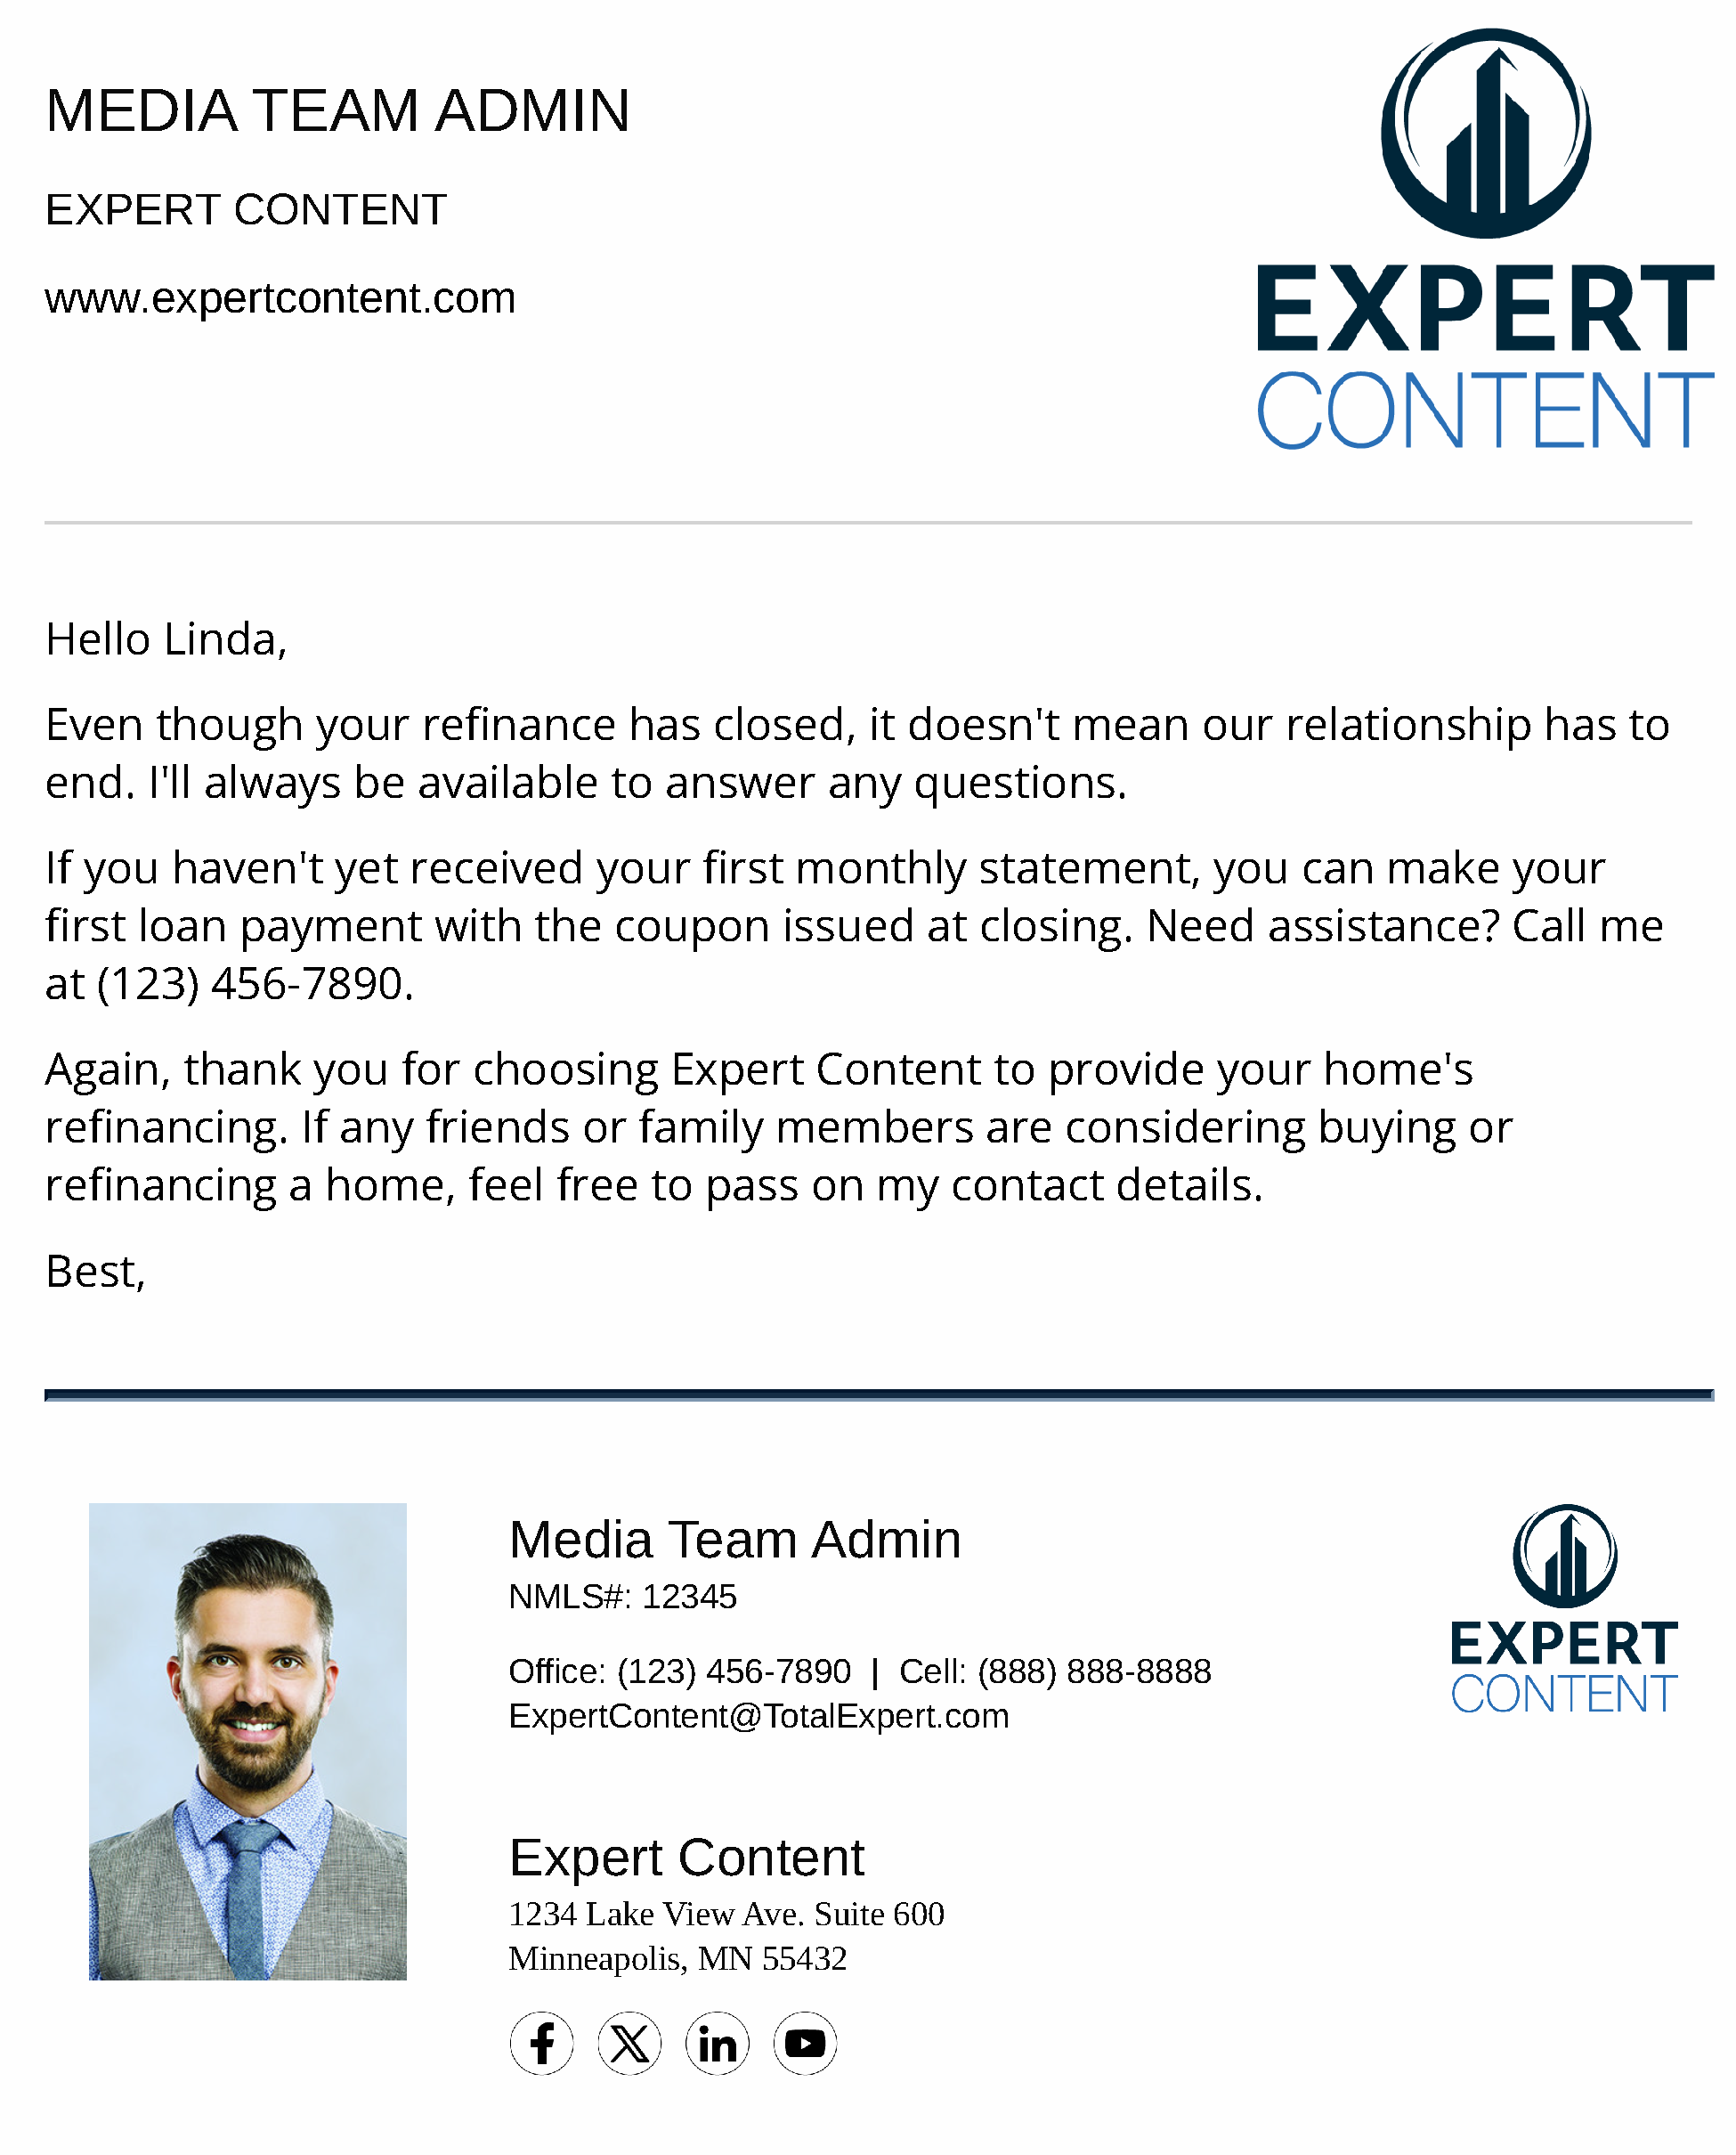
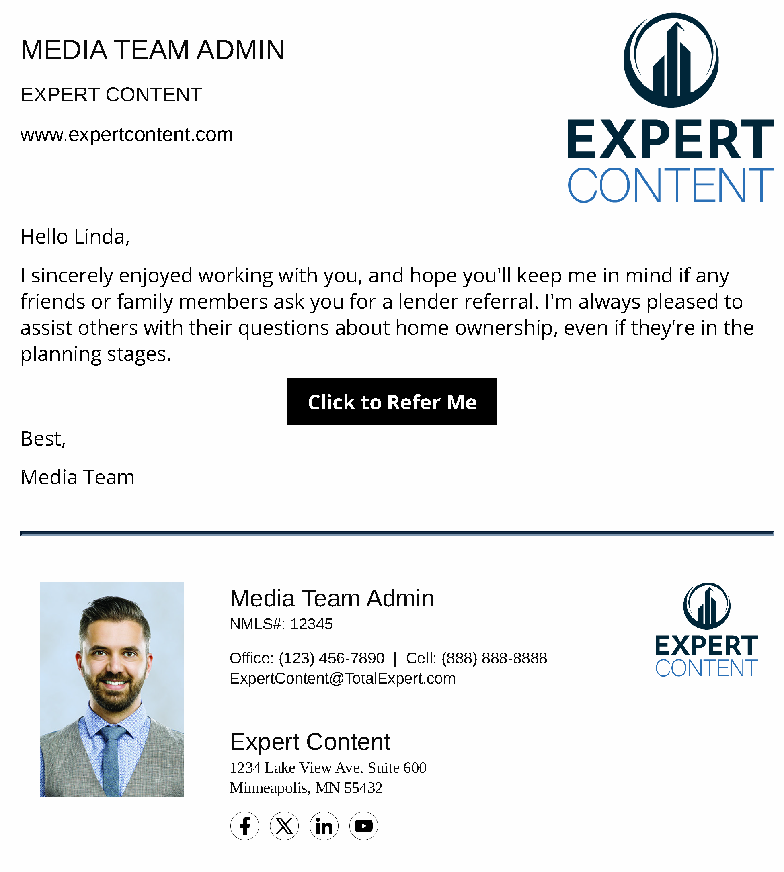
In Process Refinance Milestone
Email Subject Line:
Thank you for your business and your trust.
It was a pleasure helping you refinance!
Notes:
This page should be used for JOURNEY EMAILS (duplicate as needed)

Slide 9
In Process Refinance Milestone
SMS: Refinance Milestone - App Received
{{sender.company}} Loan update: {{recipient.f_name}}, your refinance application has been received. Please sign and return your initial loan documents ASAP to avoid delays.
SMS: In Process Milestone - E-Sign
{{sender.company}} Loan Update: {{recipient.f_name}}, you'll be receiving some mortgage-related documents soon. You'll be notified before they're sent to you, together with instructions on how to review and sign them online. Call if you have questions.
SMS: In Process Milestone - Dos and Don'ts
{{sender.company}} Loan Update: {{recipient.f_name}}, From now until the day your mortgage closes, it's important to keep your credit score intact. A career change, new credit card or changes in financial accounts may lower your score and affect your loan approval.
SMS: In Process Milestone - Appraisal Received
{{sender.company}} Loan Update: {{recipient.f_name}}, the appraisal for {{loan.address_1}} is being reviewed by our underwriter. You’ll be notified when the review is complete.
Notes:
This page should be used for Tasks, User Notifications, and SMS templates (duplicate as needed)

Slide 10
In Process Refinance Milestone
SMS: In Process Milestone - Underwriting
{{sender.company}} Loan Update: {{recipient.f_name}}, your loan and appraisal are with underwriting for review and approval. Questions? Reach out any time!
SMS: In Process Milestone - Conditional Approval
{{sender.company}} Loan Update: {{recipient.f_name}}, Good news! Your mortgage application's been conditionally approved, so you're a big step closer to your loan being finalized.
SMS: In Process Milestone - Closing Disclosure
Your mortgage's Closing Disclosure is ready. It contains all of your loan's details so you'll want to carefully review it before signing it.
SMS: Refinance Milestone - Clear to Close
{{sender.company}} Refinance Update: {{recipient.f_name}}, Good news! The estimated closing date for your refi is {{loan.closing_date_estimated | date: "m/d/Y"}}. Watch for disclosure documents to arrive, as these will require your signature.
SMS: Refinance Milestone - Closed!
Your refinance for {{loan.address_1}} has closed. Congratulations! On behalf of myself and my team at {{sender.company}}, thank you for choosing us.
Notes:
This page should be used for Tasks, User Notifications, and SMS templates (duplicate as needed)

Slide 11
In Process Refinance Milestone
User Notification: Borrower's Loan Successful - Remove from In Process Campaign
The status of the below loan was changed to {{loan.loan_status}} and will be removed from the Milestone Journey in the coming days.
Loan#: {{loan.loan_number}}
Borrower Name: {{loan.borrower.f_name}} {{loan.borrower.l_name}}
Borrower Email: {{loan.borrower.email}}
User Notification: Borrower's Loan Unsuccessful - Removed from In Process
The status of the below loan was changed to {{loan.loan_status}} and will be removed from the Milestone Journey in the coming days.
Loan#: {{loan.loan_number}}
Borrower Name: {{loan.borrower.f_name}} {{loan.borrower.l_name}}
Borrower Email: {{loan.borrower.email}}
Notes:
This page should be used for Tasks, User Notifications, and SMS templates (duplicate as needed)

Slide 12
In Process Refinance Milestone
User Notification: A Credit Inquiry Insight has been received for {{contact.f_name}}{{contact.l_name}}
Your contact, {{contact.f_name}}{{contact.l_name}} who is currently In Process with you, has an active Credit Inquiry Insight and may be shopping rates.
Reach out to {{contact.f_name}}{{contact.l_name}} through the below information:
{{contact.email}}
{{contact.phone_cell}}
{{contact.address}}
{{contact.city}}
{{contact.state}}
{{contact.zip}}
Notes:
This page should be used for Tasks, User Notifications, and SMS templates (duplicate as needed)

