Slide 1
Expert Content
Strategy Guide
Insurance Flyers

Slide 2
Insurance Flyers
Print Flyers – download or professionally printed
Flyers cover common lifestyle or family changes such as marriage and divorce, new baby/grandchild, and home renovations or moving. Custom footers/contact blocks can be applied by request during implementation. Flyers are built with self-serve template functionality so admins are able to make changes to verbiage, imagery, and some branding elements. Admins can take the content as-is, or adjust to meet company requirements, or duplicate and replace all copy and imagery to create a new flyer!
*All communications should be reviewed prior to publishing content.

Slide 3
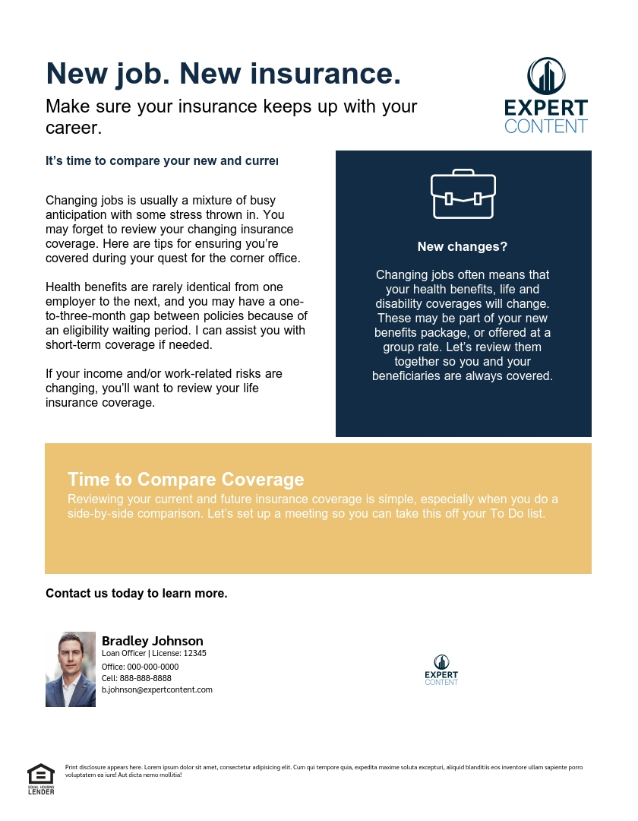
Print Flyers
Insurance Contact Block
Insurance Contact Block
Insurance Contact Block
Notes:
This page should be used for Print Flyers (duplicate as needed)

Slide 4
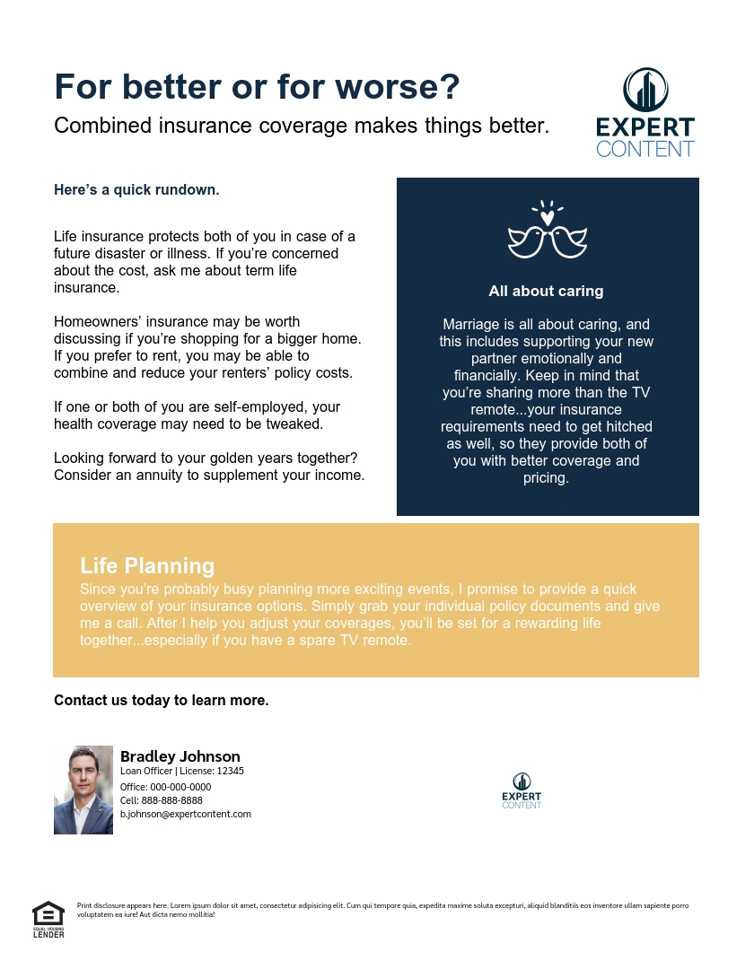
Print Flyers
Insurance Contact Block
Insurance Contact Block
Insurance Contact Block
Notes:
This page should be used for Print Flyers (duplicate as needed)

Slide 5
Print Flyers
Insurance Contact Block
Insurance Contact Block
Insurance Contact Block
Notes:
This page should be used for Print Flyers (duplicate as needed)

Slide 6
Print Flyers
Insurance Contact Block
Notes:
This page should be used for Print Flyers (duplicate as needed)

