Slide 1
Expert Content
Strategy Guide
Insurance Policy Quote Follow Up

Slide 2
Insurance Policy Quote Follow Up
Email
Engage contacts who have requested a policy quote but have not bound the policy. A series of 7 emails sent over the course of 90 days will be sent on behalf of agents. Topics range from simple follow ups, policy bundling, and quote refreshes. There are some emails where specific insurance type will need to be added or a custom field for policy type should be incorporated.
Best practice is to layer in SMS and user notifications where it makes the most sense for your business.
*All communications should be reviewed prior to initiating the journey.

Slide 3
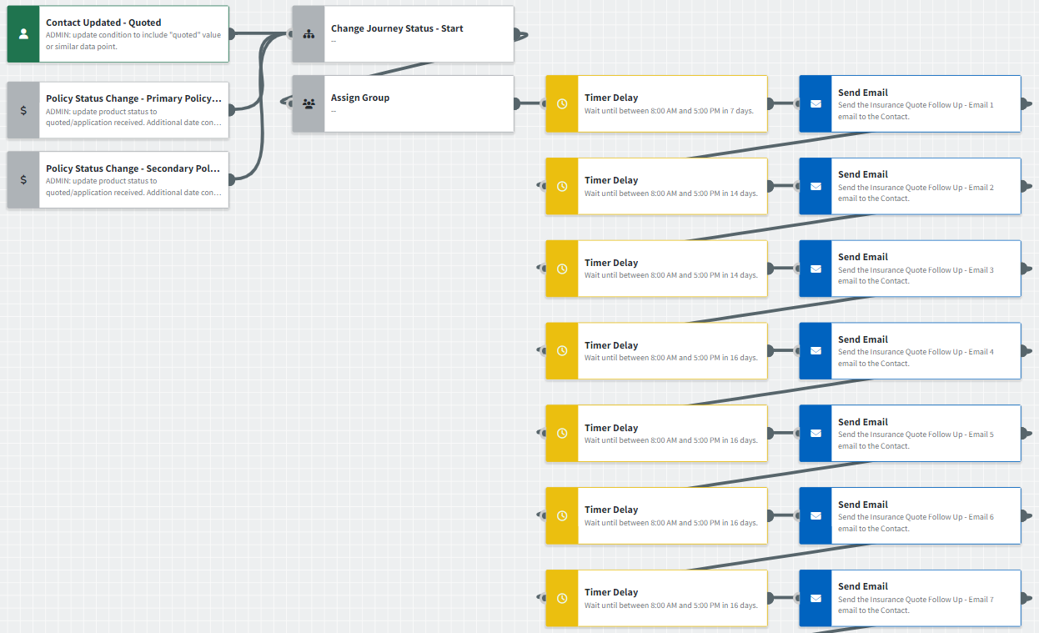
Journey Map Notes:
Keep emails that work for your organization, swap with custom, or add these emails to your existing campaigns.
Adjust onramps with organization specific groups and Focused View outcomes.

Slide 4
Insurance Policy Quote Follow Up
Email Subject:
A better deal on insurance is waiting.
Inside: some really good reasons to review your insurance quote.
"I don't mind spending too much for insurance."
Here's why I'm busy...and why you should call.
Notes:
This page should be used for JOURNEY EMAILS (duplicate as needed)

Slide 5
Insurance Policy Quote Follow Up
Email Subject:
Bundle your coverage. Save a bundle.
Let me freshen up that insurance quote for you.
This could be your last chance for a good buy.
Notes:
This page should be used for JOURNEY EMAILS (duplicate as needed)

Slide 6
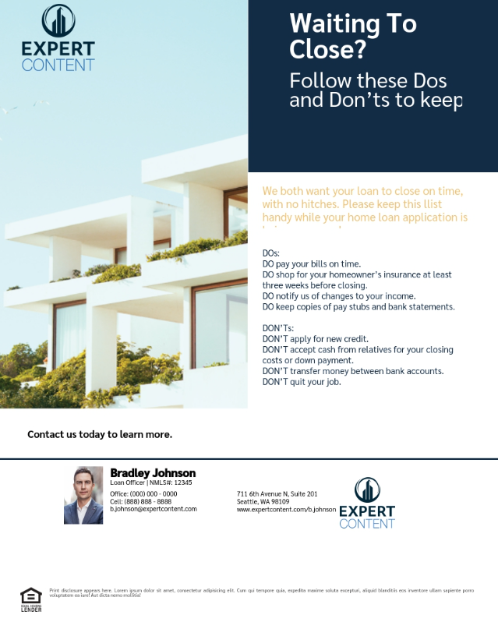
Print Flyers
Notes:
This page should be used for Print Flyers (duplicate as needed)

Slide 7
Postcards
Notes:
This page should be used for Postcards (duplicate as needed)

Slide 8
Social Media
Notes:
This page should be used for Social Media (duplicate as needed)

Slide 9
Campaign Name
Task: task snippet name
Content here.
User Notification: notification snippet name
Content here.
SMS: SMS snippet name
Content here.
Notes:
This page should be used for Tasks, User Notifications, and SMS templates (duplicate as needed)

