Slide 1
Expert Content
Strategy Guide
Insurance Policy Renewal

Slide 2
Insurance Policy Renewal
Emails, user notification
Leverage this journey to remind policyholders of upcoming renewals on their policies. Admins should configure journey triggers to include or exclude specific policy types (e.g. Medicare policies go through their own renewal journey and reminder cadence). Emails are generic to policy type and can be customized further with relevant data. 3 emails sent beginning 60 days before the policy expiration date. Timer delays are aligned with email verbiage alerting policyholder of how many days they have until the policy auto-renews. A thank you is sent on the day after the expiration date as long as no changes have been made to the policy.
*All communications should be reviewed prior to initiating the journey.

Slide 3
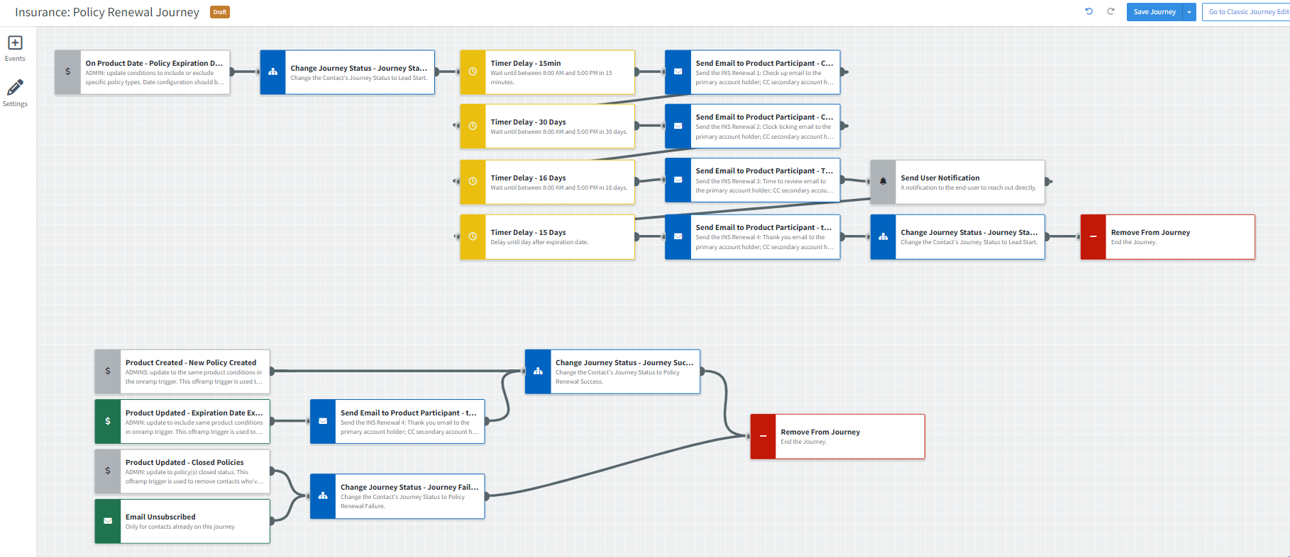
Journey Map Notes:
Keep emails that work for your organization, customize the content as needed, swap out with custom, or leverage these emails in your existing campaigns.
Timer delays are based on onramp being 60 days prior to policy expiration date. If onramp date shift is changed, admin should review and adjust all timer delays to match.

Slide 4
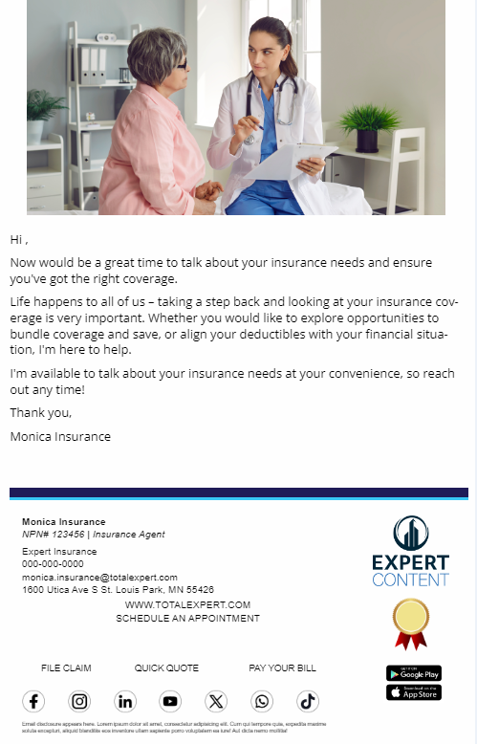
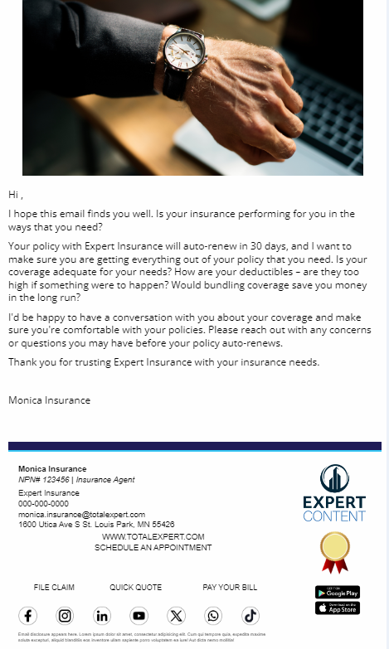
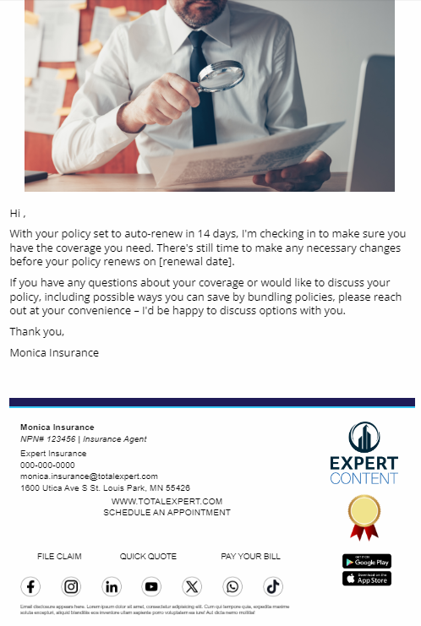
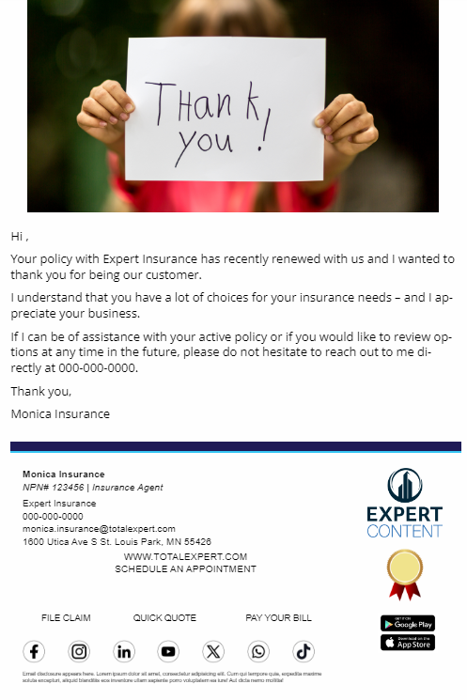
Campaign Name
Email Subject:
Time for a check-up?
The clock is ticking
It’s time to review your policy
Thank you for being a customer
Notes:
This page should be used for JOURNEY EMAILS (duplicate as needed)

Slide 5
Campaign Name
User Notification: notification snippet name
{{contact.f_name}} {{contact.l_name}} has an upcoming policy renewal date! Reach out to them to see if they need any help with adjusting their policy or learning about other offerings.
{{contact.f_name}} {{contact.l_name}}
Cell: {{contact.phone_cell}}
Email: {{contact.email}}
Notes:
This page should be used for Tasks, User Notifications, and SMS templates (duplicate as needed)

