Slide 1
Expert Content
Strategy Guide
Insurance: Generic B2B Lead Nurture
July 2025

Slide 2
Insurance: Generic B2B Lead Nurture
Communication types: Email
Leverage this journey wireframe to market to specific industry contacts about partnering with your organization for insurance coverage. 15 emails are sent over roughly 13 months, spaced out to avoid overcommunicating. Some timer delays are shorter or longer and meant to mimic an agent sending direct emails. Sending windows are set for 8am-12pm but should be adjusted to meet industry trends (e.g. manufacturing may be 8:30-10am, retail from 10am-12pm, or healthcare 7-9am or 2-4pm).
Apply industry specific information to the journey to configure it to each of the industries you work with. The wireframe does not include content but has email templates with suggested topics and talking points. You can update the existing email templates or add/replace with your own. The emails leverage corporate headers for a clean, professional look. Emails are sent on behalf of an individual agent. Adjust tone for warmer or colder lead nurture campaigns.
*All communications should be reviewed prior to initiating the journey.

Slide 3
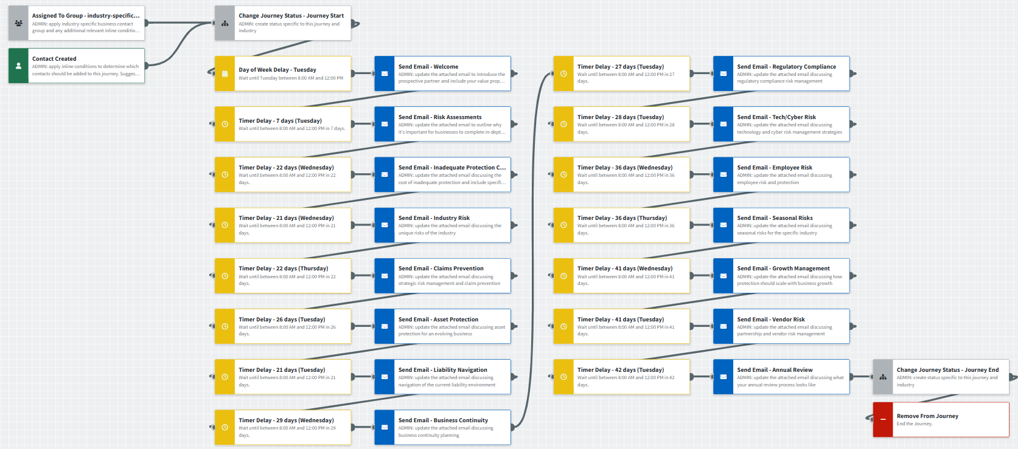
Insurance: Generic B2B Lead Nurture
Journey Notes:
Email templates include key message, talking points, and call-to-action recommendations. They are not completed templates and will need industry-specific topics and trends applied.
  Each email should be edited from your marketing admin’s email list or swapped for custom emails.
Notes:
This page should be used for JOURNEY WIREFRAMES (duplicate as needed)

Slide 4
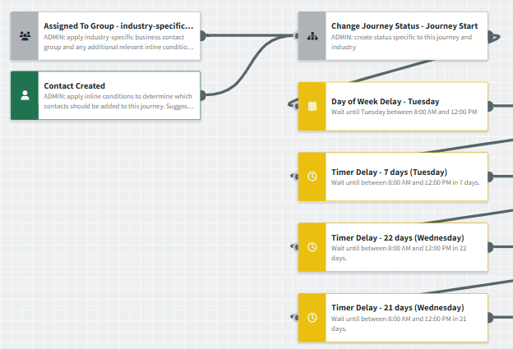
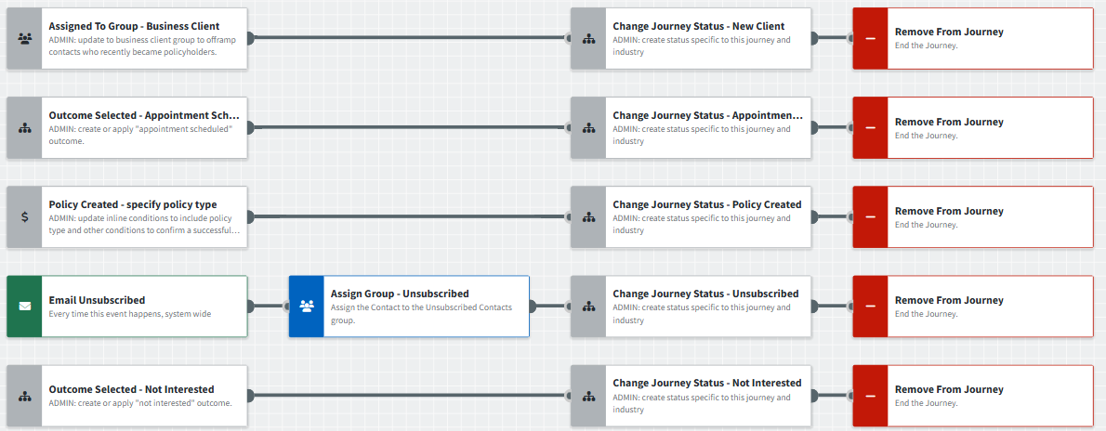
Insurance: Generic B2B Lead Nurture
Journey Notes:
Onramps and offramps will need to be reconfigured for each specific industry.
Outcomes are used as offramps by default but can be removed if agents are not active in the platform.
Timer delays are set to send Tuesday-Thursday between 8am-12pm to align with B2B email marketing trends.
Notes:
This page should be used for JOURNEY WIREFRAMES (duplicate as needed)

Slide 5


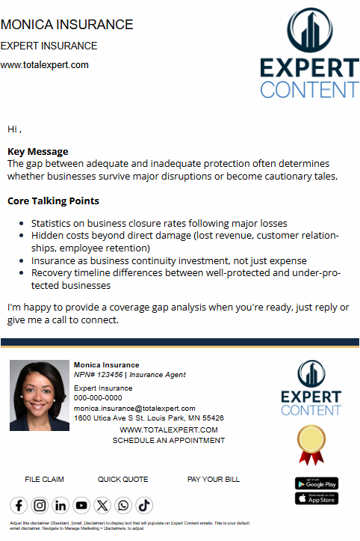
Insurance: Generic B2B Lead Nurture
Email Subject Line:
Partner with {{sender.company}} to protect your business
Go beyond basic coverage with our comprehensive risk assessment
What happens when "good enough" coverage isn't enough?
Notes:
This page should be used for EMAILS (duplicate as needed)

Slide 6



Insurance: Generic B2B Lead Nurture
Email Subject Line:
Risk management insights for [specific industry]
Is your business managing claims or mitigating risk?
Let's go beyond the basics of asset protection
Notes:
This page should be used for EMAILS (duplicate as needed)

Slide 7



Insurance: Generic B2B Lead Nurture
Email Subject Line:
Navigating today's liability environment
Learn how continuity planning can keep you in business
Did you know compliance can be a competitive advantage?
Notes:
This page should be used for EMAILS (duplicate as needed)

Slide 8



Insurance: Generic B2B Lead Nurture
Email Subject Line:
Technology poses risks beyond cyber attacks - open to learn more.
Employees: your biggest asset and your biggest exposure
Seasonal risks: weather, holidays, supply, and more
Notes:
This page should be used for EMAILS (duplicate as needed)

Slide 9



Insurance: Generic B2B Lead Nurture
Email Subject Line:
Is your business protection scaling with you?
{{sender.company}} can help develop contractual protections and vendor risk strategies.
How often do you review your business protection strategy?
Notes:
This page should be used for EMAILS (duplicate as needed)

