Slide 1
Expert Content
Strategy Guide
Insurance: Medicare IEP Lead Nurture
July 2025

Slide 2
Insurance: Medicare IEP Lead Nurture
Communication types: Email
Leverage this journey to educate and engage with prospective Medicare enrollees as they become eligible for their Initial Enrollment Period. The journey includes 7 educational emails about the basics of Medicare, your services in the Medicare space and enrollment requirements. Additional emails include follow up messages for an enrolled contact’s birthday/welcome to Medicare and a 90-day check in. Emails are sent on behalf of an individual agent and include strong calls-to-action. Adjust tone for warmer or colder lead nurture campaigns.
Configure the journey onramp to begin sending 6 months prior to a contact’s 65th birthday through a variety of ways. Best practice is a custom field for the day/year of their 65th birthday but contact groups, Life Events, and other alternatives can be leveraged. Adjust email messaging, spacing, and sending windows to align with your specific market trends.
*All communications should be reviewed prior to initiating the journey and annually for updated policy information.

Slide 3
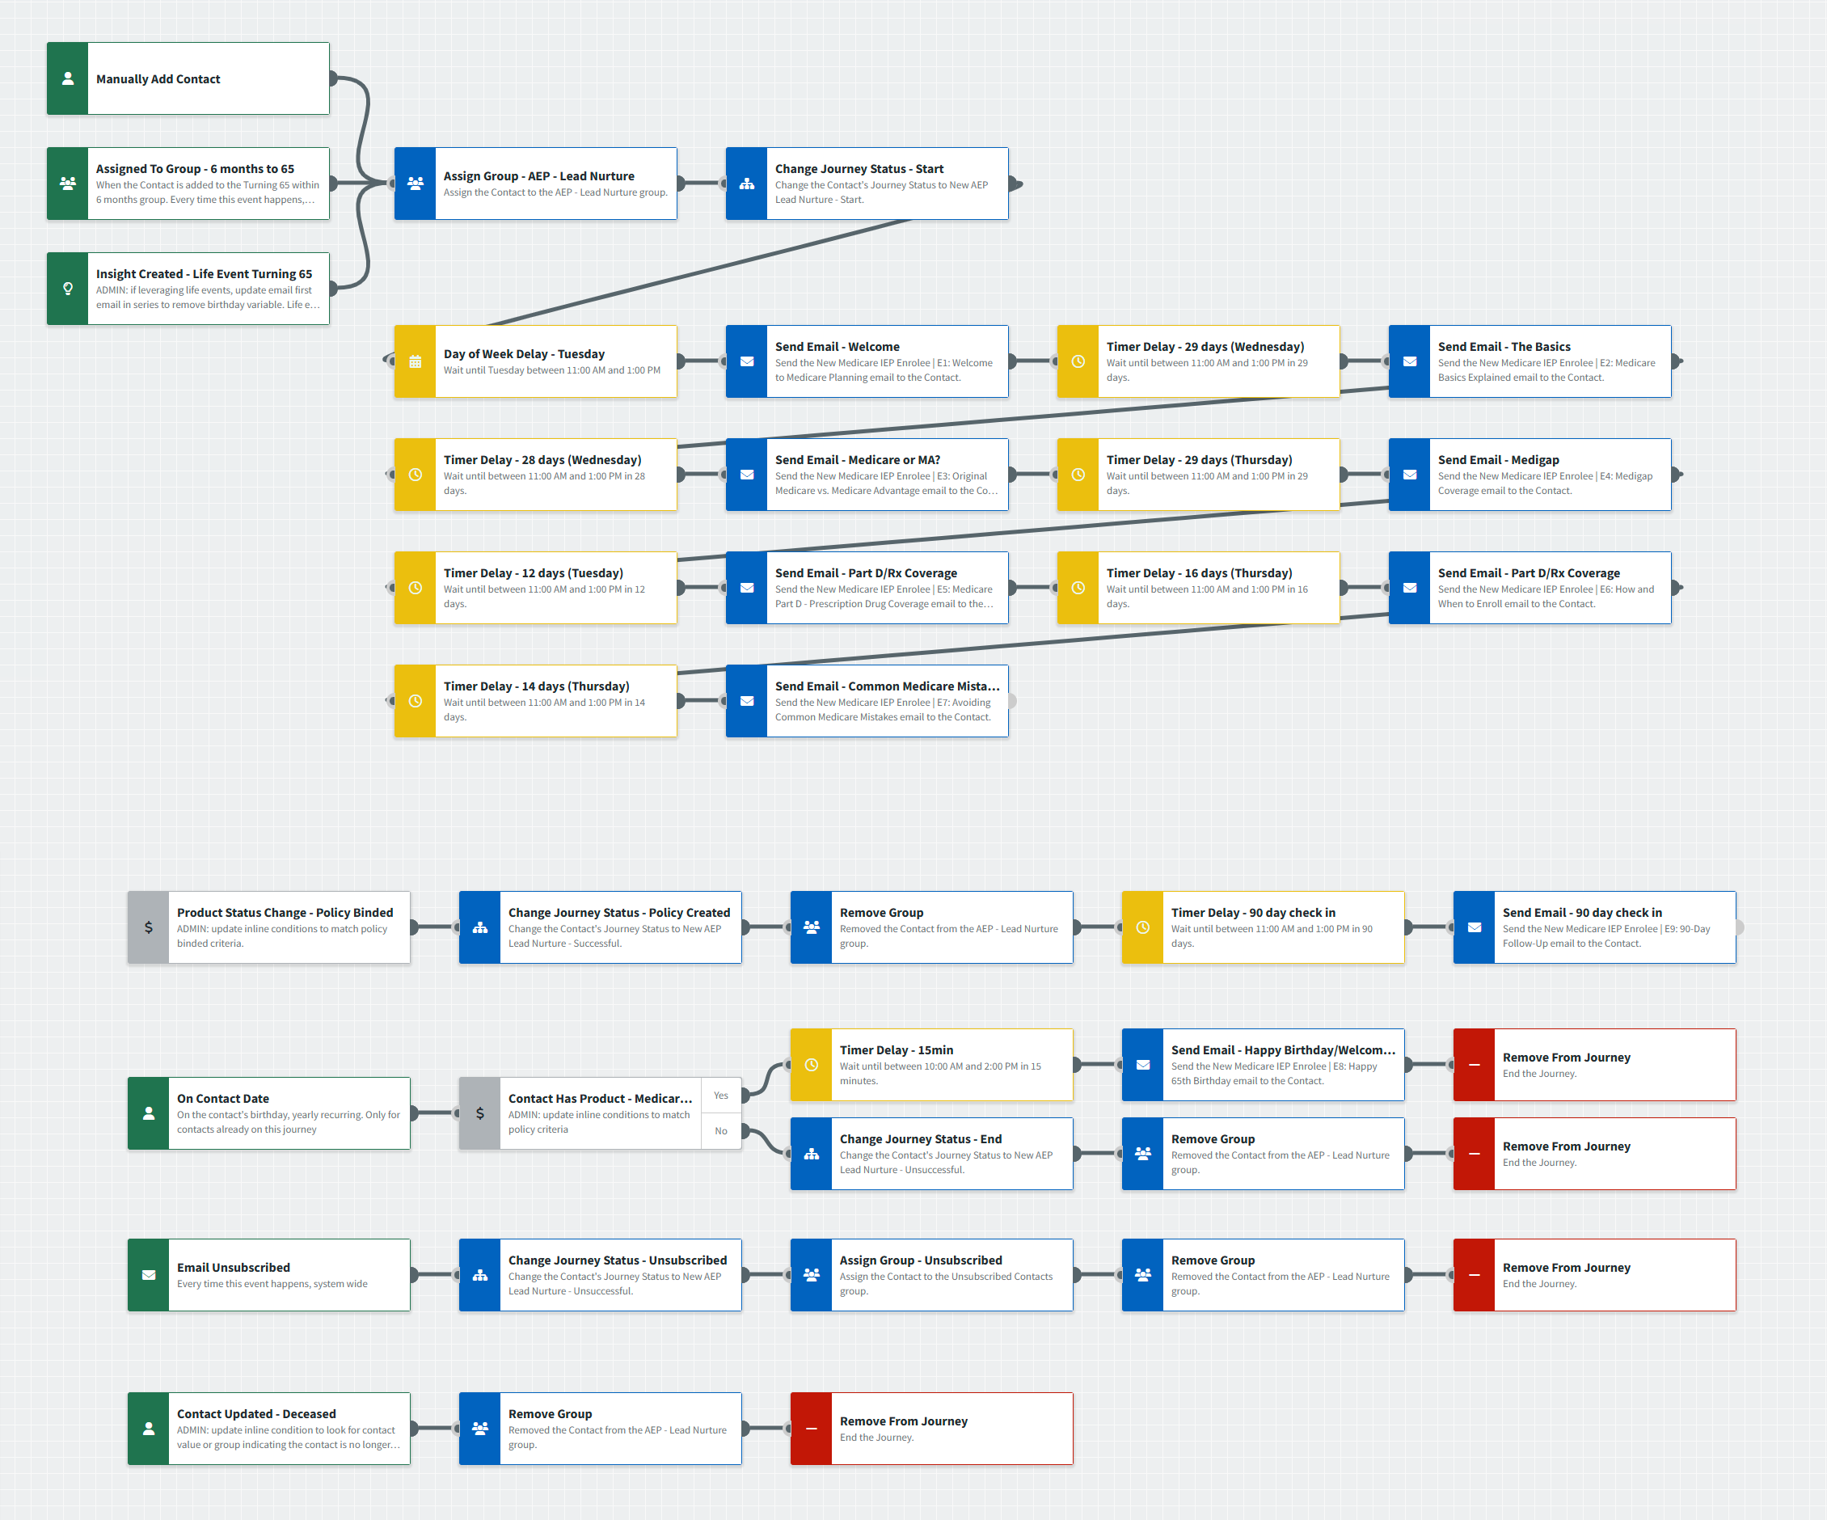
Insurance: Medicare IEP Lead Nurture
Journey Notes:
Keep emails that work for your organization, edit to meet your organization’s tone, swap with custom, or add these emails to your existing campaigns. Timer delays are set to send between 11am-1pm Tuesday-Thursday to align with email marketing trends.
Onramps will need to be configured based on your organization’s workflow and contact management process. Best practice is a custom field that signifies the date including year that the contact turns 65. Alternative options are presented in this wireframe if that is not available.
The sequence intentionally does not have a “Remove from Journey” component to enable intelligent automation. Offramps are configured for contacts who have obtained a policy and those who have not.

Slide 4
Insurance: Medicare IEP Lead Nurture
Journey Notes:
Adjust trigger and condition components with organization specific inline conditions, contact groups, and Focused View outcomes.
The sequence after “Policy Binded” intentionally does not have a “Remove from Journey” component to enable intelligent automation.
After “On Contact Date” for birthday, contacts who’ve obtained coverage will receive a “Happy Birthday/Welcome to Medicare” email. Those who did not bind a policy will be removed from the journey.

Slide 5
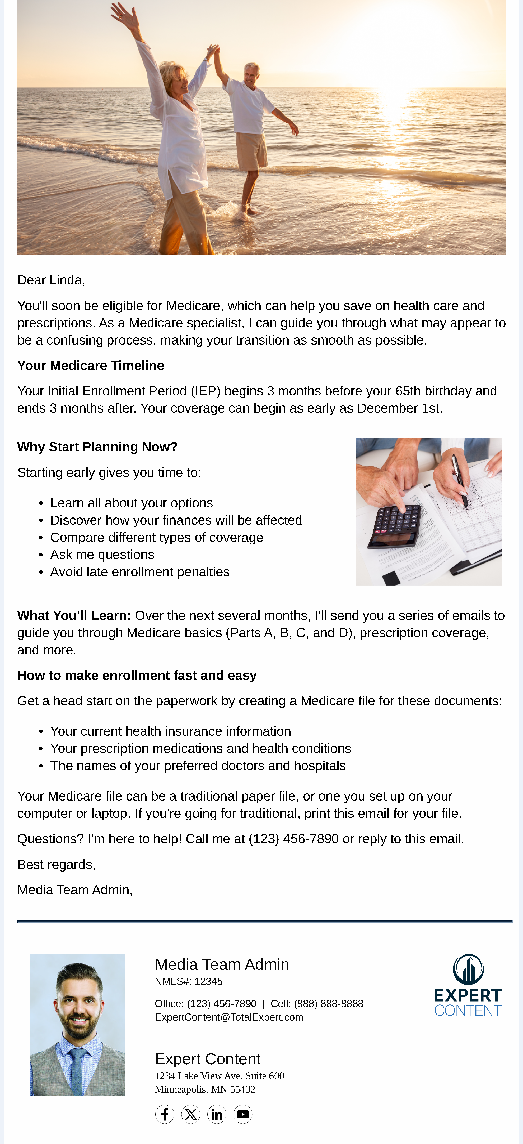
Insurance: Medicare IEP Lead Nurture
Email Subject Line: Turning 65 Soon? Your Medicare Journey Starts Now
Dear {{recipient.f_name}},
You'll soon be eligible for Medicare, which can help you save on health care and prescriptions. As a Medicare specialist, I can guide you through what may appear to be a confusing process, making your transition as smooth as possible.
Your Medicare Timeline
Your Initial Enrollment Period (IEP) begins 3 months before your 65th birthday and ends 3 months after. Your coverage can begin as early as {{recipient.birthday | date: "%B"}} 1st.
Why Start Planning Now?
Starting early gives you time to:
Learn all about your options
Discover how your finances will be affected
Compare different types of coverage
Ask me questions
Avoid late enrollment penalties
What You'll Learn: Over the next several months, I'll send you a series of emails to guide you through Medicare basics (Parts A, B, C, and D), prescription coverage, and more.
How to make enrollment fast and easy
Get a head start on the paperwork by creating a Medicare file for these documents:
Your current health insurance information
Your prescription medications and health conditions
The names of your preferred doctors and hospitals
Your Medicare file can be a traditional paper file, or one you set up on your computer or laptop. If you're going for traditional, print this email for your file.
Questions? I'm here to help! Call me at {{sender.phone_office}} or reply to this email.
Best regards,
{{sender.f_name}} {{sender.l_name}}, {{sender.title}}
Notes:
This page should be used for JOURNEY EMAILS (duplicate as needed)

Slide 6
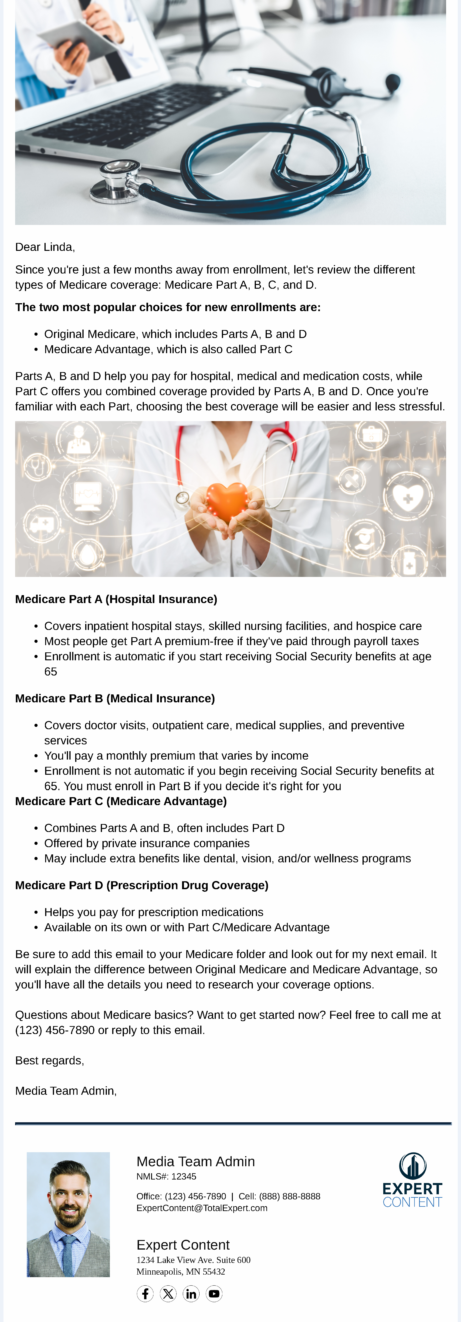
Insurance: Medicare IEP Lead Nurture
Email Subject Line: Medicare 101: Basic Types of Coverage
Dear {{recipient.f_name}},
Since you're just a few months away from enrollment, let's review the different types of Medicare coverage: Medicare Part A, B, C, and D.
The two most popular choices for new enrollments are:
Original Medicare, which includes Parts A, B and D
Medicare Advantage, which is also called Part C
Parts A, B and D help you pay for hospital, medical and medication costs, while Part C offers you combined coverage provided by Parts A, B and D. Once you're familiar with each Part, choosing the best coverage will be easier and less stressful.
Medicare Part A (Hospital Insurance)
Covers inpatient hospital stays, skilled nursing facilities, and hospice care
Most people get Part A premium-free if they've paid through payroll taxes
Enrollment is automatic if you start receiving Social Security benefits at age 65
Medicare Part B (Medical Insurance)
Covers doctor visits, outpatient care, medical supplies, and preventive services
You'll pay a monthly premium that varies by income
Enrollment is not automatic if you begin receiving Social Security benefits at 65. You must enroll in Part B if you decide it's right for you
Medicare Part C (Medicare Advantage)
Combines Parts A and B, often includes Part D
Offered by private insurance companies
May include extra benefits like dental, vision, and/or wellness programs
Medicare Part D (Prescription Drug Coverage)
Helps you pay for prescription medications
Available on its own or with Part C/Medicare Advantage
Be sure to add this email to your Medicare folder and look out for my next email. It will explain the difference between Original Medicare and Medicare Advantage, so you'll have all the details you need to research your coverage options.
Questions about Medicare basics? Want to get started now? Feel free to call me at {{sender.phone_office}} or reply to this email.
Best regards,
{{sender.f_name}} {{sender.l_name}}, {{sender.title}}
Notes:
This page should be used for JOURNEY EMAILS (duplicate as needed)

Slide 7
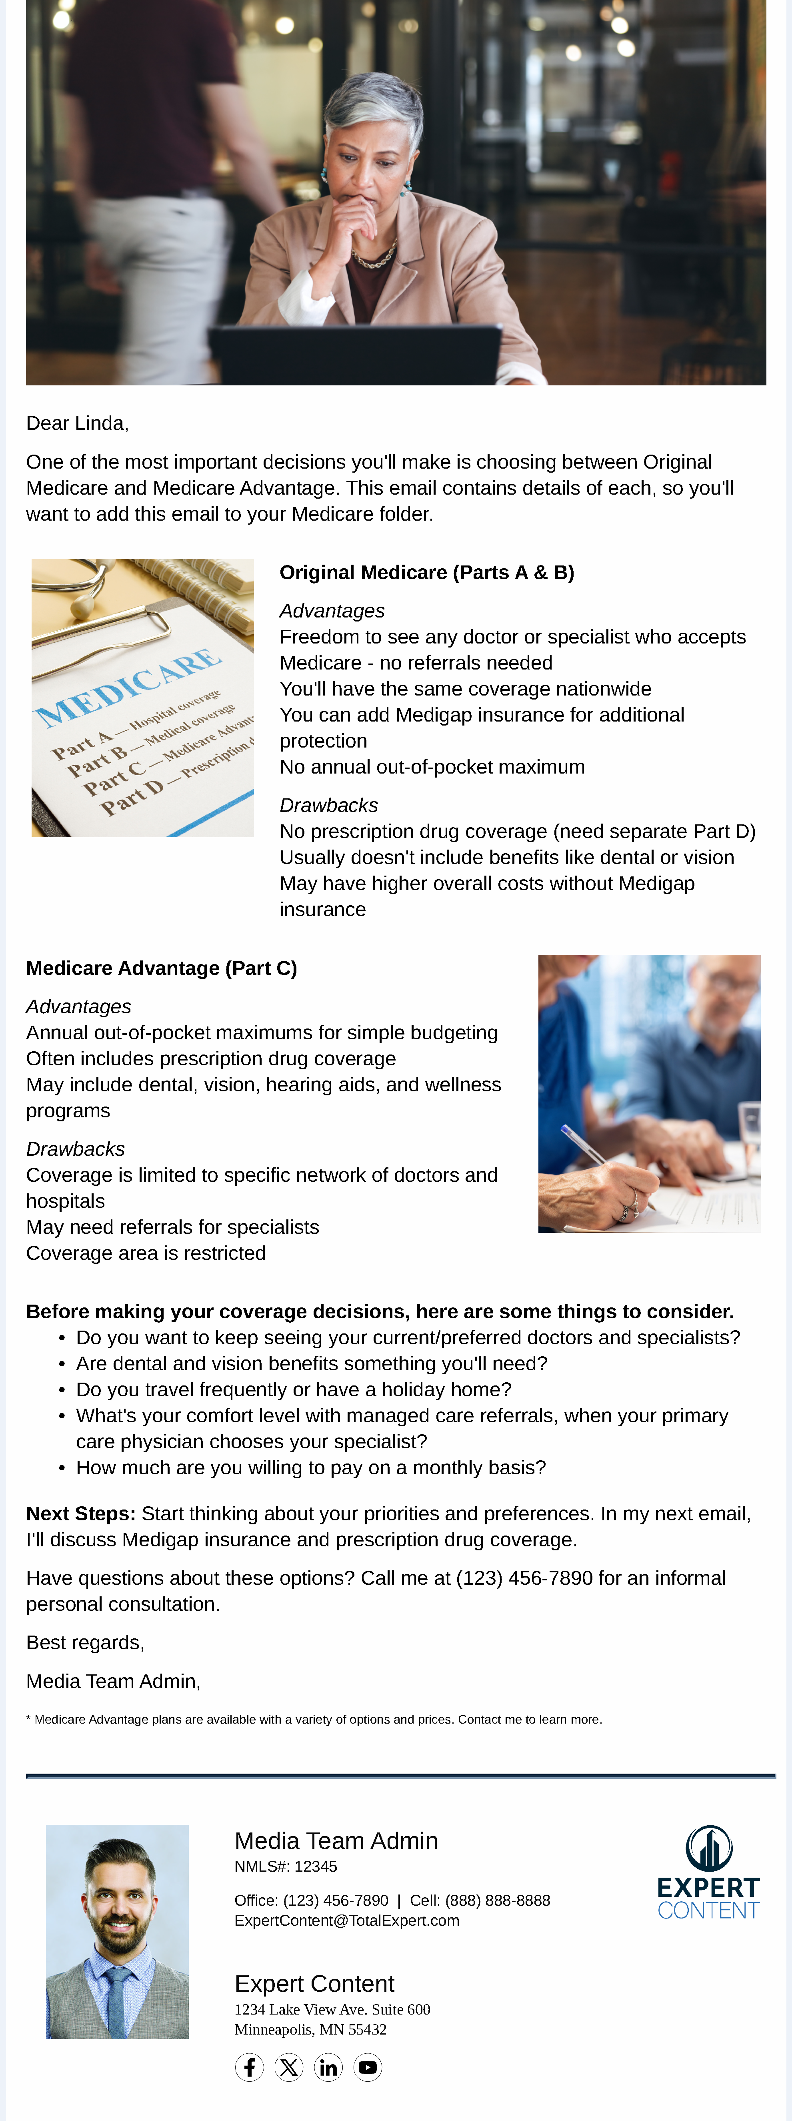
Insurance: Medicare IEP Lead Nurture
Email Subject Line: Original Medicare or Medicare Advantage?
Dear {{recipient.f_name}},
One of the most important decisions you'll make is choosing between Original Medicare and Medicare Advantage. This email contains details of each, so you'll want to add this email to your Medicare folder.
Original Medicare (Parts A & B)
Advantages
Freedom to see any doctor or specialist who accepts Medicare - no referrals needed
You'll have the same coverage nationwide
You can add Medigap insurance for additional protection
No annual out-of-pocket maximum
Drawbacks
No prescription drug coverage (need separate Part D)
Usually doesn't include benefits like dental or vision
May have higher overall costs without Medigap insurance
Medicare Advantage (Part C)
Advantages
Annual out-of-pocket maximums for simple budgeting
Often includes prescription drug coverage
May include dental, vision, hearing aids, and wellness programs
Drawbacks
Coverage is limited to specific network of doctors and hospitals
May need referrals for specialists
Coverage area is restricted
Before making your coverage decisions, here are some things to consider.
Do you want to keep seeing your current/preferred doctors and specialists?
Are dental and vision benefits something you'll need?
Do you travel frequently or have a holiday home?
What's your comfort level with managed care referrals, when your primary care physician chooses your specialist?
How much are you willing to pay on a monthly basis?
Next Steps: Start thinking about your priorities and preferences. In my next email, I'll discuss Medigap insurance and prescription drug coverage.
Have questions about these options? Call me at {{sender.phone_office}} for an informal personal consultation.
Best regards,
{{sender.f_name}} {{sender.l_name}}, {{sender.title}}
* Medicare Advantage plans are available with a variety of options and prices. Contact me to learn more.
Notes:
This page should be used for JOURNEY EMAILS (duplicate as needed)

Slide 8
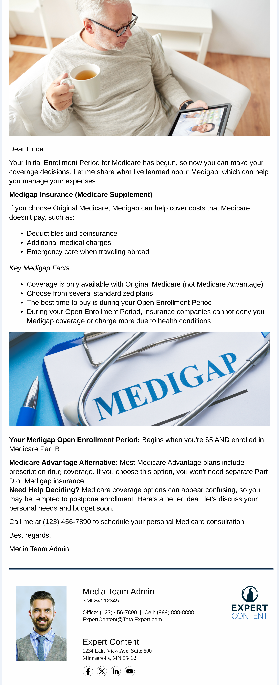
Insurance: Medicare IEP Lead Nurture
Email Subject Line: Customize Your Plan with Medigap Insurance
Dear {{recipient.f_name}},
Your Initial Enrollment Period for Medicare has begun, so now you can make your coverage decisions. Let me share what I've learned about Medigap, which can help you manage your expenses.
Medigap Insurance (Medicare Supplement)
If you choose Original Medicare, Medigap can help cover costs that Medicare doesn't pay, such as:
Deductibles and coinsurance
Additional medical charges
Emergency care when traveling abroad
Key Medigap Facts:
Coverage is only available with Original Medicare (not Medicare Advantage)
Choose from several standardized plans
The best time to buy is during your Open Enrollment Period
During your Open Enrollment Period, insurance companies cannot deny you Medigap coverage or charge more due to health conditions
Your Medigap Open Enrollment Period: Begins when you're 65 AND enrolled in Medicare Part B.
Medicare Advantage Alternative: Most Medicare Advantage plans include prescription drug coverage. If you choose this option, you won't need separate Part D or Medigap insurance.
Need Help Deciding? Medicare coverage options can appear confusing, so you may be tempted to postpone enrollment. Here's a better idea...let's discuss your personal needs and budget soon.
Call me at {{sender.phone_office}} to schedule your personal Medicare consultation.
Best regards,
{{sender.f_name}} {{sender.l_name}}, {{sender.title}}
Notes:
This page should be used for JOURNEY EMAILS (duplicate as needed)

Slide 9
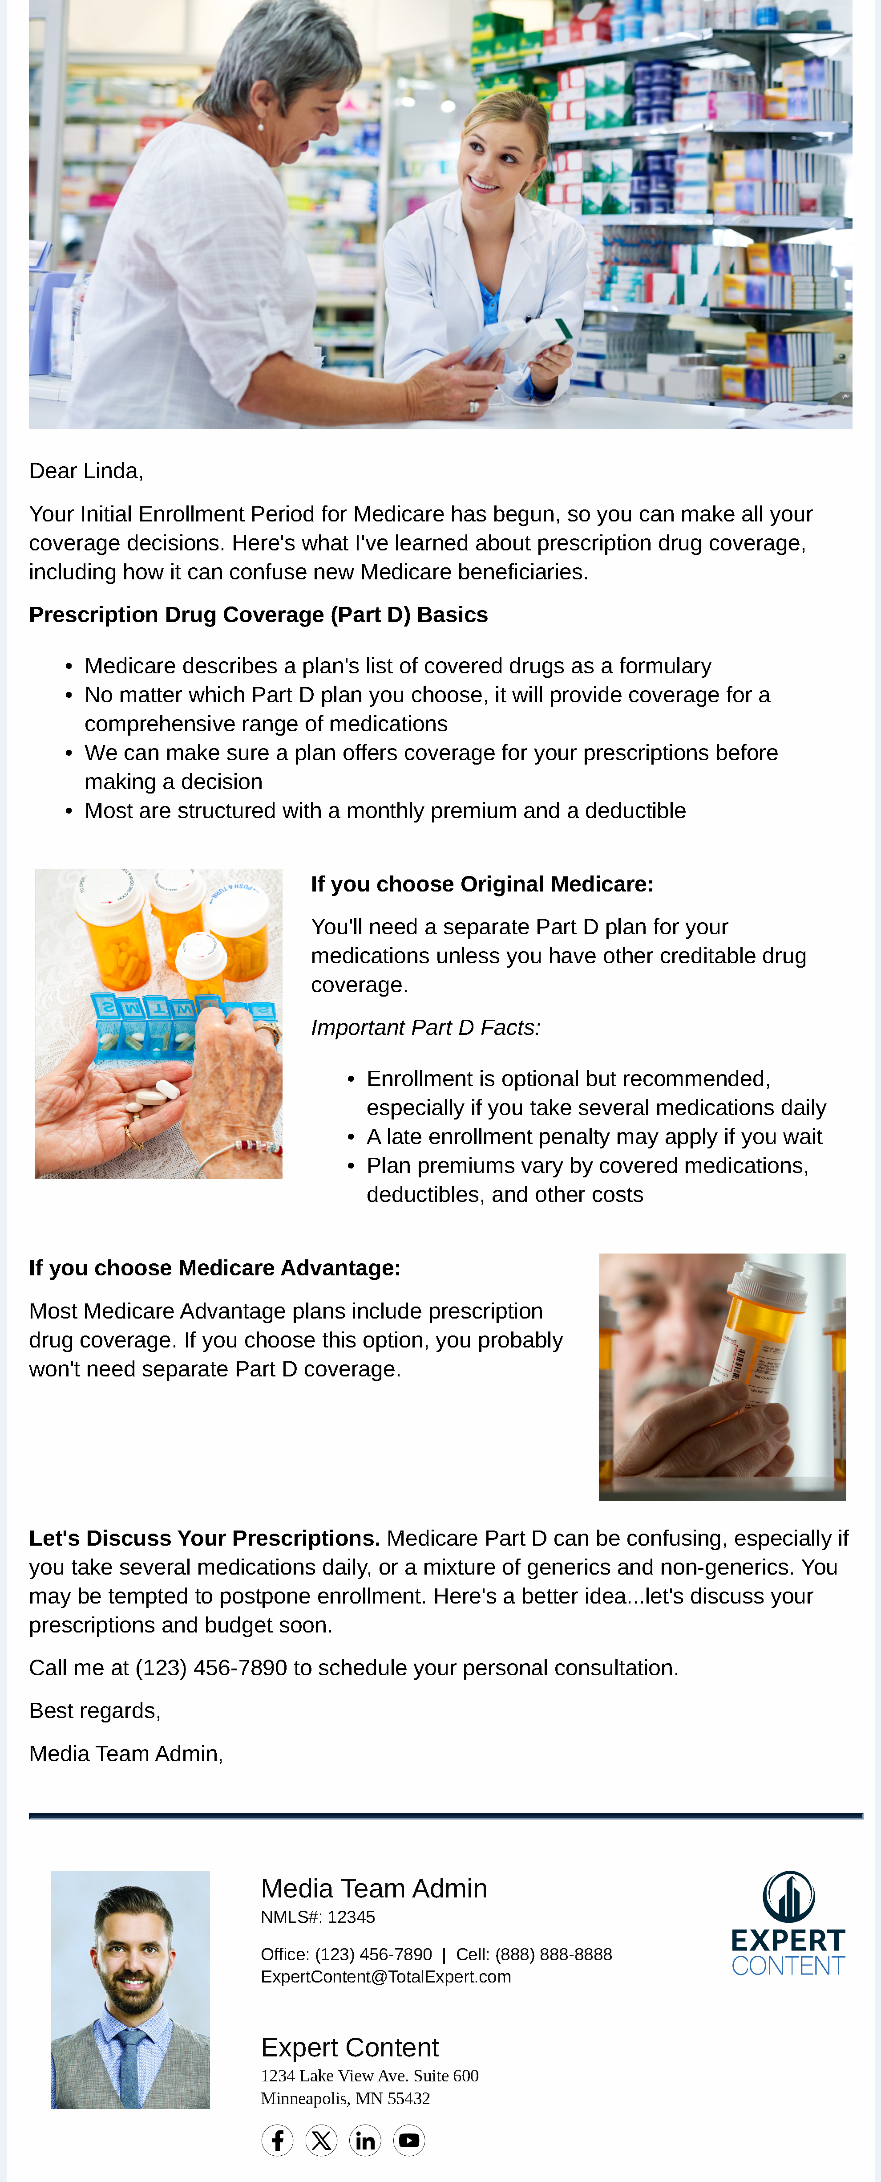
Insurance: Medicare IEP Lead Nurture
Email Subject Line: Your Prescription Drug Coverage Options
Dear {{recipient.f_name}},
Your Initial Enrollment Period for Medicare has begun, so you can make all your coverage decisions. Here's what I've learned about prescription drug coverage, including how it can confuse new Medicare beneficiaries.
Prescription Drug Coverage (Part D) Basics
Medicare describes a plan's list of covered drugs as a formulary
No matter which Part D plan you choose, it will provide coverage for a comprehensive range of medications
We can make sure a plan offers coverage for your prescriptions before making a decision
Most are structured with a monthly premium and a deductible
If you choose Original Medicare:
You'll need a separate Part D plan for your medications unless you have other creditable drug coverage.
Important Part D Facts:
Enrollment is optional but recommended, especially if you take several medications daily
A late enrollment penalty may apply if you wait
Plan premiums vary by covered medications, deductibles, and other costs
If you choose Medicare Advantage:
Most Medicare Advantage plans include prescription drug coverage. If you choose this option, you probably won't need separate Part D coverage.
Let's Discuss Your Prescriptions. Medicare Part D can be confusing, especially if you take several medications daily, or a mixture of generics and non-generics. You may be tempted to postpone enrollment. Here's a better idea...let's discuss your prescriptions and budget soon.
Call me at {{sender.phone_office}} to schedule your personal consultation.
Best regards,
{{sender.f_name}} {{sender.l_name}}, {{sender.title}}
Notes:
This page should be used for JOURNEY EMAILS (duplicate as needed)

Slide 10
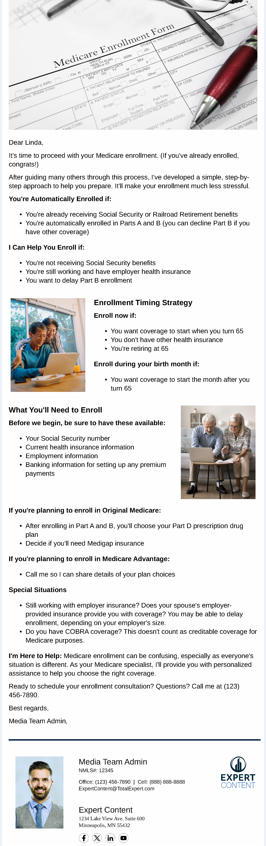
Insurance: Medicare IEP Lead Nurture
Email Subject Line: Ready to Enroll? Here's Your Step-by-Step Guide
Dear {{recipient.f_name}},
It's time to proceed with your Medicare enrollment. (If you've already enrolled, congrats!)
After guiding many others through this process, I've developed a simple, step-by-step approach to help you prepare. It'll make your enrollment much less stressful.
You're Automatically Enrolled if:
You're already receiving Social Security or Railroad Retirement benefits
You're automatically enrolled in Parts A and B (you can decline Part B if you have other coverage)
I Can Help You Enroll if:
You're not receiving Social Security benefits
You're still working and have employer health insurance
You want to delay Part B enrollment
Enrollment Timing Strategy
Enroll now if:
You want coverage to start when you turn 65
You don't have other health insurance
You're retiring at 65
Enroll during your birth month if:
You want coverage to start the month after you turn 65
What You'll Need to Enroll
Before we begin, be sure to have these available:
Your Social Security number
Current health insurance information
Employment information
Banking information for setting up any premium payments
If you're planning to enroll in Original Medicare:
After enrolling in Part A and B, you'll choose your Part D prescription drug plan
Decide if you'll need Medigap insurance
If you're planning to enroll in Medicare Advantage:
Call me so I can share details of your plan choices
Special Situations
Still working with employer insurance? Does your spouse's employer-provided insurance provide you with coverage? You may be able to delay enrollment, depending on your employer's size.
Do you have COBRA coverage? This doesn't count as creditable coverage for Medicare purposes.
I'm Here to Help: Medicare enrollment can be confusing, especially as everyone's situation is different. As your Medicare specialist, I'll provide you with personalized assistance to help you choose the right coverage.
Ready to schedule your enrollment consultation? Questions? Call me at {{sender.phone_office}}.
Best regards,
{{sender.f_name}} {{sender.l_name}}, {{sender.title}}
Notes:
This page should be used for JOURNEY EMAILS (duplicate as needed)

Slide 11
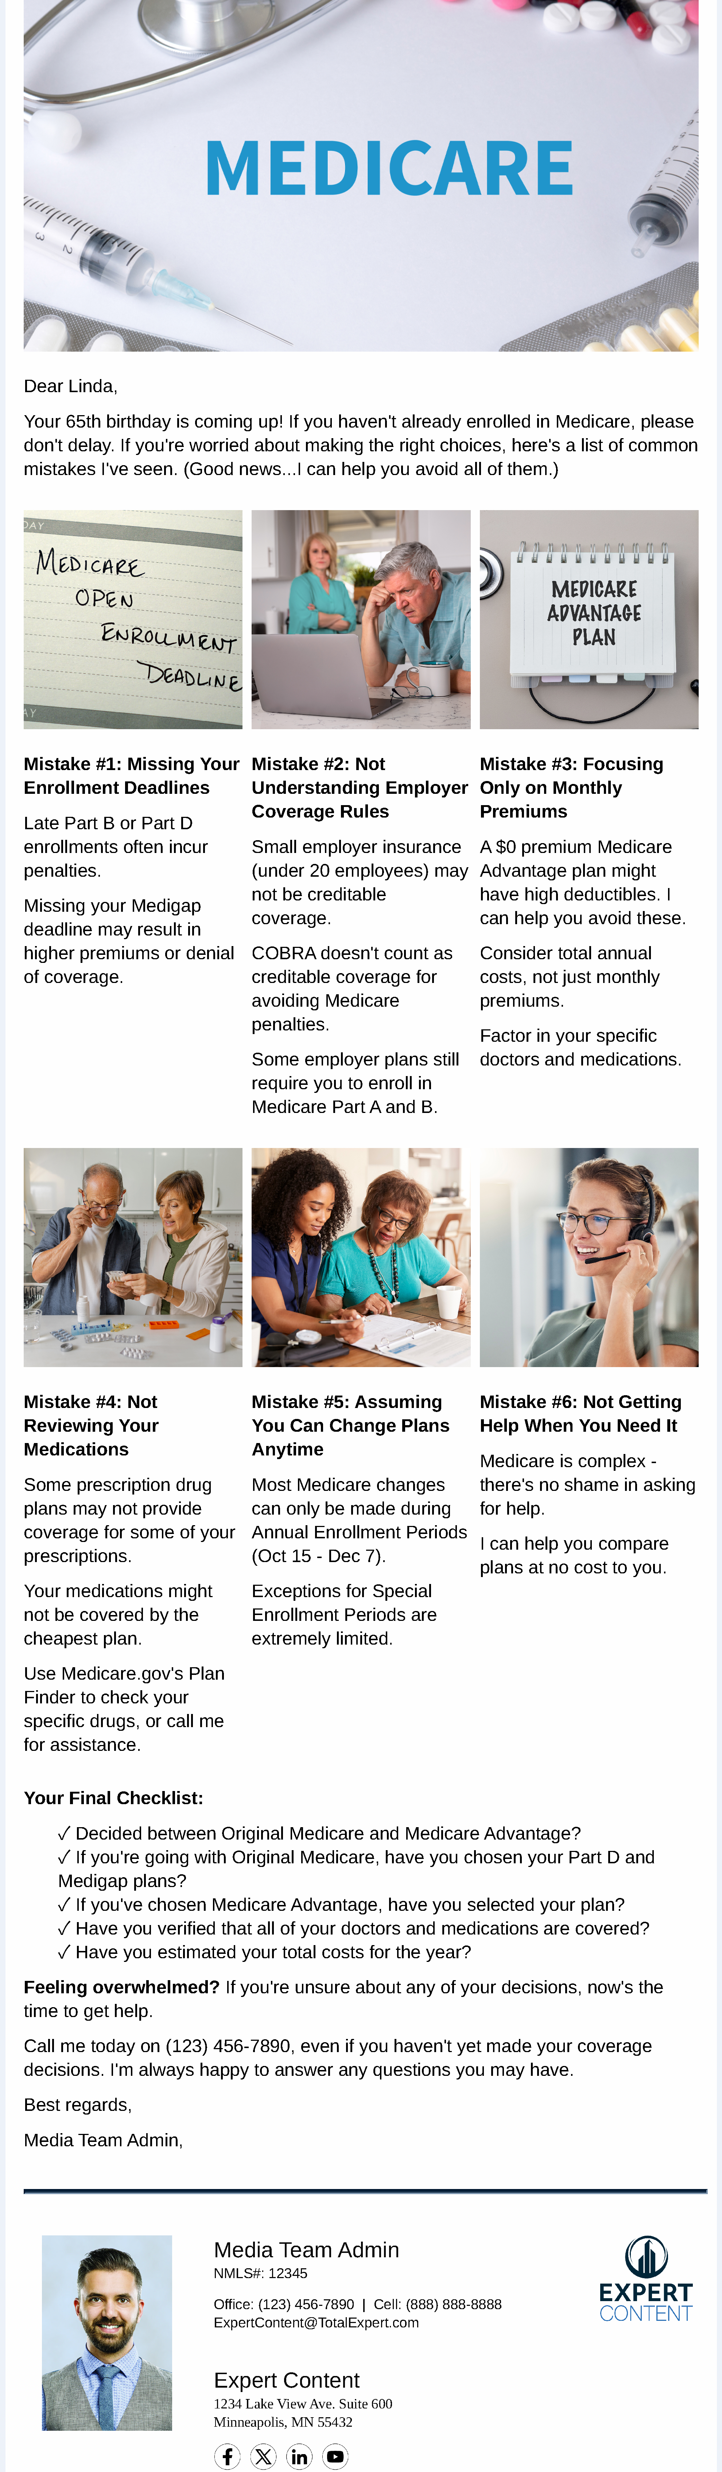
Insurance: Medicare IEP Lead Nurture
Email Subject Line: Don't Make These Costly Medicare Mistakes
Dear {{recipient.f_name}},
Your 65th birthday is coming up! If you haven't already enrolled in Medicare, please don't delay. If you're worried about making the right choices, here's a list of common mistakes I've seen. (Good news...I can help you avoid all of them.)
Mistake #1: Missing Your Enrollment Deadlines
Late Part B or Part D enrollments often incur penalties.
Missing your Medigap deadline may result in higher premiums or denial of coverage.
Mistake #2: Not Understanding Employer Coverage Rules
Small employer insurance (under 20 employees) may not be creditable coverage.
COBRA doesn't count as creditable coverage for avoiding Medicare penalties.
Some employer plans still require you to enroll in Medicare Part A and B.
Mistake #3: Focusing Only on Monthly Premiums
A $0 premium Medicare Advantage plan might have high deductibles. I can help you avoid these.
Consider total annual costs, not just monthly premiums.
Factor in your specific doctors and medications.
Mistake #4: Not Reviewing Your Medications
Some prescription drug plans may not provide coverage for some of your prescriptions.
Your medications might not be covered by the cheapest plan.
Use Medicare.gov's Plan Finder to check your specific drugs, or call me for assistance.
Mistake #5: Assuming You Can Change Plans Anytime
Most Medicare changes can only be made during Annual Enrollment Periods (Oct 15 - Dec 7).
Exceptions for Special Enrollment Periods are extremely limited.
Mistake #6: Not Getting Help When You Need It
Medicare is complex - there's no shame in asking for help.
I can help you compare plans at no cost to you.
Your Final Checklist:
✓ Decided between Original Medicare and Medicare Advantage?
✓ If you're going with Original Medicare, have you chosen your Part D and Medigap plans?
✓ If you've chosen Medicare Advantage, have you selected your plan?
✓ Have you verified that all of your doctors and medications are covered?
✓ Have you estimated your total costs for the year?
Feeling overwhelmed? If you're unsure about any of your decisions, now's the time to get help.
Call me today on {{sender.phone_office}}, even if you haven't yet made your coverage decisions. I'm always happy to answer any questions you may have.
Best regards,
{{sender.f_name}} {{sender.l_name}}, {{sender.title}}
Notes:
This page should be used for JOURNEY EMAILS (duplicate as needed)

Slide 12
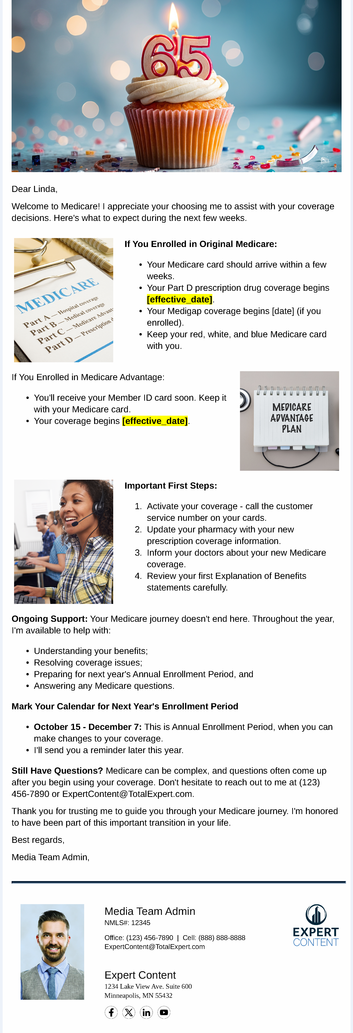
Insurance: Medicare IEP Lead Nurture
Email Subject Line: Happy Birthday! Welcome to Medicare
Dear {{recipient.f_name}},
Welcome to Medicare! I appreciate your choosing me to assist with your coverage decisions. Here's what to expect during the next few weeks.
If You Enrolled in Original Medicare:
Your Medicare card should arrive within a few weeks.
Your Part D prescription drug coverage begins [effective_date].
Your Medigap coverage begins [date] (if you enrolled).
Keep your red, white, and blue Medicare card with you.
If You Enrolled in Medicare Advantage:
You'll receive your Member ID card soon. Keep it with your Medicare card.
Your coverage begins [effective_date].
Important First Steps:
Activate your coverage - call the customer service number on your cards.
Update your pharmacy with your new prescription coverage information.
Inform your doctors about your new Medicare coverage.
Review your first Explanation of Benefits statements carefully.
Ongoing Support: Your Medicare journey doesn't end here. Throughout the year, I'm available to help with:
Understanding your benefits;
Resolving coverage issues;
Preparing for next year's Annual Enrollment Period, and
Answering any Medicare questions.
Mark Your Calendar for Next Year's Enrollment Period
October 15 - December 7: This is Annual Enrollment Period, when you can make changes to your coverage.
I'll send you a reminder later this year.
Still Have Questions? Medicare can be complex, and questions often come up after you begin using your coverage. Don't hesitate to reach out to me at {{sender.phone_office}} or {{sender.email}}.
Thank you for trusting me to guide you through your Medicare journey. I'm honored to have been part of this important transition in your life.
Best regards,
{{sender.f_name}} {{sender.l_name}}, {{sender.title}}
Notes:
This page should be used for JOURNEY EMAILS (duplicate as needed)

Slide 13
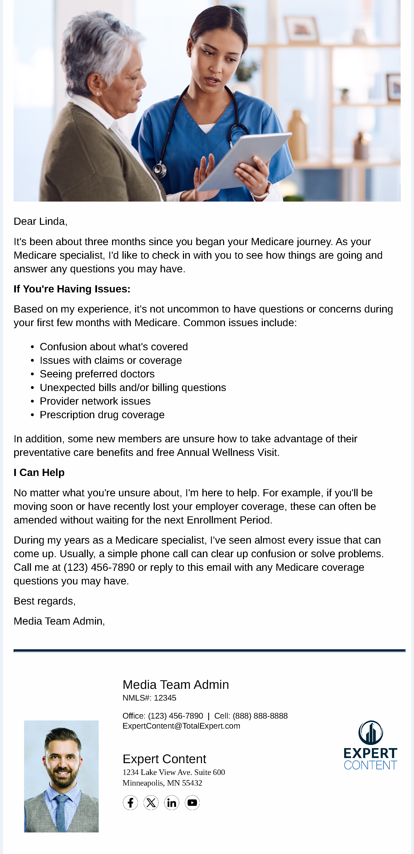
Insurance: Medicare IEP Lead Nurture
Email Subject Line: Let's Chat About Your Medicare Experience
Dear {{recipient.f_name}},
It's been about three months since you began your Medicare journey. As your Medicare specialist, I'd like to check in with you to see how things are going and answer any questions you may have.
If You're Having Issues:
Based on my experience, it's not uncommon to have questions or concerns during your first few months with Medicare. Common issues include:
Confusion about what's covered
Issues with claims or coverage
Seeing preferred doctors
Unexpected bills and/or billing questions
Provider network issues
Prescription drug coverage
In addition, some new members are unsure how to take advantage of their preventative care benefits and free Annual Wellness Visit.
I Can Help
No matter what you're unsure about, I'm here to help. For example, if you'll be moving soon or have recently lost your employer coverage, these can often be amended without waiting for the next Enrollment Period.
During my years as a Medicare specialist, I've seen almost every issue that can come up. Usually, a simple phone call can clear up confusion or solve problems. Call me at {{sender.phone_office}} or reply to this email with any Medicare coverage questions you may have.
Best regards,
{{sender.f_name}} {{sender.l_name}}, {{sender.title}}
Notes:
This page should be used for JOURNEY EMAILS (duplicate as needed)

