Slide 1
Expert Content
Strategy Guide
Lead Purchase Vacation/2nd Home
April 2025

Slide 2
Lead Purchase Vacation/2nd Home
Communication types: Email and SMS
Leverage this journey to engage with prospective vacation or second home buyers. This could be for their own use or as an investment/additional income. Nine (9) emails and two (2) SMS are sent directly to the contact discussing how to achieve their goal of owning a 2nd property.
*All communications should be reviewed prior to initiating the journey.

Slide 3
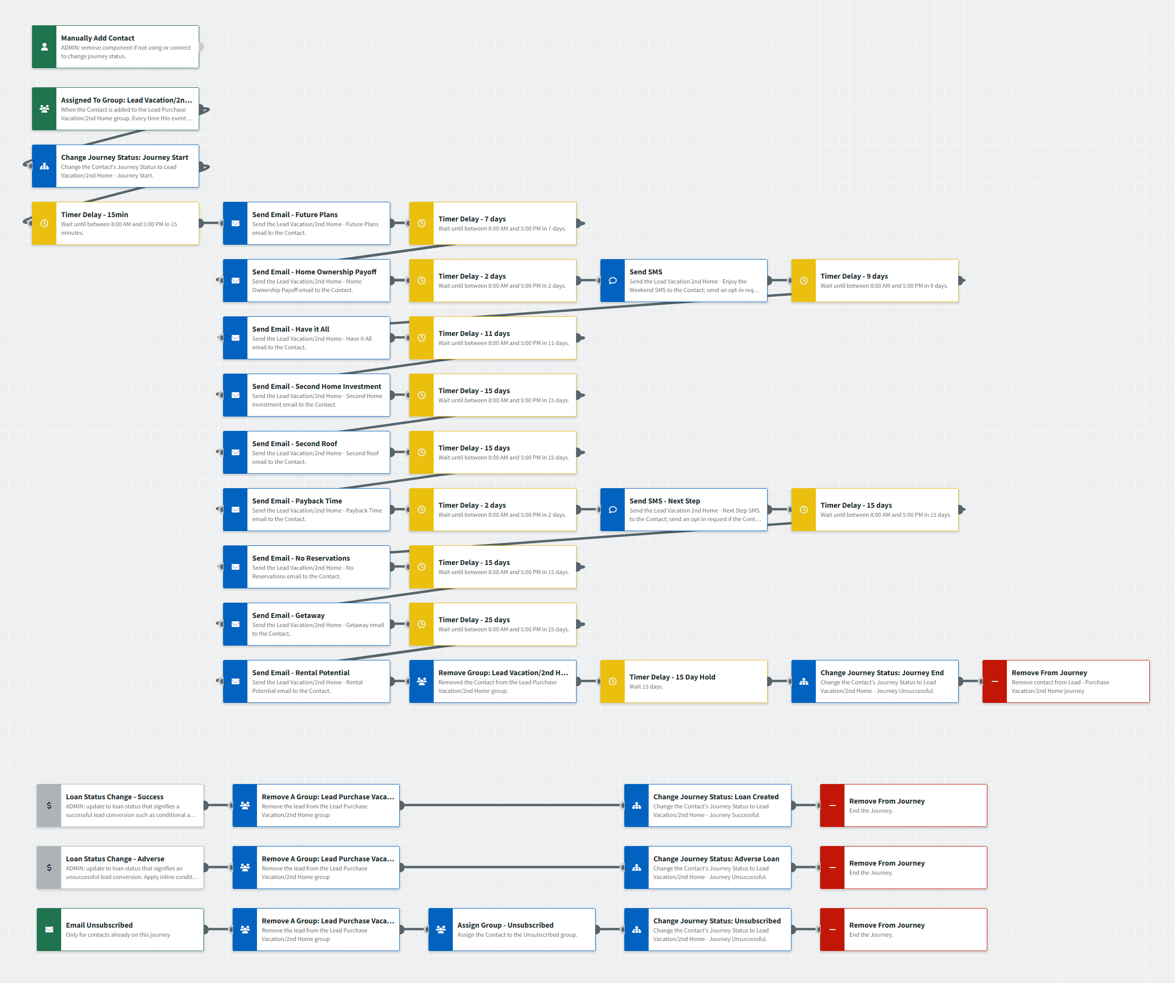
Lead Purchase Vacation/2nd Home
Journey Map Notes:
Keep emails that work for your organization, swap with custom, or add these emails to your existing campaigns.
Adjust onramps with organization specific groups, lead sources, and Focused View outcomes.

Slide 4
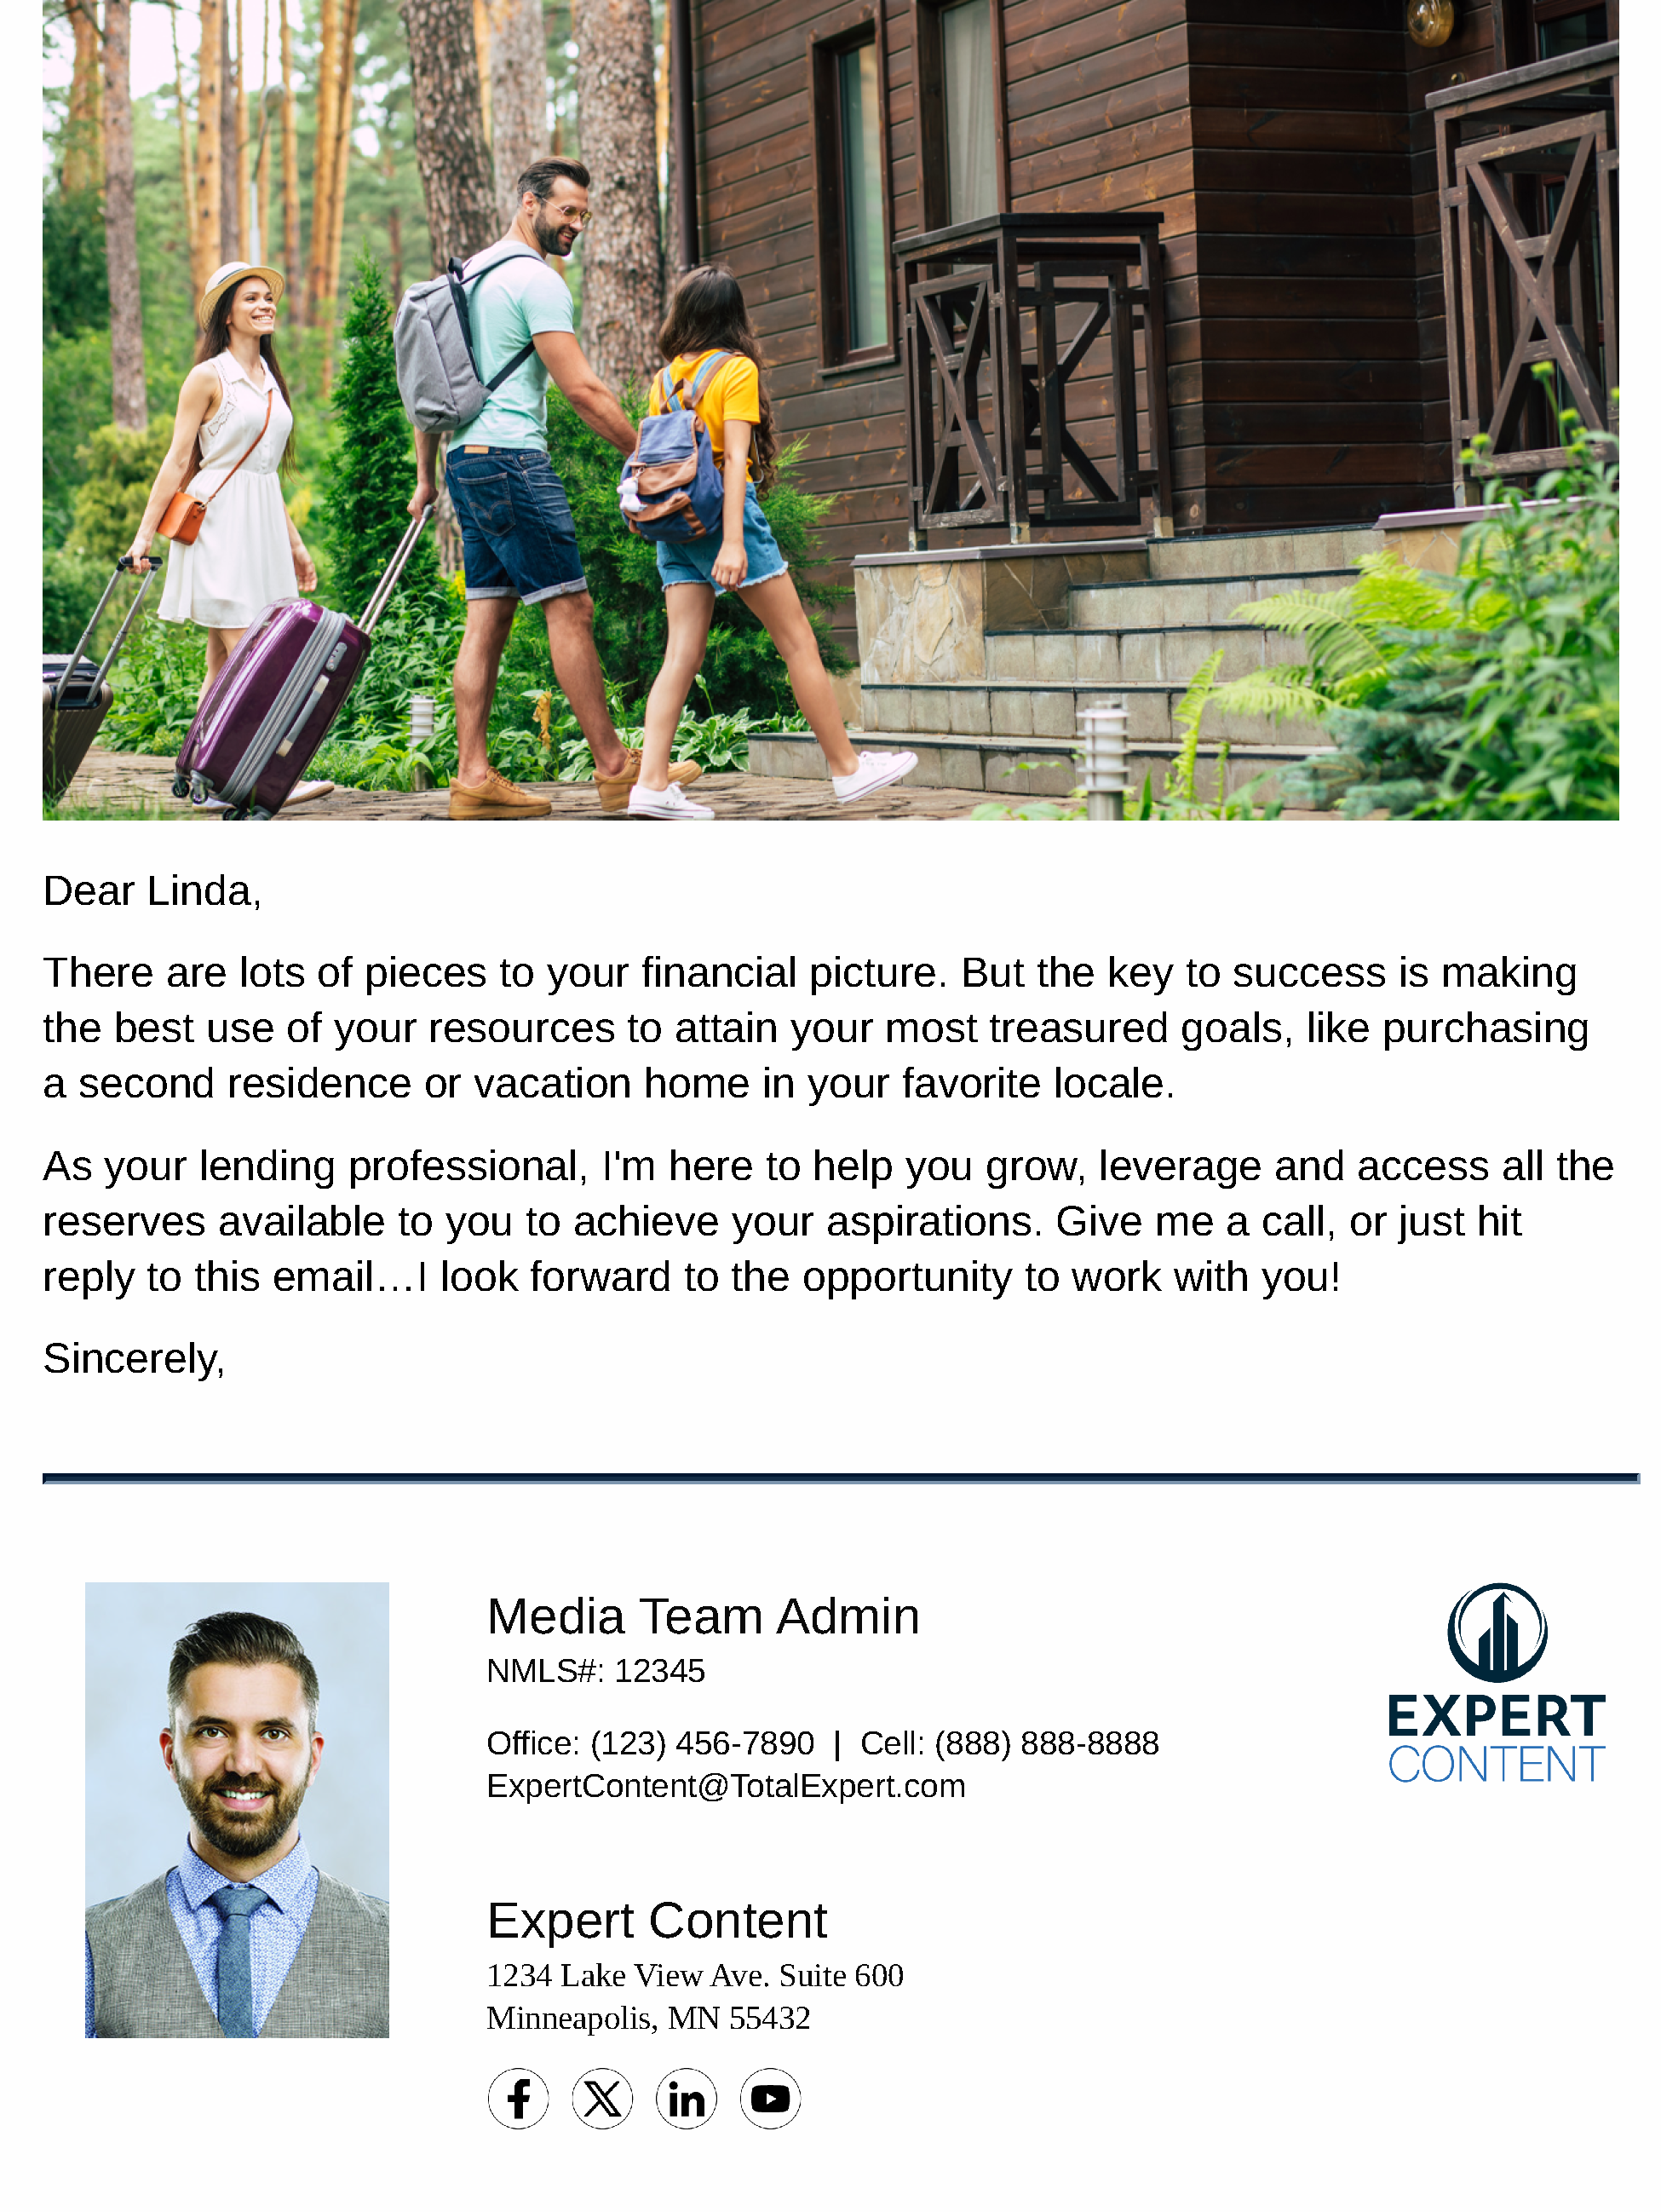
Lead Purchase Vacation/2nd Home
Email Subject Line:
Let's bring your future plans closer.
Home ownership pays off in more ways than you think.
Having it all may be just around the corner.
Notes:
This page should be used for JOURNEY EMAILS (duplicate as needed)

Slide 5
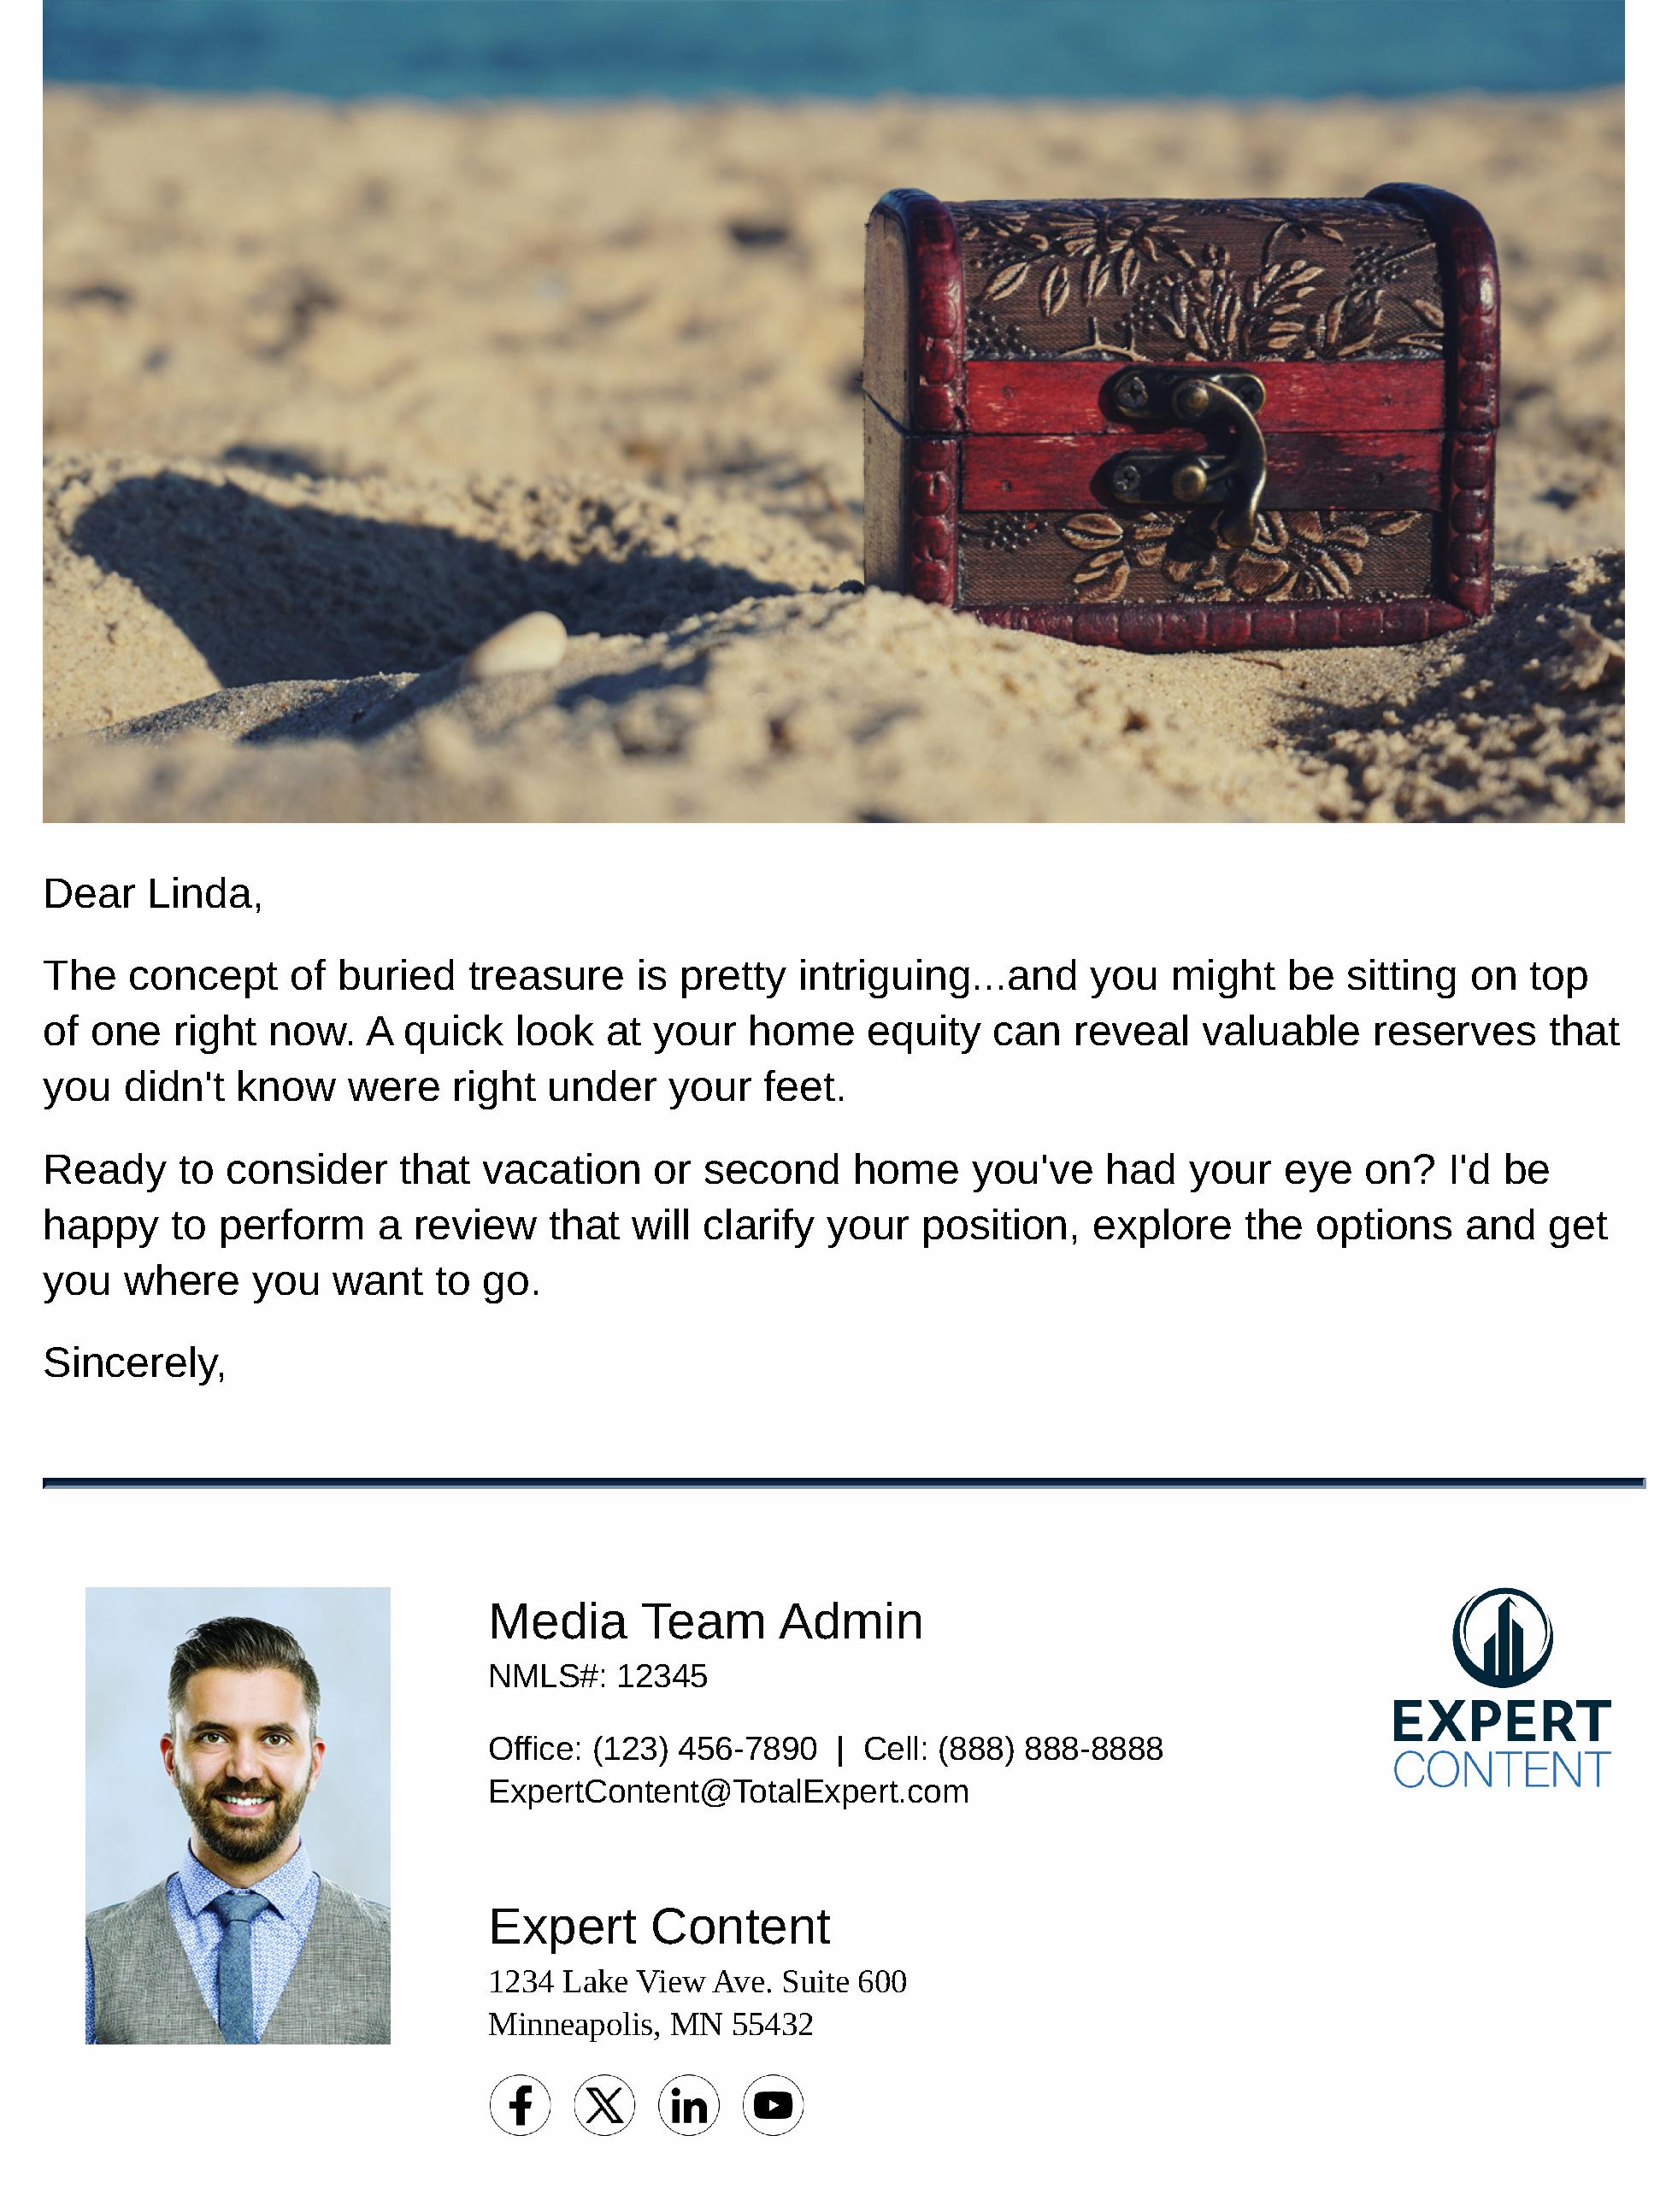
Lead Purchase Vacation/2nd Home
Email Subject Line:
Leverage your home's value to invest in a second home.
Is it time to put a second roof over your head?
Tell your home it's payback time.
Notes:
This page should be used for JOURNEY EMAILS (duplicate as needed)

Slide 6
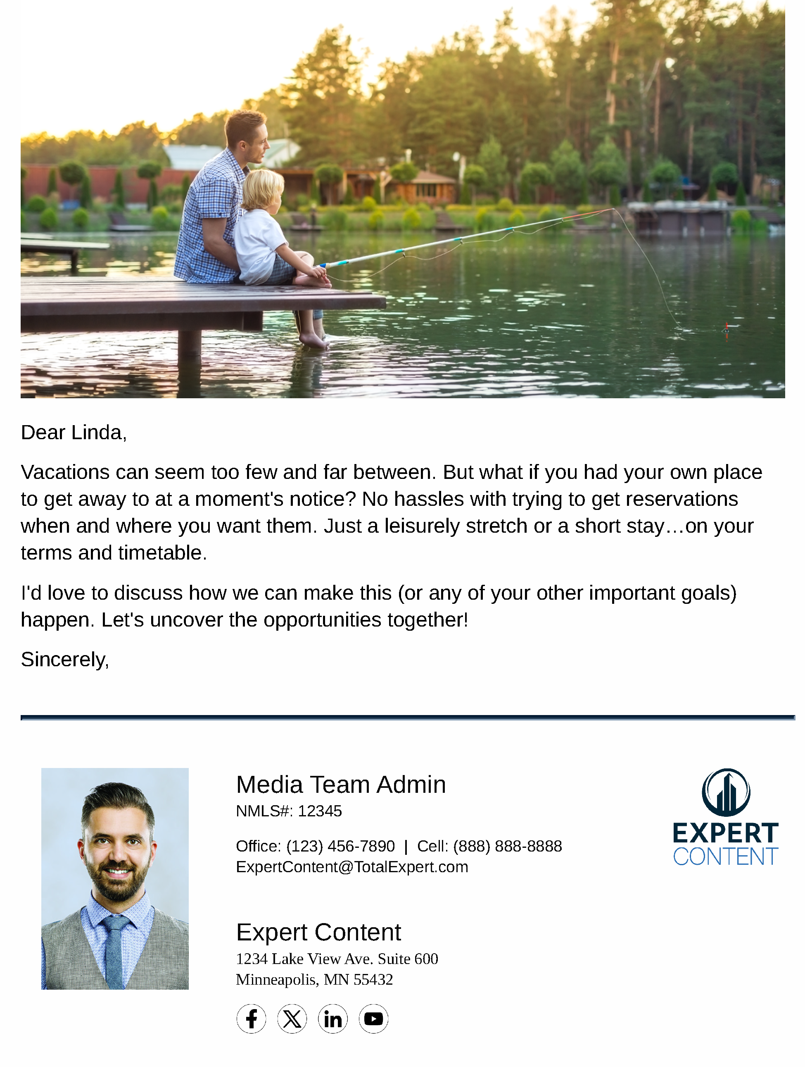
Lead Purchase Vacation/2nd Home
Email Subject Line:
The best vacations don't require reservations.
Get away from it all without leaving town.
Choose a weekend home with rental potential.
Notes:
This page should be used for JOURNEY EMAILS (duplicate as needed)

Slide 7
Lead Purchase Vacation/2nd Home
SMS: Lead Vacation 2nd Home - Enjoy the Weekend
Hi {{contact.f_name}}, this is {{sender.f_name}} {{sender.l_name}} at {{sender.company}} - have you thought about enjoying this weekend in a 2nd home of your own? Then give me a call and we can discuss your options! Your current home may be a key to the getaways you've been thinking about.
SMS: Lead Vacation 2nd Home - Next Step
Hi {{contact.f_name}}, this is {{sender.f_name}} {{sender.l_name}} at {{sender.company}} - home prices keep going up, now could be the time to take the next step toward purchasing a 2nd home. I'd be happy to talk you through your options. Reach out when you're ready to chat!
Notes:
This page should be used for TASKS, USER NOTIFICATIONS, AND SMS TEMPLATES (duplicate as needed)

