Slide 1
Expert Content
Strategy Guide
Lead Purchase
April 2025

Slide 2
Lead Purchase
Communication types: Email, SMS, and User Notifications
The Lead Purchase journey is designed as a series of 12 email touchpoints and four (4) SMS touchpoints for prospective home buyers. Initial email is sent 1 hour after contact information is placed on journey path and extends out to customers every 3-5 days until completion of journey. Messages include talking points such as personal financing options, looking at different product types and, why getting ahead of financing before finding a dream home is important.
*All communications should be reviewed prior to initiating the journey.

Slide 3
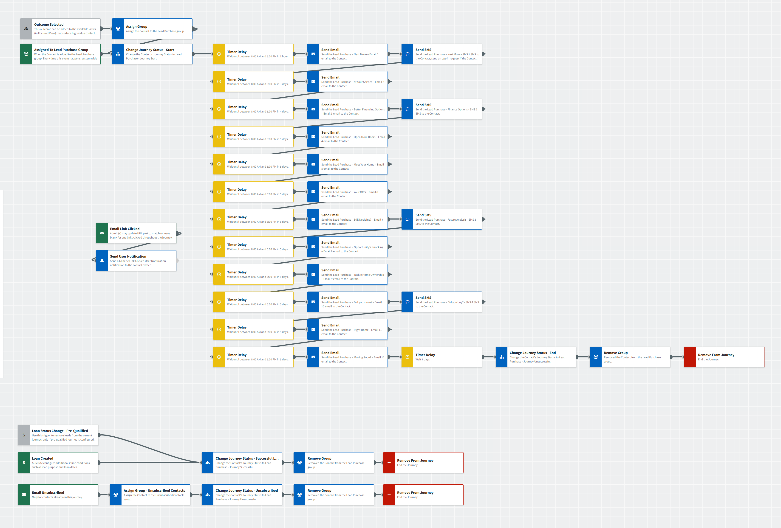
Lead Purchase
Journey Map Notes:
Keep emails that work for your organization, swap with custom, or add these emails to your existing campaigns.
Adjust onramps with organization specific groups and Focused View outcomes.

Slide 4
Lead Purchase
Email Subject Line:
Make your next move your best.
Experience and expertise at your service
We have better home financing options for you
Notes:
This page should be used for JOURNEY EMAILS (duplicate as needed)

Slide 5
Lead Purchase
Email Subject Line:
Help with opening more doors
Meet your next home in person.
An offer for you
Notes:
This page should be used for JOURNEY EMAILS (duplicate as needed)

Slide 6
Lead Purchase
Email Subject Line:
Still deciding your next move?
Opportunity’s knocking...
Let’s tackle your home ownership goals together.
Notes:
This page should be used for JOURNEY EMAILS (duplicate as needed)

Slide 7
Lead Purchase
Email Subject Line:
Did you make your move?
The right home’s out there and waiting... but for how much longer?
Moving soon? It’s a multiple choice question.
Notes:
This page should be used for JOURNEY EMAILS (duplicate as needed)

Slide 8
Lead Purchase
User Notification: Generic Link Clicked User Notification
The below contact clicked a link from within a journey email. Visit their contact details page for additional information.
Contact name: {{contact.f_name}} {{contact.l_name}}
Contact email: {{contact.email}}
Contact phone: {{contact.phone}}
Notes:
This page should be used for Tasks, User Notifications, and SMS templates (duplicate as needed)

Slide 9
Lead Purchase
SMS: Lead Purchase - Next Move - SMS 1
Hi {{recipient.f_name}}! Are you thinking of making a move? Or are you looking to move up, downsize or invest? Whether this is your first home or your fifth, I'm here to help! Give me a call for a no-obligation consultation at your convenience. - {{sender.f_name}}
SMS: Lead Purchase - Finance Options - SMS 2
Hi {{recipient.f_name}} - I'd be happy to spend time going over home financing options, especially as I may be able to provide one or more that you haven't yet explored. Reach out when you can...I'm just a phone call away. - {{sender.f_name}}, {{sender.phone_office}}
SMS: Lead Purchase - Future Analysis - SMS 3
It's me again, {{sender.f_name}} with {{sender.company}}. I can provide a thorough analysis of what homes you can afford, together with a look at your long-term plans and options. It doesn't take long and is offered as an informal, no-obligation look at your future plans. Let me know how I can help!
SMS: Lead Purchase - Did you buy? - SMS 4
I'm reaching out to ask if you've recently bought a home. If so – congratulations! If you haven't … how is your search coming? Please don't hesitate to reach out with any questions, I'd love to be part of your homebuying process and can refer you to several real estate professionals. - {{sender.f_name}}
Notes:
This page should be used for Tasks, User Notifications, and SMS templates (duplicate as needed)

