Slide 1
Expert Content
Strategy Guide
Lead Refinance
May 2025

Slide 2
Lead Refinance
Communication types: Email, SMS, and User Notifications
This journey targets homeowners who may be thinking of refinancing, but it also invites the homeowner to consider equity position, value review, potential effects of a HELOC reset, and whether they can stop paying mortgage insurance. This campaign keeps the loan officer and company in front of refinance prospect with relevant information. Spans 4 months, contains 9 emails and 3 SMS touchpoints.
*All communications should be reviewed prior to initiating the journey.

Slide 3
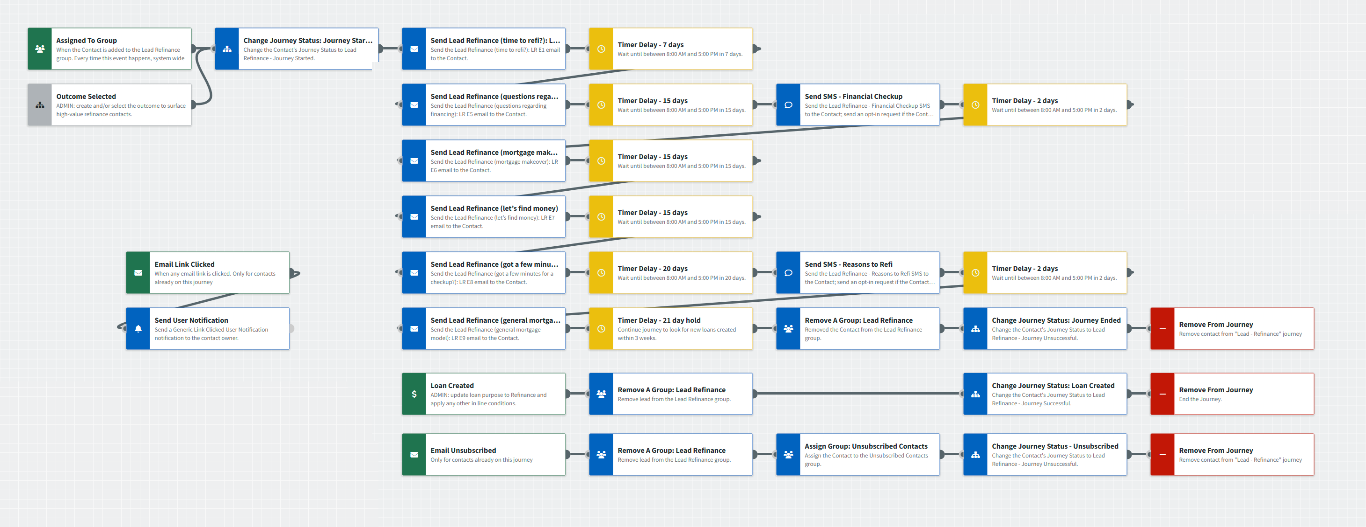
Lead Refinance
Journey Map Notes:
Keep emails that work for your organization, swap with custom, or add these emails to your existing campaigns.
Adjust onramps with organization specific groups and Focused View outcomes.
Notes:
This page should be used for JOURNEY WIREFRAMES (duplicate as needed)

Slide 4
Lead Refinance
Email Subject Line:
Is it time to consider refinancing?
Wondering about your area’s property values?
Is it time to say goodbye to MI?
Notes:
This page should be used for EMAILS (duplicate as needed)

Slide 5
Lead Refinance
Email Subject Line:
Is it time for your mortgage's annual checkup?
Questions about your mortgage?
Does your mortgage need a makeover?
Notes:
This page should be used for EMAILS (duplicate as needed)

Slide 6
Lead Refinance
Email Subject Line:
Let’s look for found money
Looking to save money?
Let's chat about your current mortgage model.
Notes:
This page should be used for EMAILS (duplicate as needed)

Slide 7
Lead Refinance
SMS: Lead Refinance - Home Equity and Value
Hi {{contact.f_name}}, I recently emailed you with an offer to review your home’s equity, which is the amount you’ve repaid plus any change in its value. You already know that home ownership’s a great investment…call or text me to see what’s it’s really worth!
SMS: Lead Refinance - Financial Checkup
Even if you're satisfied with your current mortgage, {{contact.f_name}}, it’s worth checking out your options. For example, if you pay off your mortgage earlier than scheduled, you could save a considerable sum of money. Contact me for a free financial checkup.
SMS: Lead Refinance - Reasons to Refi
Hi {{contact.f_name}}, are you thinking about a change of scenery? You may be able to finance a home remodel or a vacation property for less than you think, either by refinancing your mortgage or putting your home's equity to work. Contact me to learn more.
Notes:
This page should be used for TASKS, USER NOTIFICATIONS, AND SMS TEMPLATES (duplicate as needed)

Slide 8
Lead Refinance
User Notification: Generic Link Clicked User Notification
The below contact clicked a link from within a journey email. Visit their contact details page for additional information.
Contact name: {{contact.f_name}} {{contact.l_name}}
Contact email: {{contact.email}}
Contact phone: {{contact.phone}}
Notes:
This page should be used for TASKS, USER NOTIFICATIONS, AND SMS TEMPLATES (duplicate as needed)

