Slide 1
Expert Content
Strategy Guide
Lead Purchase Journey

Slide 2
Lead Purchase Journey
Email series
The Lead Purchase journey is designed as a series of 12 email touchpoints for prospective home buyers. Initial email is sent 1 hour after contact information is placed on journey path and extends out to customers every 3-5 days until completion of journey.
Total Expert customers who leverage text messaging may also choose to leverage this functionality within the existing wireframe.
*All communications should be reviewed prior to initiating the journey.

Slide 3
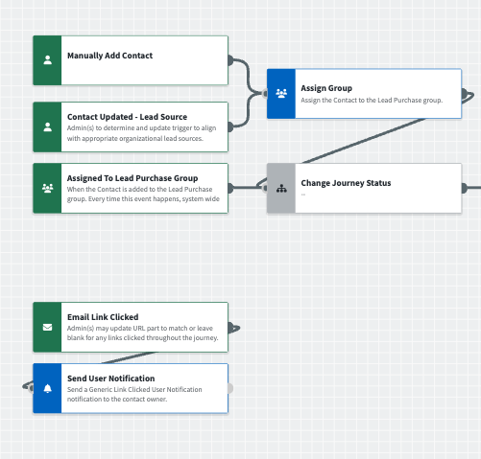
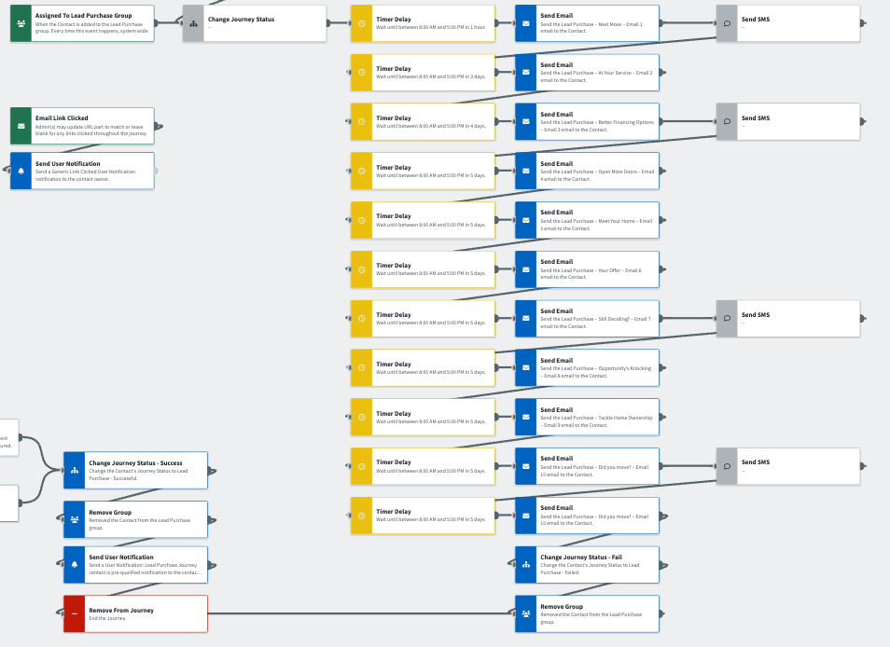
Journey Wireframe Notes:
Keep emails that work for your organization, swap with custom, or add these emails to your existing campaigns.
Adjust onramps with organization specific groups and Focused View outcomes.

Slide 4
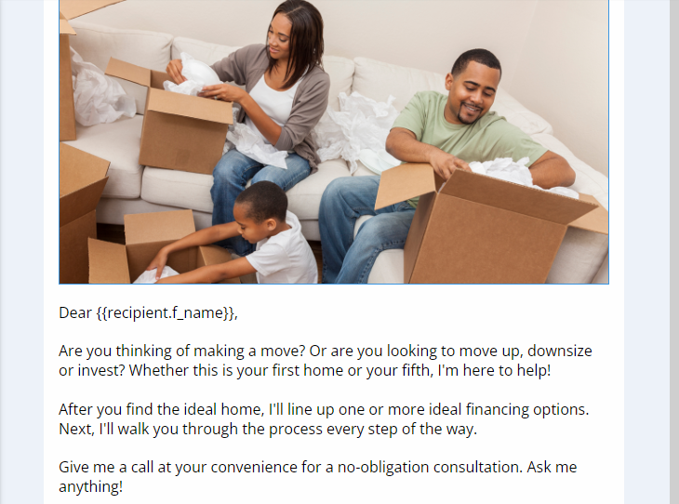
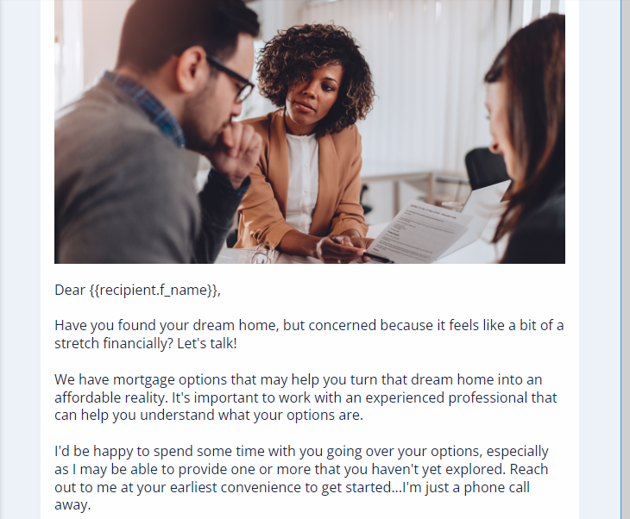
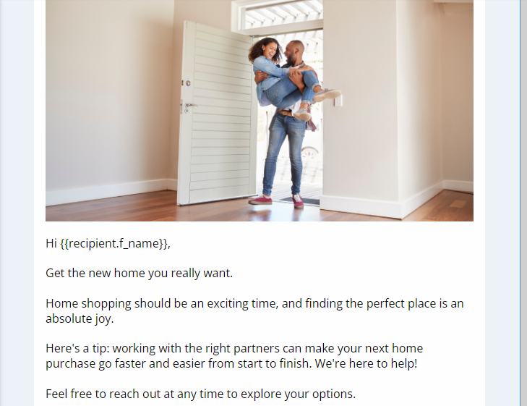
Email Subject:
Next Move
At Your Service
Better Financing Options
Open More Doors

Slide 5
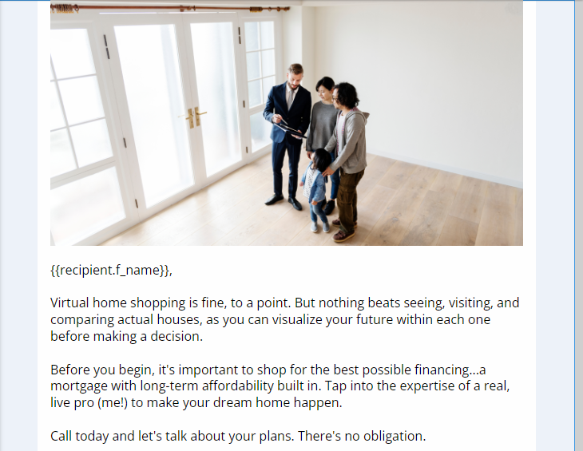
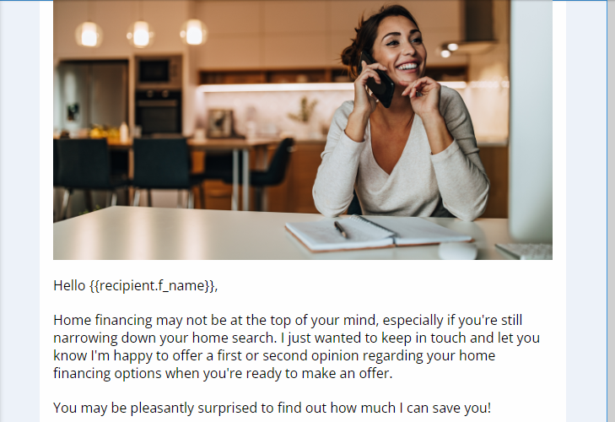
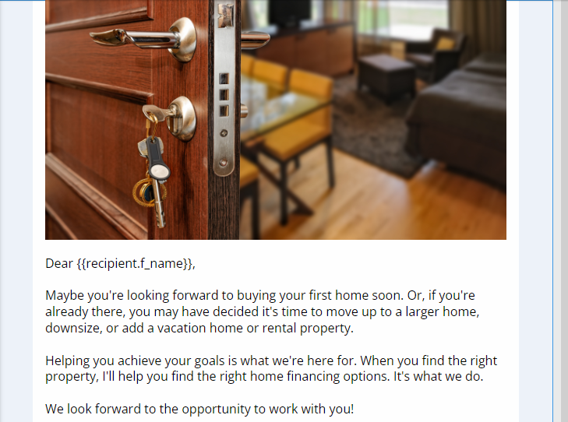
Email Subject:
Meet Your Home
Your Offer
Still Deciding?
Opportunity’s Knocking

Slide 6
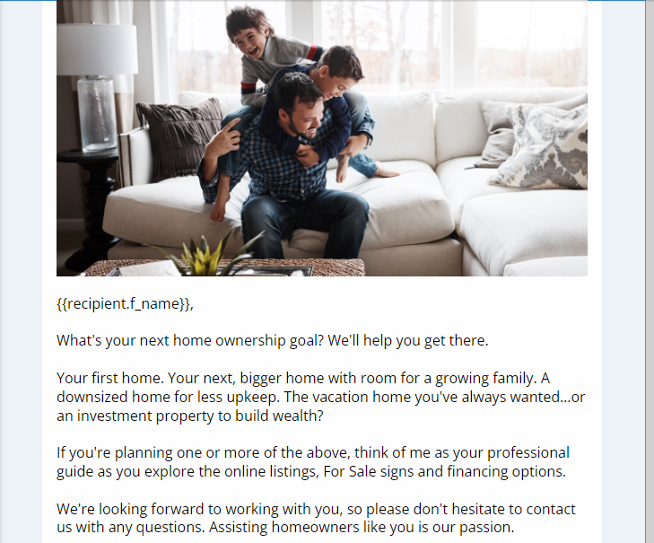
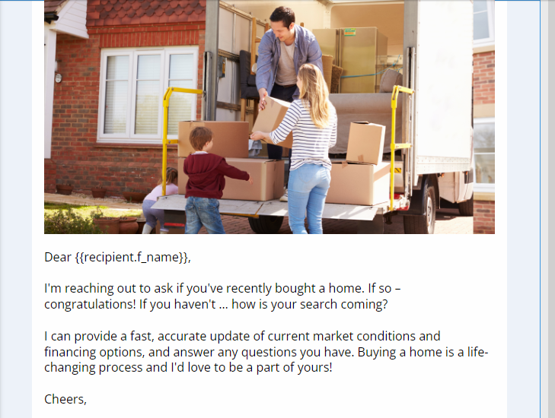
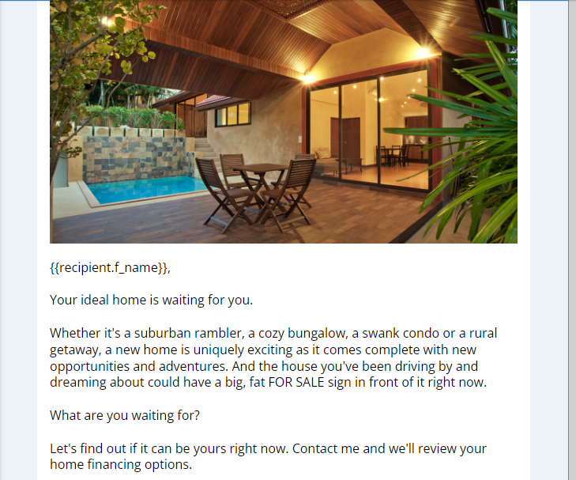
Email Subject:
Tackle Homeownership
Did You Move?
Right Home
Moving Soon?

