Slide 1
Expert Content
Strategy Guide
MLS Listing & PPE Rate Assets
January 2026

Slide 2
MLS Listing and PPE Rate Assets
Communication types: Print Flyers and EDDM® Postcards
Listing and rate assets can be printed professionally through Total Expert preferred print partners or downloaded as a PDF for local printing or sharing electronically. Postcards are set up to be delivered through the EDDM® program.
When flyers are integrated, they are connected to a Product and Pricing Engine and the MLS. Editable flyers are available for users who aren’t integrated with a PPE or have listings not on the MLS (e.g. builder partners, for sale by owner).

Slide 3
MLS Listing and PPE Rate Assets
Admin Toggle Configuration Options
Admin-level configuration is based on design. Toggles may include but are not limited to:
Branding elements including text colors, logo background, and disclaimers.
End user editability (allow end users to edit all rate data, all listing data, or both).
Background image or header image default.
Rate field display names.
  For example, admins may be able to adjust “Estimated Monthly Payment” to “Monthly Mortgage Payment” or “Mortgage Insurance” to “Mortgage Premium”.
    Warning: changing field names does not change the actual data pulling into the rate flyer. Placement of individual data points cannot be removed or repositioned. For example, Homeowners’ Insurance cannot be switched with Property Taxes.

Slide 4
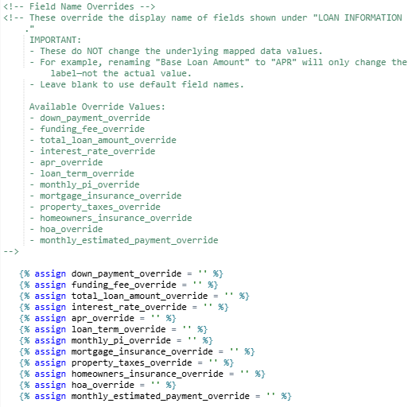
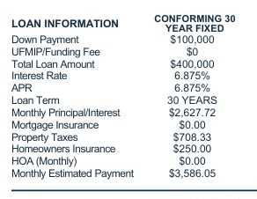
MLS Listing and Rate Assets
Listing and Rate flyer specific admin toggles
The ability to set default loan value field names. These do not change the mapped values that populate from a specific pricing scenario. It only changes the field name represented in the flyer. These are standard default text toggles.

Slide 5
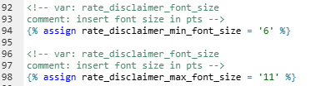
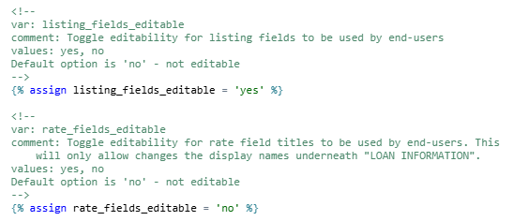
MLS Listing and Rate Assets
Listing and Rate flyer specific admin toggles
The ability to limit end user editability of specific aspects of the flyer. Admins have the option to allow MLS/Listing information to be editable and/or Rate/PPE information to be editable. These toggles lock down all corresponding fields. The exception is specific loan values that are commonly editable to the end user such as Property Taxes and Homeowners’ Insurance.
Set font size range for rate disclaimer (compliance language directly underneath the rate tables). The admin can set a minimum and maximum font size for the rate disclaimer so the text will adjust to fit within the container.

Slide 6
Flyers

Slide 7
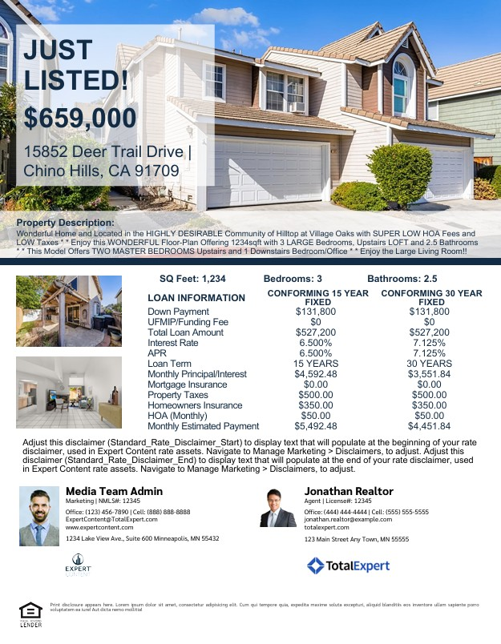
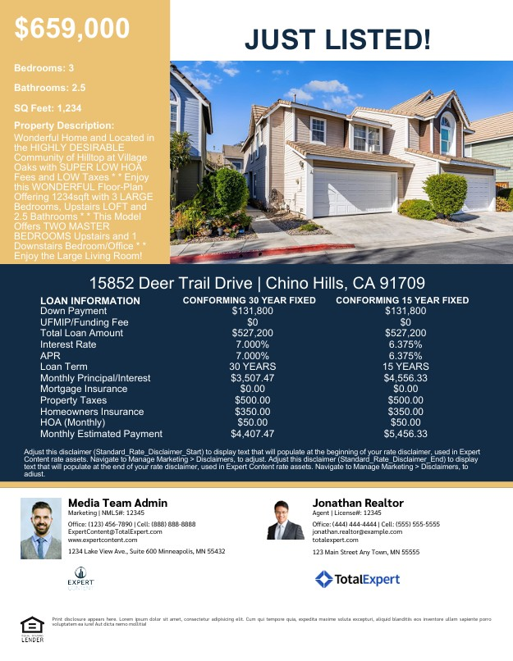
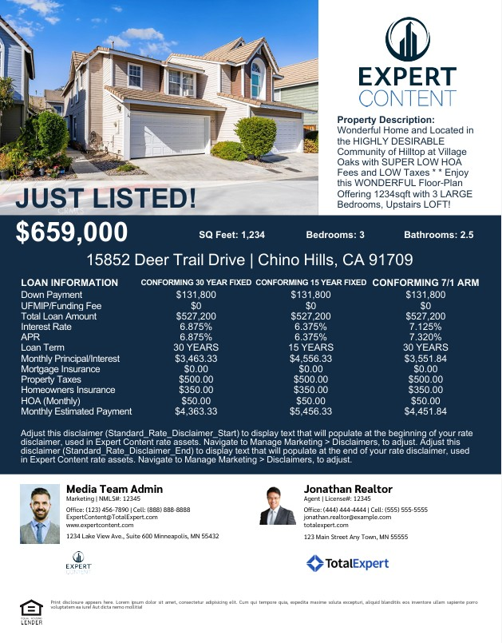
MLS Listing and Rate Flyers
Max of Two Scenarios
Max of Two Scenarios
Max of Three Scenarios
All designs shown here are available in both fully integrated and fully editable versions. Editable versions include the max number of scenarios.
Notes:
This page should be used for Print Flyers (duplicate as needed)

Slide 8
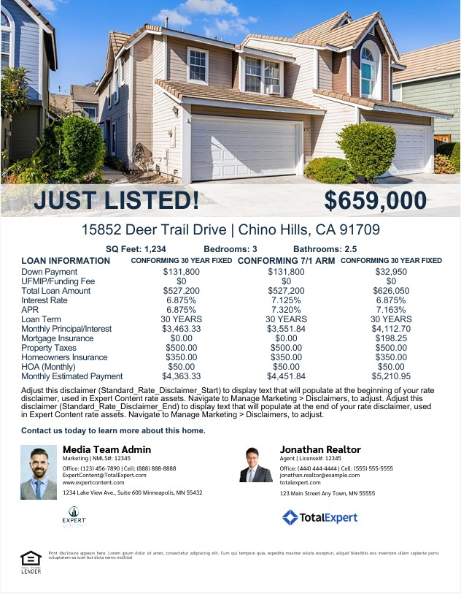
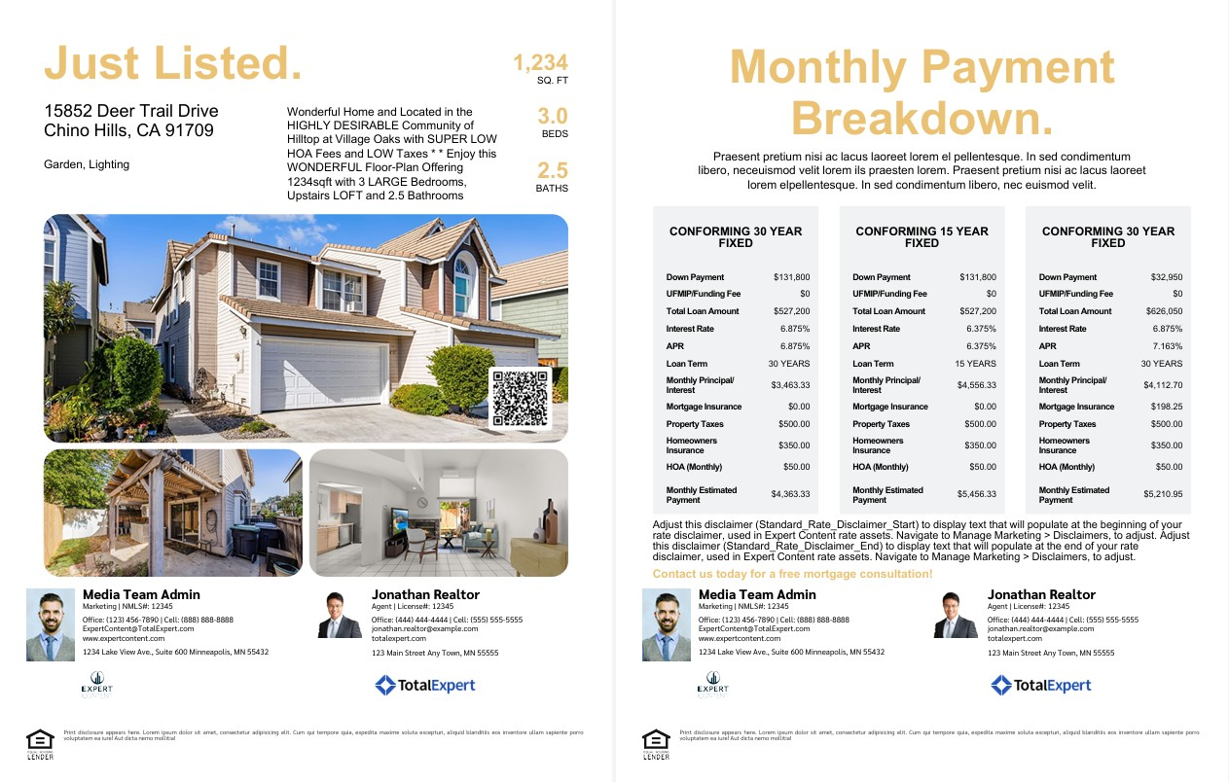
MLS Listing and Rate Flyers
Max of Two Scenarios
Double-Sided, Max of Three Scenarios
All designs shown here are available in both fully integrated and fully editable versions. Editable versions include the max number of scenarios.
Notes:
This page should be used for Print Flyers (duplicate as needed)

Slide 9
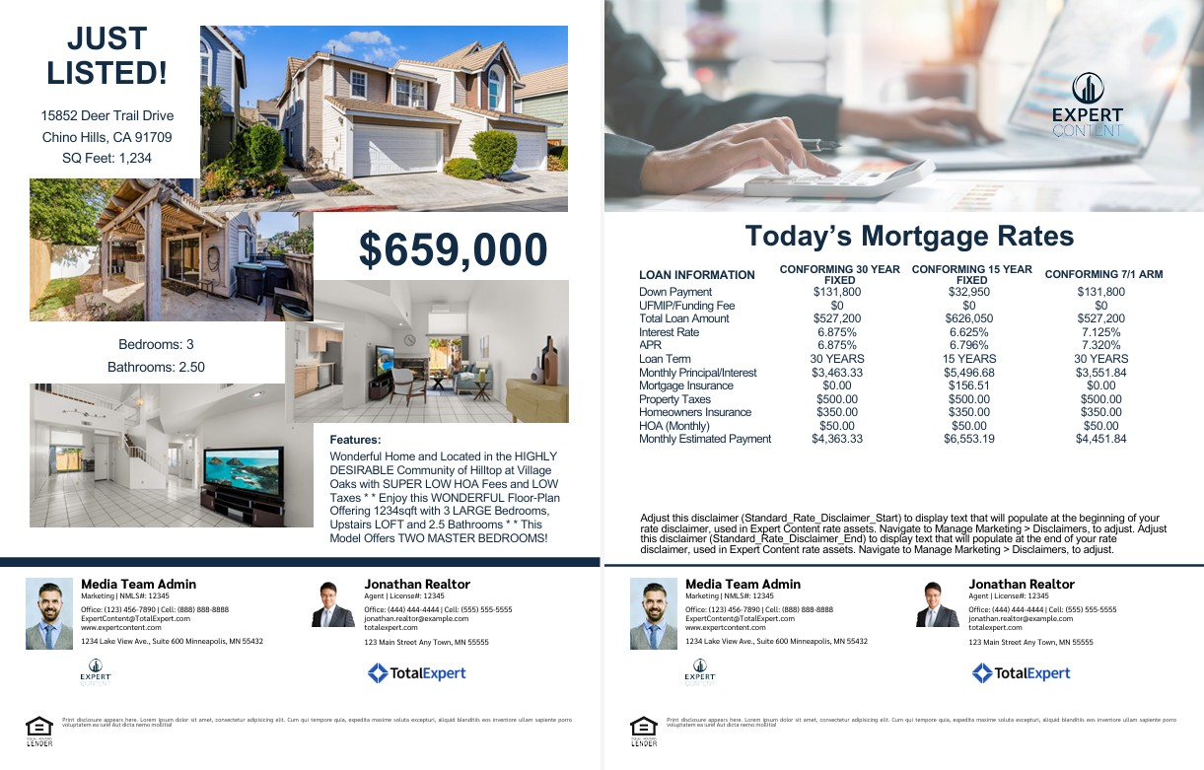
MLS Listing and Rate Flyers
Double-Sided, Max of Three Scenarios
Design shown here is available in both fully integrated and fully editable versions. Editable version includes the max number of scenarios.
Notes:
This page should be used for Print Flyers (duplicate as needed)

Slide 10
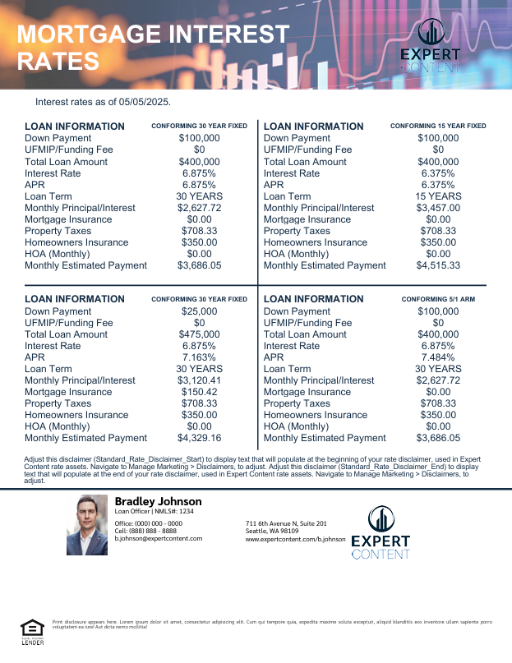

Rate Flyers
Max of Four Scenarios
Max of Three Scenarios
All designs shown here are available in both fully integrated and fully editable versions. Editable versions include the max number of scenarios.
Notes:
This page should be used for Print Flyers (duplicate as needed)

Slide 11
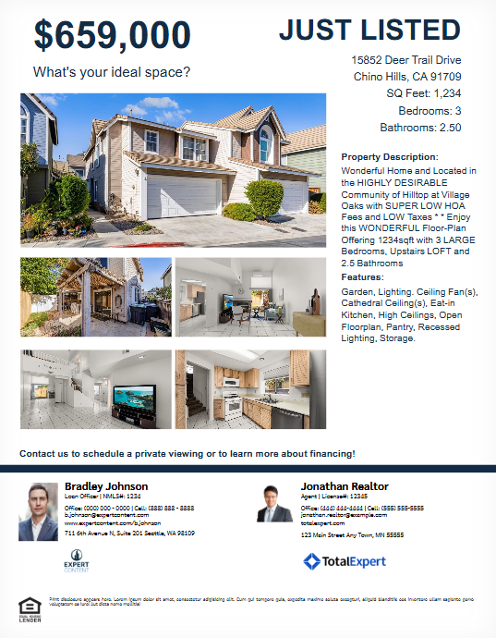
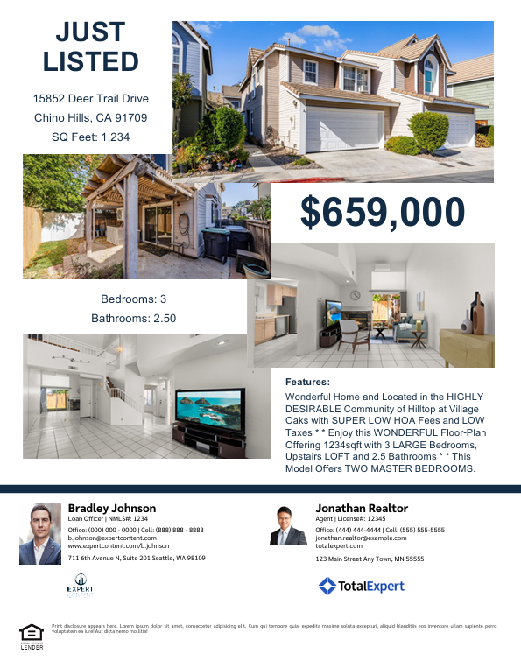
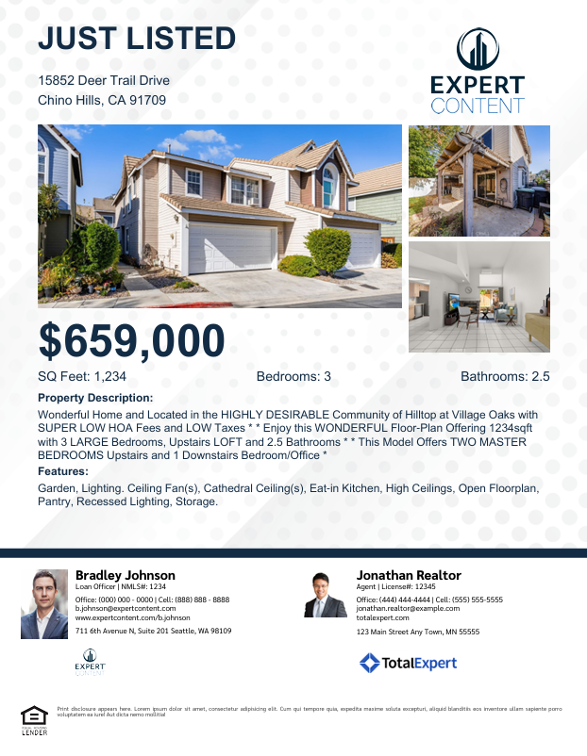
MLS Listing Flyers
All designs shown here are available in both fully integrated and fully editable versions.
Notes:
This page should be used for Print Flyers (duplicate as needed)

Slide 12
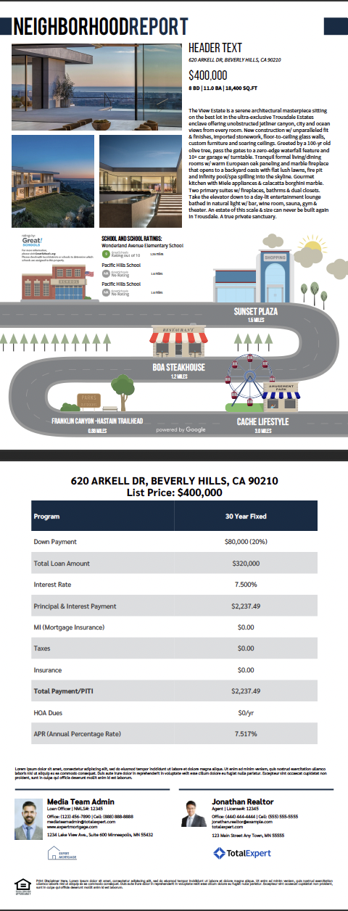
Google Places Infographics Listing and Rate flyer
Side A
Side B
Notes:
This page should be used for Print Flyers (duplicate as needed)

Slide 13
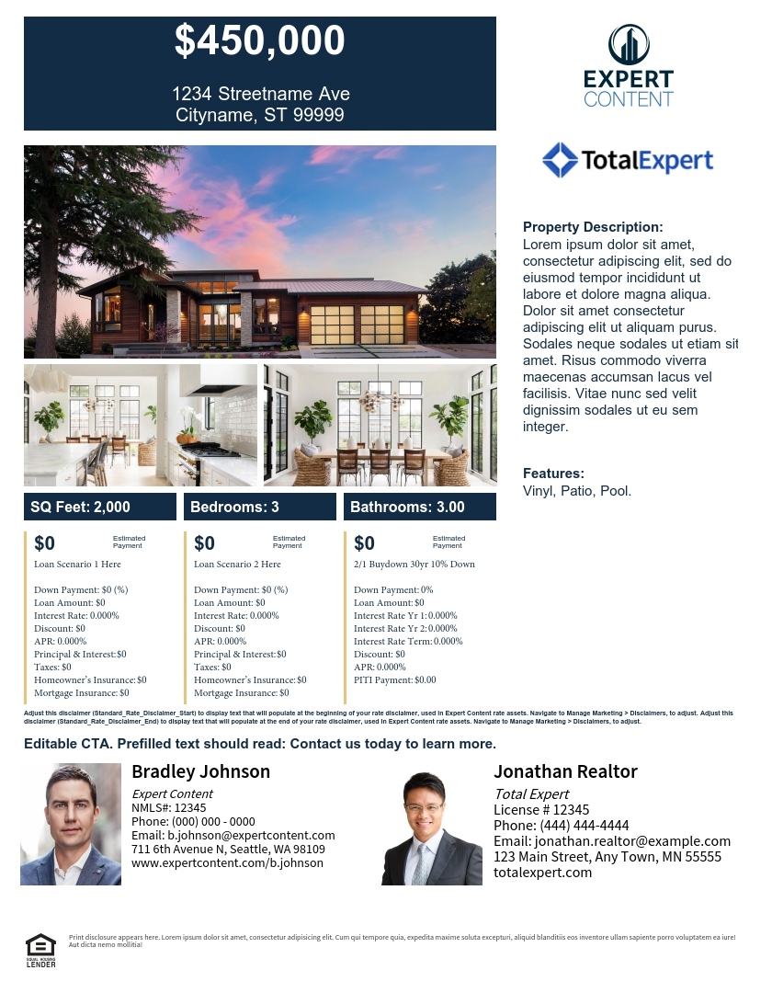
Integrated Rate Buydown Flyers
Compare two PPE scenarios with editable 3rd column for Buydowns, Discount points, etc.
Notes:
This page should be used for Print Flyers (duplicate as needed)

Slide 14
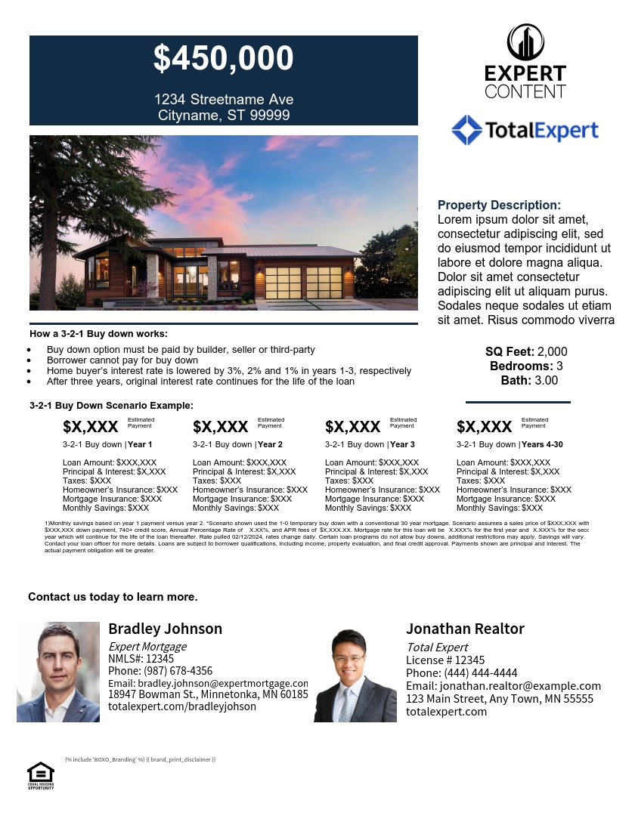
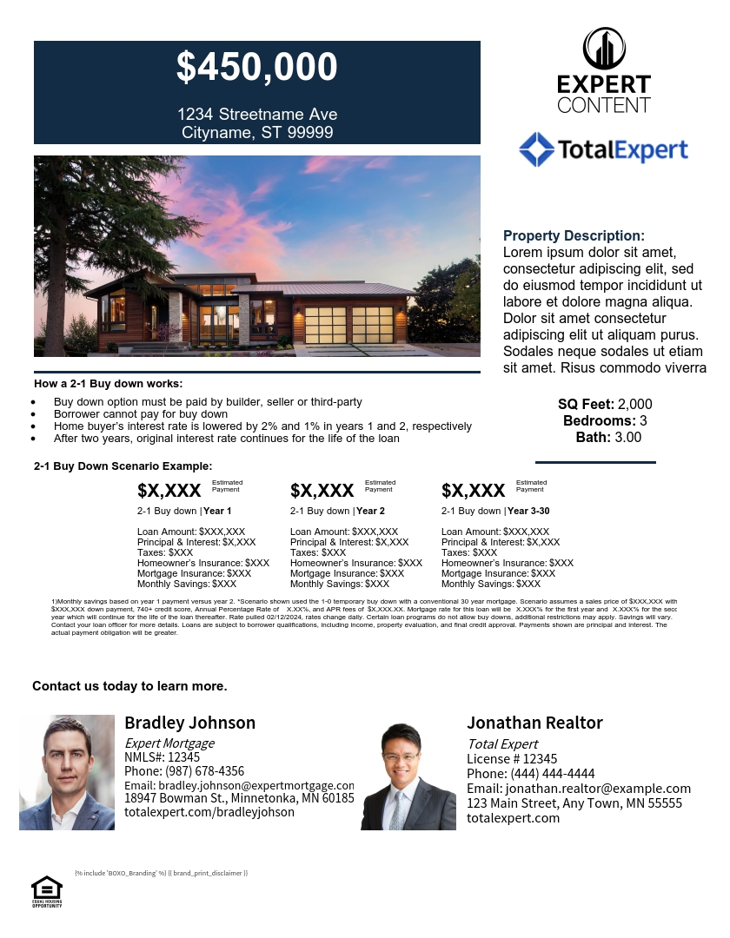

Editable Rate Buydown Flyers
3-2-1 Buydown
2-1 Buydown
1-0 Buydown
Notes:
This page should be used for Print Flyers (duplicate as needed)

Slide 15
Postcards

Slide 16
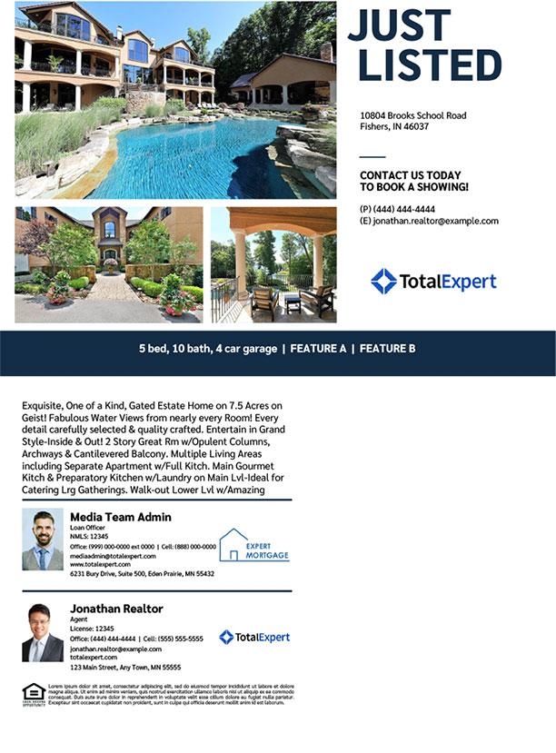
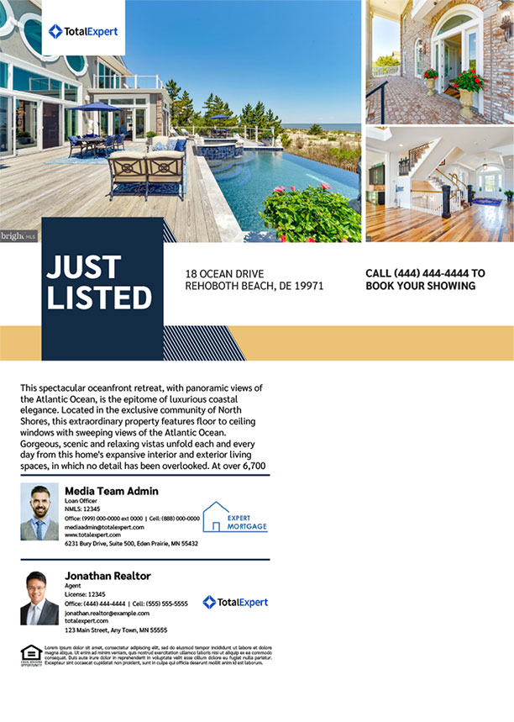
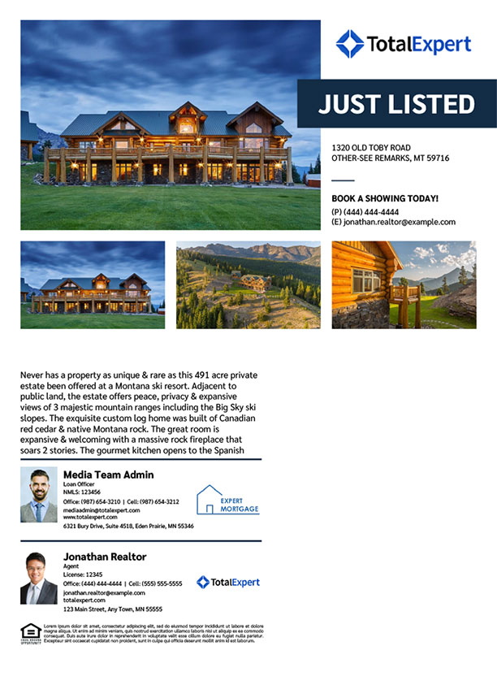
Integrated MLS Listing EDDM®
Postcards
Notes:
This page should be used for Print Flyers (duplicate as needed)

Slide 17
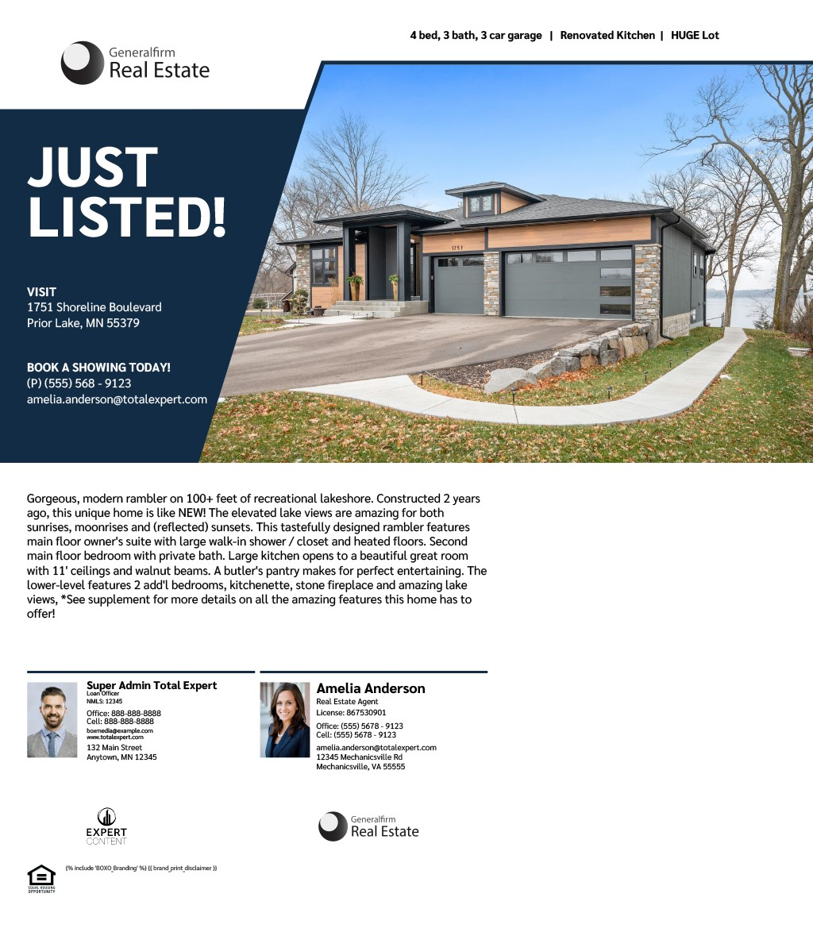
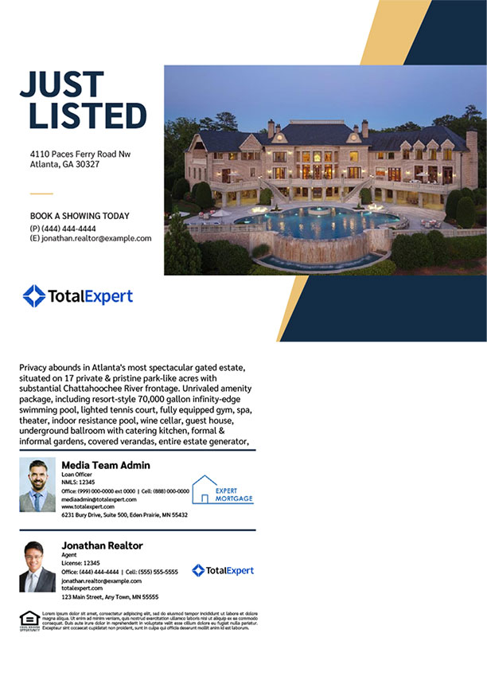
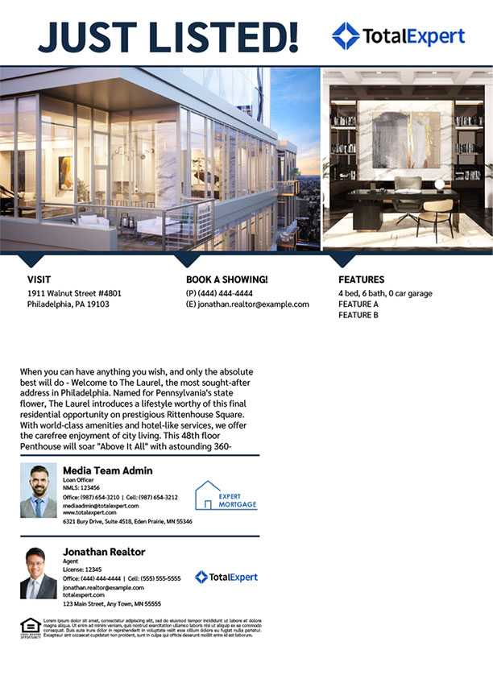
Integrated MLS Listing EDDM®
Postcards
Notes:
This page should be used for Print Flyers (duplicate as needed)

Slide 18
Door Hangers

Slide 19
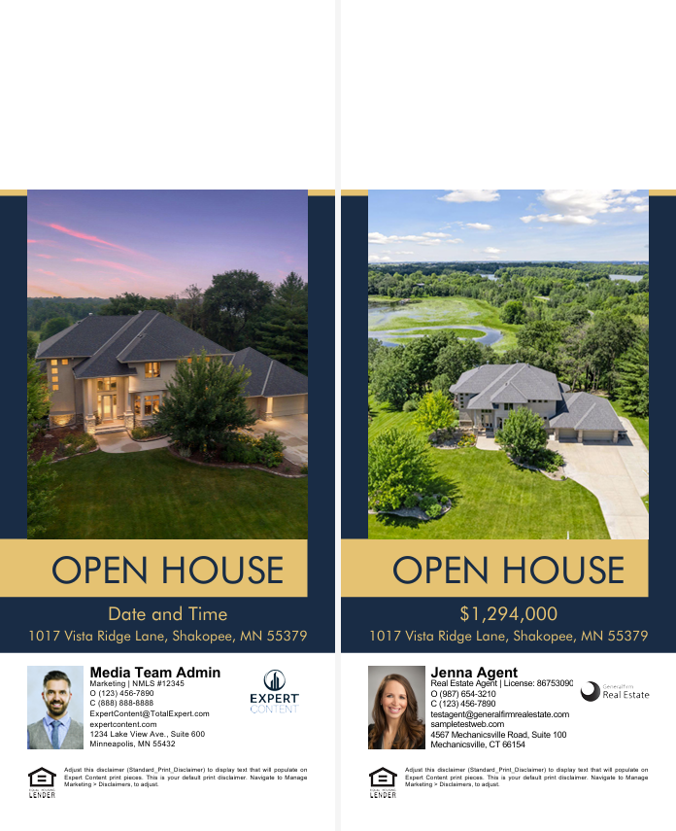
EC - Listing Door Hanger CB - 1255
Admin toggle options:
1 – Color block defaults are brand primary color (blue) and secondary color (yellow); change color, turn all color blocks on/off
2 – Upload background image(s), editability
3 – Override listing image(s), editability
4 – Fill to fit text elements, change text color (text element toggles are managed separately*)
*Text editability is toggled on a page-by-page basis. By default, the asset text and imagery are set to editable to allow updates to listing elements and subtitles such as open house date/time.
2
3
3
1
1
4
4

Slide 20
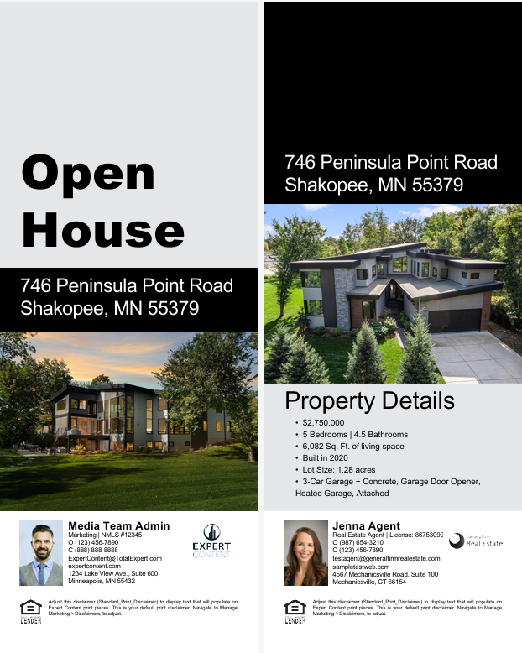
EC - Listing Door Hanger CB - 1257
1 – Change color, turn all color blocks on/off;
Alternatively: toggle color blocks off to upload background image(s), editability
2 – Override image, editability
3 – Fill to fit text elements, change text color (text element toggles are managed separately*)
Listing address and property details are populated by the MLS
*Text editability is toggled on a page-by-page basis.
*Text editability is toggled on a page-by-page basis. By default, the asset text and imagery are set to editable to allow updates to listing elements and subtitles such as open house date/time.
1
1
3
3
2
1
2
3

Slide 21
FAQs

Slide 22
MLS Listing and Rate Assets
Frequently Asked Questions
Q: Why don’t all of my Expert Content listing and rate flyers have toggles?
A: The Expert Content library has evolved over the years and has implemented toggles as a best practice moving forward. Legacy assets don’t have toggles but additional content will be coming that allows for more admin-level configuration.
Q: What kind of changes can I make to the flyer without TE involvement?
A: Any toggle-related changes that are already configured such as font colors, default text, or disclaimer updates. Any additional changes that may incur additional costs are outlined in the FAQ - Expert content Adjustments Knowledgebase resource.
Q: Why doesn’t the return value in the flyer change when I update the field name from Down Payment to Down Payment Percentage? I want it to return the percentage and not the dollar amount.
A: When an admin or end user changes the field name of a specific rate field, only the display name is updated. This flexibility is offered for customers to change the display name to align better with their organization’s language. For example, customers may want to change “UFMIP/Funding Fee” to “Funding Fees”, or “Monthly Principal/Interest” to “Monthly P&I”.

Slide 23
MLS Listing and Rate Assets
Frequently Asked Questions
Q: Why don’t the flyers include more of the values returned by the product and pricing engines?
A: This is due to spacing constraints. The flyers include the most commonly required fields and values but may not incorporate all of a customer’s desired fields. If additional fields are requested, please refer to the next question and answer for more details.
Q: How is Monthly Estimated Payment calculated?
A: Monthly Estimated Payment includes all values in the following fields: Monthly Principal/Interest + Mortgage Insurance + Homeowners Insurance + HOA (Monthly) + Property Taxes (Monthly)
Q: Why doesn’t APR change when a user adjusts editable fields?
A: The APR value that is displayed comes directly from the PPE response. Rate flyers are only setup to do simple addition to calculate Monthly Estimated Payment and adjust yearly property taxes to monthly cost.
Q: Why can’t I edit the listing description or other property information?
A: There are two admin toggles for editability – one that controls all listing information and one that controls the rate table. If a user needs to edit the property description, an admin must toggle all listing information to be editable by end users.

