Slide 1
Expert Content
Strategy Guide
Mortgage Postcards
December 2025

Slide 2
Mortgage Postcards
A postcard toolkit for borrower education, engagement, and conversion.
The Mortgage Postcard Library includes 41 postcard assets spanning nine core mortgage topics: FHA loans, Jumbo financing, rate movement, refinancing, prequalification, pre-approval, loan officer introductions, referral requests, and mortgage check-ups. Each asset is produced in the relevant combinations of ordering methods (Direct Mail, Non-Direct Mail, and EDDM) and branding formats (single and cobranded), ensuring broad and consistent applicability across use cases.
Every postcard is built on its corresponding Expert Content postcard template, with full admin configuration options for branding, imagery, QR codes, and disclaimers. Each page of this guide outlines the postcard topic, supported ordering and branding types, and the exact template used—making it easy for teams to understand where each piece fits and how to deploy it.
*All communications should be reviewed prior to publishing the assets to end users.

Slide 3


Mortgage Postcards
FHA Loan Intro (1260)
Direct Mail, Non-Direct Mail, and EDDM
Single and Cobranded
Introduce FHA loans to potential borrowers with this postcard.
Uses postcard template 1237.
Notes:
This page should be used for POSTCARDS (duplicate as needed)

Slide 4

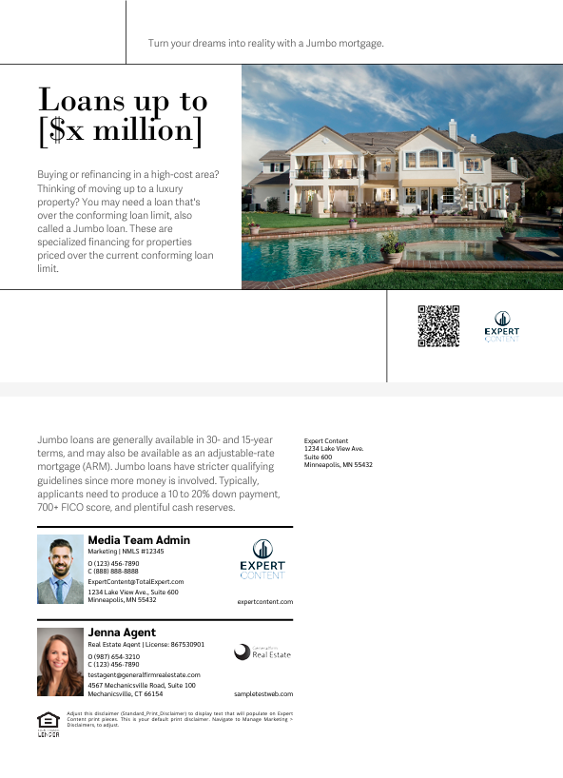
Mortgage Postcards
Jumbo Financing Basics (1261)
Direct Mail, Non-Direct Mail, and EDDM
Single and Cobranded
Introduce Jumbo loans to potential borrowers with this postcard.
Uses postcard template 1237.
Notes:
This page should be used for POSTCARDS (duplicate as needed)

Slide 5


Mortgage Postcards
Rates on the Move (1262)
Direct Mail, Non-Direct Mail, and EDDM
Single and Cobranded
Explain how rates fluctuate and what acting fast can mean during a rate dip.
Uses postcard template 1235.
Notes:
This page should be used for POSTCARDS (duplicate as needed)

Slide 6

Mortgage Postcards
Refinancing Info (1263)
Direct Mail and Non-Direct Mail
Single branded
Educate homeowners about the different refinancing options.
Admins can change out the QR code to a specific Refinancing landing page, allow users to replace it, or retain the default from the user’s profile.
Uses postcard template 1234.
Notes:
This page should be used for POSTCARDS (duplicate as needed)

Slide 7

Mortgage Postcards
Loan Officer Intro (1264)
Direct Mail, Non-Direct Mail, and EDDM
Single branded
Intended to introduce a loan officer or other mortgage professional to potential clients and new contacts. Users can change out the front image, add background info and customize experience and interests throughout.
Uses postcard template 1238.
Notes:
This page should be used for POSTCARDS (duplicate as needed)

Slide 8


Mortgage Postcards
Referral Request (1265)
Direct Mail and Non-Direct Mail
Single and Cobranded
Request referrals from past clients.
Uses postcard template 1235.
Notes:
This page should be used for POSTCARDS (duplicate as needed)

Slide 9


Mortgage Postcards
Loan Prequalification (1266)
Direct Mail, Non-Direct Mail, and EDDM
Single and Cobranded
Explain pre-qualifications to potential buyers.
Admins can change out the QR code to a specific application landing page, allow users to replace it, or retain the default from the user’s profile.
Uses postcard template 1234.
Notes:
This page should be used for POSTCARDS (duplicate as needed)

Slide 10

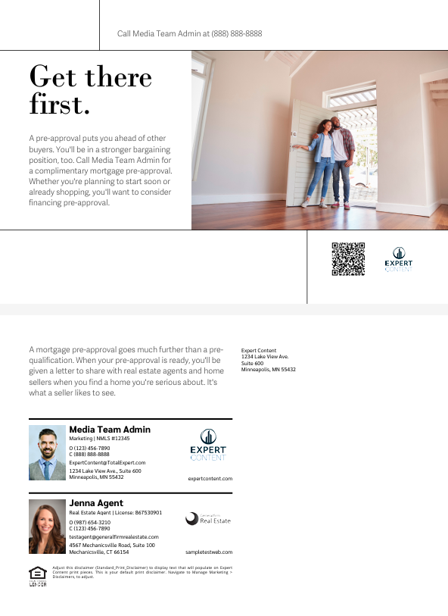
Mortgage Postcards
Loan Pre-Approval (1267)
Direct Mail, Non-Direct Mail, and EDDM
Single and Cobranded
Explain pre-approvals to potential buyers.
Admins can change out the QR code to a specific application landing page, allow users to replace it, or retain the default from the user’s profile.
Uses postcard template 1237.
Notes:
This page should be used for POSTCARDS (duplicate as needed)

Slide 11

Mortgage Postcards
Mortgage Check Up (1268)
Direct Mail and Non-Direct Mail
Single branded
Check in with past clients to offer a complimentary mortgage check up.
Uses postcard template 1235.
Notes:
This page should be used for POSTCARDS (duplicate as needed)

