Slide 1
Expert Content
Strategy Guide
Mortgage Print Flyer Library

Slide 2
Print Flyers – Mortgage
Expert Content Library
The Expert Content library of print flyers consists of educational content to help the average consumer better understand the mortgage process and various programs/products. Flyers are built in single and cobranded versions.
The flyer library covers the basics of buying a home, explores different products for military members, retirees, and first-time homebuyers, and provides a base from which many additional, company-specific flyers can be created.
All mortgage print flyers have been built leveraging self-serve templates to allow admins more flexibility in adjusting the library including imagery, some branding elements, and copy. This allows admins and compliance teams to more efficiently produce a library that meets the company’s unique needs.
Colors and logos will be dynamically populated based on the branding/DBA logic setup and have been coded to allow admins some control over how the branding is displayed (example: removing logo in design or adding a background for the logo, adjusting font color, and more).

Slide 3
General Mortgage
Print flyer samples (cobranded versions exist of each asset).

Slide 4
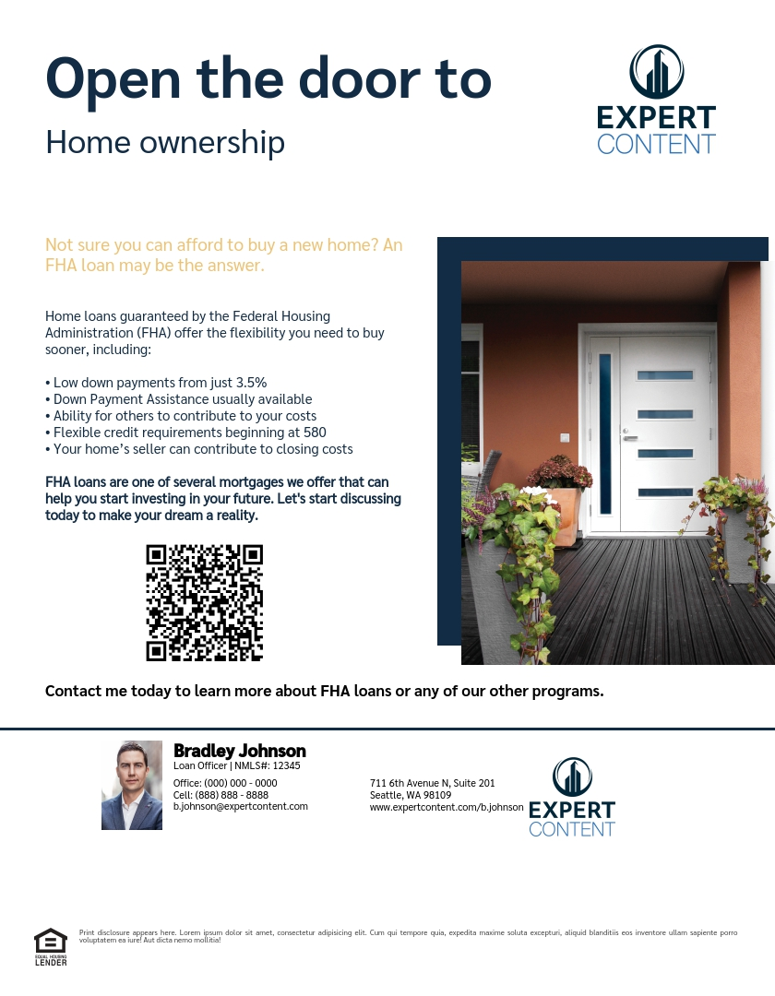
Mortgage Information

Slide 5
Mortgage Information

Slide 6
Mortgage Information

Slide 7
Mortgage Information

Slide 8
Mortgage Information

Slide 9
Mortgage Information

Slide 10
Mortgage Information

Slide 11
Products & programs
Print flyer samples (cobranded versions exist of each asset).

Slide 12
Jumbo Mortgages

Slide 13
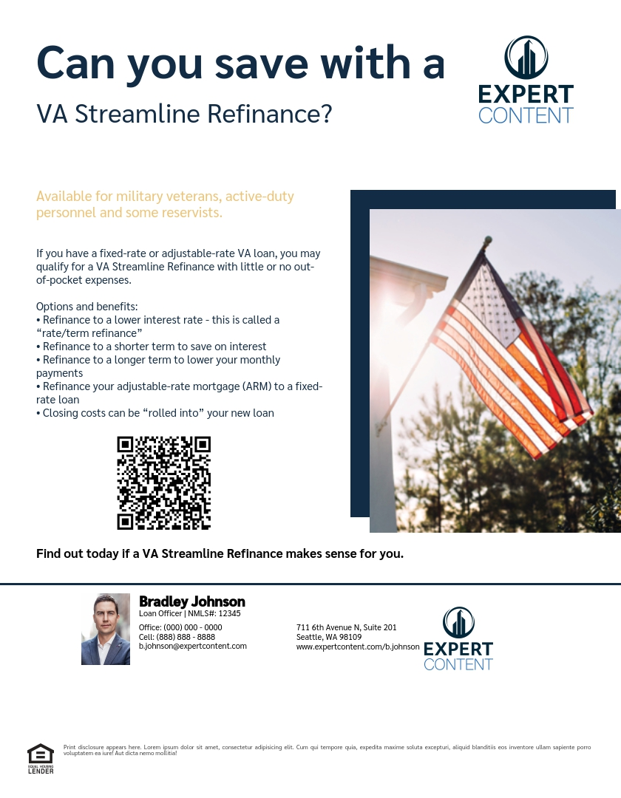
VA Loans

Slide 14
USDA Financing

Slide 15
Meet the Team

Slide 16
First-Time Homebuyer
Print flyer samples (cobranded versions exist of each asset).

Slide 17
First-Time Homebuyer Series

Slide 18
First-Time Homebuyer Series

Slide 19
First-Time Homebuyer Series

Slide 20
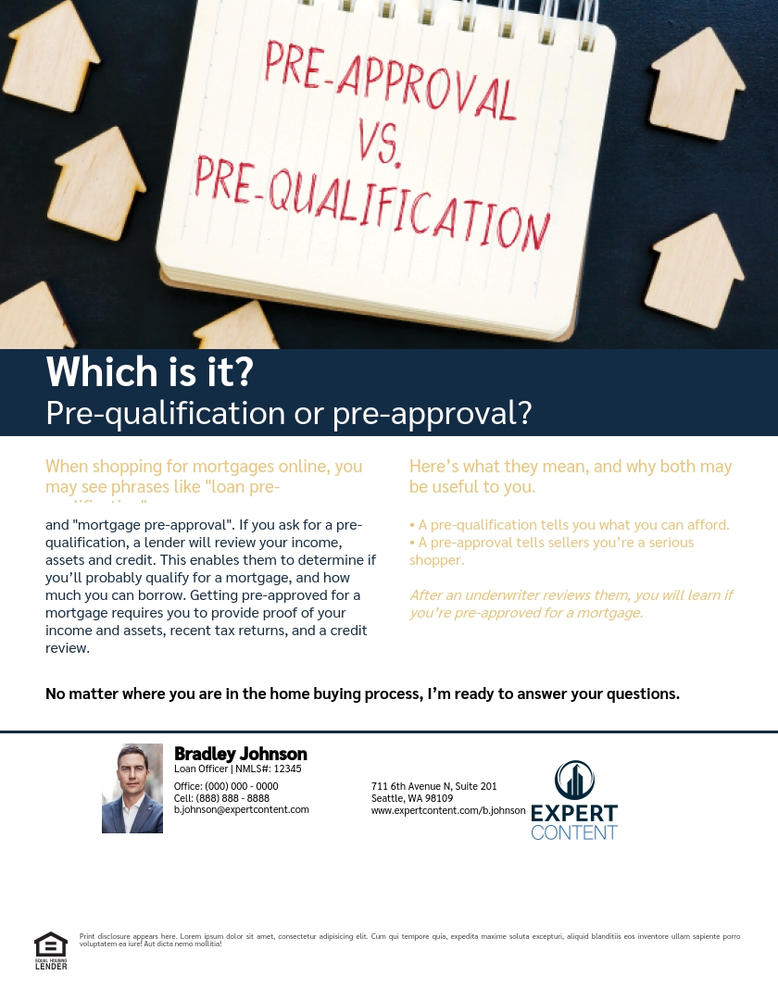
First-Time Homebuyer Series

Slide 21
First-Time Homebuyer Series

Slide 22
First-Time Homebuyer Series

Slide 23
First-Time Homebuyer Series

