Slide 1
Expert Content
Strategy Guide
MLS Listing & Mortgage Rate Assets

Slide 2
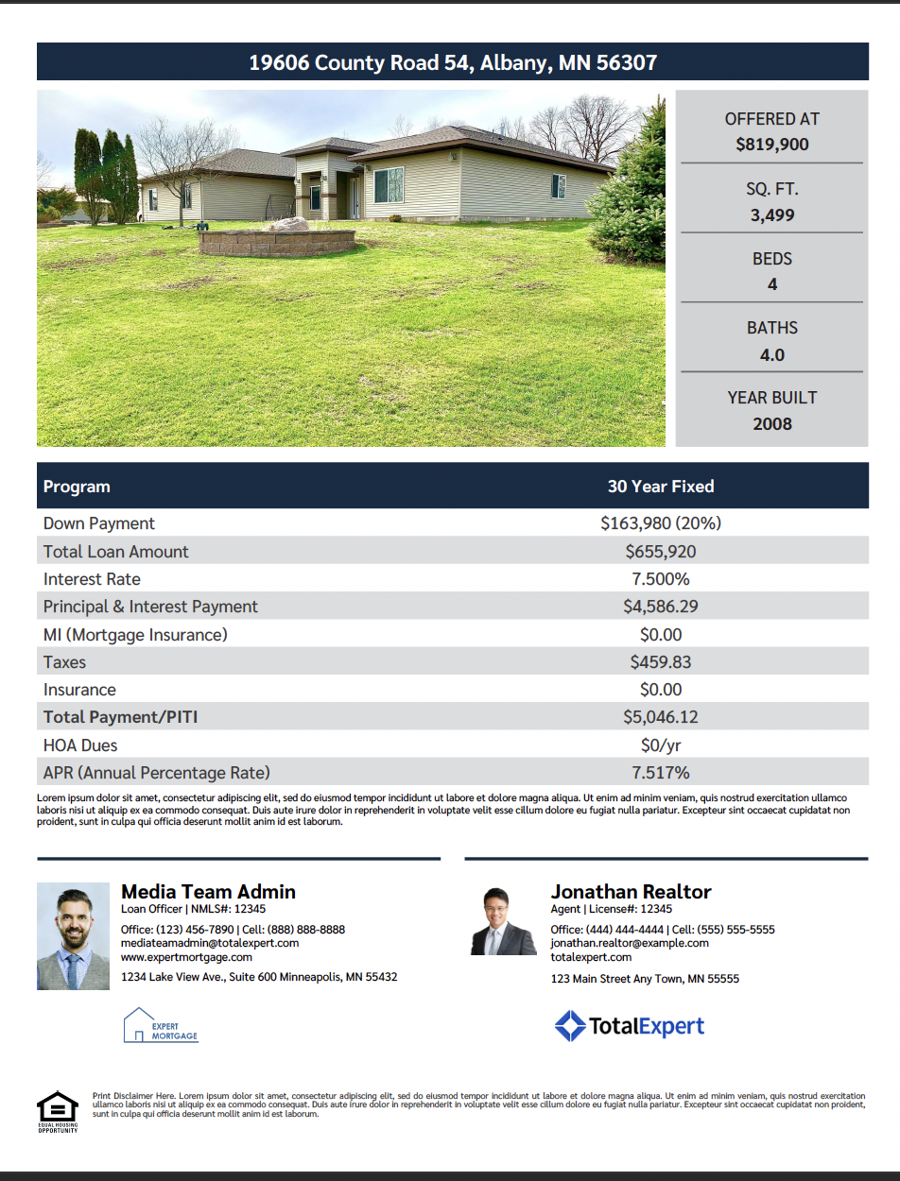
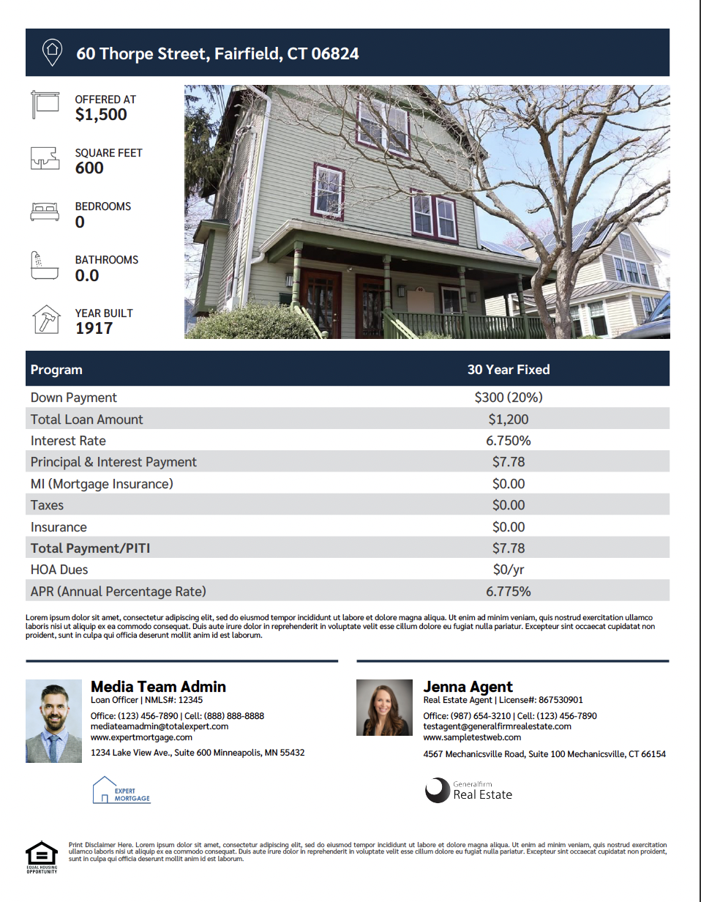
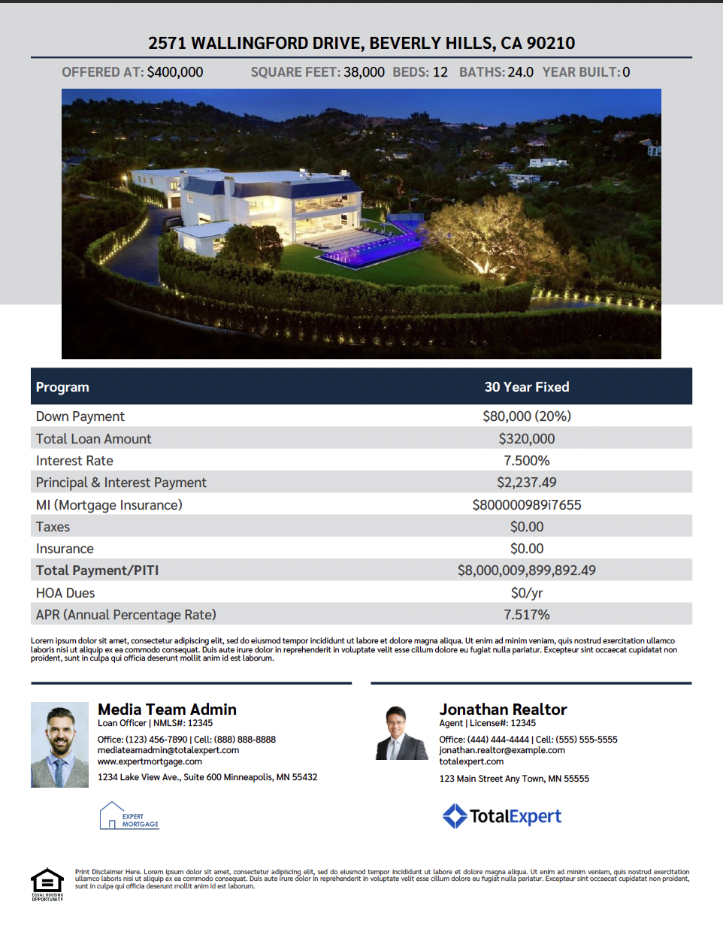
Integrated Rate Flyers
Notes:
This page should be used for Print Flyers (duplicate as needed)

Slide 3
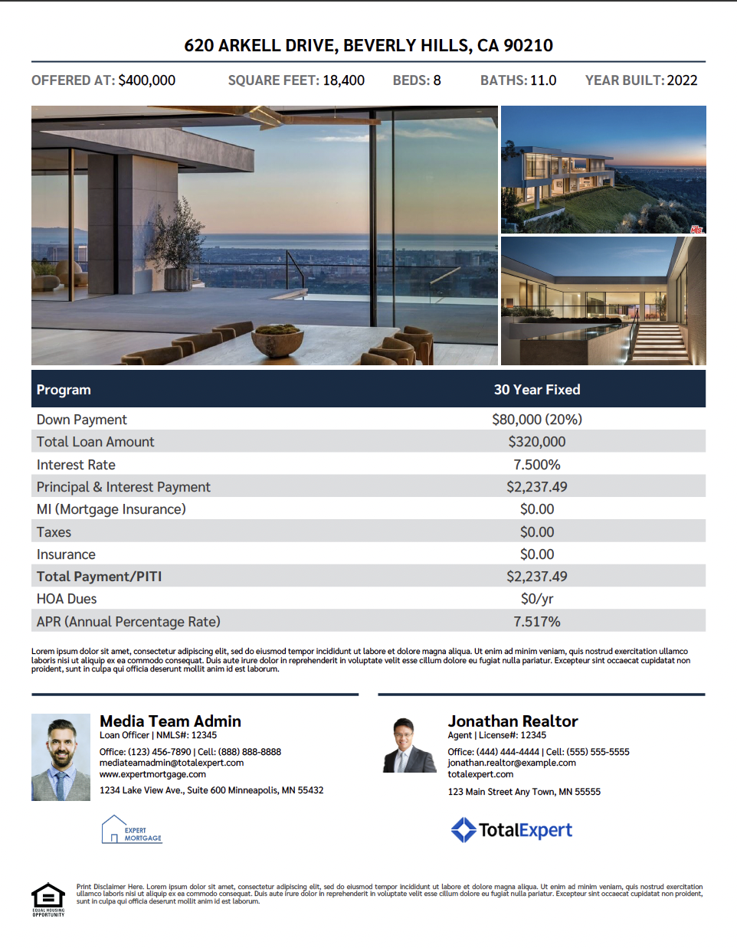
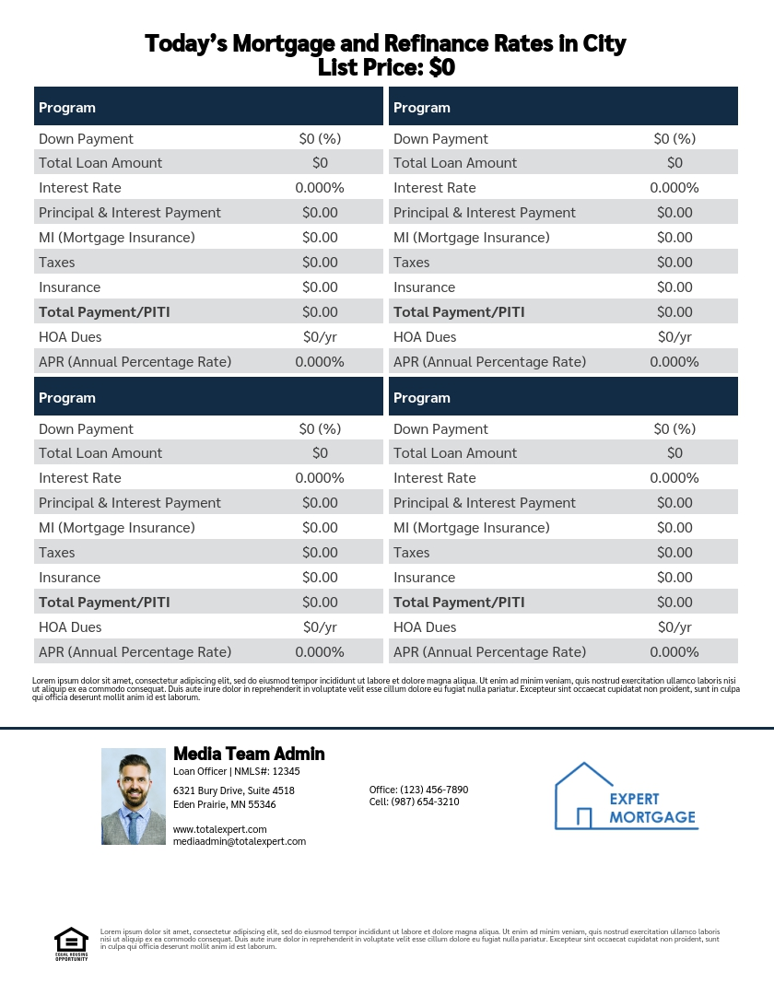
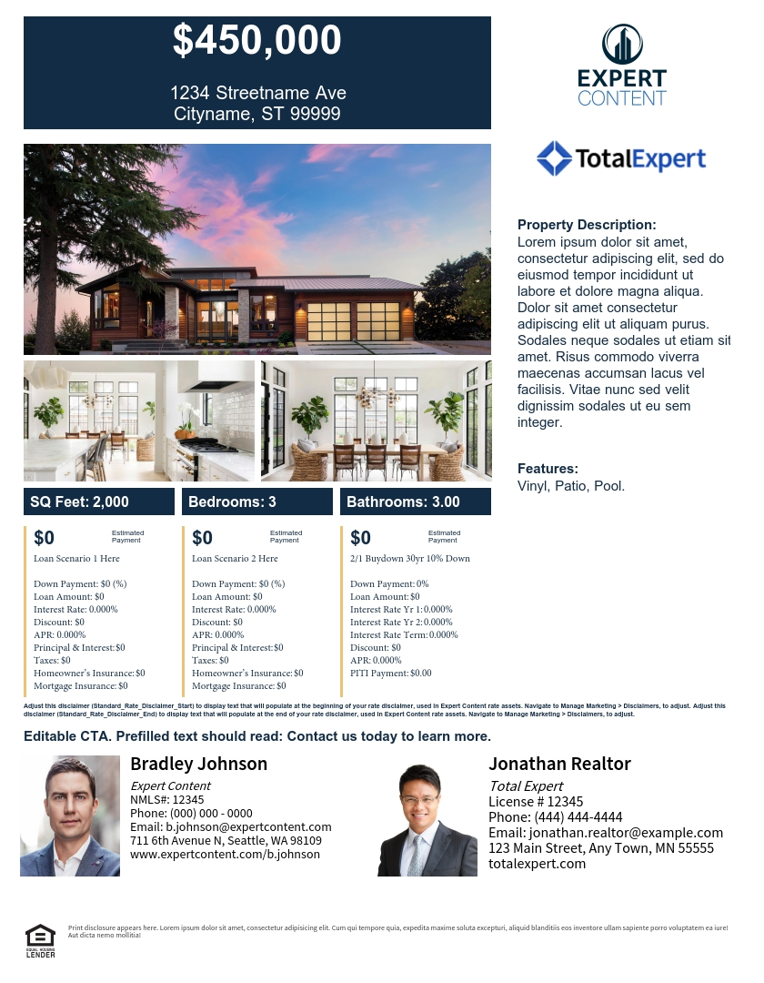
Integrated Rate Flyers
Non-MLS Rate Flyer
Compare two PPE scenarios with editable 3rd column for Buydowns, Discount points, etc.
Notes:
This page should be used for Print Flyers (duplicate as needed)

Slide 4
Integrated Rate Flyers
Side A
Side B
Notes:
This page should be used for Print Flyers (duplicate as needed)

Slide 5
Integrated Rate Flyers
Side A
Side B
Notes:
This page should be used for Print Flyers (duplicate as needed)

Slide 6
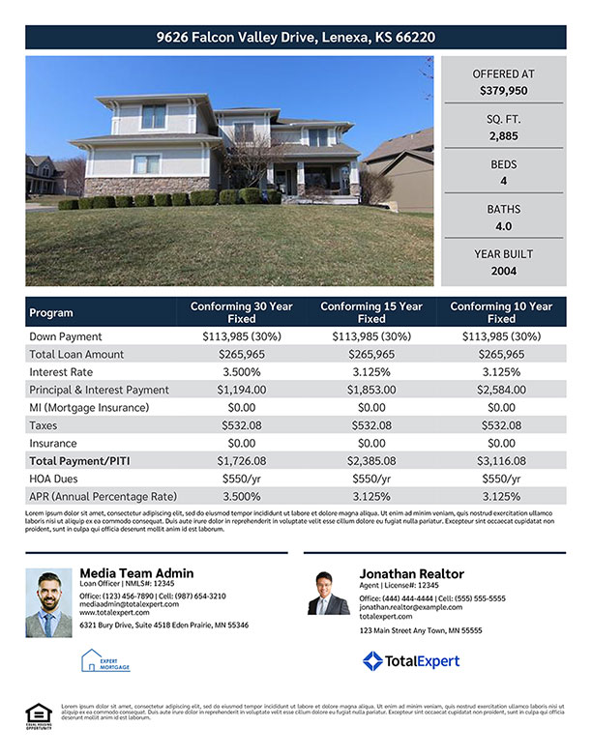
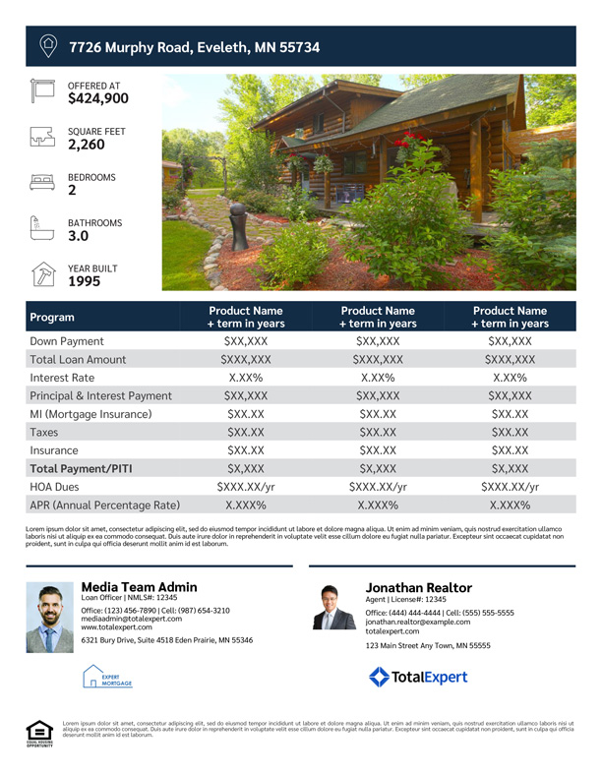
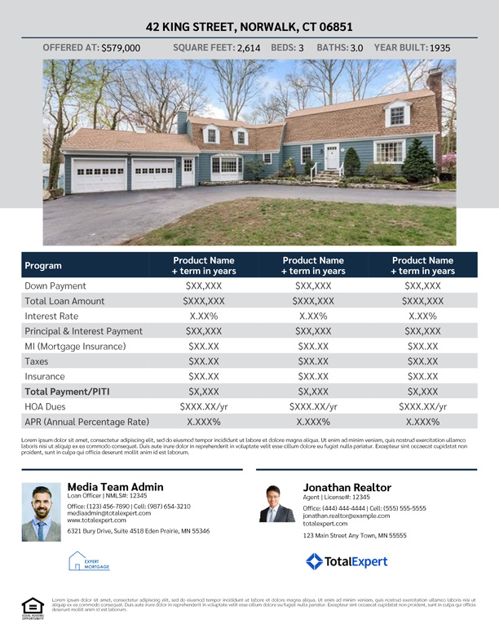
Editable Rate Flyers
Notes:
This page should be used for Print Flyers (duplicate as needed)

Slide 7
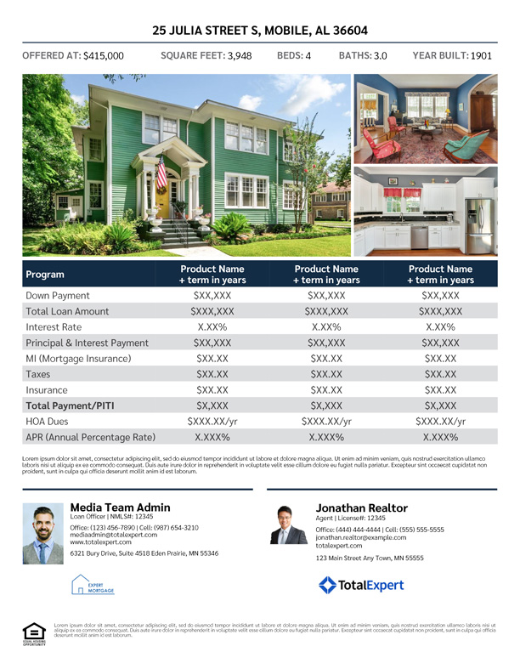
Editable Rate Flyers
Notes:
This page should be used for Print Flyers (duplicate as needed)

Slide 8
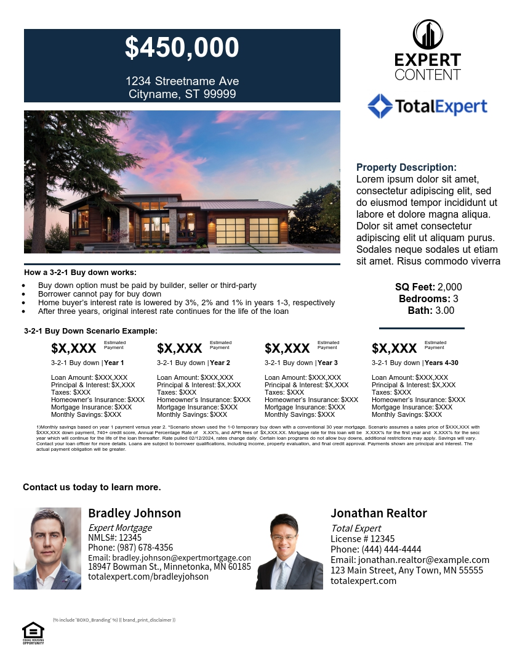
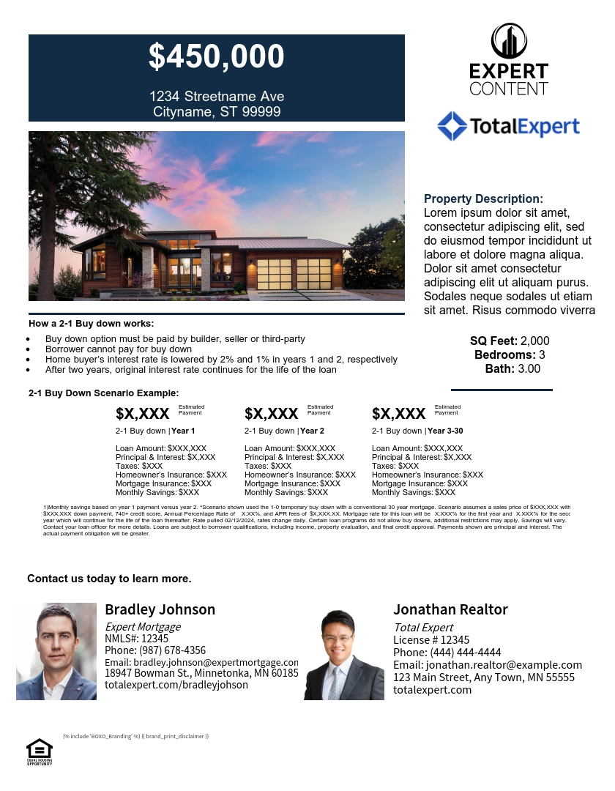
Editable Rate Buydown Flyers
3-2-1 Buydown
2-1 Buydown
1-0 Buydown
Notes:
This page should be used for Print Flyers (duplicate as needed)

Slide 9
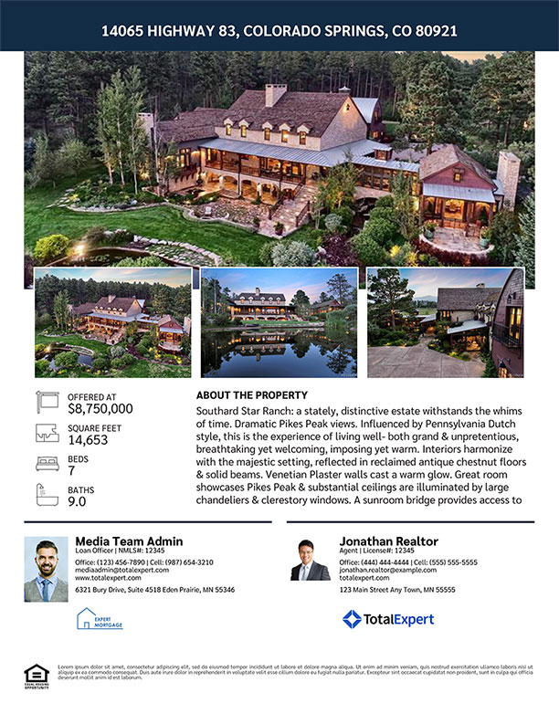
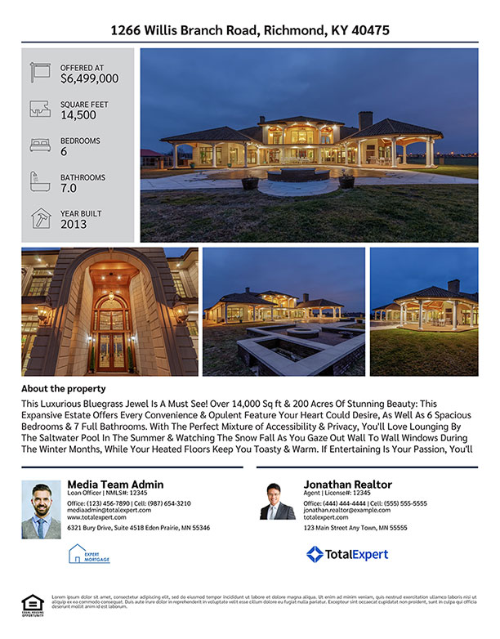
MLS Listing Flyers
Notes:
This page should be used for Print Flyers (duplicate as needed)

Slide 10
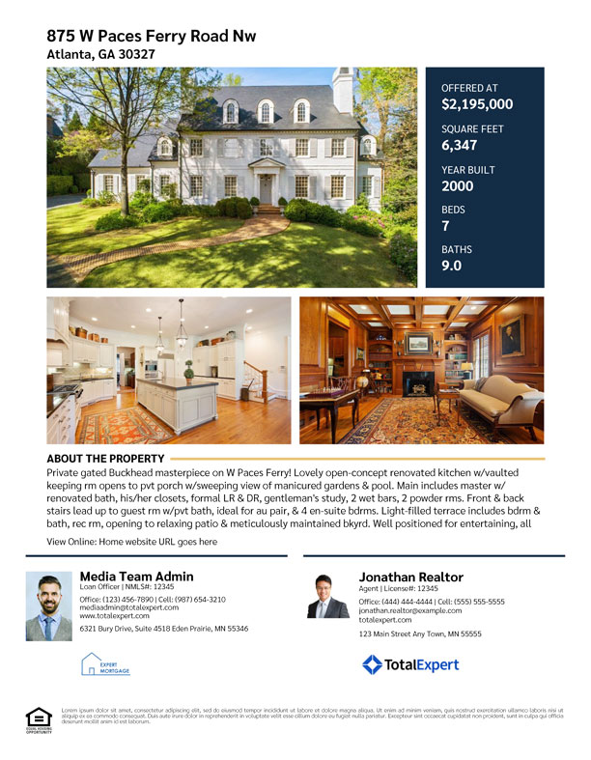
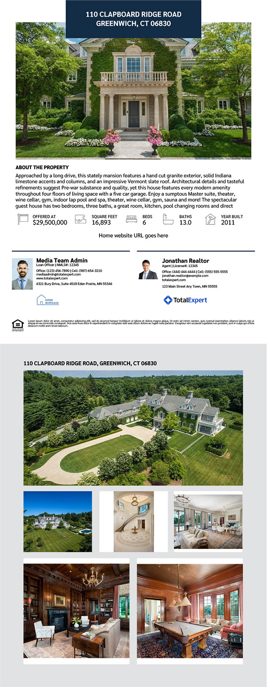
MLS Listing Flyers
Side A
Side B
Notes:
This page should be used for Print Flyers (duplicate as needed)

Slide 11
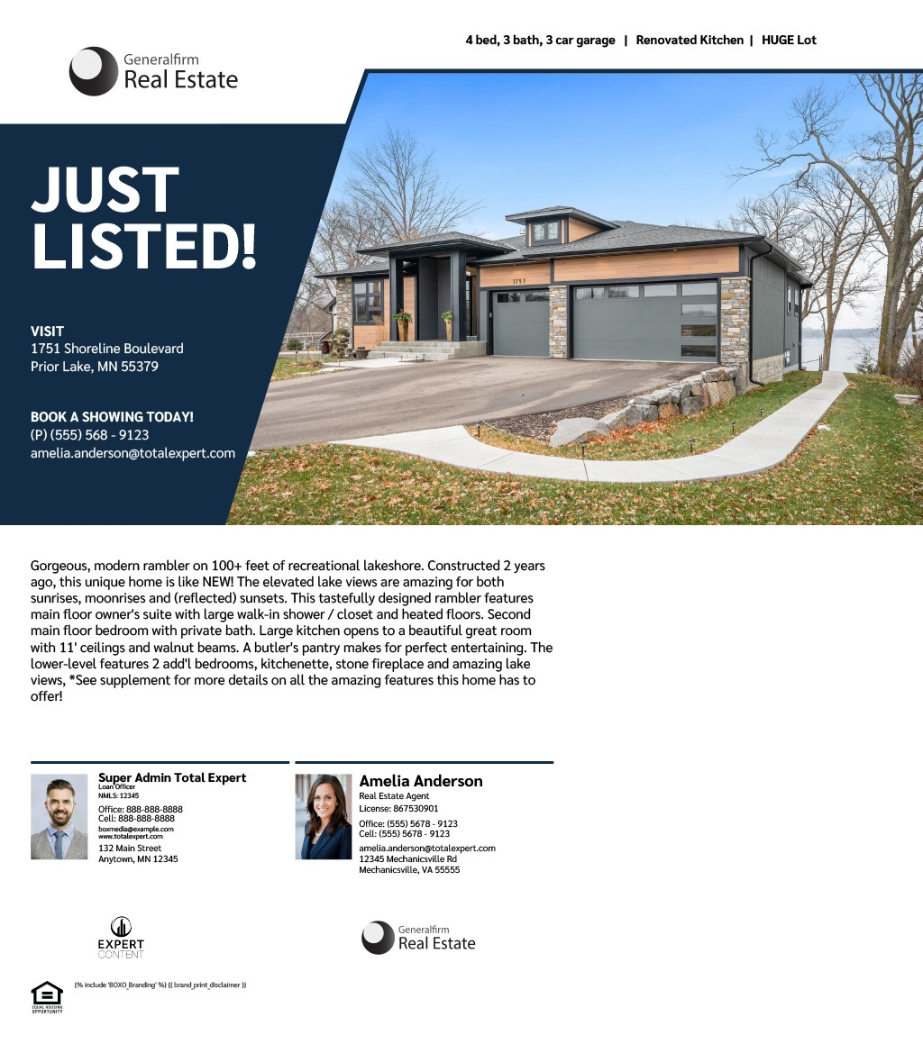
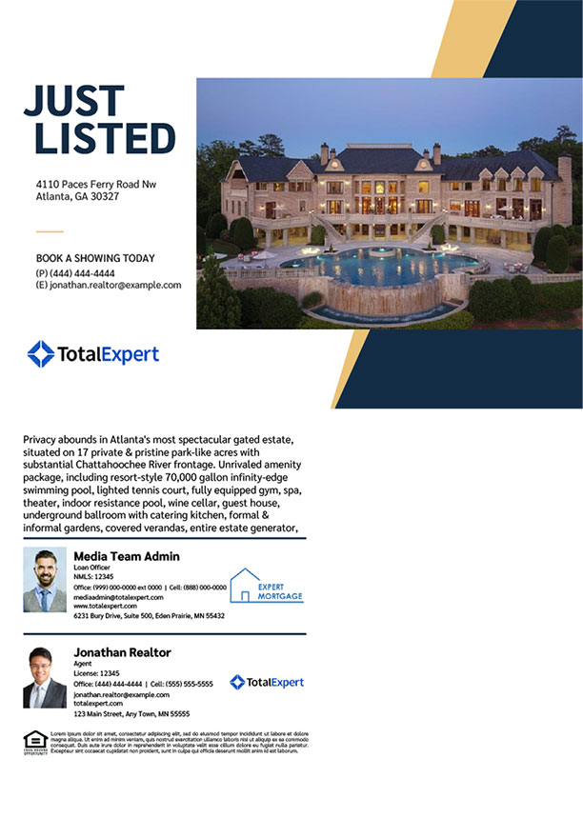
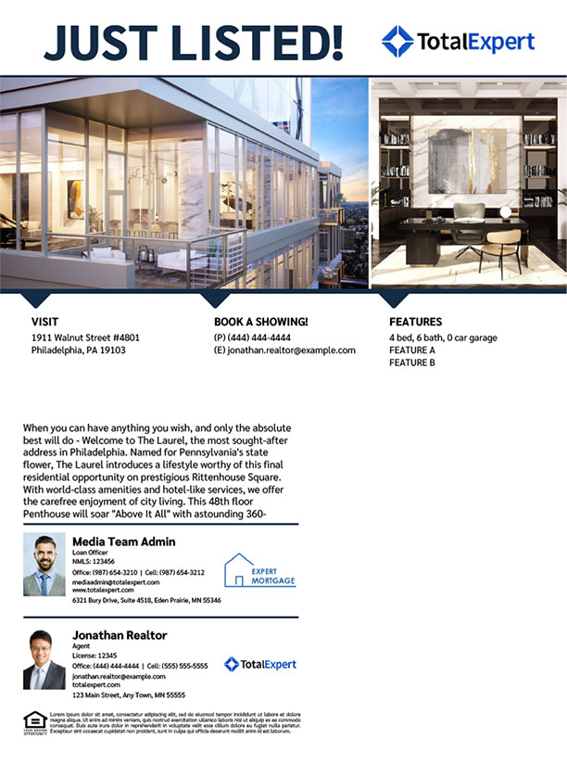
MLS Listing EDDM® Postcards
Notes:
This page should be used for Print Flyers (duplicate as needed)

Slide 12
MLS Listing EDDM® Postcards
Notes:
This page should be used for Print Flyers (duplicate as needed)

