Slide 1
Expert Content
Strategy Guide
Mortgage Financial Education

Slide 2
Mortgage Financial Education
Emails, Social Media Graphics
Emails are published to the email gallery for admins to copy into their library and use with journeys, campaign builder, or publish to end users for direct sending. Social media graphics can be found in Manage Marketing > Manage Templates. This series was designed to inform potential or current customers about mortgage literacy as it relates to general finances. Topics range from selecting a home inspector, benefits of using a real estate agent, typical steps and timelines of the home purchase process, and mortgage/homebuying financial scams.
*All communications should be reviewed prior to initiating the journey.

Slide 3
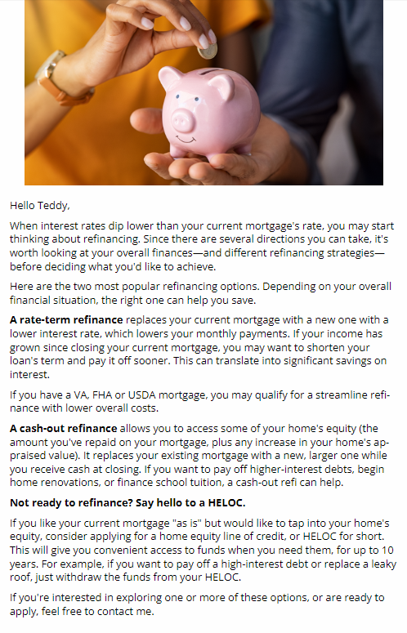
Mortgage Financial Education
Email Subject:
Buy your dream home, not a money pit.
How to put your home purchase in the fast lane
Save and be happy with the right refinance
Need more space? Consider adding an ADU.
Notes:
This page should be used for JOURNEY EMAILS (duplicate as needed)

Slide 4
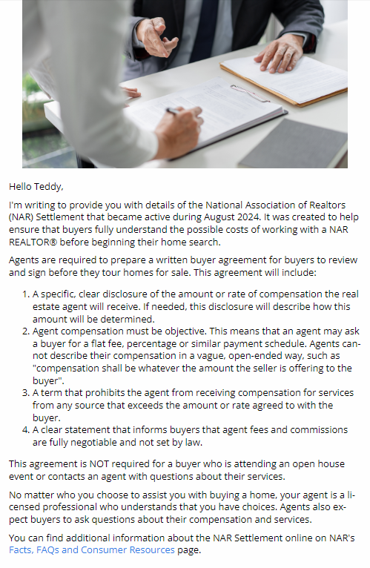
Mortgage Financial Education
Email Subject:
Tune into some good news for home buyers
NAR document requirements for home buyers
How the 2024 NAR Settlement affects home buyers
Why every home sale's better with a real estate agent
Notes:
This page should be used for JOURNEY EMAILS (duplicate as needed)

Slide 5
Mortgage Financial Education
Email Subject:
Why April 15th's less taxing for homeowners.
Watch out for these housing-related scams
Why your nest needs a nest egg
Notes:
This page should be used for JOURNEY EMAILS (duplicate as needed)

Slide 6
Social Media
An Accessory Dwelling Unit (ADU) can be anything from a she-shed to a garage apartment to a place to park weekend guests. It can increase your home's value and bump up your equity, too. Interested? Ask me about your financing options.
Planning to buy a home soon? It’s time to open a dedicated savings account. Not only does it make it easier to save funds for a down payment; you can plan ahead and save additional cash for making your new home 100% yours.
A home inspection helps you feel confident about one of life's biggest financial transactions. Trained inspectors check out properties from attic to basement, looking for hidden structural problems and damage. Contact me to learn more.
Since buying a home is one of life's biggest events, you're probably wondering how long you'll wait until it's time to move in. Contact me for a step-by-step guide that also tells you how you can help fast-track the journey.

Slide 7
Social Media
Whether you're just about to close a mortgage or an established homeowner, beware of two scams: closing funds wire fraud and home title theft. Both are based on theft of your personal information. Contact me to learn how to stay safe.
Suggested post copy: You may have heard about new document requirements for home buyers and real estate agents. These clarify agent fees and commissions, and when you'll need to sign a buyer agreement. Click to learn more or contact me for details.
Want to learn more about the 2024 National Association of REALTORS® (NAR) settlement, and how it affects home buyers? Tune into this short video presentation "Window to the Law: Terms of a Written Buyer Agreement" or contact me for details.
Thinking of buying a home on your own? Think again! Working with a licensed agent helps ensure a smoother, faster transaction. Your agent will negotiate a fair price, help you prepare for closing, provide community intel and much more.

Slide 8
Social Media
Planning to buy a home? Be sure you're familiar with the current commission and compensation guidelines created to protect buyers, together with written agreement requirements. Visit this link to learn more or contact me for details.
When rates dip lower than your mortgage's rate, it's time to consider refinancing. Want lower monthly payments? Check out a rate-term refinance. Looking for ways to pay for remodeling or school tuition? Ask me about a cash-out refi.
Home ownership comes with plenty of rewards, including some impressive tax savings. You may be able to deduct the interest portion of your mortgage payments, plus any local or state taxes up to $10,000. Visit IRS.gov for more information.

