Slide 1
Expert Content
Strategy Guide
Online Banking

Slide 2
Online Banking Journey
Email
This is a series if 3 emails sent to the customer to remind them of the benefits of online banking.
*All communications should be reviewed prior to initiating the journey.

Slide 3
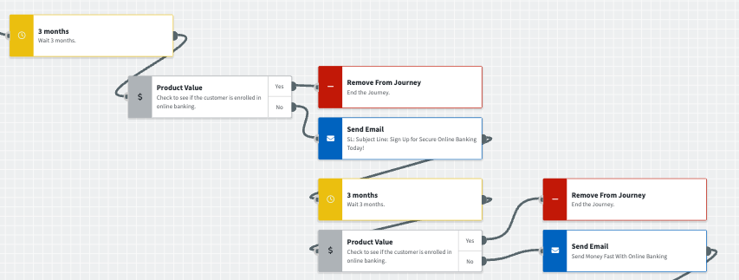
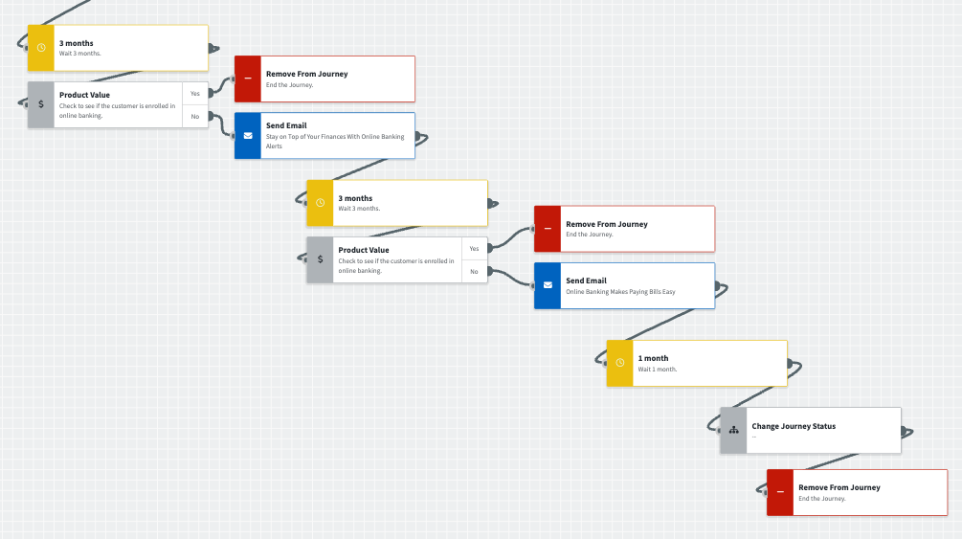
Journey Map Notes:
Keep emails that work for your organization, swap with custom, or add these emails to your existing campaigns.
Adjust onramps with organization specific groups and Focused View outcomes.

Slide 4
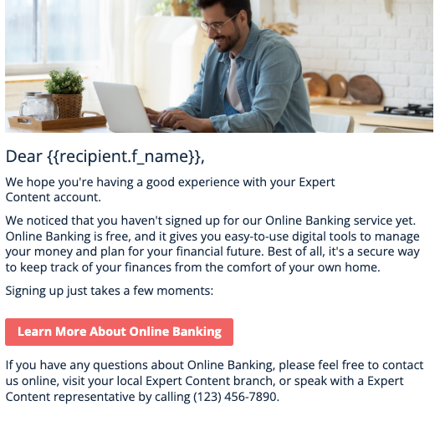
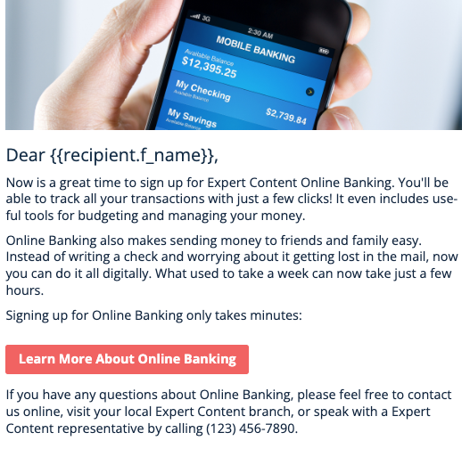
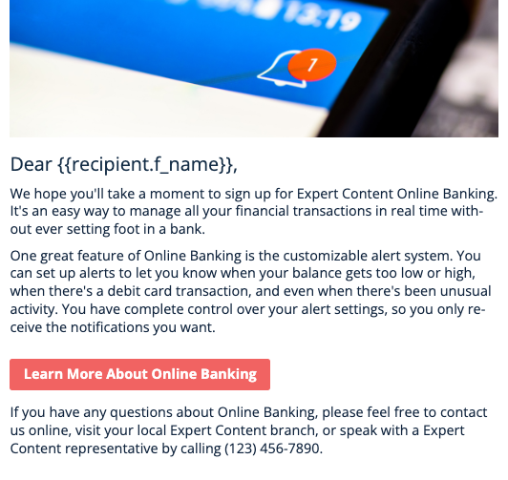
Online Banking Journey
Email Subject:
Sign up for secure online banking today!
Send money fast with online banking
Stay on top of your finances with online banking alerts
Notes:
This page should be used for JOURNEY EMAILS (duplicate as needed)

