Slide 1
Expert Content
Strategy Guide
Open House Follow Up
May 2025

Slide 2
Open House Follow Up
Communication types: Email, SMS, and User Notifications
This 9-email and 1-SMS campaign over 5 weeks can be used to follow up with homebuyers that visited a recent open house. Newly created contacts from the Open House Lead Capture form begin the journey. Emails ask about the contact’s priorities and encourages contacts to research financing early in the homebuying process.
The journey sets the shared real estate agent as a co-marketer at the beginning of each contact's journey. All emails include a co-branded signature.
*All communications should be reviewed prior to initiating the journey.

Slide 3
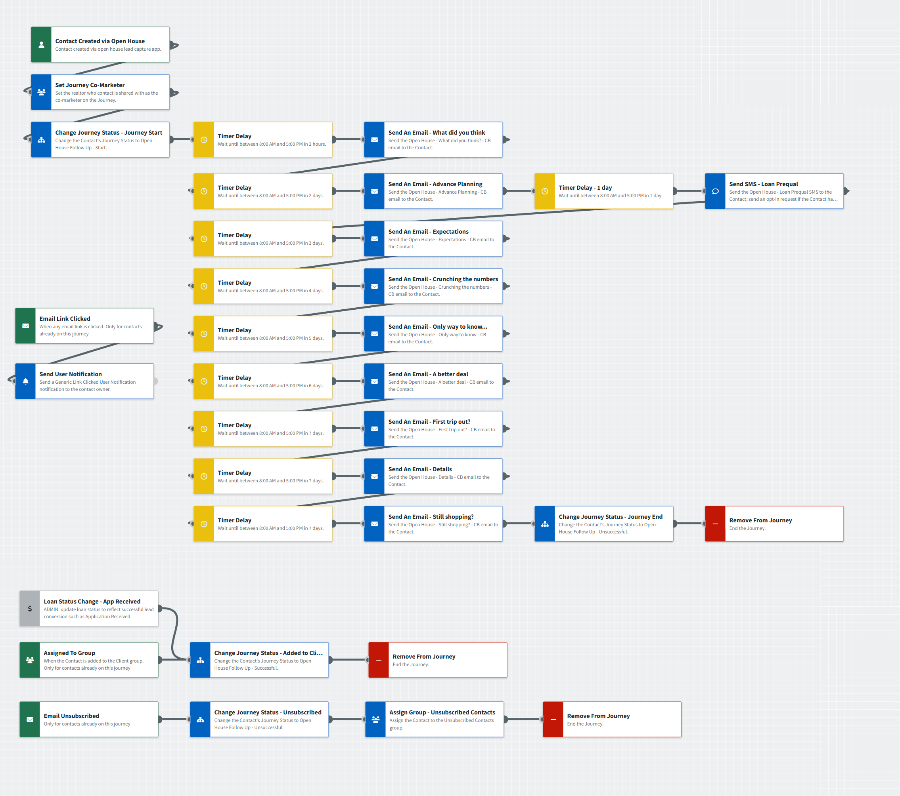
Open House Follow Up
Journey Map Notes:
Keep emails that work for your organization, swap with custom, or add these emails to your existing campaigns.
Adjust onramps with organization specific groups and Focused View outcomes.

Slide 4
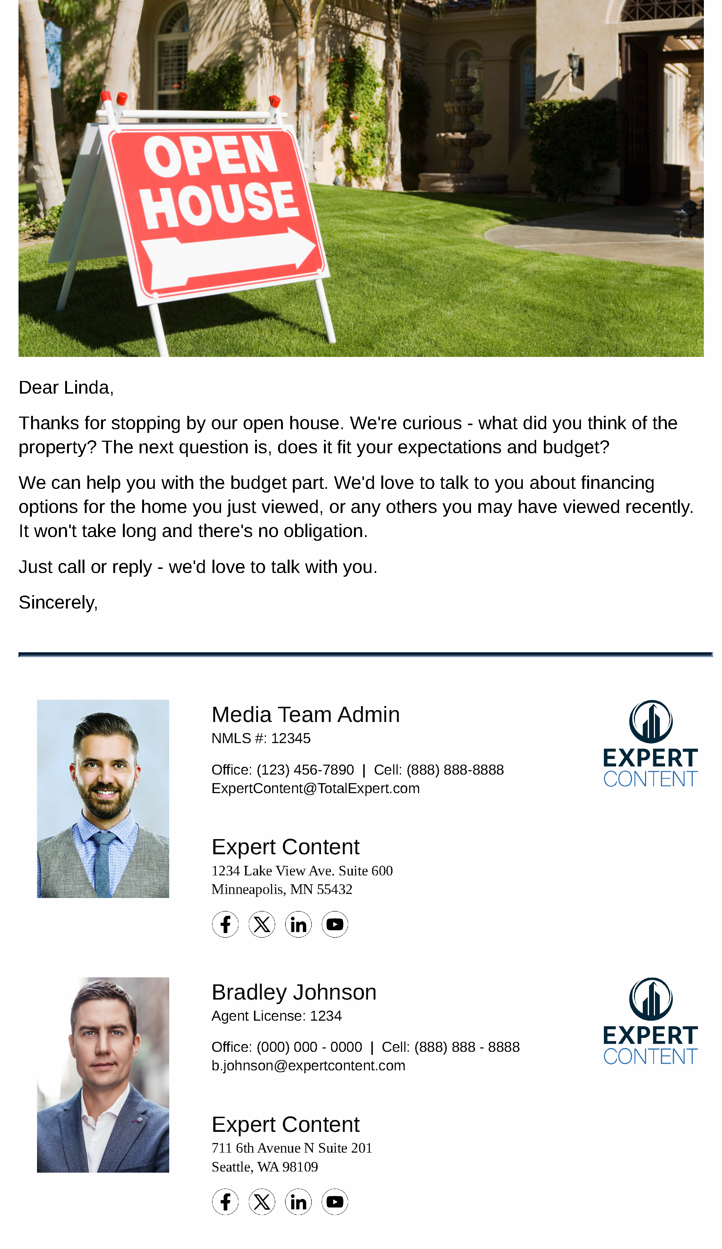
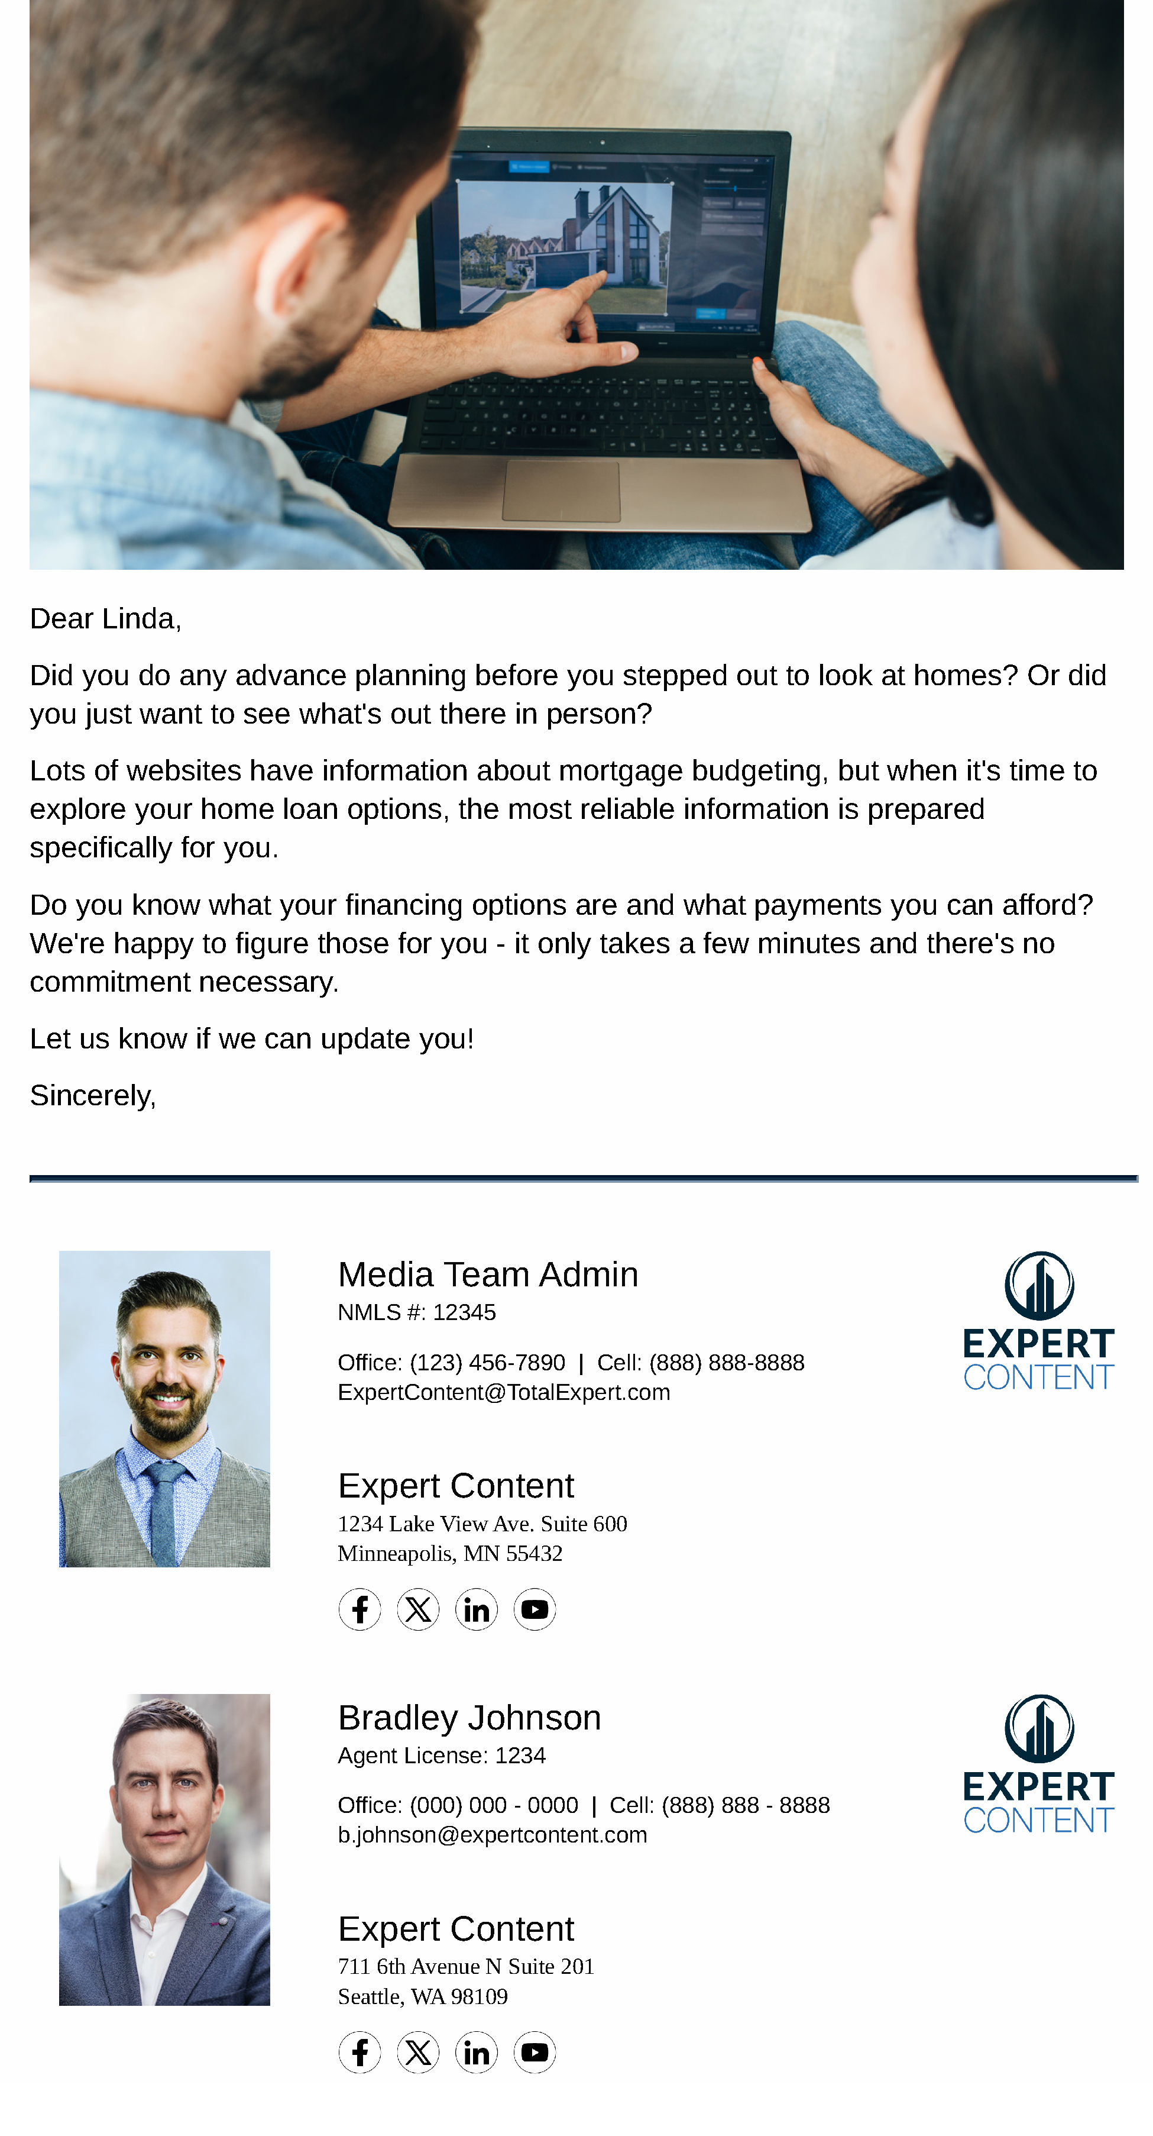
Open House Follow Up
Email Subject Line:
How was our open house?
Take a step closer to home ownership
Let's discuss your home buying priorities
Notes:
This page should be used for JOURNEY EMAILS (duplicate as needed)

Slide 5
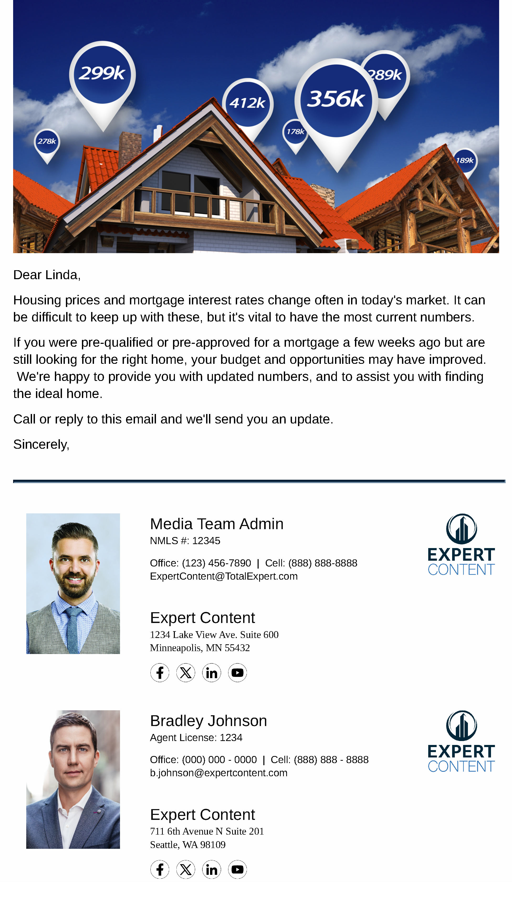
Open House Follow Up
Email Subject Line:
Are your rates up to date?
Could that special home become yours?
A better deal than renting?
Notes:
This page should be used for JOURNEY EMAILS (duplicate as needed)

Slide 6
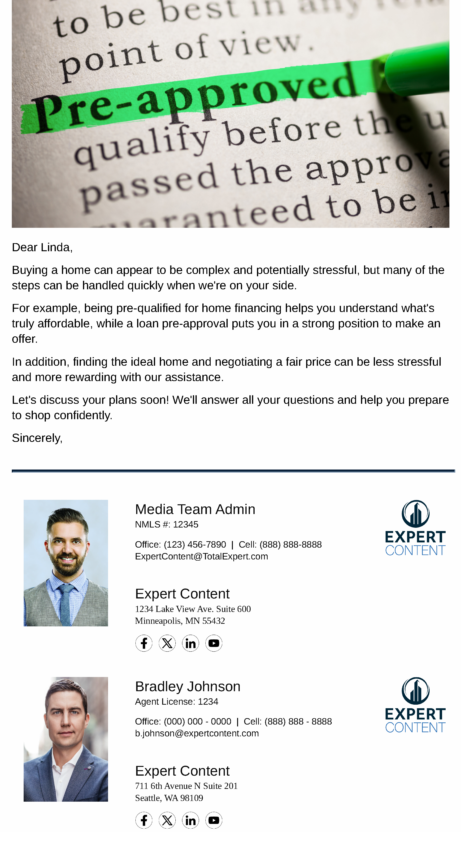
Open House Follow Up
Email Subject Line:
First Open House?
Buying a home's simple with our help
Still searching for a home?
Notes:
This page should be used for JOURNEY EMAILS (duplicate as needed)

Slide 7
Open House Follow Up
User Notification: Generic Link Clicked User Notification
The below contact clicked a link from within a journey email. Visit their contact details page for additional information.
Contact name: {{contact.f_name}} {{contact.l_name}}
Contact email: {{contact.email}}
Contact phone: {{contact.phone}}
SMS: Open House - Loan Prequal
Hi {recipient.f_name}}, it's {{sender.f_name}} from {{sender.company}}. Are you visiting Open Houses to see what's out there, or are you planning to buy soon? If you're a serious shopper, it's important to have your financing ducks in a row. Call for a fast, free loan prequalification so you'll know what you can afford.
Notes:
This page should be used for Tasks, User Notifications, and SMS templates (duplicate as needed)

